Slide 1
BMP image processing
with linear data structures
Kaito Snezhko and Ana Gasperov
Data Structures · Lab Assignment 1 · UAH 2026–2027
Notes:
Kaito, 20 seconds. Introduce the project and the group. We use our own linked data structures to process a BMP image, then offer search, sorting and reconstruction. Source: README.md and Assignment1/Core.cpp.

Slide 2
Four stages of image processing
Load BMP
into a stack
Write the
test image
Reorder pixels
through DS
Search, sort
and reconstruct
Input: RGB pixels, image width and image height
Outputs: _test.bmp, _stage3.bmp, _sorted_R/G/B.bmp, _flop.bmp
02
Notes:
Kaito, 30 seconds. Explain the complete pipeline. The first three stages run automatically. The fourth offers a menu. The original filename supplies the output names. Source: Assignment1/Core.cpp and the Fall 2026 assignment, pp. 5–7.

Slide 3
ADT selection and operations
StackDS and QueueDS
push(Pixel): void
pop(): Pixel
top(): Pixel
isEmpty(): bool
enqueue(Pixel): void
dequeue(): Pixel
isEmpty(): bool
getSize(): int
Rows and image
insertEnd(Pixel): void
insertSorted(Pixel, component): void
addRow(RowListDS*): void
getFirstRow(): RowListDS*
03
Notes:
Kaito, 40 seconds. A Pixel contains RGB data and a next pointer. Position follows from traversal rather than fields in the pixel. StackDS is LIFO. QueueDS is FIFO. A RowListDS is a linked pixel row, and ImageListDS owns a linked sequence of rows. Input and output stay in Core. Sources: Pixel.hpp, StackDS.hpp, QueueDS.hpp, RowListDS.hpp, ImageListDS.hpp.

Slide 4
Linked stack and queue in memory
Stack: insertion and removal at the top
topElem
RGB + next
RGB + next
nullptr
Queue: remove at front, insert at rear
frontElem
RGB + next
RGB + next
nullptr
rearElem points to the last pixel node
Each pixel stores RGB values and one next pointer
04
Notes:
Kaito, 40 seconds. Explain pointer updates. Push creates a new top. Pop advances top and deletes its old node. Enqueue links a new rear. Dequeue advances front and resets rear when the queue becomes empty. Both structures own and delete their nodes. Sources: StackDS.cpp, QueueDS.cpp and Pixel.hpp.

Slide 5
Stage 2 preserves the original stack
pixelStack
last pixel on top
helper stack
reversed order
Copy back after writing
One pop writes one output pixel at a descending index
Moving every helper pixel back restores the stack
Result: the same image and the same stack contents
05
Notes:
Kaito, 40 seconds. The input library supplies a BGR byte buffer. Stage 1 pushes pixels in buffer order. Stage 2 pops the last pixel first, so the output index starts at N minus one and decreases. Every popped pixel goes into a helper stack. Moving the helper back restores the original top and all node values in the same order. Source: Assignment1/Core.cpp and the Fall 2026 assignment, pp. 5–7.

Slide 6
Stage 3 distributes pixels by priority
S1
i = 1 or i divisible by 2
S2
otherwise, i divisible by 3
S3
otherwise, i divisible by 5
S4
otherwise, i divisible by 7
S5
otherwise, i divisible by 11
S6
all remaining pixels
Example: i = 6 enters S1 because the first rule wins
06
Notes:
Kaito, 45 seconds. Number pixels as they leave the initial stack, beginning at one. Use an if/else-if chain. The first matching condition wins. A pixel divisible by six therefore goes into stack one, not stack two. The counter counts popped pixels, not original image coordinates. Source: Assignment1/Core.cpp and the Fall 2026 assignment, pp. 5–7.

Slide 7
Stage 3 merges the stacks into a queue
Queue position 1 and every even position take from S1.
Other odd positions drain S6, then S5, S4, S3 and S2.
Queue positions
1
2
3
4
5
6
S1
S1
S6…S2
S1
S6…S2
S1
The queue preserves the new order for building image rows
07
Notes:
Kaito, 45 seconds. Position one and every even queue position take from S1. Other odd positions drain S6, then S5 down to S2. The implementation falls back to the remaining stack if needed. Each selected value comes from the top of its stack, then enqueue appends it to the FIFO queue. Explain the labels in the example. Source: Assignment1/Core.cpp and the Fall 2026 assignment, pp. 5–7.

Slide 8
A list of lists represents the image
Row 0
Pixel
Pixel
nullptr
Row 1
Pixel
Pixel
nullptr
Each row contains W pixels. The image contains H rows.
Coordinates come from position, so nodes store only colour and links
08
Notes:
Kaito, 35 seconds. The first width pixels from the queue form the first stored row. Each row has first and last pixel pointers plus nextRow. ImageListDS has firstRow and lastRow. Stored row zero follows the BMP buffer order, which starts at the bottom for the supplied images. Search converts to top-origin y coordinates. Sources: Core::fillListOfLists, RowListDS.hpp and ImageListDS.hpp.

Slide 9
Class diagram
Core
+ run(): void
7
1
1
uses
StackDS
+ push(), pop(), top()
QueueDS
+ enqueue(), dequeue()
ImageListDS
+ addRow(), getFirstRow()
TinyImageJM
BMP read/write
0..* rows
Pixel
RGB fields, next: Pixel*
RowListDS
+ insertEnd(), insertSorted()
09
Notes:
Kaito, 45 seconds. Core coordinates the workflow and all user/file I/O. StackDS and QueueDS manage Pixel nodes. ImageListDS owns RowListDS objects, and each row owns its pixel nodes. TinyImageJM handles BMP buffering. The counts in Core include one initial stack and six routing stacks. Sources: the project headers and destructors. Ownership uses filled diamonds. Core contains seven stack objects, one queue and one image list. StackDS, QueueDS and RowListDS own Pixel nodes. ImageListDS owns its rows. TinyImageJM is a local library dependency.

Slide 10
Source files and dependencies
main.cpp
Core.hpp / Core.cpp
StackDS.hpp/.cpp
QueueDS.hpp/.cpp
ImageListDS.hpp/.cpp
RowListDS.hpp/.cpp
TinyImageJM.hpp/.cpp
provided library
Pixel.hpp / Pixel.cpp supports the linked structures
10
Notes:
Kaito, 25 seconds. Each implementation file includes its matching header. The headers declare dependencies. Main only creates Core and calls run. The external image library is separate from our data structures. Sources: main.cpp and all project #include directives.

Slide 11
Search by RGB colour
Input: red, green and blue values from 0 to 255
One traversal checks every pixel for an exact RGB match.
Output: compact (x, y) coordinates and the number of matches.
Coordinate conversion
x = position in the row
y = H − 1 − stored row index
11
Notes:
Ana, 35 seconds. Ask for RGB integers from 0 to 255. Traverse every row and every pixel, comparing all three channels. Search uses the stage-three arrangement. Display compact coordinates and a count. Convert stored row indices because the BMP buffer starts at the bottom. Leave all lists unchanged. Source: Core::searchPixels and Core::askNumber.

Slide 12
Insertion sort builds a separate sorted row
Example: selected red-channel values
90
20
60
20
Original row
20
20
60
90
Sorted copy
Ascending order by the selected component
Equal values keep their order. The source row stays unchanged.
12
Notes:
Ana, 50 seconds. Select R, G or B. For each source row, insert pixel copies into a temporary sorted linked list. Fast paths handle insertion at the head or tail. Otherwise walk until the next component is larger. Insert after equals to preserve their relative order. Write the temporary row to the image buffer and destroy it before processing the next row. Source: Core::sortRows and RowListDS::insertSorted.

Slide 13
Reconstruction reverses the permutation
List copy
into a queue
Replay the
source schedule
Restore the
six stacks
Recover original
pixel order
Horizontal mirror
(x, y) becomes (W − 1 − x, y)
Temporary structures preserve the stored stage-3 image
13
Notes:
Ana, 55 seconds. A direct mirror of the stage-three list would mirror scrambled data. The active flopImage first reconstructs the original. Count stack assignments with chooseStack. Copy the lists to a queue. Replay the queue-source schedule, routing pixels into reverseOrder stacks using remaining counts. Reverse those stacks to restore their original state. Visit pixel numbers N down to one, pop from chooseStack(i), and recover the original buffer sequence. Write each value to the mirrored column. The source list stays unchanged. Source: active Core::flopImage.

Slide 14
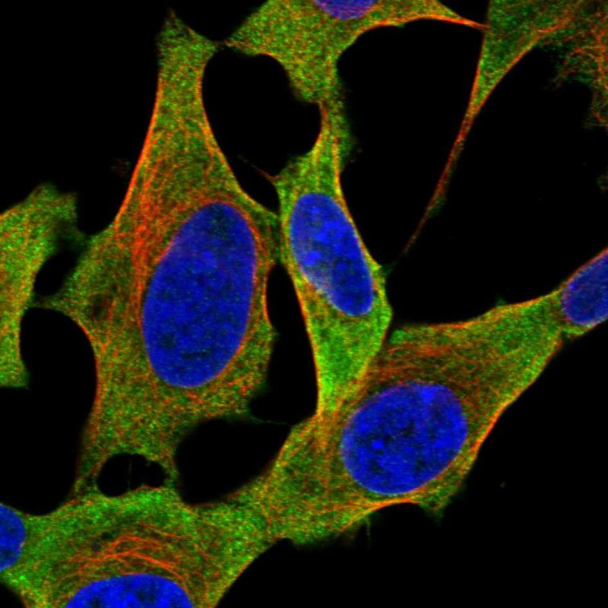
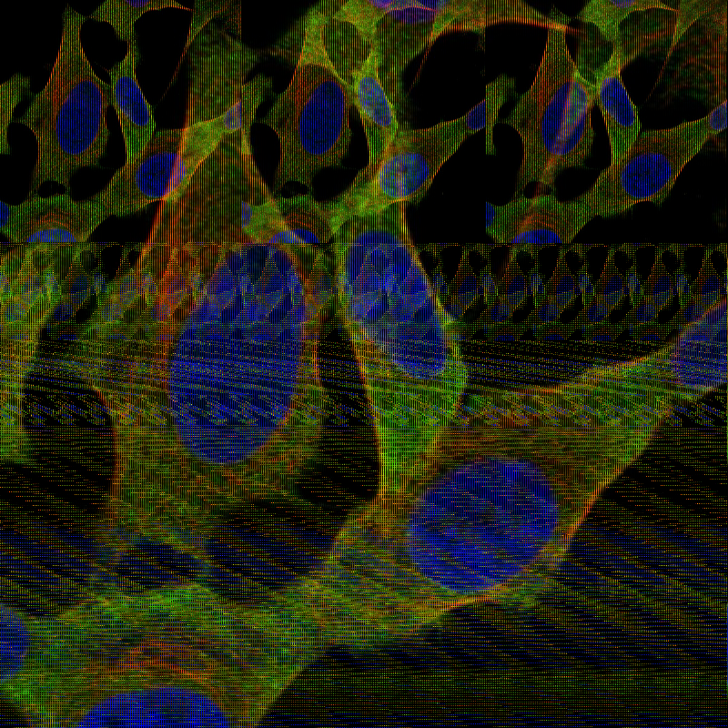
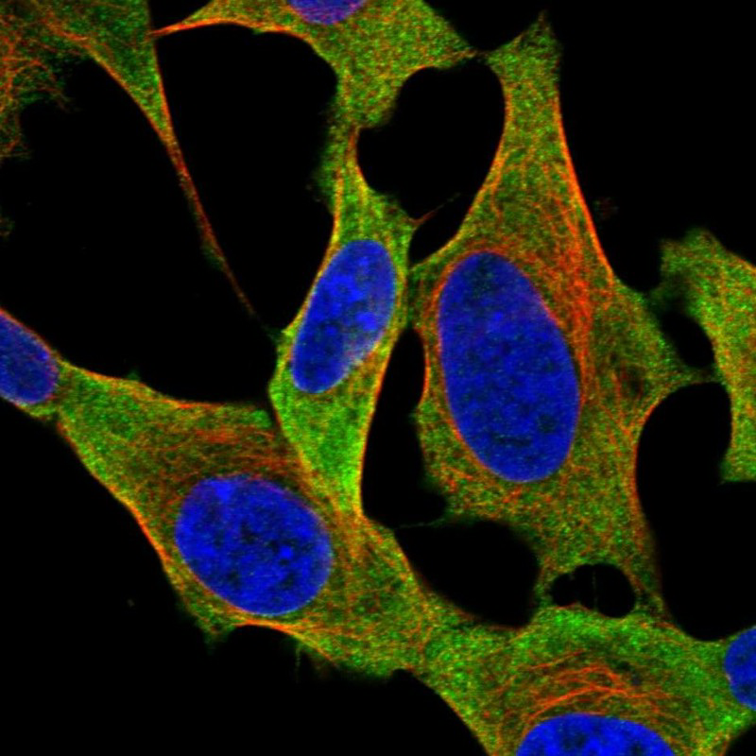
Image outputs
Original
After stage 3
Reconstructed + mirrored
14
Notes:
Ana, 25 seconds. The original, stage-three arrangement and reconstructed mirror are existing project files. Reconstruction undoes the permutation before applying the mirror. Sources: Assignment1/small.bmp, small_stage3.bmp and small_flop.bmp.

Slide 15
Running time
W = width H = height N = W × H
Stack push/pop and queue enqueue/dequeue
O(1)
Automatic stages, search and reconstruction
O(N)
Row sorting, worst case
O(HW²)
Already ascending rows use the tail shortcut: O(N) sorting
15
Notes:
Ana, 50 seconds. Define width W, height H and N=WH. End-pointer operations take O(1). The automatic pipeline uses a constant number of traversals per pixel. Six stacks are a fixed constant. Search and reconstruction take O(N). Insertion sort can traverse a growing prefix for each row insertion, giving O(HW²)=O(NW) in the worst case. Ascending input uses the tail shortcut for O(N). This is not the runtime of an unbounded interactive session, which depends on user choices. Sources: Core.cpp and DS implementations.

Slide 16
Dynamic storage and memory costs
Why linked structures fit this assignment
The node count follows the image size.
Stack and queue end operations need no pixel shifts.
Pointers and individual allocations add overhead.
Auxiliary storage
Sorting: O(W) temporary row
Reconstruction: O(N) temporary nodes
16
Notes:
Ana, 35 seconds. Linked nodes grow with the image and avoid shifts for end operations. Each node adds a pointer and allocation overhead. Linked storage also has poorer locality than contiguous arrays. Static arrays need a fixed capacity. An array allocated from the dimensions is an alternative outside this assignment, which requires dynamic linked DS. Total storage is O(N). Sorting adds one row O(W). Reconstruction adds O(N) temporary nodes. Sources: DS headers/destructors and Core.cpp.

Slide 17
Checks on the saved image outputs
Three input sizes
800 × 800 1108 × 1108 2000 × 1334
_test.bmp matches the original pixel for pixel.
_flop.bmp matches a horizontal mirror of the original.
Evidence: pixel comparisons of the existing saved output files
17
Notes:
Ana, 35 seconds. Pixel comparisons of the already saved files show that all three test outputs match their originals and all three flop outputs match horizontal mirrors. These checks concern saved image artifacts, not a new complete interactive program run. Sources: Assignment1 small/mid/big BMP images and the corresponding _test and _flop outputs.

Slide 18
User operations
Load a BMP
Search by RGB
User
Sort rows by R, G or B
Reconstruct and mirror
Exit and release memory
18
Notes:
Ana, 30 seconds. Keep a live demonstration brief. Load small.bmp and point out the stage counts. Search for a colour known to occur in the image. Sort by green and inspect the first-row values and saved image. Reconstruct, show the mirrored file and exit. Use the output slide if a live demo is unavailable. Source: README and Core::stage4Menu. This slide presents the user use cases. The first loading step precedes the automatic stages. The other operations appear in the menu.

Slide 19
Conclusions and improvements
What the program demonstrates
Stacks and a queue create a reversible pixel permutation.
Temporary structures preserve data during menu operations.
Row insertion sort has the highest worst-case cost.
Further improvements
Check each image reload. Expand BMP edge-case tests.
Consider merge sort for wider rows if the specification allows it.
19
Notes:
Ana, 35 seconds. Summarize LIFO, FIFO and linked-list roles, state preservation, and sorting cost. Future work includes checking every BMP reload before dereferencing its buffer, testing additional dimensions and BMP formats, and considering merge sort for wider rows if allowed. Sources: Core.cpp and RowListDS.cpp.

Slide 20
References
UAH Data Structures, Fall 2026 laboratory assignment
Presentation-session instructions and Group G feedback checklist
Project sources: Core, Pixel, StackDS, QueueDS, RowListDS, ImageListDS
Provided TinyImageJM library and project BMP test/output files
20
Notes:
Ana, 10 seconds. The older 2015–2016 presentation and report provided an example of structure only. The current assignment and project code provide the actual technical content. Full paths: C:/Users/Ana/OneDrive - fer.hr/FER/erasmus/Data_Structures_UAH/2026-2027-DS-LabAssignment-Fall.pdf; C:/Users/Ana/Downloads/DS-LabAssignment-Presentations Session-Instructions.pdf; C:/Users/Ana/Downloads/DS-LabAssignment-feedback-group G.pdf; project Assignment1 source/image files.

