Slide 1



Name of Project
Sustainable Agriculture
Fertilizer Recommendation System using AI
Details:
Name : Phanindra Vushakola
AICTE Student ID: STU669a15eb0dfe81721374187 AICTE Internship ID:INTERNSHIP_17513641056863b20937d78

Slide 2

Learning Objectives
Understand agricultural datasets and key soil parameters
Perform data preprocessing and feature encoding
Build a Decision Tree model to recommend fertilizers
Evaluate model performance with accuracy and confusion matrix
Present findings clearly with visualizations and metrics
GOAL
Source :
www.freepik.com/

Slide 3
Tools and Technology used :
Programming Language: Python
Libraries: Pandas, NumPy, Matplotlib, Seaborn, Scikit-learn
Environment: Jupyter Notebook
Model: Decision Tree Classifier
Dataset: Crop & Fertilizer dataset (soil nutrients, rainfall, temperature, crop type)

Slide 4
Methodology
Data Collection: Agricultural dataset containing soil nutrients, climate conditions, and recommended fertilizers
Data Preprocessing:
Handle missing and duplicate values
Encode categorical features (Soil color, Crop, District)
Model Training: Decision Tree Classifier with entropy criterion and max depth = 20
Model Evaluation: Accuracy score, classification report, confusion matrix visualization
Deployment Preparation: Saved trained model for future predictions

Slide 5
Problem Statement:
Farmers often face difficulties selecting the right fertilizer due to variations in soil nutrients, pH, rainfall, and temperature.Incorrect fertilizer application results in low yield, increased costs, and environmental damage.

Slide 6
Solution:
An AI-based Fertilizer Recommendation System that:
Analyzes soil nutrients, pH level, and weather conditions to understand the farming environment.
Predicts the most suitable fertilizer for the selected crop using machine learning techniques.
Provides quick, data-driven recommendations to help farmers improve productivity, optimize crop yield, and promote sustainable agricultural practices.

Slide 7
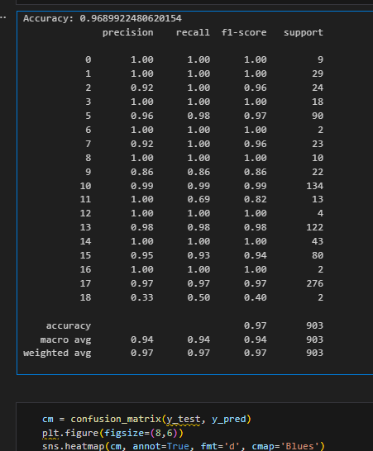
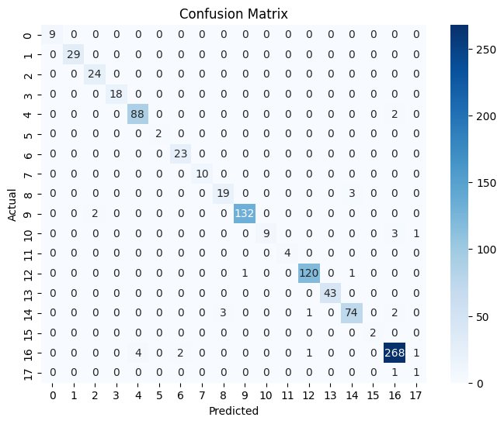
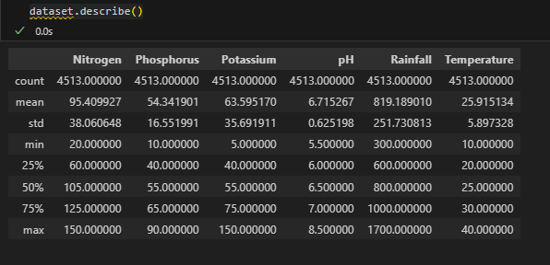
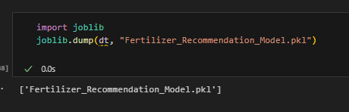
Screenshot of Output:

Slide 8
Conclusion:
The Fertilizer Recommendation System was successfully developed using a Decision Tree Classifier to accurately predict the most suitable fertilizer based on soil nutrients, pH, rainfall, temperature, and crop type. By leveraging machine learning, the model helps farmers make data-driven decisions that improve crop yield and reduce costs. This AI-powered solution supports sustainable agriculture by minimizing the overuse of fertilizers, thereby protecting soil health and the environment. The project demonstrates how technology can address real-world farming challenges, and it lays the foundation for future improvements such as integrating real-time sensor data and expanding recommendations to a wider range of crops.
Future Enhancements:
Include real-time IoT sensor data
Expand to more crops and regions
Deploy as a user-friendly web or mobile application

