Slide 1
DATABASE DESIGN
Tables Design
Entity Relationship Diagram

Slide 2
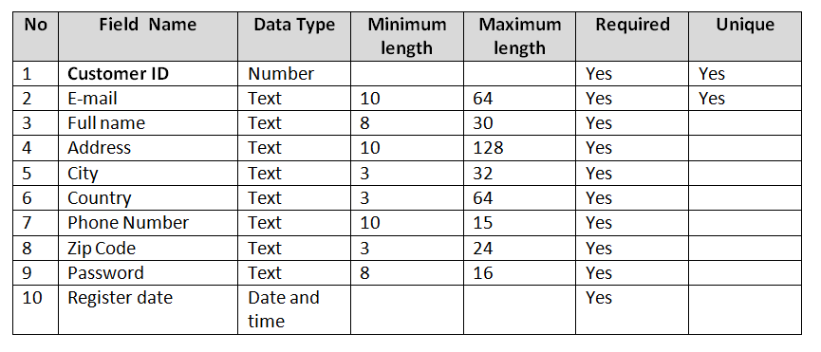
CUSTOMER TABLE

Slide 3
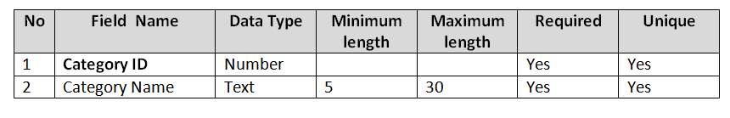
CATEGORY TABLE

Slide 4
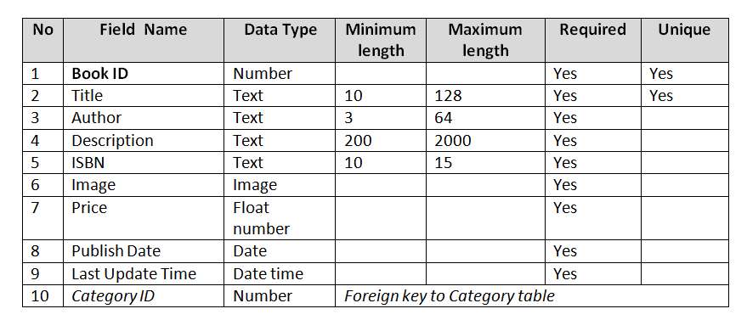
BOOK TABLE
CATEGORY => BOOK: One to Many

Slide 5
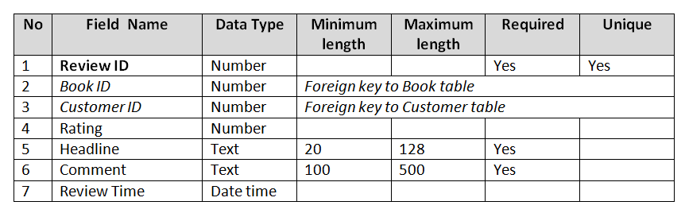
REVIEW TABLE
BOOK => REVIEW: One to Many
CUSTOMER => REVIEW: One to Many

Slide 6
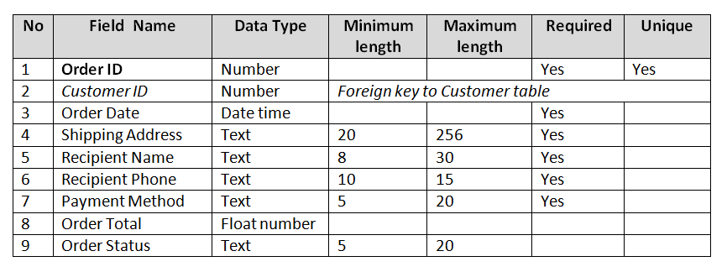
BOOK ORDER TABLE
CUSTOMER => BOOK ORDER: One to Many

Slide 7
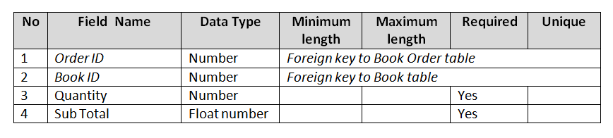
ORDER DETAIL TABLE
BOOK => BOOK ORDER: Many to Many

Slide 8
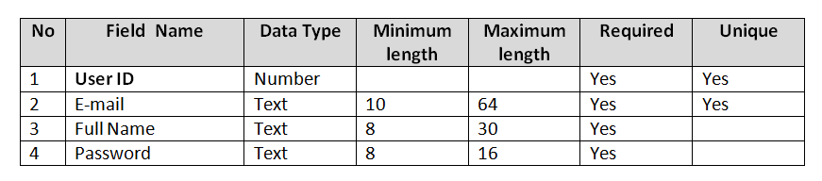
USERS TABLE

Slide 9
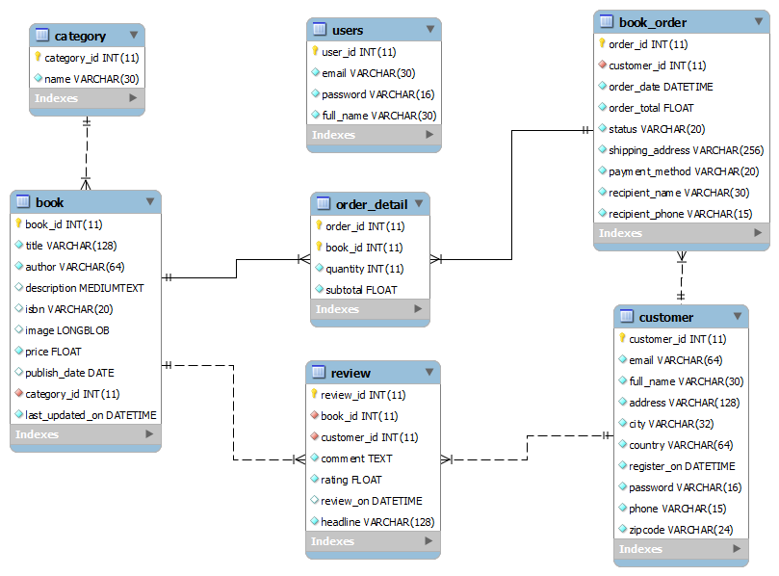
Entity Relationship Diagram

Slide 10
END

