Slide 1
TECHNICAL DESIGN
System Architecture
Application Architecture
Java Packages Organization
Class Diagram (Sample)
Activity Diagram (Sample)
Sequence Diagram (Sample)

Slide 2
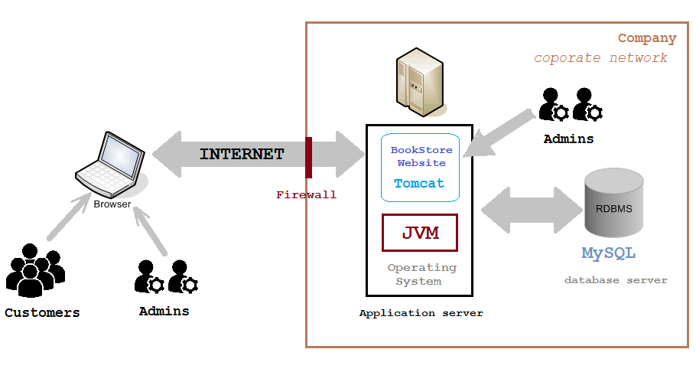
System Architecture
Client – Server Architecture

Slide 3
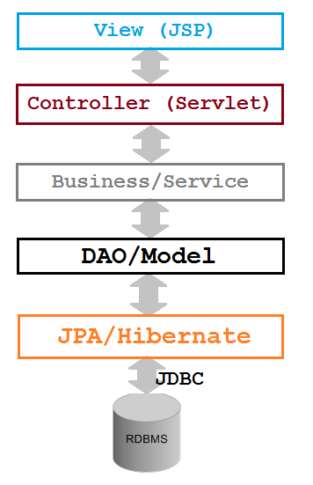
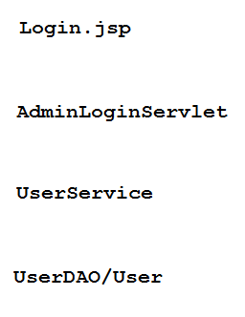
APPLICATION ARCHITECTURE
N-tier architecture

Slide 4
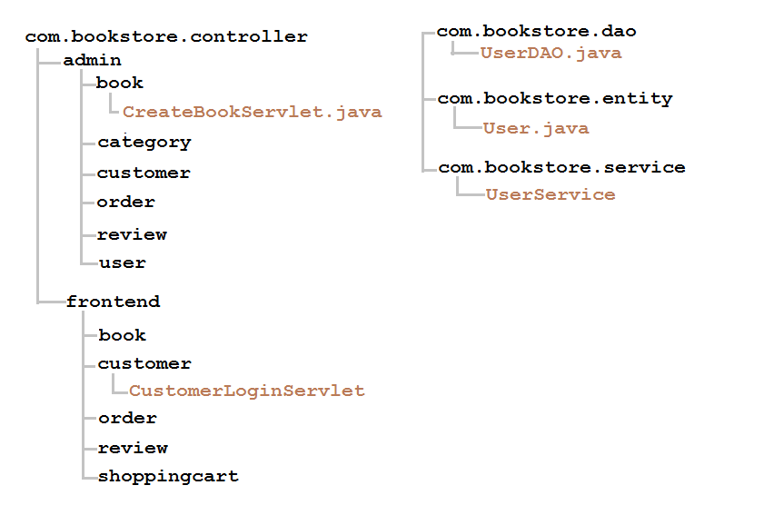
JAVA PACKAGES ORGANIZATION

Slide 5
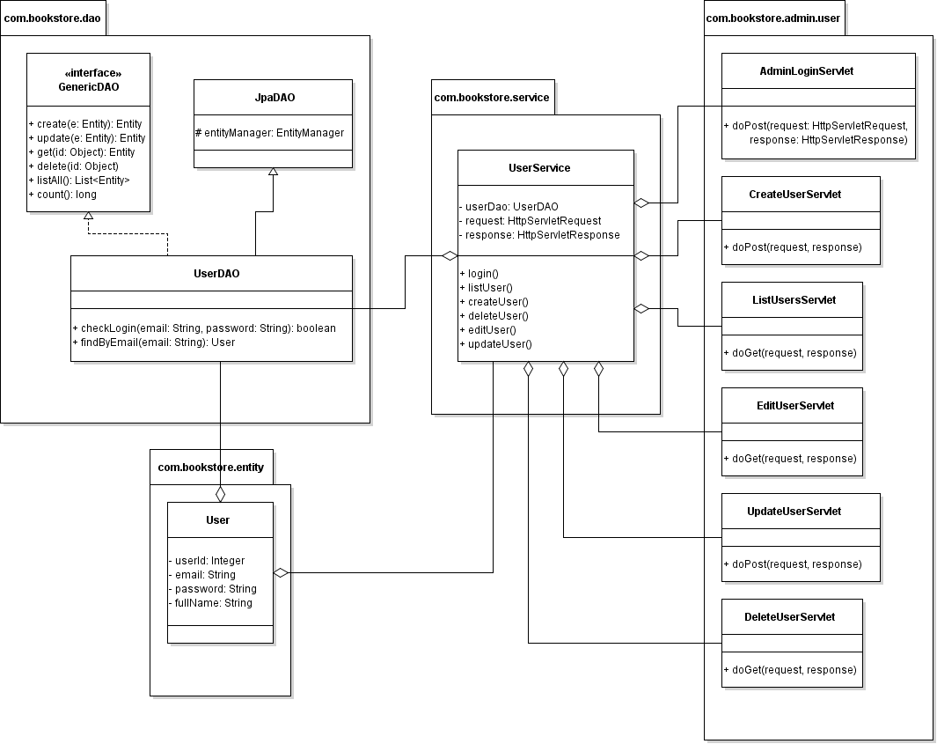
CLASS DIAGRAM (SAMPLE)
User Management Class Diagram

Slide 6
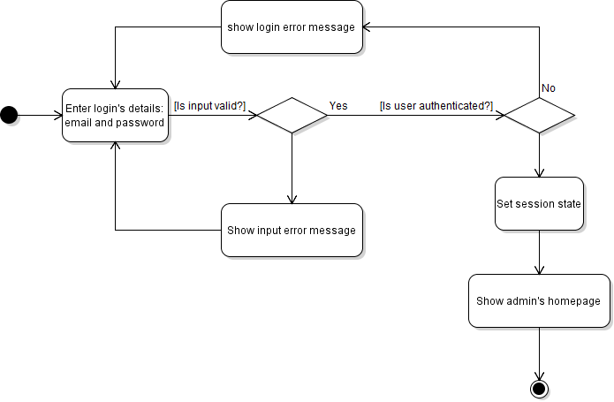
ACTIVITY DIAGRAM (SAMPLE)
User Login Activity Diagram

Slide 7
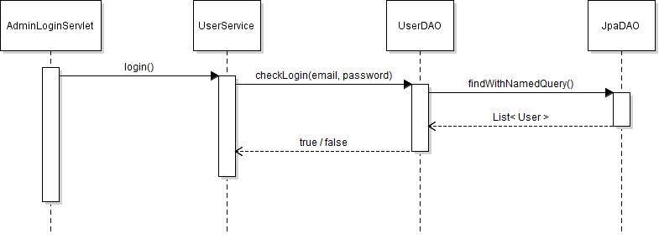
SEQUENCE DIAGRAM (SAMPLE)
User Login Sequence Diagram

Slide 8
END.

