Slide 1
Approximation Algorithms for MaxWIST in d Regular Graphs
Group - 8
Jahid Hasan - 1024052109
Abdul Wazed Rifat - 1024052031

Slide 2
Paper Titled:
Approximation algorithms for maximum weighted internal spanning trees in regular graphs and subdivisions of graphs
Published On:
The Computer Journal, Volume 67, Issue 10, October 2024, Pages 2898–2905,
Authors:
Sheikh Azizul Hakim , Rahnuma Islam Nishat , Md Saidur Rahman

Slide 3
Contents
Introduction
Problem Definition
Computational Complexity
Prior Work & Our Novel Contributions
Research motivation & Application
D Regular Graphs & Subdivision
Example with d=4 regular graph
4 regular graph simulation
4 regular 4-subdivision graph simulation
Hamiltonian graph 4-subdivision simulation
4-subdivision hypohamiltonian graph simulation
4-subdivision bi-connected outerplanar graph simulation
4-subdivision 4-connected planar graph simulation
Experimental results

Slide 4
Introduction

Slide 5
Problem Definition
Given: A vertex-weighted connected graph G = (V, E) with n vertices
Find: A spanning tree T of G that maximizes w(I(T))
Where: I(T) = internal vertices of T (degree ≥ 2), w(I(T)) = sum of weights of internal vertices

Slide 6
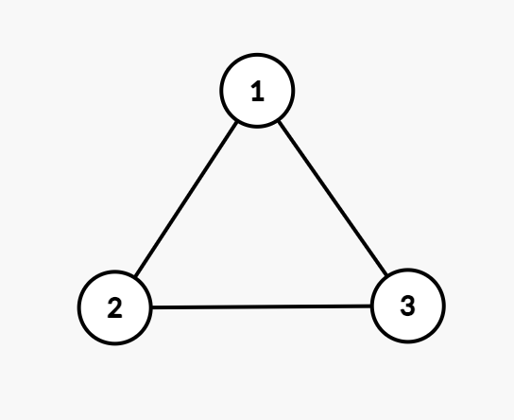
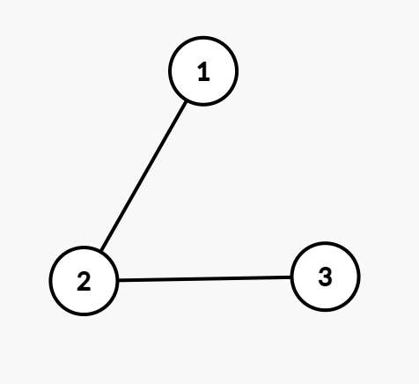
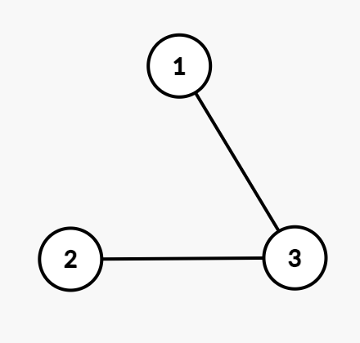
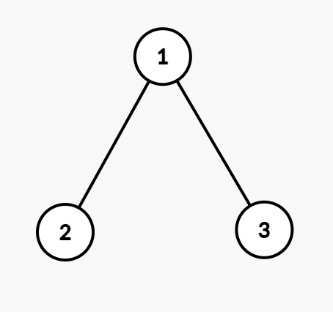
Problem Definition
Graph G
Spanning Tree, Subgraph of G

Slide 7
Computational Complexity & Challenges
NP-Complete Problem
General MaxWIST: Proven NP-complete
Implication: No polynomial-time exact algorithm exists (unless P = NP)
Comparison with Classical MST
Minimum Spanning Tree (MST) - Polynomial - Kruskal, Prim - O(E log V)
Maximum Weighted Internal ST - NP-Complete - Approximation algorithms needed

Slide 8
Prior Work & Our Novel Contributions
Evolution of MaxwIST Research
2018
Biniaz
Result: 3/4-approximation for MaxwIST in cubic graphs
Method: Extended to weighted vertices with novel techniques
Innovation: Bridged unweighted to weighted case
Gap: Still limited to cubic graphs (d=3)
2024
Hakim, Nishat & Rahman
Result: Generalized approximation for arbitrary d-regular graphs
Method: Novel algorithmic framework with subdivision analysis
Breakthrough: First solution for general d-regular graphs
Achievement: Polynomial-time algorithms with practical performance
2004
Salamon & Weiner
Result: 5/6-approximation for MaxIST in cubic graphs
Method: Unweighted case analysis using LP relaxation
Limitation: Restricted to degree-3 graphs only
Impact: First theoretical breakthrough for this problem

Slide 9



Our Key Contributions
1. Generalized Framework
Extended approximation algorithms from cubic graphs to arbitrary d-regular graphs
2. Subdivision Analysis
Novel algorithms for x-subdivisions of various graph classes
3. Special Graph Classes
Near-optimal results for Hamiltonian, outerplanar, and hypoHamiltonian graphs
Efficient Implementation
Polynomial Time O(dn) algorithms with practical performance

Slide 10
Research Motivation & Real-World Applications
Bridging Classical Problems
Connects traditional spanning tree optimization with modern vertex-centric graph analysis
Approximation Theory
Advances techniques for handling NP-hard optimization problems in graph theory
Algorithmic Innovation
Develops new frameworks applicable to broader classes of graph optimization problems
Communication Networks
Maximize capacity at hub routers while ensuring all nodes remain connected
VLSI Circuit Layout
Minimize leaf components while maximizing internal processing units
Database Systems
Optimize query processing trees by emphasizing internal join operations
Social Network Analysis
Identify influential users who bridge different communities

Slide 11
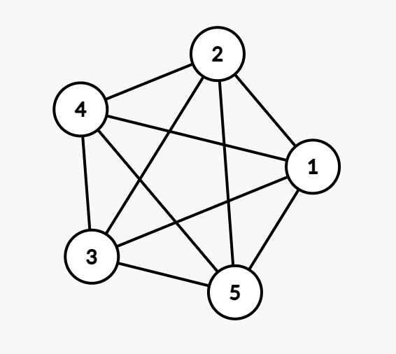
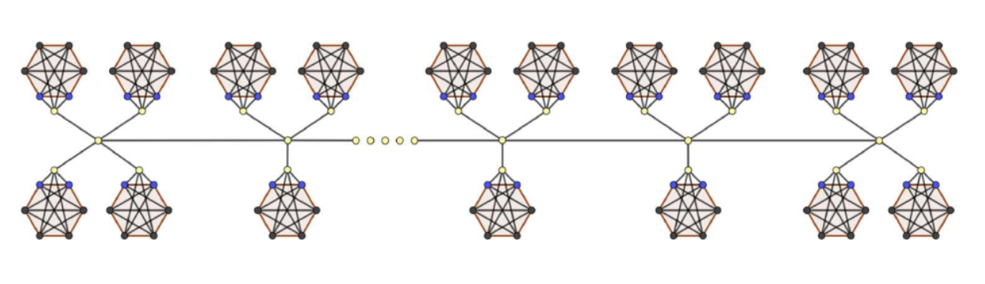
d-REGULAR GRAPHS AND THEIR SUBDIVISIONS
Theorem 3.1
Statement: For every d ≥ 3 and n₀ ≥ 1, there exists a d-regular graph of at least n₀ vertices, such that for any of its spanning trees, w(I)/w(V) ≤ d/(d+1).

Slide 12
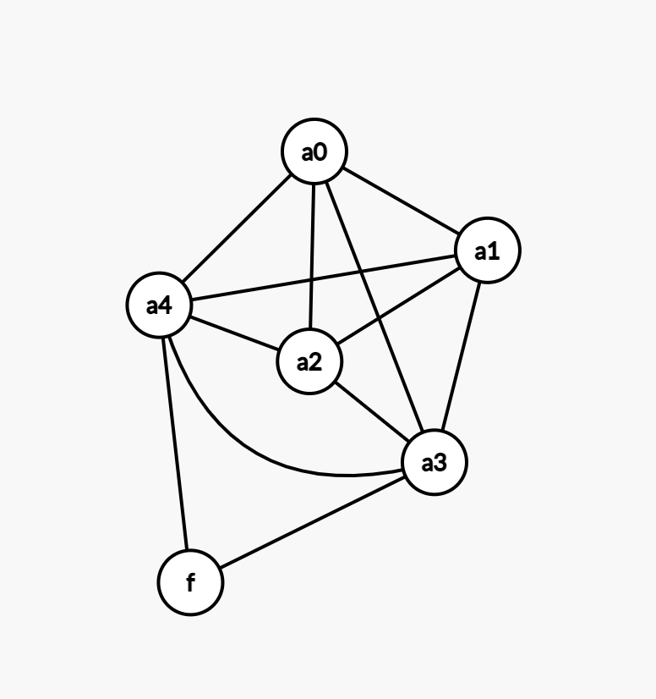
Step 1: Understanding the Construction (d=4, Even Case)
Step 1.1: Build the Gadget Φ
Vertices: {a₀, a₁, a₂, a₃, a₄} ∪ {f}
Total vertices in gadget: 6 vertices
Step 1.2: Initial Edge Construction
Complete graph edges between aᵢ vertices:
(a₀,a₁), (a₀,a₂), (a₀,a₃), (a₀,a₄)
(a₁,a₂), (a₁,a₃), (a₁,a₄)
(a₂,a₃), (a₂,a₄)
(a₃,a₄)
Edges from f to aₖ (k ≥ 3):
(f,a₃), (f,a₄)

Slide 13
Vertex | Degree | Target | Status
a₀ | 4 | 4 | ✓ Complete
a₁ | 4 | 4 | ✓ Complete
a₂ | 4 | 4 | ✓ Complete
a₃ | 4+1=5 | 4 | ❌ Excess +1
a₄ | 4+1=5 | 5 | ❌ Excess +1
f | 2 | 4 | ❌ Need +2

Slide 14
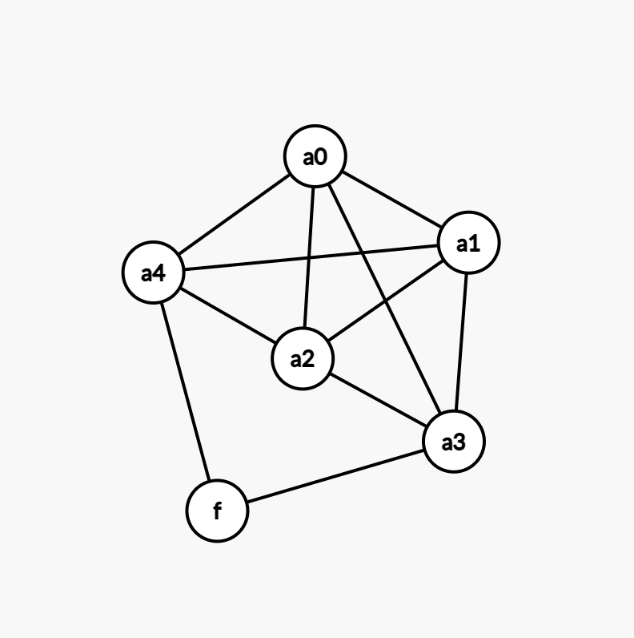
Step 1.3: Edge Removal to Fix Degrees
Problem: a₃ & a₄ has degree 5, but we need degree 4
Solution: Remove edge (a₃,a₄) from the cycle a₃,a₄,a₃
Since d=4 is even, we remove edges where i is odd and j=i+1

Slide 15
Vertex | Final Degree | Status
a₀ | 4 | ✓ Perfect
a₁ | 4 | ✓ Perfect
a₂ | 4 | ✓ Perfect
a₃ | 4 | ✓ Perfect
a₄ | 4 | ✓ Perfect
f | 2 | ❌ Needs 2 more (has "two hands")

Slide 16
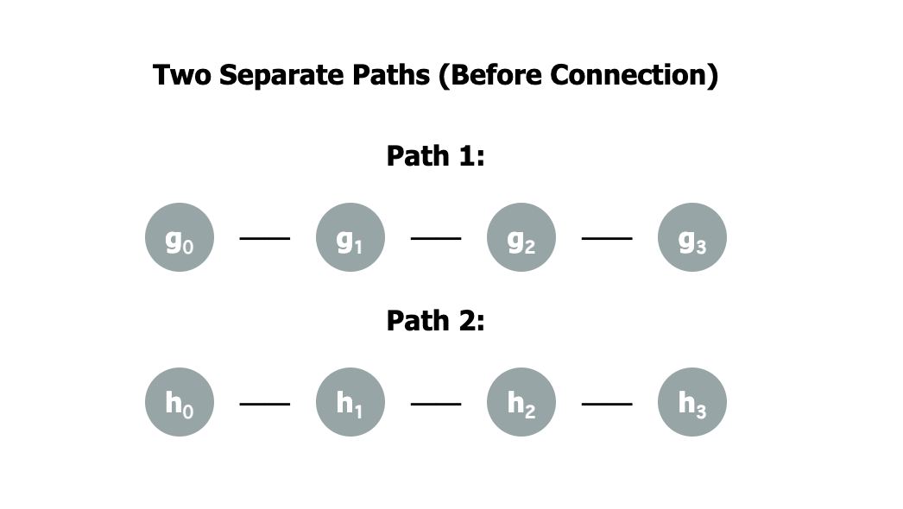
Step 2: Building the Frame Graph G₄ (Detailed Breakdown)
Vertex Type | Current Degree | Target Degree | Additional Connections Needed
Endpoints (g₀, g₃, h₀, h₃) | 1 | 4 | 3 more
Internal (g₁, g₂, h₁, h₂) | 2 | 4 | 2 more
Step 2.1: Start with Two Simple Path Graphs

Slide 17
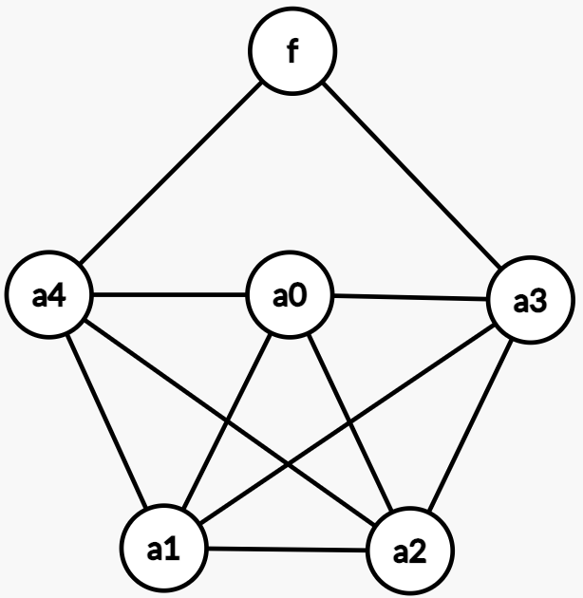
g0
g1
g2
g3
h0
h1
h2
h3
Weights:
All aᵢ vertices (i = 0,1,2,3,4): weight = 1
All other vertices (f, gᵢ, hᵢ): weight = 0

Slide 18
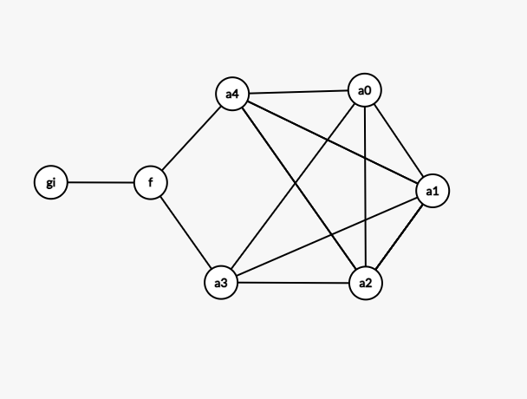
a₂ → a₀ → a₁ → a₃ → f
1
1
w(I): 4 (from a₂, a₀, a₁ a₃, f)
Total weight in gadget: 5 (from all aᵢ vertices)
Ratio: 4/5
0
1
1
1
w(I)/w(V) ≤ d/(d+1)

Slide 19
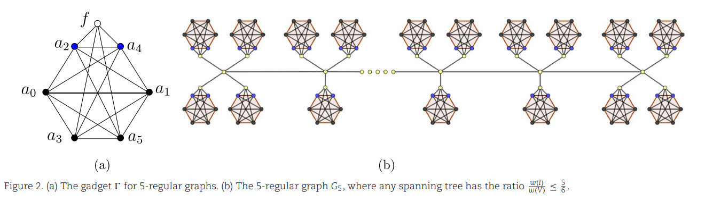

Slide 20
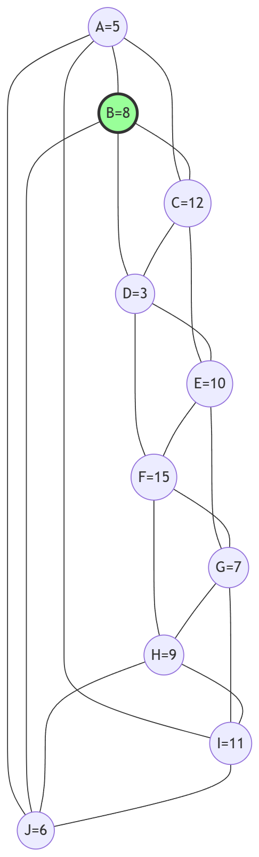
Choose Root Node
w(N(A)) = w(A) + w(B) + w(C) + w(I) + w(J) = 5 + 8 + 12 + 11 + 6 = 42
w(N(B)) = w(B) + w(A) + w(C) + w(D) + w(J) = 8 + 5 + 12 + 3 + 6 = 34
w(N(C)) = w(C) + w(A) + w(B) + w(D) + w(E) = 12 + 5 + 8 + 3 + 10 = 38
w(N(D)) = w(D) + w(B) + w(C) + w(E) + w(F) = 3 + 8 + 12 + 10 + 15 = 48
w(N(E)) = w(E) + w(C) + w(D) + w(F) + w(G) = 10 + 12 + 3 + 15 + 7 = 47
w(N(F)) = w(F) + w(D) + w(E) + w(G) + w(H) = 15 + 3 + 10 + 7 + 9 = 44
w(N(G)) = w(G) + w(E) + w(F) + w(H) + w(I) = 7 + 10 + 15 + 9 + 11 = 52
w(N(H)) = w(H) + w(F) + w(G) + w(I) + w(J) = 9 + 15 + 7 + 11 + 6 = 48
w(N(I)) = w(I) + w(A) + w(G) + w(H) + w(J) = 11 + 5 + 7 + 9 + 6 = 38
w(N(J)) = w(J) + w(A) + w(B) + w(H) + w(I) = 6 + 5 + 8 + 9 + 11 = 39
Here W(N(B)) is lowest (34). So, B is selected as root.

Slide 21
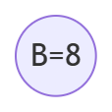
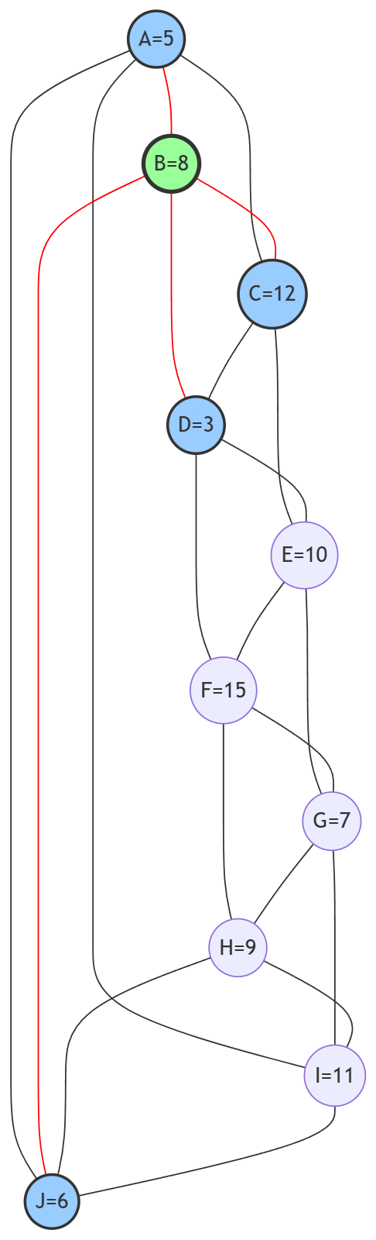
Dfs Traversal - Iteration 1
Get Neighbour with maximum w(x) / u(x)
A : w(A)/ u(A) = 5/3 = 1.67
C : w(C) / u(C) = 12/3 = 4
D: w(D) / u(D) = 3/3 = 1
J = w(J) / u(J) = 6/3 = 2
So next node is C with maximum value 4

Slide 22
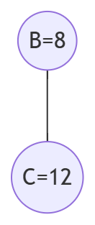
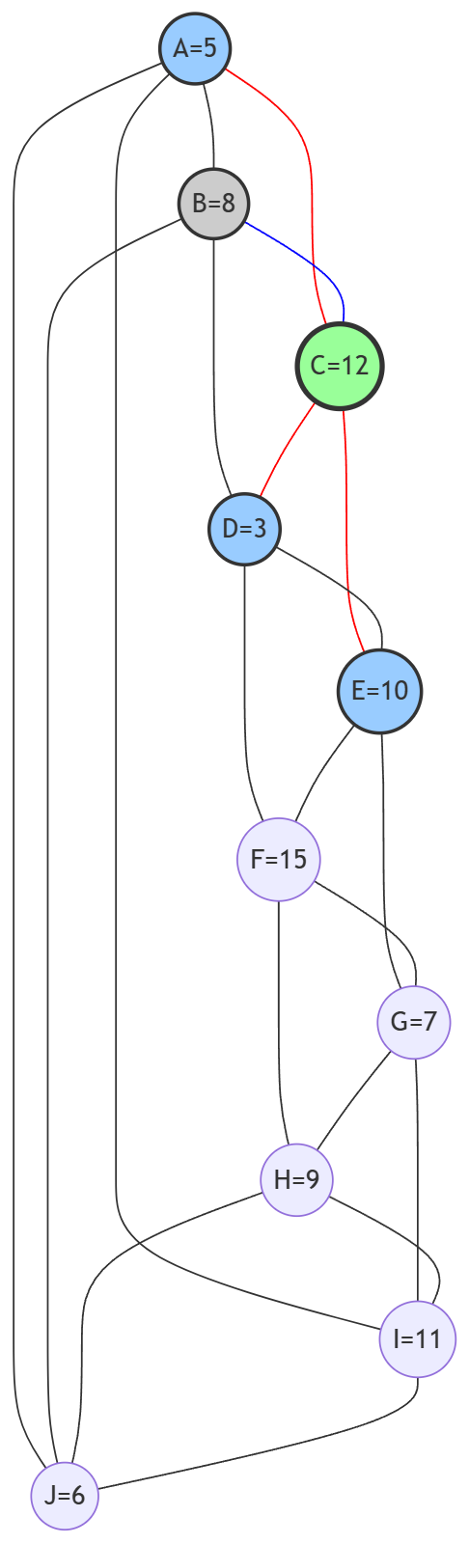
Dfs Traversal - Iteration 2
Get Neighbour with maximum w(x) / u(x)
A : w(A)/ u(A) = 5/2 = 2.5
D: w(D) / u(D) = 3/2 = 1.5
E = w(E) / u(E) = 10/2 = 5
So next node is E with maximum value 5

Slide 23
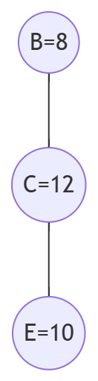
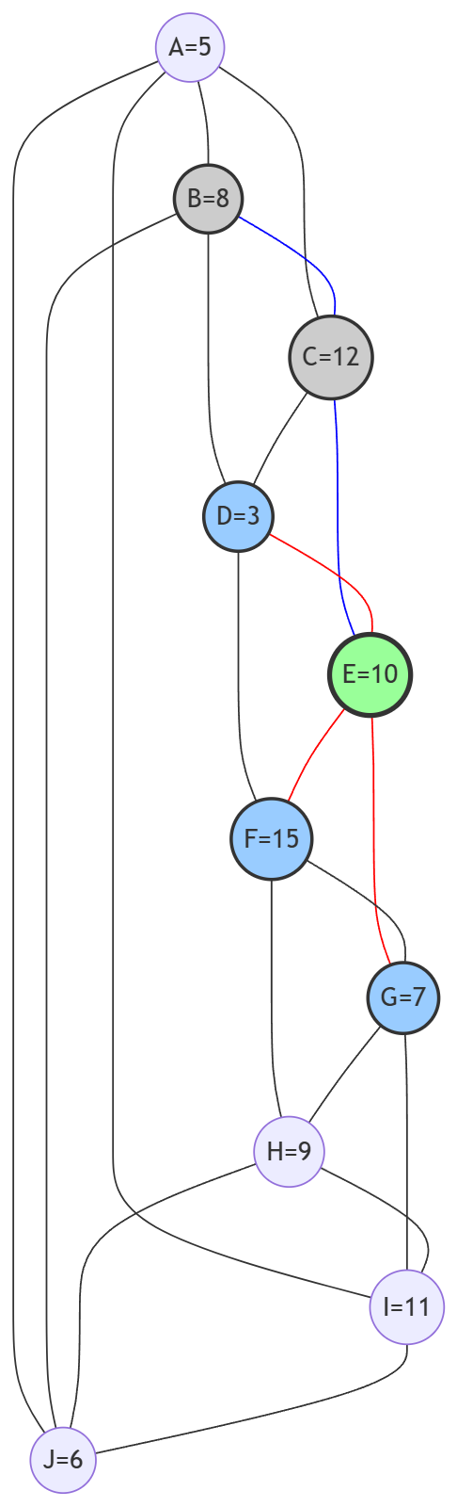
Dfs Traversal - Iteration 3
Get Neighbour with maximum w(x) / u(x)
D: w(D)/u(D) = 3/1 = 3
F: w(F)/u(F) = 15/3 = 5
G: w(G)/u(G) = 7/3 ≈ 2.33
So next node is F with maximum value 5

Slide 24
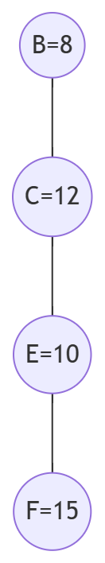
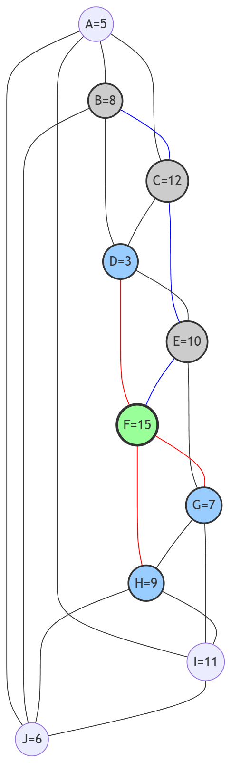
Dfs Traversal - Iteration 4
Get Neighbour with maximum w(x) / u(x)
D: w(D)/u(D) = 3/1 = 3
G: w(G)/u(G) = 7/3 ≈ 2.33
H: w(H)/u(H) = 9/3 = 3
So D and H both has maximum value. Let’s choose one of them.
So next node is D with maximum value 3

Slide 25
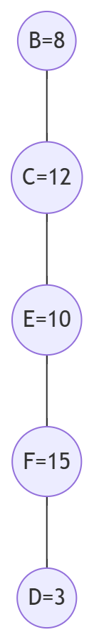
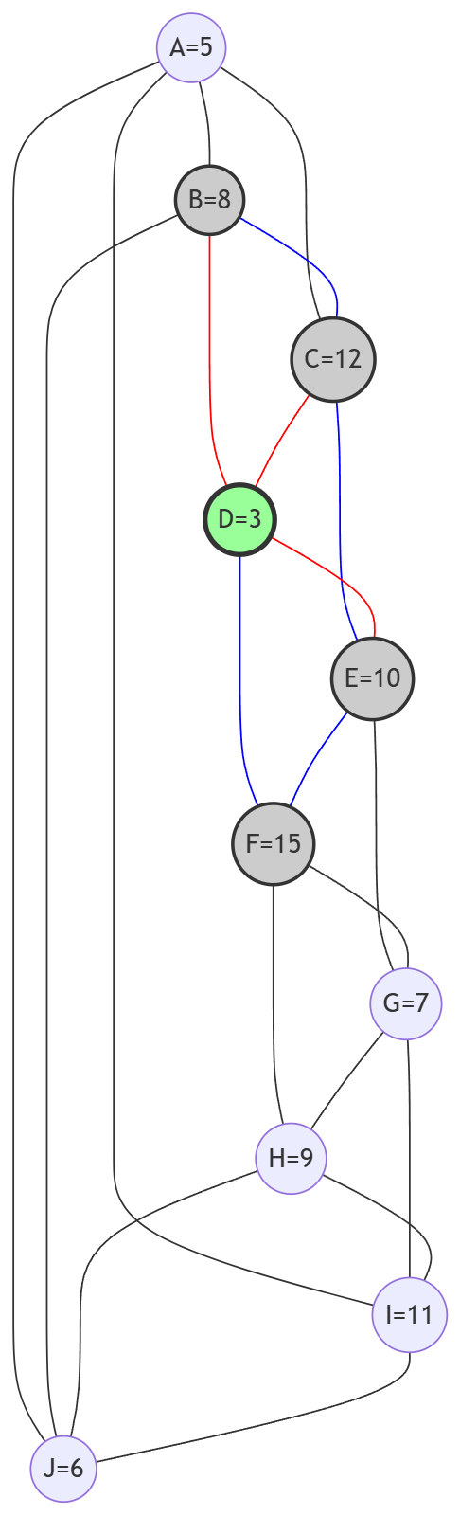
Dfs Traversal - Iteration 5
No unvisited neighbors.
So we backtrack and find F node with unvisited neighbors. So, we will go back to F node

Slide 26
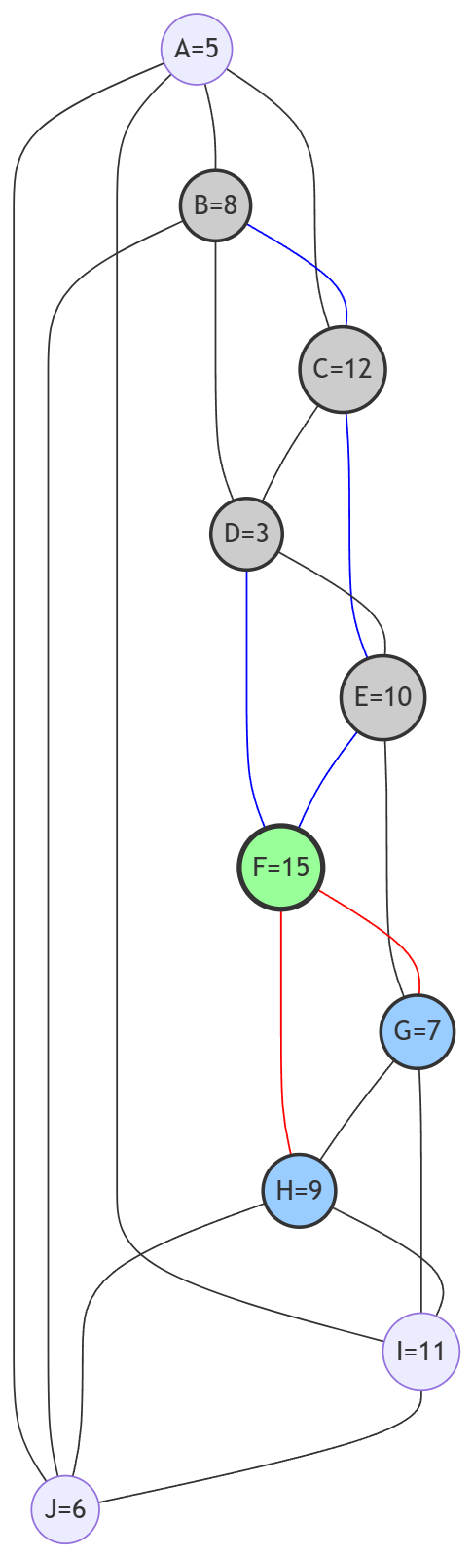
Dfs Traversal - Iteration 6
Get Neighbour with maximum w(x) / u(x)
G: w(G)/u(G) = 7/2 = 3.5
H: w(H)/u(H) = 9/3 = 3
So next node is G with maximum value 3.5

Slide 27
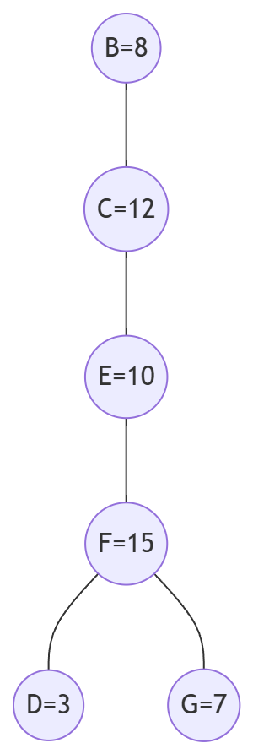
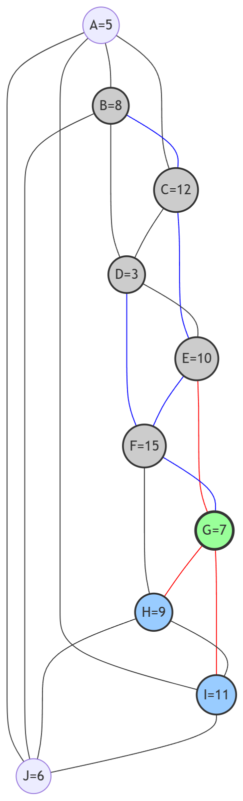
Dfs Traversal - Iteration 7
Get Neighbour with maximum w(x) / u(x)
H: w(H)/u(H) = 9/2 = 4.5
I: w(I)/u(I) = 11/3 ≈ 3.67
So next node is H with maximum value 4.5

Slide 28
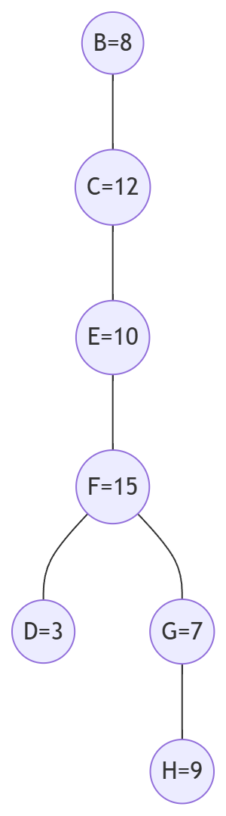
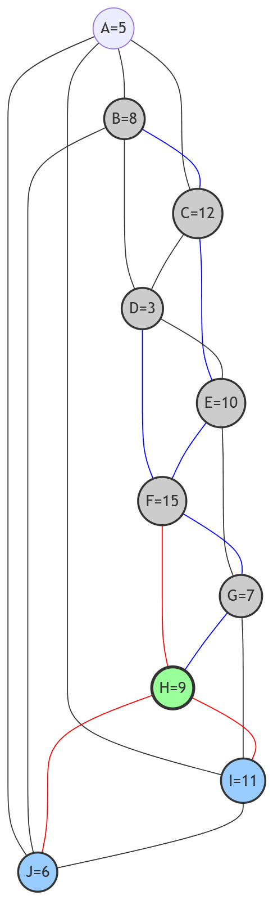
Dfs Traversal - Iteration 8
Get Neighbour with maximum w(x) / u(x)
I: w(I)/u(I) = 11/2 = 5.5
J: w(J)/u(J) = 6/2 = 3
So next node is I with maximum value 5.5

Slide 29
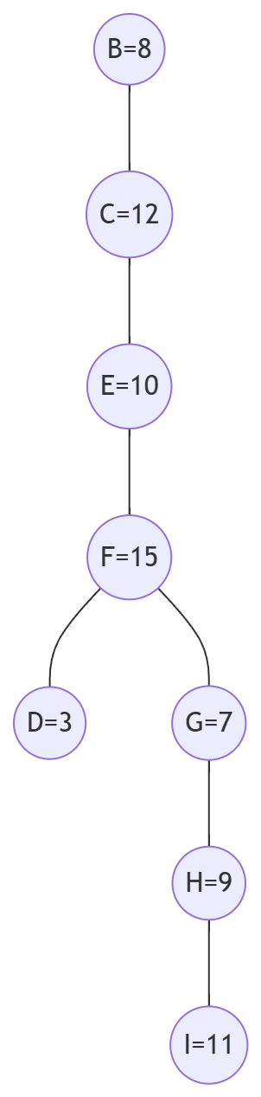
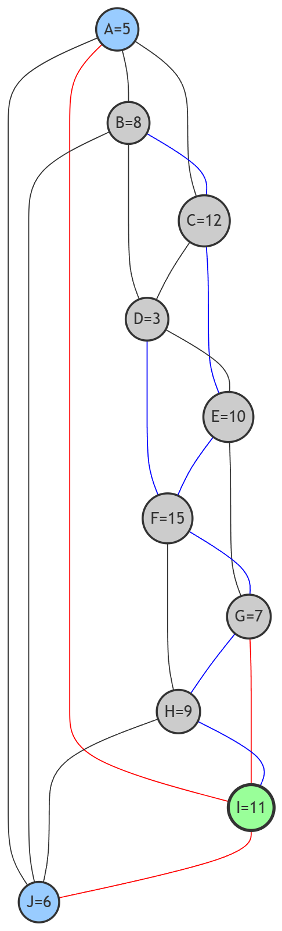
Dfs Traversal - Iteration 9
Get Neighbour with maximum w(x) / u(x)
A: w(A)/u(A) = 5/1 = 5
J: w(J)/u(J) = 6/1 = 6
So next node is J with maximum value 6

Slide 30
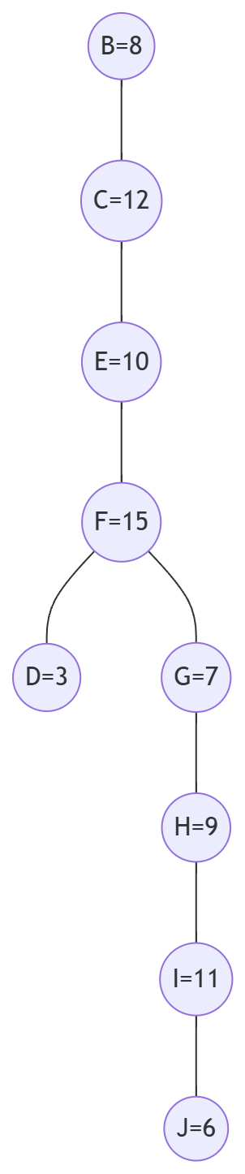
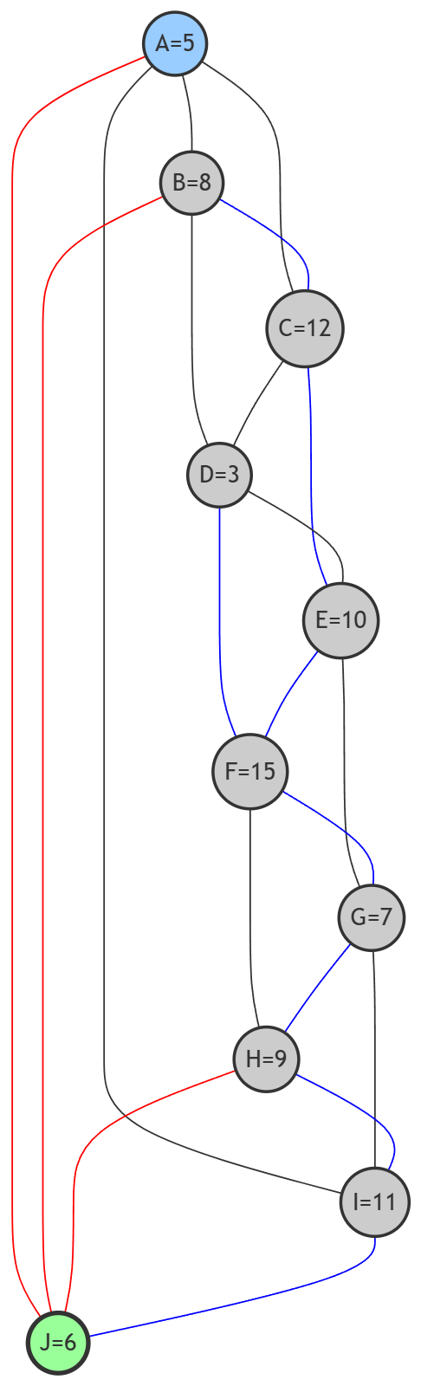
Dfs Traversal - Iteration 10
A is the only unvisited node left. So, A is the next node

Slide 31
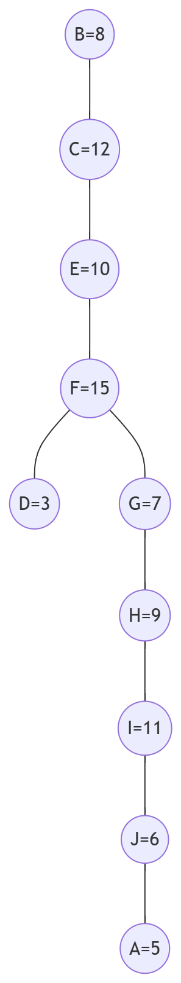
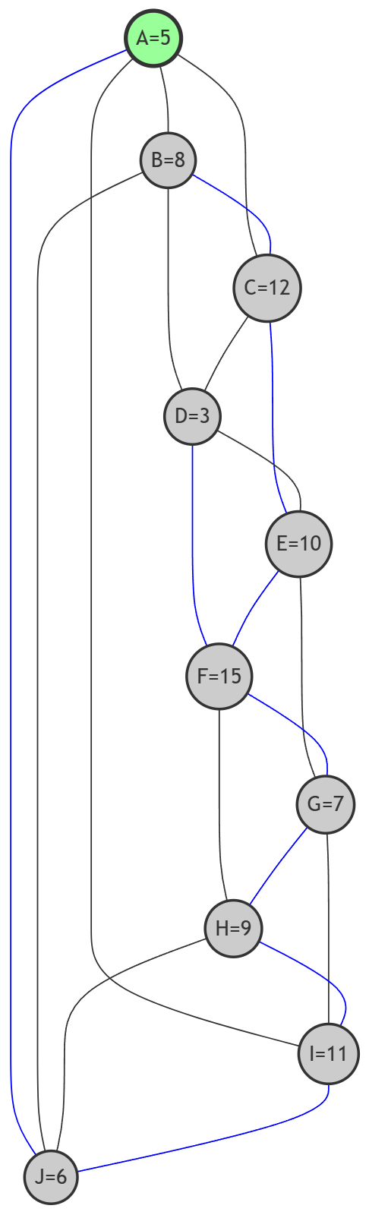
Dfs Traversal - Iteration 11

Slide 32
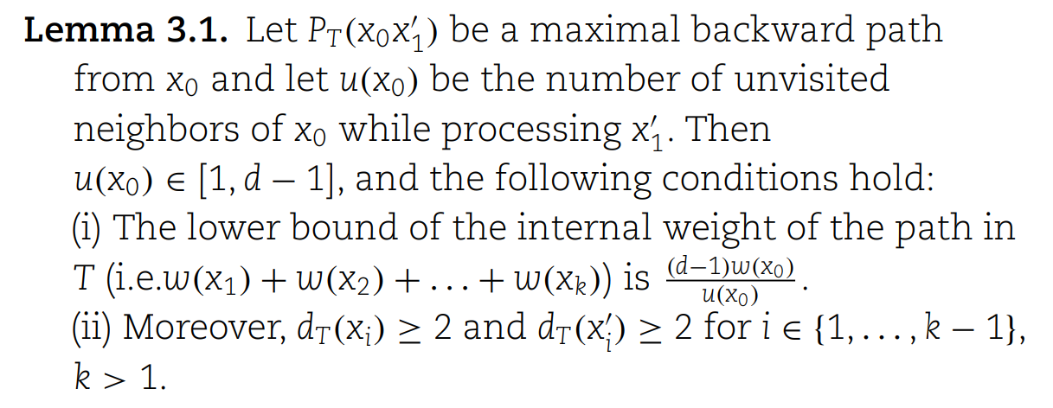
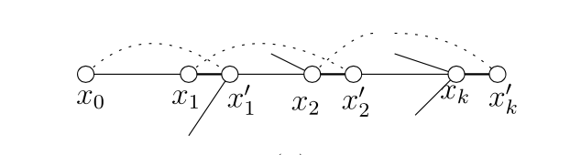
Lemma 3.1

Slide 33
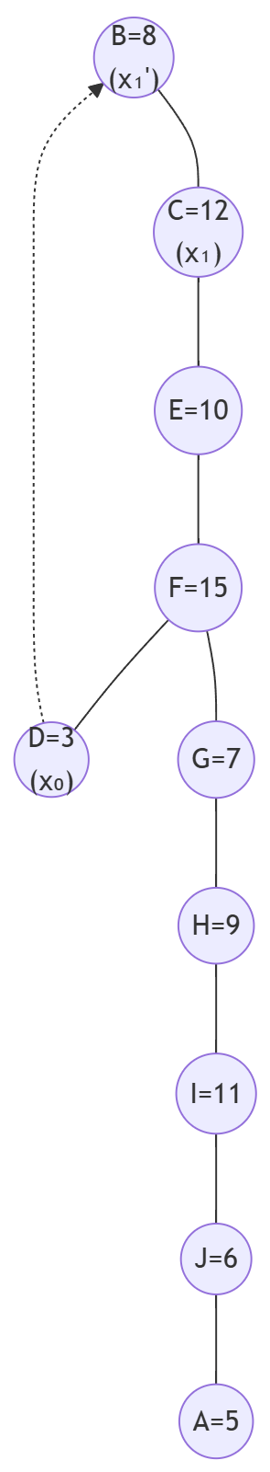
Backward Edge D -> B -> C
x₀=D , x₁’=B , x₁=C
So W(x₁) ≥ (d-1)w(x₀)/u(x₀)
=> 12 ≥ 3 * 3 / 3
=> 12 ≥ 3 So Lemma 3.1 holds

Slide 34
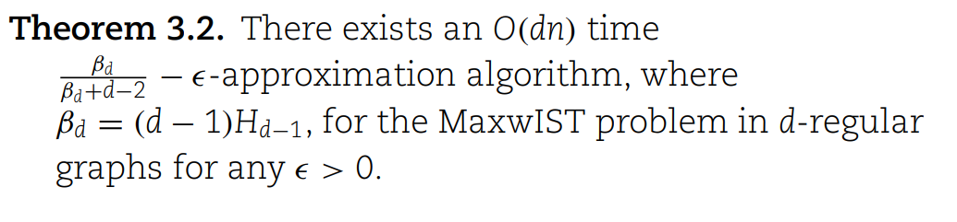
Internal weight w(I)=8+12+10+15+7+9+11+6=78
Total weight w(V)=5+8+12+3+10+15+7+9+11+6=86
So w(I) / w(V) = 78 / 86 = 0.907
𝛃₄ = (d-1)H_{d-1} = 3 * (1 + ½ + ⅓) = 5.5
𝛃₄ /(𝛃₄ + 4 - 2) - 𝜺 = 5.5 / (5.5+2) - 𝜺 = 0.733 - 𝜺
So, w(I) / w(V) ≥ 𝛃₄ /(𝛃₄ + 4 - 2) - 𝜺

Slide 35
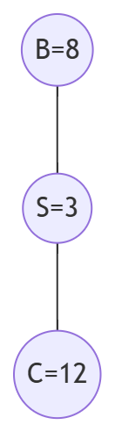
Subdivisions of d-regular graphs
Subdivided vertex has 2 degree. So next node is fixed. No change to algorithm But the internal vertex weight to the total vertex weight ratio of the spanning tree becomes
(d-1) / (2d-3) - 𝜺

Slide 36
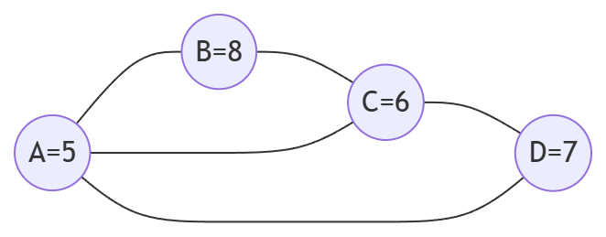
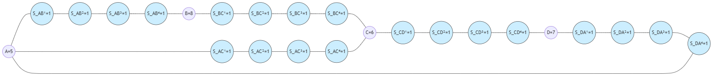
Hamiltonian graph x-subdivisions
4-subdivision hamiltonian graph

Slide 37
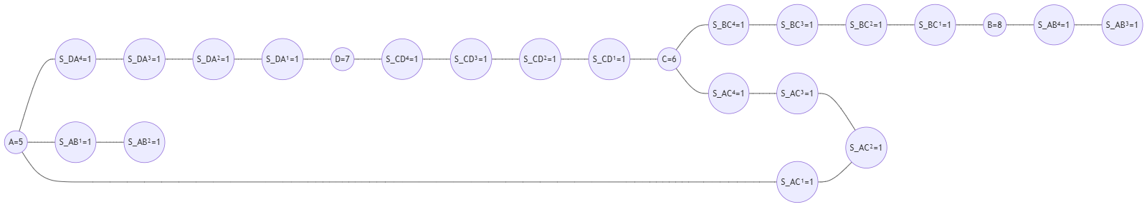
Hamiltonian graph x-subdivisions
Broke A -> B -> C -> A hamiltonian cycle

Slide 38
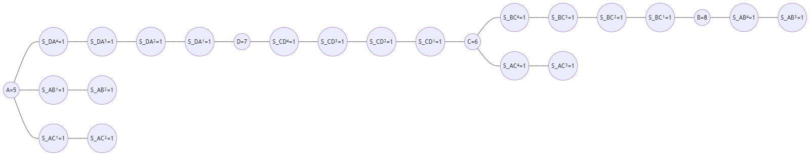
Hamiltonian graph x-subdivisions
Broke A -> C -> D -> A chordal chain

Slide 39
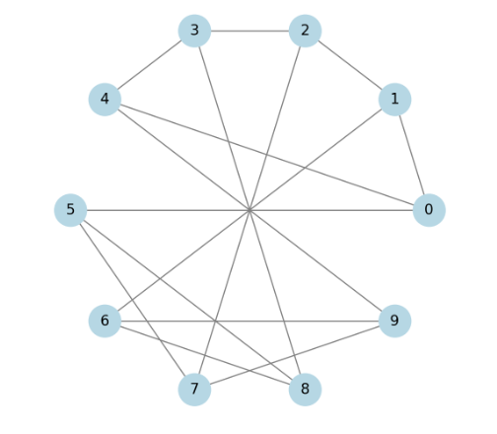
HypoHamiltonian graphs
Remove one vertex (E) to make this Hamiltonian graph
Generate spanning tree
Add the removed edge
Break cycle at minimum edge if exists

Slide 40

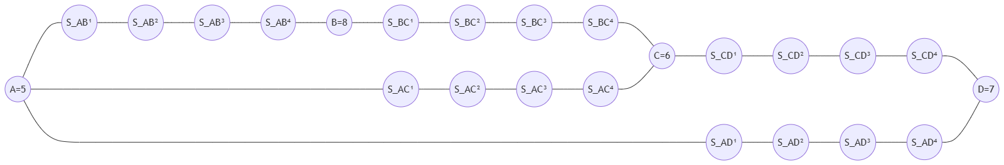
x-subdivisions of biconnected outerplanar graphs

Slide 41
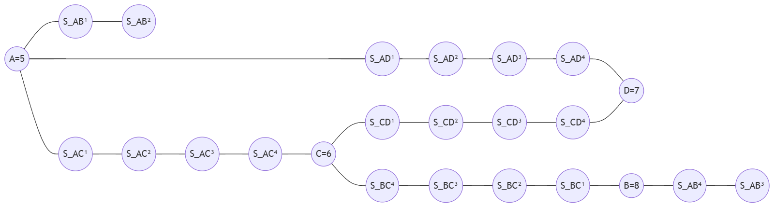
x-subdivisions of biconnected outerplanar graphs
Break outer cycle A->B->C->D->A at minimum edge (S_AB², S_AB³)

Slide 42
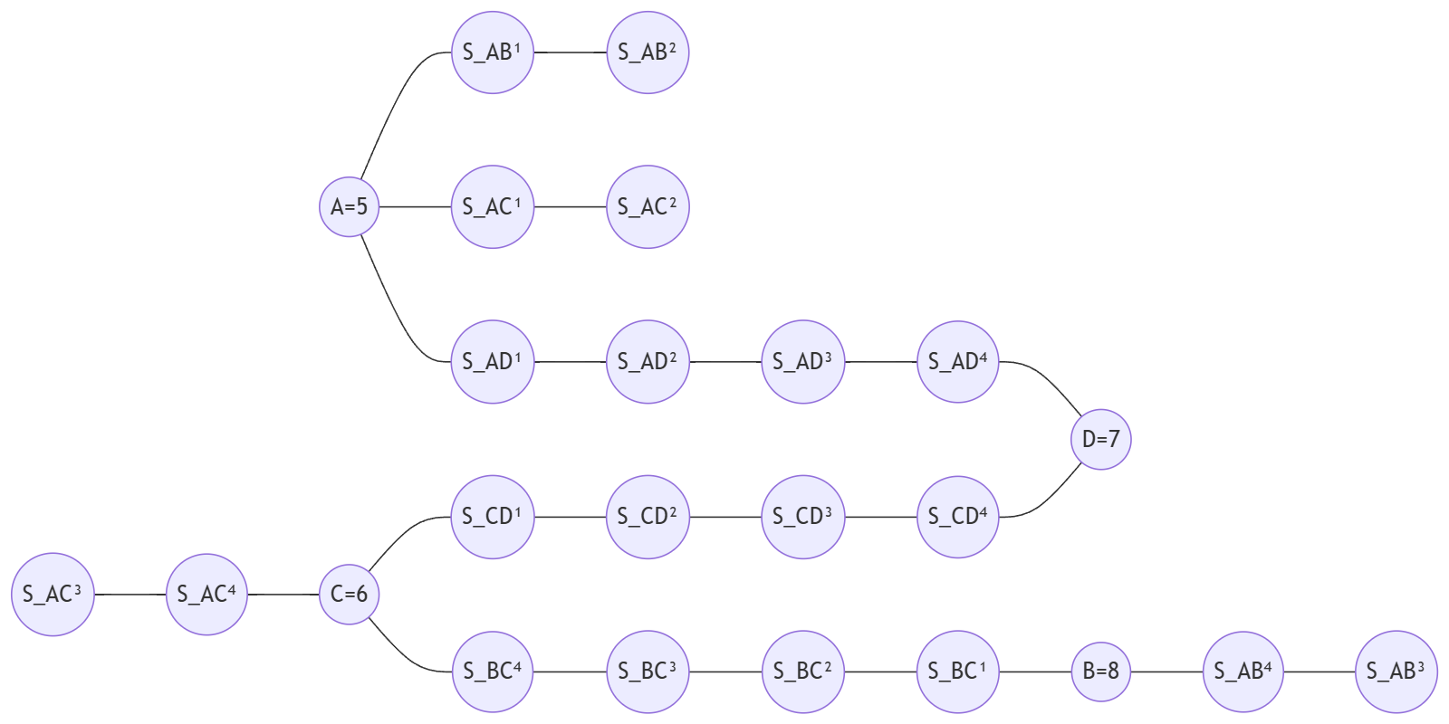
x-subdivisions of biconnected outerplanar graphs
Break Chord chain A->C->D->A at minimum edge (S_AC², S_AC³)

Slide 43
x-subdivisions of 4-connected planar graphs
Find Hamiltonian cycle
Break Hamiltonian cycle
Continue creating spanning tree like x-subdivisions of biconnected outerplanar graphs

Slide 44
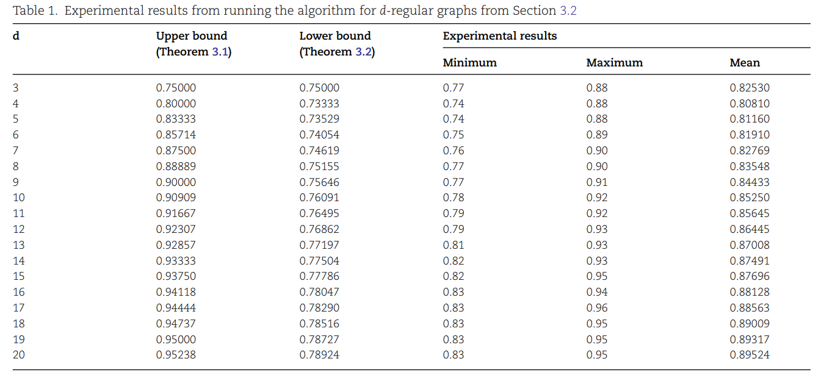
Experimental results

Slide 45
Thank you

