Slide 1

Notes:
Seven minutes on a single claim: on CICIDS2017, a near-perfect F1 is usually a property of the evaluation pipeline, not of the model.

Slide 2


Slide 3
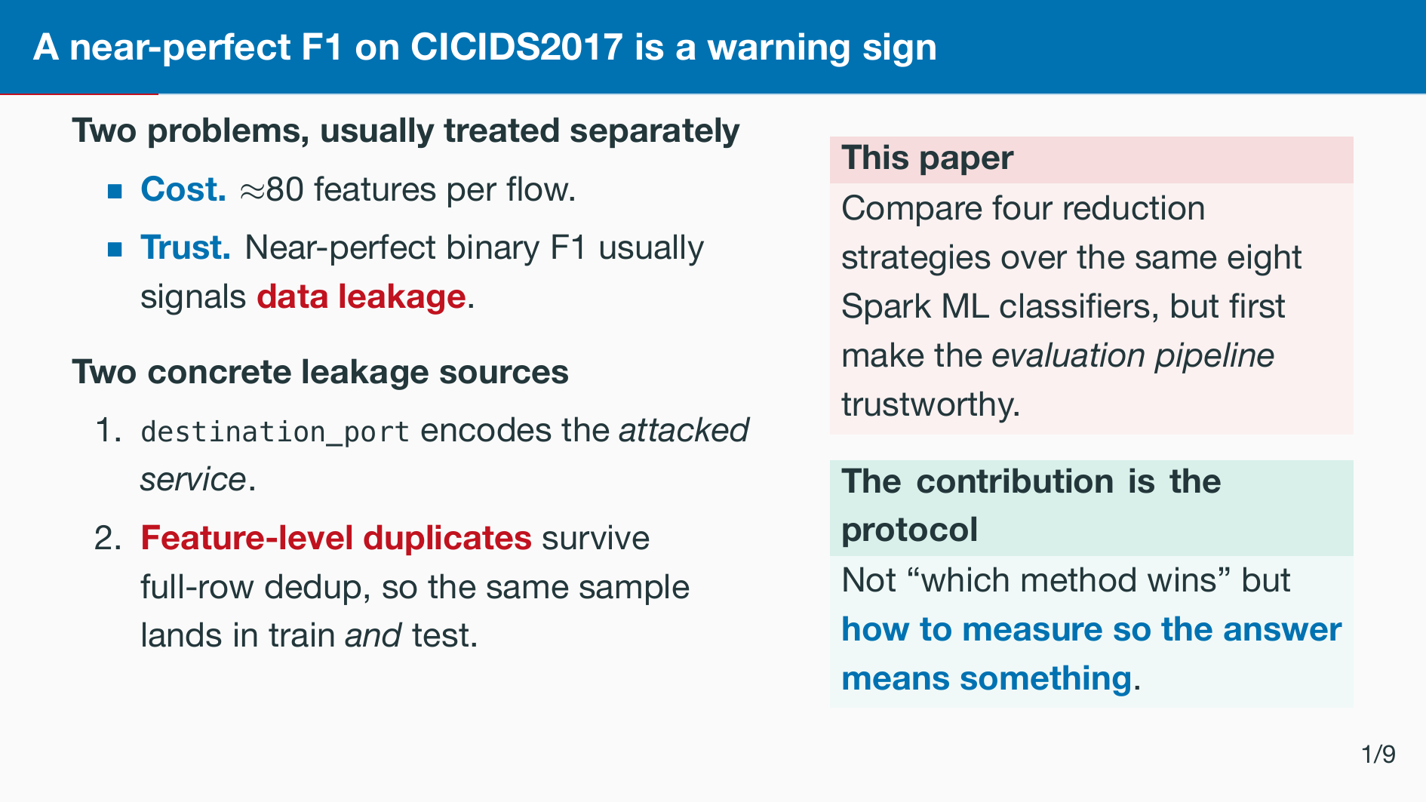
Notes:
Frame the talk as a measurement paper. The port gives the model a port-to-label shortcut, and 80 features are expensive to train, to score and to ﬁt on an edge device. Both leakage sources are removed before any split.

Slide 4
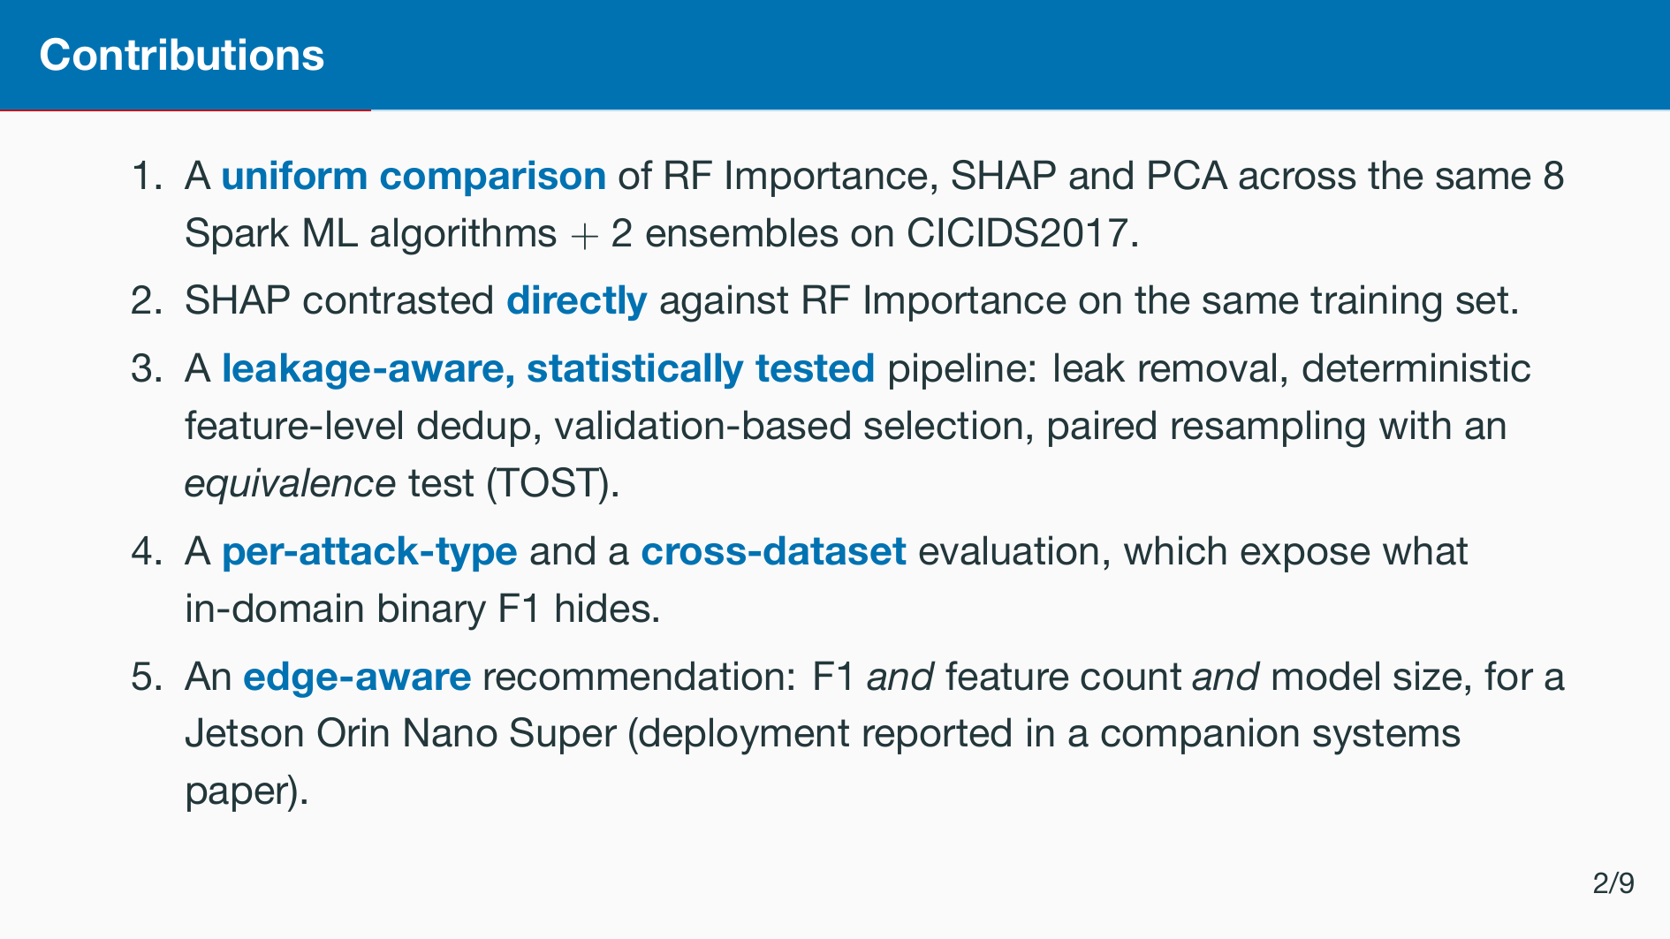
Notes:
Five contributions. Three, four and ﬁve are the ones rarely done together.

Slide 5


Slide 6
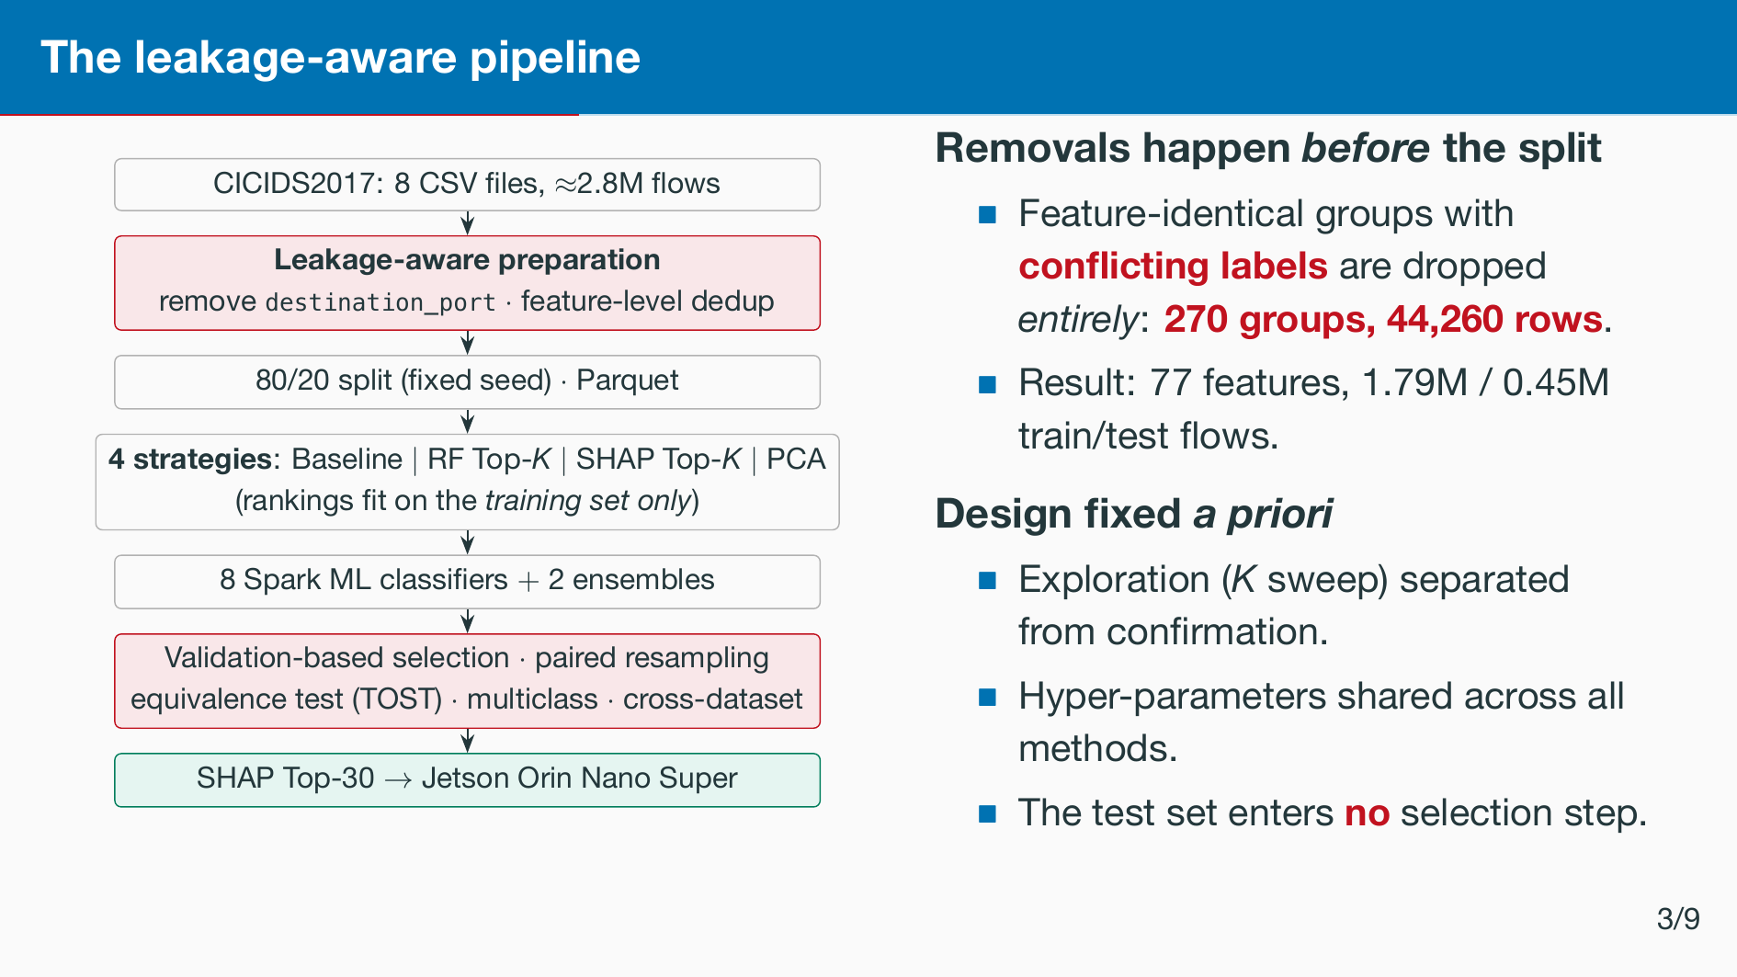
Notes:
Deterministic deduplication is the part people get wrong. Conﬂicting groups are removed wholesale, so the result does not depend on how Spark partitions the data.

Slide 7


Slide 8
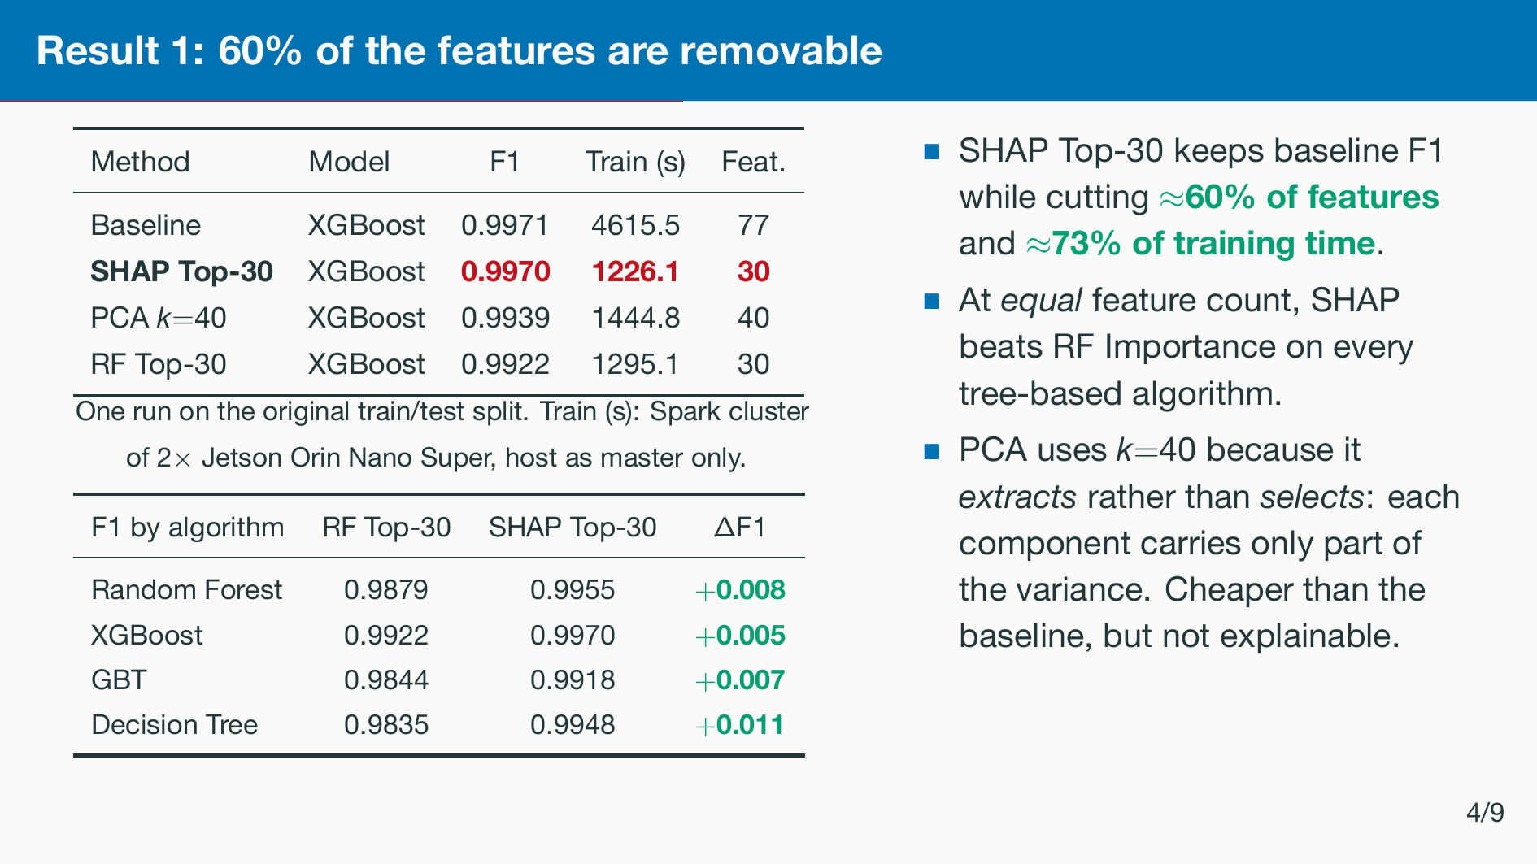
Notes:
Two tables, one message: SHAP Top-30 is the operating point. Same accuracy, 60 percent fewer features, and it is explainable, which matters for the SOC analyst and for the edge board downstream.

Slide 9
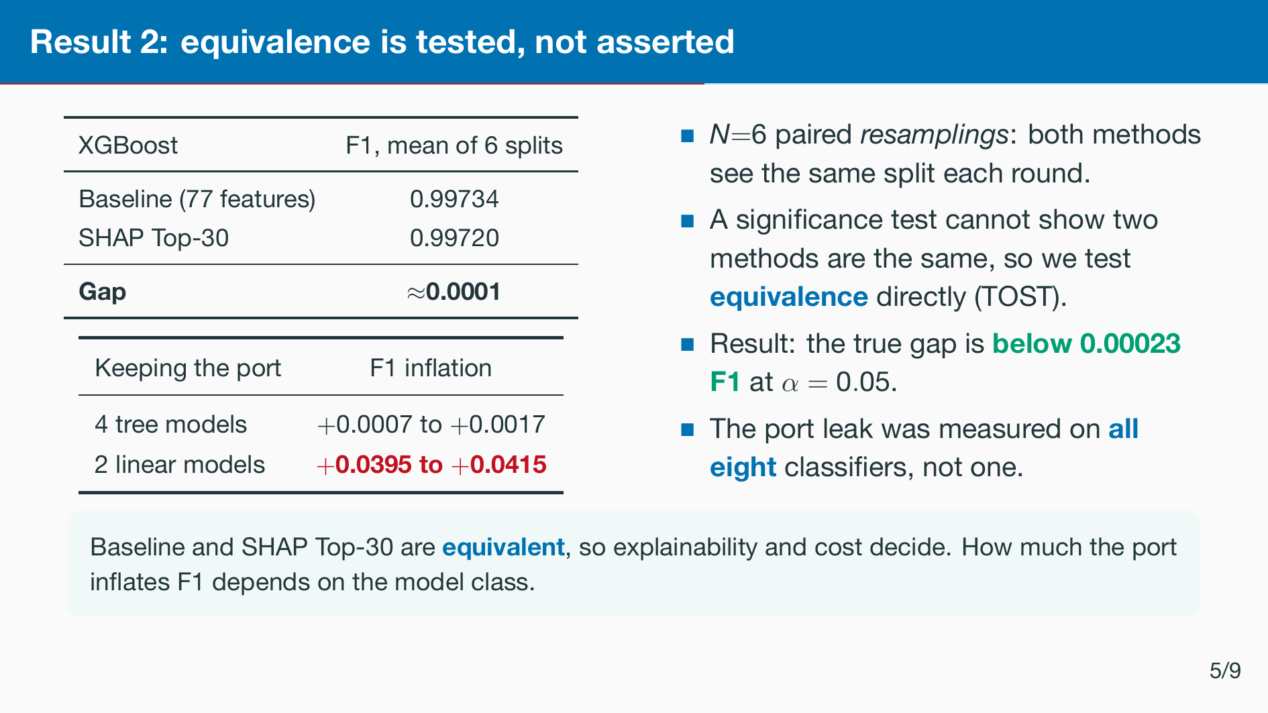
Notes:
Say the gap ﬁrst: one ten-thousandth of F1 over six paired splits. Then the point: we do not argue from a non-signiﬁcant p-value, we test equivalence. If asked: exact paired permutation over all 26 sign ﬂips gives p = 0.031, the ﬂoor of that test, Cohen’s d ≈ 1.94. TOST against a ±0.001 margin ﬁxed in advance, on the Nadeau–Bengio error, gives p = 3.9 ×10−6, and the tightest supported margin is ±2.3 × 10−4. Port table: per-model rows are in the paper. MLP is +0.0052 and Naive Bayes +0.0108. All later results have the port removed.

Slide 10
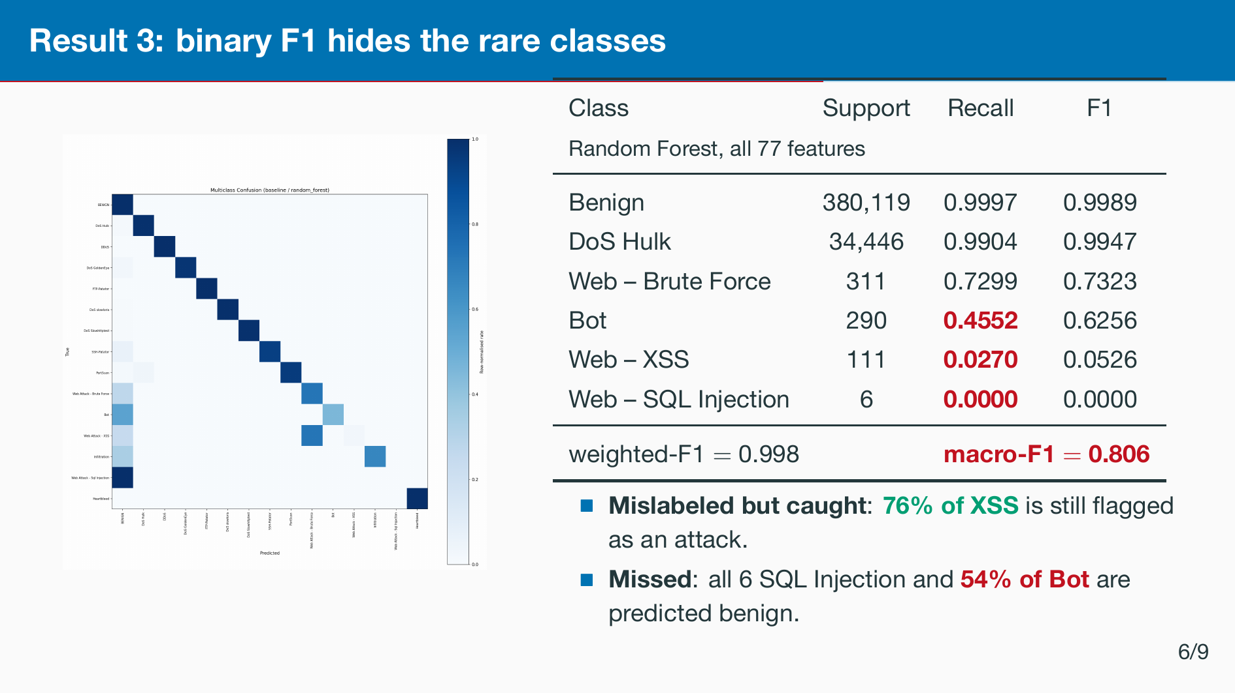
Notes:
Random Forest on all 77 features. Weighted F1 0.998 versus macro F1 0.806. XSS: 81 of 111 land on Web Brute Force, so they are still ﬂagged at the binary level. 27 percent of Brute Force also goes to Benign. Three plausible causes. The imbalance is extreme. With the port removed there is no port-80 shortcut, so short HTTP attack ﬂows look like browsing. And Bot C&C beaconing resembles background traﬃc. Comparing the reduction methods in multiclass mode is future work.

Slide 11
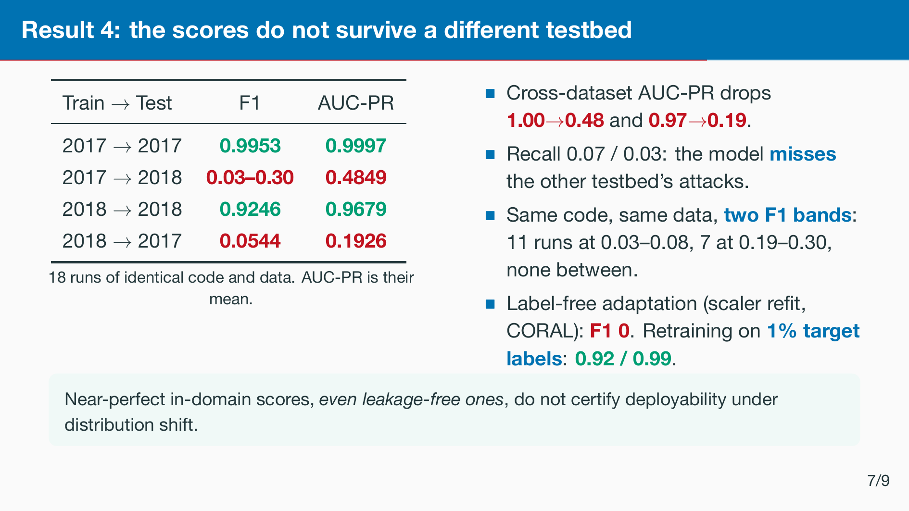
Notes:
Do not soften this. In-domain 0.99, cross-dataset AUC-PR 0.48 / 0.19. Recall 0.073 / 0.030 at precision 0.772 / 0.272: it misses attacks rather than alarming indiscriminately. If asked about the two F1 bands: AUC-PR is the same in both, so the ranking does not change between runs, only where the 0.5 threshold falls against a cluster of near-identical ﬂows. A mean (0.13) would sit in the empty gap, so we report both bands and judge the collapse on AUC-PR. Causes of the shift: CICFlowMeter version, network conﬁguration, attack tooling. 1% of the target is about 19k ﬂows. Consistent with prior cross-dataset IDS studies, and the reason domain adaptation is a prerequisite rather than a nice-to-have.

Slide 12
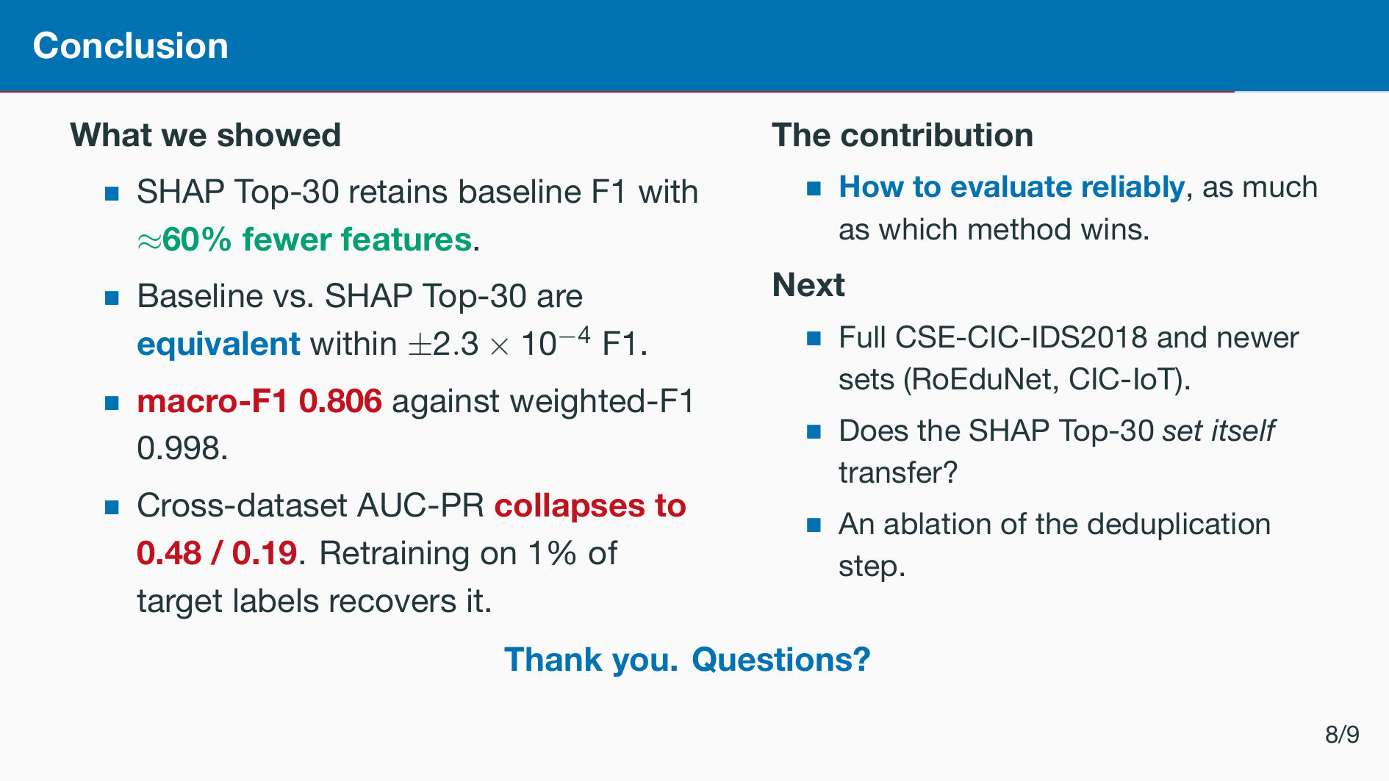
Notes:
Close on the protocol, not the leaderboard.

Slide 13
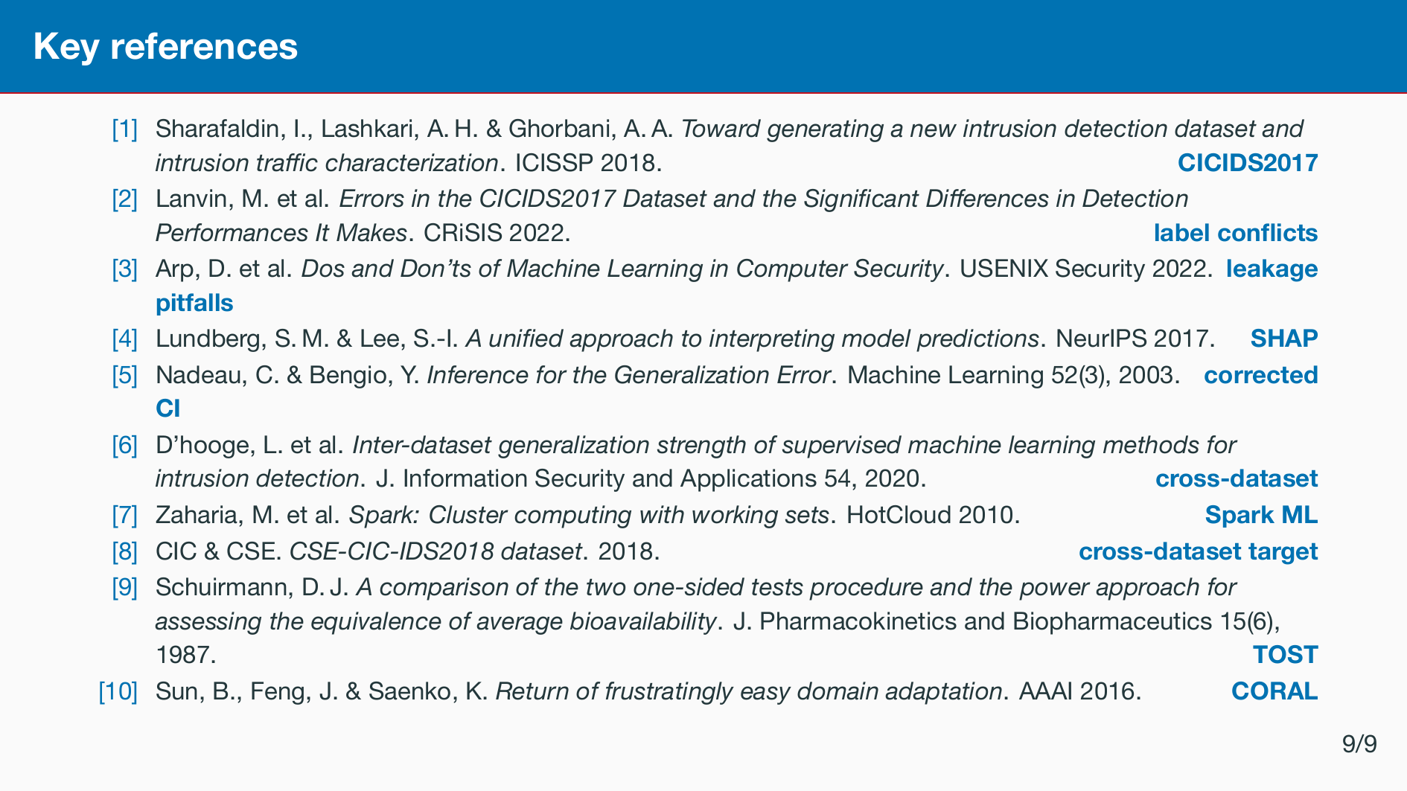
Notes:
Not presented. Shown while taking questions, so sources are on screen if the audience asks. Full list is in the paper.

Slide 14


Slide 15
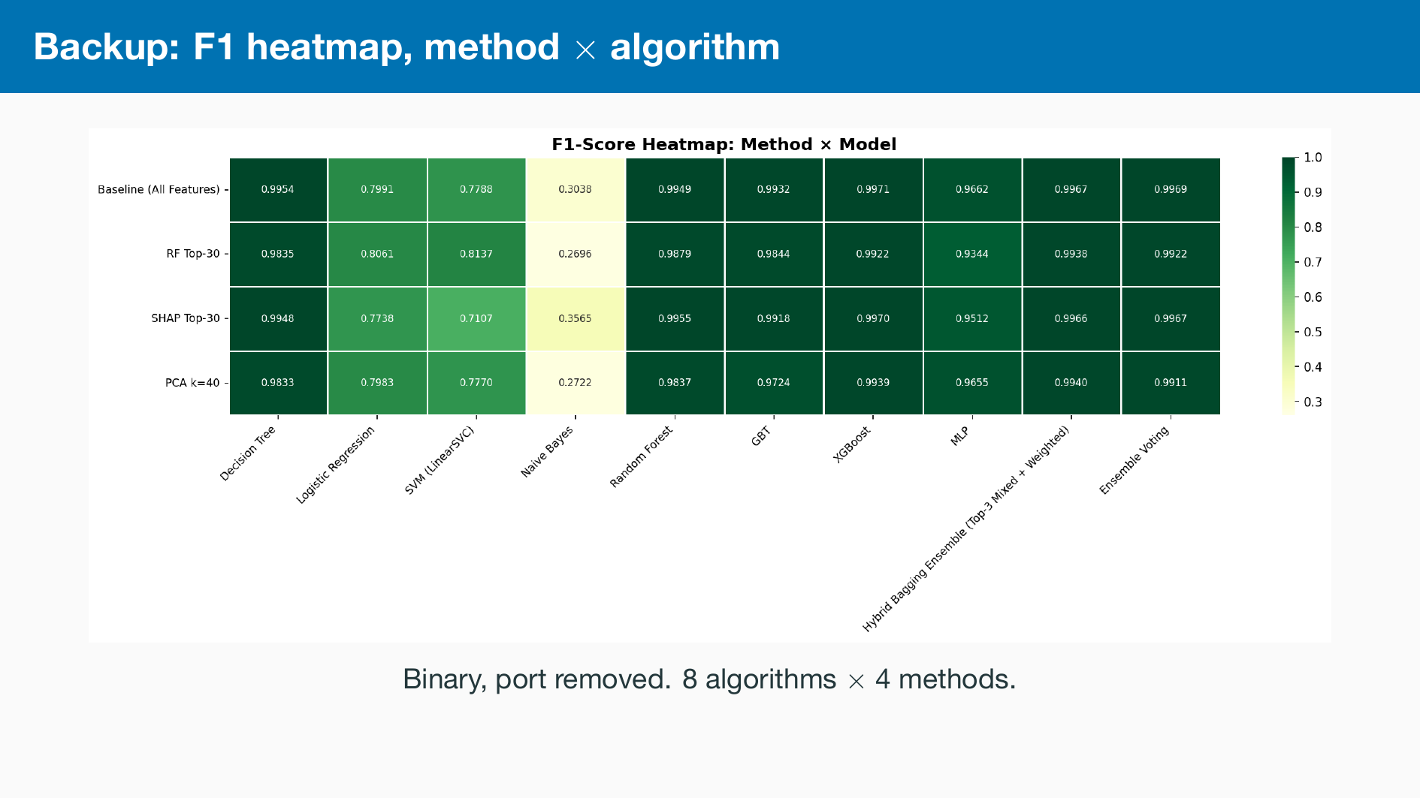

Slide 16
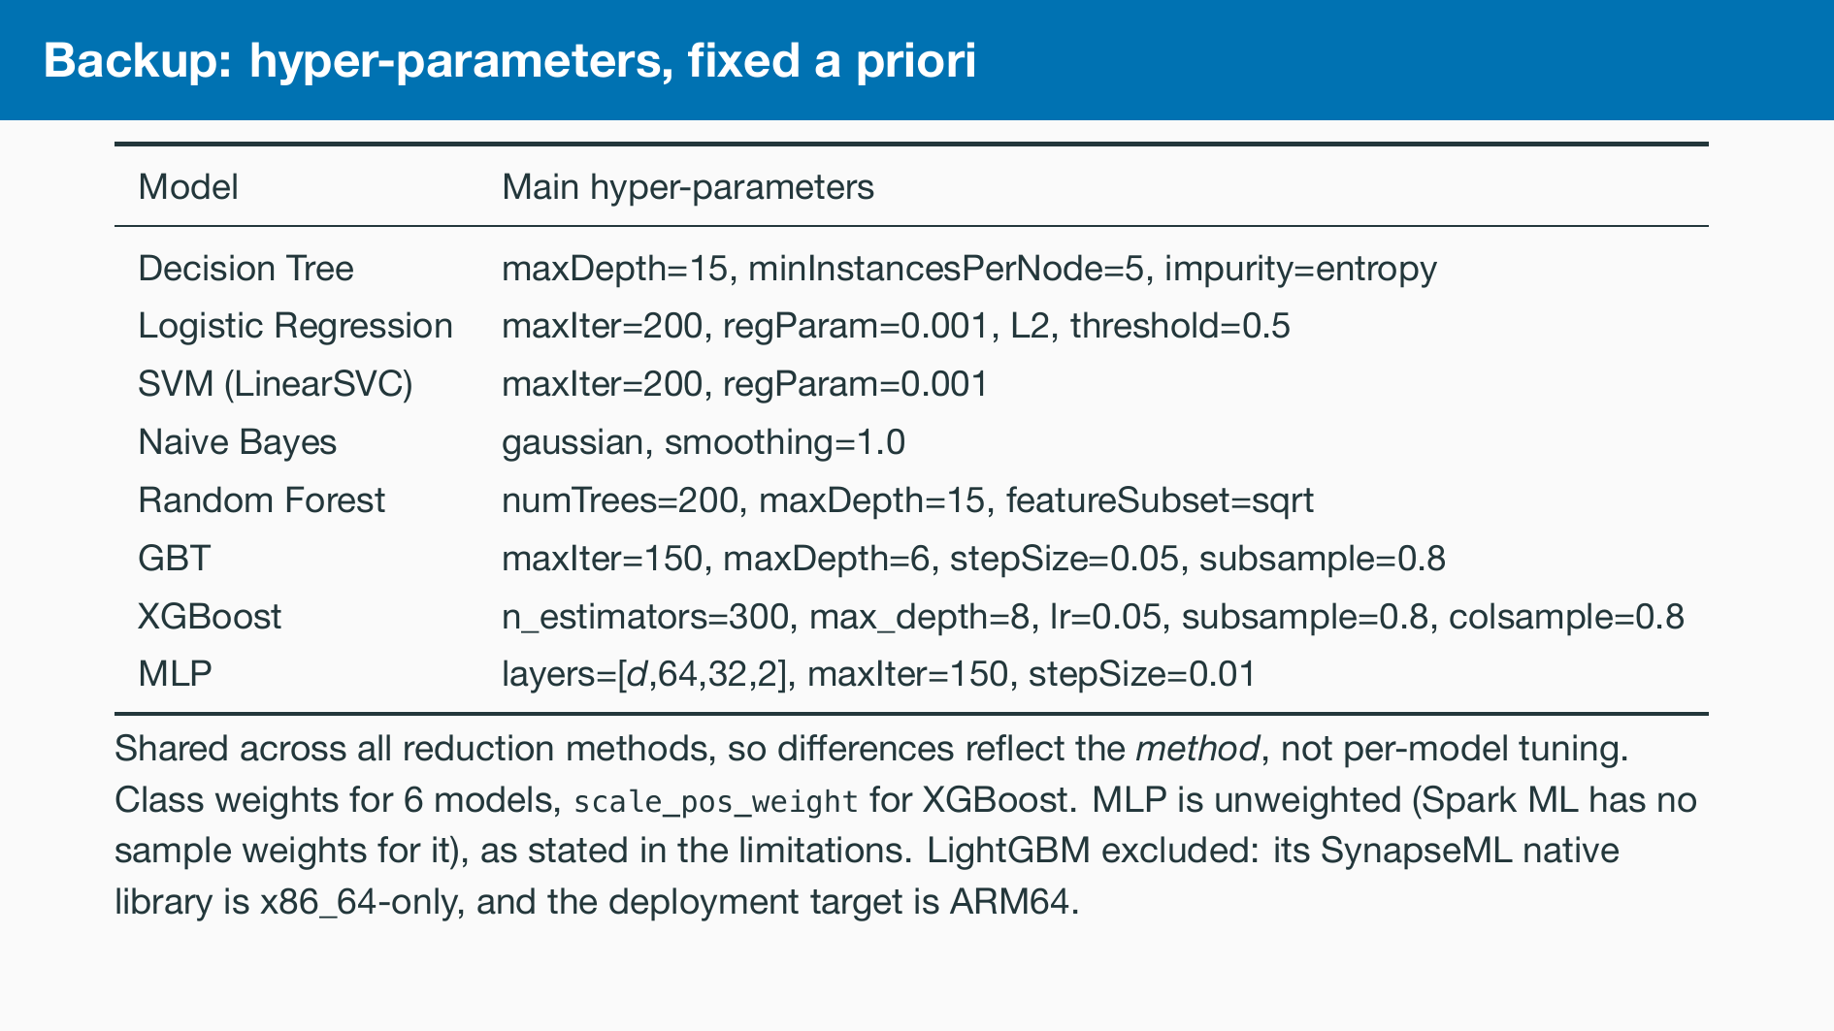

Slide 17
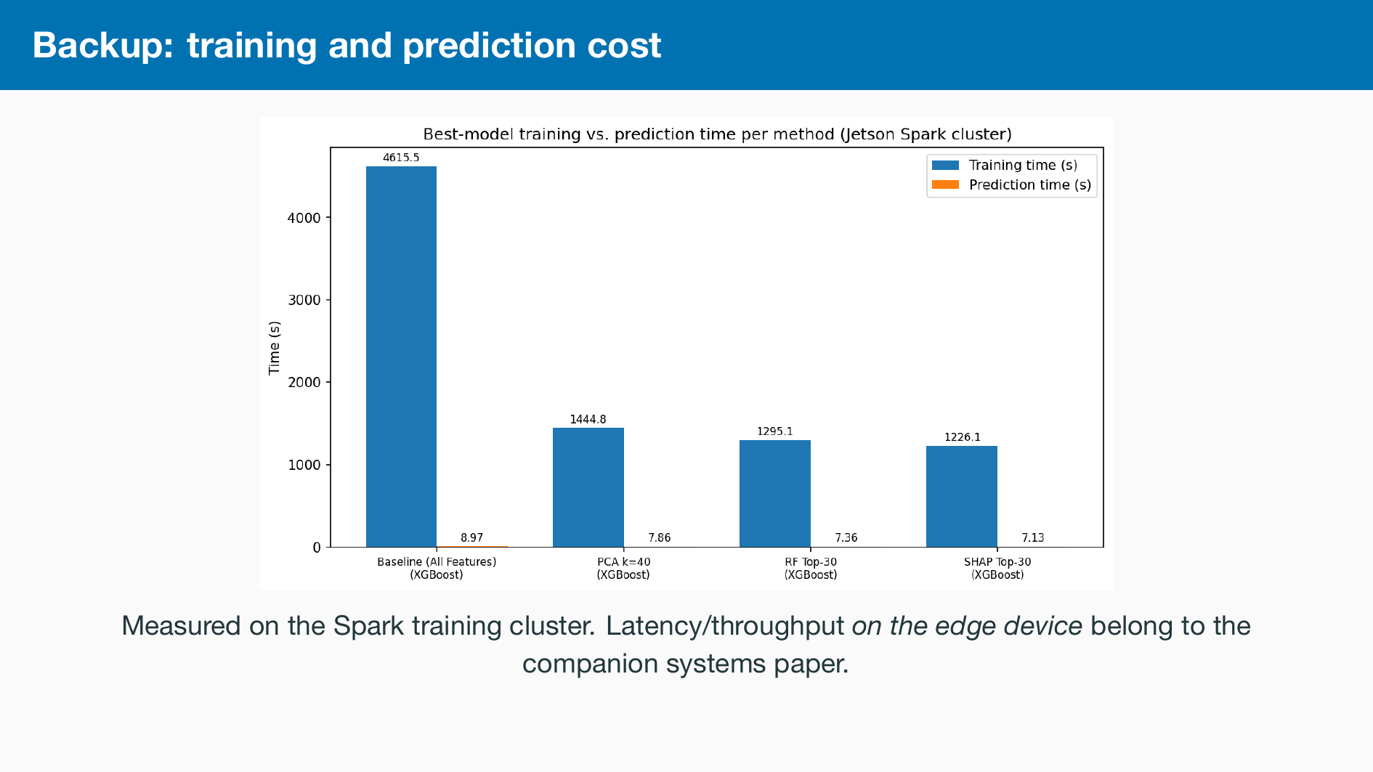

Slide 18
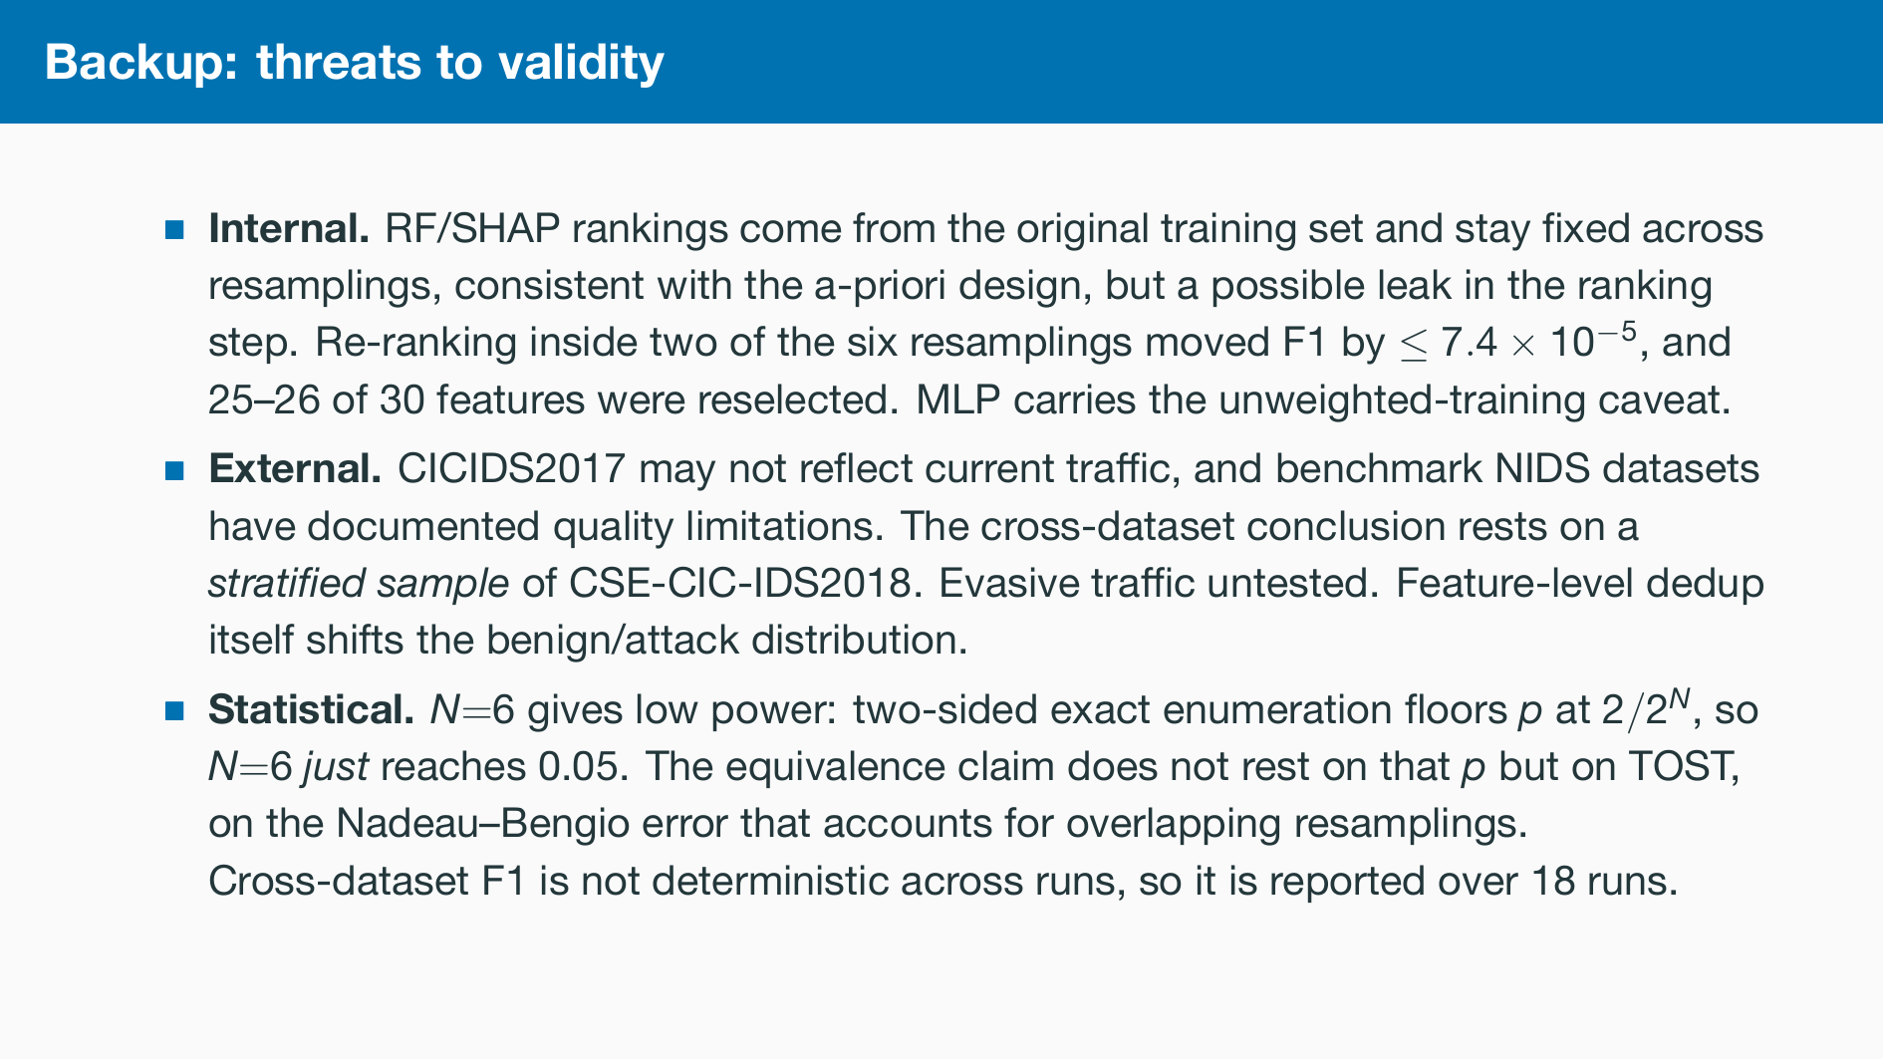

Slide 19
