Slide 1

Notes:
Good morning. I will show what a second edge board actually buys you when you split an ML intrusion detector across two Jetson Orin Nano Super devices, and what it costs in detection. Eight minutes, ﬁve results.

Slide 2
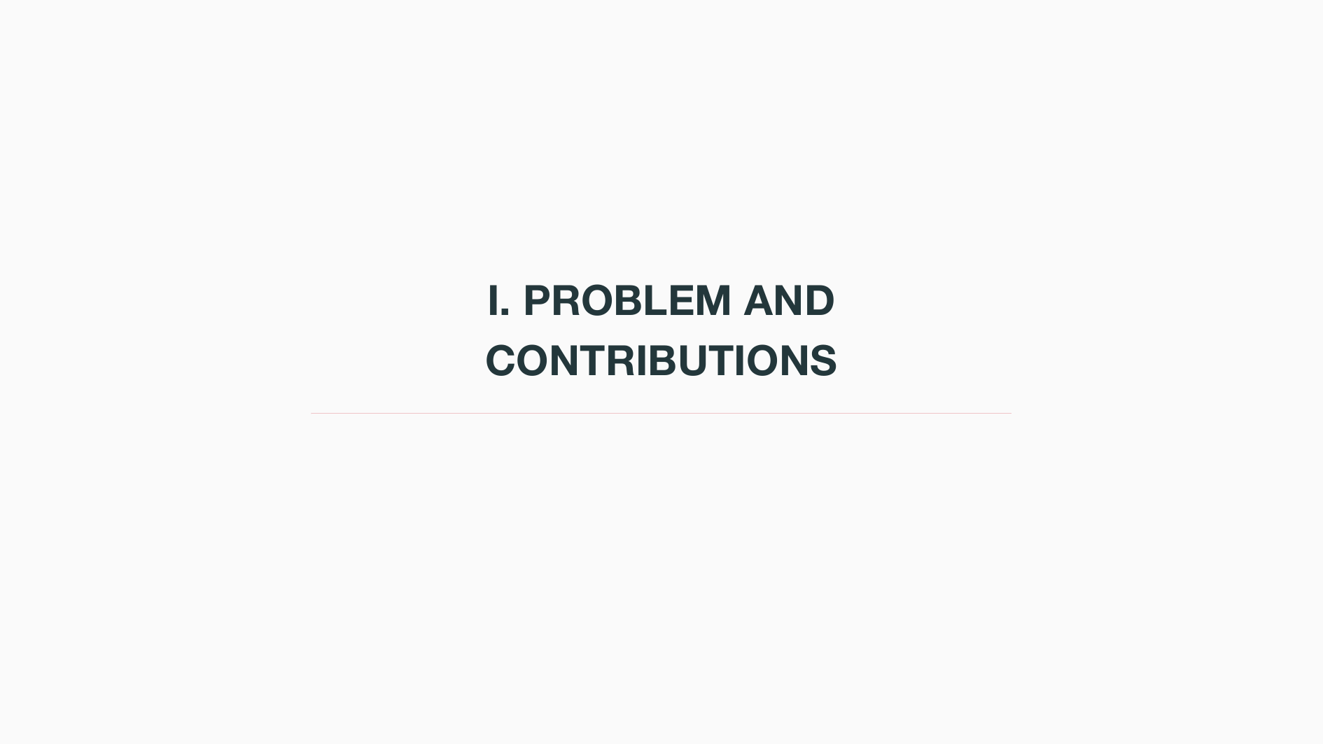

Slide 3
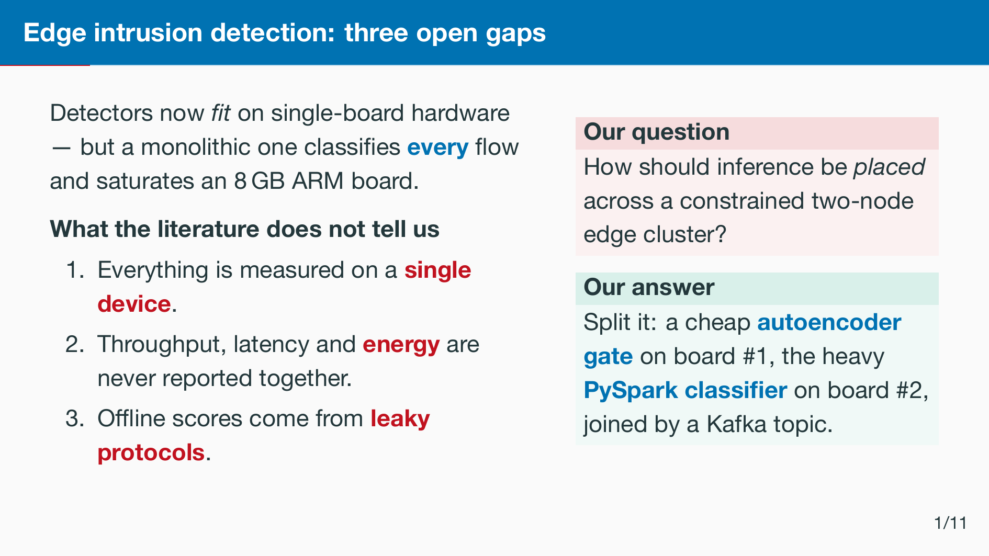
Notes:
Three gaps: single-device evaluation, energy never reported next to latency, and oﬄine numbers taken from leaky pipelines. Which model to deploy is the other half of the ques- tion. We attack all three with one system.

Slide 4
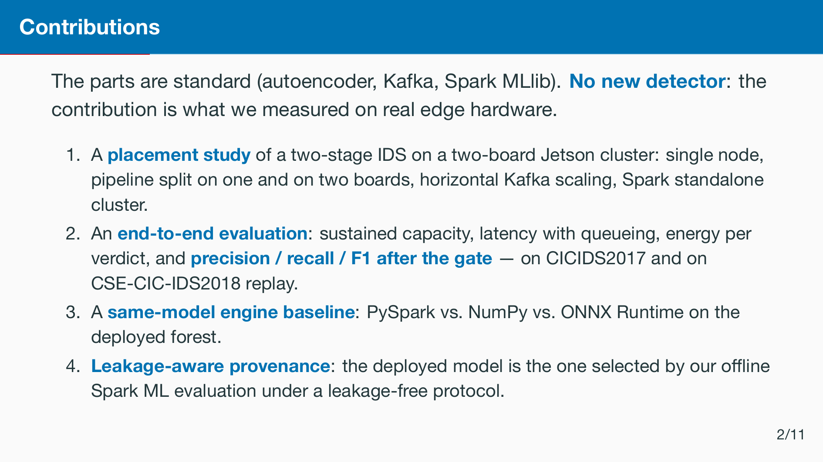
Notes:
We do not claim a new detector or a new distributed method. The contribution is the measurement: which placement pays, why, and what the gate costs in detection. The model we deploy is the one that survived a strict oﬄine audit.

Slide 5
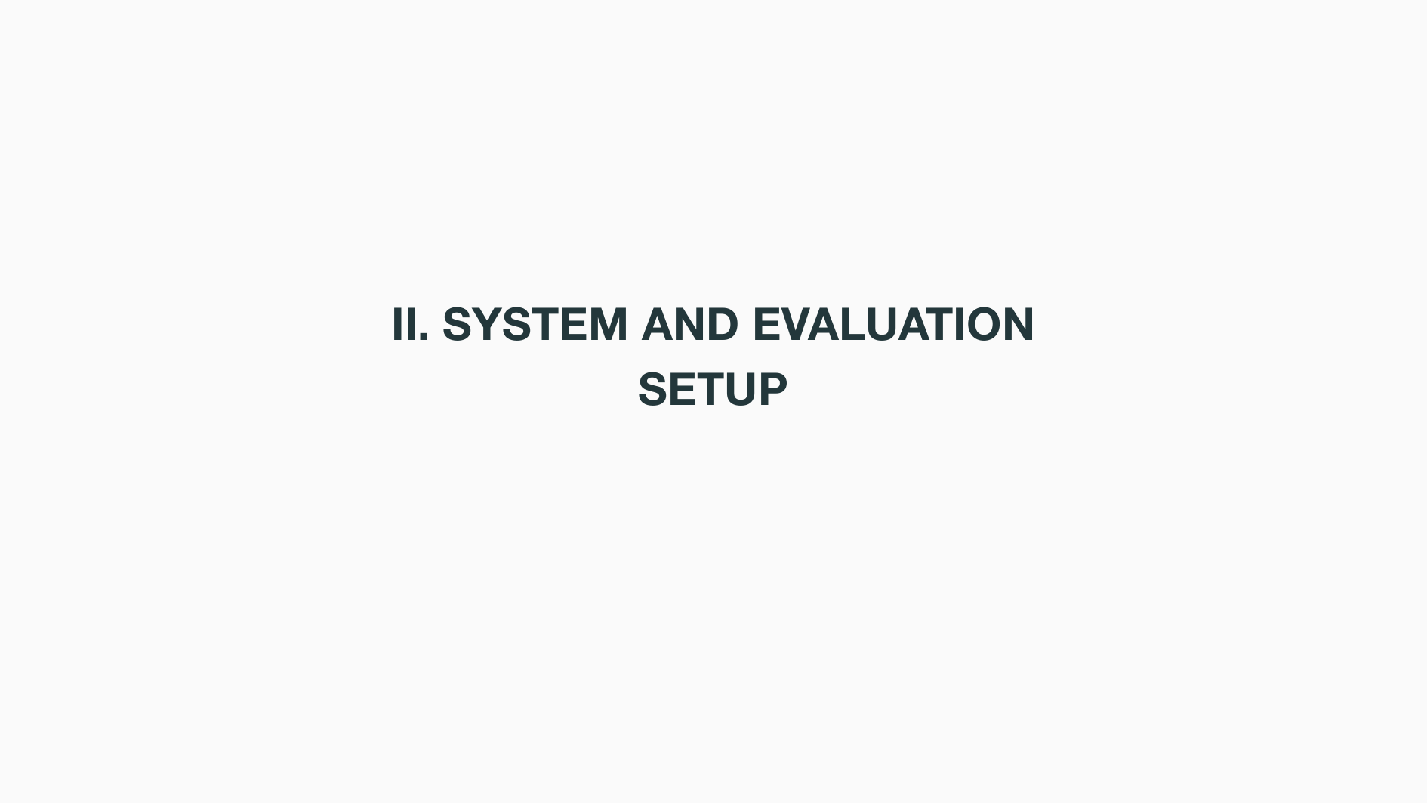

Slide 6
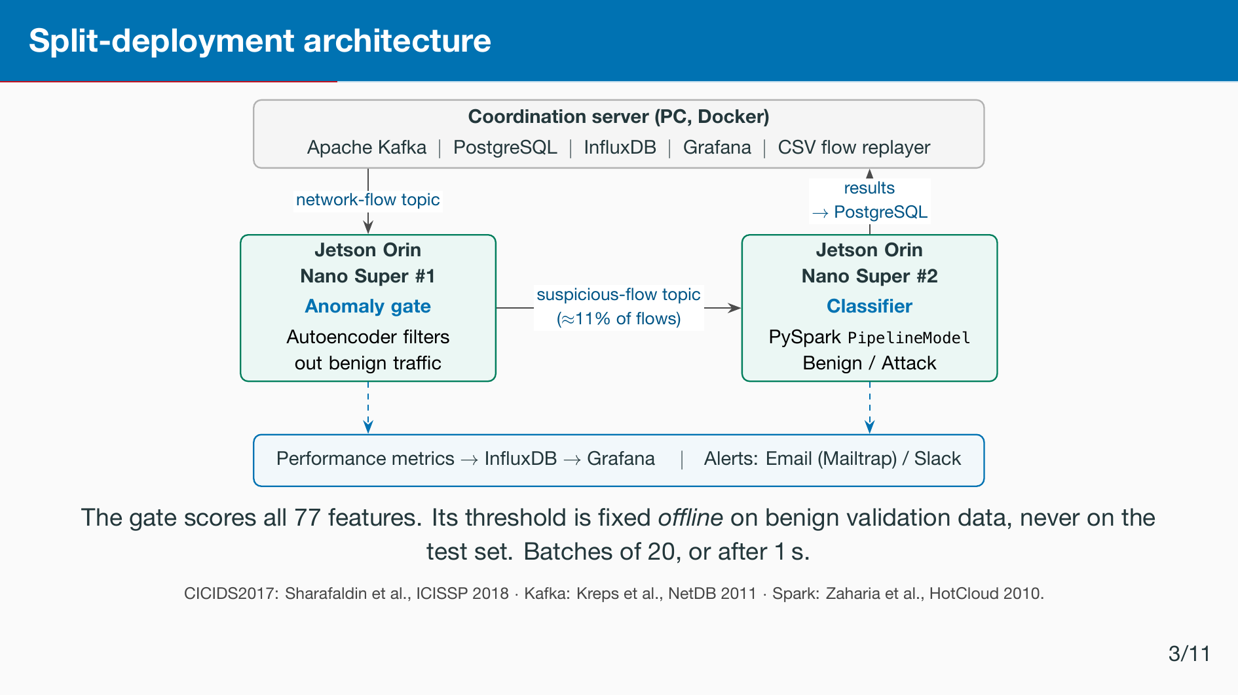
Notes:
Host runs the infrastructure. Board one gates, board two classiﬁes. Only suspicious ﬂows cross the Kafka topic between them. Everything is instrumented into Grafana.

Slide 7
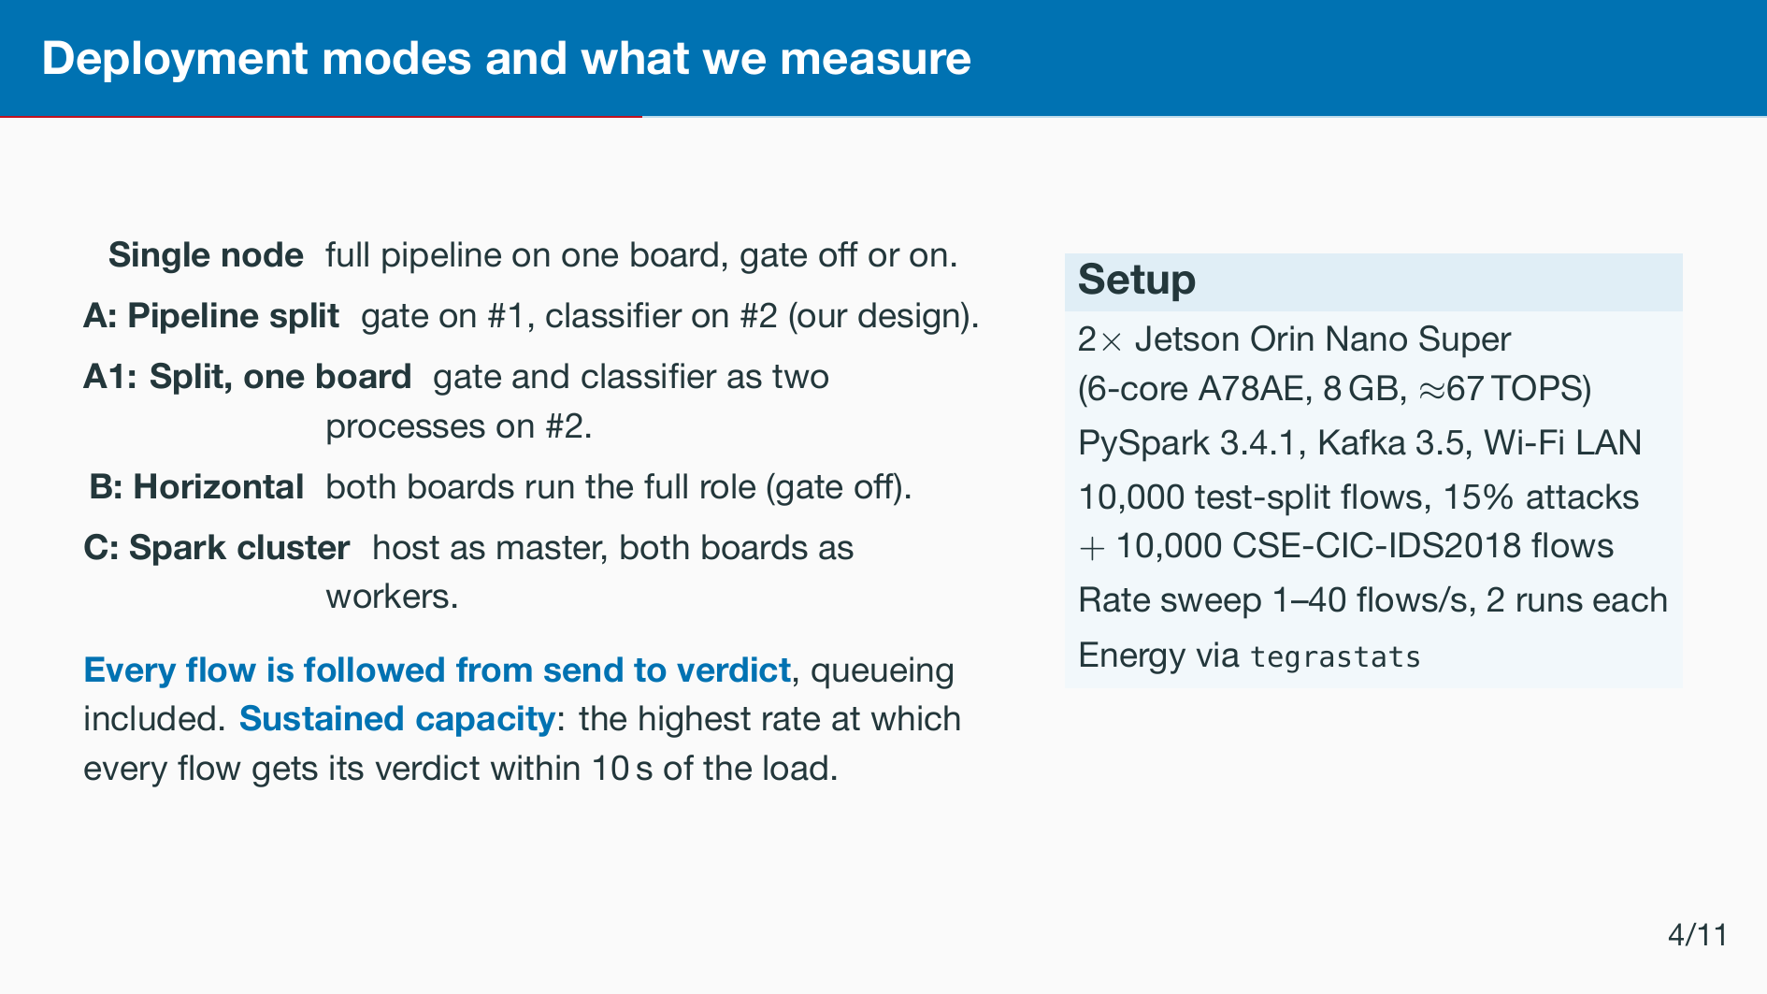
Notes:
Latency is measured from the moment a ﬂow is sent to the moment its verdict is written, so time spent waiting in a queue counts. A fresh Kafka consumer group per run, so no run inherits another’s backlog.

Slide 8


Slide 9
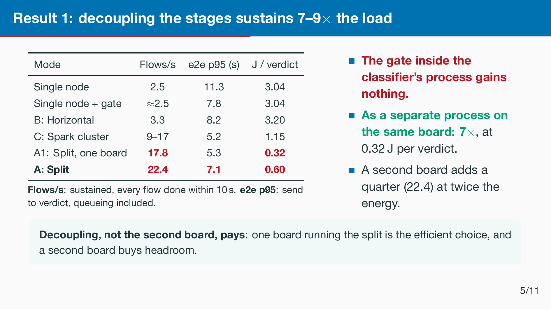
Notes:
Single node and horizontal run with the gate oﬀ, as in the submitted version. Energy is measured at each mode’s sustained rate: 2.0, 2.0, 3.9, 9.5, 17.8 and 18.4 ﬂows per second. Tail latency is seconds in every mode because one PySpark batch takes seconds. A1 was measured in a later session with the same boards, models and replay ﬁle. At 30 ﬂows per second both repeats drained late, in 15 and 16 seconds. Gate skip is about 89 percent in every gated mode. Median latency in split mode is about one second. Single node plus gate: the 10 second rule puts it at 2.0 only because one repeat drained in 10.6 seconds. At 3 ﬂows per second it delivers 2.4 to 2.5 like the single node. Spark cluster: at 20 ﬂows per second one repeat kept up at 17.1 and the other did not, so its capacity is only known to lie between about 9 and 17.

Slide 10
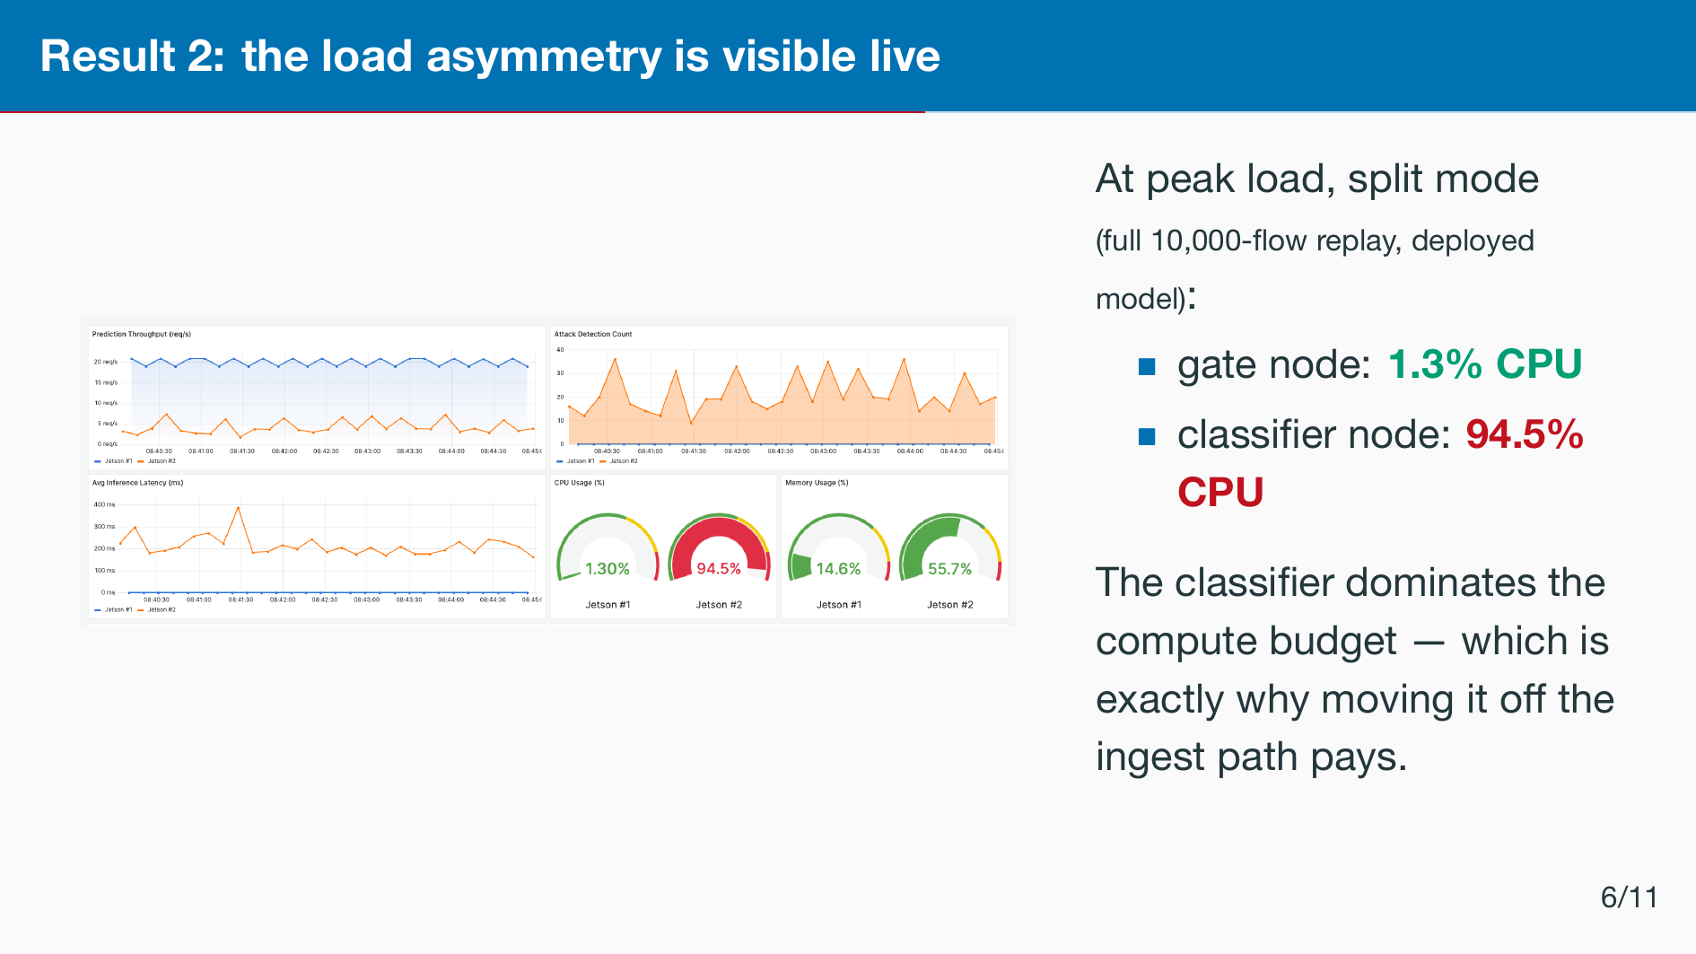
Notes:
Grafana at peak load during the full replay. About one versus ninety-ﬁve percent. The asymmetry is the whole argument for the split. Add: the gate is a tunable ﬁlter, not a ﬁxed point — backup slide has the operating curve.

Slide 11
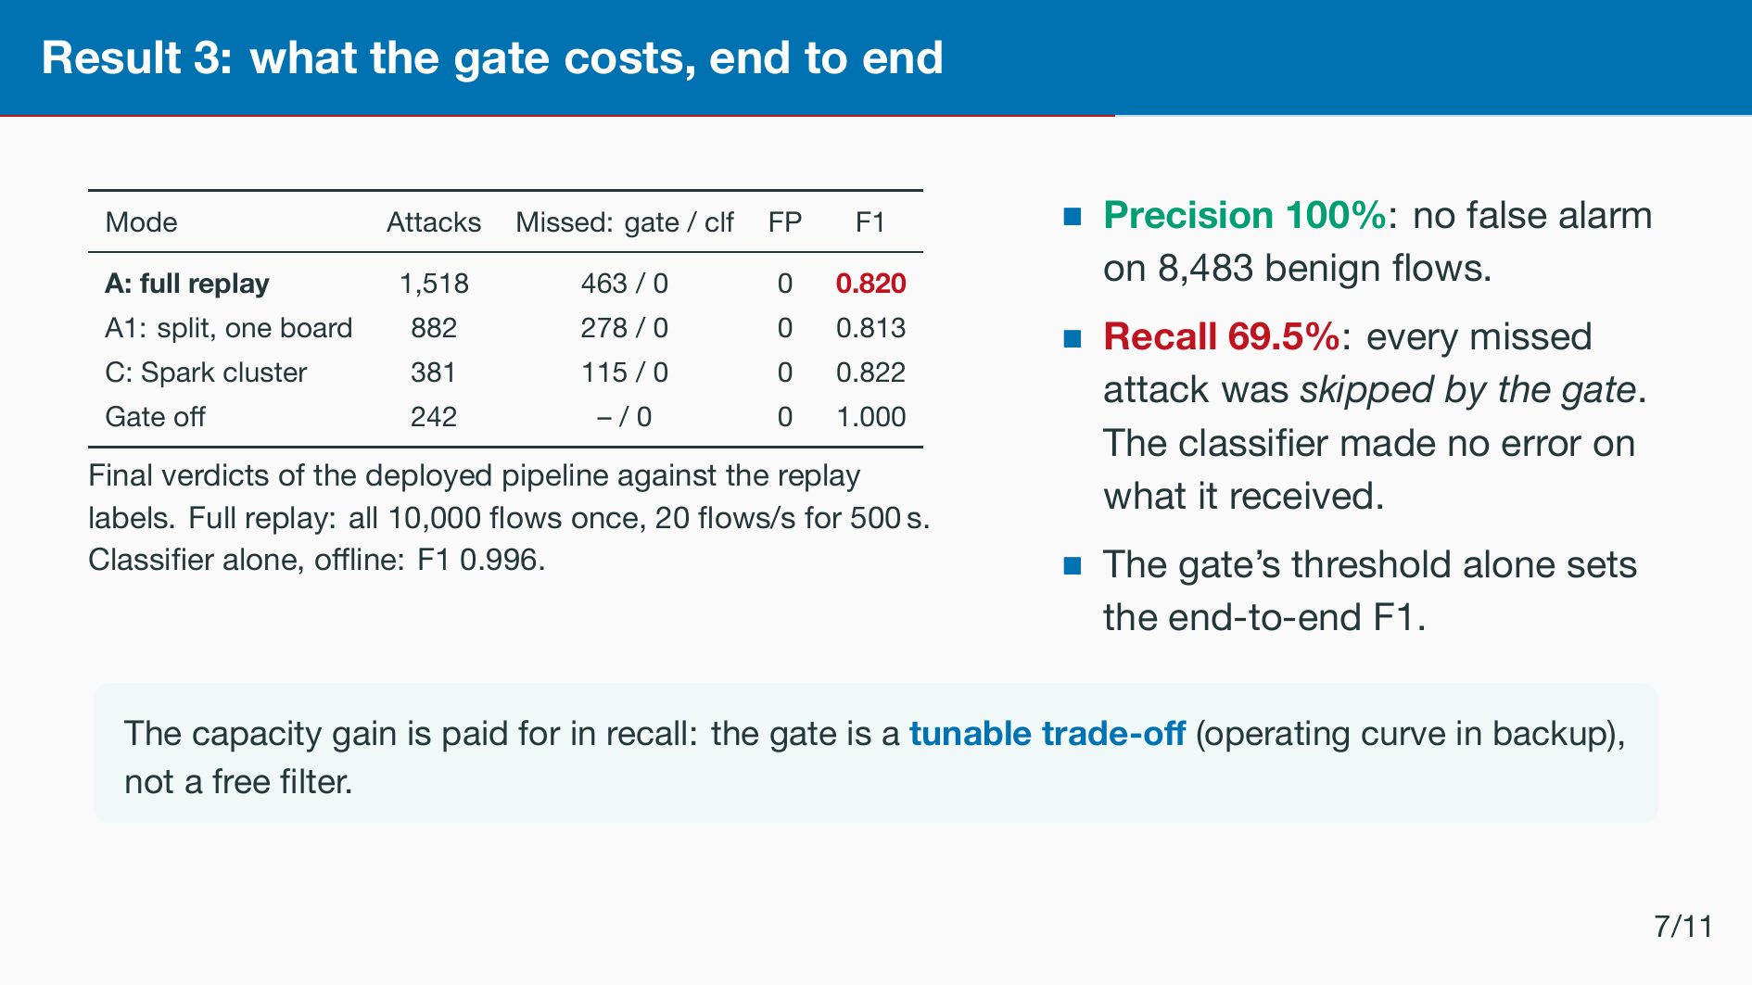
Notes:
The reviewers asked for exactly this: precision, recall and F1 of the whole deployed pipeline, not the oﬄine classiﬁer. The deployed threshold is the 0.995 quantile of benign validation errors, ﬁxed before any test. The capacity-window rows overlap because every window replays the sample from its ﬁrst row. The full replay covers every ﬂow once.

Slide 12
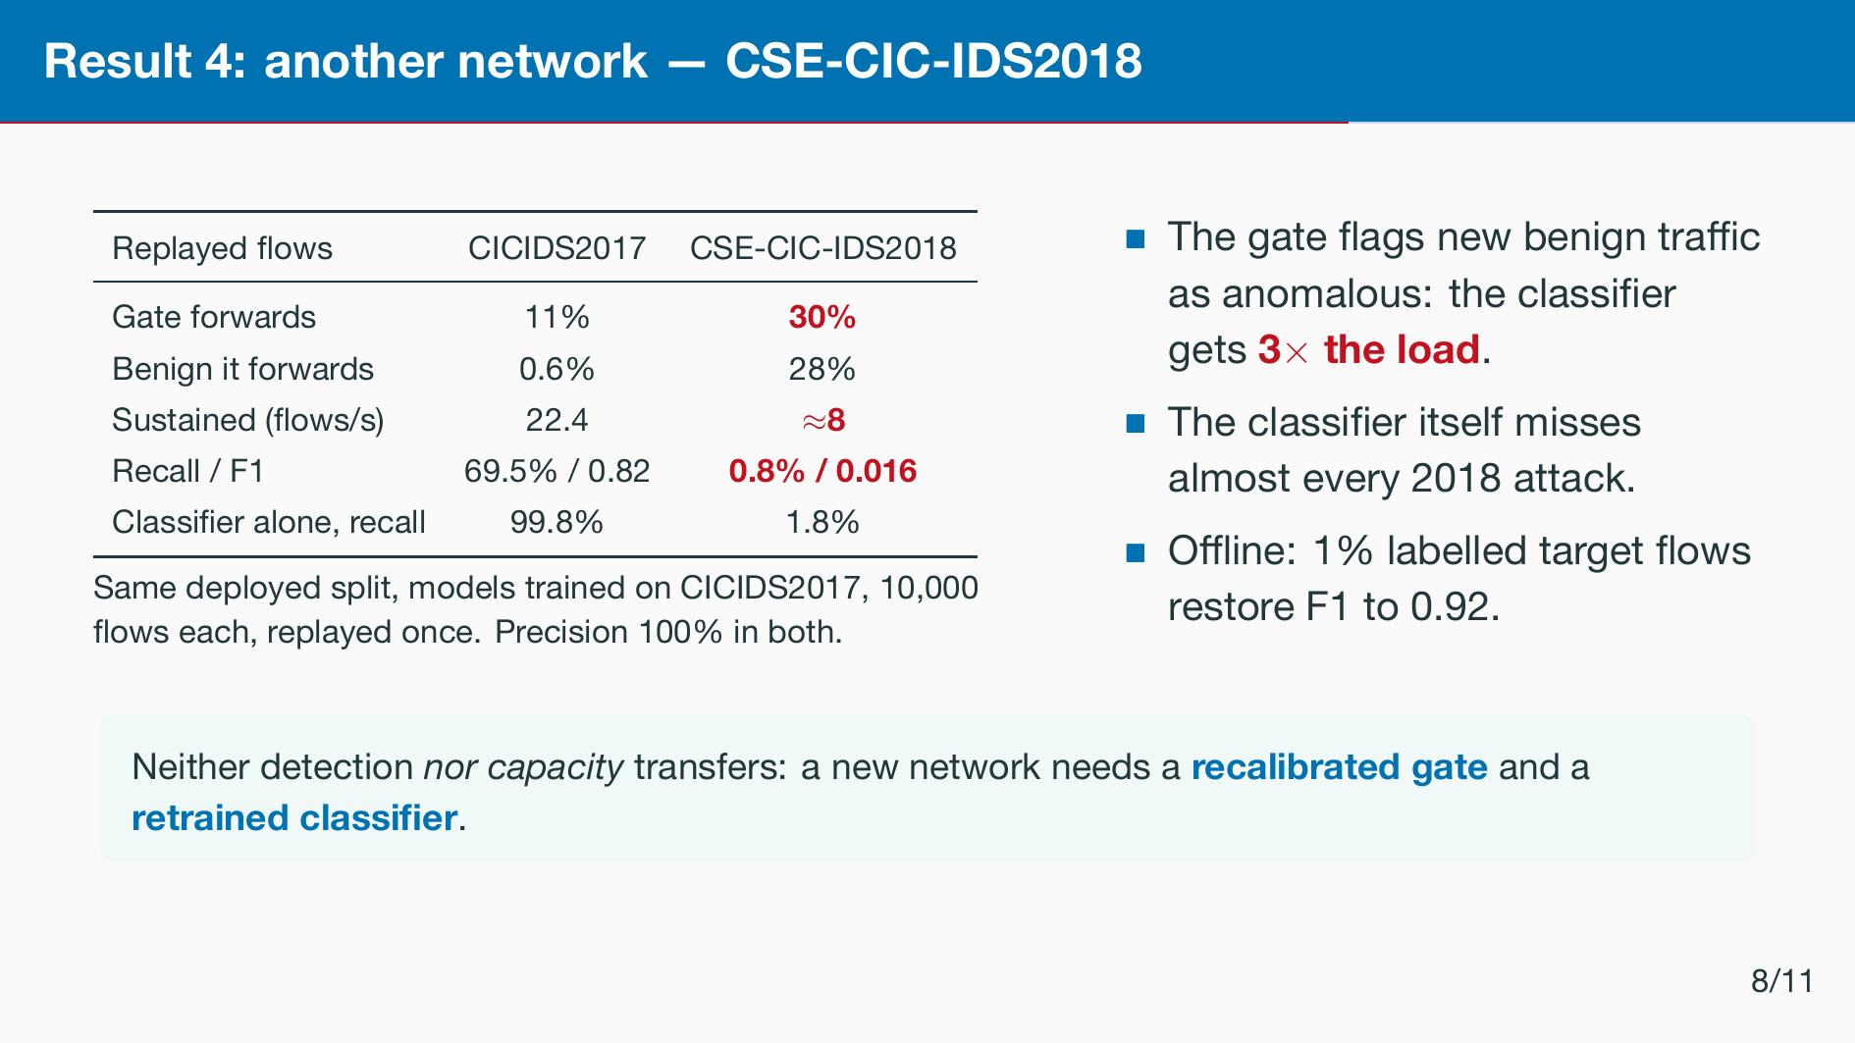
Notes:
Reviewer one asked for a second dataset, so we replayed CSE-CIC-IDS2018 through the deployed boards without retraining. Capacity is not a property of the pipeline alone: the gate’s skip ratio depends on the traﬃc, and with it the load on the classiﬁer. At 12 ﬂows per second both repeats drained late, in 19 and 29 seconds. The oﬄine cross-dataset study, 18 runs, gives AUC-PR 0.48 from 2017 to 2018 and 0.19 the other way.

Slide 13
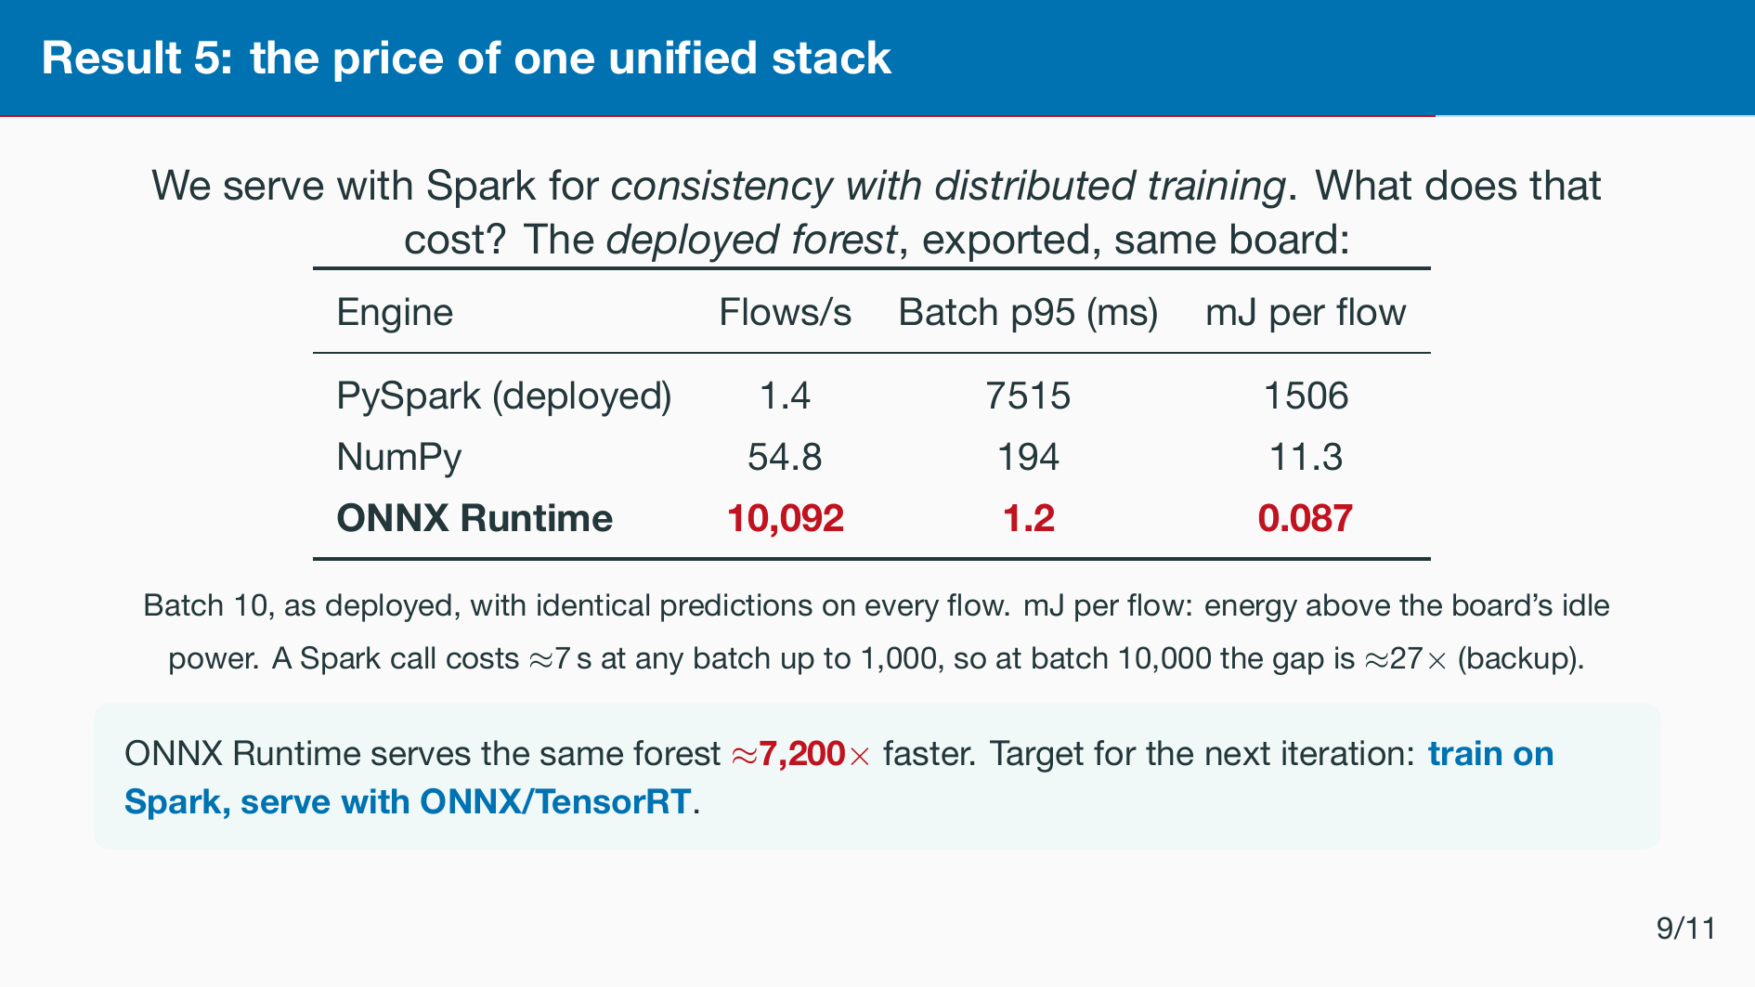
Notes:
The JVM costs us more than three orders of magnitude, and that sets the roadmap. Batch size 10. If asked whether bigger batches ﬁx it: a Spark call costs about seven seconds whatever the batch, so the gap shrinks to about 27 times at ten thousand ﬂows, but a streaming IDS at 20 ﬂows per second would wait eight minutes to ﬁll such a batch.

Slide 14
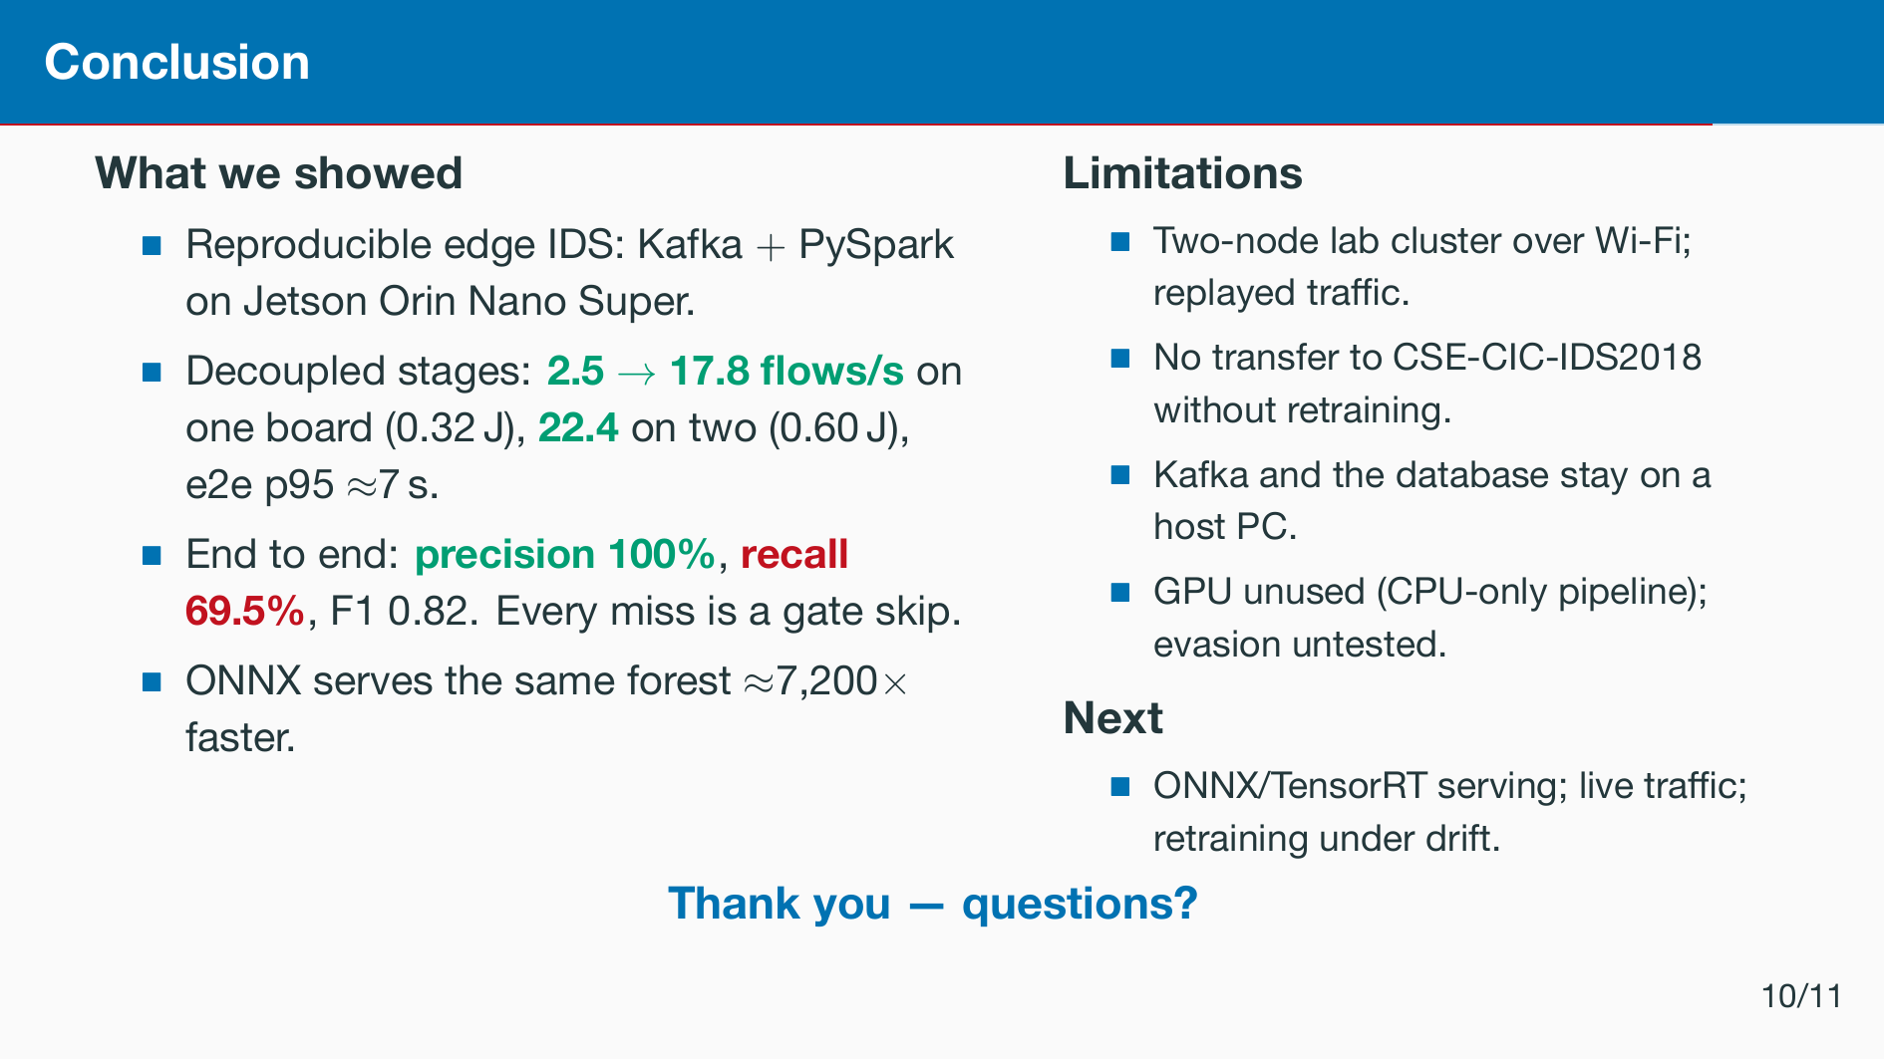
Notes:
Recap: decoupling gives seven to nine times the load at a fraction of the energy. The price is about thirty percent of attacks skipped by the gate. On another dataset both detection and capacity fall, so a new network needs recalibration and retraining.

Slide 15
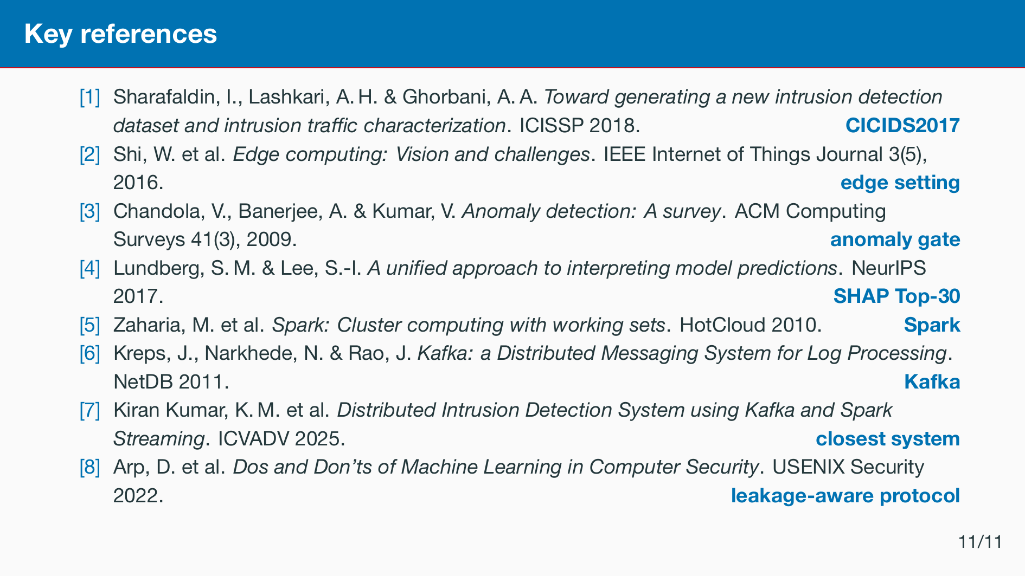
Notes:
Not presented — shown while taking questions, so sources are on screen if the audience asks. Full list is in the paper.

Slide 16
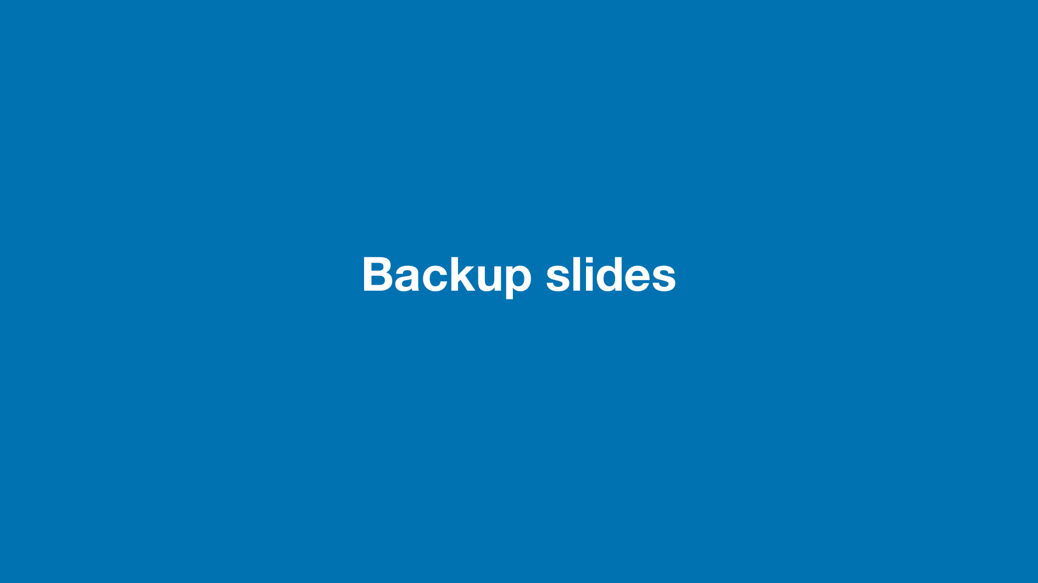

Slide 17
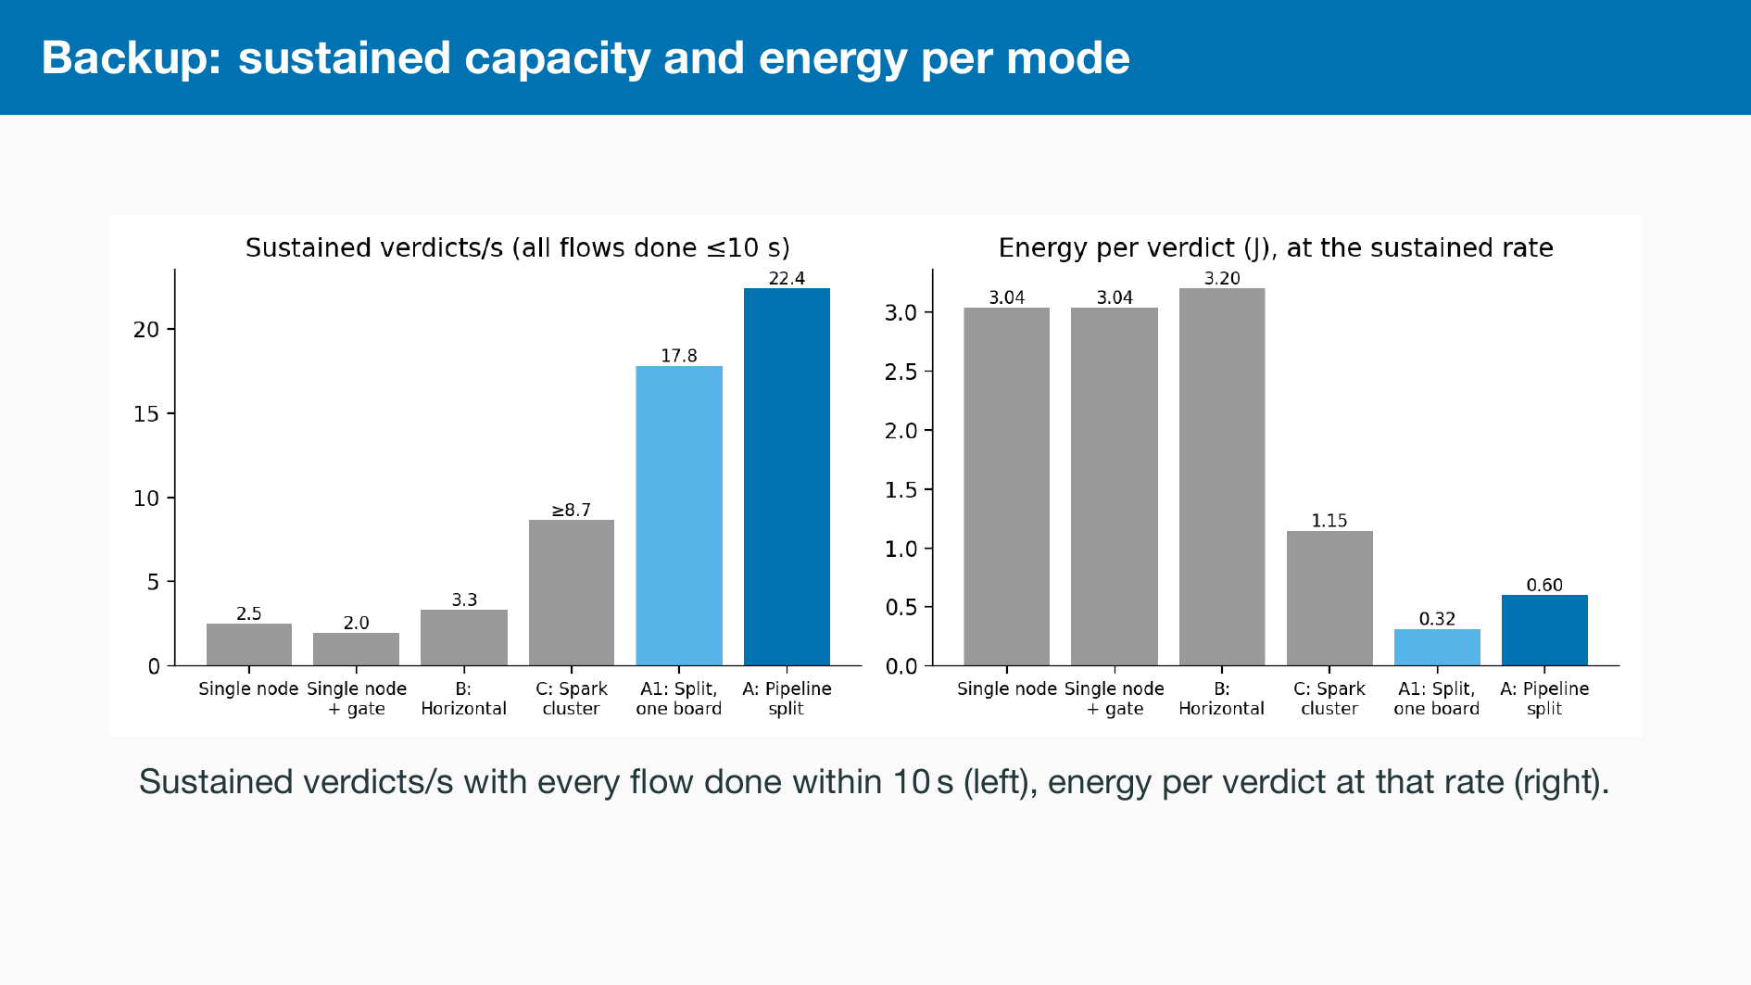

Slide 18
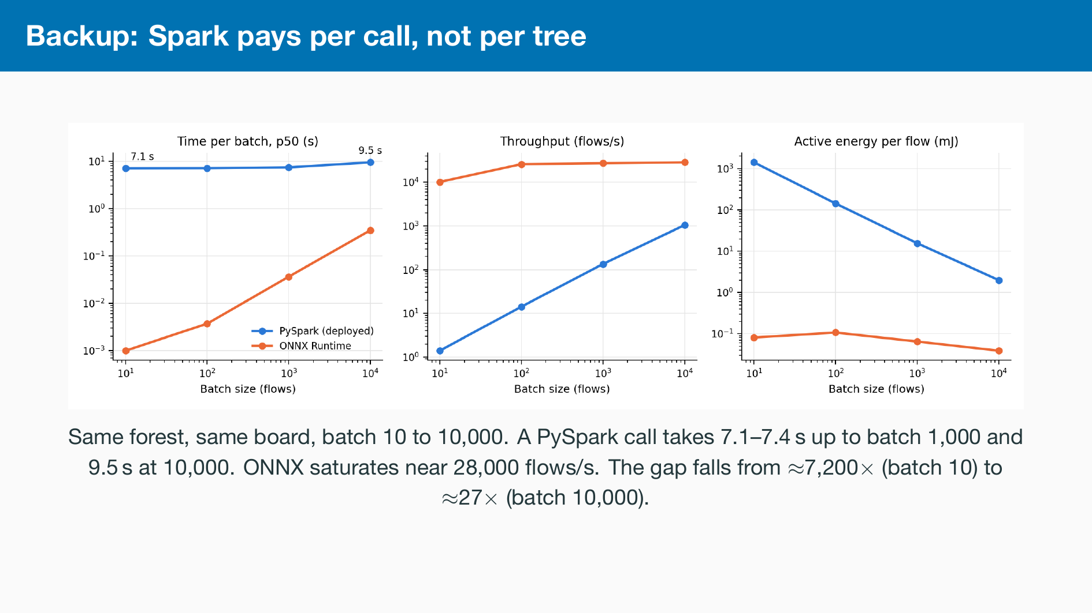

Slide 19
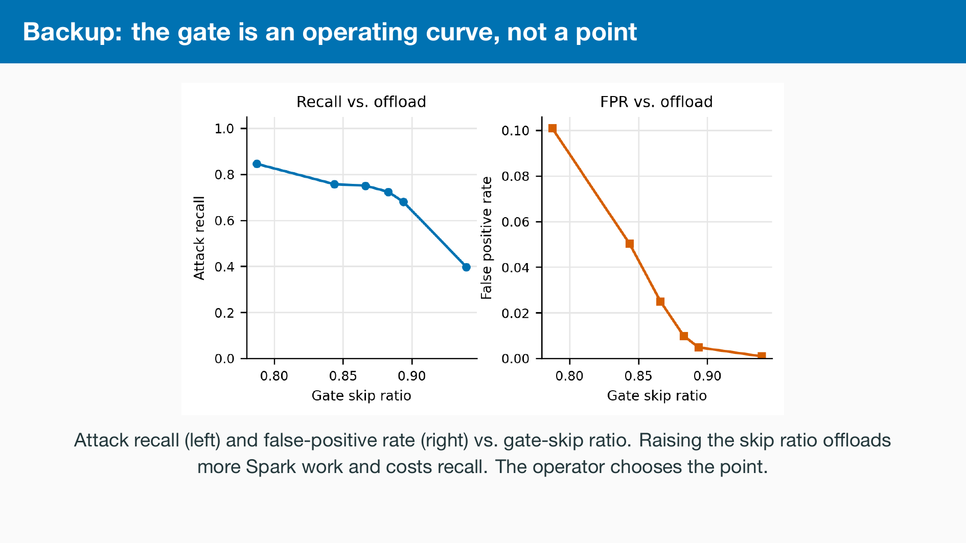

Slide 20
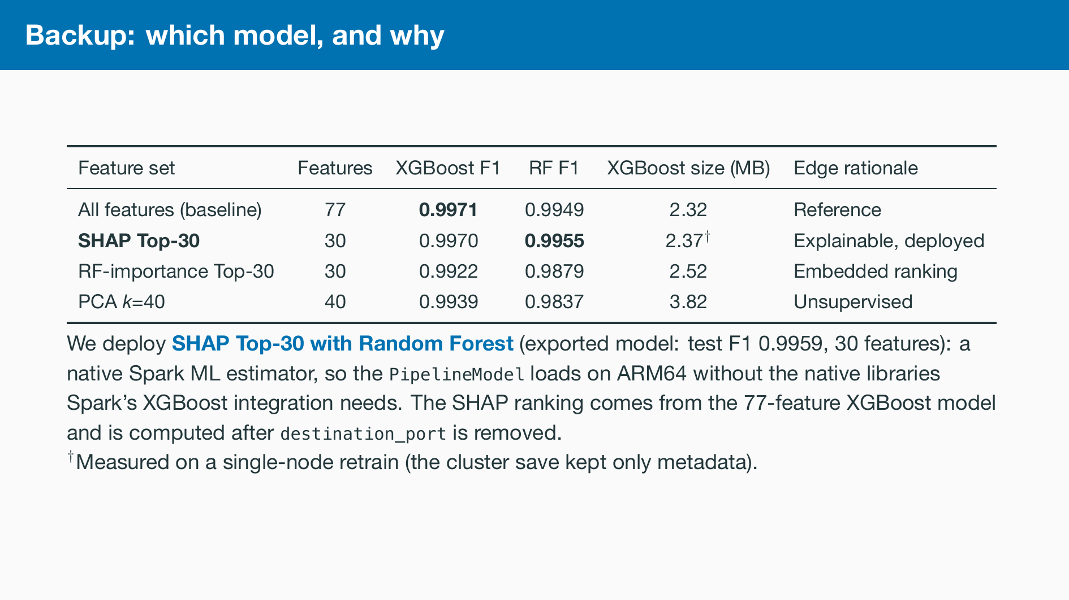

Slide 21
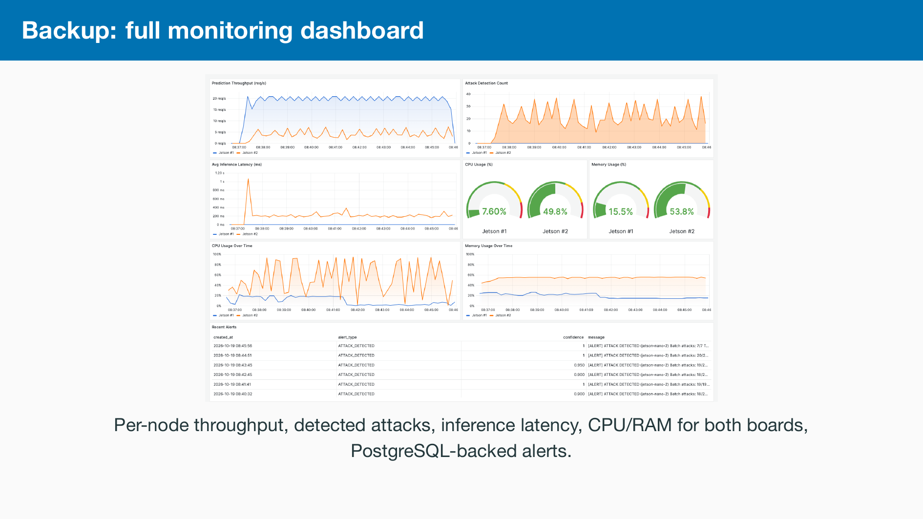

Slide 22
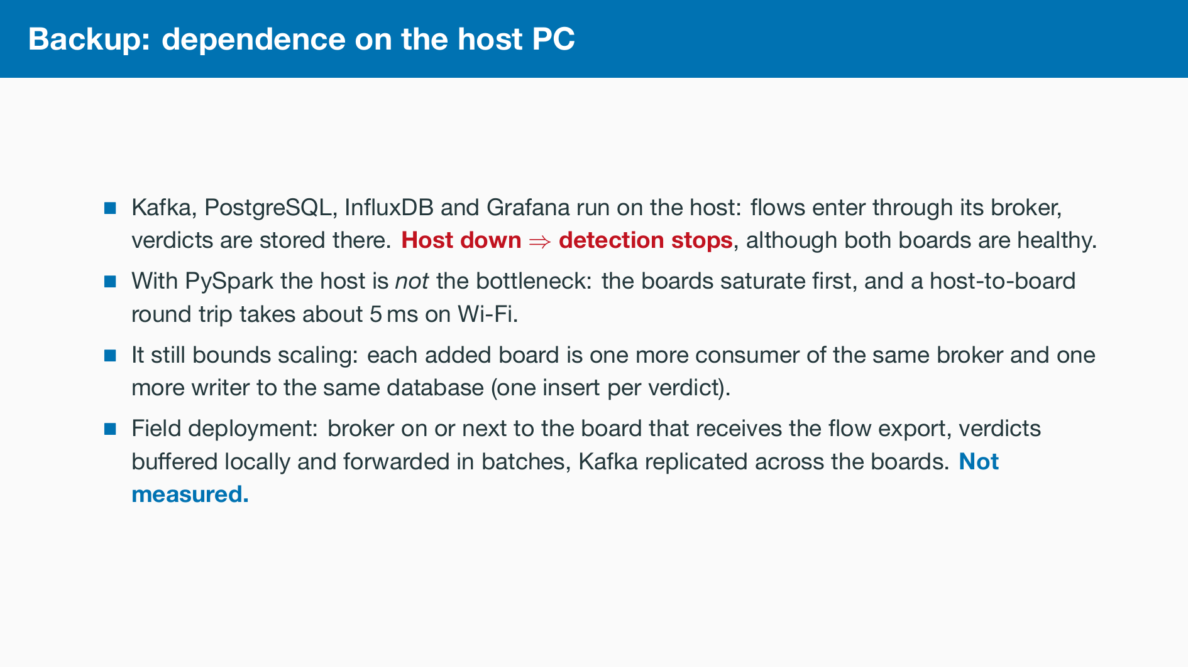

Slide 23
