Slide 1
Online Banking
Our eProject 3 - C1908G2
Instructor : Mr. Phan Huu Tri

Slide 2
PRESENTATION OUTLINE
TODAY'S TOPICS
Our Team
About Our eProject
Feature of Website
Database
Technology Used

Slide 3
ABOUT OUR TEAM
HOANG MINH TIEN
NGUYEN HOANG BICH
Leader
TRINH PHUONG NAM
VU THI THOM

Slide 4
ABOUT OUR EPROJECT
Nowadays, with the advancements of the internet, people want to make everything more convenient. Same for banking and money transactions. With our website, banks and customers can connect faster, more secure, broader than ever. With just a click, customers can transfer money from their accounts to any other account in this system - Online Banking System.

Slide 5
FEATURE OF WEBSITE
USER:
Create a customer account and many bank accounts to transfer money between all bank accounts in the system.
View all past transactions, bank account’s detail.
Protect user account and money with 2FA.
Contact and send question to admin for help.
ADMIN:
Manage customer accounts, bank accounts, and database.
Answer customer’s problems directly via mail.

Slide 6
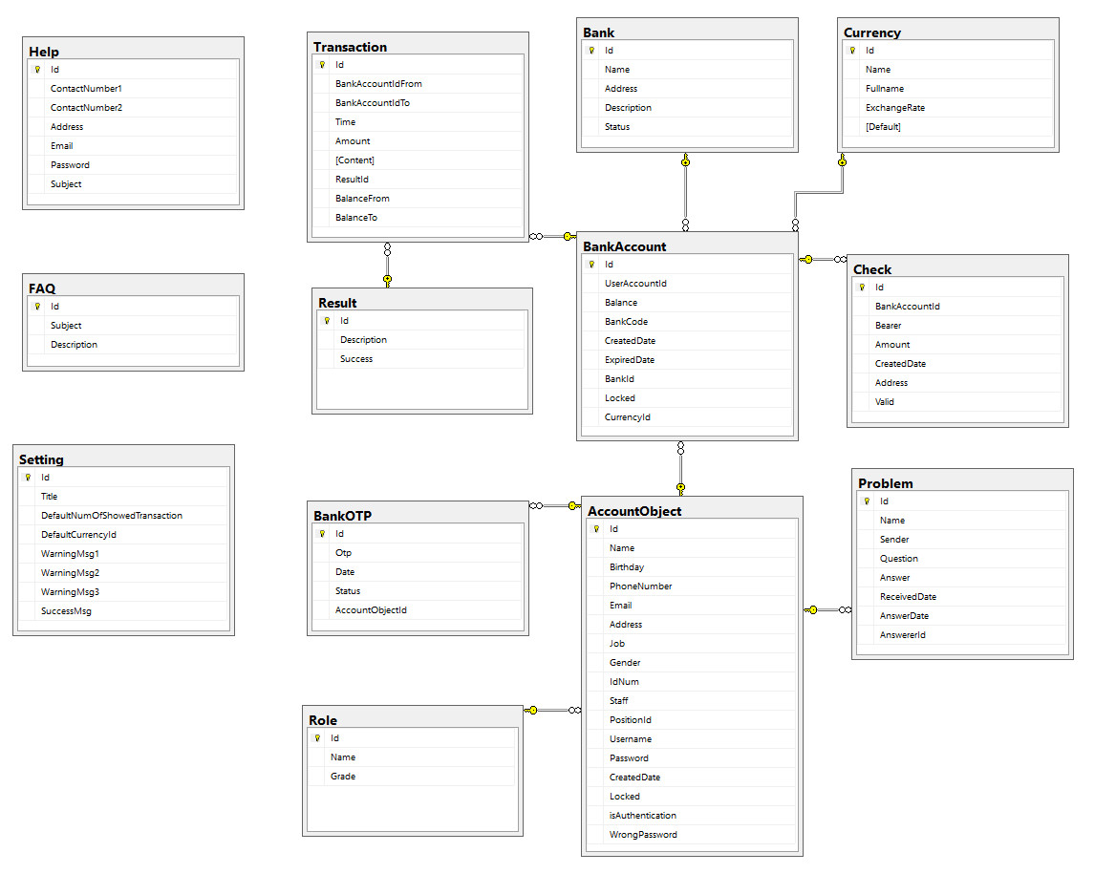
DATABASE

Slide 7
TECHNOLOGY USED
IDE
PROGRAM LANGUAGES
WEB
BROWSER
◕ Visual Studio Code
Version : 1.46
◕ My SQL Sever
version:
◕ HTML 5
◕ JavaScript
◕ ASP .NET
◕Boostrap 5
◕ MySQL
◕ Firefox
◕ Google Chorme
◕ Coc Coc

Slide 8
THANK FOR YOUR LISTENING

