Slide 1


Welcome to eProject PRESENTATION
C1908G2 V TRIPLE T
Insurance interview and E-Commerce

Slide 2


Members
Lê Minh Triệu (Leader – Fullstack)
Đăng Vũ Thủy Trúc (Fullstack)
Vũ Thị Thơm (Backend)
Nguyễn Thị Thanh Vân (Backend)

Slide 3
Assignment
Base:
Frontend:
Triệu (Menu, GUI)
Triệu (Home,Admin-Control,User Control)
Trúc(Buying page)
Thơm(Contact us page)
Backend:
Trúc(Buying page)
Vân (Search Engine)
Thơm (Login,Register)
Triệu (Money Format,Admin-Control,User-Control)
Advenced Part: (Triệu)
Internal Chat (Admin-control)
Support Multiple Different Languages(VN,EN)
E-Commerce System (Buy insurance)

Slide 4
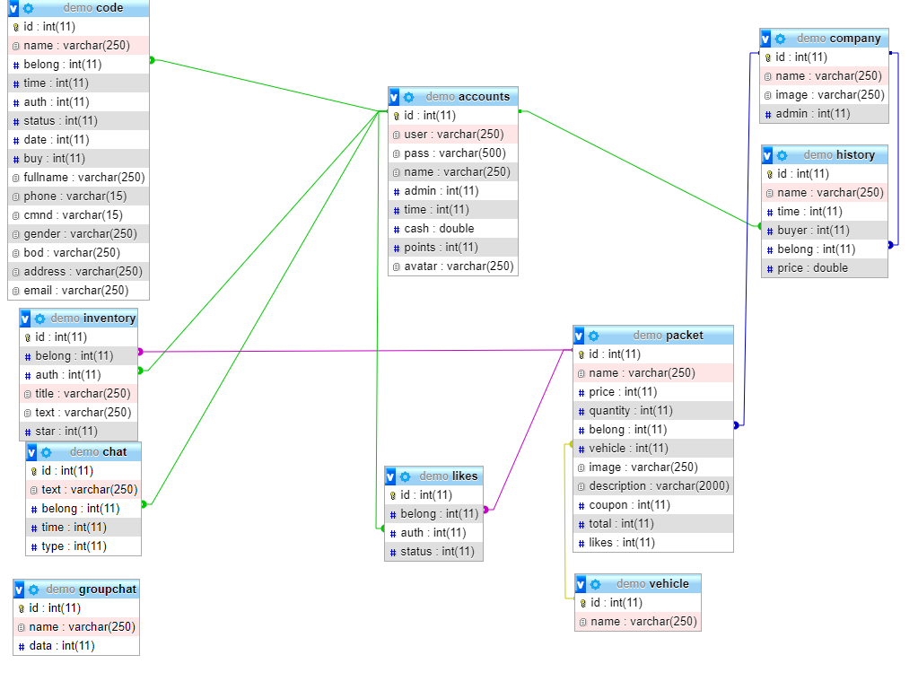
Database Relationz

Slide 5
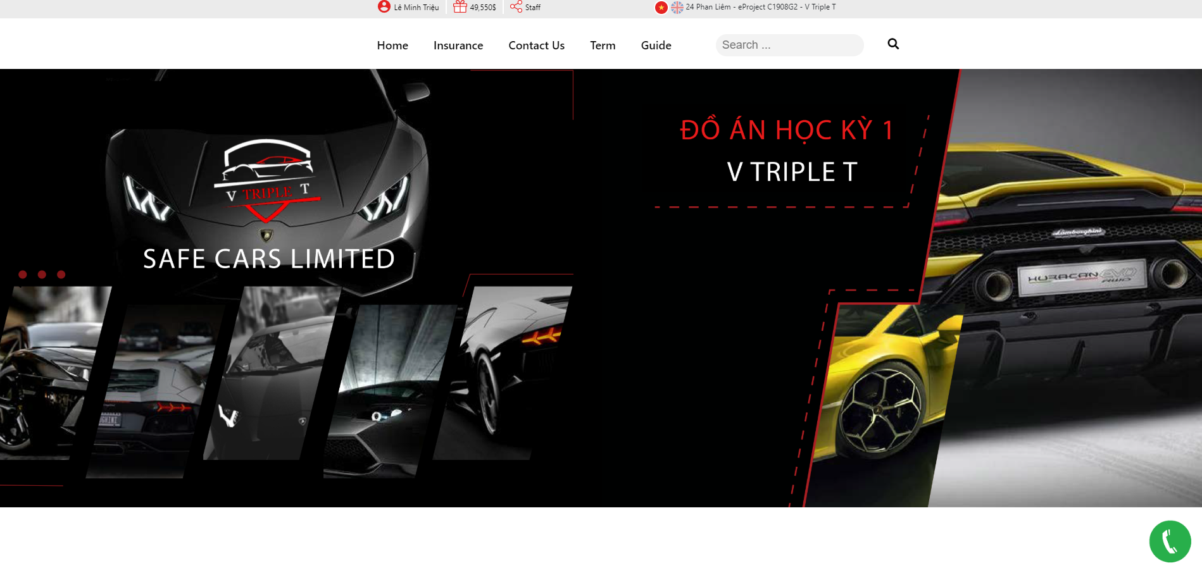
Home Page

Slide 6
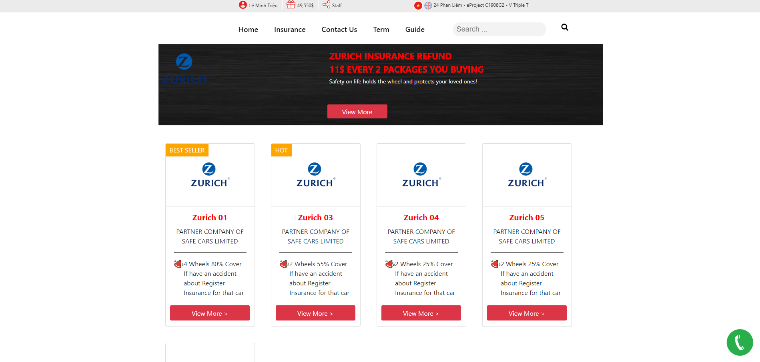
Insurance Packages

Slide 7
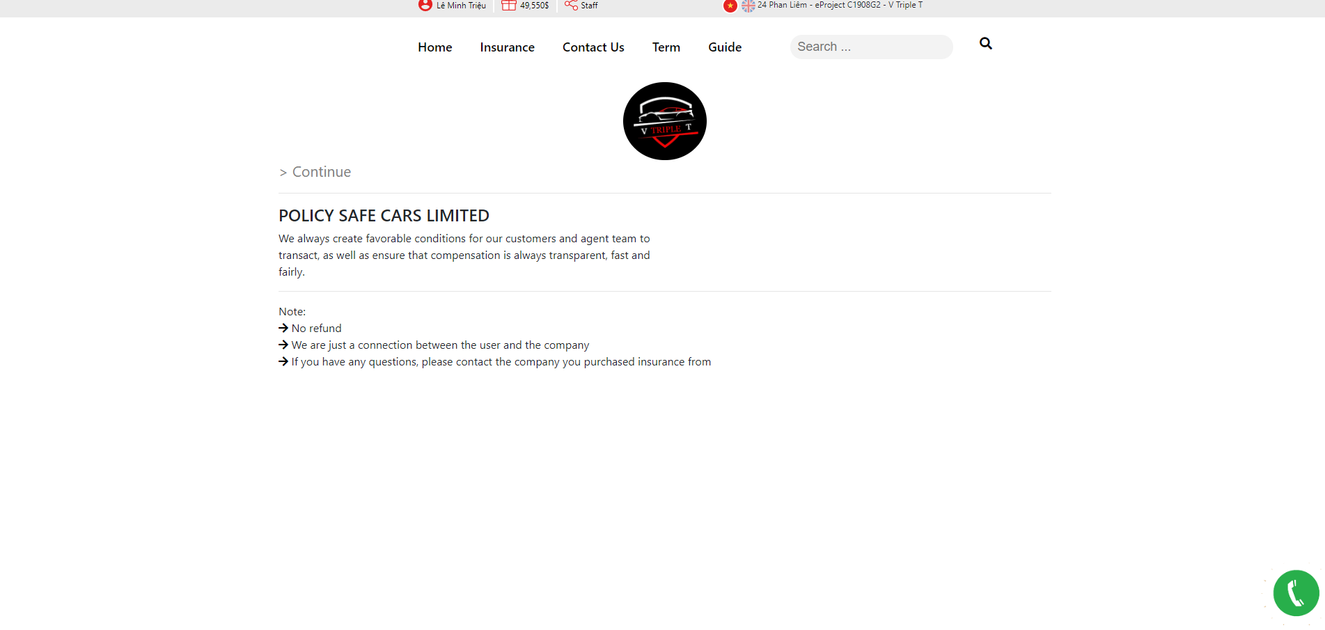
Policy

Slide 8
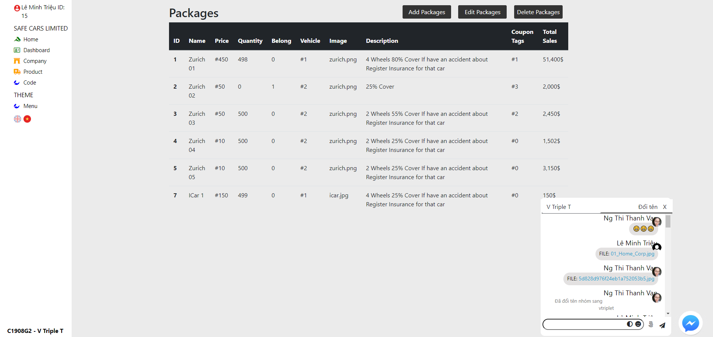
Admin-Panel

