Slide 1

INDUSTRIAL
TRAINING
REPORT
Student Name: Ashish Singh
Kandari
B.TECH (CSE)
MAHARAJA AGRASEN INSTITUTE OF TECHNOLOGY
Notes:
Links:
https://pixabay.com/vectors/connection-internet-digital-network-4166469/

Slide 2
ABOUT UDEMY
Udemy is a platform that allows instructors to build online courses on their preferred topics. Using Udemy's course development tools, instructors can upload videos, source code for developers, PowerPoint presentations, PDFs, audio, ZIP files and any other content that learners might find helpful.
ABOUT MENTOR
Professor Dr Angela Yu studied computer science, theoretical mathematics and cognitive science at Massachusetts Institute of Technology, United States, completing her doctorate at University College London in 2005. She then returned to the United States as a postdoctoral researcher at Princeton University.
Notes:
Links:
https://www.pexels.com/photo/photo-of-people-looking-on-laptop-3182801/

Slide 3


PROJECTS
During the Course I build projects such as:
Portfolio Website
Food delivery
Website

Slide 4
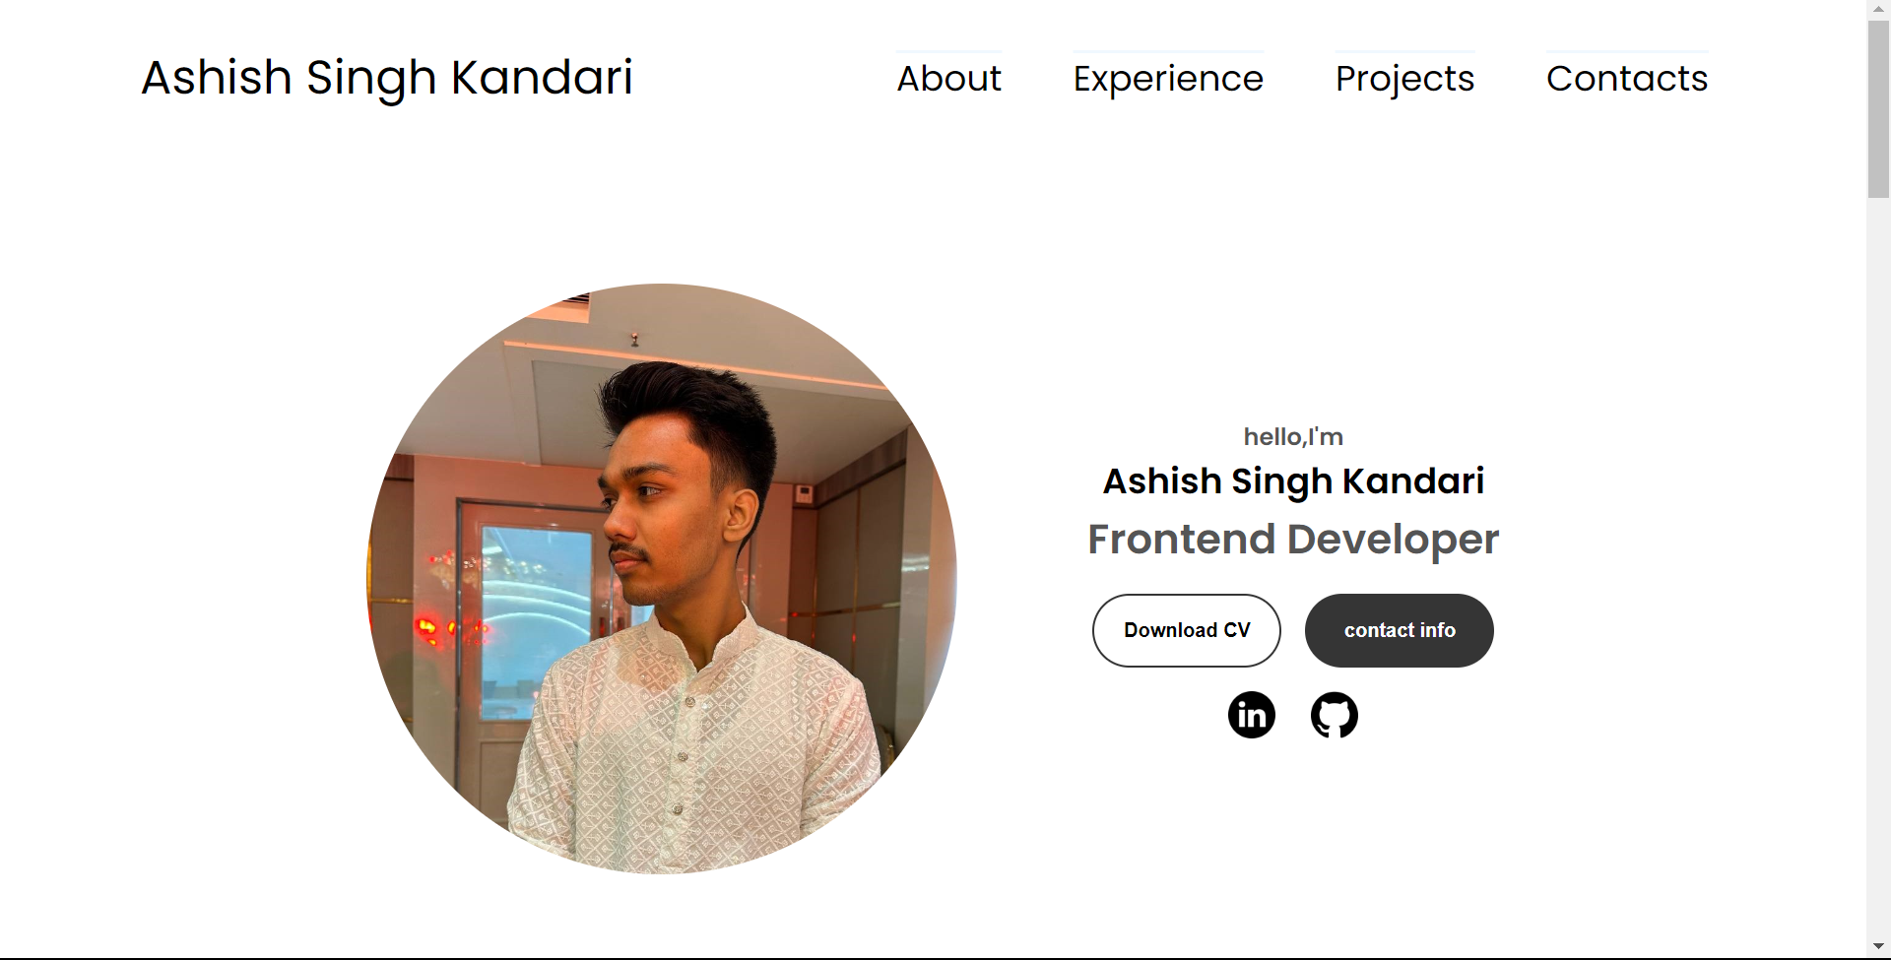
Project - 01
Portfolio website
This project aimed to create a digital platform where I could showcase my skills, projects, and experiences. The primary goal was to design and develop a visually appealing and user-friendly website that would serve as a comprehensive representation of my professional and personal journey.
Notes:
Links:
https://www.pexels.com/photo/photo-of-people-looking-on-laptop-3182812/

Slide 5
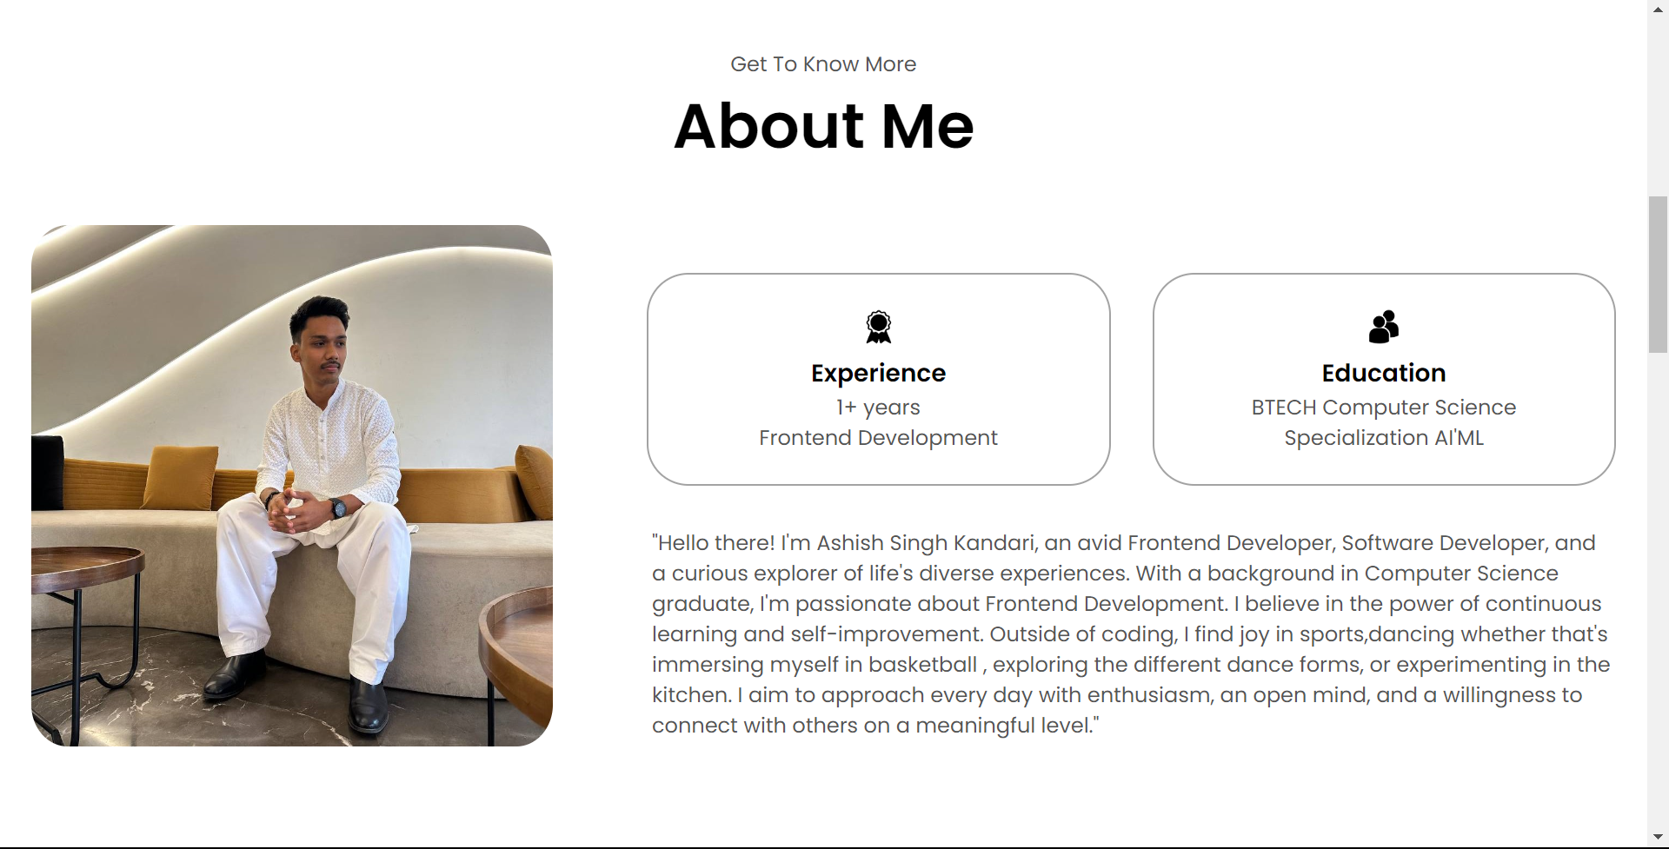
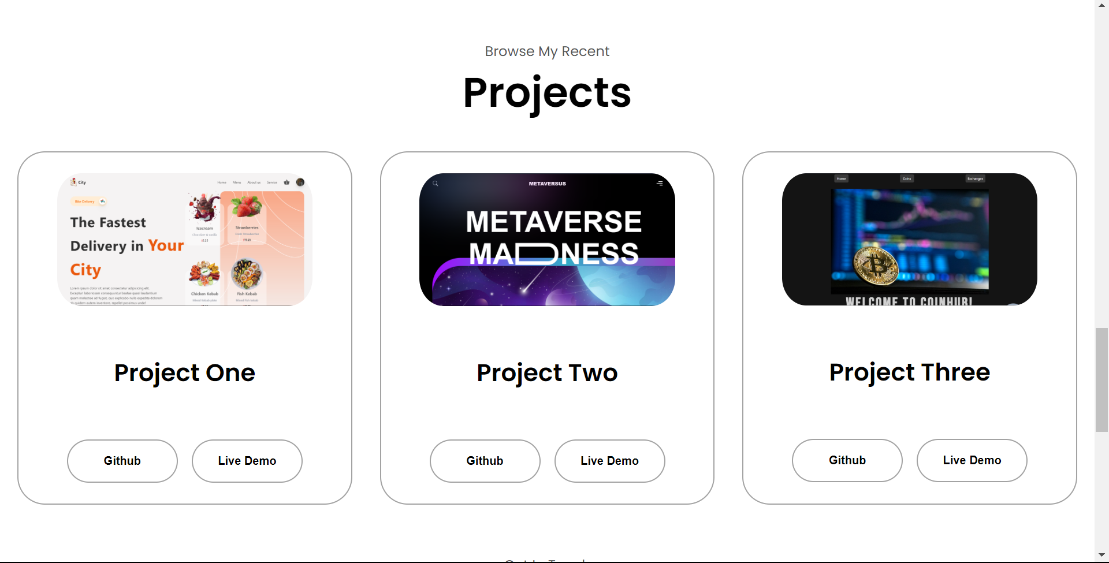

Snapshots
Notes:
Links:
https://www.pexels.com/photo/multi-cultural-people-3184419/

Slide 6
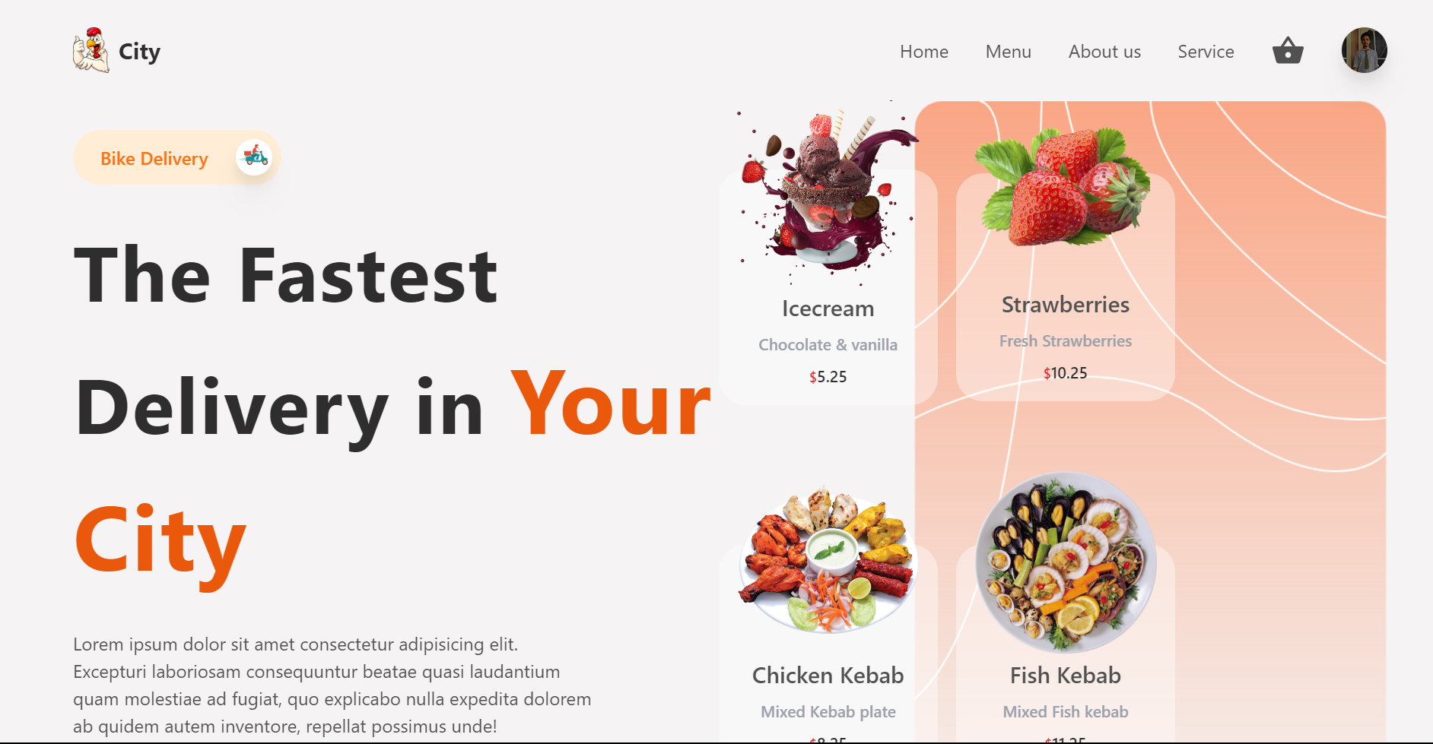
Project - 02
Food delivery Website
During my course training, I implemented a simple yet another food delivery website. This is a based on design skills and Frontend Skills. This project is all about build a responsive page by using my react framework and firbase cloud.
Notes:
Links:
https://www.pexels.com/photo/photo-of-people-looking-on-laptop-3182812/

Slide 7
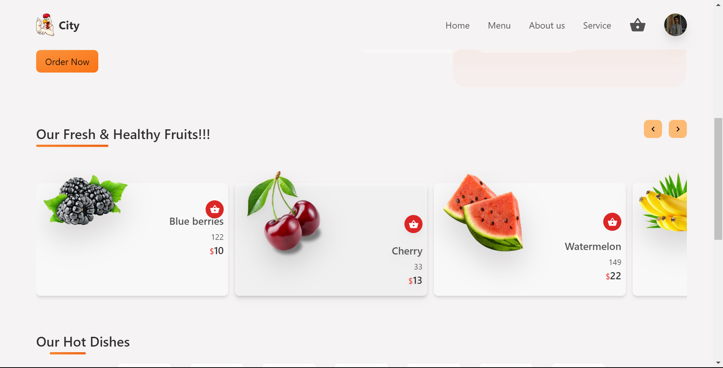
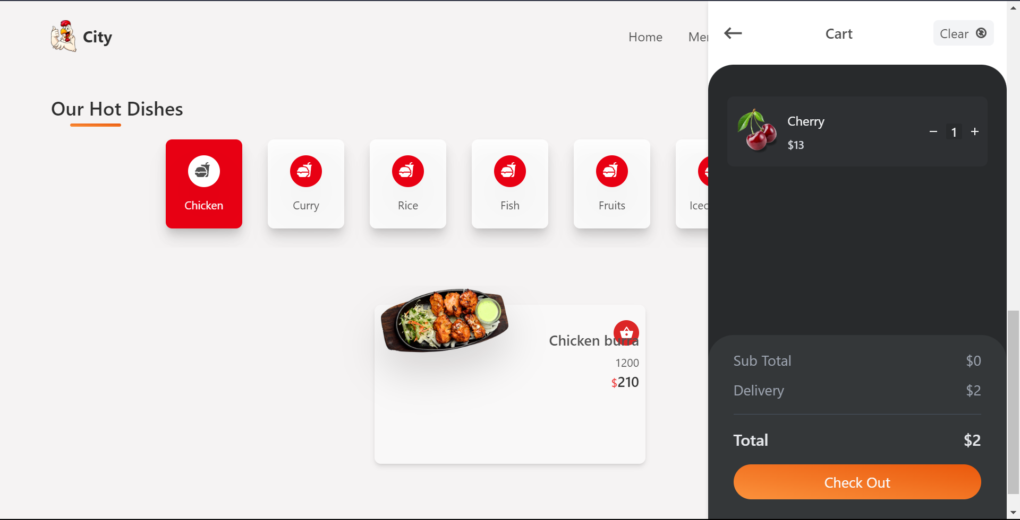
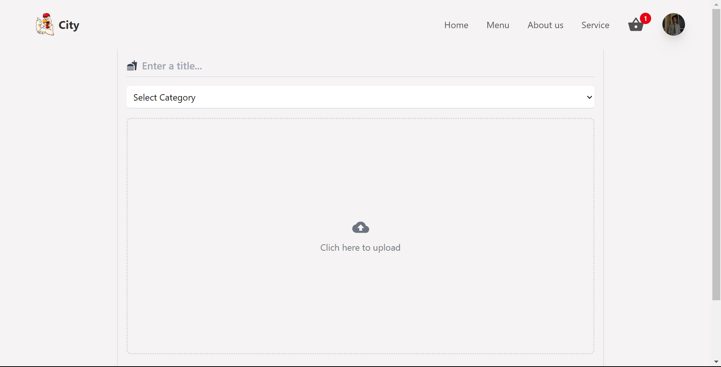
Snapshots
Notes:
Links:
https://www.pexels.com/photo/multi-cultural-people-3184419/

Slide 8
Thank You!
PRESENTATION
Notes:
Links:
https://pixabay.com/vectors/connection-internet-digital-network-4166469/

