Slide 1
DSCI49: Introduction to Computational Thinking and Data Science
10d – Representing Provenance

Slide 2
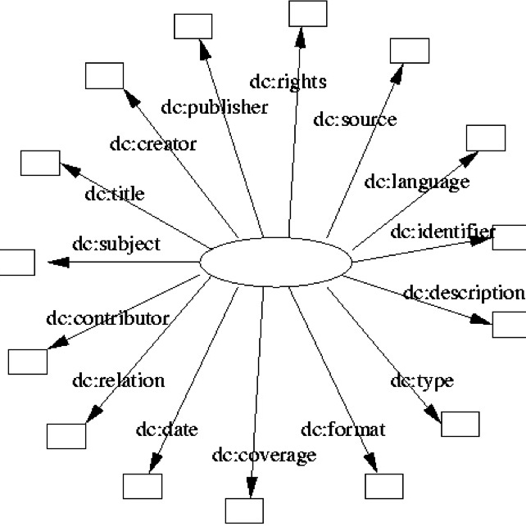
The Dublin Core
From library sciences
http://dublincore.org/documents/dcmi-terms/
http://dublincore.org/documents/dcq-rdf-xml/

Slide 3
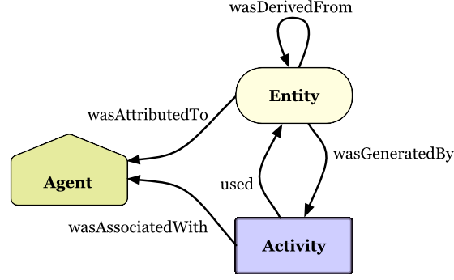
A Widely-Used Provenance Representation: PROV
actedOnBehalfOf
http://www.w3.org/TR/prov-primer/

Slide 4
Provenance Scenario Overview
A blogger looking over an online newspaper article spots what she thinks to be an error in a chart that the article includes. The chart was produced by a chart generator company from a government agency dataset.
The blogger explores the provenance records for the article, which combine provenance provided by the newspaper, the chart generator company, and the government agency.
The provenance provided by each source uses a different prefix: exn, exc, and exg respectively.
http://www.w3.org/TR/prov-primer/

Slide 5
PROV Scenario (I): Entities
Entities are physical, digital, conceptual, or other kinds of things. Provenance records describe the provenance of entities, and an entity’s provenance may refer to many other entities.
An online newspaper publishes an article with a chart about crime statistics based on data provided by a government portal.
The article includes a chart based on the data, with data values composed (aggregated) by geographical regions.
http://www.w3.org/TR/prov-primer/

Slide 6
PROV Scenario (II): Activities
Activities are how entities come into existence and how their attributes change to become new entities, often making use of previously existing entities to achieve this.
There was an activity done by the chart agency (exc:compile1) denoting the compilation of the chart from the data set.
This activity includes more specific steps involved in this compilation, which are first composing the data by region (exc:compose1) and then generating the chart graphic (exc:illustrate1).
http://www.w3.org/TR/prov-primer/

Slide 7

PROV Scenario (III): Use and Generation
Activities generate new entities. Activities make use of entities.
The composition activity (exc:compose1) used the original data set, the list of regions. The composed data was generated by this activity.
Similarly, the chart graphic creation activity (exc:illustrate1) used the composed data, and the chart was generated by this activity.
http://www.w3.org/TR/prov-primer/

Slide 8
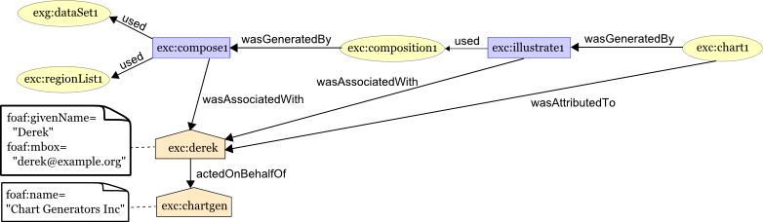
PROV Scenario (IV): Agents
An agent takes a role in an activity such that the agent can be assigned some degree of responsibility for the activity taking place. An agent can be a person, a piece of software, an organization, etc.
Betty sees that Derek was involved composing the data and creating the chart.
Derek is a person who works for an organization called ChartGen (Chart Generators).
http://www.w3.org/TR/prov-primer/

Slide 9
PROV Scenario (V): Revision and Derivation
An entity’s characteristics can derived from another one’s characteristics. An entity is revised when its characteristics change over time.
Betty looks at the dataset exg:dataset1, and sees that it is missing data from one of the zipcodes in the area. She contacts the government agency.
The government agency creates a new version of the dataset. The provenance of this new dataset, exg:dataset2, states that it is a revision of the old data set, exg:dataset1.
Derek notices that there is a new dataset available and creates a new chart exc:chart2 based on the revised data, using another compilation activity.
http://www.w3.org/TR/prov-primer/

Slide 10
Derivation as a Direct Link Between Entities
wasDerivedFrom

Slide 11
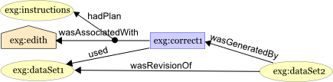
PROV Scenario (VI): Plans
An agent executing an activity may follow a pre-defined procedure, such as a recipe, a tutorial, an instruction set, or a workflow.
The correction was done by Edith (exg:edith) following clearly defined correction instructions (exg:instructions).
http://www.w3.org/TR/prov-primer/

