Slide 1
Course 2 Topic Models or probabilistic Latent Variable Models (LVMs) + Bayesian inference methods
Hoa M. Le
Data Science Lab, HUST
hoamle.github.io

Slide 2

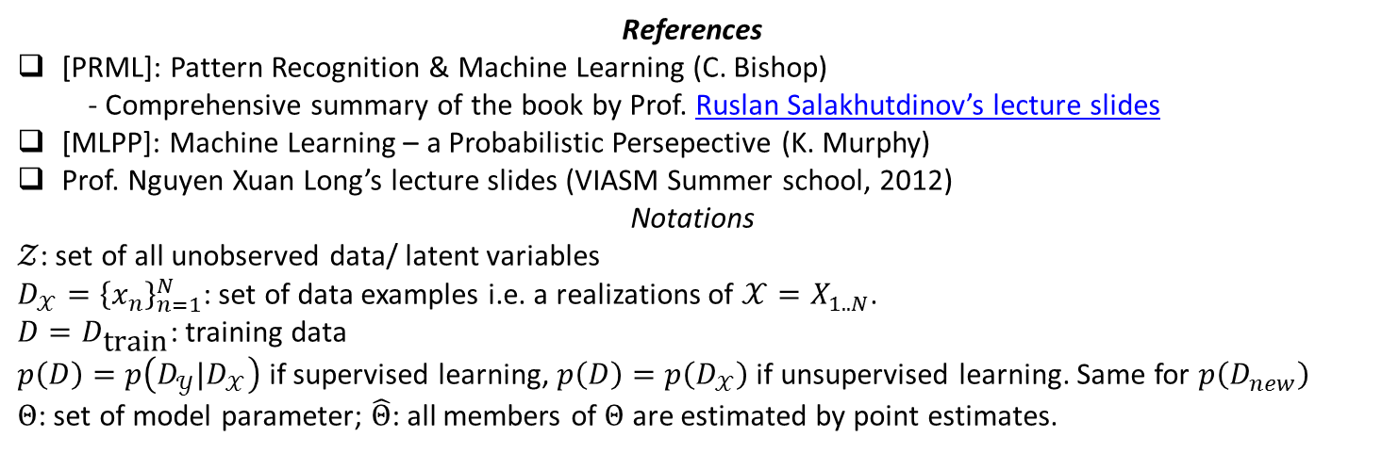
RECOMMENDED PRACTICE
Ask questions! Also for any foreign concept X, try asking yourself “what are the parent concepts of X?”
Read more + Study in groups
“Visualize”: take notes, draw and/or code
[MLPP] has all the source codes available for you to play with
References
[PRML]: Pattern Recognition & Machine Learning (C. Bishop)
- Comprehensive summary of the book by Prof. Ruslan Salakhutdinov’s lecture slides
[MLPP]: Machine Learning – a Probabilistic Persepective (K. Murphy)
Prof. Nguyen Xuan Long’s lecture slides (VIASM Summer school, 2012)
Notations
$𝒵$: set of all unobserved data/ latent variables
$D_{𝒳}={\left\{x_{n}\right\}}_{n=1}^{N}$: set of data examples i.e. a realizations of $𝒳=X_{1..N}$.
$D=D_{\text{train}}$: training data
$p\left(D\right)=p\left(D_{𝒴}|D_{𝒳}\right)$ if supervised learning, $p\left(D\right)=p\left(D_{𝒳}\right)$ if unsupervised learning. Same for $p\left(D_{new}\right)$
$Θ$: set of model parameter; $\hat{Θ}$: all members of $Θ$ are estimated by point estimates.
For any concepts, read the slides before the books to gain a complete overview

Slide 3
Review Why going probabilistic?
[PRML:1], [MPLL:1]
Probability theory is a unified framework for …

Slide 4
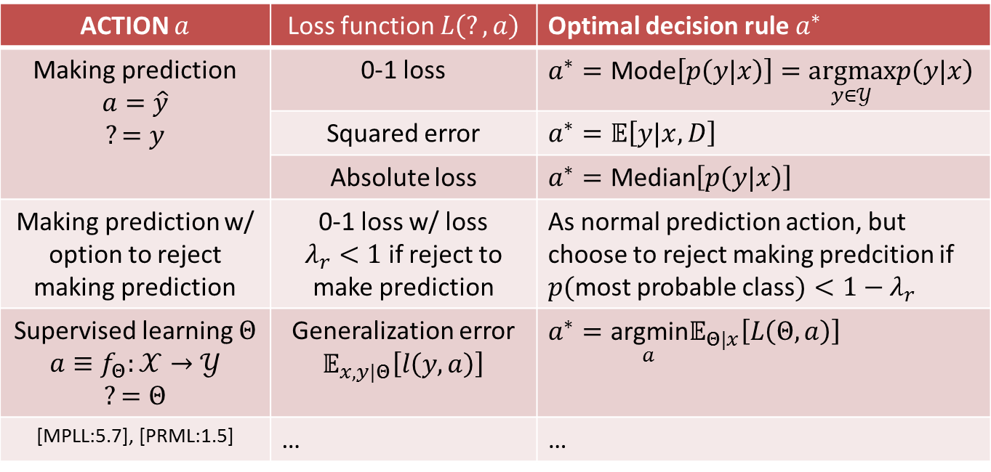
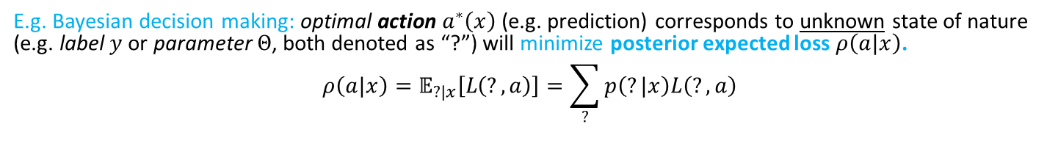
… Decision-making i.e. taking action under uncertainty
E.g. Bayesian decision making: optimal action $a^{∗}\left(x\right)$ (e.g. prediction) corresponds to unknown state of nature (e.g. label $y$ or parameter $Θ$, both denoted as “?”) will minimize posterior expected loss $ρ\left(a|x\right)$.
$$ρ\left(a|x\right)=𝔼_{?|x}\left[L\left(?,a\right)\right]=\sum_{?}{p\left(?|x\right)L\left(?,a\right)}$$
ACTION $a$ | Loss function $L\left(?,a\right)$ | Optimal decision rule $a^{∗}$
Making prediction $$a=\hat{y}$$ $$?=y$$ | 0-1 loss | $a^{∗}=\text{Mode}\left[p\left(y|x\right)\right]=\underset{y∈𝒴}{\text{argmax}}p\left(y|x\right)$
 | Squared error | $a^{∗}=𝔼\left[y|x,D\right]$
 | Absolute loss | $a^{∗}=\text{Median}\left[p\left(y|x\right)\right]$
Making prediction w/ option to reject making prediction | 0-1 loss w/ loss $λ_{r}<1$ if reject to make prediction | As normal prediction action, but choose to reject making predcition if $p($most probable class$)<1−λ_{r}$
Supervised learning $Θ$ $$a≡f_{Θ}:𝒳→𝒴$$ $$?=Θ$$ | Generalization error $𝔼_{x,y|Θ}\left[l\left(y,a\right)\right]$ | $a^{∗}=\underset{a}{\text{argmin}}𝔼_{Θ|x}\left[L\left(Θ,a\right)\right]$
[MPLL:5.7], [PRML:1.5] | … | …

Slide 5
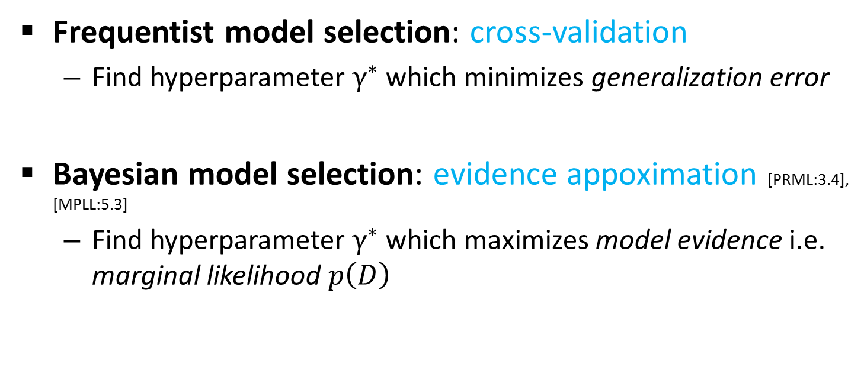
… Model selection i.e. comparison under uncertainty
Model selection is about finding an optimal hyperparameter setting, thus selecting a single “winning” model.
Frequentist model selection: cross-validation
Find hyperparameter $γ^{∗}$ which minimizes generalization error
Bayesian model selection: evidence appoximation [PRML:3.4], [MPLL:5.3]
Find hyperparameter $γ^{∗}$which maximizes model evidence i.e. marginal likelihood $p\left(D\right)$

Slide 6
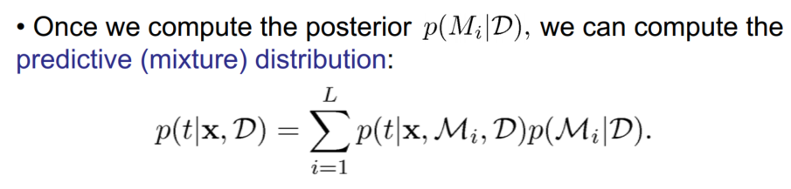
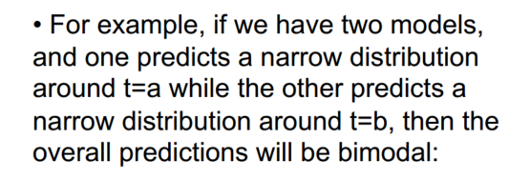
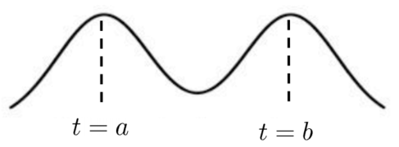
… Model averaging i.e. ensemble under uncertainty
Model averaging combines prediction from multiple models, addressing the fact “there is no single model that is better than all others” (no-free-lunch theorem).
Bayesian model averaging [PRML:3.4]
Frequentist model averaging [further reading]
Boosting
Bagging (Bootstrap Aggregation)

Slide 7
… and more [MPLL:5.7.3], [AI: A Modern Approach]

Slide 8


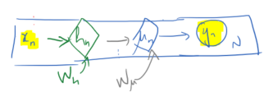

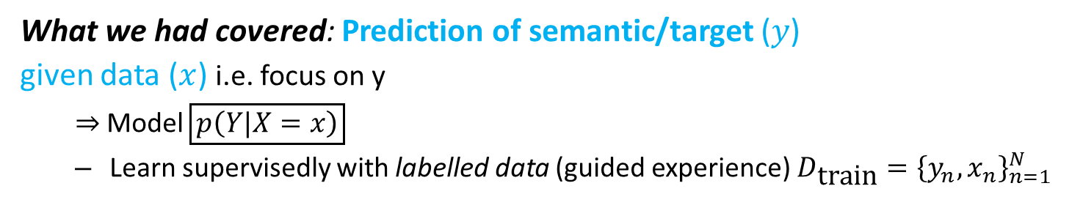
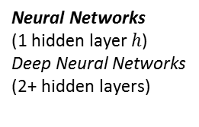
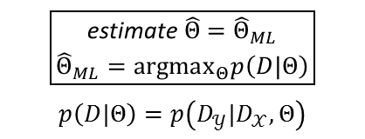




Course 1 – Review
What we had covered: Prediction of semantic/target ($y$)
given data ($x$) i.e. focus on y
$⇒$Model $\boxed{p\left(Y|X=x\right)}$
Learn supervisedly with labelled data (guided experience) $D_{\text{train}}={\left\{y_{n},x_{n}\right\}}_{n=1}^{N}$
$x$ – raw data: image, text, acoustic
$y$ – semantic/target: cat, dog, NOT car, Amy, Bob, …
MODEL STRUCTURE
Parameters to learn $\left(Θ\right)$
LEARNING FRAMEWORK
maximum Likelihood estimation
e.g. Categorical/ Bernoulli/ Normal distribution
$$Θ=\left\{μ\right\}$$
$$\boxed{\begin{aligned}\text{estimate} \hat{Θ}={\hat{Θ}}_{ML} \\ {\hat{Θ}}_{ML}={\text{argmax}}_{Θ}p\left(D|Θ\right)\end{aligned}}$$
$$p\left(D|Θ\right)=p\left(D_{𝒴}|D_{𝒳},Θ\right)$$
Linear models
e.g. Softmax/ Logistic/ Linear Regression
$$Θ=\left\{w\right\}$$
Neural Networks
(1 hidden layer $h$)
Deep Neural Networks
(2+ hidden layers)
$$Θ=\left\{w_{μ},w_{h}\right\}$$
TOOLS for fitting the models (not a complete list)
(mini-batch) gradient descent (first-order optimization method)
Second-order optimization methods [further reading]

Slide 9


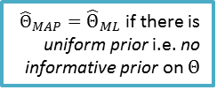






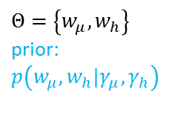
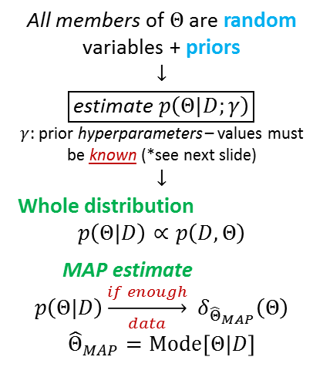
Course 1 – Review
What we had covered: Prediction of semantic/target ($y$)
given data ($x$) i.e. focus on y
$⇒$Model $\boxed{p\left(Y|X=x\right)}$
Learn supervisedly with labelled data (guided experience) $D_{\text{train}}={\left\{y_{n},x_{n}\right\}}_{n=1}^{N}$
$x$ – raw data: image, text, acoustic
$y$ – semantic/target: cat, dog, NOT car, Amy, Bob, …
MODEL STRUCTURE
Parameters to learn $\left(Θ\right)$
LEARNING FRAMEWORK
Bayesian inference
Dirichlet-Multinomial/ Beta-Binomial model
$$Θ=\left\{μ\right\}$$
$$\text{prior}\text{:} p\left(μ|γ\right)$$
All members of $Θ$ are random variables + priors
$$↓$$
$$\boxed{\text{estimate} p\left(Θ|D;γ\right)}$$
$γ$: prior hyperparameters – values must be known (*see next slide)
$$↓$$
Whole distribution
$$p\left(Θ|D\right)∝p\left(D,Θ\right)$$
MAP estimate
$$p\left(Θ|D\right)\underset{data}{\underset{→}{if enough}} δ_{{\hat{Θ}}_{MAP}}\left(Θ\right)$$
$${\hat{Θ}}_{MAP}=\text{Mode}\left[Θ|D\right]$$
$$\boxed{γ}→$$
further reading [PRML:3.3,4.5]
[PRML:5.7]
Bayesian Linear Regression; Bayesian Logistic Regression
$$Θ=\left\{w\right\}$$
$$\text{prior}\text{:} p\left(w|γ\right)$$
$$\boxed{γ}→$$
Bayesian Neural Networks
$$Θ=\left\{w_{μ},w_{h}\right\}$$
$$\text{prior}\text{: }$$
$$p\left(w_{μ},w_{h}|γ_{μ},γ_{h}\right)$$
$$\boxed{γ_{h}}→$$
$$\boxed{γ_{μ}}→$$
TOOLS for fitting the models (not a complete list)
Conjugate priors
EM algorithm, Variational inference (VI), sampling-based methods [course 2]
VI + SGD [further reading]
${\hat{Θ}}_{MAP}={\hat{Θ}}_{ML}$ if there is uniform prior i.e. no informative prior on $Θ$

Slide 10
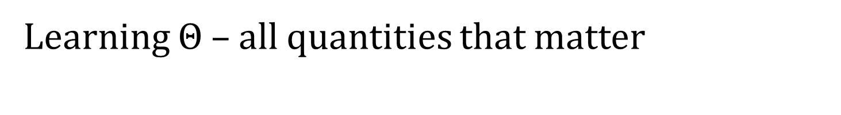

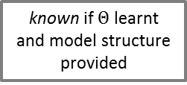
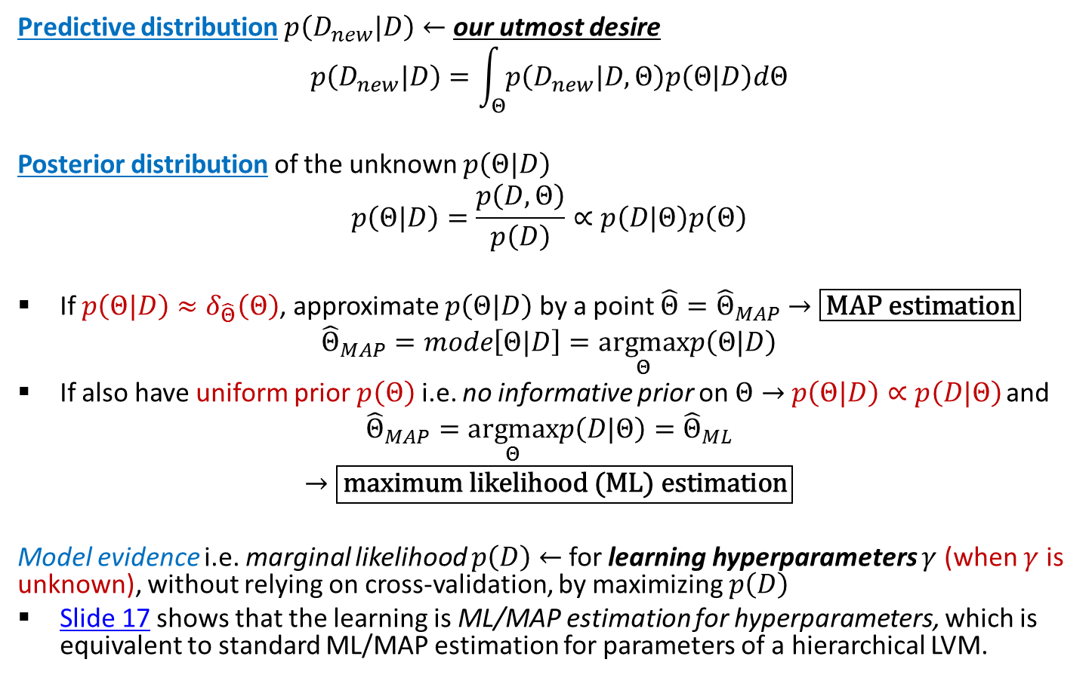
Learning $Θ$ – all quantities that matter
known if $Θ$ learnt and model structure provided
Predictive distribution $p\left(D_{new}|D\right)←$ our utmost desire
$$p\left(D_{new}|D\right)=\int_{Θ}{p\left(D_{new}|D,Θ\right)p\left(Θ|D\right)dΘ}$$
Posterior distribution of the unknown $p\left(Θ|D\right)$
$$p\left(Θ|D\right)=\frac{p\left(D,Θ\right)}{p\left(D\right)}∝p\left(D|Θ\right)p\left(Θ\right)$$
If $p\left(Θ|D\right)≈δ_{\hat{Θ}}\left(Θ\right)$, approximate $p\left(Θ|D\right)$ by a point $\hat{Θ}{=\hat{Θ}}_{MAP}$ $→\boxed{\text{MAP} \text{estimation}}$
$${\hat{Θ}}_{MAP}=mode\left[Θ|D\right]=\underset{Θ}{\text{argmax}}p\left(Θ|D\right)$$
If also have uniform prior $p\left(Θ\right)$ i.e. no informative prior on $Θ→$ $p\left(Θ|D\right)∝p\left(D|Θ\right)$ and
$${\hat{Θ}}_{MAP}=\underset{Θ}{\text{argmax}}p\left(D|Θ\right)={\hat{Θ}}_{ML}$$
$$→\boxed{\text{maximum} \text{likelihood}\text{ (}\text{ML}\text{)} \text{estimation}}$$
Model evidence i.e. marginal likelihood $p\left(D\right)$ $←$ for learning hyperparameters $γ$ (when $γ$ is unknown), without relying on cross-validation, by maximizing $p\left(D\right)$
Slide 17 shows that the learning is ML/MAP estimation for hyperparameters, which is equivalent to standard ML/MAP estimation for parameters of a hierarchical LVM.
$Θ$ is unknown

Slide 11








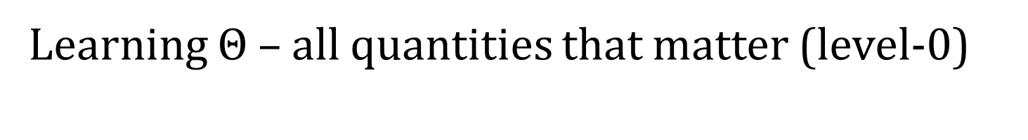


Learning $Θ$ – all quantities that matter (level-0)
$$Θ$$
$$Θ$$
$$\boxed{γ}$$
$$μ$$
$$D$$
$$\boxed{μ}$$
$$D$$
$$D_{\text{new}}$$
$$D_{\text{new}}$$
 | if Bayesian inference (full form) | if MAP estimation | if ML estimation
$$p\left(D_{\text{new}}|D\right)$$ Predictive distribution | $$=\int_{Θ}{p\left(D_{\text{new}}|D\backslash ,Θ\right)p\left(Θ|D\right)}dΘ$$ | $$≈p\left(D_{\text{new}}|D\backslash ,{\hat{Θ}}_{MAP}\right)$$ | $$\underset{≈}{∝}p\left(D_{\text{new}}|D\backslash ,{\hat{Θ}}_{ML}\right)$$
$$p\left(Θ|D\right)$$ posterior distribution (of $Θ$) | $$=\frac{p\left(D|Θ\right)p\left(Θ\right)}{p\left(D\right)}$$ | $$≈δ_{\text{mode}\left[Θ|D\right]}\left(Θ\right)$$ | $$≈δ_{\text{mode}\left[D|Θ\right]}\left(Θ\right)$$
Learning objective | compute $$p\left(Θ|D\right)∝p\left(D,Θ\right)$$ | solve $$\underset{Θ}{\text{argmax}}p\left(Θ|D\right)$$ | solve $$\underset{Θ}{\text{argmax}}p\left(D|Θ\right)$$
Always hard to compute exactly.
Point estimates can make learning easier

Slide 12
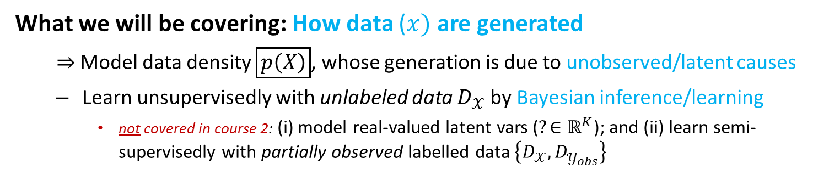
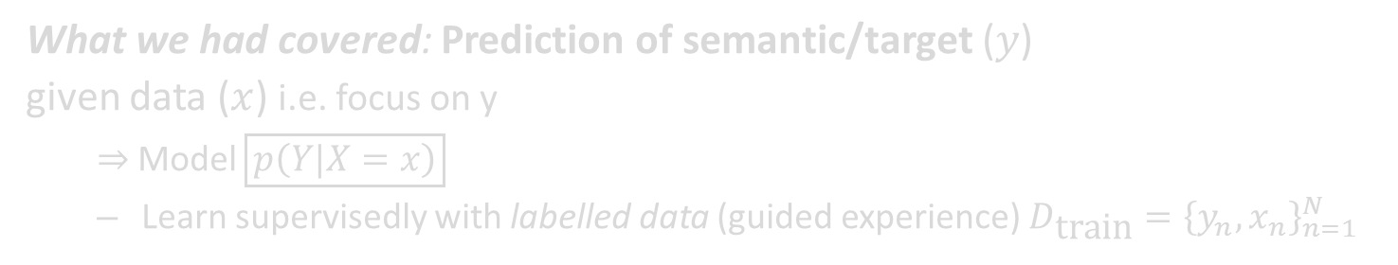
Course 2 – in 3 lines
What we had covered: Prediction of semantic/target ($y$)
given data ($x$) i.e. focus on y
$⇒$Model $\boxed{p\left(Y|X=x\right)}$
Learn supervisedly with labelled data (guided experience) $D_{\text{train}}={\left\{y_{n},x_{n}\right\}}_{n=1}^{N}$
What we will be covering: How data ($x)$ are generated
$⇒$ Model data density $\boxed{p\left(X\right)}$, whose generation is due to unobserved/latent causes
Learn unsupervisedly with unlabeled data $D_{𝒳}$ by Bayesian inference/learning
not covered in course 2: (i) model real-valued latent vars ($?∈ℝ^{K}$); and (ii) learn semi-supervisedly with partially observed labelled data $\left\{D_{𝒳},D_{𝒴_{obs}}^{}\right\}$
WHY?
Accurate model (i.e. assumptions) of how data are generated may yield better prediction
E.g. prediction on data that are already clustered (grouped) properly
Prediction when there is lack of (labelled) data.
Applications: synthesis (e.g. automated painting, poem generation, …); imputation i.e. filling-in missing values (e.g. inpainting); retrieval and compression via latent representation; …
See more: http://videolectures.net/deeplearning2016_mohamed_generative_models/ (first 12min – upto slide 19)

Slide 13
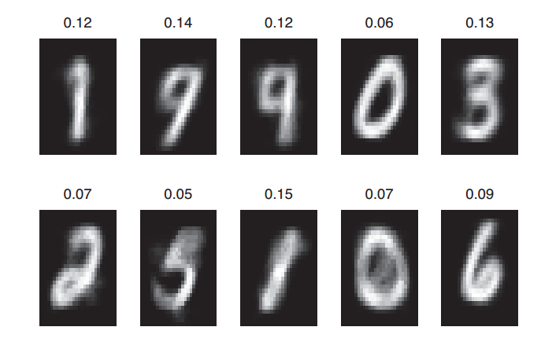
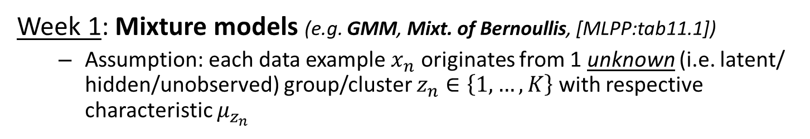
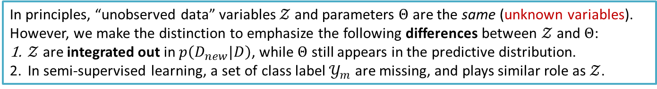
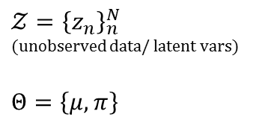




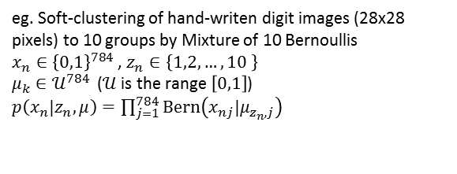
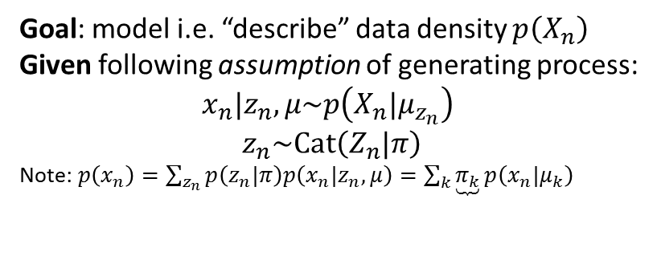
Course 2 – Week 1
Week 1: Mixture models (e.g. GMM, Mixt. of Bernoullis, [MLPP:tab11.1])
Assumption: each data example $x_{n}$ originates from 1 unknown (i.e. latent/ hidden/unobserved) group/cluster $z_{n}∈\left\{1,…,K\right\}$ with respective characteristic $μ_{z_{n}}$
$${\hat{π}}_{k}$$
$$μ$$
$${\hat{μ}}_{k}$$
$$𝒵={\left\{z_{n}\right\}}_{n}^{N}$$
(unobserved data/ latent vars)
$$Θ=\left\{μ,π\right\}$$
$$π$$
Goal: model i.e. “describe” data density $p\left(X_{n}\right)$
Given following assumption of generating process:
$x_{n}|z_{n},μ\sim p\left(X_{n}|μ_{z_{n}}\right)$
$$z_{n}\sim \text{Cat}\left(Z_{n}|π\right)$$
Note: $p\left(x_{n}\right)=\sum_{z_{n}}{p\left(z_{n}|π\right)p\left(x_{n}|z_{n},μ\right)}=\sum_{k}{\underbrace{π_{k}}p\left(x_{n}|μ_{k}\right)}$
eg. Soft-clustering of hand-writen digit images (28x28 pixels) to 10 groups by Mixture of 10 Bernoullis
$x_{n}∈{\left\{0,1\right\}}^{784}$ , $z_{n}∈\left\{1,2,…,10 \right\}$
$μ_{k}∈𝒰^{784 }$ ($𝒰$ is the range $\left[0,1\right]$)
$p\left(x_{n}|z_{n},μ\right)=\prod_{j=1}^{784}{\text{Bern}\left(x_{nj}|μ_{z_{n},j}\right)}$
[MPLL:fig11.5]
mixing weight
In principles, “unobserved data” variables $𝒵$ and parameters $Θ$ are the same (unknown variables). However, we make the distinction to emphasize the following differences between $𝒵$ and $Θ$:
$𝒵$ are integrated out in $p\left(D_{new}|D\right)$, while $Θ$ still appears in the predictive distribution.
In semi-supervised learning, a set of class label $𝒴_{m}$ are missing, and plays similar role as $𝒵$.

Slide 14




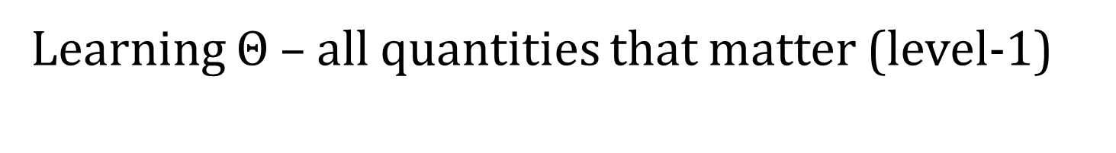














Learning $Θ$ – all quantities that matter (level-1)
$$Θ$$
$$𝒵$$
$$Θ$$
$$𝒵$$
$$\boxed{γ}$$
$$π$$
$$μ$$
$$z$$
$$D$$
$$\boxed{π}$$
$$\boxed{μ}$$
$$z$$
$$D$$
$$D_{\text{new}}$$
$$D_{\text{new}}$$
$$\tilde{z}$$
$$\tilde{z}$$
 | if Bayesian inference (full form) | if MAP estimation | if ML estimation
$$p\left(D_{\text{new}}|D\right)$$ Predictive distribution | $$=\int_{Θ,\tilde{z} }{\begin{aligned}p\left(D_{\text{new}}|\tilde{z},D\backslash ,Θ\right) \\ p\left(\tilde{z}|D,Θ\right)p\left(Θ|D\right)\end{aligned}}d\left\{Θ,\tilde{z}\right\}$$ | $$≈p\left(D_{\text{new}}|D\backslash ,{\hat{Θ}}_{MAP}\right)$$ | $$\underset{≈}{∝}p\left(D_{\text{new}}|D\backslash ,{\hat{Θ}}_{ML}\right)$$
$$p\left(Θ|D\right)$$ posterior distribution (of $Θ$) | $$=\frac{p\left(D|Θ\right)p\left(Θ\right)}{p\left(D\right)}$$ | $$≈δ_{\text{mode}\left[Θ|D\right]}\left(Θ\right)$$ | $$≈δ_{\text{mode}\left[D|Θ\right]}\left(Θ\right)$$
Learning objective | compute $$p\left(𝒵,Θ|D\right)∝p\left(D,𝒵,Θ\right)$$ | solve $$\underset{Θ}{\text{argmax}}p\left(Θ|D\right)$$ | solve $$\underset{Θ}{\text{argmax}}p\left(D|Θ\right)$$
Only need expectation over this distribution i.e. compute
$$𝔼_{\tilde{z}|D,Θ}\left[⋅\right]$$
to infer/predict some-thing that concern $𝒵$
e.g. cluster assigment, E-step in EM algorithm
$p\left(\tilde{z},Θ|D\right)$is always hard to compute exactly.
Point estimates (of $Θ$) make both learning $Θ$ and inference about $𝒵$ easier. Note:
$$p\left(\tilde{z},Θ|D\right)≈p\left(\tilde{z}|D,\hat{Θ}\right)$$

Slide 15

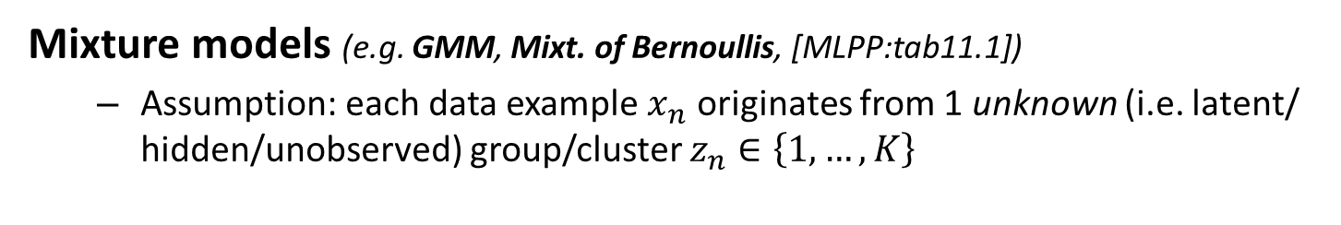
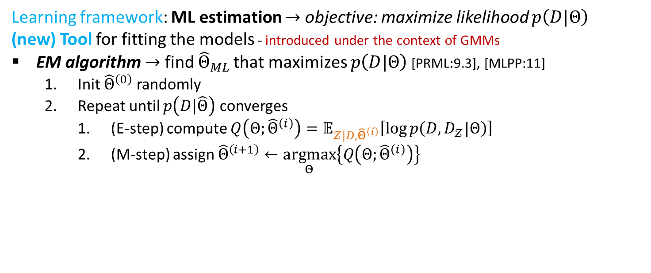

Course 2 – Week 1 (cont.)
Mixture models (e.g. GMM, Mixt. of Bernoullis, [MLPP:tab11.1])
Assumption: each data example $x_{n}$ originates from 1 unknown (i.e. latent/ hidden/unobserved) group/cluster $z_{n}∈\left\{1,…,K\right\}$
$${\hat{π}}_{k}$$
$$\boxed{μ}$$
$${\hat{μ}}_{k}$$
$$𝒵={\left\{z_{n}\right\}}_{n}^{N}$$
(unobserved data/ latent vars)
$$Θ=\left\{μ,π\right\}$$
$$\boxed{π}$$
eg. Mixture of 10 Bernoullis [MPLL:fig11.5]
Learning framework: ML estimation $→$ objective: maximize likelihood $p\left(D|Θ\right)$
(new) Tool for fitting the models - introduced under the context of GMMs
EM algorithm $→$ find ${\hat{Θ}}_{ML}$ that maximizes $p\left(D|Θ\right)$ [PRML:9.3], [MLPP:11]
Init ${\hat{Θ}}^{\left(0\right)}$ randomly
Repeat until $p\left(D|\hat{Θ}\right)$ converges
(E-step) compute $Q\left(Θ;{\hat{Θ}}^{\left(i\right)}\right)=𝔼_{𝒵|D,{\hat{Θ}}^{\left(i\right)}}\left[\log{p\left(D,D_{𝒵}|Θ\right)}\right]$
(M-step) assign ${\hat{Θ}}^{\left(i+1\right)}←\underset{Θ}{\text{argmax}}\left\{Q\left(Θ;{\hat{Θ}}^{\left(i\right)}\right)\right\}$

Slide 16


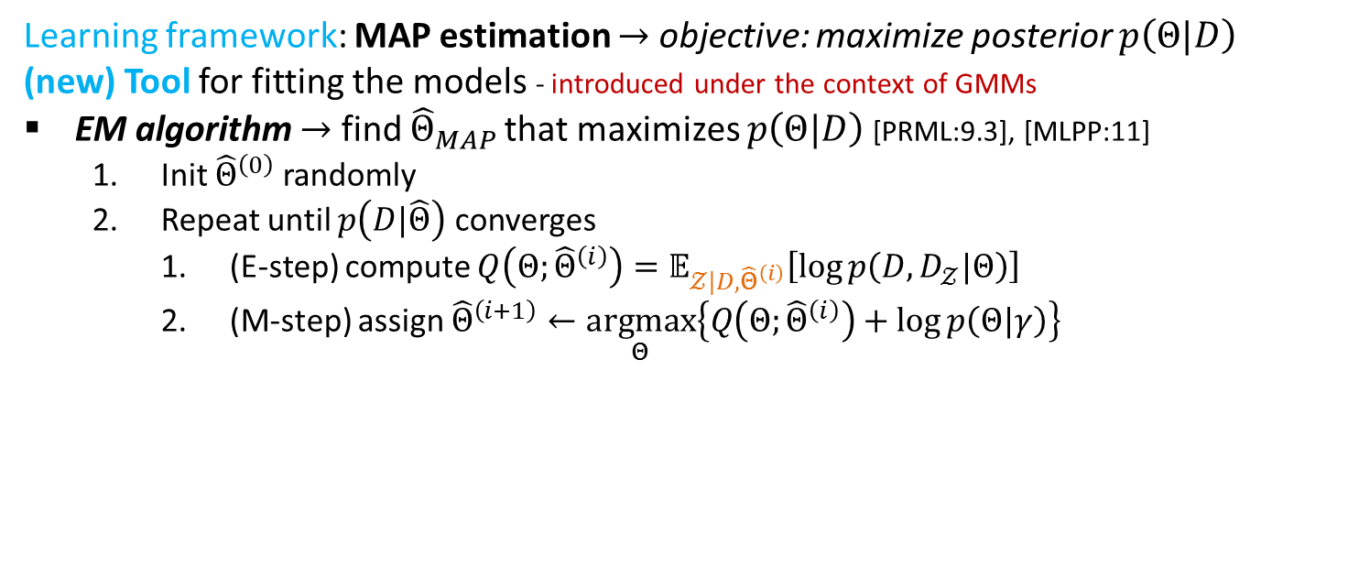

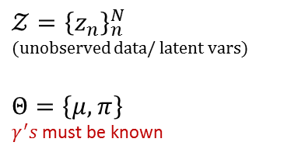

Course 2 – Week 1 (cont.)
Mixture models (e.g. GMM, Mixt. of Bernoullis, [MLPP:tab11.1])
Assumption: each data example $x_{n}$ originates from 1 unknown (i.e. latent/ hidden/unobserved) group/cluster $z_{n}∈\left\{1,…,K\right\}$
$${\hat{π}}_{k}$$
$$μ$$
$${\hat{μ}}_{k}$$
$$𝒵={\left\{z_{n}\right\}}_{n}^{N}$$
(unobserved data/ latent vars)
$$Θ=\left\{μ,π\right\}$$
$γ^{′}s$ must be known
$$←\boxed{γ_{μ}}$$
$$π$$
$$\overset{↑}{\boxed{γ_{π}}}$$
eg. Mixture of 10 Bernoullis [MPLL:fig11.5]
Learning framework: MAP estimation $→$ objective: maximize posterior $p\left(Θ|D\right)$
(new) Tool for fitting the models - introduced under the context of GMMs
EM algorithm $→$ find ${\hat{Θ}}_{MAP}$ that maximizes $p\left(Θ|D\right)$ [PRML:9.3], [MLPP:11]
Init ${\hat{Θ}}^{\left(0\right)}$ randomly
Repeat until $p\left(D|\hat{Θ}\right)$ converges
(E-step) compute $Q\left(Θ;{\hat{Θ}}^{\left(i\right)}\right)=𝔼_{𝒵|D,{\hat{Θ}}^{\left(i\right)}}\left[\log{p\left(D,D_{𝒵}|Θ\right)}\right]$
(M-step) assign ${\hat{Θ}}^{\left(i+1\right)}←\underset{Θ}{\text{argmax}}\left\{Q\left(Θ;{\hat{Θ}}^{\left(i\right)}\right)+\log{p\left(Θ|γ\right)}\right\}$
Note: $\log{p\left(Θ|D\right)}=\log{p\left(D|Θ\right)}+\log{p\left(Θ\right)}−\text{const}$

Slide 17

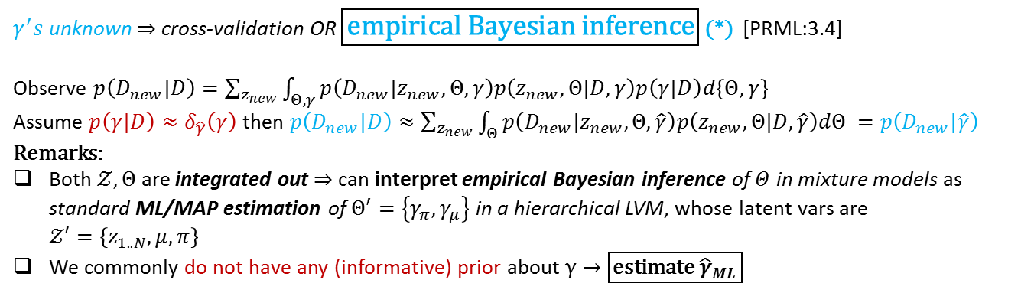
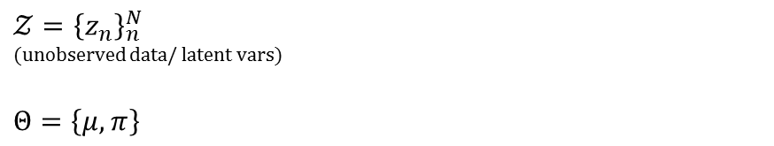

Course 2 – preparing for Week 2-4
Mixture models (e.g. GMM, Mixt. of Bernoullis, [MLPP:tab11.1])
Assumption: each data example $x_{n}$ originates from 1 unknown (i.e. latent/ hidden/unobserved) group/cluster $z_{n}∈\left\{1,…,K\right\}$
$${\hat{π}}_{k}$$
$$μ←γ_{μ}$$
$${\hat{μ}}_{k}$$
$$𝒵={\left\{z_{n}\right\}}_{n}^{N}$$
(unobserved data/ latent vars)
$$Θ=\left\{μ,π\right\}$$
$$π \\ \overset{↑}{γ_{π}}$$
eg. Mixture of 10 Bernoullis [MPLL:fig11.5]
$γ^{′}s$ unknown$⇒$ cross-validation OR $\boxed{\text{empirical} \text{Bayesian} \text{inference}}$ (*) [PRML:3.4]
Observe $p\left(D_{new}|D\right)=\sum_{z_{new}}{\int_{Θ,γ}{p\left(D_{new}|z_{new},Θ,γ\right)p\left(z_{new},Θ|D,γ\right)p\left(γ|D\right)d\left\{Θ,γ\right\}}}$
Assume $p\left(γ|D\right)≈δ_{\hat{γ}}\left(γ\right)$ then $p\left(D_{new}|D\right)≈\sum_{z_{new}}{\int_{Θ}{p\left(D_{new}|z_{new},Θ,\hat{γ}\right)p\left(z_{new},Θ|D,\hat{γ}\right)dΘ }}=p\left(D_{new}|\hat{γ}\right)$
Remarks:
Both $𝒵,Θ$ are integrated out $⇒$ can interpret empirical Bayesian inference of $Θ$ in mixture models as standard ML/MAP estimation of $Θ^{′}=\left\{γ_{π},γ_{μ}\right\}$ in a hierarchical LVM, whose latent vars are $𝒵′=\left\{z_{1..N},μ, π\right\}$
We commonly do not have any (informative) prior about $γ→\boxed{\text{estimate} {\hat{γ}}_{ML}}$
(*) “almost”, but not “fully Bayesian”, in the inference of $Θ$, because prior $p\left(Θ|γ\right)$ is not known and $γ$ need to be learnt from data. Necessary condition: “prior knowledge” – encoded in model structure i.e. assumption of how data are generated – must be correct i.e. the model structure defines a model space that contains “correct” structure.

Slide 18


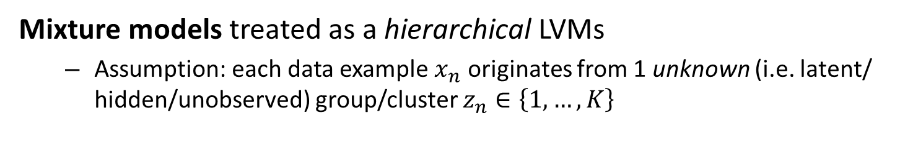
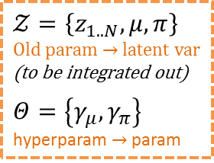
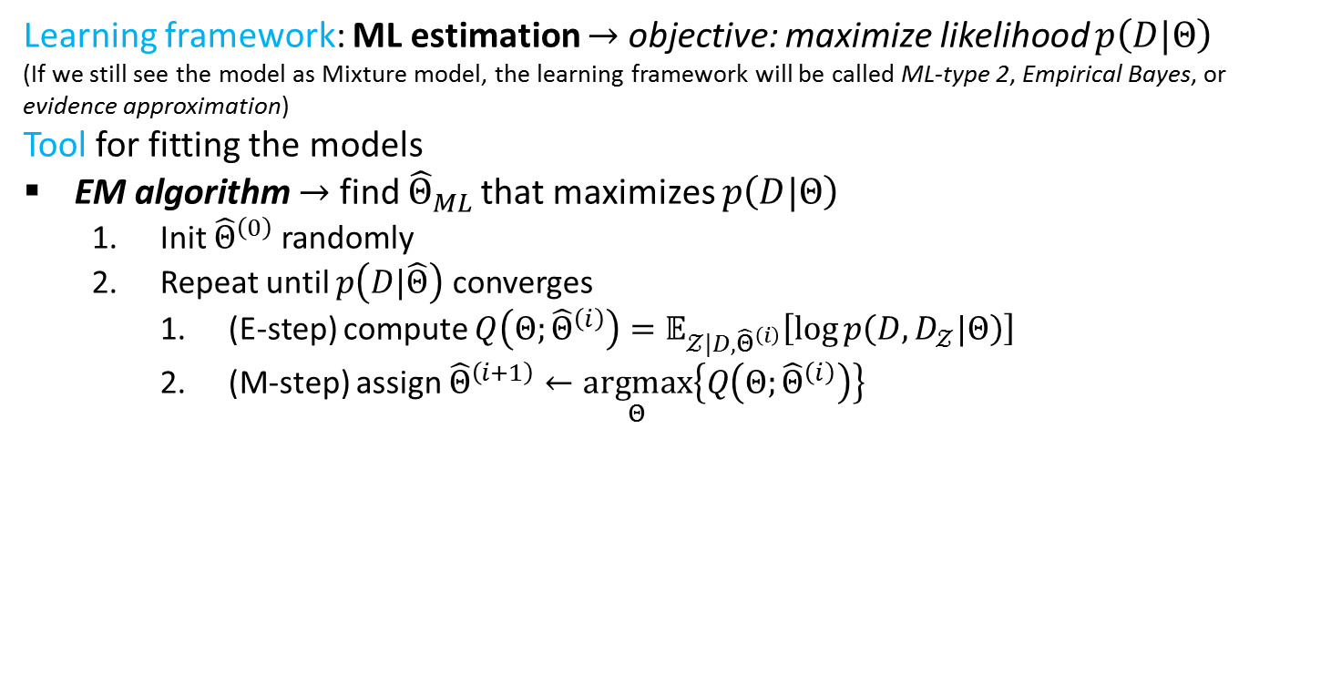




Course 2 – preparing for Week 2-4
Mixture models treated as a hierarchical LVMs
Assumption: each data example $x_{n}$ originates from 1 unknown (i.e. latent/ hidden/unobserved) group/cluster $z_{n}∈\left\{1,…,K\right\}$
$${\hat{π}}_{k}$$
$$←\boxed{γ_{μ}}$$
$${\hat{μ}}_{k}$$
$$𝒵=\left\{z_{1..N},μ,π\right\}$$
Old param $→$ latent var
(to be integrated out)
$$Θ=\left\{γ_{μ},γ_{π}\right\}$$
hyperparam $→$ param
$$μ$$
$$π$$
$$\overset{↑}{\boxed{γ_{π}}}$$
eg. Mixture of 10 Bernoullis [MPLL:fig11.5]
Learning framework: ML estimation $→$ objective: maximize likelihood $p\left(D|Θ\right)$
(If we still see the model as Mixture model, the learning framework will be called ML-type 2, Empirical Bayes, or evidence approximation)
Tool for fitting the models
EM algorithm $→$ find ${\hat{Θ}}_{ML}$ that maximizes $p\left(D|Θ\right)$
Init ${\hat{Θ}}^{\left(0\right)}$ randomly
Repeat until $p\left(D|\hat{Θ}\right)$ converges
(E-step) compute $Q\left(Θ;{\hat{Θ}}^{\left(i\right)}\right)=𝔼_{𝒵|D,{\hat{Θ}}^{\left(i\right)}}\left[\log{p\left(D,D_{𝒵}|Θ\right)}\right]$
(M-step) assign ${\hat{Θ}}^{\left(i+1\right)}←\underset{Θ}{\text{argmax}}\left\{Q\left(Θ;{\hat{Θ}}^{\left(i\right)}\right)\right\}$
“type 2” for maximization over $γ$ instead of $μ,π$
Trouble: $𝒵$|D is now joint $z_{1..N },μ,π$|D !!!

Slide 19

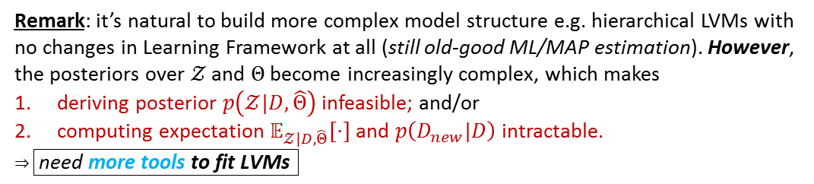




Learning $Θ$ – all quantities that matter (level-2)
Remark: it’s natural to build more complex model structure e.g. hierarchical LVMs with no changes in Learning Framework at all (still old-good ML/MAP estimation). However, the posteriors over $𝒵$ and $Θ$ become increasingly complex, which makes
deriving posterior $p\left(𝒵|D,\hat{Θ}\right)$ infeasible; and/or
computing expectation $𝔼_{𝒵|D,\hat{Θ}}\left[⋅\right]$ and $p\left(D_{new}|D\right)$ intractable.
$⇒\boxed{\text{need} \text{more} \text{tools} \text{to} \text{fit} \text{LVMs} }$
$$Θ$$
$$𝒵$$
$$\boxed{γ}$$
$$π$$
$$μ$$
$$z$$
$$D$$
$$D_{\text{new}}$$
$$\tilde{z}$$
 | if Bayesian inference (full form) | if MAP estimation | if ML estimation
$$p\left(D_{\text{new}}|D\right)$$ Predictive distribution | $$=\int_{Θ,\tilde{z} }{\begin{aligned}p\left(D_{\text{new}}|\tilde{z},D\backslash ,Θ\right) \\ p\left(\tilde{z}|D,Θ\right)p\left(Θ|D\right)\end{aligned}}d\left\{Θ,\tilde{z}\right\}$$ | $$≈p\left(D_{\text{new}}|D\backslash ,{\hat{Θ}}_{MAP}\right)$$ | $$\underset{≈}{∝}p\left(D_{\text{new}}|D\backslash ,{\hat{Θ}}_{ML}\right)$$
$$p\left(Θ|D\right)$$ posterior distribution (of $Θ$) | $$=\frac{p\left(D|Θ\right)p\left(Θ\right)}{p\left(D\right)}$$ | $$≈δ_{\text{mode}\left[Θ|D\right]}\left(Θ\right)$$ | $$≈δ_{\text{mode}\left[D|Θ\right]}\left(Θ\right)$$
Learning objective | compute $$p\left(𝒵,Θ|D\right)∝p\left(D,𝒵,Θ\right)$$ | solve $$\underset{Θ}{\text{argmax}}p\left(Θ|D\right)$$ | solve $$\underset{Θ}{\text{argmax}}p\left(D|Θ\right)$$
Most of the time, only requires summary statstic over this distribution e.g.
$$𝔼_{\tilde{z}|D,Θ}\left[⋅\right]$$
to infer/predict some-thing that concern $𝒵$
e.g. cluster id, missing label, E-step in EM algorithm
$p\left(\tilde{z},Θ|D\right)$ is always hard to compute exactly.
Point estimates (of $Θ$) make both learning $Θ$ and inference about $𝒵$ little bit easier
$$p\left(\tilde{z},Θ|D\right)≈p\left(\tilde{z}|D,\hat{Θ}\right)$$
but still HARD!!!

Slide 20
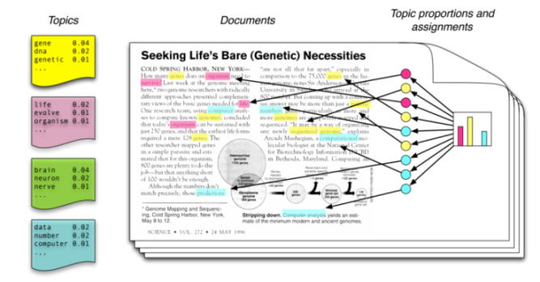
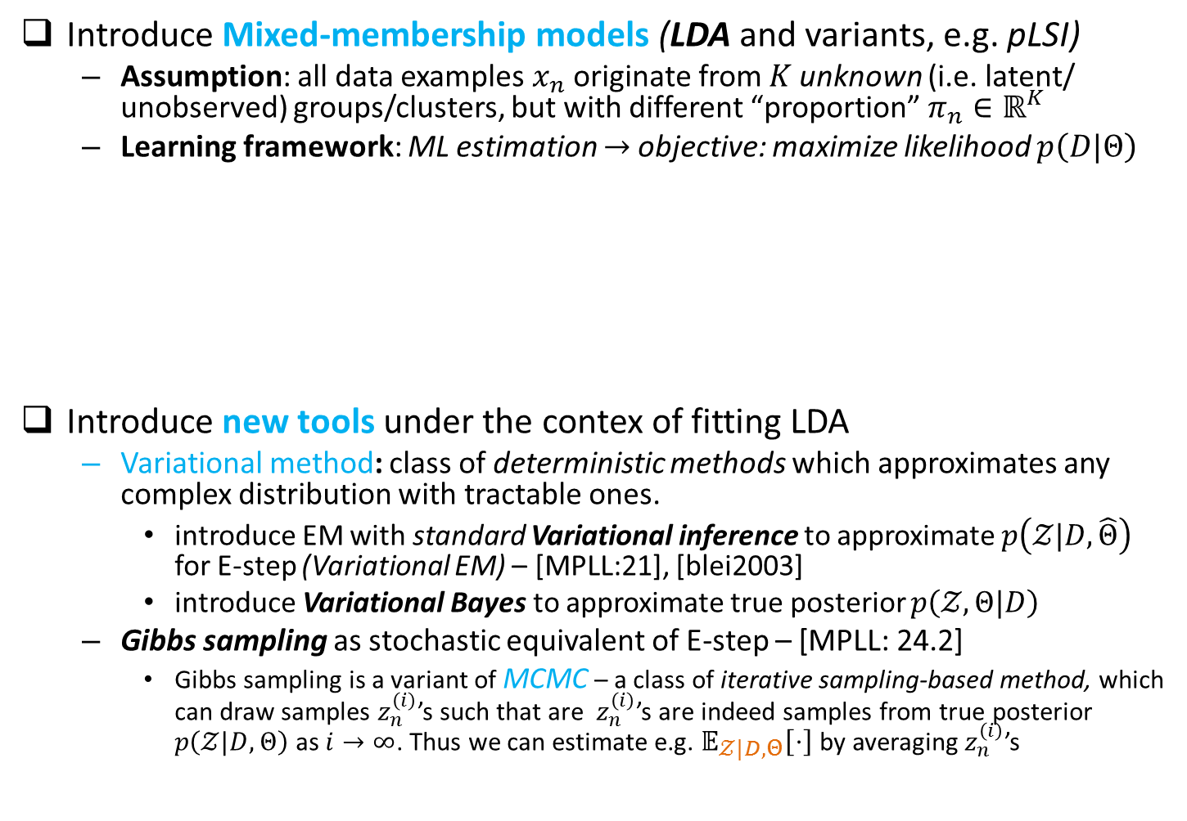







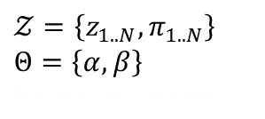

Course 2 – Week 2-4
Introduce Mixed-membership models (LDA and variants, e.g. pLSI)
Assumption: all data examples $x_{n}$ originate from $K$unknown (i.e. latent/ unobserved) groups/clusters, but with different “proportion” $π_{n}∈ℝ^{K}$
Learning framework: ML estimation $→$ objective: maximize likelihood $p\left(D|Θ\right)$
Introduce new tools under the contex of fitting LDA
Variational method: class of deterministic methods which approximates any complex distribution with tractable ones.
introduce EM with standard Variational inference to approximate $p\left(𝒵|D,\hat{Θ}\right)$ for E-step (Variational EM) – [MPLL:21], [blei2003]
introduce Variational Bayes to approximate true posterior $p\left(𝒵,Θ|D\right)$
Gibbs sampling as stochastic equivalent of E-step – [MPLL: 24.2]
Gibbs sampling is a variant of MCMC – a class of iterative sampling-based method, which can draw samples $z_{n}^{\left(i\right)}$’s such that are $z_{n}^{\left(i\right)}$’s are indeed samples from true posterior $p\left(𝒵|D,Θ\right)$ as $i→∞$. Thus we can estimate e.g. $𝔼_{𝒵|D,Θ}\left[⋅\right]$ by averaging $z_{n}^{\left(i\right)}$’s
$$\boxed{β}$$
$β$
$x_{n}$
$z_{n}$
Each $x_{n}$ is an L-dimensional vector
$$𝒵=\left\{z_{1..N},π_{1..N}\right\}$$
$Θ=\left\{α, β\right\}$
hyperparam $→$ param
$π_{n}$
$$\boxed{α}$$
$$π_{n}$$
e.g. a document rerpesented by LDA
Notes:
(*) Language models:
@doc-level: model word sequence $p\left(w_{1},w_{2},…,w_{T}\right)$
@corpus-level: model collection of docs $p\left(x_{1},x_{2},…,x_{N}\right)$
An evaluation metric for assessment of language model: Perplexity

Slide 21
By the end of course 2, you should reckon that …

Slide 22
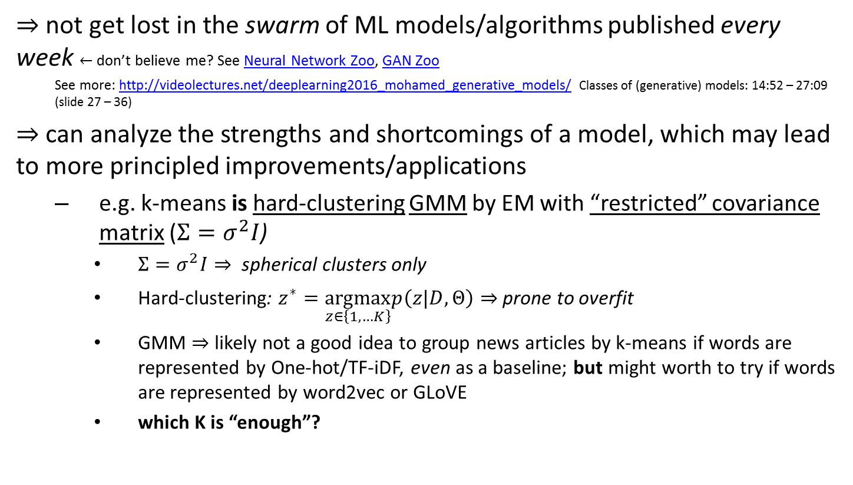
… many ML algorithms can be derived from a class of probabilistic models
$⇒$ not get lost in the swarm of ML models/algorithms published every week $←$ don’t believe me? See Neural Network Zoo, GAN Zoo
See more: http://videolectures.net/deeplearning2016_mohamed_generative_models/ Classes of (generative) models: 14:52 – 27:09 (slide 27 – 36)
$⇒$ can analyze the strengths and shortcomings of a model, which may lead to more principled improvements/applications
e.g. k-means is hard-clustering GMM by EM with “restricted” covariance matrix ($Σ=σ^{2}I$)
$Σ=σ^{2}I⇒$ spherical clusters only
Hard-clustering: $z^{∗}=\underset{z∈\left\{1,…K\right\}}{\text{argmax}}p\left(z|D,Θ\right)⇒$ prone to overfit
GMM $⇒$ likely not a good idea to group news articles by k-means if words are represented by One-hot/TF-iDF, even as a baseline; but might worth to try if words are represented by word2vec or GLoVE
which K is “enough”?

Slide 23

… Models and “Tools” are modular
A Model can be trained by different “Tools” (algorithms used for fitting models); and a “Tool” can fit different Models
e.g. choosing hyperparameter $K$ in a Mixture model [MPLL:11.5]
Cross-validation $←$ slow, because search space for K is $ℕ$
Maximize the evidence i.e. ML-type 2
approximation by BIC term, or Variational Bayes [MPLL:21.6.1.6]
MCMC sampling on model space $←$ might not be slower than CV
Side-note: for a more relaxed restriction on prior knowledge about K (e.g. search space), see Dirichlet Process Mixture Model, which put non-parametric prior over K [MPLL:25.2]
See more: http://videolectures.net/deeplearning2016_mohamed_generative_models/ List of “Tools” (14:15 - slide 24) + Variational EM with SGD, which allow LVM + DNN marriage (41:28–47:00 – slide 48-52), applied in VAE i.e. LVM-level1 i.e. (roughly) “Mixture model on steroid” (Part V – 54:19-end – slide 57-end)

Slide 24

… All tasks in ML are about
Learning task: find parameters $Θ$ to materialize a model design
Model design: Model = Structure + Learning Framework
Inference tasks: estimate hidden causes $𝒵$; the unobserved data $𝒳_{\text{new}}$ or missing label $𝒴_{m}$; and/or action $𝒜$ (e.g. prediction $𝒴_{\text{new}}$)
Learning and Inference tasks can be tightly coupled while fitting the models, as we have seen with EM

