Slide 2


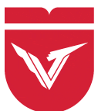








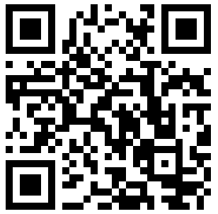

2026 School on Quantum Optimization Algorithms (SQOA)
2026 School on
Quantum Optimization Algorithms
22 – 25/4
University of Phan Thiet, Phu Thuy, Lam Dong
The School on Quantum Optimization Algorithms (SQOA) 2026 is a specialized program for undergraduate and graduate students interested in quantum optimization algorithms. The course provides a theoretical foundation, the latest results, and the implementation of quantum optimization algorithms through hands-on projects.
The School on Quantum Optimization Algorithms (SQOA) 2026 is a specialized program for undergraduate and graduate students interested in quantum optimization algorithms. The course provides a theoretical foundation, the latest results, and the implementation of quantum optimization algorithms through hands-on projects.
Date 1:
Foundation for quantum computing
Date 2:
Basic quantum computing
Date 3:
Project: Q-optimization
22 – 25/4
University of Phan Thiet, Phu Thuy, Lam Dong
Scientific Advisors
Lecturer
Date 1:
Foundation for quantum computing
Date 2:
Basic quantum computing
Date 3:
Project: Q-optimization
Prof. Nguyen Minh Tho, VinUni
Prof. Le Van Hoang, HCMUE
Assist.Prof. Le Bin Ho, Tohoku Univ
Dr. Nguyen Van Duy, Phenikaa Univ
Dr. Huynh Minh Trung, US-VNUHCM
Dr. Vu Tuan Hai, UIT-VNUHCM
MA. Nguyen Quoc Chuong, DTU
Scientific Advisors
Prof. Nguyen Minh Tho, VinUni
Prof. Le Van Hoang, HCMUE
Organizing Committee
Dr. Tran Nguyen Lan, US-VNUHCM
Dr. Nguyen Minh Tam, UPT
Msc. Truong Đuc Toan, VLU
Organizing Committee
Dr. Tran Nguyen Lan, US-VNUHCM
Dr. Nguyen Minh Tam, UPT
Msc. Truong Đuc Toan, VLU
Email: quantum.vnuhcm@gmail.com
Registration deadline: 31/03/2026
Lecturer
Assist.Prof. Le Bin Ho, Tohoku Univ
Dr. Nguyen Van Duy, Phenikaa Univ
Dr. Huynh Minh Trung, US-VNUHCM
Dr. Vu Tuan Hai, UIT-VNUHCM
MA. Nguyen Quoc Chuong, DTU
Email: quantum.vnuhcm@gmail.com
Registration deadline: 31/03/2026

