Slide 1

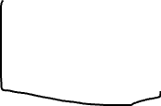


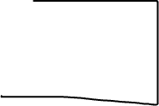
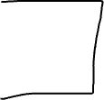

Slide 2
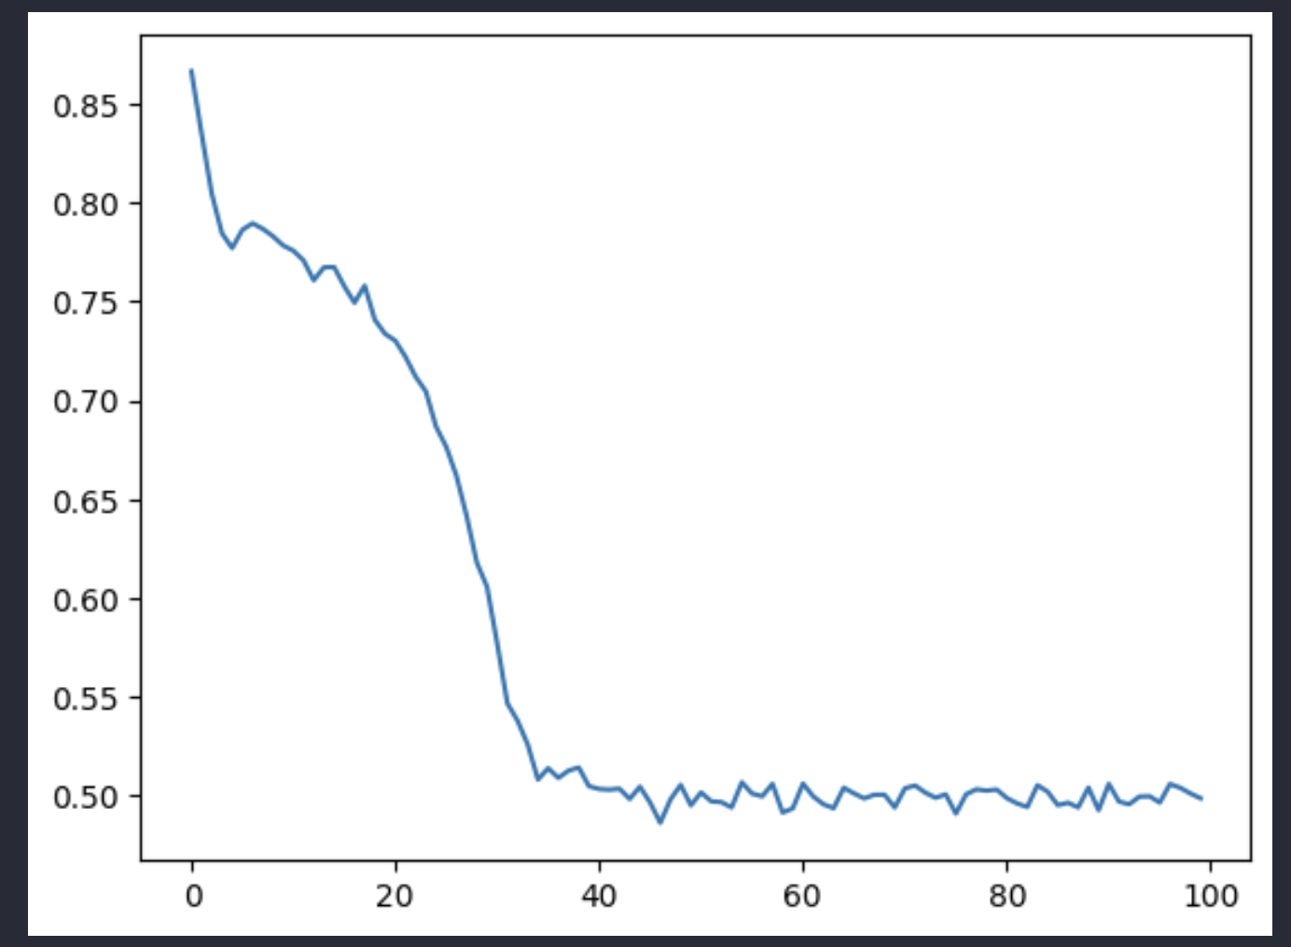
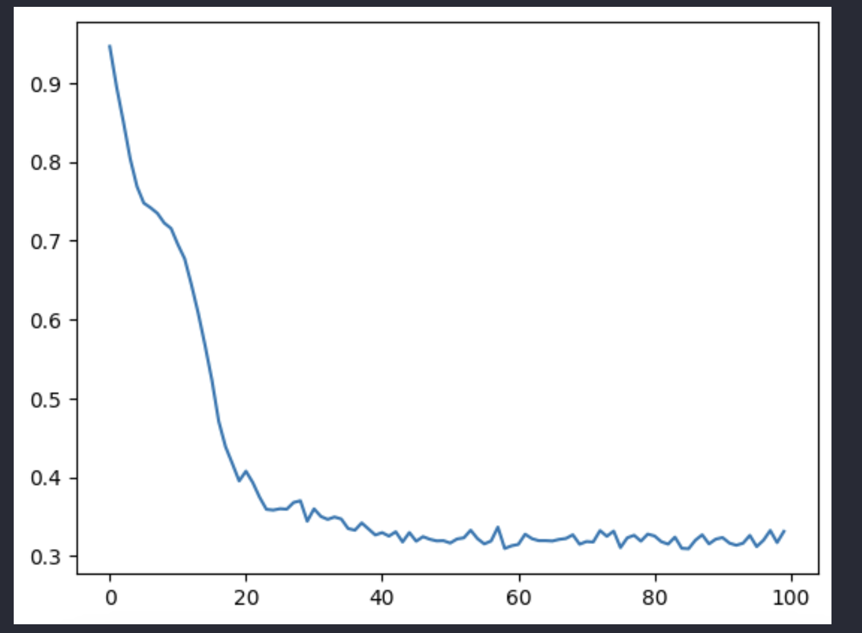
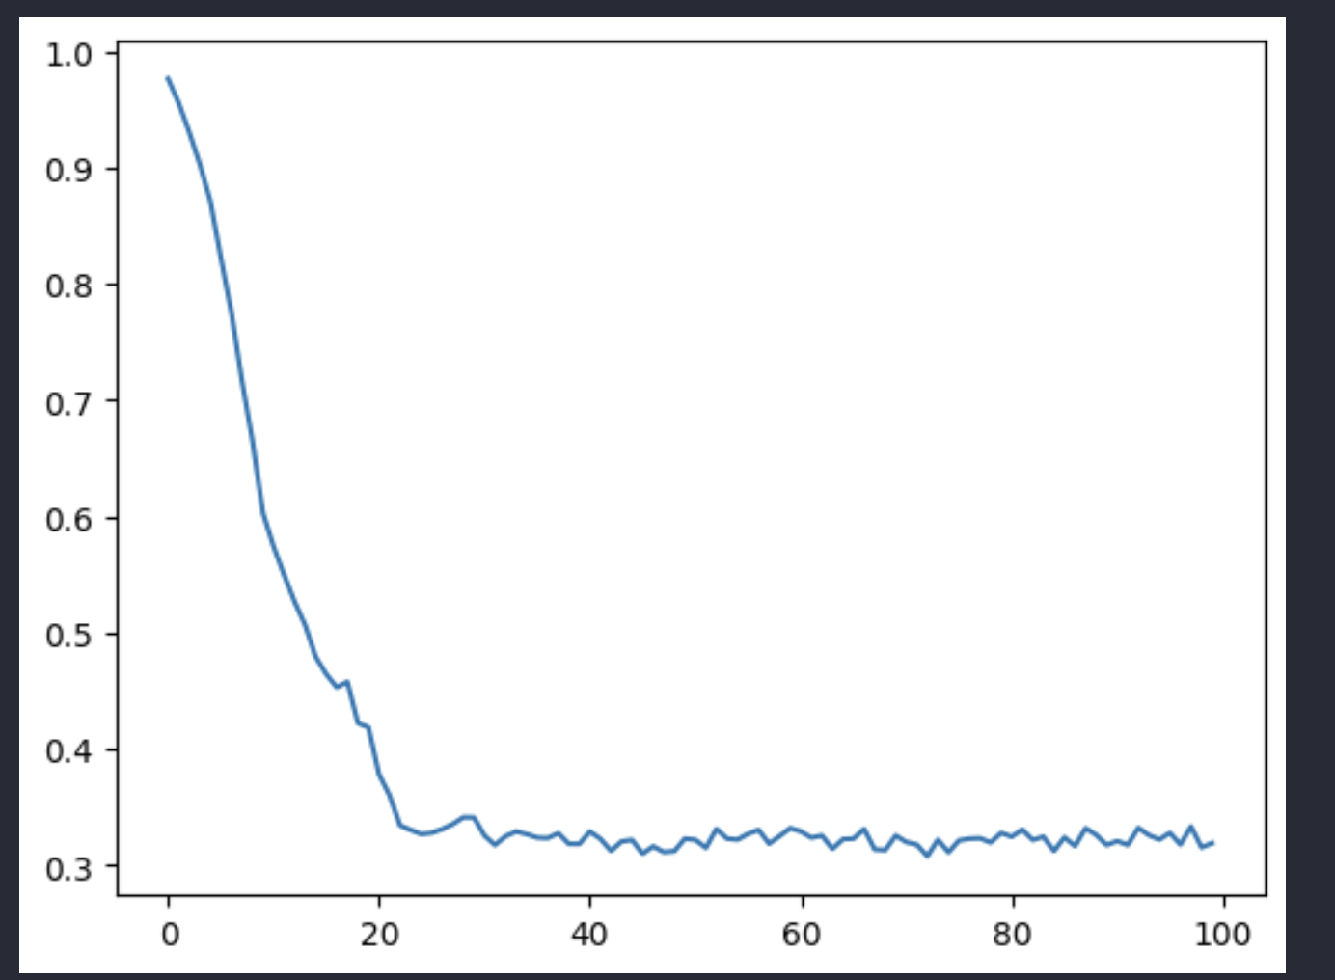
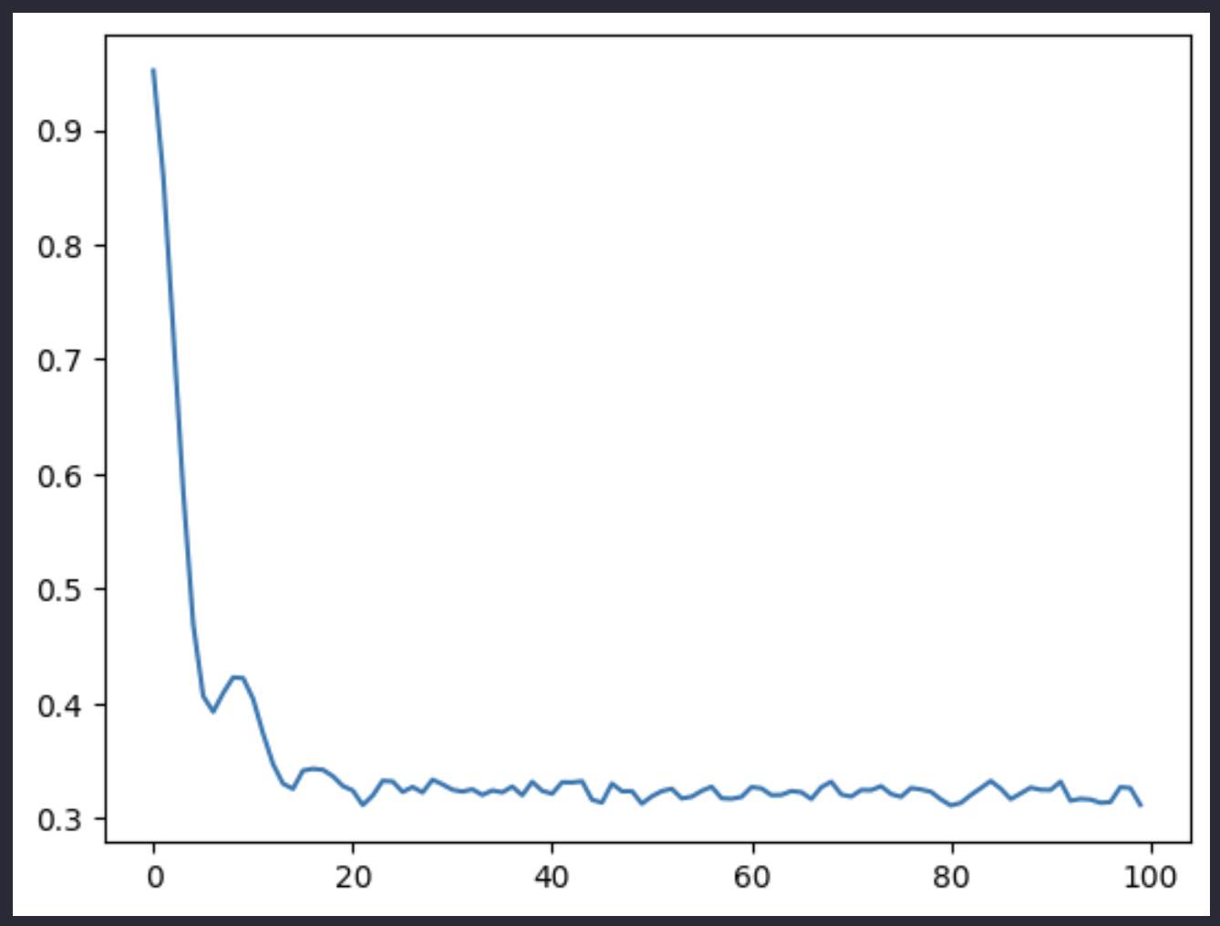
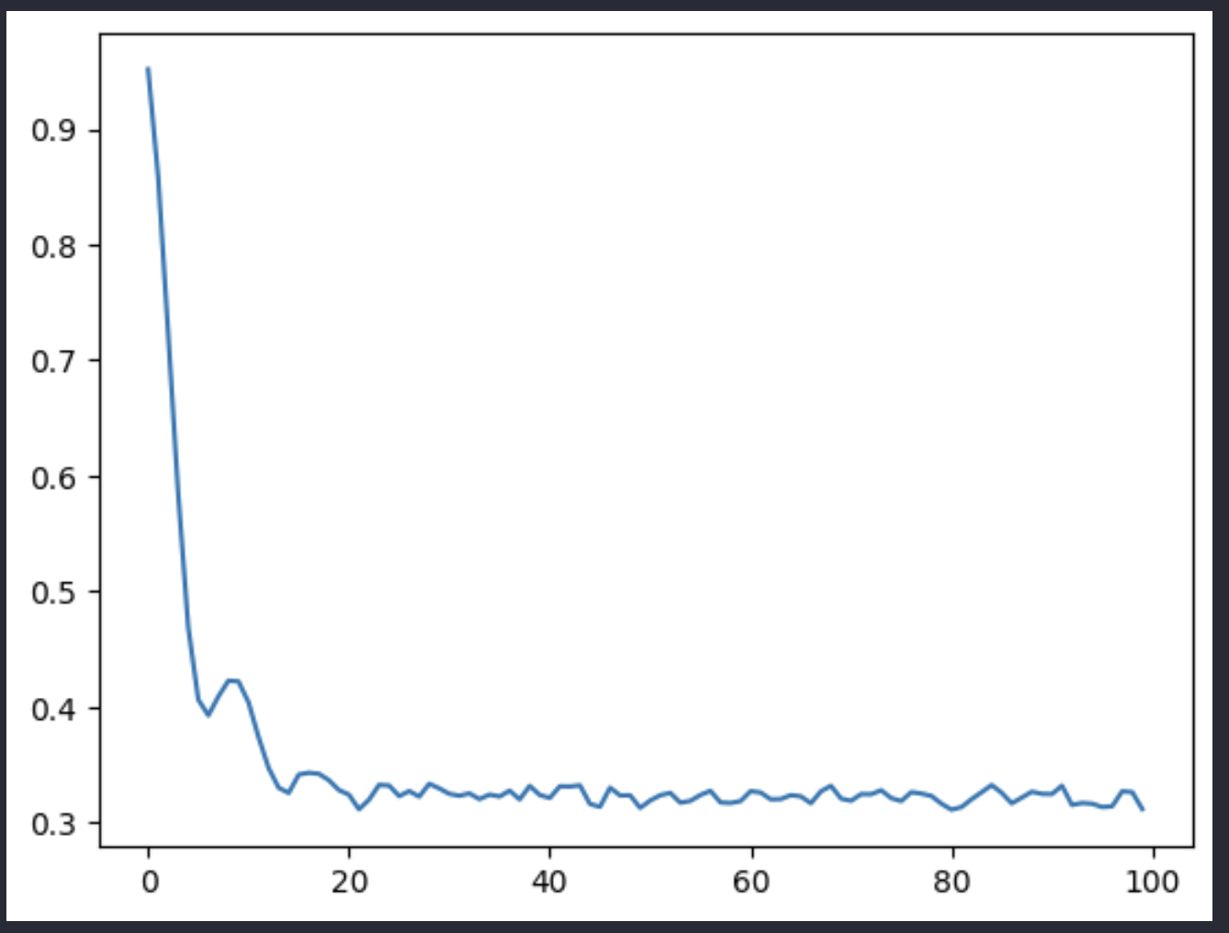
1 layer
2 layers
Polygon_graph
hyper_graph

Slide 3

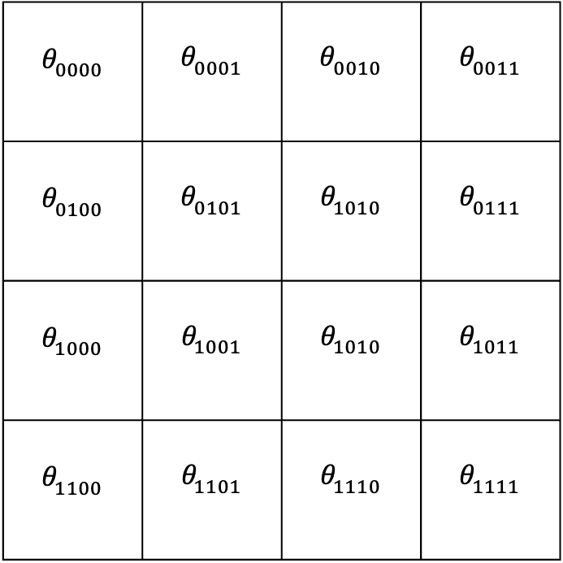


$$O$$
$$x$$
$$θ_{0000}$$ | $$θ_{0001}$$ | $$θ_{0010}$$ | $$θ_{0011}$$
$$θ_{0100}$$ | $$θ_{0101}$$ | $$θ_{1010}$$ | $$θ_{0111}$$
$$θ_{1000}$$ | $$θ_{1001}$$ | $$θ_{1010}$$ | $$θ_{1011}$$
$$θ_{1100}$$ | $$θ_{1101}$$ | $$θ_{1110}$$ | $$θ_{1111}$$
$$y$$

Slide 4
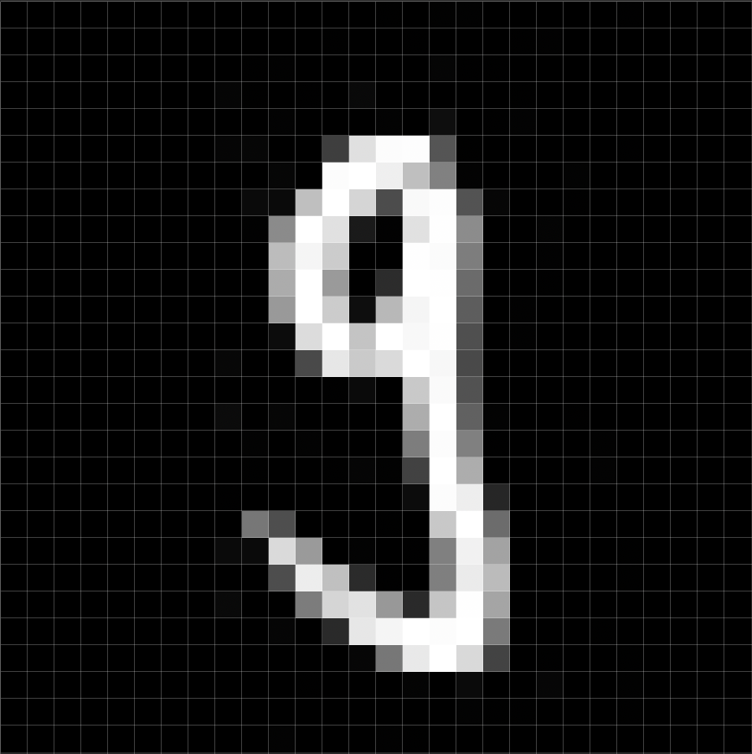





a) Training
b) Testing
Label $y$
Extractor
Extractor
Feature vector
Feature vector
$$f\left(θ,w\right)$$
$$f\left(θ^{∗},w^{∗}\right)$$
Label $y′$
Predicted label
Update
Comparator
$$L\left(y^{′},y\right)$$

Slide 5





a) Training
b) Testing
Label $y$
Extractor
Extractor
Feature vector
Feature vector
$$f\left(θ,w\right)$$
$$f\left(θ^{∗},w^{∗}\right)$$
Label $y′$
Predicted label
Update
Comparator
$$L\left(y^{′},y\right)$$

Slide 6







I
$$Y$$
$$R_{Z}\left(θ\right)$$
$$Z$$
$$R_{Y}\left(θ\right)$$
$$H$$
$$R_{X}\left(θ\right)$$
$$X$$

Slide 7



Patch image
$$U_{3}(θ)$$
Amplitude
Encoding
$$U_{2}(θ)$$
Flatten
Measure
$$U_{1}(θ)$$
Input: image
Quanvolutional filter
Output: feature maps

Slide 8






Patch image
$$U_{3}(θ)$$
Amplitude
Encoding
$$U_{2}(θ)$$
Flatten
Measure
$$U_{1}(θ)$$
Encoder $ℰ$
Circuit $𝒰$
Decoder $𝒟$
Input: image
Quanvolutional filter
Output: feature maps

Slide 9






Patch image
Dense
$$U(2)(θ)$$
$$U\left(1\right)(θ)$$
Dense
Flatten
Amplitude
Encoding
Measure
$$U\left(0\right)(θ)$$
1024
10
Encoder $U_{φ}$
Circuit $U\left(θ\right)$
Decoder $𝒟$
Dense
Input: image
Quanvolutional filter
Feature maps

Slide 10









$$U(2)(θ)$$
Encode
$$U\left(1\right)(θ)$$
Flatten
Measure
$$U\left(0\right)(θ)$$
Feature maps $h × w × k$
Replace
$$n$$
Funccly $n$ connected layer
Encoder $U_{φ}$
Circuit $U\left(θ\right)$
Decoder $𝒟$
Patch image
Quanvolutional filter
Convolutional
Max pooling
Convolutional
Max pooling
1024
10
Input: image
Convolutional filter
Output: label

Slide 11





$$U_{3}(θ)$$
(a)
Amplitude
Encoding
$$U_{2} (θ)$$
Patch image
Flatten
Measure
$$U_{1} (θ)$$
1024
10
Dense
Encoder $U_{φ}$
Circuit $U\left(θ\right)$
Decoder $𝒟$
Dense
Quanvolutional filter
Feature maps
(b)
Input: image
1024
10
Convo
-lutional
Max pooling
Convo
-lutional
Max pooling
Dense
Dense
Feature maps

Slide 12





















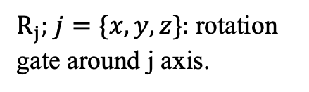









Odd layer
Even layer
$$R_{Y}$$
$$R_{Y}$$
$$R_{Y}$$
$$R_{Y}$$
$$R_{Y}$$
$$R_{Y}$$
$$R_{Y}$$
$$R_{Y}$$
$$R_{Y}$$
$$R_{Y}$$
$$R_{Y}$$
$$R_{Y}$$
$$R_{Y}$$
$$a) W_{chain}$$
$${b) W}_{alternating}$$
$${c) W}_{all−to−all}$$
$$R_{Y}$$
$$W_{i}$$
$$R_{X}$$
$$R_{Z}$$
$R_{j};$ $j=\{x,y,z\}:$rotation gate around j axis.
$$R_{Y}$$
$$R_{X}$$
$$R_{Z}$$
$$R_{Y}$$
$$R_{X}$$
$$R_{Z}$$
$L$: number of layer
$$R_{X}$$
$$R_{Z}$$
$L$ times
d) Graph-Star
$L$ times

Slide 13











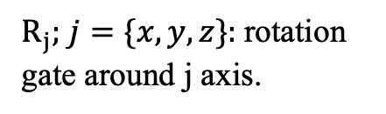



Odd layer
Even layer
$$R_{Y}$$
$$R_{Y}$$
$$R_{Y}$$
$$R_{Y}$$
$$R_{Y}$$
$$R_{Y}$$
$$R_{Y}$$
$$R_{Y}$$
$$R_{Y}$$
$$R_{Y}$$
$$R_{Y}$$
$$R_{Y}$$
$$R_{Y}$$
$$e) W_{chain}$$
$${f) W}_{alternating}$$
$${g) W}_{all−to−all}$$
$$W_{i}$$
$$R_{X}$$
$$R_{Z}$$
$R_{j};$ $j=\{x,y,z\}:$rotation gate around j axis.
$$R_{X}$$
$$R_{Z}$$
$$R_{X}$$
$$R_{Z}$$
$L$: number of layer
$$R_{X}$$
$$R_{Z}$$
$L$ times

Slide 14




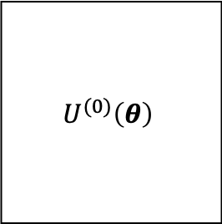

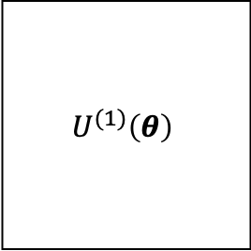




$$R_{Y}\left(θ_{0,0}^{\left(0\right)}\right)$$
c)
$$R_{Y}\left(θ_{0,1}^{\left(0\right)}\right)$$
$$R_{Y}\left(θ_{0,2}^{\left(0\right)}\right)$$
$$U_{0}^{(0)}\left(θ_{0}^{(0)}\right)$$
$$V_{0}^{(0)}$$
$$U_{L}^{(0)}\left(θ_{L}^{(0)}\right)$$
$$V_{L}^{(0)}$$
b)
$$…$$
$$U^{(0)}\left(θ\right)$$
$$U^{(1)}\left(θ\right)$$
a)
$$…$$

Slide 15



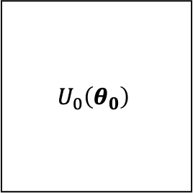

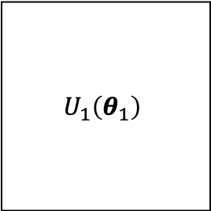




$$U_{0}\left(θ_{0}\right)$$
$$U_{1}\left(θ_{1}\right)$$
a)
$$U_{1,0}\left(θ_{1,0}\right)$$
$$V_{1,0}$$
$$U_{1,L}\left(θ_{1,L}\right)$$
$$V_{1,L}$$
b)
$$…$$
$$R_{Y}\left(θ\right)$$
c)
$$R_{Y}\left(θ\right)$$
$$R_{Y}\left(θ\right)$$

Slide 16


(a)
(b)
(c)
Image
Image
Image
Conv₁
MaxPool₁
Quanvolutional filter
$1^{st}$ block
Conv₂
MaxPool₂
FC₁
FC₂
$2^{nd}$ block
Output

Slide 17
a)
b)
c)
Image
Image
Image
Conv₁
Quanvolutional filter
MaxPool₁
Khối 1
Conv₂
MaxPool₂
FC₁
FC₂
Khối 2
Output

Slide 18






















$$R_{Y}$$
$$R_{Y}$$
$$R_{Y}$$
$$R_{Y}$$
$$R_{Y}$$
(a)
$$R_{Y}$$
(b)
(c)
$$R_{Y}$$
$$R_{Y}$$
$$R_{Y}$$
$$R_{Y}$$
$$R_{Y}$$
$$R_{Y}$$
$$R_{Y}$$
$$R_{Y}$$
$$R_{Y}$$
(d)
$$R_{Y}$$
$$R_{Y}$$
$$R_{Y}$$
$$R_{Y}$$
$$R_{Y}$$
$$R_{Y}$$
$$R_{Y}$$

Slide 19












$$R_{Y}$$
$$R_{Y}$$
$$R_{Y}$$
$$R_{Y}$$
$$R_{Y}$$
$$R_{Y}$$
$$R_{Y}$$
$$R_{Y}$$
$$R_{Y}$$
$$R_{Y}$$
a) Graph-star
b) Nearest neighboor
c) Ring
$$R_{Y}$$
$$R_{Y}$$
$$R_{Y}$$
$$R_{Y}$$
$$R_{Y}$$
$$R_{Y}$$
$$R_{Y}$$
$$R_{Y}$$
$$R_{Y}$$
$$R_{Y}$$
$$R_{Y}$$
$$R_{Y}$$
d) All-to-all

Slide 20
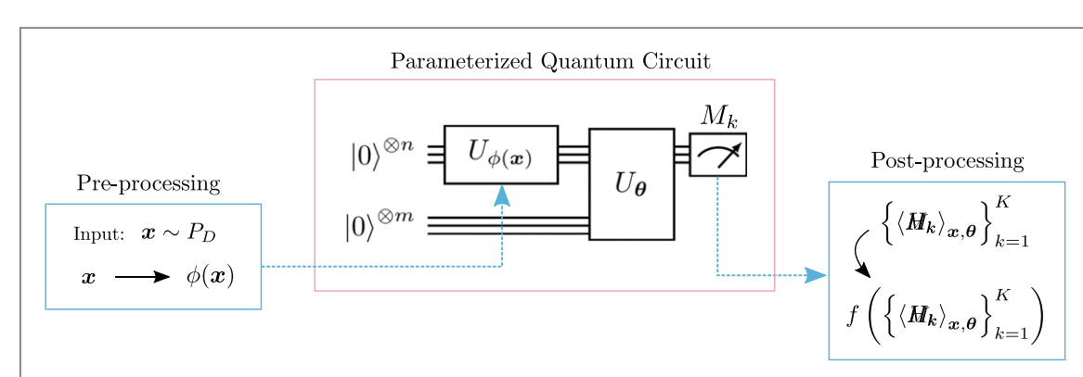







Parameterized quantum circuit
Ancilla qubits
$${\left|0\right\rangle }^{⊗m}$$
$$U\left(θ\right)$$
$$\left\{M_{i}\right\}$$
$${\left|0\right\rangle }^{⊗n}$$
$${ U}_{φ}$$
Initial qubits
Encode
Output: $f\left(\left\{{\left\langle M\right\rangle }_{x,θ}\right\}\right)$
Input: $x$

Slide 21


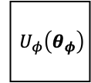


Ancilla qubits
$$\left\{M_{i}\right\}$$
$${\left|0\right\rangle }^{⊗m}$$
$$U\left(θ\right)$$
Initial qubits
$${ U}_{φ}\left(θ_{φ}\right)$$
$${\left|0\right\rangle }^{⊗n}$$
Encode
Output: $f\left(\left\{{\left\langle M\right\rangle }_{x,θ}\right\}\right)$
Input: $x$

Slide 22



Quantum computer
Parameterized quantum circuit
$$θ^{t+1}$$
Classical computer
Pre-processing
Optimizer
Post-processing
Input: $x$
Output: $f\left(\left\{{\left\langle H\right\rangle }_{x,θ}\right\}\right)$

Slide 23



Parameterized quantum circuit
Quantum computer
New parameter: $θ^{t+1}$
Pre-processing
Optimizer
Post-processing
Classical computer
Input: $x$
Output: $f\left(\left\{{\left\langle H\right\rangle }_{x,θ}\right\}\right)$

Slide 24
