Slide 1
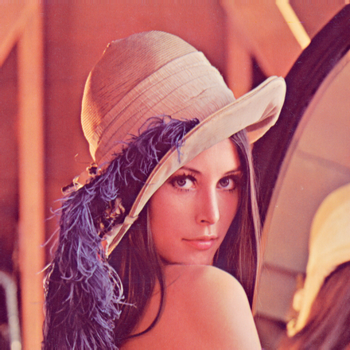




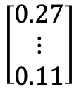



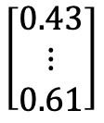
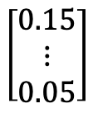


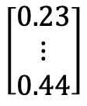




$$\left[\begin{matrix}0.43 \\ ⋮ \\ 0.61\end{matrix}\right]$$
$$\left[\begin{matrix}0.27 \\ ⋮ \\ 0.11\end{matrix}\right]$$
$$\left[\begin{matrix}0.23 \\ ⋮ \\ 0.44\end{matrix}\right]$$
$$\left[\begin{matrix}0.15 \\ ⋮ \\ 0.05\end{matrix}\right]$$
$$⋯$$
$$⋯$$
$$Divide(image, k)$$
$$Vec(block)$$
Vectors
$$Norm(vector)$$
Quantum states
$$QSP(U)$$
Image $x$
Blocks
$$Reconstruct(blocks)$$
$$s=\left[s_{0},s_{1},…s_{\left|blocks\right|}\right]$$
Scale factors
Blocks
Vectors
Quantum states
$$Reshape(vector, k)$$
$$Scale(state, s)$$
$$U$$
$$Θ=\left[θ_{0},θ_{1},…θ_{\left|blocks\right|}\right]$$
Parameters
Compressed image

Slide 2
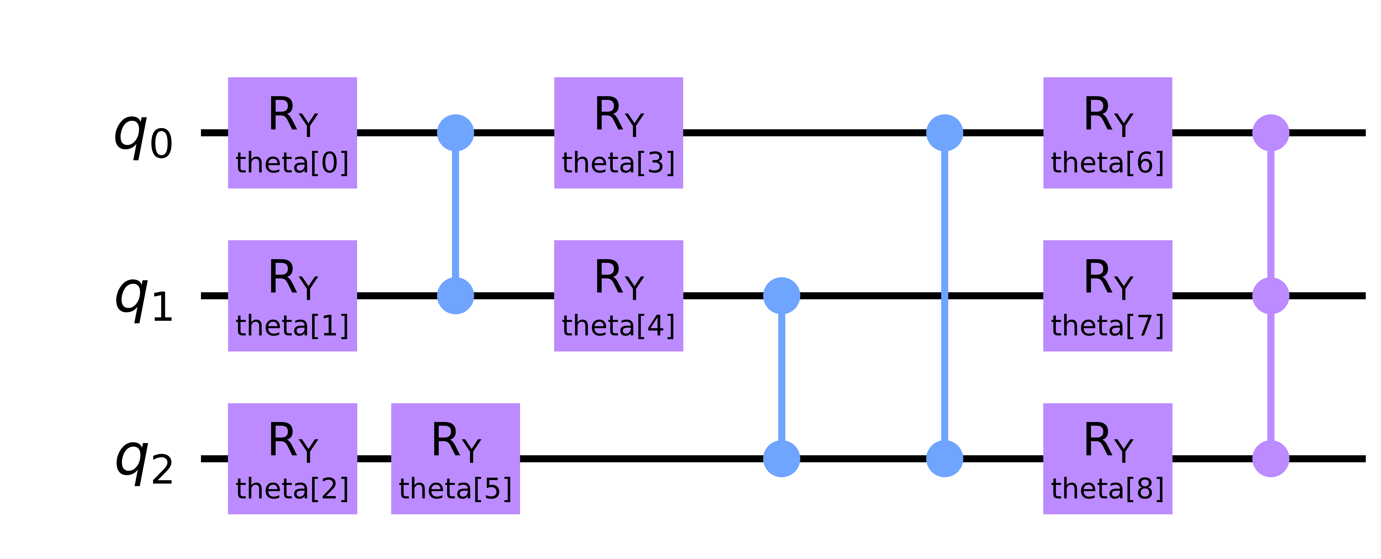
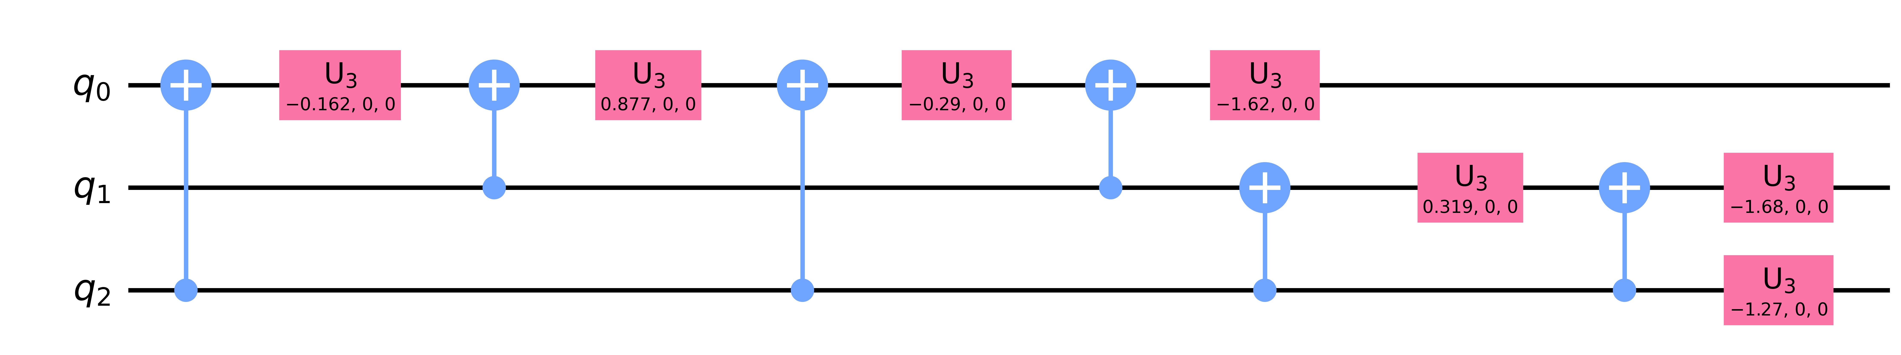










$$U\left(θ\right)$$
$$|g_{2}⟩$$
$$|g_{n}⟩$$
$θ^{t+1}=Optimizer(θ^{t},∇_{θ}C\left(θ\right))$
$$Optimizer$$
$$|0^{⊗n}⟩$$
Cost value $C\left(θ\right)$
Cost function
$$V^{†}$$
$$p_{0}$$
$$Measurement$$
Quantum computer
Classical computer

