Slide 1





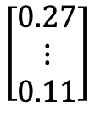



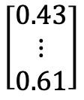
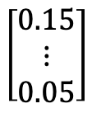


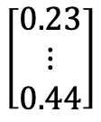




$$\left[\begin{matrix}0.43 \\ ⋮ \\ 0.61\end{matrix}\right]$$
$$\left[\begin{matrix}0.27 \\ ⋮ \\ 0.11\end{matrix}\right]$$
$$\left[\begin{matrix}0.23 \\ ⋮ \\ 0.44\end{matrix}\right]$$
$$\left[\begin{matrix}0.15 \\ ⋮ \\ 0.05\end{matrix}\right]$$
$$⋯$$
$$⋯$$
$$Divide(image, k)$$
$$Vec(block)$$
Vectors
$$Norm(vector)$$
Quantum states
$$QSP(U)$$
Image $x$
Blocks
$$Reconstruct(blocks)$$
$$s=\left[s_{0},s_{1},…s_{\left|blocks\right|}\right]$$
Scale factors
Blocks
Vectors
Quantum states
$$Reshape(vector, k)$$
$$Scale(state, s)$$
$$U$$
$$Θ=\left[θ_{0},θ_{1},…θ_{\left|blocks\right|}\right]$$
Parameters
Compressed image

Slide 2
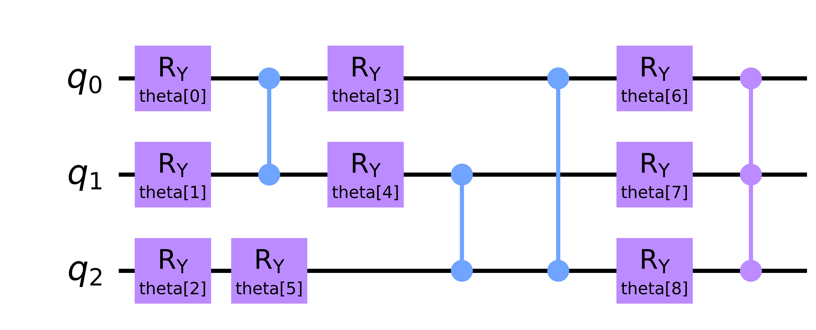
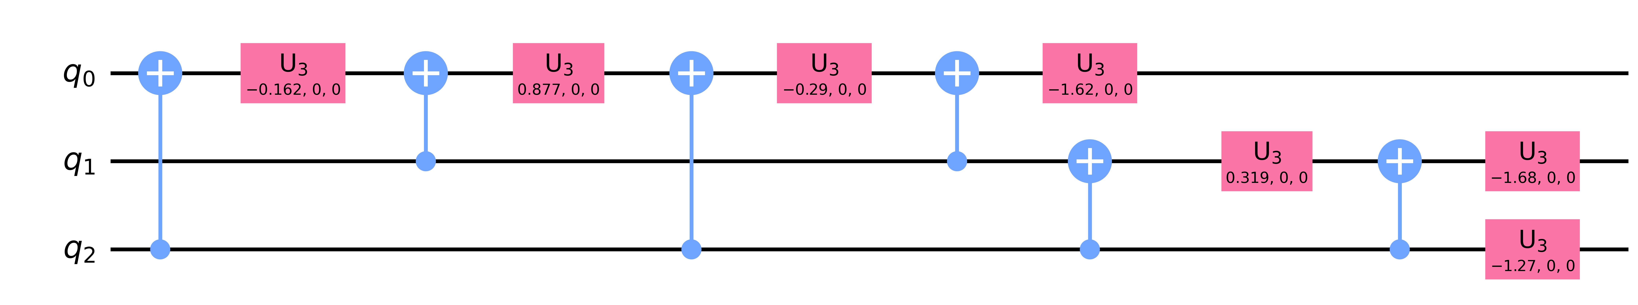










$$U\left(θ\right)$$
$$|g_{2}⟩$$
$$|g_{n}⟩$$
$θ^{t+1}=Optimizer(θ^{t},∇_{θ}C\left(θ\right))$
$$Optimizer$$
$$|0^{⊗n}⟩$$
Cost value $C\left(θ\right)$
Cost function
$$V^{†}$$
$$p_{0}$$
$$Measurement$$
Quantum computer
Classical computer

Slide 3



































$$N$$
$$M$$
$${\text{multi}\text{−}\text{c}\text{ompilation} }_{U}\left(…\right)$$
$$\left\{θ^{∗}\right\}$$
End
Begin
divide($k$)
loop
[for $\left(i,j\right)$ in suffer$(\left\{\left(1,1\right),\left(1,2\right),…,(N,M)\right\})$]
(a)
get($i,j$)
$${|ψ⟩}_{i,j}$$
getNeighbor($i,j\text{,}\text{R}$)
$${\left\{ℬ\right\}}_{i,j}$$
$${\left\{θ\right\}}_{i,j}$$
$$ℐ$$
$$ℬ$$
$${\left\{θ^{∗}\right\}}_{i,j}$$
${\text{compilation}}_{U}$(${argmin}_{θ}\left\{𝒞^{′}\right\},{|ψ⟩}_{i,j}$)
$${\left\{θ\right\}}_{i,j}≠∅$$
Begin
$$|0⟩$$
$$U\left(θ^{\left(t\right)}\right)$$
$$V^{†}\left(x\right)$$
Measurement
(b)
$p_{0}$
${argmin}_{θ}\left\{𝒞^{′}\right\}$
loop
[for each $θ$ in ${\left\{θ\right\}}_{i,j}$]
$$𝒞\left(θ,x\right)$$
$$𝒞^{′}\left(…\right)$$
${\tilde{𝔈}}_{θ_{x}→θ_{y}}\left(θ\right)$
$$θ$$
(c)
$$×$$
$${ R}_{x}−R_{y}−R_{z}$$
$$θ^{′}$$
AdamOpt$(…)$
$$𝒞\left(θ,x\right)<τ$$
$$min\left(\left\{𝒞′\right\}\right)<τ$$
$$×$$
$${ R}_{x}−R_{y}−R_{z}$$
True
False
$$×$$
$${ R}_{x}−R_{y}−R_{z}$$
End
$$θ^{∗}$$
$$× L$$

Slide 4






Compress flow
divide($k$)
vec()
norm()
compilation()
$$ℐ$$
reshape($k$)
scale($s$)
substitute($U\left(θ^{∗}\right)$)
$$\left\{{s,θ}^{∗}\right\}$$
Decompress flow

