Slide 1
A Fast Quantum Image Compression Algorithm based on Taylor Expansion
Vu Tuan Hai [1], Huynh Ho Thi Mong Trinh [2,3], Pham Hoai Luan [2,3]
[1] Nara Institute of Science and Technology, 8916–5 Takayama-cho, Ikoma, Nara 630-0192, Japan.
[2] University of Information Technology, Vietnam.
[3] Vietnam National University, Ho Chi Minh City, Vietnam.
Notes:
Ứng dụng: nén ảnh có mất mát
Khác biệt so với cổ điển như JPEG: JPEG có tỉ suất nén cổ định, quantum có tỉ suất nén dựa vào tham số k
Chạy được ko: mô phỏng cx được nhưng lâu (k càng lớn thì chạy càng lâu), có máy thiệt thì chạy nhanh hơn
Kết quả mất mát như thế nào: như slide experiments,
PP này có gì mới: khi chia ảnh thành các block để nén từng block, các block gần nhau có thể giống nhau, do đó có thể giảm bớt thời gian chạy cho 1 block đã có có block lân cận được nén bằng một estimator
Estimator được suy ra từ chuỗi TAYLOR bậc 1

Slide 2
Content
Introduction
Quantum image compression (QIC)
Using Taylor series as gradient estimator
Results
Conclusion

Slide 3
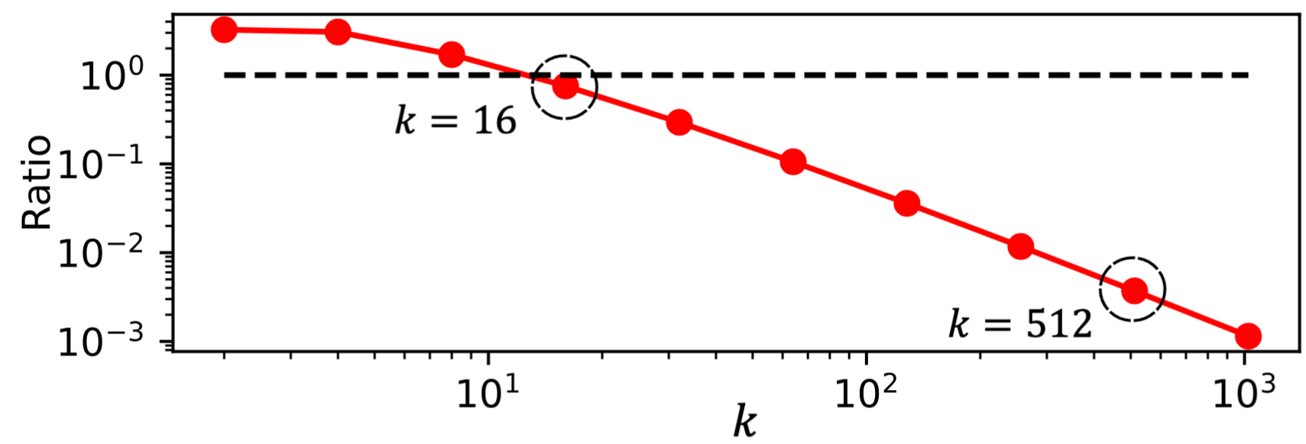
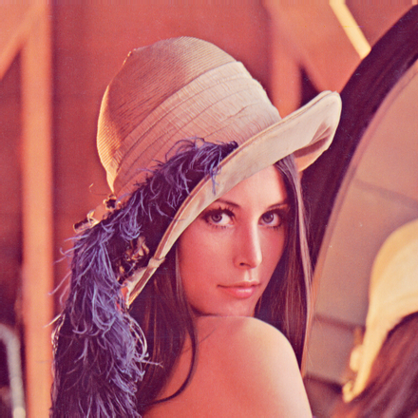







1. Intro
A digital image can be compressed by lossy/lossless compression algorithm
There are standard (classical) compressed format for image such as PNG and JPEG
Classical image compression | Quantum image compression
Trade-off between loss and compression ratio | Trade-off between loss and compression time
Fixed compression ratio | Changeable compression ratio by block size $k$
Fig 1. The ratio (data size) between compressed image and original image. The dotted line is ratio = 1.
Compress
Compress flow
Phases from parameterized gates
divide($k$)
vec()
norm()
compilation()
Decompress
$$ℐ$$
reshape($k$)
scale($s$)
substitute($U\left(θ^{∗}\right)$)
$$\left\{{s,θ}^{∗}\right\}$$
Fig 2. Quantum image compression flow
Decompress flow
Notes:
Compression is the wide technique that use for multiple media application. With the increasing demand for storing im- ages, traditional image compression methods face challenges in balancing the compressed size and image quality. However, the hybrid quantum-classical model can recover this weakness by using the advantage of qubits. In this study, we upgrade a quantum image compression algorithm within parameterized quantum circuits. Our approach encodes image data as unitary operator parameters and applies the quantum compilation algorithm to emulate the encryption process. By utilizing first-order Taylor expansion, we significantly reduce both the computational cost and loss, better than the previous version. Experi- mental results on benchmark images, including Lenna and Cameraman, show that our method achieves up to 86% reduction in the number of iterations while maintaining a lower compression loss, better for high-resolution images. The results confirm that the proposed algorithm provides an efficient and scalable image compression mechanism, making it a promising candidate for future image processing applications.

Slide 4


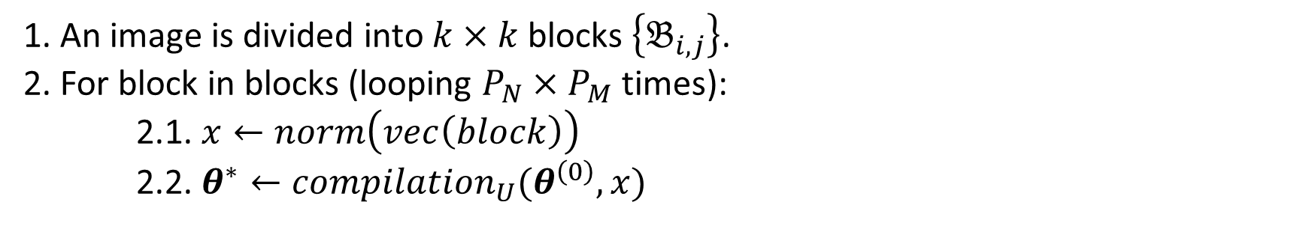






2. Quantum image compression (QIC)
$$N$$
$$M$$
divide($k$)
$${\text{multi}\text{−}\text{c}\text{ompilation} }_{U}\left(…\right)$$
$$\left\{θ^{∗}\right\}$$
Main idea: any $2^{n}$- dim vector can be encoded as $n$ – qubit state preparation circuit
$$ℐ$$
$$ℬ$$
1. An image is divided into $k×k$ blocks $\left\{𝔅_{i,j}\right\}$.
2. For block in blocks (looping $P_{N}×P_{M}$ times):
2.1. $x←norm\left(vec\left(block\right)\right)$
2.2. $θ^{∗}←{compilation}_{U}(θ^{\left(0\right)},x)$
Notes:
An image can be separated blocks, then each block can be vectorize, normalize (such as its norm = 1) into a normalized vector (quantum state)
A quantum state then can be prepared by some quantum state preparation algorithm. A n qubit circuit can encode 2^n – dim quantum state.
So the compressed image here will be the parameter in the quantum circuit, because the #qubit is logarithm scale based on image size, the size of compressed image also increase logarithmically.

Slide 5
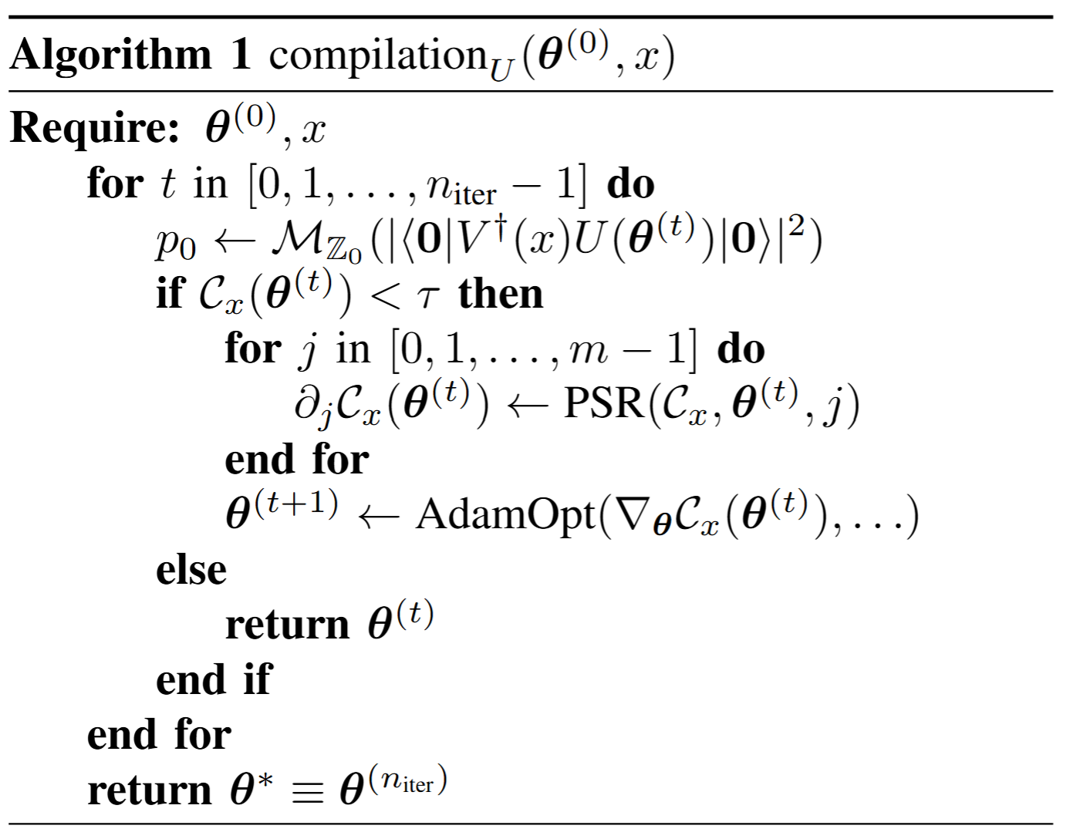
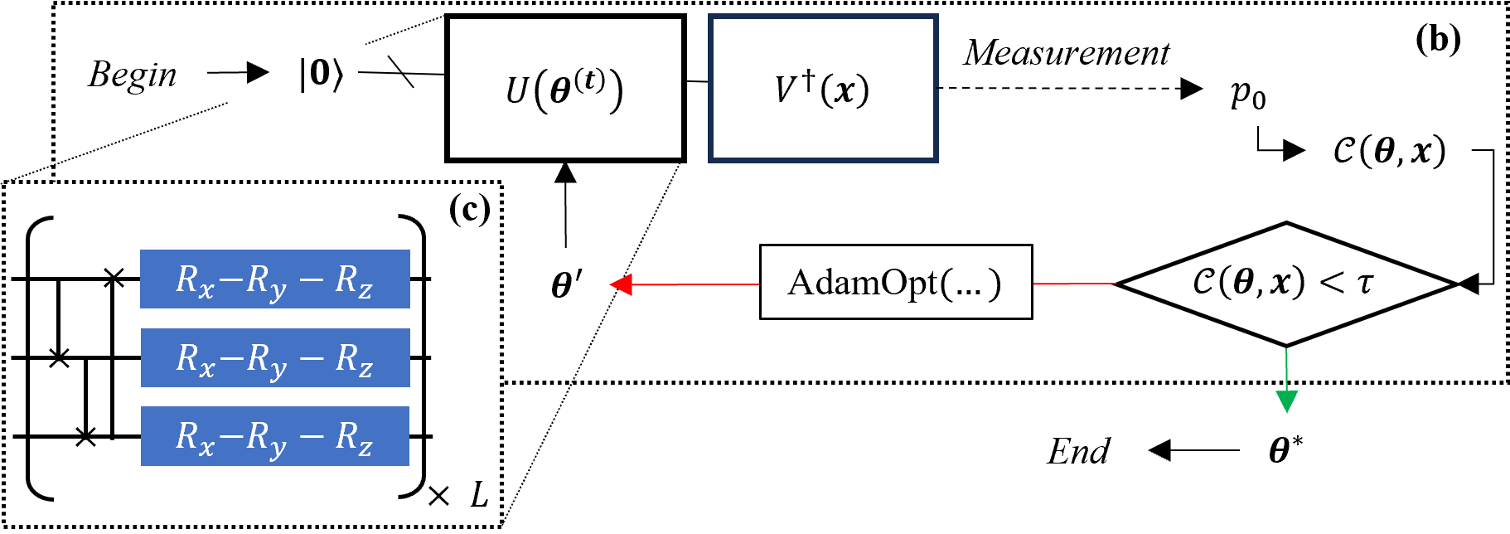
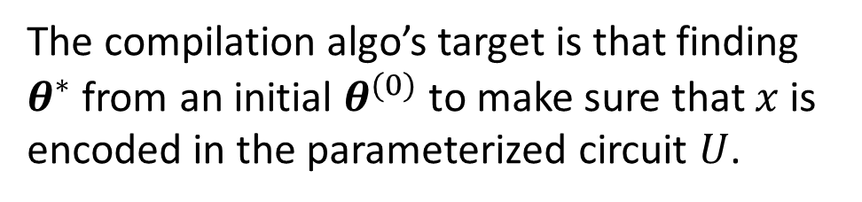
2.1. Compilation algorithm
The compilation algo’s target is that finding
$θ^{∗}$ from an initial $θ^{(0)}$ to make sure that $x$ is encoded in the parameterized circuit $U$.
Notes:
The compilation can be viewed as an optimization process, we found some optimal parameter theta for satisfy some cost function. The parameters are stored into the phase values of rotation (parameterized) gates.
This process repated in n iteration, and can be stop early if the loss less the some threshold t.
As the standard quantum optimization algorithm, this scheme is the hybrid one. The cost is measured from circuit, the gradient is calculated based on parameter-shift rule and the updated parameter is taken from classical computer.
The ansatz (quantum circuit structure) here can be any formulated ansatz, from layered type (XYZ on slide) to graph, chain, neightbor, … anything

Slide 6
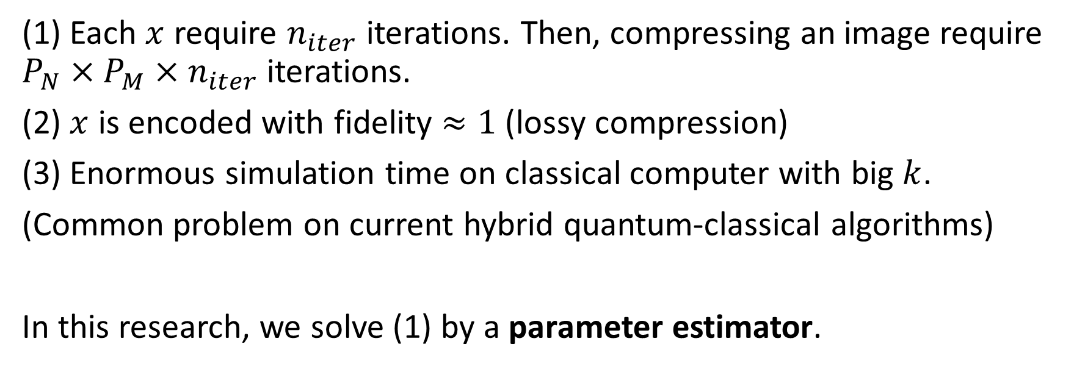
2.2. Drawback of quantum image compression algorithm
(1) Each $x$ require $n_{iter}$ iterations. Then, compressing an image require $P_{N}×P_{M}×n_{iter}$ iterations.
(2) $x$ is encoded with fidelity $≈1$ (lossy compression)
(3) Enormous simulation time on classical computer with big $k$.
(Common problem on current hybrid quantum-classical algorithms)
In this research, we solve (1) by a parameter estimator.
Notes:
There are some Drawback of quantum image compression algorithm based on compilation.
Quadratic scale following by image size
I would strongly said that this method is the lossy type. So it only suitable for application that require speed, not accuracy.
With the current generation of quantum, we actually don’t have the real one, so using simulation take a lot of time for experiment
We solve (1) by a parameter estimator, In general spending less #iteration for compressing process. It indirectly cover (3) by reducing the total simulation time.

Slide 7
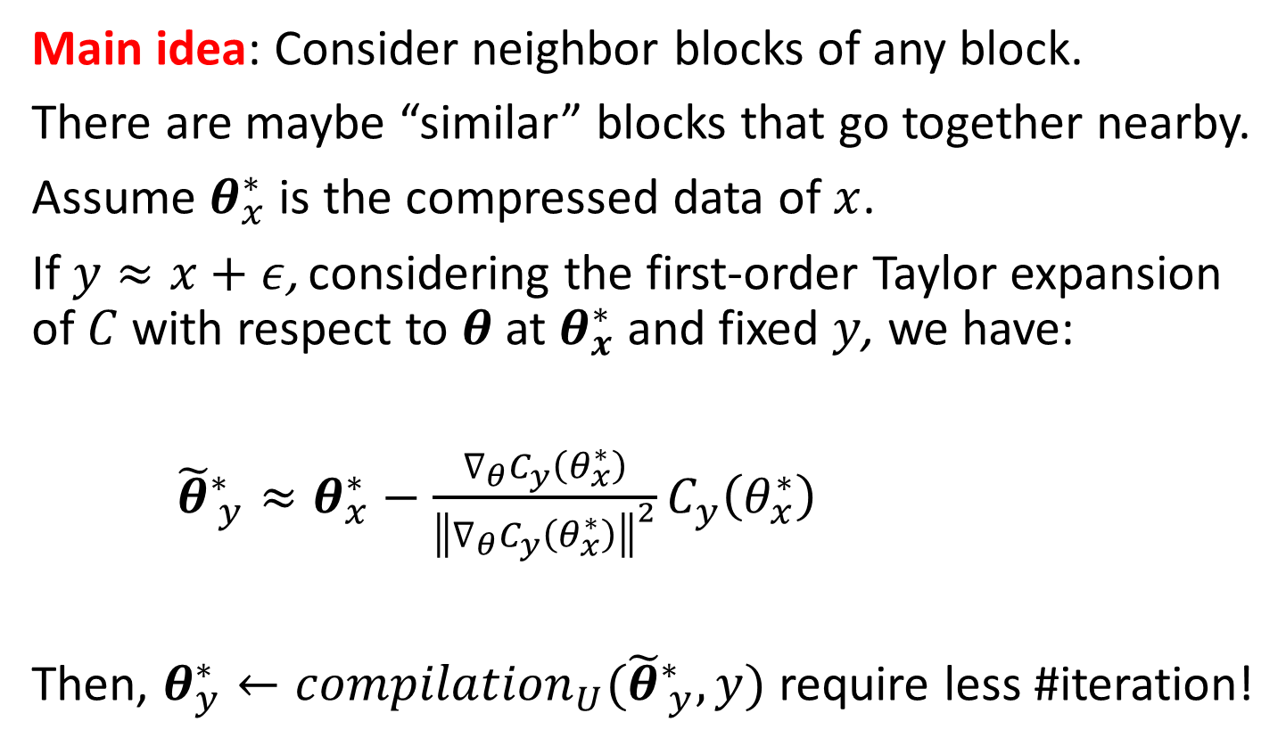



3. Using Taylor series as parameter estimator
$$N$$
Main idea: Consider neighbor blocks of any block.
There are maybe “similar” blocks that go together nearby.
Assume $θ_{x}^{∗}$ is the compressed data of $x$.
If $y≈x+ε$, considering the first-order Taylor expansion of $C$ with respect to $θ$ at $θ_{x}^{∗}$ and fixed $y$, we have:
${\tilde{θ}}_{ y}^{∗}≈θ_{x}^{∗}−\frac{∇_{θ}C_{y}\left(θ_{x}^{∗}\right)}{{\left\|∇_{θ}C_{y}\left(θ_{x}^{∗}\right)\right\|}^{2}}C_{y}\left(θ_{x}^{∗}\right)$
Then, $θ_{y}^{∗}←{compilation}_{U}({\tilde{θ}}_{ y}^{∗},y)$ require less #iteration!
$$M$$
$$ℬ$$
Parameter estimator
Notes:
Consider a region around a block, called neighbor blocks, if there is at least one compressed block in neighbor block set, we can use the parameter estimator on the slide.
This formula expand from first-order Taylor series, the detail process can be found on paper and I do not put it here. But simplicity, for any compressed parameter for y, we can found its “estimated best parameter”.
After that we substitute into C_y, if C_y < threshold, we no need to run compilation anymore. Otherwise, run normal compilation with initial parameter = \theta^*_y. Averagely, do it many times will cost less total #iteration

Slide 8
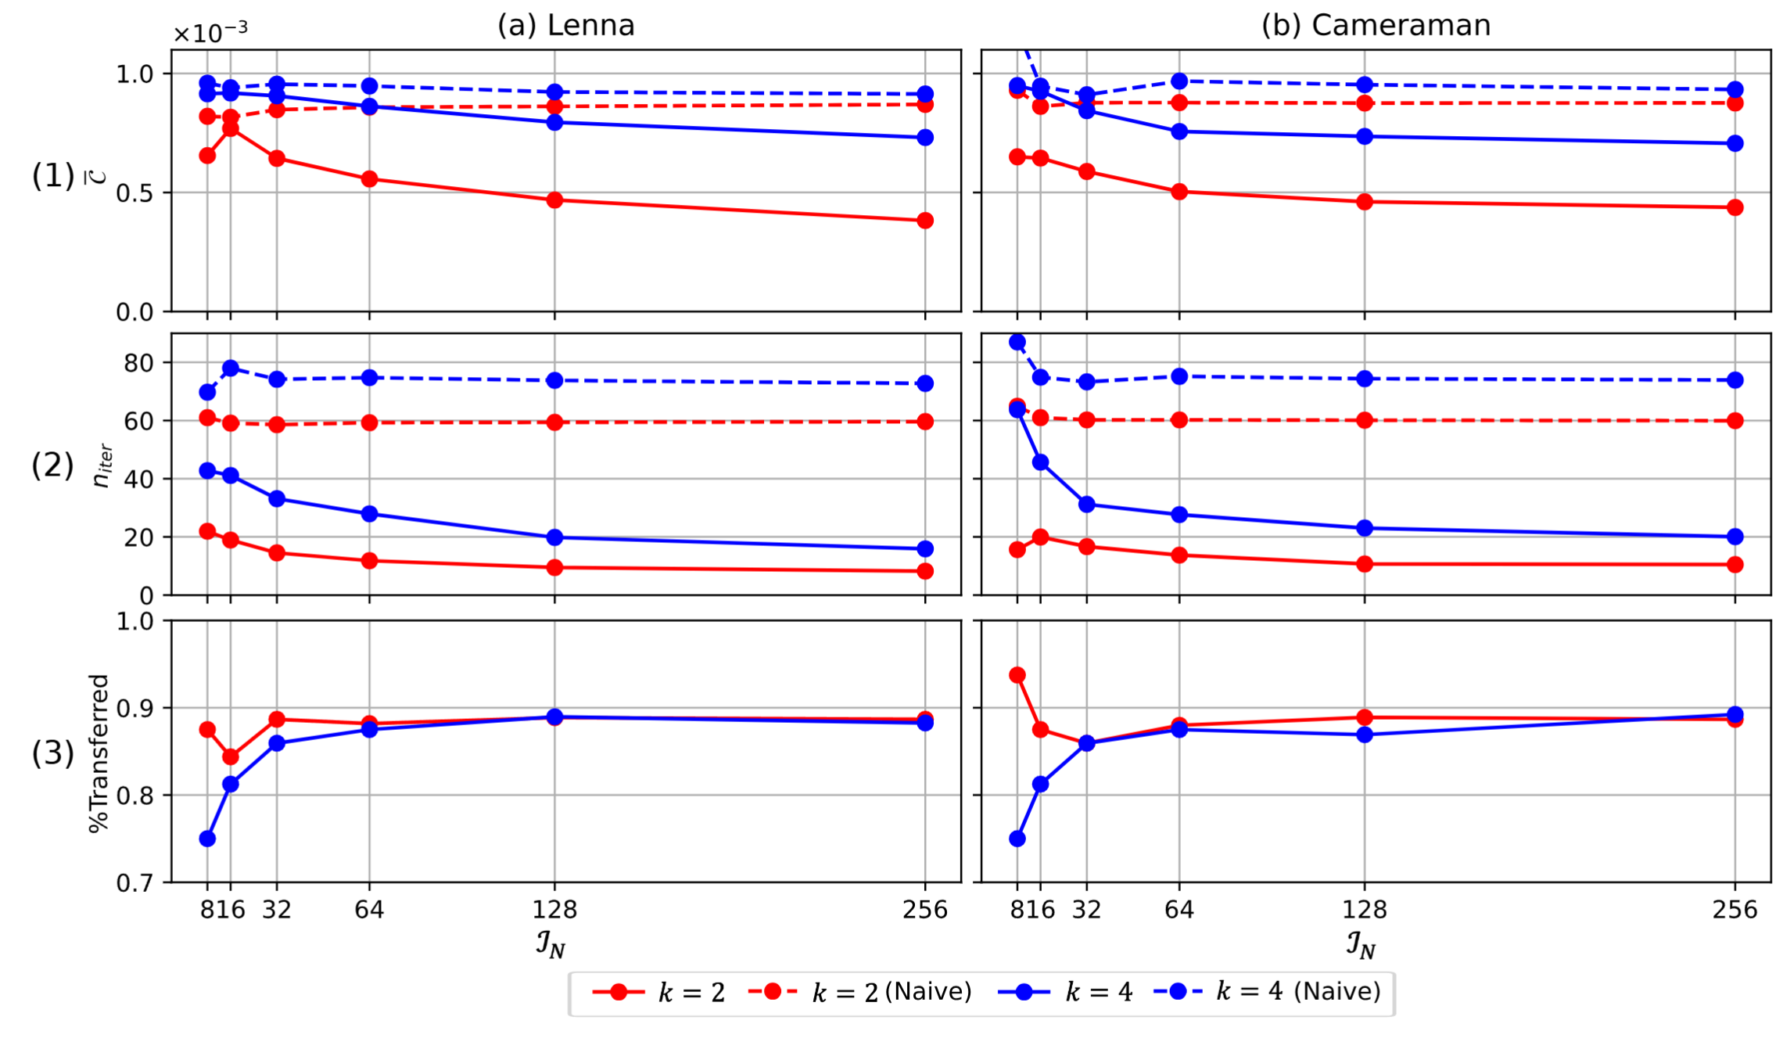
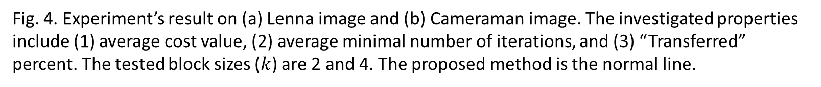
4. Results
Better loss
Require less resources
Higher %transferred for higher-resolution images
Fig. 4. Experiment’s result on (a) Lenna image and (b) Cameraman image. The investigated properties include (1) average cost value, (2) average minimal number of iterations, and (3) “Transferred” percent. The tested block sizes ($k$) are 2 and 4. The proposed method is the normal line.
Notes:
Fig. 4. Experiment’s result on (a) Lenna image and (b) Cameraman image. The investigated properties include (1) average cost value, (2) average minimal number of iterations, and (3) “Transferred” percent. We experimented with two images: Lenna and Cameraman. The originalsize of these images is 256 × 256 which is scaled as 8 × 8, 16 × 16, . . . and 128 × 128. The fast method and the naive method’s results are presented as normal (—-) and dotted lines ( ), respectively. The tested block sizes (k) are 2 and 4
C: cost, but it can be considered as loss between decompressed image and original image, lower is better
N_iter: average minimal number of iterations for compressing an image, lower is better
Transferred percent (only available for proposed method) is the percent which a block is compressed with less iterations thanks to one of their neighbor compressed blocks. Higher is better

Slide 9
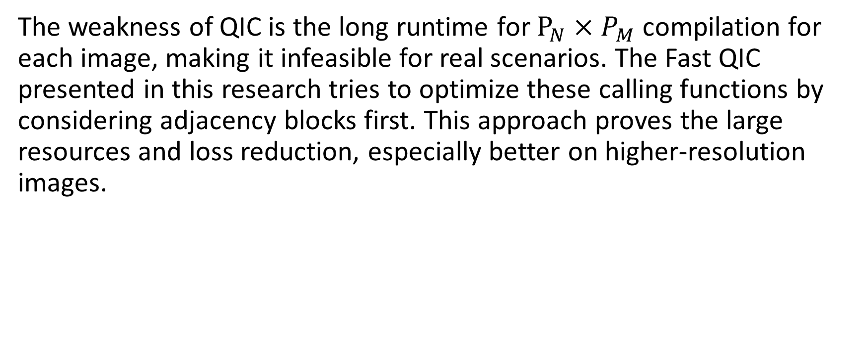
5. Conclusion
The weakness of QIC is the long runtime for $P_{N}×P_{M}$ compilation for each image, making it infeasible for real scenarios. The Fast QIC presented in this research tries to optimize these calling functions by considering adjacency blocks first. This approach proves the large resources and loss reduction, especially better on higher-resolution images.
Notes:
The weakness of QIC is the long runtime for $P_{N}×P_{M}$ compilation for each image, making it infeasible for real scenarios. The Fast QIC presented in this research tries to optimize these calling functions by considering adjacency blocks first. This approach proves the large resources and loss reduction, especially better on higher-resolution images.
As quantum computing technology progresses, the potential for further advancements in image processing and compression methodologies is increasingly promising.

Slide 10
Thank you!

