Slide 1
Architechture search policy gradient Qdas

Slide 2
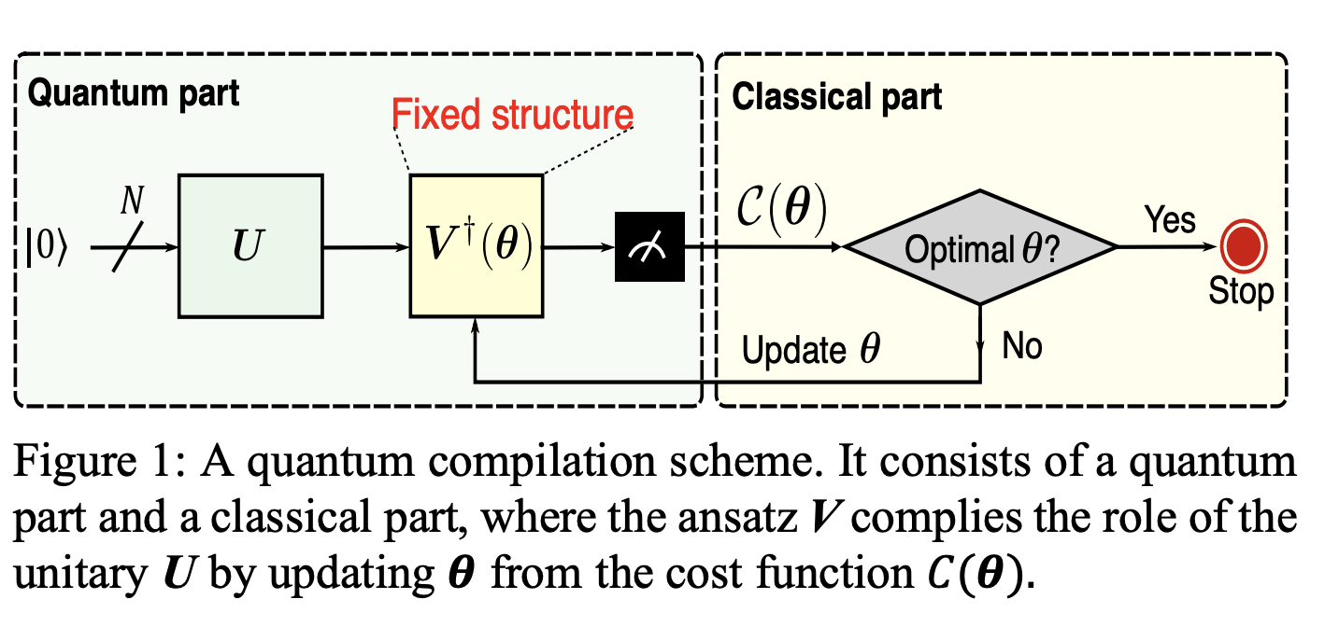

Quantum compilation scheme
What is the best structure for $V^{†}\left(θ\right)$?

Slide 3
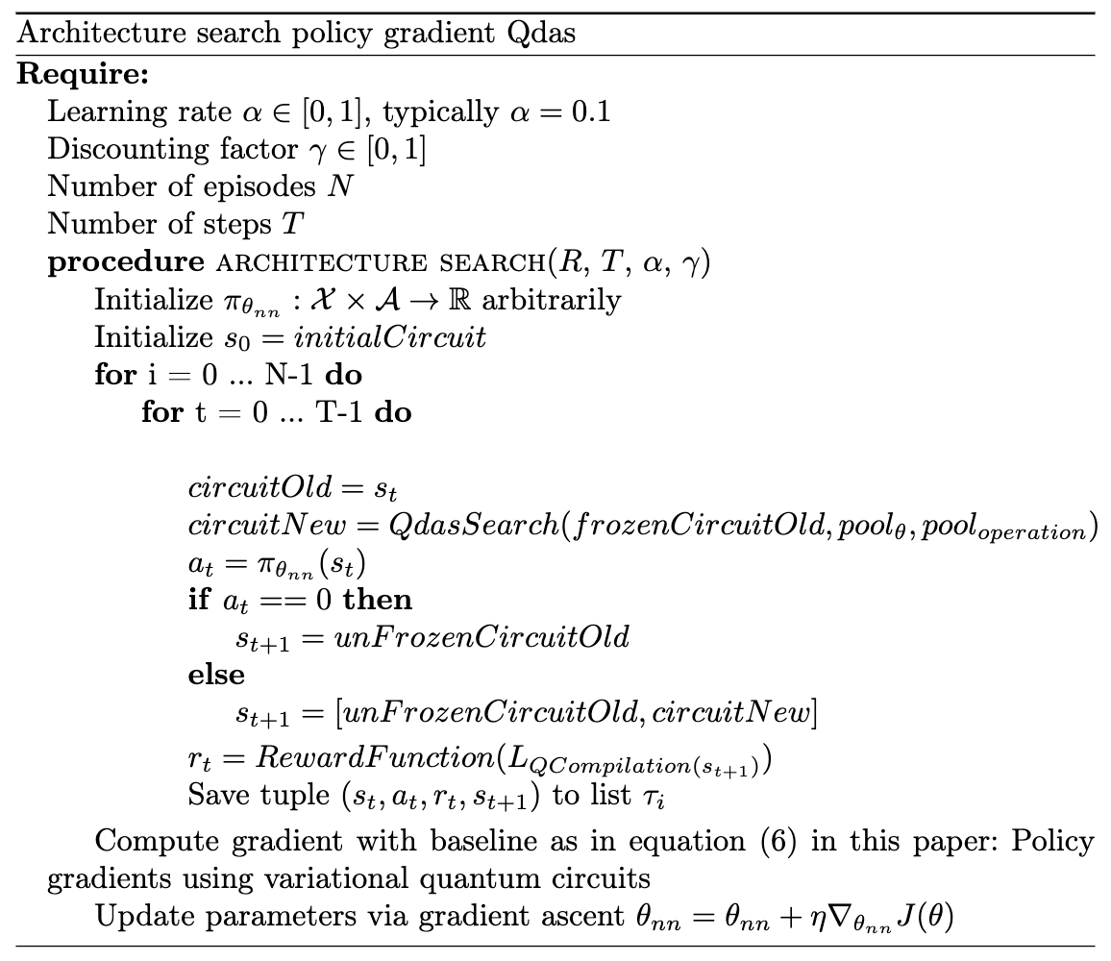

Slide 4
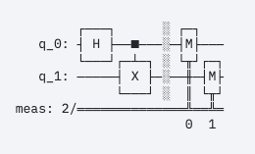
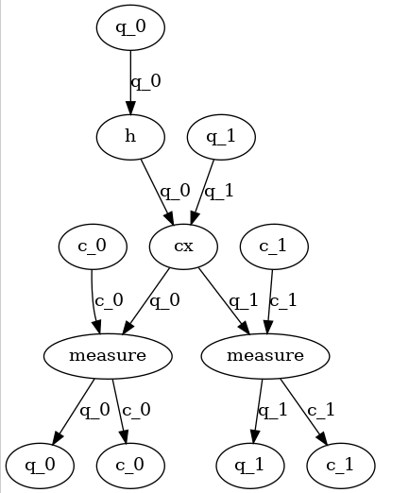

Solve $π_{θ_{nn}}:qc→ℝ∈[0,1]$
Step 1: convert a qc into Directed Acyclic Graphs (DAG)
=>

Slide 5
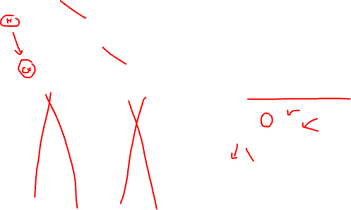
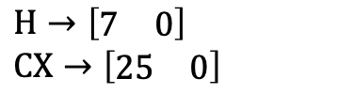

Solve $π_{θ_{nn}}:qc→ℝ∈[0,1]$
Step 2: convert DAG to n x n adjacency matrix and n node features vector
$$\left[\begin{matrix}0 & 1 \\ 0 & 0\end{matrix}\right]$$
How to encode a operation as features (vector)?
[convert_string_to_int(operation), params]
$H→\left[\begin{matrix}7 & 0\end{matrix}\right]$
$CX→\left[\begin{matrix}25 & 0\end{matrix}\right]$

Slide 6


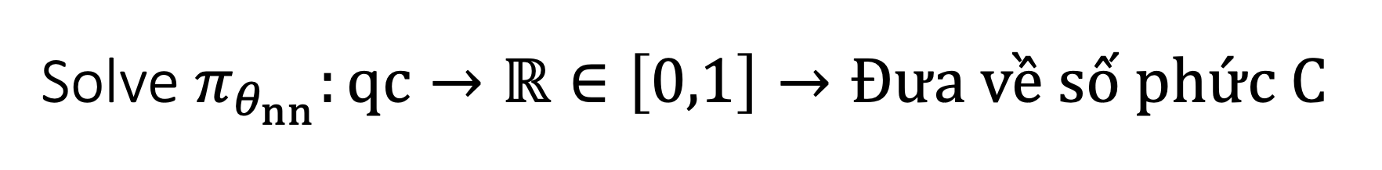



Solve $π_{θ_{nn}}:qc→ℝ∈\left[0,1\right]→Đưa về số phức C$
Step 3: put adjacency matrix and node features into Graph Convolutional Neural Network
$$\left[\begin{matrix}0 & 1 \\ 0 & 0\end{matrix}\right]$$
Sigmod$\left(x\right)=\frac{1}{1+e^{−x}}$
GCNN
$$x∈ℝ$$
$$x∈[0,1]$$
$$\left[\begin{matrix}7 & 0 \\ 25 & 0\end{matrix}\right]$$

