Slide 1
Module F-Arrays
Arrays
Sorting Algorithms
Additional reading: Structs

Slide 2
Arrays
A data structure is a collection of data types designed to store information in some optimal way.
Data structures improve readability and simplify coding considerably.
The simplest example of a data structure is an array.

Slide 3
Session Objectives
Class Problem (without array)
Array Definition
Array Declaration
Array Elements
Array Initialization
Passing Arrays To Functions
Solution (with array)
In-Class Practice

Slide 4
Example showing the necessity of an array
Design and code a program that displays the binary equivalent of a positive integer less than 32767. The program prompts the user for a positive whole number and uses iteration constructs and array syntax. For an input value of 92, the program displays
92 in binary is 00000000 01011100

Slide 5
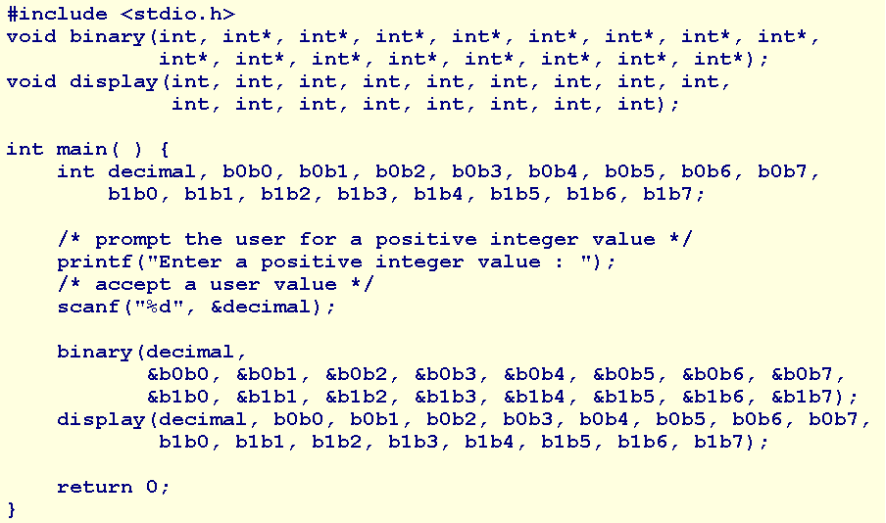
The solution without array syntax (1)

Slide 6
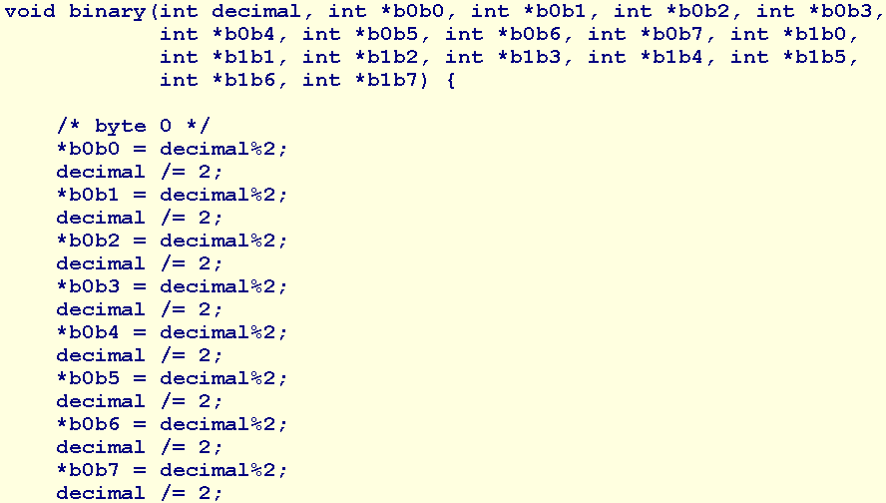
The solution without array syntax (2)

Slide 7
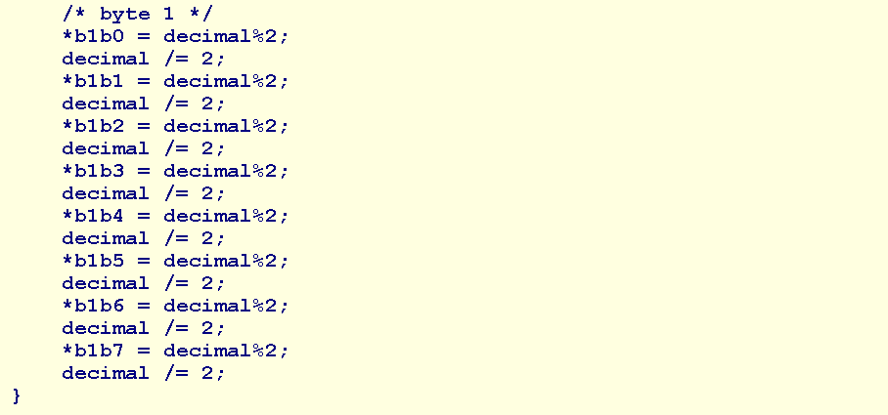
The solution without array syntax (3)

Slide 8
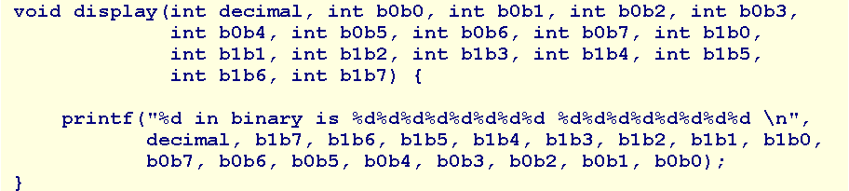
The solution without array syntax (4)
What are the disadvantages of this solution?

Slide 9
Array Definition
An array is an ordered set of related elements of common data type that are stored contiguously in memory.

Slide 10
Array Declaration
dataType identifier [ size ];
For example,
int digit[16];
allocates contiguous storage in primary memory for an array named digit of 16 int elements.

Slide 11
Array Elements
The fundamental unit of an array is an element.
Each element holds has an index and holds one data value.
Index numbering starts at 0 and extends to one less than the size of the array.
To refer to an element, we use the array name followed by bracket notation around the element index.
  For example,
  we denote the 4-th element of digit by digit[3]
The index may be an integer variable, an integer expression or an integer constant.

Slide 12
Array Initialization
  dataType arrayIdentifier[ size ] = { value, ... , value };
  For example:
  int digit[BITS] = {0,0,0,0,0,0,0,0,0,1,0,1,1,1,0,0};
  Or
  int digit[] = {0,0,0,0,0,0,0,0,0,1,0,1,1,1,0,0};

Slide 13
Passing Arrays To Functions (1)
Because compilers store the elements of an array contiguously in memory, passing the address of the array to a function is sufficient to enable access to all of the elements of the array within the function.
The location of any element is simply the produce of the offset from the address of the first element and the number of bytes in a sinlge element.
By only passing the address of the array, we avoid copying the array, which may be a rather expensive operation.

Slide 14
Passing Arrays To Functions (2)
Arguments
The syntax of a function call that passes an array is
  functionIdentifier ( arrayIdentifier, ... )
Where functionIdentifier is the name of the function and arrayIdentifier is the array name without brackets.

Slide 15
Passing Arrays To Functions (3)
Parameters
The syntax of a function header that receives an array address is
  dataType functionIdentifier ( dataType arrayIdentifier [ ], ... )
The brackets following arrayIdentifier inform the compiler that the parameter holds the address of a one-dimensional array

Slide 16
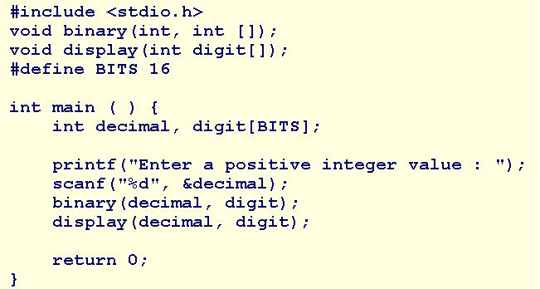
Solution with array (1)

Slide 17
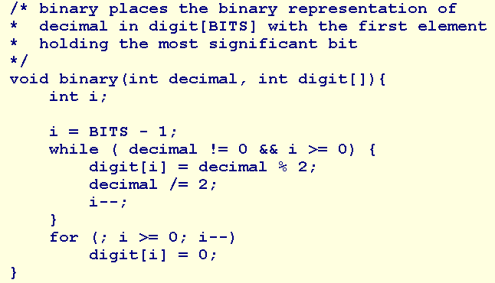
Solution with array (2)

Slide 18
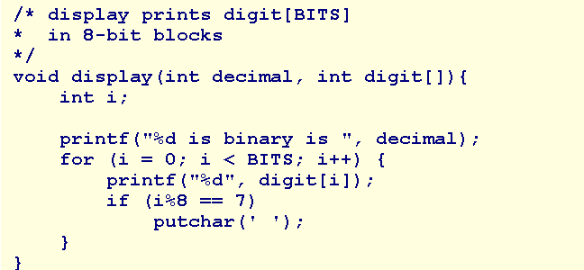
Solution with array (3)

Slide 19
Summary
Array
Class Problem (without array)
Array Definition
Array Declaration
Elements
Initialization
Passing Arrays To Functions
Solution (with array)
Q&A

Slide 20
In Class Practice
Design and code a program named coinToss.c that
  prompts the user for the number of times to toss a coin,
  accepts a positive value as the number of times,
  simulates the coin tosses for the requested number of times, and
  reports the percentage of head results and the percentge of tail results for the coin tosses.

Slide 21
Parallel Arrays
Parallel arrays are arrays of identical size that hold elements in a common order. The i-th element of one array is related to the i-th element of a parallel array.
Parallel arrays store tabular information

Slide 22
Tabular Information
Roll Number | Name
12298 | John Smith
42424 | Mary
25425 | Bill Gates
83833 | Mahesh

Slide 23
Record Searches
A search algorithm finds the record of interest using the key array
Two common search algorithms are
  linear search
  binary search

Slide 24
Linear Search (1)
A linear search algorithm starts at one end of the key array and steps through the elements sequentially, until the algorithm locates the search value

Slide 25
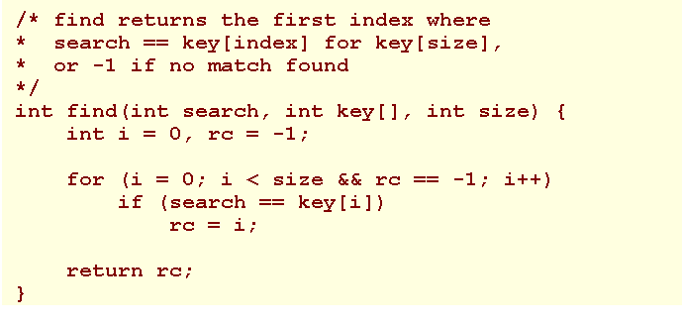
Linear Search (2)
Demo

Slide 26
Binary Searches (1)
A binary search algorithm works with a sorted array.
The algorithm discards half of the array that does not contain the search value and keeps discarding the half of the remaining subset of elements that does not contain the search value.

Slide 27
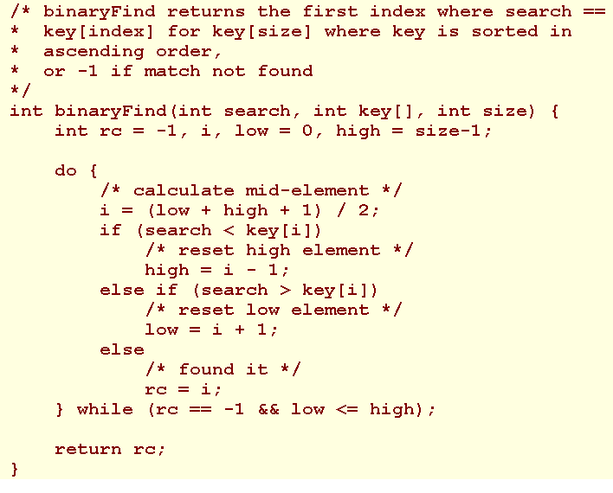
Binary Searches (2)
Demo

Slide 28
Mixing Algorithms
Examples of algorithms for mixing elements include ones for shuffling the cards in a deck or tumbling numbered balls into a lottery chute.
Such algorithms vary in the extent to which they generate a truly fair result.

Slide 29
Linear Shuffle (1)
Consider a program that shuffles a deck of cards and displays the results of the shuffle. With each iteration, the program sets aside one card and shuffles the remaining cards.

Slide 30
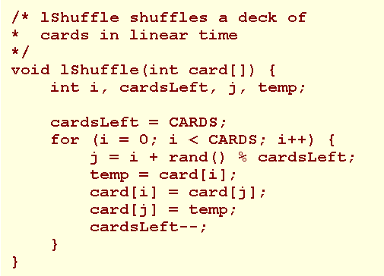
Linear Shuffle (2)

Slide 31
Masking (1)
Masking is a technique where one array hides or 'masks' the corresponding elements of parallel arrays.
Masking is a technique where one array hides or 'masks' the corresponding elements of parallel arrays.

Slide 32
Masking (2)
Consider the drawing of cards from a shuffled deck. To identify a card as having been drawn, let us introduce an array named drawn that is parallel to card[] and initialize the elements of this masking array to 0. For each card drawn, let us reset the corresponding element in drawn to 1.

Slide 33
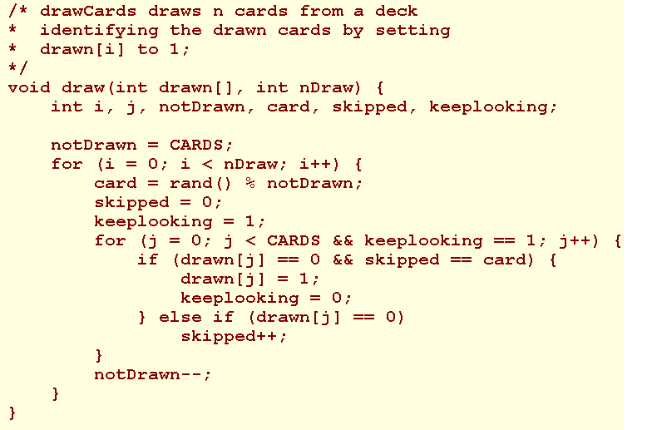
Masking (3)

Slide 34
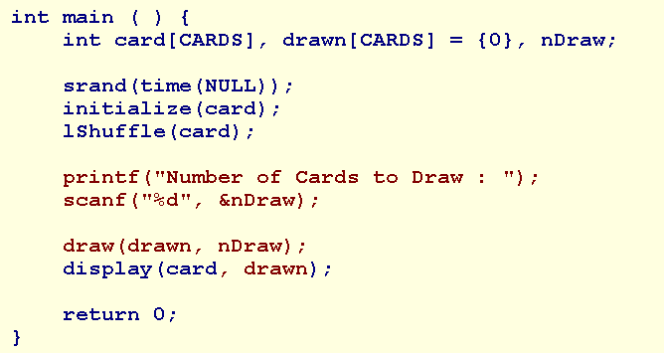
Masking (4)

Slide 35
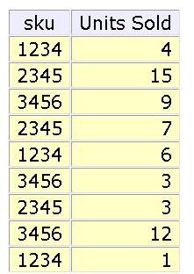
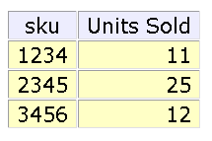
Flagging (1)
subtotal the units sold of each sku

Slide 36
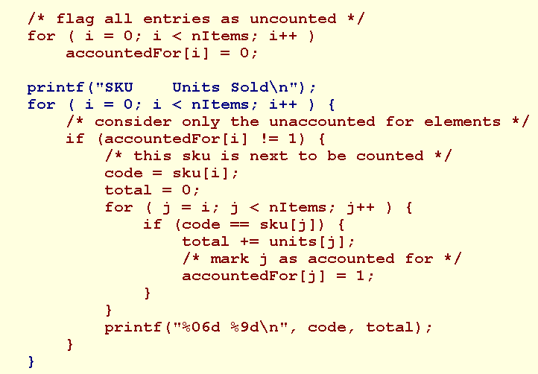
Flagging (2)

Slide 37
Sorting Algorithms
Two common alogithms are
  selection sorts
  bubble sorts

Slide 38
Selection Sort
Find the maximum value in the list
Swap it with the value in the last position
Repeat the steps above for remainder of the list
Demo

Slide 39
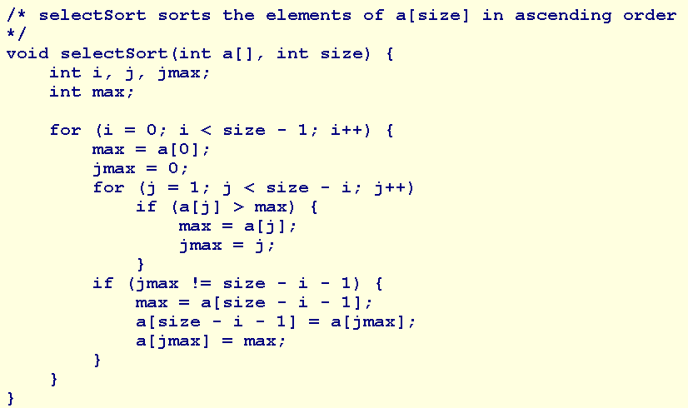
Selection Sort

Slide 40
Bubble Sort-1
Bubble sort is a simple sorting algorithm. It works by repeatedly stepping through the list to be sorted, comparing two items at a time and swapping them if they are in the wrong order.
The pass through the list is repeated until no swaps are needed, which means the list is sorted
Demo

Slide 41
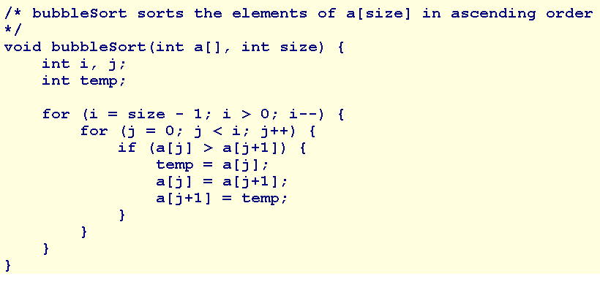
Bubble Sort-2

Slide 42
Summary
Parallel Arrays
Tabular Information
Record Searches
  linear search
  binary search
Mixing, Masking and Sorting Algorithms
Mixing Algorithms
  Linear Shuffle
  Masking
  Flagging
Sorting Algorithms
  selection sorts
  bubble sorts
Q&A

Slide 43
Additional reading:
Structures
A structure consists of a number of data items, which need not be of the same data type, grouped together
The structure could hold as many of these items as desired
}
1
I
I
L
L
U
S
I
O
N
B
A
C
H
1
}
Variable
L
L
U
Name of the book
Author
Edition
S
I
Structure
O
N
Array

Slide 44
Defining a Structure
A structure definition forms a template for creating structure variables
The variables in the structure are called structure elements or structure members
Example:
  struct Book
  { char bk_name [25];
  char author [20];
  int edn;
  float price;
  };

Slide 45
Declaring Structure Variables
Once the structure has been defined, one or more variables of that type can be declared
Example: Book books1;
The statement sets aside enough memory to hold all items in the structure

Slide 46
Accessing Structure Elements
Structure elements are referenced through the use of the dot operator (.), also known as the membership operator
Syntax:
structure_name.element_name
Example:
scanf(“%s”, books1.bk_name);

Slide 47
Initializing structures
Like variables and arrays, structure variables can be initialized at the point of declaration
  struct Employee
  { int no;
  char name [20];
  };
Variables emp1 and emp2 of the type Employee can be declared and initialized as:
Employee emp1 = {346, “Abraham”};
Employee emp2 = {347, “John”};

Slide 48
Assignment statements used
with structures (1)
It is possible to assign the values of one structure variable to another variable of the same type using a simple assignment statement
For example, if books 1 and books2 are structure variables of the same type, the following statement is valid
books2 = books1;

Slide 49
Assignment statements used
with structures (2)
In cases where direct assignment is not possible, the in-built function memcpy() can be used
Syntax:
memcpy (char * destn, char &source, int nbytes);
Example:
int a[10], b[10];
for(int
…
memcpy (a, b, 10*sizeof(int)); // copy b to a

