Slide 1
Module F-Arrays
Parallel Arrays
Mixing, Masking and Sorting Algorithms

Slide 2
Session Objectives
Parallel Arrays
Tabular Information
Record Searches
  linear search
  binary search
Mixing, Masking and Sorting Algorithms
Mixing Algorithms
  Linear Shuffle
  Masking
  Flagging
Sorting Algorithms
  selection sorts
  bubble sorts

Slide 3
Parallel Arrays
Parallel arrays are arrays of identical size that hold elements in a common order. The i-th element of one array is related to the i-th element of a parallel array.
Parallel arrays store tabular information

Slide 4
Tabular Information
Roll Number | Name
12298 | John Smith
42424 | Mary
25425 | Bill Gates
83833 | Mahesh

Slide 5
Record Searches
A search algorithm finds the record of interest using the key array
Two common search algorithms are
  linear search
  binary search

Slide 6
Linear Search-1
A linear search algorithm starts at one end of the key array and steps through the elements sequentially, until the algorithm locates the search value

Slide 7
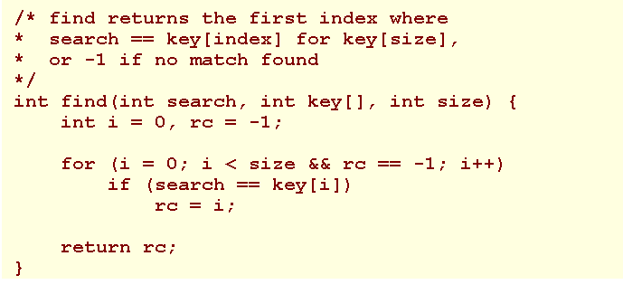
Linear Search-2
Demo

Slide 8
Binary Searches-1
A binary search algorithm works with a sorted array.
The algorithm discards half of the array that does not contain the search value and keeps discarding the half of the remaining subset of elements that does not contain the search value.

Slide 9
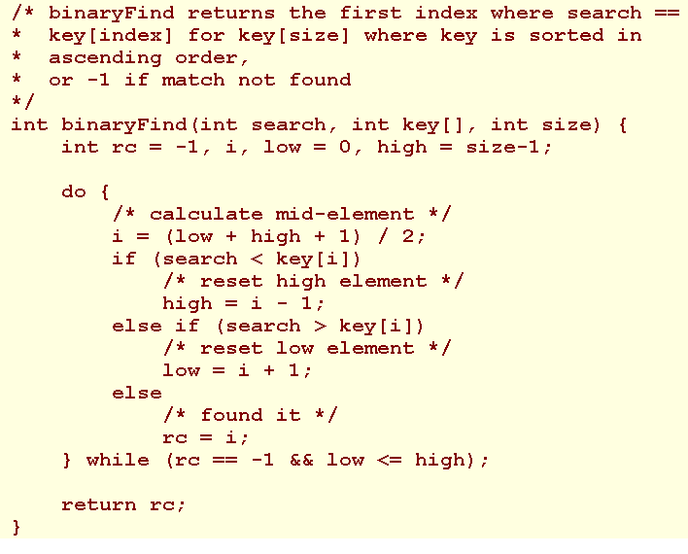
Binary Searches-2
Demo

Slide 10
Mixing Algorithms
Examples of algorithms for mixing elements include ones for shuffling the cards in a deck or tumbling numbered balls into a lottery chute.
Such algorithms vary in the extent to which they generate a truly fair result.

Slide 11
Linear Shuffle-1
Consider a program that shuffles a deck of cards and displays the results of the shuffle. With each iteration, the program sets aside one card and shuffles the remaining cards.

Slide 12
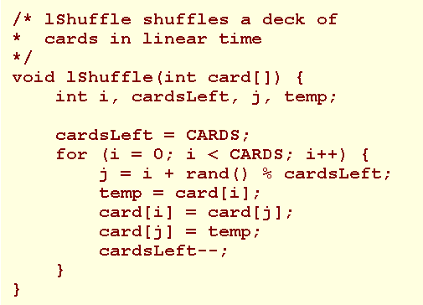
Linear Shuffle-2

Slide 13
Masking-1
Masking is a technique where one array hides or 'masks' the corresponding elements of parallel arrays.

Slide 14
Masking-2
Consider the drawing of cards from a shuffled deck. To identify a card as having been drawn, let us introduce an array named drawn that is parallel to card[] and initialize the elements of this masking array to 0. For each card drawn, let us reset the corresponding element in drawn to 1.

Slide 15
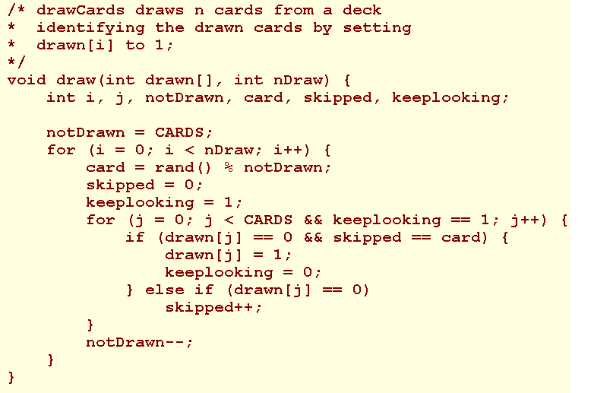
Masking-3

Slide 16
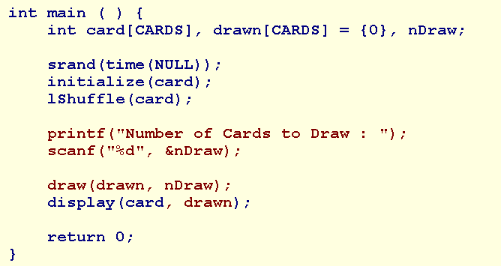
Masking-4

Slide 17
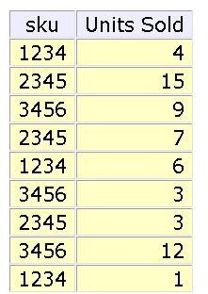
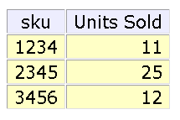
Flagging-1
subtotal the units sold of each sku

Slide 18
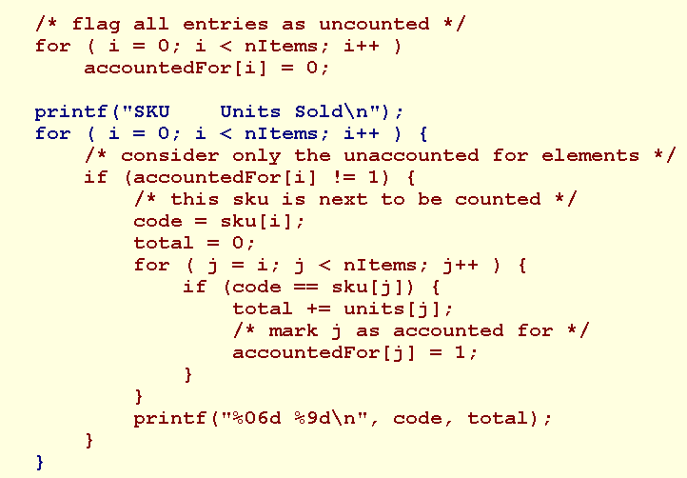
Flagging-2

Slide 19
Sorting Algorithms
Two common alogithms are
  selection sorts
  bubble sorts

Slide 20
Selection Sort
Find the maximum value in the list
Swap it with the value in the last position
Repeat the steps above for remainder of the list
Demo

Slide 21
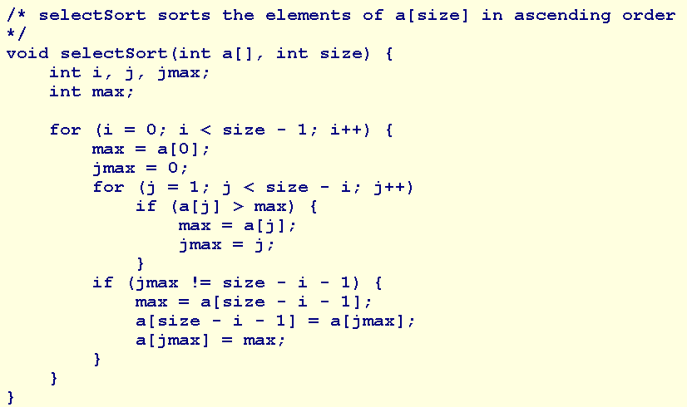
Selection Sort

Slide 22
Bubble Sort-1
Bubble sort is a simple sorting algorithm. It works by repeatedly stepping through the list to be sorted, comparing two items at a time and swapping them if they are in the wrong order.
The pass through the list is repeated until no swaps are needed, which means the list is sorted
Demo

Slide 23
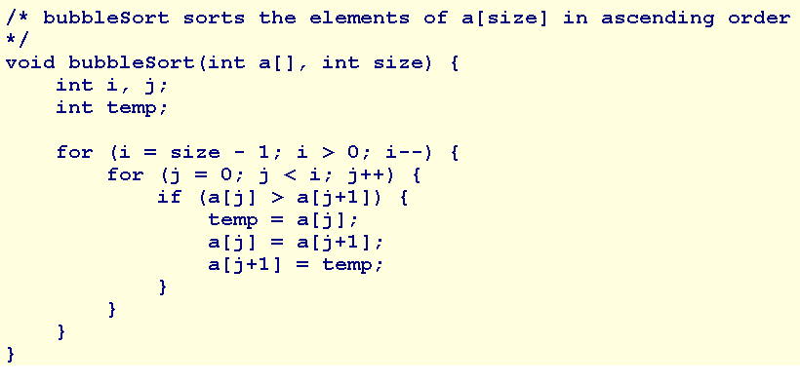
Bubble Sort-2

Slide 24
Summary
Parallel Arrays
Tabular Information
Record Searches
  linear search
  binary search
Mixing, Masking and Sorting Algorithms
Mixing Algorithms
  Linear Shuffle
  Masking
  Flagging
Sorting Algorithms
  selection sorts
  bubble sorts
Q&A

