Slide 1
Chebyshev Center of polyhedron
Nhóm 2:
Đặng Văn Tú
Lã Ngọc Tuấn
Vũ Trường Xuân

Slide 2
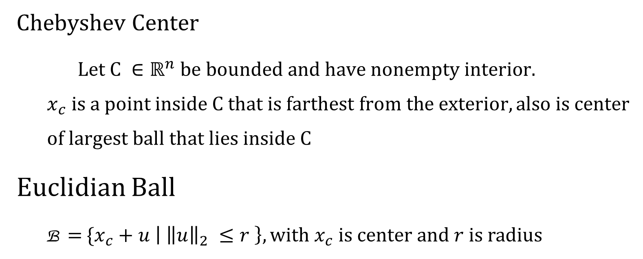
Definition
Chebyshev Center
Let$C ∈ℝ^{n} be bounded and have nonempty interior.$
$$x_{c} is a point inside C that is farthest from the exterior, also is center$$
$$of largest ball that lies inside C$$
Euclidian Ball
B = {$x_{c}+u \left| {\left\|u\right\|}_{2} ≤r \right\}, with x_{c} is center and r is radius$

Slide 3
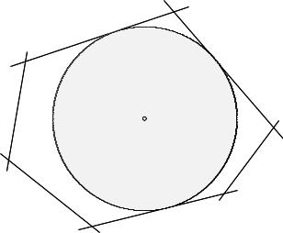

Chebyshev Center of polyhedron
Chebyshev center of polyhedron P = {$x$| $a_{i}^{T} x ≤ b_{i}, i=1 …m \}$ is center of largest inscribed Euclidian ball B = {$x_{c}+u | {\left\|u\right\|}_{2} ≤r \}$

Slide 4

Init Linear programming problem
$r$ is radius and $x_{c}$ is center of inscribed ball inside polyhedron P
$a_{i}^{T}x ≤ b_{i}$for all $x ∈$ B if and only if ${sup⁡(a}_{i}^{T}\left(x_{c}+u\right)| {\left\|u\right\|}_{2} ≤r) ≤b_{i}$ $⇒ a_{i}^{T}x_{c}+\sup\left(a_{i}^{T}u\right)≤ b_{i}$

Slide 5

Init Linear programming problem
$$a_{i} and u are vectors in ℝ^{n}, {so a}_{i}^{T}u is dot product.$$
$$It gets maximum when u and a_{i} are in the same direction.$$
$$Choose u is in the same direction as a_{i} with length r$$
$$⇒\sup\left\{a_{i}^{T}u \right| {\left\|u\right\|}_{2} ≤r\}≥ a_{i}^{T}\left[\frac{r}{{\left\|a_{i}\right\|}_{2}} a_{i}\right]=r {\left\|a_{i}\right\|}_{2}$$

Slide 6

Init Linear programming problem
Other way: $\sup\left\{a_{i}^{T}u \right|{\left\|u\right\|}_{2} ≤r\} ≤\{ \left|a_{i}^{T}u\right| \left| {\left\|u\right\|}_{2} ≤r \right\}$
$$Apply Cauchy −Schwarz inequality$$
$$⇒ \{ \left|a_{i}^{T}u\right| \left| {\left\|u\right\|}_{2} ≤r \right\}{ ≤\{ {\left\|a_{i}\right\|}_{2}{\left\|u\right\|}_{2}| {\left\|u\right\|}_{2} ≤r}\} ≤r{\left\|a_{i}\right\|}_{2}$$
So $sup⁡\left\{a_{i}^{T}u \right|{\left\|u\right\|}_{2} ≤r\}= r{\left\|a_{i}\right\|}_{2}$

Slide 7

Init Linear programming problem
Hence
$$a_{i}^{T}x_{c}+r{\left\|a_{i}\right\|}_{2} ≤ b_{i}$$
Our problem becomes
maximize $r$
s.t $a_{i}^{T}x_{c}+r{\left\|a_{i}\right\|}_{2} ≤ b_{i}$

Slide 8

Example
Find Chebyshev center of polyhedron
P $=\left\{Ax ≤b\right\} with A= \left[\begin{matrix}2 & 1 \\ 2 & −1 \\ −1 & 2 \\ −1 & −2\end{matrix}\right] and b= \left[\begin{matrix}1 \\ 1 \\ 1 \\ 1\end{matrix}\right]$

Slide 9
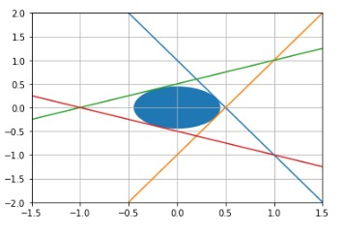

Example
Result using pulp
$r$ = 0.44721
Center point${ x}_{c}=(0, 0)$

Slide 10
References
Boyd, S. P., & Vandenberghe, L. (2018). Convex optimization. Cambridge: Cambridge University Press.
https://math.stackexchange.com/questions/34758/supremum-of-vector-dot-product
http://www.math.uwaterloo.ca/~hwolkowi/henry/teaching/w10/367.w10/367miscfiles/Lecture1.pdf

