Slide 1
SpaceX Falcon 9
Launch Analysis
IBM Applied Data Science Capstone Project
Historical launch data • Python • SQL • Visualisation • Machine learning

Slide 2
Executive Summary
This project analysed SpaceX Falcon 9 launch data to investigate factors that may affect successful rocket landings.
Data was collected, cleaned and analysed using Python and SQL. Charts and an interactive dashboard were used to explore launch sites, payload masses and booster versions.
Most launches in the prepared dataset were successful. The analysis identified patterns in launch performance and explored whether machine learning could help predict landing outcomes.
IBM Applied Data Science Capstone Project | SpaceX Falcon 9
02

Slide 3
Introduction
• SpaceX develops and launches rockets and spacecraft.
• The Falcon 9 carries payloads into space, and its first-stage booster is designed to return to Earth for reuse.
• The project analysed historical Falcon 9 launch data.
• The aim was to understand how launch site, payload mass and booster version relate to launch success.
IBM Applied Data Science Capstone Project | SpaceX Falcon 9
03

Slide 4
Data Collection
The project used historical SpaceX Falcon 9 launch data.
Data was collected using the SpaceX API and web scraping.
The dataset included:
• Launch dates
• Launch sites
• Payload masses
• Booster versions
• Launch outcomes
IBM Applied Data Science Capstone Project | SpaceX Falcon 9
04

Slide 5
Data Cleaning and Preparation
The collected data was cleaned before analysis.
Python and Pandas were used to:
• Remove unnecessary information.
• Handle missing values.
• Convert data into the correct formats.
• Organise launch dates and other details.
• Prepare the dataset for analysis.
This helped make the data more suitable for analysis.
IBM Applied Data Science Capstone Project | SpaceX Falcon 9
05

Slide 6
Exploratory Data Analysis
Exploratory Data Analysis (EDA) was used to understand the SpaceX launch data. Python libraries such as Pandas, Matplotlib and Seaborn were used to explore the data and create visualisations.
The analysis focused on:
• Launch success and failure
• Launch sites
• Payload mass
• Booster versions
Charts helped identify patterns and compare launch performance.
IBM Applied Data Science Capstone Project | SpaceX Falcon 9
06

Slide 7
SQL Analysis
SQL was used to explore the SpaceX launch dataset and answer important questions.
The analysis included:
• Counting launches at each launch site.
• Comparing successful and unsuccessful launches.
• Finding the launch site with the most launches.
• Examining payload mass and launch outcomes.
SQL queries helped organise the data and identify useful results.
IBM Applied Data Science Capstone Project | SpaceX Falcon 9
07

Slide 8
Launch Site Map
Folium was used to create an interactive map showing the locations of SpaceX launch sites.
The map helped show where launches took place and allowed the launch sites to be viewed geographically.
This visualisation made it easier to understand the geographical distribution of SpaceX launch activities.
IBM Applied Data Science Capstone Project | SpaceX Falcon 9
08

Slide 9
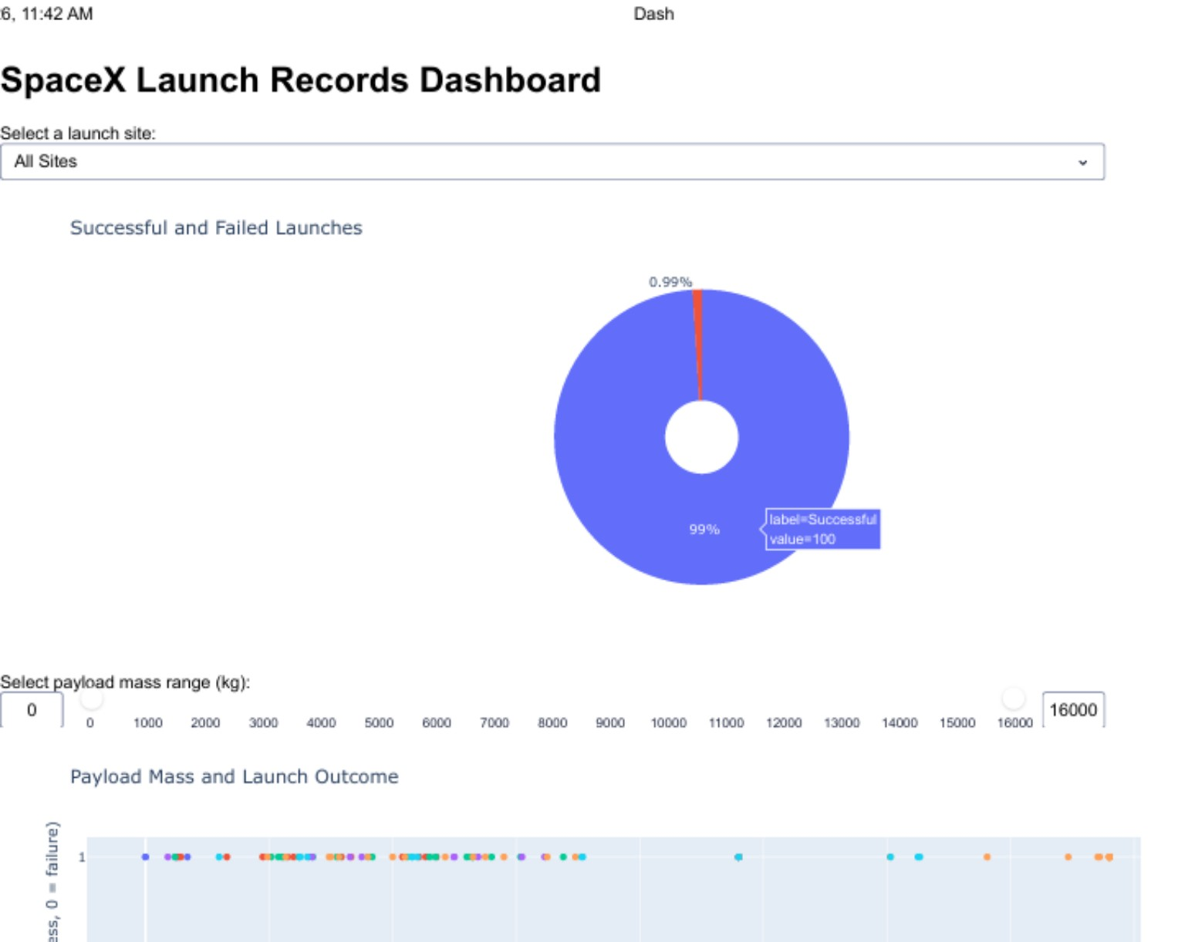
Interactive Launch Dashboard
A dashboard was developed using Python, Plotly and Dash.
It includes a launch-site dropdown, a chart of successful and failed launches, a payload-mass range slider, and a scatter plot comparing payload mass with launch outcome.
The dashboard lets users explore the launch records interactively and compare results.
Screenshot of the completed SpaceX Launch Records Dashboard
IBM Applied Data Science Capstone Project | SpaceX Falcon 9
09

Slide 10
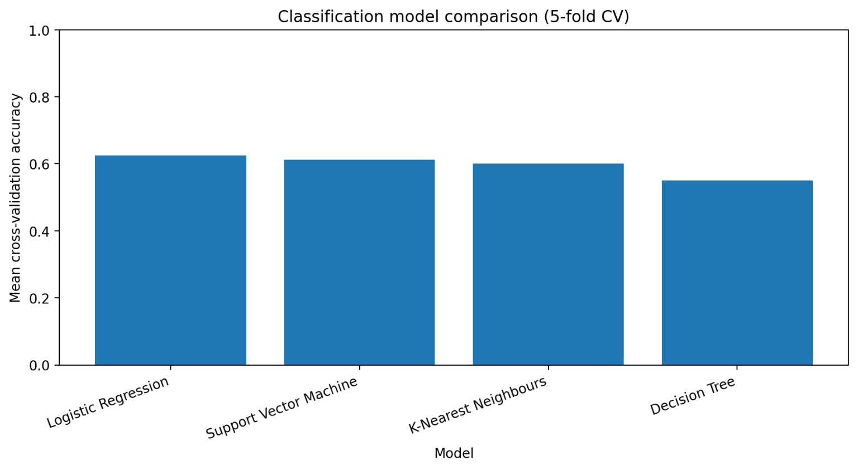
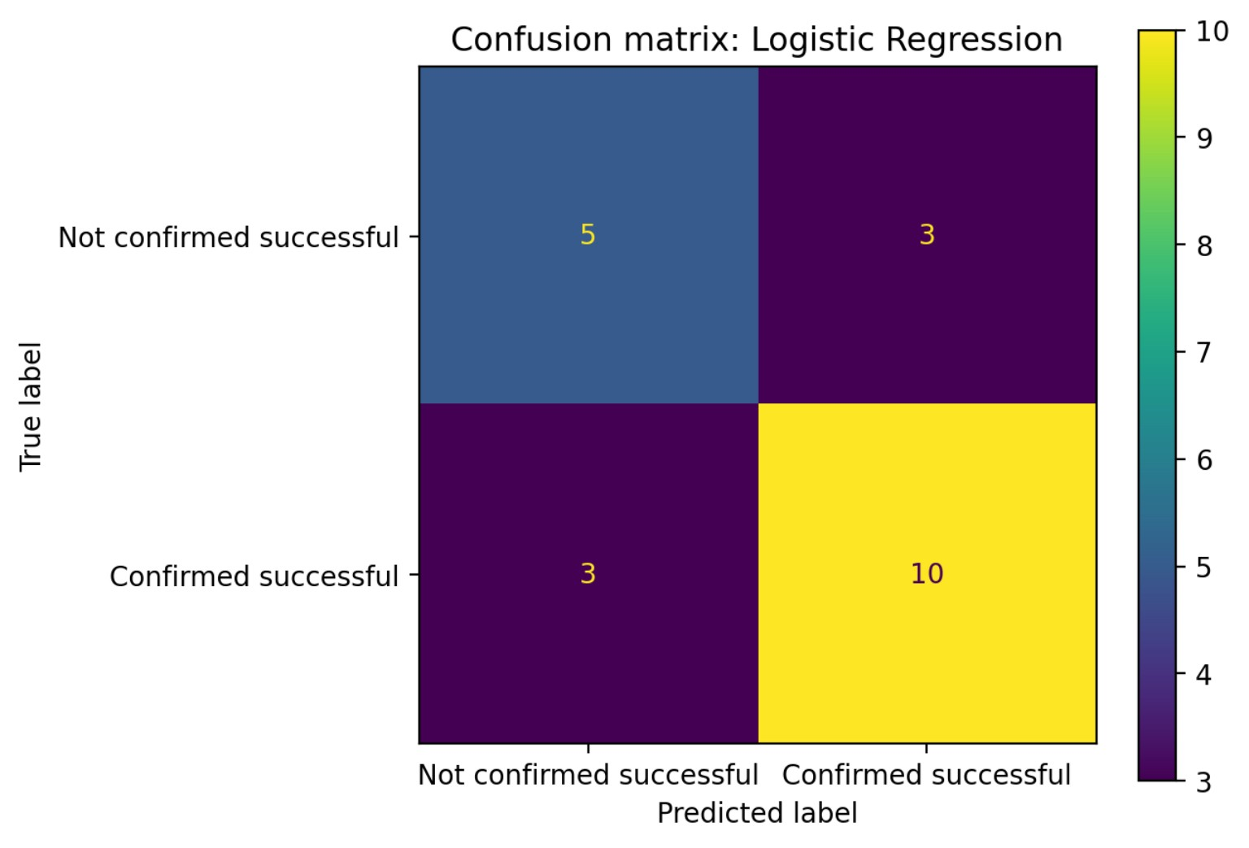
Machine Learning: Classification Results
Exploratory model comparison and test-set evaluation
Selected model
Test accuracy
Balanced accuracy
Classification report
Logistic Regression
71.4%
69.7%
Class | Precision | Recall | F1-score | Support
Not confirmed successful | 0.63 | 0.62 | 0.62 | 8
Confirmed successful | 0.77 | 0.77 | 0.77 | 13
Macro average | 0.70 | 0.70 | 0.70 | 21
Weighted average | 0.71 | 0.71 | 0.71 | 21
5-fold cross-validation model comparison
Confusion matrix – Logistic Regression
The matrix shows 15 correct predictions and 6 incorrect predictions among 21 test records. The results are exploratory because the test set is small.
Class 0 means a confirmed successful landing was not recorded; it does not necessarily mean the booster crashed.
IBM Applied Data Science Capstone Project | SpaceX Falcon 9
10

Slide 11
Key Findings
The analysis of the prepared dataset showed that:
• CCAFS SLC-40 had the largest number of launches, with 34.
• Three launch sites had a 100% success rate.
• CCAFS LC-40 had one unsuccessful launch.
• The F9 v1.1 booster category had a lower success rate than the other recorded F9 categories.
• The classification model achieved 71.4% test accuracy; results should be treated as exploratory.
These findings show how launch sites, booster versions and model outputs can be compared using historical data.
IBM Applied Data Science Capstone Project | SpaceX Falcon 9
11

Slide 12
Conclusion
This project showed how data science can be used to analyse SpaceX Falcon 9 launch performance.
Python, SQL, visualisations and an interactive dashboard helped explore the launch data and identify patterns.
Most recorded launches in the prepared dataset were successful. The findings should be interpreted carefully because the dataset contains a limited number of unsuccessful launches.
More launch records and additional information could improve future analysis and prediction.
IBM Applied Data Science Capstone Project | SpaceX Falcon 9
12

Slide 13
Project Value and Future Improvements
This project brought together data science tools to investigate SpaceX launch performance and make the results easier to explore.
Future improvements could include:
• Adding more launch records.
• Using more information about each launch.
• Improving the predictive models.
• Making the dashboard easier to explore.
IBM Applied Data Science Capstone Project | SpaceX Falcon 9
13

