Slide 1
DSC HACKATHON 2026 · FINANCIAL CRIME & TRANSACTION MONITORING CHALLENGE
Suspicious Transaction Detection
From EDA to a Validated Fraud Classifier
“In God we trust; all others must bring data.”
— W. Edwards Deming
Team Shap Shifters
Dataset: ~630,000 synthetic mobile money transactions (10% sample of a 6.3M-row
PaySim-style simulation), calibrated against real African financial services data

Slide 2
The Problem: Mobile Money Operators Are Missing Fraud
In February 2023, FATF greylisted South Africa partly because banks and mobile money operators weren't doing enough to detect and report suspicious transactions. Every major mobile money operator now needs stronger transaction monitoring.
630K
transactions analysed
The Toolkit's Problem Statement
0.13%
“Using transaction-level data, build a system that identifies potentially fraudulent transactions, and explains what makes flagged transactions anomalous. Build a classifier that identifies fraudulent transactions, and present how your findings are essential for a banking institution.”
are actually fraud
0.24%
caught by the mobile money operator's
current system
Shap Shifters | Suspicious Transaction Detection | DSC Hackathon 2026
2

Slide 3
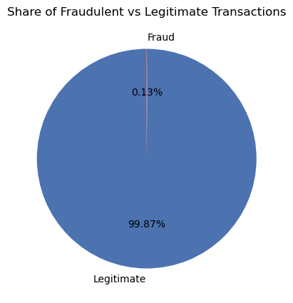
A Realistic, Extremely Imbalanced Dataset
What We Received
636,262 transactions, 5 types: CASH_IN, CASH_OUT, DEBIT, PAYMENT, TRANSFER 849 confirmed fraud cases (0.133%) - no missing values, no duplicates isFlaggedFraud - the mobile money operator's existing rule-based flag, included for comparison
Why this matters: at 0.13% fraud, a model predicting “not fraud” every time scores 99.87% accuracy while catching zero fraud. Every result in this deck is judged on precision, recall, and F1 - not accuracy.
Shap Shifters | Suspicious Transaction Detection | DSC Hackathon 2026
3

Slide 4
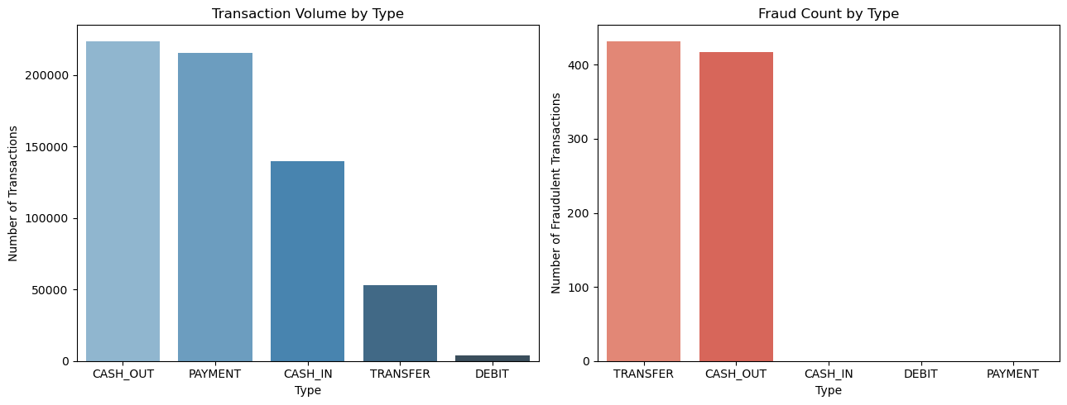
Fraud Lives in Just Two Transaction Types
Every fraud case is a TRANSFER (432) or CASH_OUT (417). PAYMENT, CASH_IN, and DEBIT carry zero fraud despite high volume - so both monitoring and modelling can focus on just these two types.
Shap Shifters | Suspicious Transaction Detection | DSC Hackathon 2026
4

Slide 5
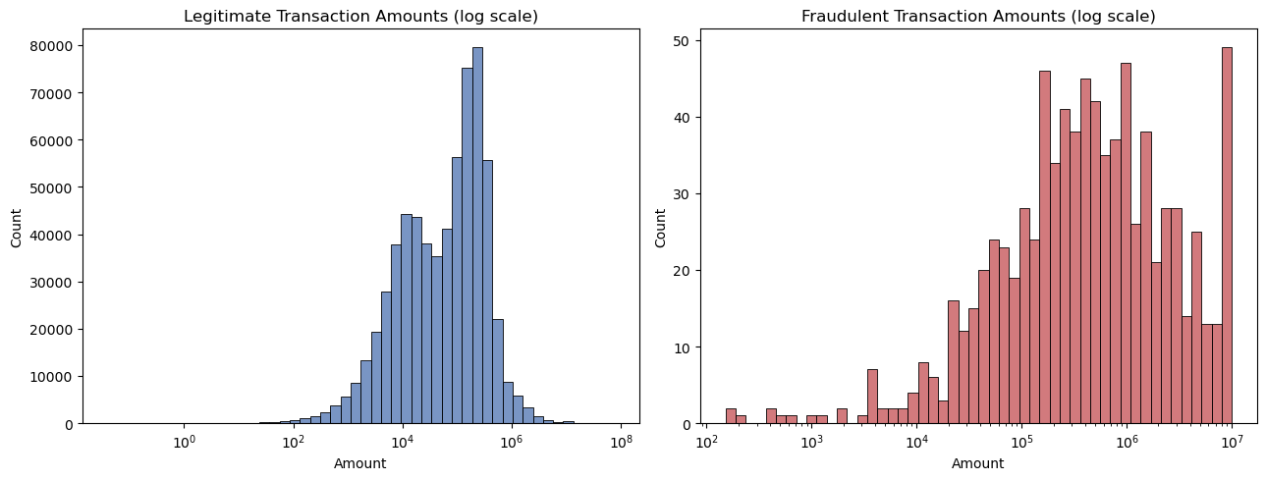
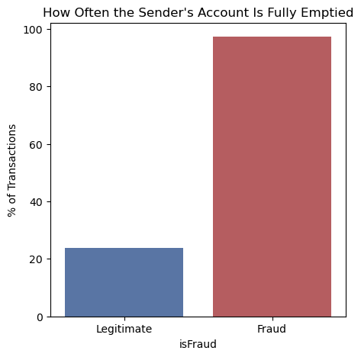
The Fraud Signature: Bigger Amounts, Emptied Accounts
6x
97.3%
larger median
fraud amount
of fraud fully
empties the account
The median fraud transaction (R429,257) is roughly 6x the median legitimate one (R74,407) - useful, but not sufficient alone. The far stronger signal: 97.3% of fraud fully empties the sender's account, versus only 23.9% of legitimate transactions. This single, explainable pattern - stated to an auditor in one sentence - turned out to be the strongest predictor in the entire project, confirmed independently later by our machine learning model's own feature importance ranking (Slide 9).
Shap Shifters | Suspicious Transaction Detection | DSC Hackathon 2026
5

Slide 6
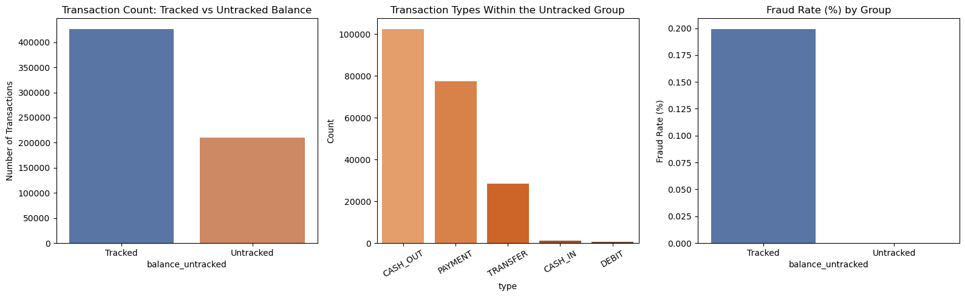
A Caveat: Not Every Zero Balance Is Suspicious
33%
untracked balances
(EDA)
What happened: ~210,000 transactions (33%) show a starting sender balance of zero that never moves at all - a balance-logging artifact, not fraud (zero fraud cases appear here). Cross-checked during modelling: a broader, independent check for balance-arithmetic inconsistency during model development found ~63% of the dataset affected - corroborating the EDA's finding from a different angle. Either way: flag it, don't drop it, and fix logging upstream.
Shap Shifters | Suspicious Transaction Detection | DSC Hackathon 2026
6

Slide 7
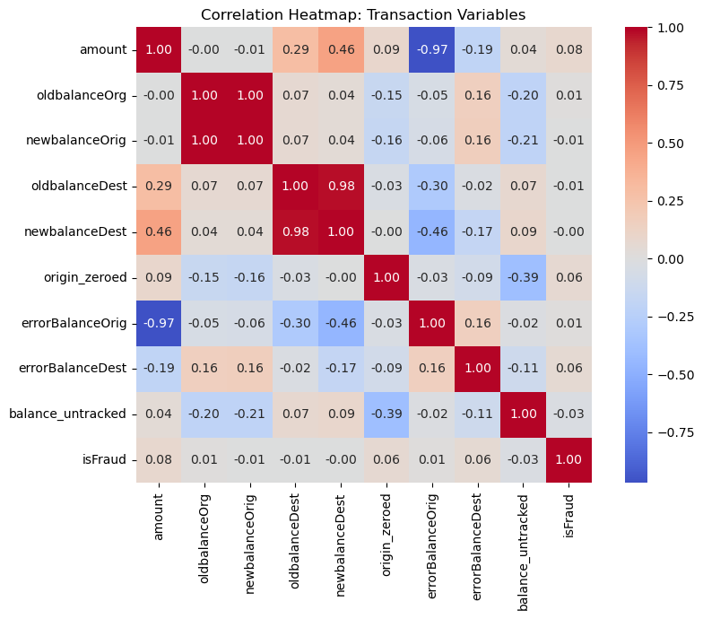
Which Signals Actually Predict Fraud?
Ranked by correlation with isFraud
origin_zeroed & errorBalanceOrig - the two strongest predictors, well ahead of raw amount Balance fields correlate with each other - a reminder to watch for redundant features when modelling
This confirms the balance-draining pattern carries more signal than amount alone - the right foundation for both the rule-based flag and the machine learning model that follows.
Shap Shifters | Suspicious Transaction Detection | DSC Hackathon 2026
7

Slide 8
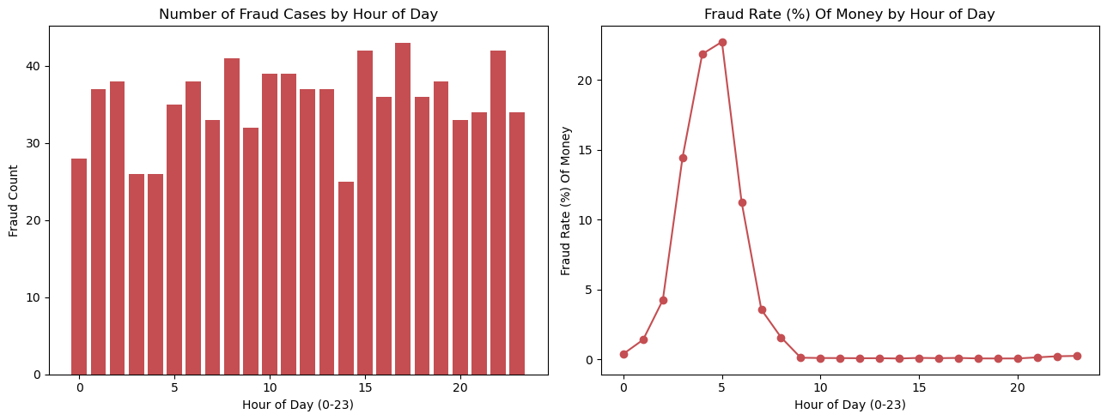
When Does Fraud Happen?
Fraud rate spikes during quiet overnight hours relative to overall traffic - a smaller number of overnight frauds makes up a larger share of that hour's transactions. A real-time system may need a lower alert threshold overnight than during the day.
Shap Shifters | Suspicious Transaction Detection | DSC Hackathon 2026
8

Slide 9
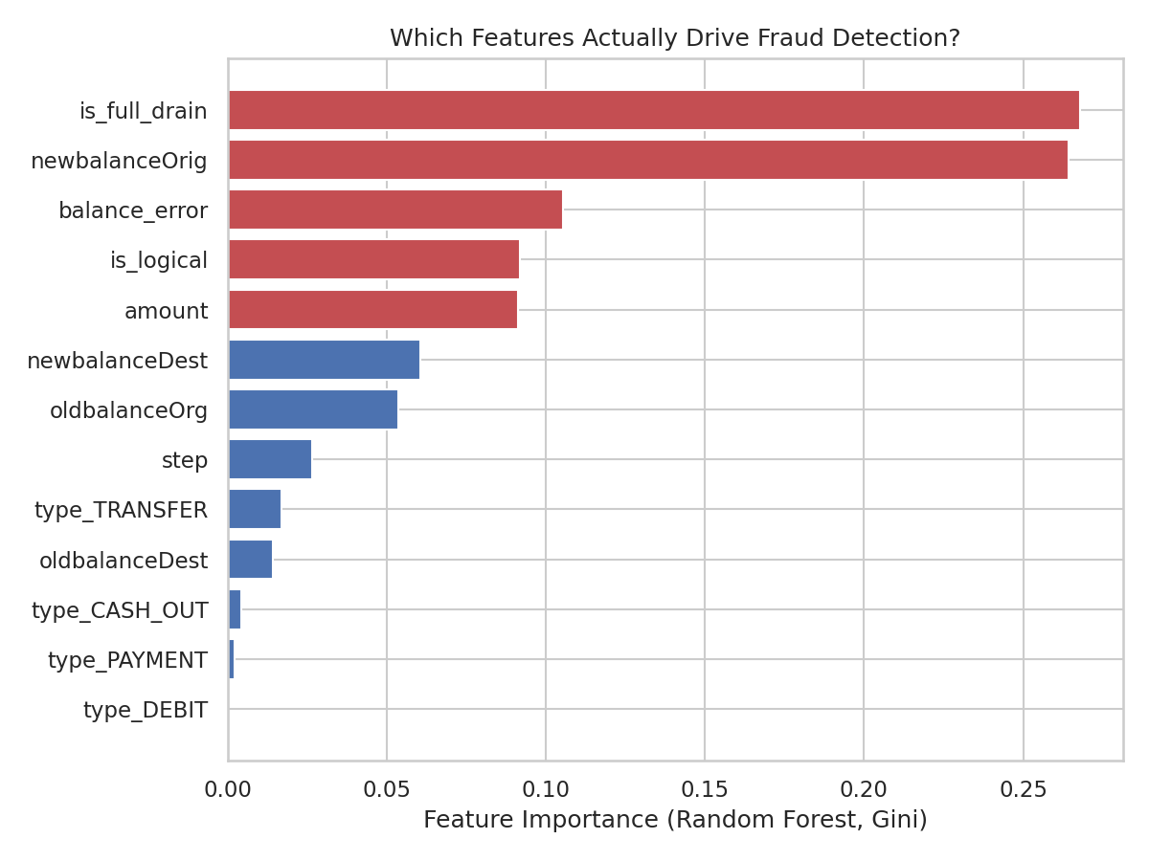
What Does the Model Actually Rely On?
Random Forest Feature Ranking
is_full_drain (26.8%) + newbalanceOrig (26.4%) account for over half the model's decision-making weight Directly corroborates the EDA's balance-draining finding (Slide 5) - from a completely independent analytical path type_DEBIT and type_PAYMENT ranked lowest and were dropped - consistent with fraud never occurring in those types
Shap Shifters | Suspicious Transaction Detection | DSC Hackathon 2026
9

Slide 10
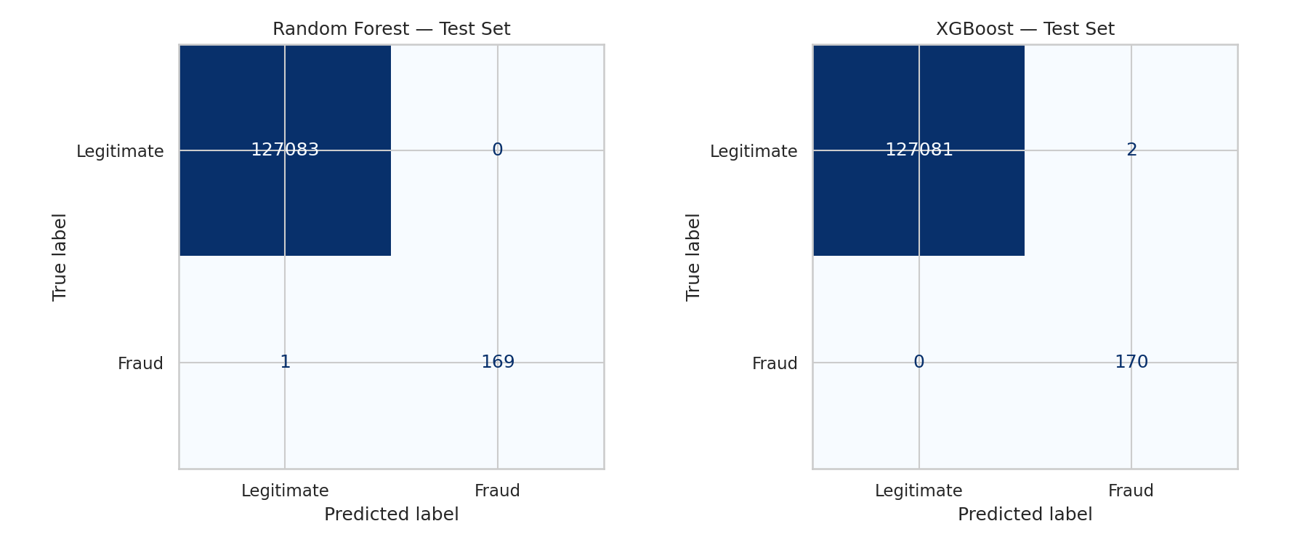
Random Forest vs. XGBoost — Test Set Results
1/170
0/170
127K
fraud missed
(Random Forest)
fraud missed
(XGBoost)
test-set
transactions
Both models score above 0.99 precision and recall on the fraud class. Random Forest: 0 false alarms, 1 missed fraud. XGBoost: 2 false alarms, 0 missed fraud. Compare that to the mobile money operator's current system, which catches just 2 of 849 fraud cases (0.24%) system-wide.
Shap Shifters | Suspicious Transaction Detection | DSC Hackathon 2026
10

Slide 11
A Necessary Reality Check, Then Our Recommendations
Why Scores This High Deserve Scrutiny
Recommendations
Deploy a two-layer system: an explainable rule alongside the ML model, live before full model validation Retire the current rule-based flag - 0.24% detection is not a meaningful control Fix balance logging upstream for the 33-63% affected segment; monitor it separately in the meantime Favour recall over precision given a missed fraud costs far more than a false alarm Keep a human in the loop on every flagged transaction before customer-facing action
Both models converge on one clean, almost deterministic pattern (balance-draining). That suggests the near-perfect scores reflect how separable this synthetic dataset is, not model sophistication. Real fraudsters adapt once a pattern is known - live performance should be expected to be materially lower than this upper-bound result.
Shap Shifters | Suspicious Transaction Detection | DSC Hackathon 2026
11

Slide 12
Blockchain-Based Solution: Overall Approach
Overall Solution
Accommodating the Elderly
Keep familiar channels: USSD, ATM, branch, and agent-assisted serviceAccessible design: large fonts, simple menus, local languages, voice guidanceCaregiver support: trusted family members assist through controlled, revocable authorizationInvisible infrastructure: blockchain runs in the background - no technical knowledge required to use the service
Permissioned blockchain: shared by banks, mobile money operators, and approved regulators - not a public, anonymous networkBanks stay central: responsible for customer accounts, compliance, and dispute resolutionTamper-resistant record: of every transaction and fraud alertSmart contracts: automate agreed rules without removing human oversight
Shap Shifters | Suspicious Transaction Detection | DSC Hackathon 2026
13

Slide 13
Smart Contracts, Accessibility & Security
What Is a Smart Contract?
Balancing Accessibility and Security
Accessibility: simple interfaces, multiple channels, assisted support, low-data optionsSecurity: encryption, multi-factor authentication, transaction monitoring, immutable recordsRisk-based controls: low-risk transactions stay easy; suspicious ones get stronger checksHuman review: for customers who cannot complete digital verification independently
Self-executing program: stored on the blockchain, applying predefined rules automaticallyExample: a transaction exceeding a risk threshold is paused and sent for extra verificationFaster and transparent: reduces delays while creating a clear audit trail
Shap Shifters | Suspicious Transaction Detection | DSC Hackathon 2026
14

Slide 14
South African Legal & Regulatory Compliance
Key Legislation
Standards & Governance
FICA: monitor, identify, and report suspicious transactionsPOPIA: process personal information lawfully, protect privacyBanks Act: registered banks manage risk, maintain governanceNational Payment System Act: compliance for mobile money and payment transactions
Cybercrimes Act: protect systems and data from cyber-enabled fraudNational Credit Act: consider impact of flagged transactions on credit accessFATF recommendations: align controls with international AML standardsKing IV: ethical governance, accountability, and responsible tech use
Shap Shifters | Suspicious Transaction Detection | DSC Hackathon 2026
15

Slide 15
Implementation Outcome
Banks remain central to customer service and regulatory accountability.Elderly customers keep their channels, with additional caregiver and human-review support.Smart contracts improve speed, consistency, and traceability of fraud controls.The platform strengthens trust, security, and compliance across the mobile money ecosystem.
Shap Shifters | Suspicious Transaction Detection | DSC Hackathon 2026
16

Slide 16
Conclusion
This project combined a thorough exploratory analysis with two supervised machine learning models to address the DSC Hackathon's Suspicious Transaction Detection challenge. Fraud in this dataset is concentrated in TRANSFER and CASH_OUT transactions, dominated by a single explainable balance-draining pattern, and almost entirely missed by the mobile money operator's existing rule-based system. Both Random Forest and XGBoost, trained on features that capture this pattern, achieve precision and recall above 0.99 on held-out data - a result we present with appropriate scientific caution given the synthetic, non-adversarial nature of the dataset.
Combined with our business recommendations, this gives our mobile money partner a concrete, data-driven path to materially improving on a current detection rate of 0.24% - directly answering the transaction-monitoring standard the FATF greylisting requires South African banks and mobile money operators to meet.
Shap Shifters | DSC Hackathon 2026

