Slide 1
Los Angeles Airbnb Capstone
June 2023

Slide 2
Capstone Steps
Problem Statement
Data Wrangling
Exploratory Data Analysis
Feature Engineering
Modeling
Further Improvement

Slide 3
Problem Statement
Encouraged by the idea of making money from my home when I am not living in it, in January 2022, I started traveling, working remotely and rented out my two-bedroom condo in Venice in the county of Los Angeles. So far, the revenue does not look promising due to the low occupancy rate. With one year host experience, I decided to use my data science skills to analyze Airbnb data to improve the revenue by 30% in 2023.
The goal is to answer the questions below:
How are the listings distributed across the area of Los Angeles?
How do the prices vary with respect to the neighborhood, property type, month, and day?
Can machine learning be used to predict prices?
The data is from insideairbnb.com/get-the-data/

Slide 4
Data Wrangling
Original listing dataset was 21,003 rows and 75 columns.
Removed columns with no data or un-useful data that have no good information for the solving problem.
Removed listing with prices equal to zero or over $5,000 to avoid skewed data
Removed special characters in host-response-rate, host-acceptance-rate, and price and convert them from object to float. Split bathroom text into qty and type
Final data shape is 20,993 rows and 34 columns.

Slide 5
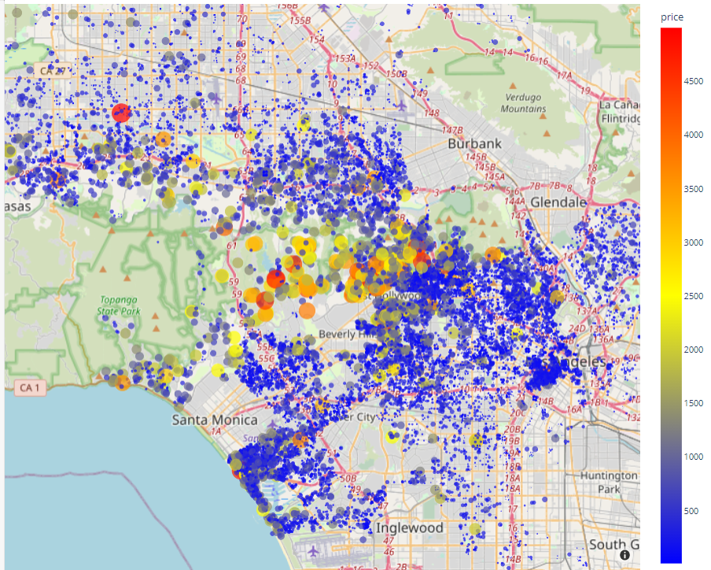
Exploratory Data Analysis
Map of Los Angeles, flat and hilly
Bel-Air, Beverly Crest, and Hollywood Hills West are prestigious and super expensive
Clusters in Downtown and Venice areas
My property

Slide 6
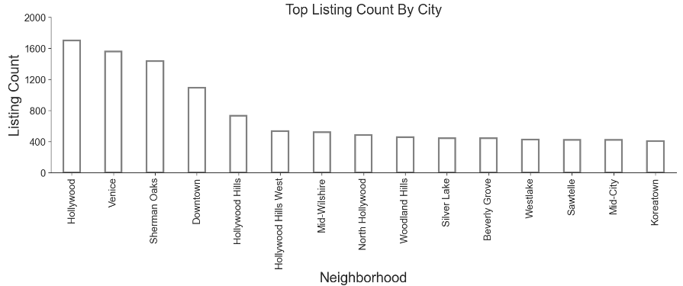
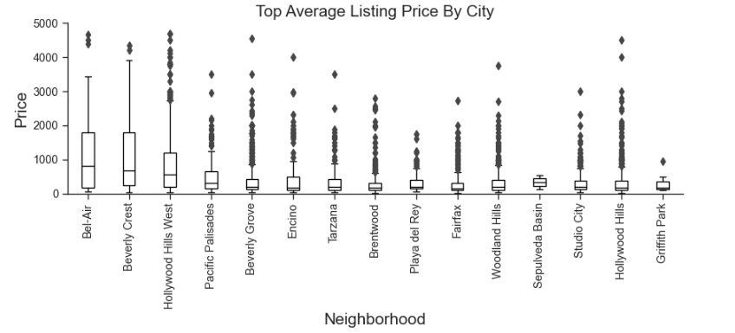
Where to stay

Slide 7
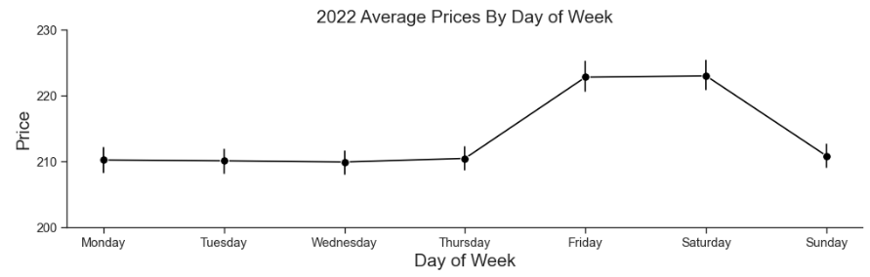
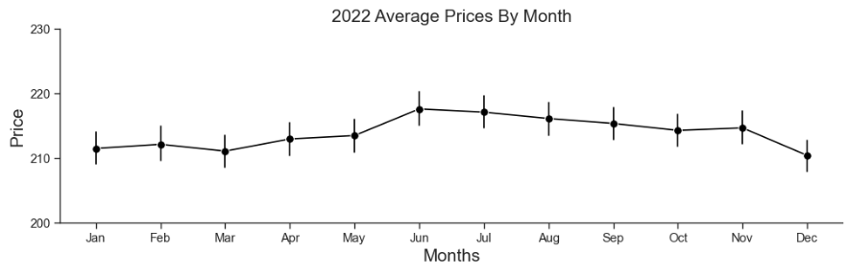
Flexible Pricing

Slide 8
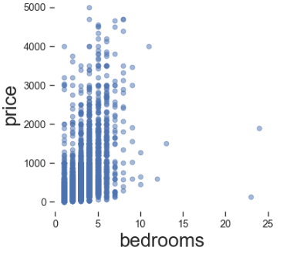
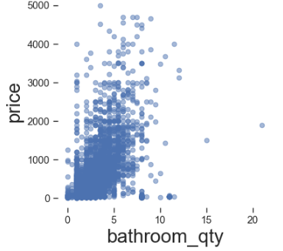
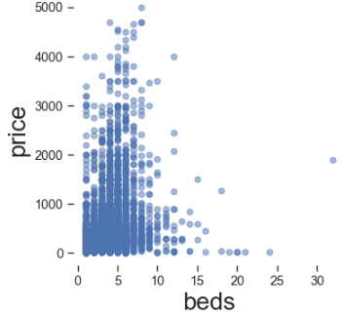
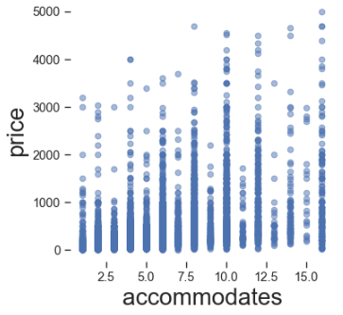
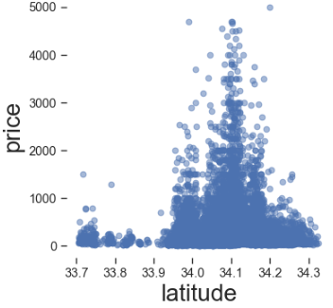
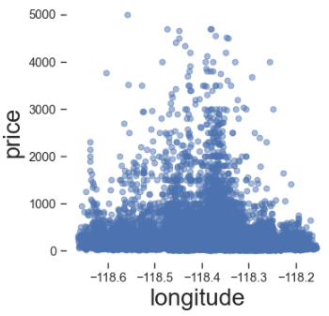
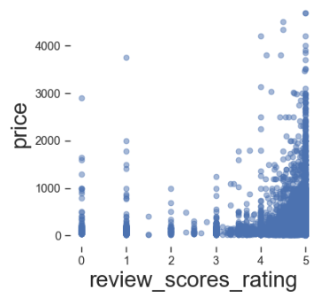
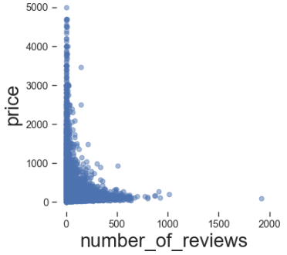
Price Correlation

Slide 9
Feature Engineering
Removed listings with missing bedroom and bed counts
Got dummies variables for neighborhood
Imputed reviews with median value
Use standard scaler

Slide 10
Modeling
Linear Regression
1
Lasso
2
Ridge
3
Random Forest
4
Decision Tree
5

Slide 11
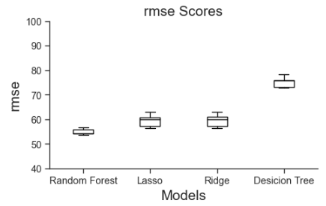
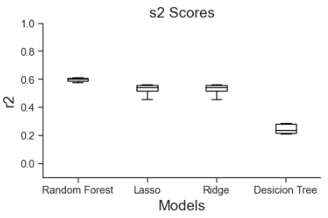
Cross Validation

Slide 12
Modeling Scores
 | Linear regression | Lasso | Ridge | Random Forest
r2 | 0.51 | 0.54 | 0.54 | 0.57
mae | 45.6 | 45.9 | 42.5 | 40.81
mse | 3667 | 3700 | 3185 | 3244
rmse | 60 | 60 | 62 | 56.9

Slide 13
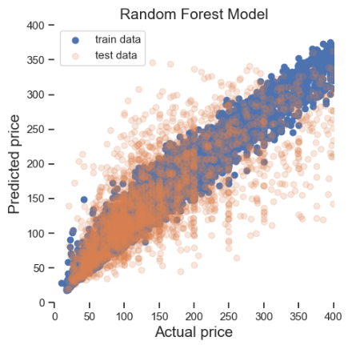
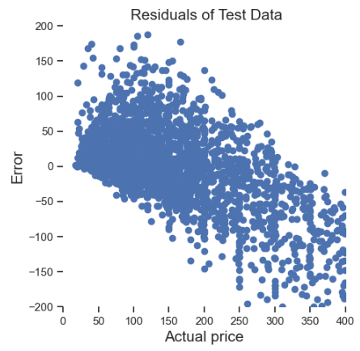
Random Forest Prediction
Train data is overfitted
Overpredicted
Underpredicted
Underpredicted
Overfitted
R2: Train data 0.94, test data 0.57
Hyperparameters n-estimator improve r2 from 0.54 to 0.57
$20 to $100 mostly overpredicted
$300 to $400 are under predicted

Slide 14
Future Improvements
1/ Bedroom shows as the number one important feature. To target bigger groups for better price, I plan to convert the loft on the second floor to a third bedroom
2/ Set higher rates for Friday, Saturday, and high season to maximize profit and lower prices for Sunday to Thursday and low season to maximize occupancy
3/ Besides, bedrooms, bathrooms, and locations, the property pictures are the feature that people use to make the final decision. New and nicely decorated properties cost way more than old properties. How can I incorporate pictures to price prediction?

