Slide 1
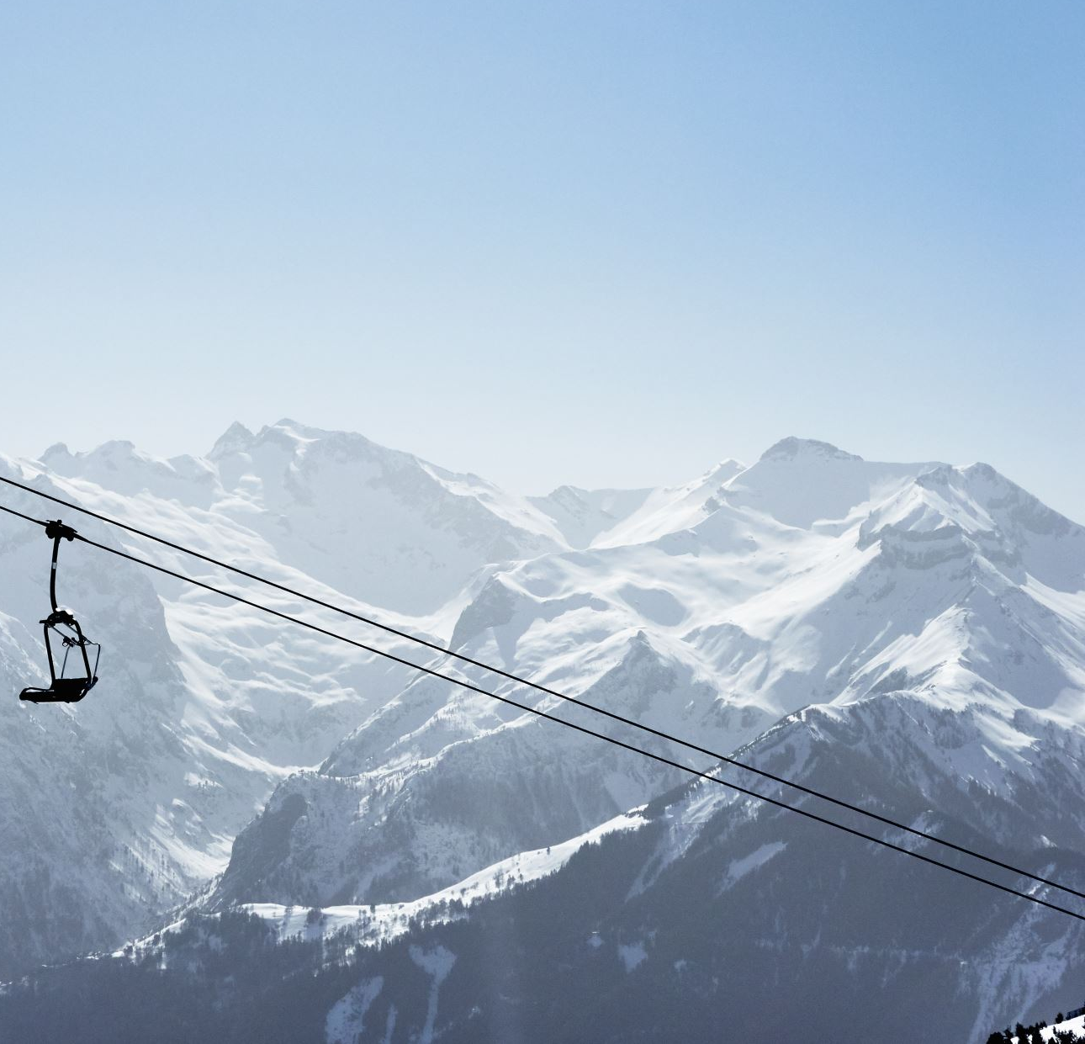
Big Mountain Resort

Slide 2
Problem Identification
Problem statement:
How can Big Mountain Resort improve its pricing strategy to grow revenue by 10% in the next year by either higher ticket prices or cutting costs without undermining the ticket price?
Context:
Big Mountain Resort is a top-notch resort but it is not capitalizing on its facilities as much as it should. To grow revenue, it needs to select a better value for its ticket prices.
Success criteria:
Success for this project is a clear set of actions to grow revenue by 10% in the next year
Constraints:
Need to improve revenue as it has recently installed an additional chair lift which increased its operating cost significantly
Solely depend on the data source which may not be 100% accurate
Scope + risks:
There is a risk of losing customers with higher price tickets or disappointing existing customers with changes.

Slide 3
Recommendation and Key Findings
The predicted ticket price for the Big Mountain Resort was $94.22 while the averaging pricing strategy was $81
Features that came up as important with a strong correlation to pricing in the modeling included:
Vertical_drop, Snow Making_ac, total_chairs
fastQuads, Runs, LongestRun_mi, Trams, SkiableTerrain_ac
The potential revenue increase could be twenty-three million dollars if the resort chooses to use the predicted model price assuming 350,000 visitors per year with an average of five tickets per stay
Regarding four potential scenarios for either cutting costs or increasing revenue, scenario#2 was recommended as it supported per ticket increase of $1.99 while the operating cost was $0.88

Slide 4
Modeling Results and Analysis
State did not show a correlation to the ticket price
Dropped Weekday ticket price as it was very close to the weekend ticket price
Filled missing numeric data with median value ( mean yielded similar results)
Big Mountain Resort ticket price was removed from the data set for modeling to avoid bias
Random forest model was selected to predict the ticket price over the simple regression as it provided smaller cross-validation mean absolute error and smaller variability. The verification on the test set was also close to the cross-validation results.
Below are features that came up as important during modeling as they have a strong correlation to pricing and the Big Mountain Resort is doing well for all of these features.
Vertical_drop
Snow Making_ac
total_chairs
fastQuads
Runs
LongestRun_mi
Trams, SkiableTerrain_ac

Slide 5
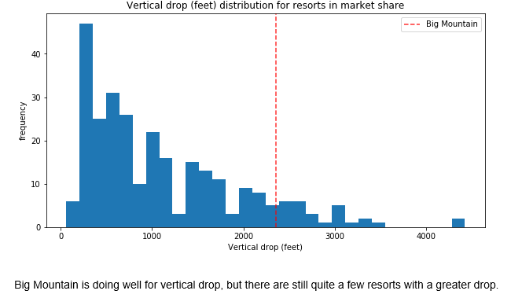
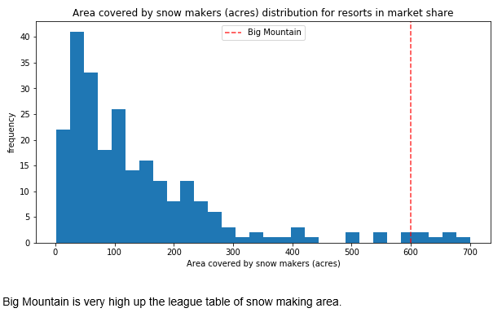
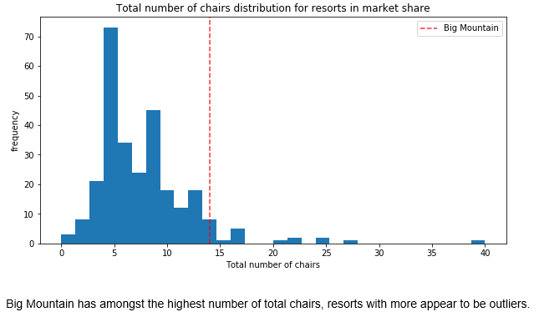
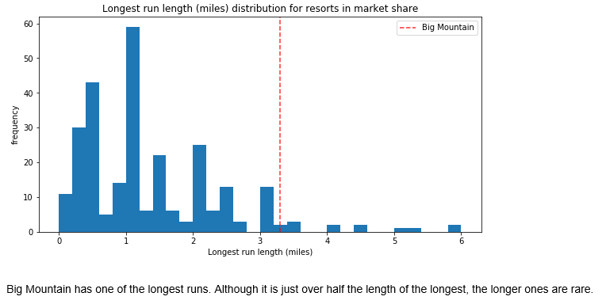
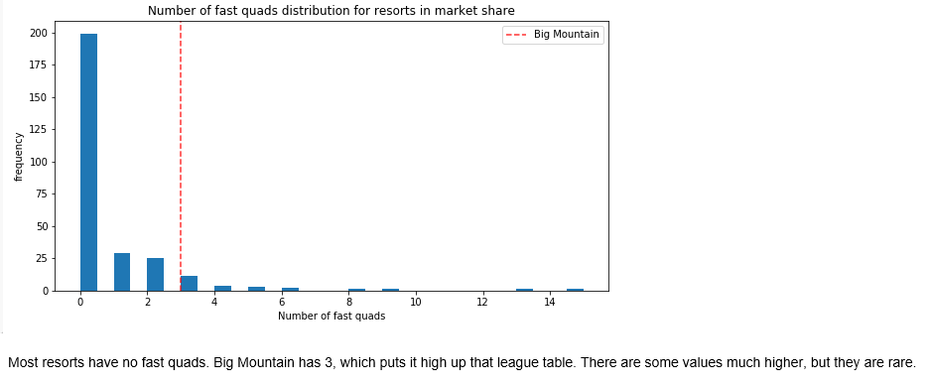
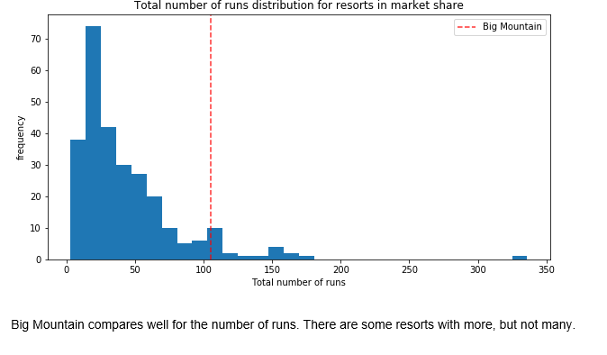
Modeling Results and Analysis Cont…
Where does Big Mountain Resort sit among all resorts for price and important features? price and important features

Slide 6
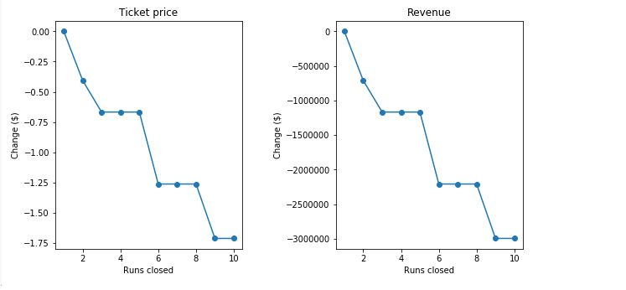
Modeling Results and Analysis Cont…
Big Mountain Resort has been reviewing potential scenarios for either cutting costs or increasing revenue (from ticket prices). All four of the scenarios have been modeled and the result is shown below:
Scenario#1: Permanently closing down up to 10 of the least used runs. This doesn't impact any other resort statistics. See the revenue impact in the plot right below.
Scenatio#2: Increase the vertical drop by adding a run to a point 150 feet lower down but requiring the installation of an additional chair lift to bring skiers back up, without additional snow-making coverage. This scenario increases support for the ticket by $1.99 which will bring in an additional 3.5 million over the season
Scenario#3: Same as scenario#2, but adding 2 acres of snow-making cover. The modeled result is similar to scenario#2.
Scenario#4: Increase the longest run by 0.2 miles to boast 3.5 miles length, requiring additional snow-making coverage of 4 acres. The model showed these changes made no change to the ticket price.

Slide 7
Summary and Conclusion
Big Mountain Resort sits high for all top-notch facility features that are important to skiers
Recommended ticket price is $94 ( current $84)
Potential yearly revenue increase could be twenty-three million dollars
Among four scenarios for cutting cost and increasing ticket price, scenario#2 is recommended

