Slide 1

Loan default prediction

Slide 2
CONTENTS
Problem Statement
Data Wrangling
EDA
Modeling
Summary

Slide 3
Problem statement
The finance sector is focused on one essential mathematical problem how can we assess and quantify risk? While this is usually calculated by large firms, in recent years more and more opportunities have arisen for individuals to not only buy but also sell financial products. LendingClub enables borrowers to create unsecured personal loans and investors to search and browse the loan listing on their website. This puts normal people in the same position as banks, allowing them to select loans that they want to invest in based on the information supplied about the borrower.
With Machine Learning, I aim to help answer this question by building a model that can evaluate and learn from previous loans to help recommend the best loans for individuals to invest in.

Slide 4
Data wrangling
Original listing dataset had 855,969 rows and, 73 columns
Removed un-useful columns
Converted categorical column to numeric to avoid creating more dummies for modeling
The final dataset is 855,969 rows and, 25 columns

Slide 5
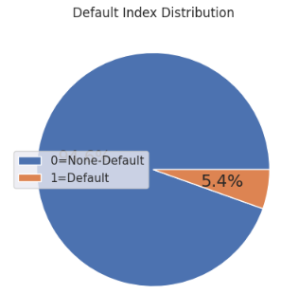
TARGET DEFAULT
Why LendingClub default is higher than the average bank default of 3.9%?
Are individual investors willing to tolerate extra risk for high returns with low-credit borrowers?

Slide 6
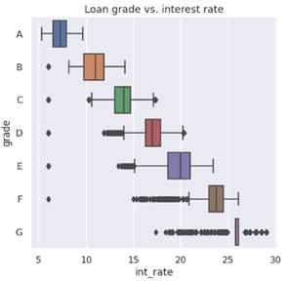
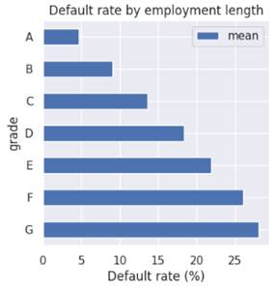
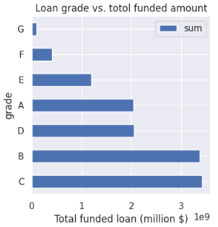
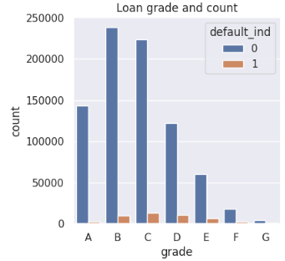
Loan grade

Slide 7
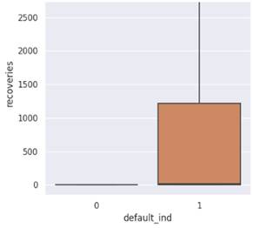
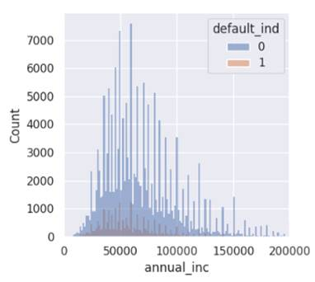
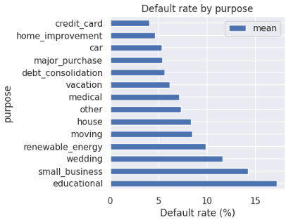
recoveries AND PURPOSE

Slide 8
modeling
Logistic Regression
Random
Forest
Gradient Boosting

Slide 9
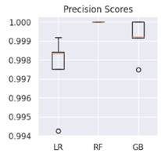
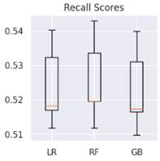
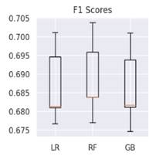
Precision/recall
LR= Logistic Regression, RF= Random Forest, GB= Gradient Boosting

Slide 10
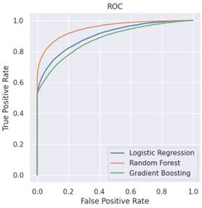
Roc/auc
 | Logistic Regression (LR) | Random Forest (RF) | Gradient Boosting (GB)
AUC | 0.9 | 0.95 | 0.88
Best Estimators | Penalty=l2 Standardscaler=None | N_estimators=300 Standardscaler=None | Learning-rate=1 Standardscaler=standardscaller()

Slide 11
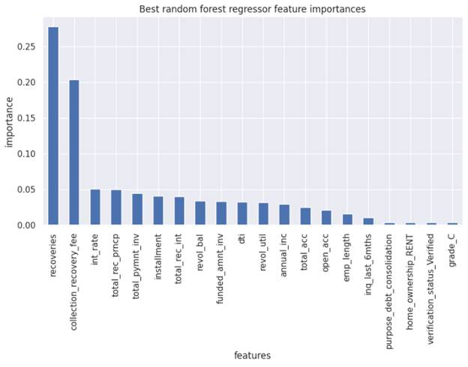
Feature importance

Slide 12
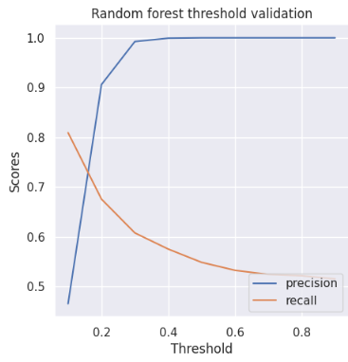
Random forest VS. THRESHOLD

Slide 13
SUMMARY
Focusing on the need to maximize returns and minimize risks for investors, the random forest classifier seems like the best model as it has the best performance scores. Would recommend loan grades A and B to investors
Future Improvement
We are in the middle of a challenging macroeconomic environment with the highest inflation and the highest interest rate. As a result, default risk increases. Now is the time to be conservative. I would only recommend loan grades A, B, and C to investors as they have low default rates and are in the top three funded loans which means they have investors’ trust.

Slide 14
THANK YOU

