Slide 1


REVIEW-1 EcoSolar: Enhancing Renewable Energy with Dust Detection Project Category: RESEARCH
Student Name & Registration Number:
V Kanaka Durga Prasad -RA2111027010204
Ranjith kumar Govindasu-RA2111027010192
S Vishnu Vardhan-RA2111027010206
Aketi Sai Manhora Naveen-RA2111027010197
Guide Name:Mrs. Anna Anbumozhi
Designation: Assistant Professor
Department : DSBS

Slide 2
Abstract
Solar panels are a cornerstone of renewable energy initiatives, but their efficiency is significantly hampered by dust accumulation, which blocks sunlight and diminishes energy output. To address this issue, we propose an advanced automated dust detection system leveraging deep learning techniques. Our solution employs the VGG16 Convolutional Neural Network (CNN), renowned for its high accuracy in image classification, utilizing its deep architecture for detailed feature extraction to effectively differentiate between clean and dusty solar panels.Developed with the TensorFlow framework, our model ensures efficient and reliable operation, capable of processing extensive image data with precision. Trained on a comprehensive dataset of solar panel images under various dust conditions, the model exhibits robust classification capabilities.This automated system reduces the need for manual inspections, maintaining solar panel efficiency and supporting continuous performance. Our approach not only enhances operational efficiency but also aligns with sustainable energy goals, ensuring optimal solar panel performance and contributing to a greener future.

Slide 3
Introduction
Solar panels are crucial for renewable energy and sustainability. Dust accumulation obstructs sunlight and reduces their energy output.
Dust buildup not only impacts efficiency but also increases maintenance costs and efforts. Addressing this issue is essential for optimal panel performance.
An automated dust detection system is proposed to ensure solar panels operate efficiently. This solution leverages advanced deep learning techniques.
The approach utilizes the VGG16 Convolutional Neural Network (CNN). VGG16 is known for its high accuracy in image classification and detailed feature extraction.
The system was developed using the TensorFlow framework. TensorFlow provides efficient and reliable model operation for processing large image datasets.
.

Slide 4
The model was trained on a comprehensive dataset of solar panel images. This dataset includes various conditions of dust accumulation to enhance classification accuracy.
Our approach automates the dust detection process, providing a robust tool for maintaining solar panel efficiency. This integration of deep learning with practical image analysis reduces manual inspection efforts.
The automated dust detection system significantly advances solar panel maintenance technology. It uses deep learning and sophisticated image analysis for proactive dust identification.
The solution ensures solar panels remain in optimal condition, maximizing energy output and minimizing the need for frequent manual inspections.
This innovative system enhances operational efficiency and supports sustainable energy goals by maintaining peak solar panel performance.
By contributing to more efficient solar energy systems, the solution aids in achieving a greener and more sustainable future.

Slide 5
Problem Statement
Dust accumulation on solar panels significantly reduces their efficiency, blocking sunlight and impairing power generation. Current manual inspection methods are inefficient, costly, and prone to delays, leading to performance losses. There is a critical need for an automated system to detect dust buildup in real-time, ensuring panels maintain optimal functionality. This system would enhance output, reduce maintenance efforts, and support the advancement of sustainable energy solutions.

Slide 6
Objective
Automate dust detection on solar panels using deep learning.
Deploy VGG16 CNN for precise differentiation between clean and dusty panels
Implement with TensorFlow for robust and scalable system performance.
Train on diverse image data to ensure the model's accuracy under varying dust conditions.
Minimize manual inspections and associated operational costs.
Optimize solar panel efficiency by maintaining clear surfaces for maximum sunlight exposure.
Align with sustainable energy initiatives by improving renewable energy output.

Slide 7
Methodology
Collect a diverse dataset of solar panel images under various dust conditions.
Preprocess the images by normalizing, resizing, and labeling them according to dust levels.
Select and modify the VGG16 architecture to suit the dust classification task.
Train the model using the dataset, adjusting hyperparameters for optimal performance.
Evaluate model performance using accuracy, precision, recall, and F1-score metrics.
Integrate the trained model into the automated dust detection system.
Conduct real-world testing and calibrate the system based on performance feedback.
Implement continuous monitoring to adapt the model to changing conditions.
Analyze and report on the system’s performance and its impact on solar panel efficiency
.

Slide 8
Research Gap
Lack of efficient, real-time monitoring systems that accurately detect dust on solar panels.
Dependence on manual inspections or basic sensors, which are less effective for detailed dust analysis.
Limited capability of existing systems to process and analyze large volumes of image data accurately.
Insufficient integration of advanced deep learning techniques for precise dust differentiation.
Need for seamless integration with existing solar panel infrastructure to enhance maintenance and efficiency.

Slide 9
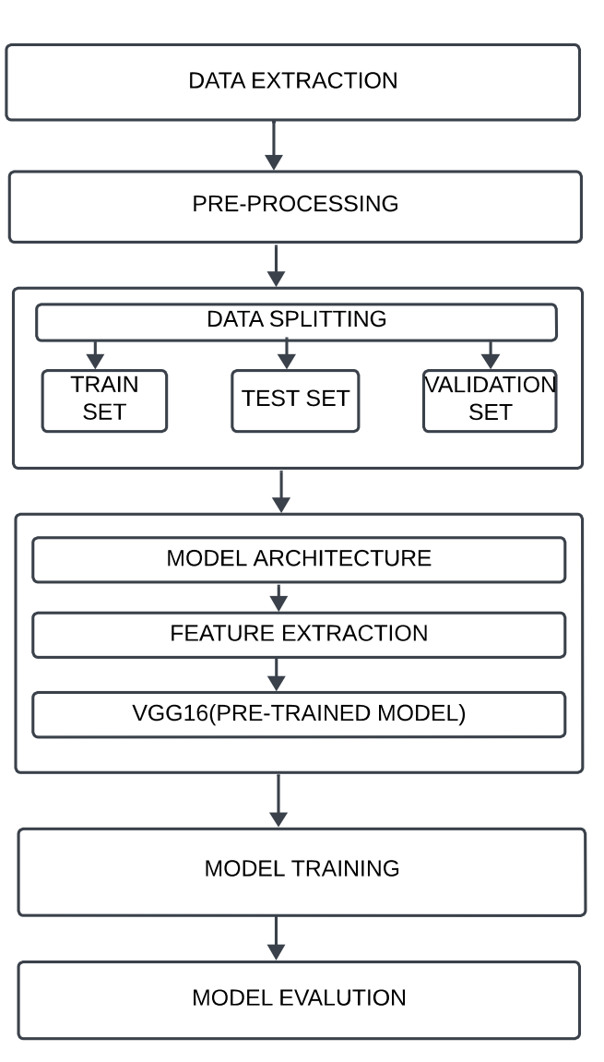
Architecture Diagram

Slide 10
Literature Survey
S. No | Title (Name of the journal, author and publication details) | Methodology (Provide a Summary of key studies and their findings) | Identification of gaps and limitations. (Identify the limitations of the Research Paper)
1 | Dust Detection on Solar Panels: A Computer Vision Approach by Abukhait,Jaafar(2023). | Feature Extraction Techniques Classification Model Experimental Validation | Limited Understanding of Dust Variations Challenges with Real-World Conditions Potential for Contextual Ambiguity
2 | Real-Time IoT-Enabled Solar Panel Cleaning System with Dust Detection by Nazmun Nahar Karima , Mahmudul Hasan Saikat (2024). | Image Acquisition and Dust Detection Automated Cleaning Mechanism Real-Time Monitoring and Notifications | Image Processing Accuracy and Environmental Factors Mechanical Wear and Tear Connectivity and System Reliability
3 | Design and Development of Smart Self-Cleaning Solar Panel System by Nurul F. Zainuddin, M. N.Mohammed, S. Al-Zubaidi and Sami . Khogali(2019). | Self-Cleaning Mechanism Design IoT-Based Monitoring and Control Performance Evaluation and Testing | Limited Cleaning Coverage Dependence on IoT Connectivity High Initial Cost and Complexity

Slide 11
S. No | Title (Name of the journal, author and publication details) | Methodology (Provide a Summary of key studies and their findings) | Identification of gaps and limitations. (Identify the limitations of the Research Paper)
4 | Inspection of Photovoltaic Panel Surface Cleanliness Using Ratio of Power to Illumination Method by Guilian Ma, Qingguang Yu, Hengjun Qiu (2023) | Measurement of Power and Illumination Calculation of Power-to-Illumination Ratio Standardization and Detection | Variability in Dust Types and Effects Environmental Factors Impacting Measurement Maintenance and Calibration Needs
5 | A comprehensive study for solar panel fault detection using VGG16 and VGG19 convolutional neural networks by Asif Mahmud, Md.Shamsur Rahman Shishir,Rifat Hasan, Mushifiqur Rahman(2023) | Drone-Based Imaging for Fault Detection CNN-Based Fault Classification Integration of Thermography with Telemetry | Annual Efficiency Decline Data Processing and Analysis Complexity Algorithm Limitations and Calibration
6 | Studies on Techniques to Improve YOLO in Fault Detection Using RGB Images of Solar Panels by Weng Ti Wong, Swee King Phang(2024) | Application of YOLOv7 on RGB Images Optimization Techniques Performance Evaluation | Cost and Equipment Limitations Accuracy and Training Time Optimization Generalization Across Different Fault Types

Slide 12
S. No | Title (Name of the journal, author and publication details) | Methodology (Provide a Summary of key studies and their findings) | Identification of gaps and limitations. (Identify the limitations of the Research Paper)
7 | AUTOMATIC SOLAR PANEL CLEANER by Gayathry Menon, Anjana N Sathyan, John J Tharayil, Aswin Ramesh, Dr Jayan A.R(2024) | Dust Detection Mechanism Cleaning Process Operational Integration | Incomplete Dust Detection Cleaning Efficiency Challenges Movement and Coordination Issues
8 | Enhancement of Photovoltaic Dust Detection using Deep Learning Technique by R. Lillian Gracia, Priyadharsini.C, B.Elizabeth Caroline(2024) | Input Layer Convolutional Layer Activation Function | Incomplete Feature Extraction Ineffective Pooling Training and Hyperparameter Issues
9 | A Novel High-Speed Sensorless Faulty Panel Detection Technique for an SPV String/Array by Sreedhar Madichetty, Yellepeddi Venkata Sai Manoj, Shaik Abdul Kareem, and Sukumar Mishra(2022) | Healthy Mode OperationFault Mode Operation Validation and Testing | Healthy Mode Efficiency Issues Fault Detection Accuracy Testing and Communication Limitations

Slide 13
S. No | Title (Name of the journal, author and publication details) | Methodology (Provide a Summary of key studies and their findings) | Identification of gaps and limitations. (Identify the limitations of the Research Paper)
10 | Advanced Deep Learning Solutions for Automated Diagnosis of Solar Panel Issues by Chaitra Pala, Poojitha Bollem, Neelima N(2024) | Dataset Acquisition Image Preprocessing Feature Extraction and Data Splitting | Dataset Acquisition Gaps Image Preprocessing Issues Feature Extraction and Data Splitting Challenges
11 | A Novel Technique for Detecting and Monitoring Dust and Soil on Solar Photovoltaic Panel by Kamal Adel Abuqaaud , Azzeddine Ferrah(2022) | Dataset Acquisition Image PreprocessingFeature Extraction and Model Training | Data Labeling and Annotation Errors Generalization to Diverse Environments Model Overfitting
12 | Advanced Image Processing Based Solar Panel Dust Detection System by Nazmun Nahar Karima, Kamruzzaman Rimon, MD Sumon Molla, Mahmudul Hasan, and Muhibul Haque Bhuyan(2023) | Calibration and Dust Detection Image Processing Techniques Advanced Image Processing with NVIDIA Jetson | Calibration Accuracy Issues Reliability of Image Processing Real-Time Processing Delays

Slide 14
S. No | Title (Name of the journal, author and publication details) | Methodology (Provide a Summary of key studies and their findings) | Identification of gaps and limitations. (Identify the limitations of the Research Paper)
13 | Image Processing Based Dust Detection and prediction of Power using ANN in PV systems by Dania Saquib, Mohammed Nabeel Nasser, Swaroop Ramaswamy(2020) | techniques for Dust Detection and Calibration Innovative Image Analysis Methods Edge Computing with NVIDIA Jetson for Real-Time Processing | Implications of Calibration Inaccuracies Challenges in Image Analysis Precision Consequences of Real-Time Processing Inefficiencies
14 | Photovoltaic Panel Temperature Monitoring and Prediction by Raman Distributed Temperature Sensor With Fuzzy Temperature Difference Threshold Method by Tao Yu, Chunguang Ren, Yanbing Jia, Jian Li, Jianzhong Zhang , Yang Xu(2021) | Fuzzy Temperature Difference Threshold Method (FTDTM) Overview Raman Distributed Temperature Sensor (RDTS) System Implementation Experimental Validation and Error Analysis | Accuracy Limitations in Temperature Prediction Effects of Environmental Factors on Temperature Detection Challenges in Scaling and Early Warning Systems
15 | Evaluation of Effect of Pre-Processing Techniques in Solar Panel Fault Detection by SUJATA P. PATHAK(2023) | Thermal Imaging for Fault Detection Pre-Processing Techniques and Their Impact Segmentation Methods for Fault Analysis | Accuracy of Fault Detection and Demarcation Influence of Pre-Processing on Detection Performance Challenges in Identifying and Addressing Faults

Slide 15
Justification of SDG Plan of Action
Our dust detection system for solar panels aligns seamlessly with SDG 7: Affordable and Clean Energy by significantly boosting the performance and sustainability of renewable energy technologies.
Enhancing Solar Panel Efficiency: Our system optimizes performance by accurately identifying and addressing dust. This ensures panels operate at maximum efficiency, improving clean energy technology reliability.
Promoting Renewable Energy: Enhanced panel efficiency supports the broader goal of expanding renewable energy use, reducing reliance on fossil fuels, and transitioning to a sustainable energy infrastructure.
Reducing Maintenance Costs: The system decreases the need for frequent manual inspections, lowering maintenance costs and making solar energy more accessible and affordable.

Slide 16
Result and Discussion
Utilizing the VGG16 CNN, the automated dust detection system significantly enhances solar panel monitoring by achieving high accuracy in distinguishing between clean and dusty panels. This advancement reduces the need for manual inspections, saving time and labor costs. By ensuring timely detection and cleaning, the system maintains optimal panel performance and prevents energy losses. Its seamless integration with existing infrastructure makes it scalable across various solar installations. This approach not only improves efficiency but also aligns with sustainability goals by boosting renewable energy production and supporting a greener future.

Slide 17
Conclusion
The implementation of the automated dust detection system utilizing the VGG16 CNN significantly enhances the efficiency of solar panel operations. By accurately distinguishing between clean and dusty panels, the system reduces the need for manual inspections, thereby saving time and labor costs. Its effective integration with existing infrastructure ensures optimal performance and increased energy output. This advancement not only improves operational efficiency but also contributes to sustainability goals by maximizing renewable energy production.

Slide 18
Future Enhancements
Improve Detection in Varied Conditions: Enhance accuracy in detecting dust under different environmental conditions such as varying light and weather.
Incorporate Predictive Maintenance: Develop features to predict dust accumulation trends and schedule maintenance proactively.
Expand Dataset: Include a broader range of dust conditions and panel types in the training dataset for increased model robustness.
Integrate Real-Time Adaptation: Implement real-time data processing to handle dynamic changes in dust patterns and panel usage.
Analyze Energy Savings: Calculate and analyze the total energy savings achieved from improved panel efficiency to assess the system's impact on overall energy production.
Reduce Costs: Explore ways to lower system costs to make the technology more accessible for smaller-scale solar installations.

