Slide 1
Stock Trading Strategy with machine learning methods
Team 2

Slide 2

The steps to build our strategy
-> Download data of SPY500 components (yfinance)
-> Labels assigning
-> Factors-calculation
-> Model training:
---> Random Forest
--->Logistic Regression
--->naive bayes
--->lightgbm
-> Weights assigning

Slide 3

Features
01 BBands Width
02 Chaikin A/D Line
03 MACD
04 RSI
05 ROC
06 Momentum
07 Adj Close

Slide 4
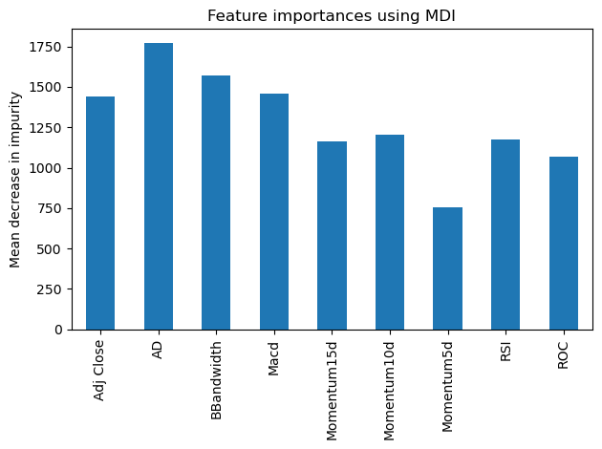
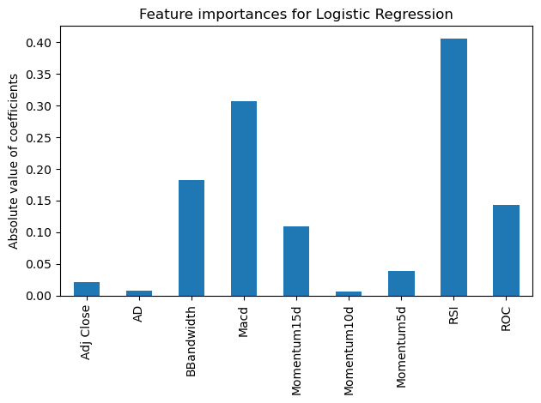
Feature importance
Random Forest
Logistic Regression

Slide 5
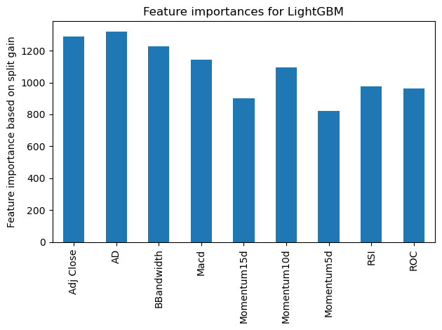
Feature importance
Lightgbm
Random Forest

Slide 6
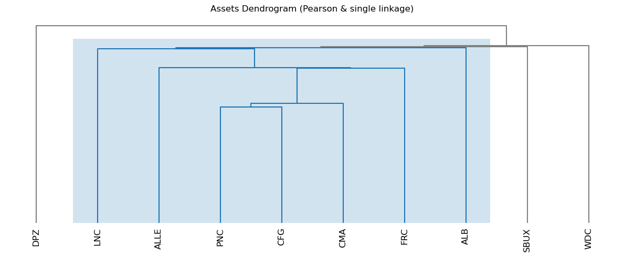
HPR
How it works:
Define the set of assets
Compute the pairwise correlations
Cluster the assets
Allocate risk within each cluster
Construct the portfolio
Assets Dendrogram

Slide 7
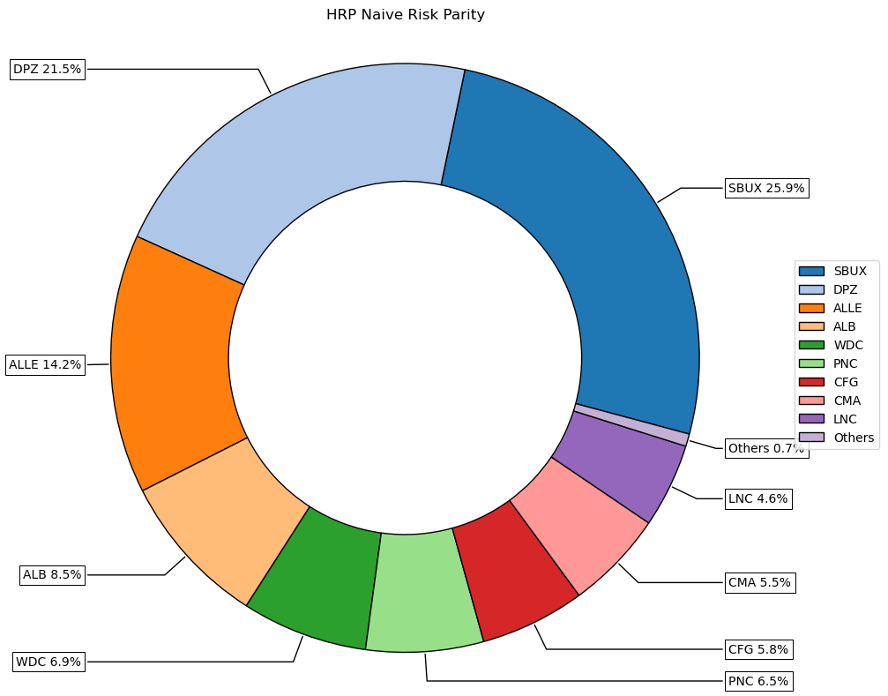
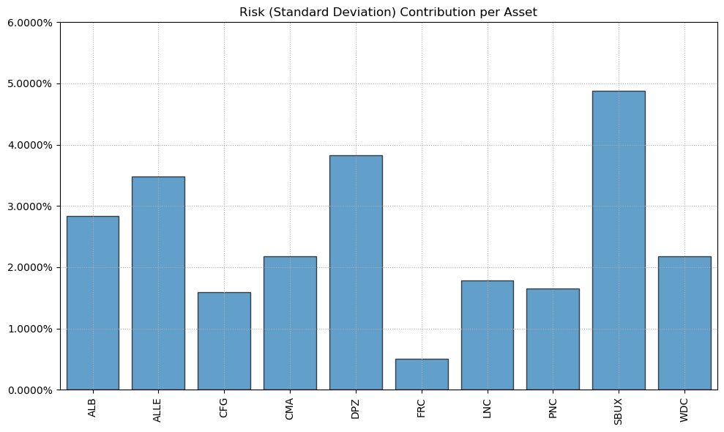
Results
Risk Contribution
Portfolio Composition

Slide 8

Performance

Slide 9
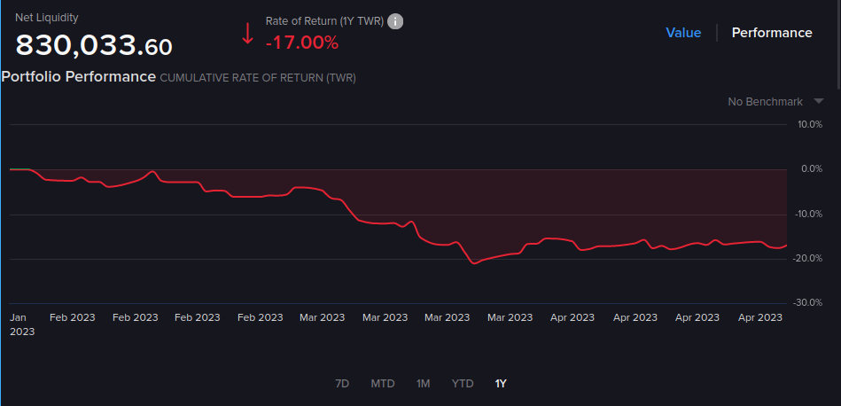
Performance

Slide 10
THANKS FOR LISTENING!

