Slide 1
Software Quality Evaluation Project
Vladi Valsecchi 730030

Slide 2
Objective
Perform the analysis of the ant-1.7 dataset in order to assess whether there are any problems / limitations in the use of the data for the recognition of software faultiness.

Slide 3
Used techniques
Linear regression, with one indipendent variable and a dependent variable;
Logistic regression, using three independent variables to classify data into two categories (bugged, non-bugged)

Slide 4
Dataset
Contains 745 elements and their mesurements.
The file contains 24 fields like:
Wmc
Rfc
Loc
Lcom
…

Slide 5
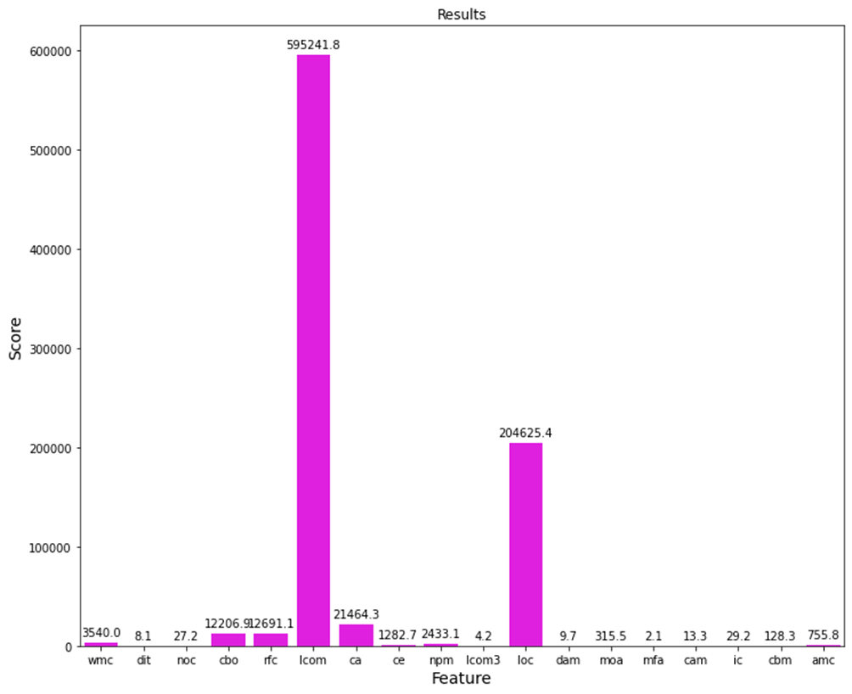
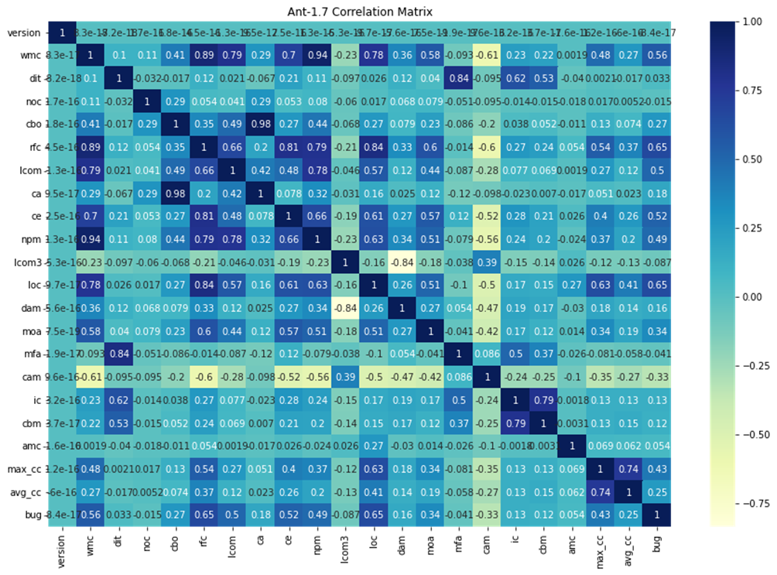
Feature selection
Used 2 approaches, correlation matrix and SelectKbest.
The features were selected through correlation matrix approach after a quick test to evaluate the R2 coefficient.Selected features are:
Rfc
Lcom
Wmc

Slide 6
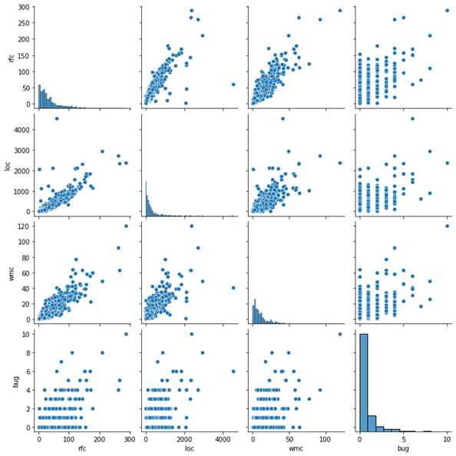
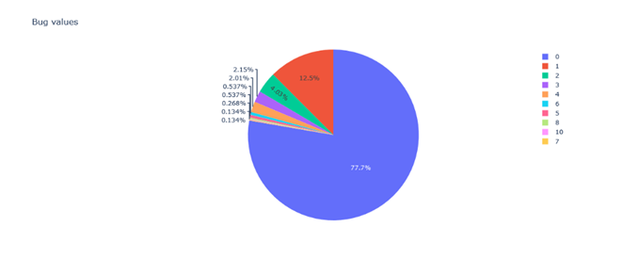
Data visualization

Slide 7
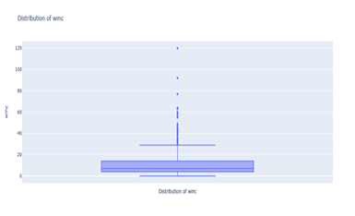
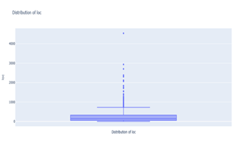
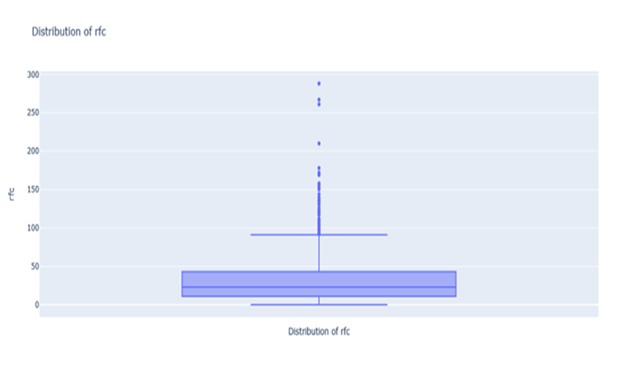
Data visualization 2

Slide 8
Descriptive statistics
# of bugs | Total records
0 | 579
1 | 93
2 | 30
3 | 16
4 | 15
6 | 4
5 | 4
8 | 2
10 | 1
7 | 1
The minimum number of rfc : 0
The maximum number of rfc : 288
The average number of rfc : 34.36241610738255
The value of the standard deviation of the feature rfc : 36.02497169398523
The minimum number of loc : 0
The maximum number of loc : 4541
The average number of loc : 280.07114093959734
The value of the standard deviation of the feature loc : 411.87207539635864
The minimum number of wmc : 0
The maximum number of wmc : 120
The average number of wmc : 11.071140939597315
The value of the standard deviation of the feature wmc : 11.97596324330988

Slide 9
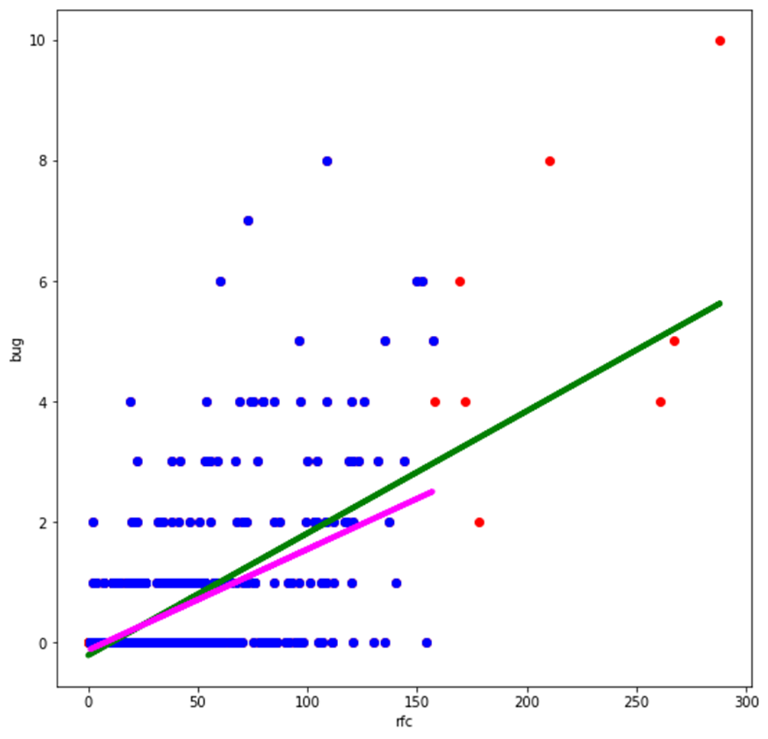
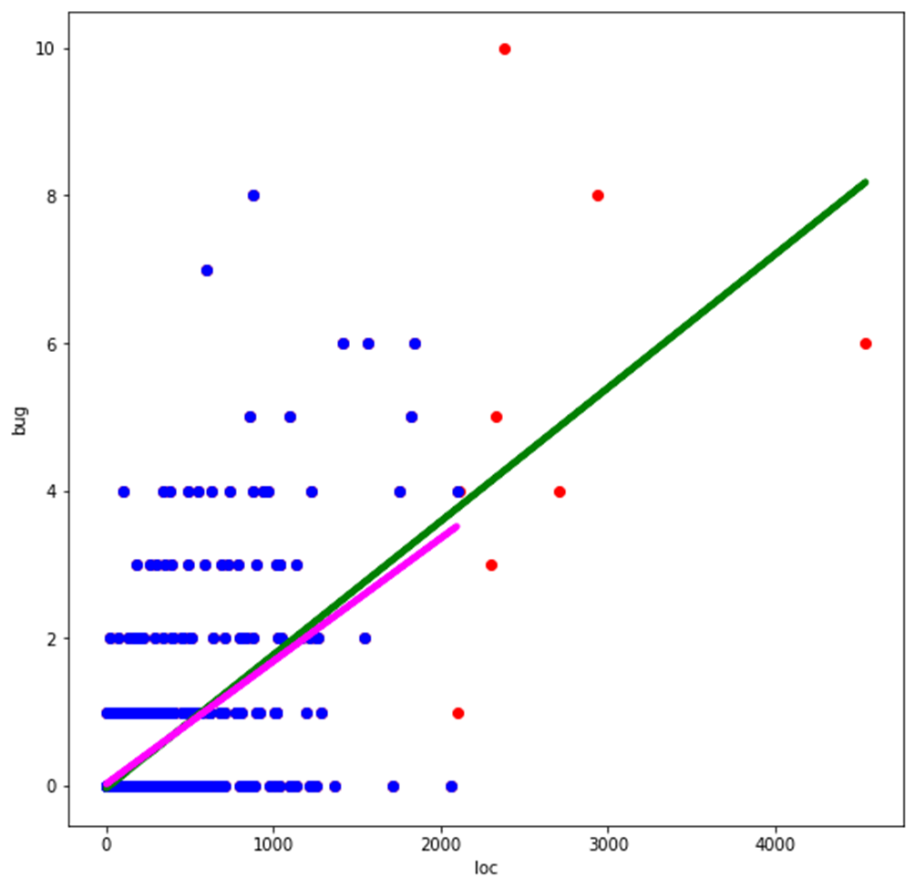
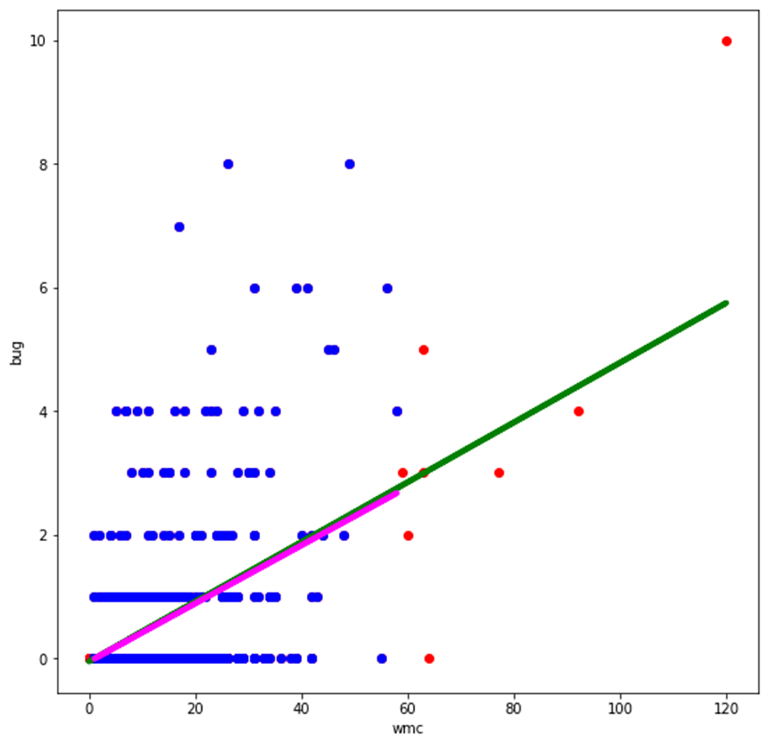
Linear regression
Rfc, loc, wmc

Slide 10
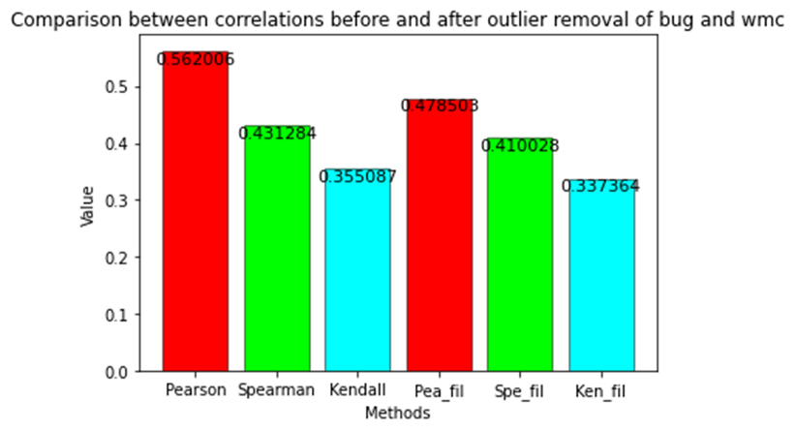
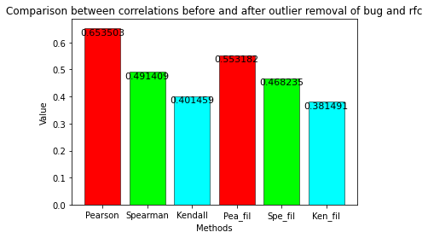
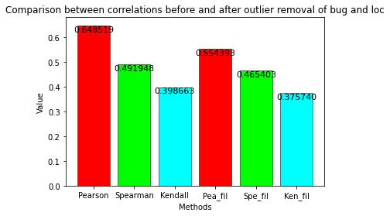
Correlation before and after outlier removal

Slide 11
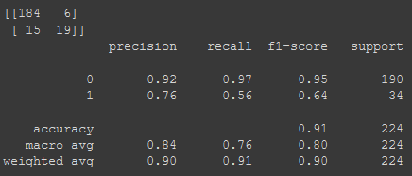
Logistic regression

Slide 12
Result description
Linear regression: The model works well enough for predicting bug values. Rfc is the feature that performs better.
Logistic regression: Despite the high accuracy, the data provided are not the best for training the model as they are unbalanced, containing 77% of non-bugged elements and only 23% of elements with at least one bug. Providing more varied data could train the model better.

