Slide 1
NFTz
Critical Analysis
Assignment
Group 3
Nicolette - Anqi Xiang
Sissi - Nianxi Wang
Sozy - Ziyi Shao
Vivian - Hanzhi Wang

Slide 2

Overview
01
Qualitative evaluation
02
Quantitative evaluation
Using POCD analysis
stats & comparison
03
Critical analysis
Overall prospect
04
qualitative & quantitative
From VC investors perspective

Slide 3
Part I
People-Introduction of founders
Opportunity-External factors(pros & cons)
Context-Internal factors(pros & cons)
Qualitative evaluation(POCD)

Slide 4
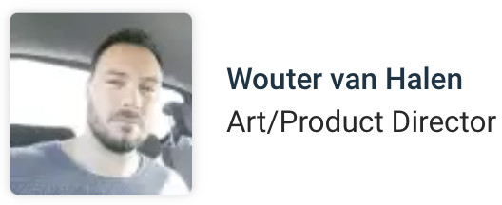

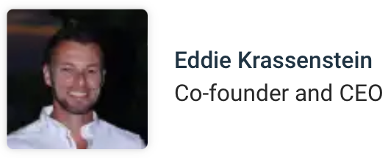

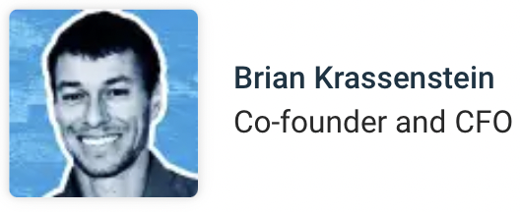
People - Introduction of the founders
A concentrated team culture with consensus to create, innovate, and lead

Slide 5
Opportunity(External factors)
Pros: How does the NFT industry offers great opportunities for NFTz
-Digital ownership & scarcity offering of NFTs
-Global market access
-Diversification of assets
Cons: Concerns associated with the NFT industry
-Fierce competition in the NFT market
-Technological barriers

Slide 6
Context(Internal factors)
Pros: NFTz’s main strength
-Creative 3D social function: 3D galleries/3D NFTs/VR technology
Cons: NFTz’s main weaknesses
-High implementation cost: Company burden high cost for innovation, investors facing exposure for investment failure
-Limited user base for advanced features: NFTs and its associated technologies are not main stream.

Slide 7
Part II
Website Traffic & Engagement Analysis
Market stats
Quantitative evaluation

Slide 8
NFTz’s platform data v.s. its peer competitor & leading player in NFT industry

Slide 9
NFTz’s crypto and blockchain technology (DeSo) v.s. Opensea’s (ETH)

Slide 10
Part III
What makes NFTz stand out in both qualitative and quantitative matters
Critical analysis

Slide 11
Critical analysis
-What makes NFTz stand out in both qualitative and quantitative matters
1. Qualitative analysis
NFTz has winning potential as it solves real-world problems
People facing problems
High cost of offline entertainment→More people switch to online entertainment(less costly)
NFTz’s 3D social
Serves both online entertaining and profit-making purposes→Business customers win-win

Slide 12
Critical analysis
-What makes NFTz stand out in both qualitative and quantitative matters
2. Quantitative analysis
NFTz utilizes DeSo:
Blockchain technology & Cryptocurrency
The value of cryptocurrency is up to people’s consensus
transaction frequency & volume
Combine with qualitative features
More and more people use 3D →DeSo’s transaction frequency increases→Higher value of DeSo
Qualitative & quantitative features closely tie to each other

Slide 13
Part IV.
Overall prospect from a VC investor’s perspectives
Conclusion
Overall prospect

Slide 14
Overall prospect
-From VC investors perspectives
After analyzing NFTz’s qualitative and quantitative functions, we stand in a VC investor’s perspective to see whether this company is worth investing in for its seed-funding stage
Optimists > Pessimists

Slide 15
Overall prospect
-From VC investors perspectives
1. Optimists
NFTz’s 3D metaverse platform→entertaining & profit generating for customers→achieve business customers win-win purpose
NFTz uses DeSo→differentiate from traditional crypto utilization(i.e. ETH, BTC, etc)

Slide 16
Overall prospect
-From VC investors perspectives
2. Pessimists
Fierce competition in the NFT industry
However, everything has two sides:
Healthy competition→Motivate NFTz

Slide 17
Conclusion
Overall, based on all the critical evaluation and analysis to NFTz, we’re optimistic about the firm.
NFTz’s original intention
1. Solving real problems and achieving “business customer win-win”
2. NFTz’s socialization function of DeSo utilization
3. NFTz’s promising founder team.
We’d like to invest in NFTz in its Seed Funding Stage.

Slide 18
Thanks
Group 3
Vivian - Hanzhi Wang
Nicolette - Anqi Xiang
Sissi - Nianxi Wang
Sozy - Ziyi Shao

