Slide 2

Modelling is key to forecast how climate change will impact ecosystems
▶ Credible model projections are critical for natural resource managers
Need a thorough model evaluation

Slide 3
Modelling is key to forecast how climate change will impact ecosystems
▶ Credible model projections are critical for natural resource managers
▶ One approach: compare model predictions to observations from previous time periods (hindcasting)
Need a thorough model evaluation

Slide 4
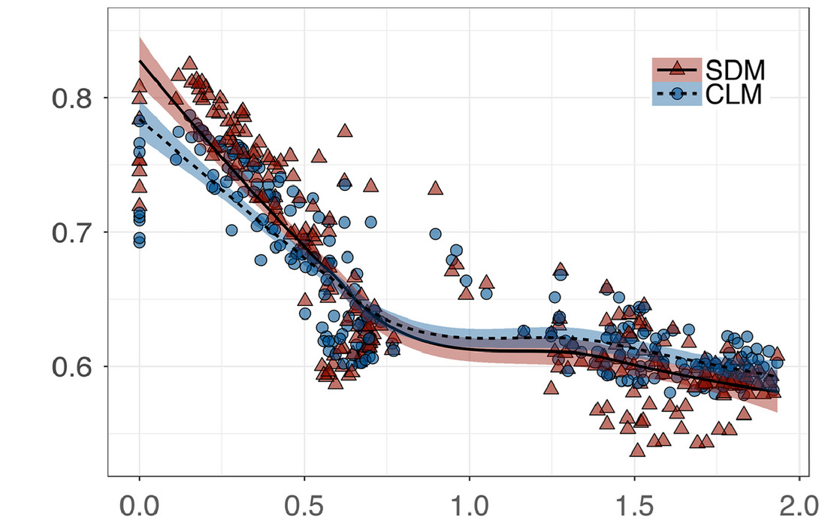
Decrease of model performance in the past
Model performance
Present
Climate novelty
Distant past
Adapted from Fitzpatrick et al. (2018)

Slide 5
Future climatic conditions are expected to be challenging
0.6
0.5
0.4
Climatic dissimilarity
0.3
0.2
0.1
0.0
11000
9000
7000
5000
3000
1000
Years (BP)

Slide 6
Future climatic conditions are expected to be challenging
0.6
0.5
0.4
Climatic dissimilarity
0.3
0.2
0.1
0.0
11000
9000
7000
5000
3000
1000
2020
2040
2060
2080
2100
Years (BP)
Years (AD)

Slide 7
Future climatic conditions are expected to be challenging
0.6
0.5
0.4
Climatic dissimilarity
SSP5
0.3
SSP2
0.2
0.1
0.0
11000
9000
7000
5000
3000
1000
2020
2040
2060
2080
2100
Years (BP)
Years (AD)

Slide 8
Urgency for action?
▶ Concerns about statistical model transferability
into future climatic conditions
▶ Process-based models could provide more robust projections?

Slide 9
Urgency for action?
▶ Concerns about statistical model transferability
into future climatic conditions
▶ Process-based models could provide more robust projections?
Yet to be verified !

Slide 10
What conveys model robustness and transferability?
Correlative models (SDM)
PATTERNS
▶ statistical relationships
▶ calibrated with current distribution data
Adapted from Dormann et al. (2012)

Slide 11
What conveys model robustness and transferability?
Correlative models (SDM)
Process-based models (PBM)
PATTERNS
PROCESSES
▶ statistical relationships
▶ calibrated with current distribution data
▶ causal relationships
▶ calibrated with
ecophysiological data
Adapted from Dormann et al. (2012)

Slide 12

What conveys model robustness and transferability?
Correlative models (SDM)
Process-based models (PBM)
PATTERNS
PROCESSES
▶ statistical relationships
▶ calibrated with current distribution data
▶ causal relationships
▶ calibrated with
ecophysiological data
Adapted from Dormann et al. (2012)

Slide 13

What conveys model robustness and transferability?
Correlative models (SDM)
Process-based models (PBM)
PATTERNS
PROCESSES
▶ statistical relationships
▶ calibrated with current distribution data
▶ causal relationships
▶ calibrated with
ecophysiological data
Adapted from Dormann et al. (2012)

Slide 14
What conveys model robustness and transferability?
Correlative models (SDM)
Process-based models (PBM)
PATTERNS
PROCESSES
Fitted process-based models
▶ calibrated with current distribution data
▶ causal relationships
Adapted from Dormann et al. (2012)
Van der Meersch & Chuine (2023)

Slide 15
Multi-model comparison across the Holocene
▶ 5 European tree species (F. sylvatica, A. alba, Q. ilex, Q. robur, Q. petraea)
▶ 8 models: 4 correlative models (RF, BRT, GLM, GAM)
2 fitted process-based models
2 process-based models (PHENOFIT, CASTANEA)

Slide 16
Multi-model comparison across the Holocene
▶ 5 European tree species (F. sylvatica, A. alba, Q. ilex, Q. robur, Q. petraea)
▶ 8 models: 4 correlative models (RF, BRT, GLM, GAM)
2 fitted process-based models
2 process-based models (PHENOFIT, CASTANEA)
model based
on phenology!

Slide 17
Multi-model comparison across the Holocene
▶ 5 European tree species (F. sylvatica, A. alba, Q. ilex, Q. robur, Q. petraea)
▶ 8 models: 4 correlative models (RF, BRT, GLM, GAM)
2 fitted process-based models
2 process-based models (PHENOFIT, CASTANEA)
▶ past climate data from HadCM3B simulations (+ daily weather generation)
▶ model performance evaluated against fossil pollen data
model based
on phenology!

Slide 18




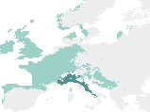
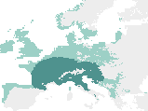

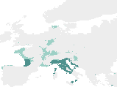
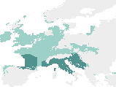





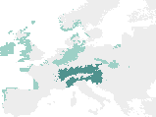
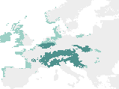

Example of deciduous Quercus paleosimulations
11.750 BP
11.000 BP
9.000 BP
7.000 BP
500 BP
SDM
Pollen
Fitted
PBM
Suitable
Occupied
PBM

Slide 19
Decrease of model performance when moving further into the past
SDM
Fitted PBM
PBM
1.0
0.8
0.6
Model predictive performance
0.4
0.2
0.0
0.10
0.15
0.20
0.25
0.30
Climatic dissimilarity

Slide 20
Decrease of model performance when moving further into the past
SDM
Fitted PBM
PBM
1.0
Early Holocene (before 8200 BP)
= the most challenging conditions
0.8
0.6
Model predictive performance
0.4
0.2
0.0
0.10
0.15
0.20
0.25
0.30
Climatic dissimilarity

Slide 21
Process-based models are more performant/transferable?
Late-Middle
Holocene
(after 8200BP)
Early
Holocene
(before 8200BP)
Late-Middle
Holocene
Early
Holocene
1.0
ab
a
b
a
b
b
150
a b
c
b
a a
b
b
0.8
100
0.6
50
Performance
Transferability
0.4
0
CV
0.2
-50
CV
0.0
-100
SDM
Fitted PBM
PBM
CV = « cross-validation »

Slide 22
Process-based models are more performant/transferable
Late-Middle
Holocene
(after 8200BP)
Early
Holocene
(before 8200BP)
Late-Middle
Holocene
Early
Holocene
1.0
ab
a
b
a
b
b
150
a b
c
b
a a
b
b
0.8
100
0.6
50
Performance
Transferability
0.4
0
CV
0.2
-50
CV
0.0
-100
SDM
Fitted PBM
PBM
CV = « cross-validation »

Slide 23
Mechanisms, not calibration method, convey model robustness
▶ Expert and fitted PBMs less affected by the increase
in climatic dissimilarity
▶ Fitted PBMs similar to expert PBMs

Slide 24
Mechanisms, not calibration method, convey model robustness
▶ Expert and fitted PBMs less affected by the increase
in climatic dissimilarity
▶ Fitted PBMs similar to expert PBMs
Biological mechanisms are necessary to improve the robustness of models
(more important than the calibration method?)

Slide 25
A real advantage to increase projections reliability in the upcoming decades?
1.0
SDM
Fitted PBM
PBM
0.8
2060 projections: SSP245 and SSP585
0.6
Model predictive performance
0.4
0.2
0.0
0.10
0.15
0.20
0.25
0.30
Climatic dissimilarity

Slide 26
On our way to scale-up process-based models
▶ Fitted PBMs bring together the strengths from
statistical and mechanistic approaches
▶ Inverse calibration: an opportunity to improve parameter estimates?

Slide 27
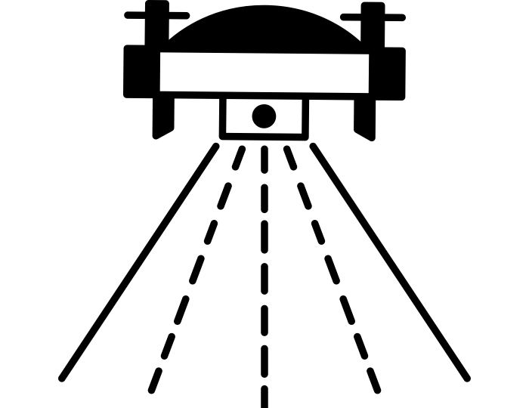



On our way to scale-up process-based models
▶ Fitted PBMs bring together the strengths from
statistical and mechanistic approaches
▶ Inverse calibration: an opportunity to improve parameter estimates?
Data fusion
Mechanisms
Spread the use of process-based approches?

