Slide 1


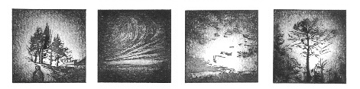

CONTRASTED HINDCAST PERFORMANCES CALL
FOR MORE REALISTIC SPECIES DISTRIBUTION MODELS
Victor Van der Meersch, E. Armstrong, F. Saltré, F. Mouillot, A. Duputié, C. Randin, I. Chuine
CEFE, CNRS, Montpellier (France)
victor.vandermeersch@cefe.cnrs.fr

Slide 2
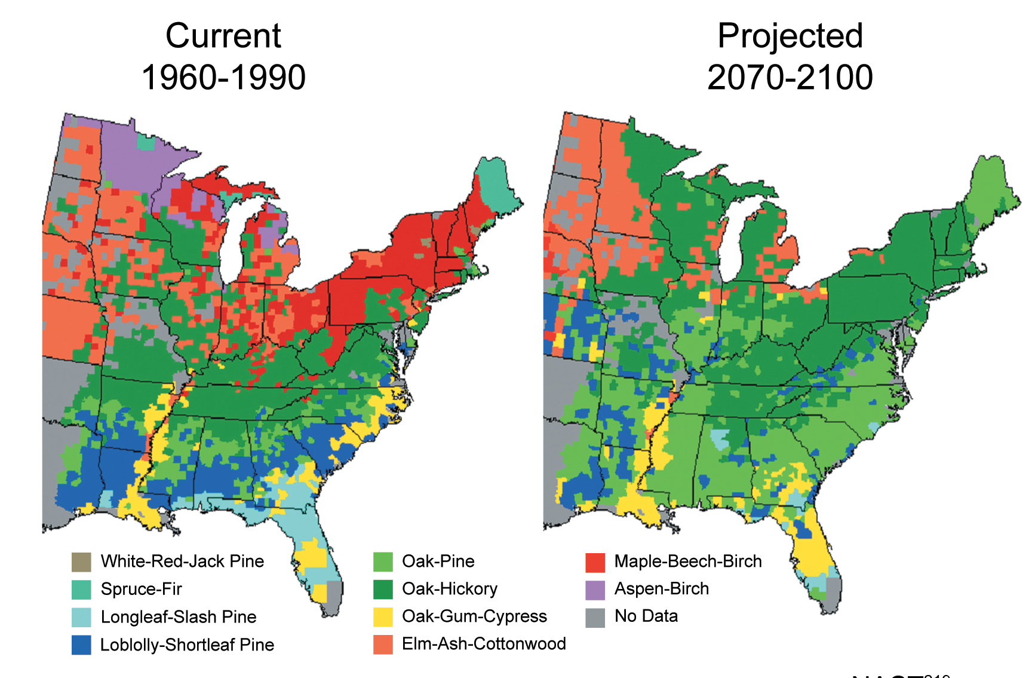
The need for reliable species distribution projections
1960-1990
2070-2100
United States Environmental Protection Agency (2009)

Slide 3
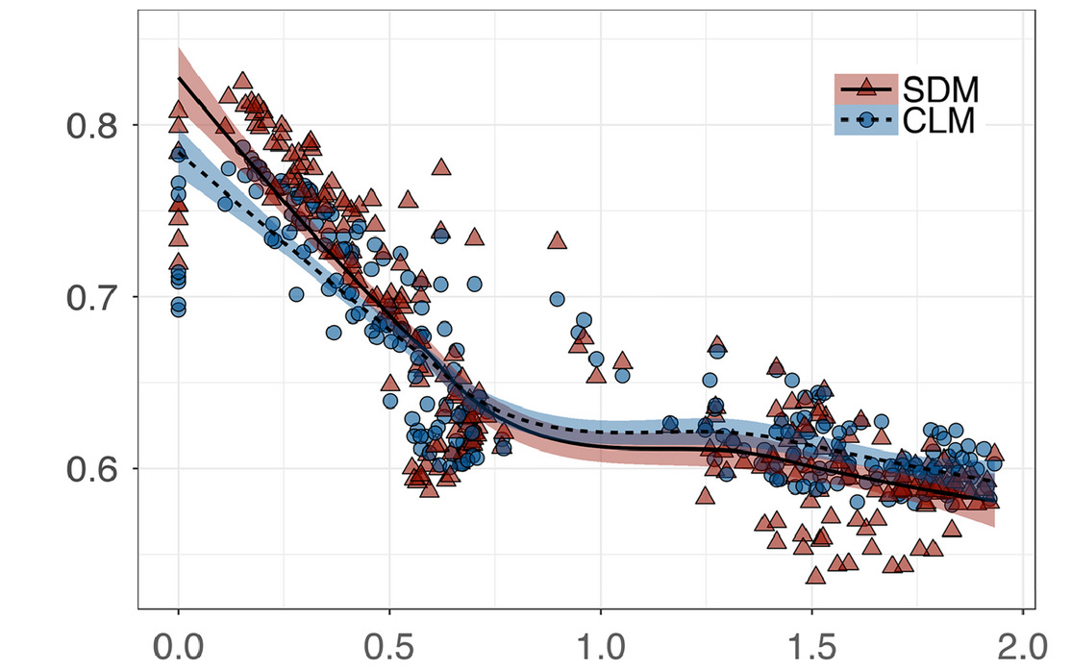
Decrease of model performance in the past
Model performance
Present
Climate novelty
Distant past
Adapted from Fitzpatrick et al. (2018)

Slide 4
Future climatic conditions expected to be challenging
0.75
SSP585
0.50
Climatic dissimilarity
0.25
SSP245
0.00
11000
9000
7000
5000
3000
1000
2010
2030
2050
2070
2090
Years (BP)
Years (AD)
BP = « Before Present » (1950)

Slide 5
What conveys model robustness and transferability?
Correlative models (SDM)
Process-based models (PBM)
PATTERNS
PROCESSES
▶ statistical relationships
▶ calibrated with current distribution data
▶ causal relationships
▶ calibrated with
ecophysiological data
Adapted from Dormann et al. (2012)

Slide 6
What conveys model robustness and transferability?
PATTERNS
PROCESSES
Fitted process-based models
▶ calibrated with current distribution data
▶ causal relationships
Adapted from Dormann et al. (2012)
Van der Meersch & Chuine (2023)

Slide 7
Multi-model comparison across the Holocene
▶ 5 European tree species (F. sylvatica, A. alba, Q. ilex, Q. robur, Q. petraea)
▶ 8 models: 4 correlative models (RF, BRT, GLM, GAM)
2 fitted process-based models
2 process-based models (PHENOFIT, CASTANEA)
▶ + migration model since 12.000 BP (BP = “before present”, 1950)
▶ past climate data from HadCM3B simulations (+ daily weather generation)
▶ model performance evaluated against fossil pollen data

Slide 8
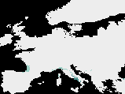

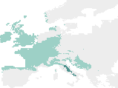

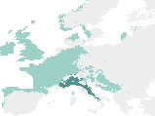
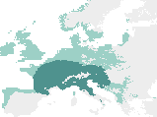

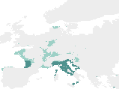
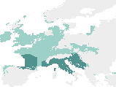
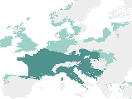


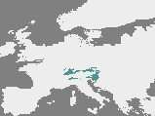
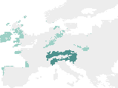
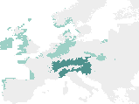
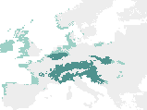
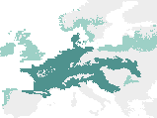
Example of deciduous Quercus paleosimulations
11.750 BP
11.000 BP
9.000 BP
7.000 BP
500 BP
SDM
Pollen
Fitted
PBM
Suitable
Occupied
PBM

Slide 9
Strong impact of novel climatic conditions
SDM
Fitted PBM
PBM
1.0
0.8
0.6
Model predictive performance
0.4
0.2
0.0
0.10
0.15
0.20
0.25
0.30
Climatic dissimilarity

Slide 10
Strong impact of novel climatic conditions
SDM
Fitted PBM
PBM
1.0
Late-Mid. Holocene
Early Holocene
0.8
0.6
Model predictive performance
0.4
0.2
0.0
0.10
0.15
0.20
0.25
0.30
Climatic dissimilarity

Slide 11
Model hindcasting skills
Late-Middle
Holocene
(after 8200BP)
Early
Holocene
(before 8200BP)
Late-Middle
Holocene
Early
Holocene
1.0
ab
a
b
a
b
b
150
a b
c
b
a a
b
b
0.8
100
0.6
50
Performance
Transferability
0.4
0
CV
0.2
-50
CV
0.0
-100
SDM
Fitted PBM
PBM
CV = « cross-validation »

Slide 12


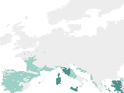
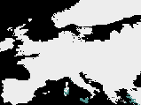
Importance of refugia: evergreen Quercus simulations
11.750 BP
11.000 BP
Pollen
Suitable
Occupied

Slide 13
Strong impact of novel climatic conditions
1.0
SDM
Fitted PBM
PBM
0.8
2050 projections: SSP245 and SSP585
0.6
Model predictive performance
0.4
0.2
0.0
0.10
0.15
0.20
0.25
0.30
Climatic dissimilarity

Slide 14
Take-home message
▶ Climate change: a challenge for both SDM and PBM projection reliability
▶ Causal relationships: higher model robustness in more novel climatic conditions
▶ Inverse calibration: mixing the strengths of SDM and PBM
→ facilitate the extensive use of process-based approach

Slide 15
Take-home message
▶ Climate change: a challenge for both SDM and PBM projection reliability
▶ Causal relationships: higher model robustness in more novel climatic conditions
▶ Inverse calibration: mixing the strengths of SDM and PBM
→ facilitate the extensive use of process-based approach
Thank you for listening!
victor.vandermeersch@cefe.cnrs.fr

Slide 16
SUPPLEMENTARY SLIDES

Slide 17
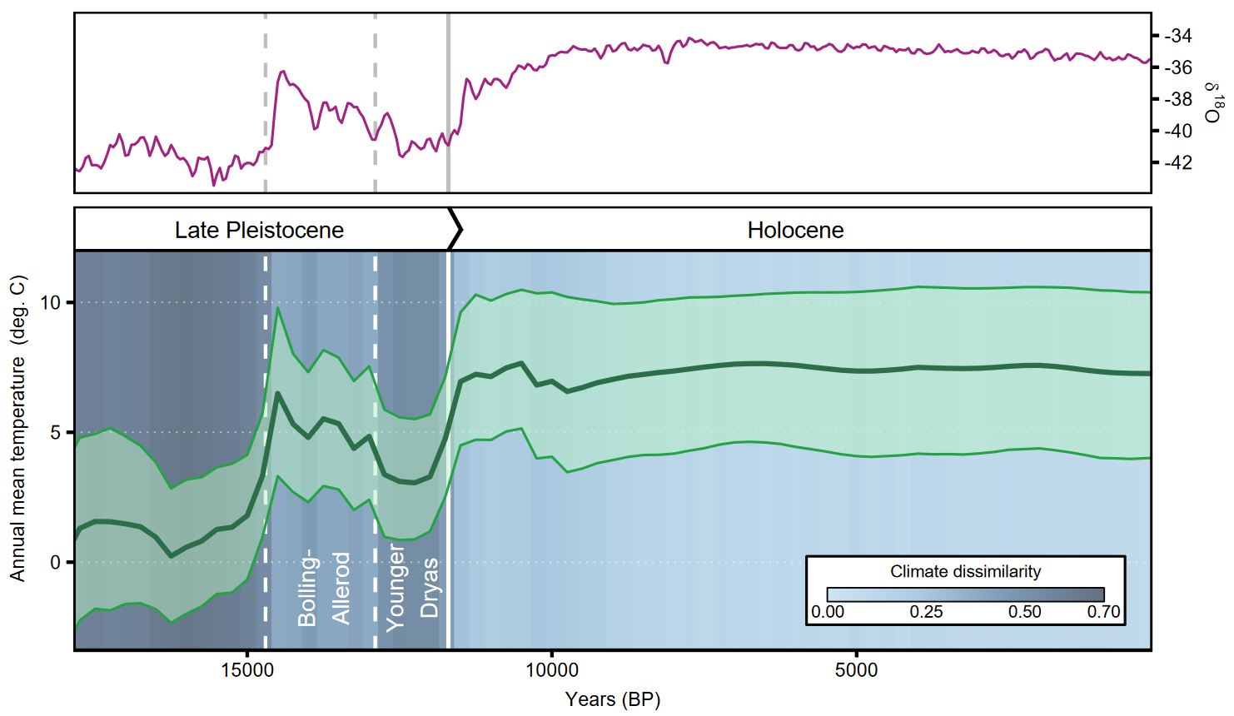
Paleoclimate overview

Slide 18
HadCM3B – 0.5°
(Armstrong et al. 2019)
Orbital parameters
Computed daily values
Radiation processing
(Kaplan et al. 2016)
ICE-6G-C altitude
(Peltier et al. 2015)
Global radiation
Downscaled HadCM3B
Monthly - 0.25°
Generated daily values
Temperatures
Precipitation
Wind
Cloudiness
No. of wet days
Temperatures
Precipitation
Wind
Cloudiness
GWGEN
(Sommer & Kaplan 20197)

Slide 19
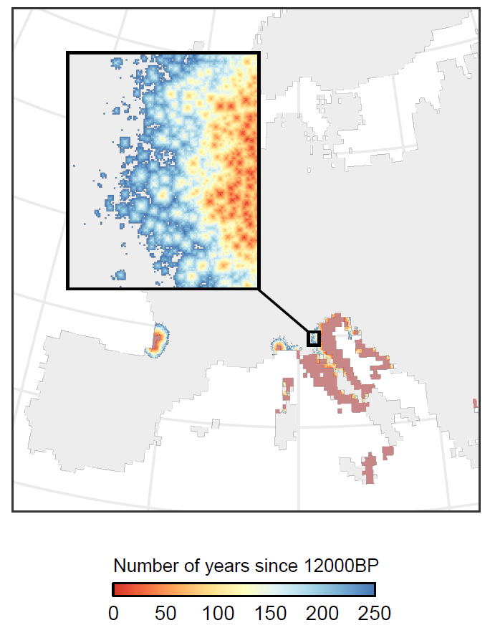
Migration simulation

Slide 20







PHENOFIT: focus on phenology
FITNESS
Reproductive success
Survival
Frost resistance
Thermal energy
Frost and drought
Leaf unfolding
Flowering
Fruit maturation
Leaf senescence

Slide 21
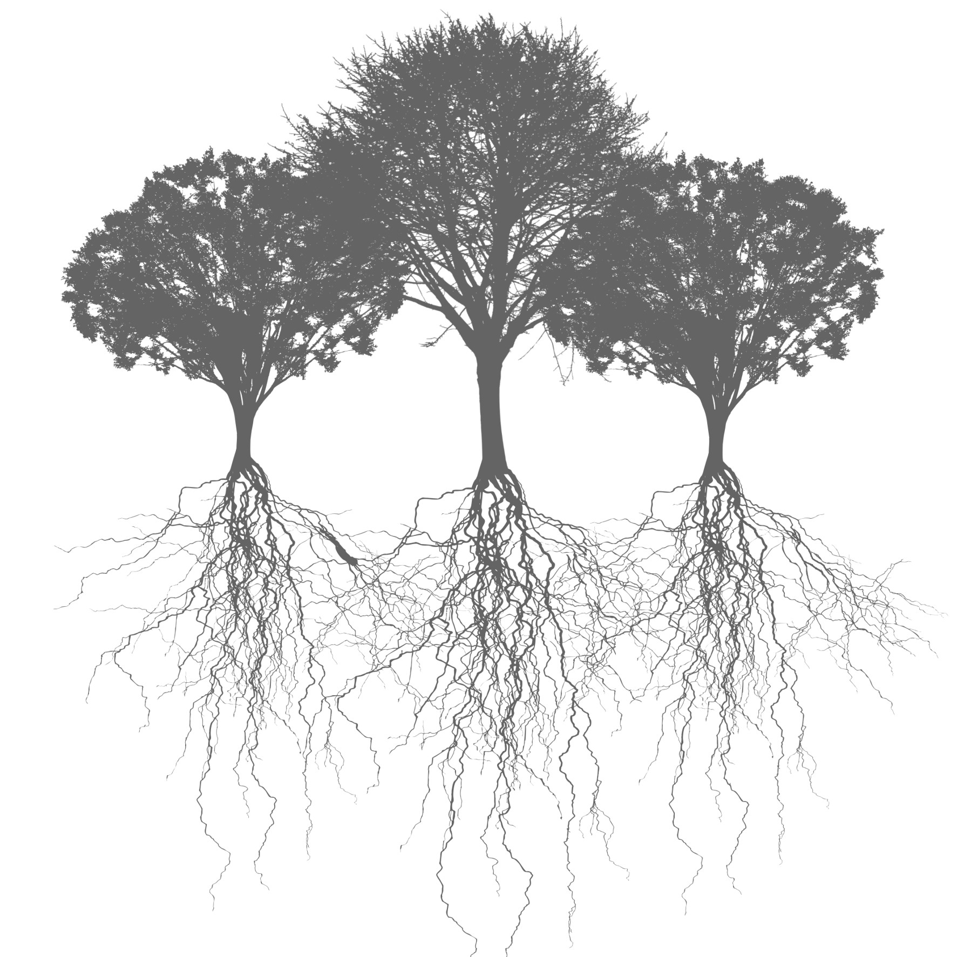
CASTANEA:
focus on
fluxes
Water vapour
Solar radiation
CO
2
Precipitation
Transpiration
Energy
interception
Canopy
evaporation
Stomatal
Photosynthesis
Heterotrophic
conductance
respiration
Canopy
Carbon allocation
interception
Leaves C
Aerial
Growth
Wood C
respiration
Thrroughfall
Maintenance
Stem floow
Soil
evaporation
Reserves C
respiration
Coarse
F
roots C
Soil
Soil
Fine
roots C
Drainage

Slide 22
Climatic dissimilarity
Reference
Projection
N-dimensional hypervolume
N-dimensional hypervolume

Slide 23
Climatic dissimilarity

Slide 24
Climatic dissimilarity
Hypervolume overlap
2 |A ∩ B |
Sørensen similarity =
|A | + | B |

