Slide 1
Third team meeting
Assessing the robustness and uncertainty of species distribution model projections
02/06/2023

Slide 2




RECENT past
FUTURE
Late Pleistocene - Holocene
1970 - 2000
20th century
21St century
DISTANT PAST
PREsent

Slide 3
Model calibrationS
- Inverse calibration of process-based models
- Statistical fit of niche models
RECENT past
FUTURE
Late Pleistocene - Holocene
1970 - 2000
20th century
21St century
DISTANT PAST
PREsent

Slide 4
Inverse calibration of process-based models
- models: PHENOFIT, CASTANEA

Slide 5
Inverse calibration of process-based models
- models: PHENOFIT, CASTANEA
- climate data: ERA5-Land
- occurrence records: EU-Forest (+GBIF, WOODIV)

Slide 6
Inverse calibration of process-based models
- models: PHENOFIT, CASTANEA
- climate data: ERA5-Land
- occurrence records: EU-Forest (+GBIF, WOODIV)
- evolutionary algorithm: CMA-ES

Slide 7
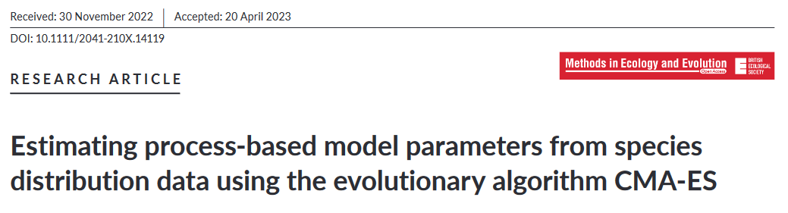
Inverse calibration of process-based models
- models: PHENOFIT, CASTANEA
- climate data: ERA5-Land
- occurrence records: EU-Forest (+GBIF, WOODIV)
- evolutionary algorithm: CMA-ES
- paper published in Methods in Ecology and Evolution

Slide 8
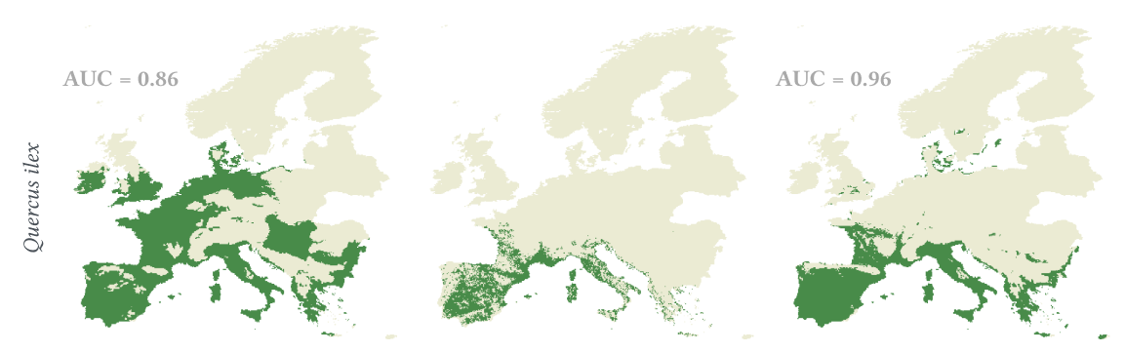
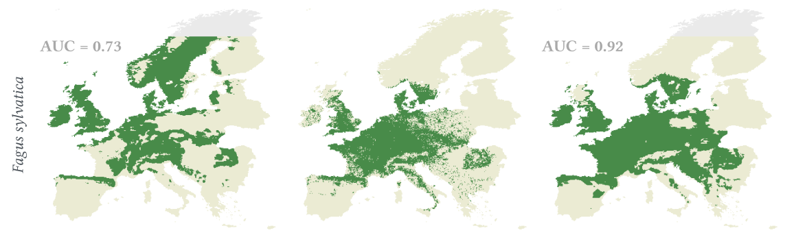
Results
Expert calibration
Species occurrence
Inverse calibration
PHENOFIT
CASTANEA

Slide 9
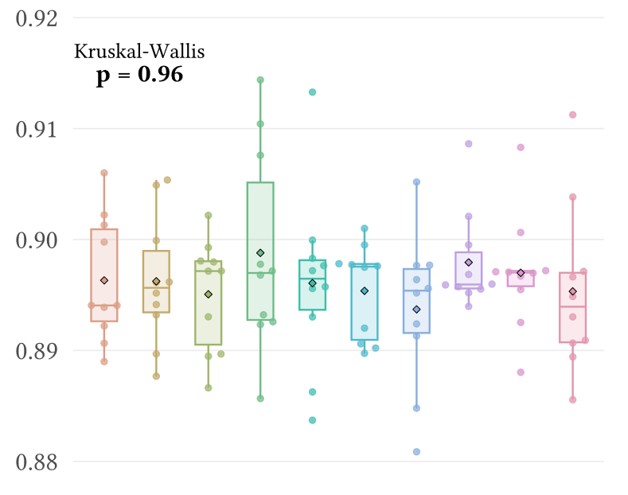
Results

Slide 10
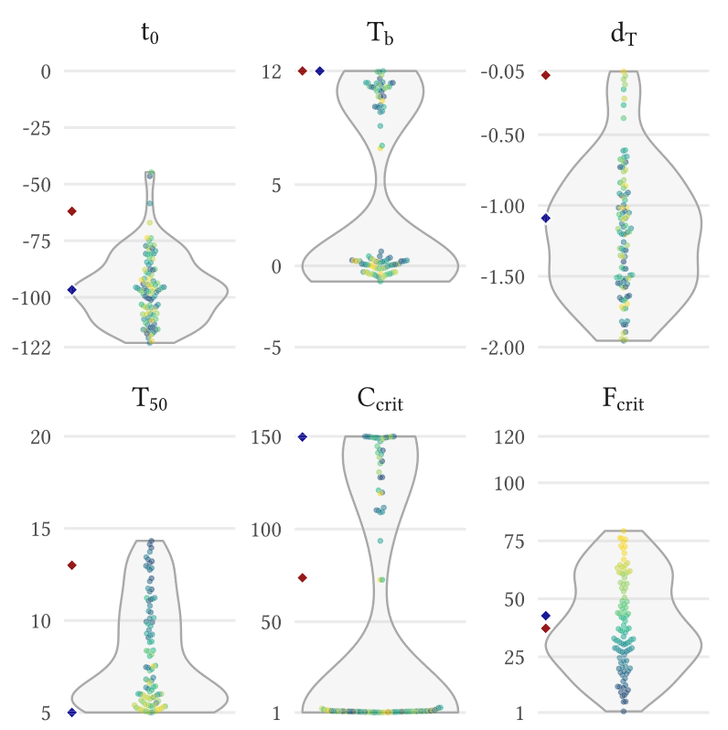
Results

Slide 11
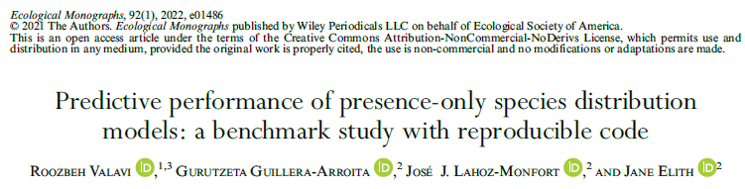
Calibration of niche models
- presence-only approach, Valavi et al. (2022)
- models: GLM with lasso penalty, GAM, BRT, RandomForest
(+ biomod et Maxent)

Slide 12
Calibration of niche models
- presence-only approach, Valavi et al. (2022)
- models: GLM with lasso penalty, GAM, BRT, RandomForest
(+ biomod et Maxent)
- predictors: minimum temperature of the coldest month (frost tolerance)
GDD >5°C April-September (growth)
total precipitation (accumulated water)
water balance June-July (summer drought)

Slide 13
Calibration of niche models
- presence-only approach, Valavi et al. (2022)
- models: GLM with lasso penalty, GAM, BRT, RandomForest
(+ biomod et Maxent)
- predictors: minimum temperature of the coldest month (frost tolerance)
GDD >5°C April-September (growth)
total precipitation (accumulated water)
water balance June-July (summer drought)
+ soil: pH, water holding capacity

Slide 14
Calibration of niche models
- presence-only approach, Valavi et al. (2022)
- models: GLM with lasso penalty, GAM, BRT, RandomForest
(+ biomod et Maxent)
- predictors: minimum temperature of the coldest month (frost tolerance)
GDD >5°C April-September (growth)
total precipitation (accumulated water)
water balance June-July (summer drought)
+ soil: pH, water holding capacity
- occurrence data: EU-Forest (+GBIF, WOODIV)
+ background points: « sampled irrespective of the location of species records »

Slide 15
Calibration of niche models
- 5-fold environmental block cross-validation to estimate errors

Slide 16
Calibration of niche models
- 5-fold environmental block cross-validation to estimate errors

Slide 17
Calibration of niche models
- 5-fold environmental block cross-validation to estimate errors
training set
testing set

Slide 18
Calibration of niche models
- 5-fold environmental block cross-validation to estimate errors
Combine predictions
training set
testing set
Error estimation (AUC, ...)

Slide 19
Calibration of niche models
- 5-fold environmental block cross-validation to estimate errors
- final model: all the available data used to fit the model
« favours final prediction quality over perfect accuracy of error estimates » (Roberts et al. 2017)
Combine predictions
training set
testing set
Error estimation (AUC, ...)

Slide 20
Calibration of niche models
- 5-fold environmental block cross-validation to estimate errors
- final model: all the available data used to fit the model
« favours final prediction quality over perfect accuracy of error estimates » (Roberts et al. 2017)
Combine predictions
training set
testing set
Error estimation (AUC, ...)
Over-estimated AUC

Slide 21
Calibration of niche models
Fagus sylvatica
 | Lasso GLM | GAM | Random Forest | BRT
« True » AUC | 0.68 | 0.79 | 0.81 | 0.79
Over-estimated AUC | 0.92 | 0.93 | 0.99 | 0.96

Slide 22
Model calibrationS
- Inverse calibration of process-based models
- Statistical fit of niche models
RECENT past
FUTURE
Late Pleistocene - Holocene
1970 - 2000
20th century
21St century
DISTANT PAST
PREsent

Slide 23
Lessons from the past
- Comparison of models’ predictions to pollen records
- Identify the strengths and weaknesses of each model
Model calibrationS
- Inverse calibration of process-based models
- Statistical fit of niche models
RECENT past
FUTURE
Late Pleistocene - Holocene
1970 - 2000
20th century
21St century
DISTANT PAST
PREsent

Slide 24
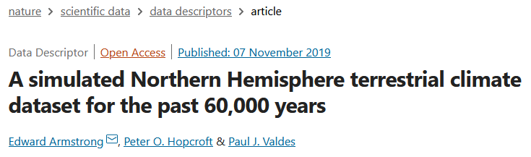
Paleoclimate
- Monthly data from HadCM3B general circulation model simulations
- 0.5° spatial resolution, bias corrected
- Collaboration with E. Armstrong (Univ. of Bristol), who generated specific variables for the project

Slide 25
Paleoclimate
HadCM3B – 0.5°
(Armstrong et al. 2019)

Slide 26
Paleoclimate
HadCM3B – 0.5°
(Armstrong et al. 2019)
ICE-6G-C altitude
(Peltier et al. 2015)
Downscaled HadCM3B
Monthly - 0.25°
Temperatures
Precipitation
Wind
Cloudiness
No. of wet days

Slide 27
Paleoclimate
HadCM3B – 0.5°
(Armstrong et al. 2019)
ICE-6G-C altitude
(Peltier et al. 2015)
Downscaled HadCM3B
Monthly - 0.25°
Generated daily values
Temperatures
Precipitation
Wind
Cloudiness
No. of wet days
Temperatures
Precipitation
Wind
Cloudiness
GWGEN
(Sommer & Kaplan 20197)

Slide 28
Paleoclimate
HadCM3B – 0.5°
(Armstrong et al. 2019)
Orbital parameters
Radiation processing
(Kaplan et al. 2016)
ICE-6G-C altitude
(Peltier et al. 2015)
Downscaled HadCM3B
Monthly - 0.25°
Generated daily values
Temperatures
Precipitation
Wind
Cloudiness
No. of wet days
Temperatures
Precipitation
Wind
Cloudiness
GWGEN
(Sommer & Kaplan 20197)

Slide 29
Paleoclimate
HadCM3B – 0.5°
(Armstrong et al. 2019)
Orbital parameters
Computed daily values
Radiation processing
(Kaplan et al. 2016)
ICE-6G-C altitude
(Peltier et al. 2015)
Global radiation
Downscaled HadCM3B
Monthly - 0.25°
Generated daily values
Temperatures
Precipitation
Wind
Cloudiness
No. of wet days
Temperatures
Precipitation
Wind
Cloudiness
GWGEN
(Sommer & Kaplan 20197)

Slide 30
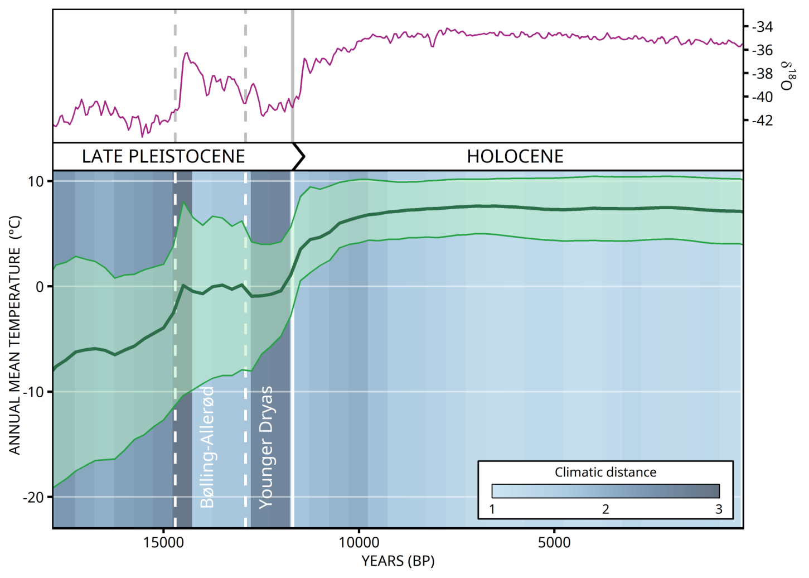
Paleoclimate

Slide 31
Temporal coverage per pollen site
e.g. 3kyr BP
Multiple samples within the same site

Slide 32
Temporal coverage per pollen site
500-year time slice
e.g. 3kyr BP

Slide 33
Temporal coverage per pollen site
500-year time slice
e.g. 3kyr BP
Weighted mean of pollen counts, taking into account both uncertainty and time distance

Slide 34
Spatial upscaling
e.g. 3kyr BP
0.25°
Species pollen relative abundance

Slide 35
Spatial upscaling: relative abundance
e.g. 3kyr BP
0.25°
Average species relative abundance

Slide 36
Spatial upscaling: presence/absence
« one is enough »
average presence
Presence threshold

Slide 37
Spatial upscaling: presence/absence
« one is enough »
average presence
Presence threshold

Slide 38
Spatial upscaling: presence/absence
« one is enough »
average presence
absence
presence

Slide 39
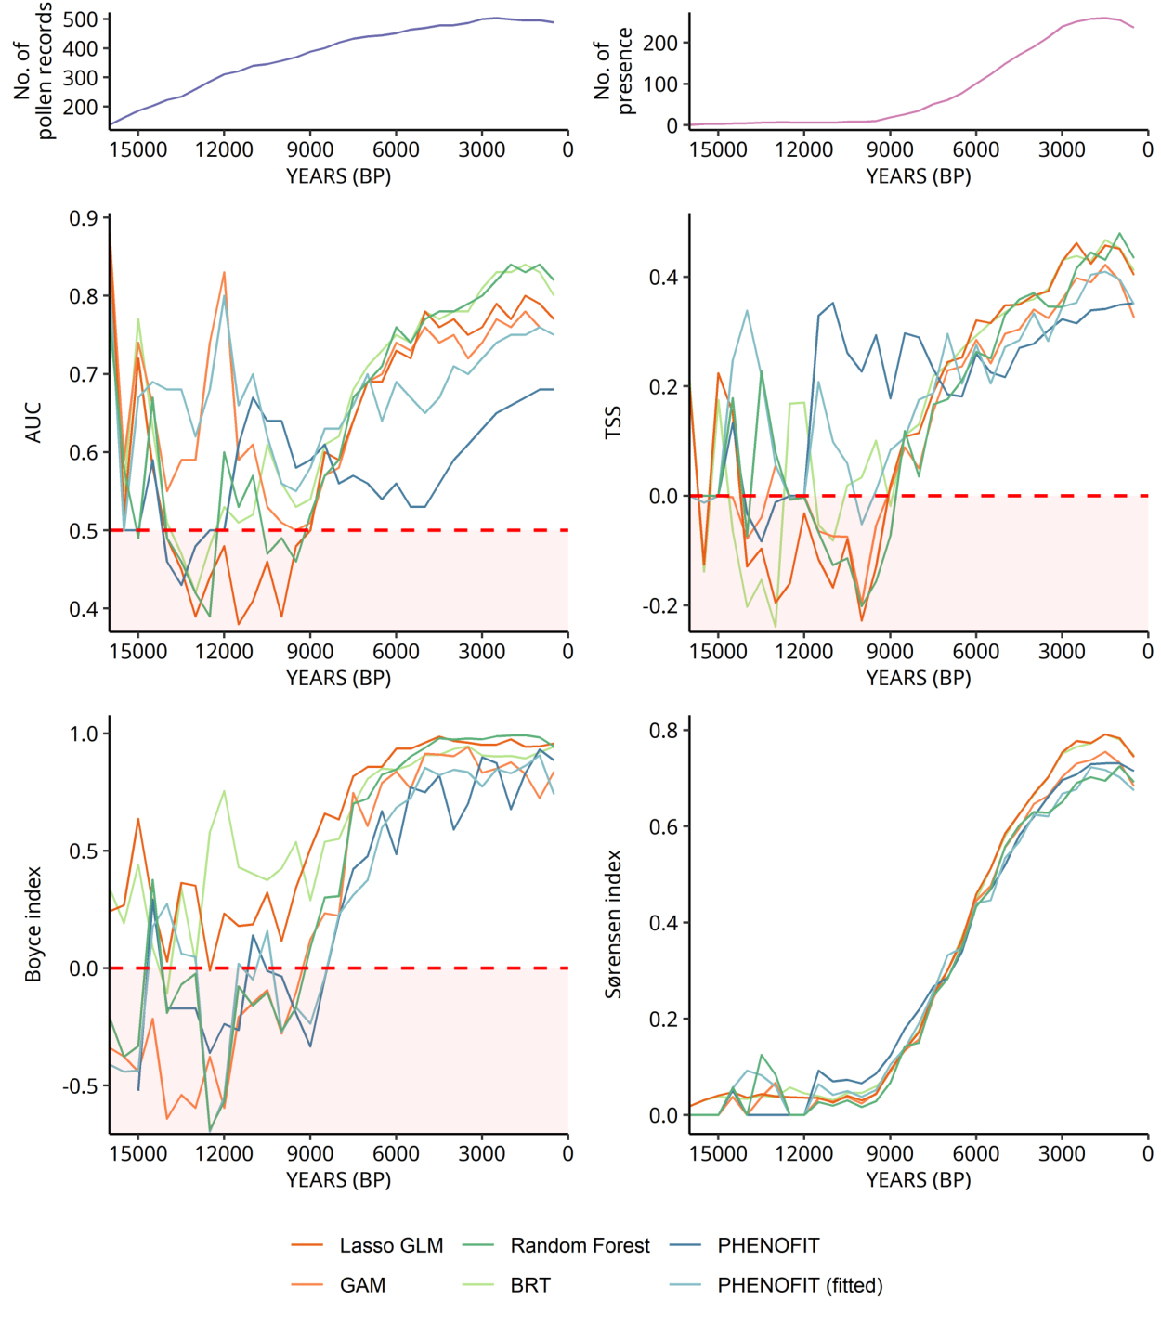
First paleosimulations

Slide 40
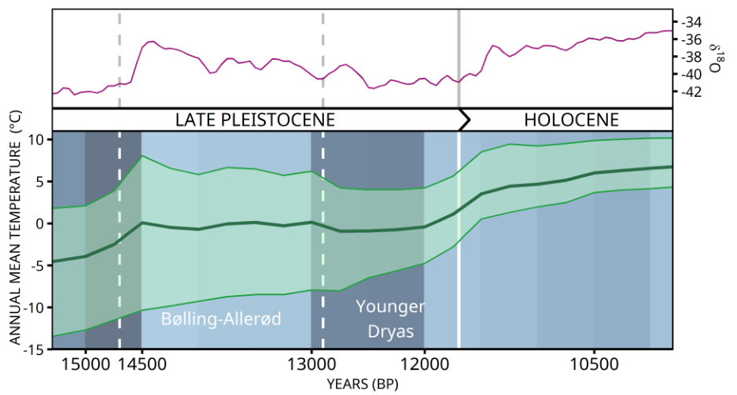
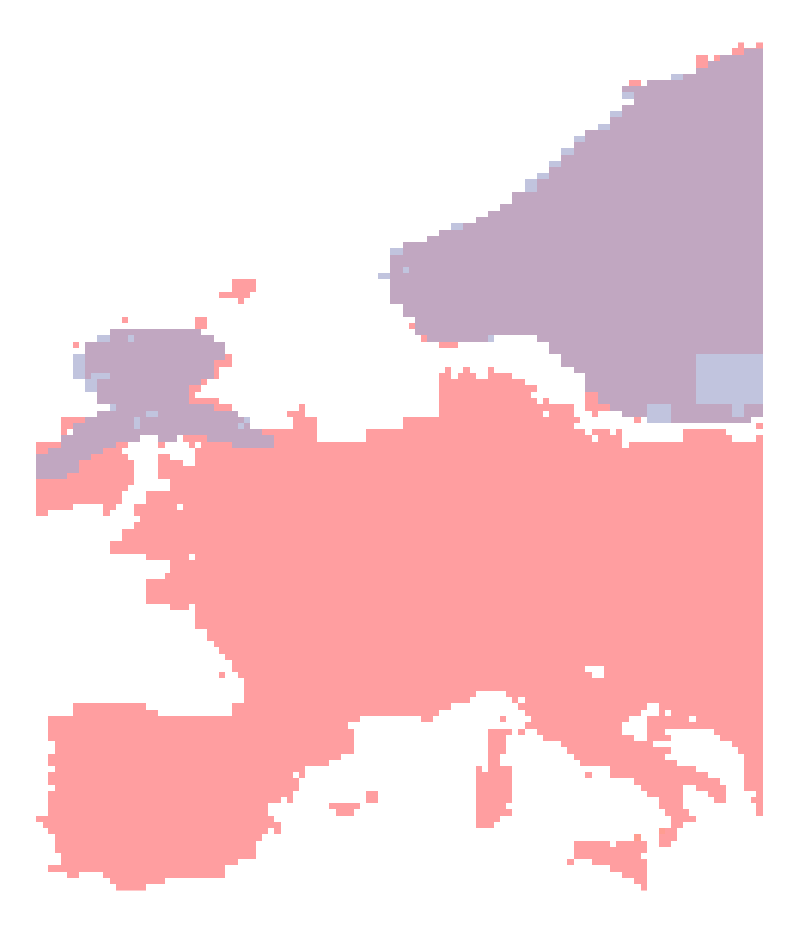
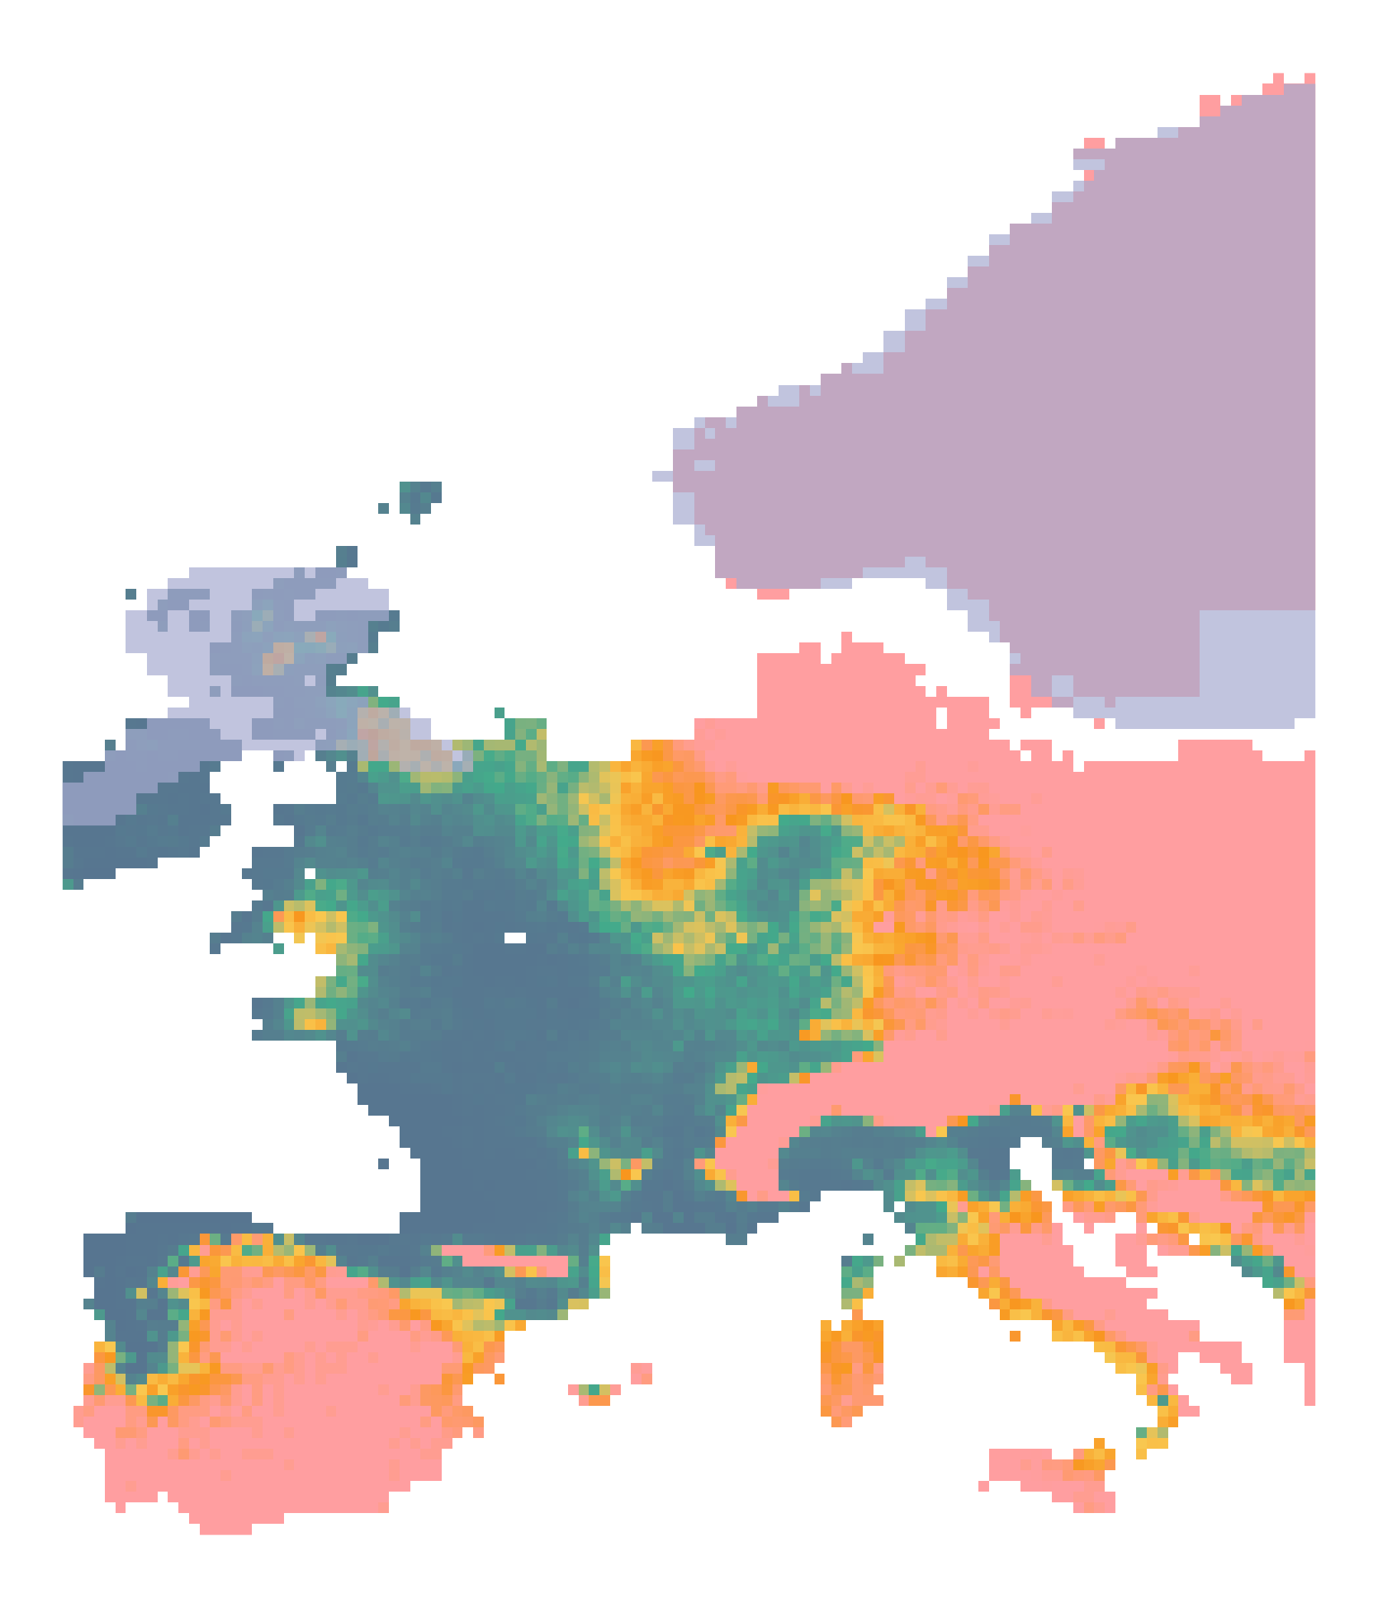
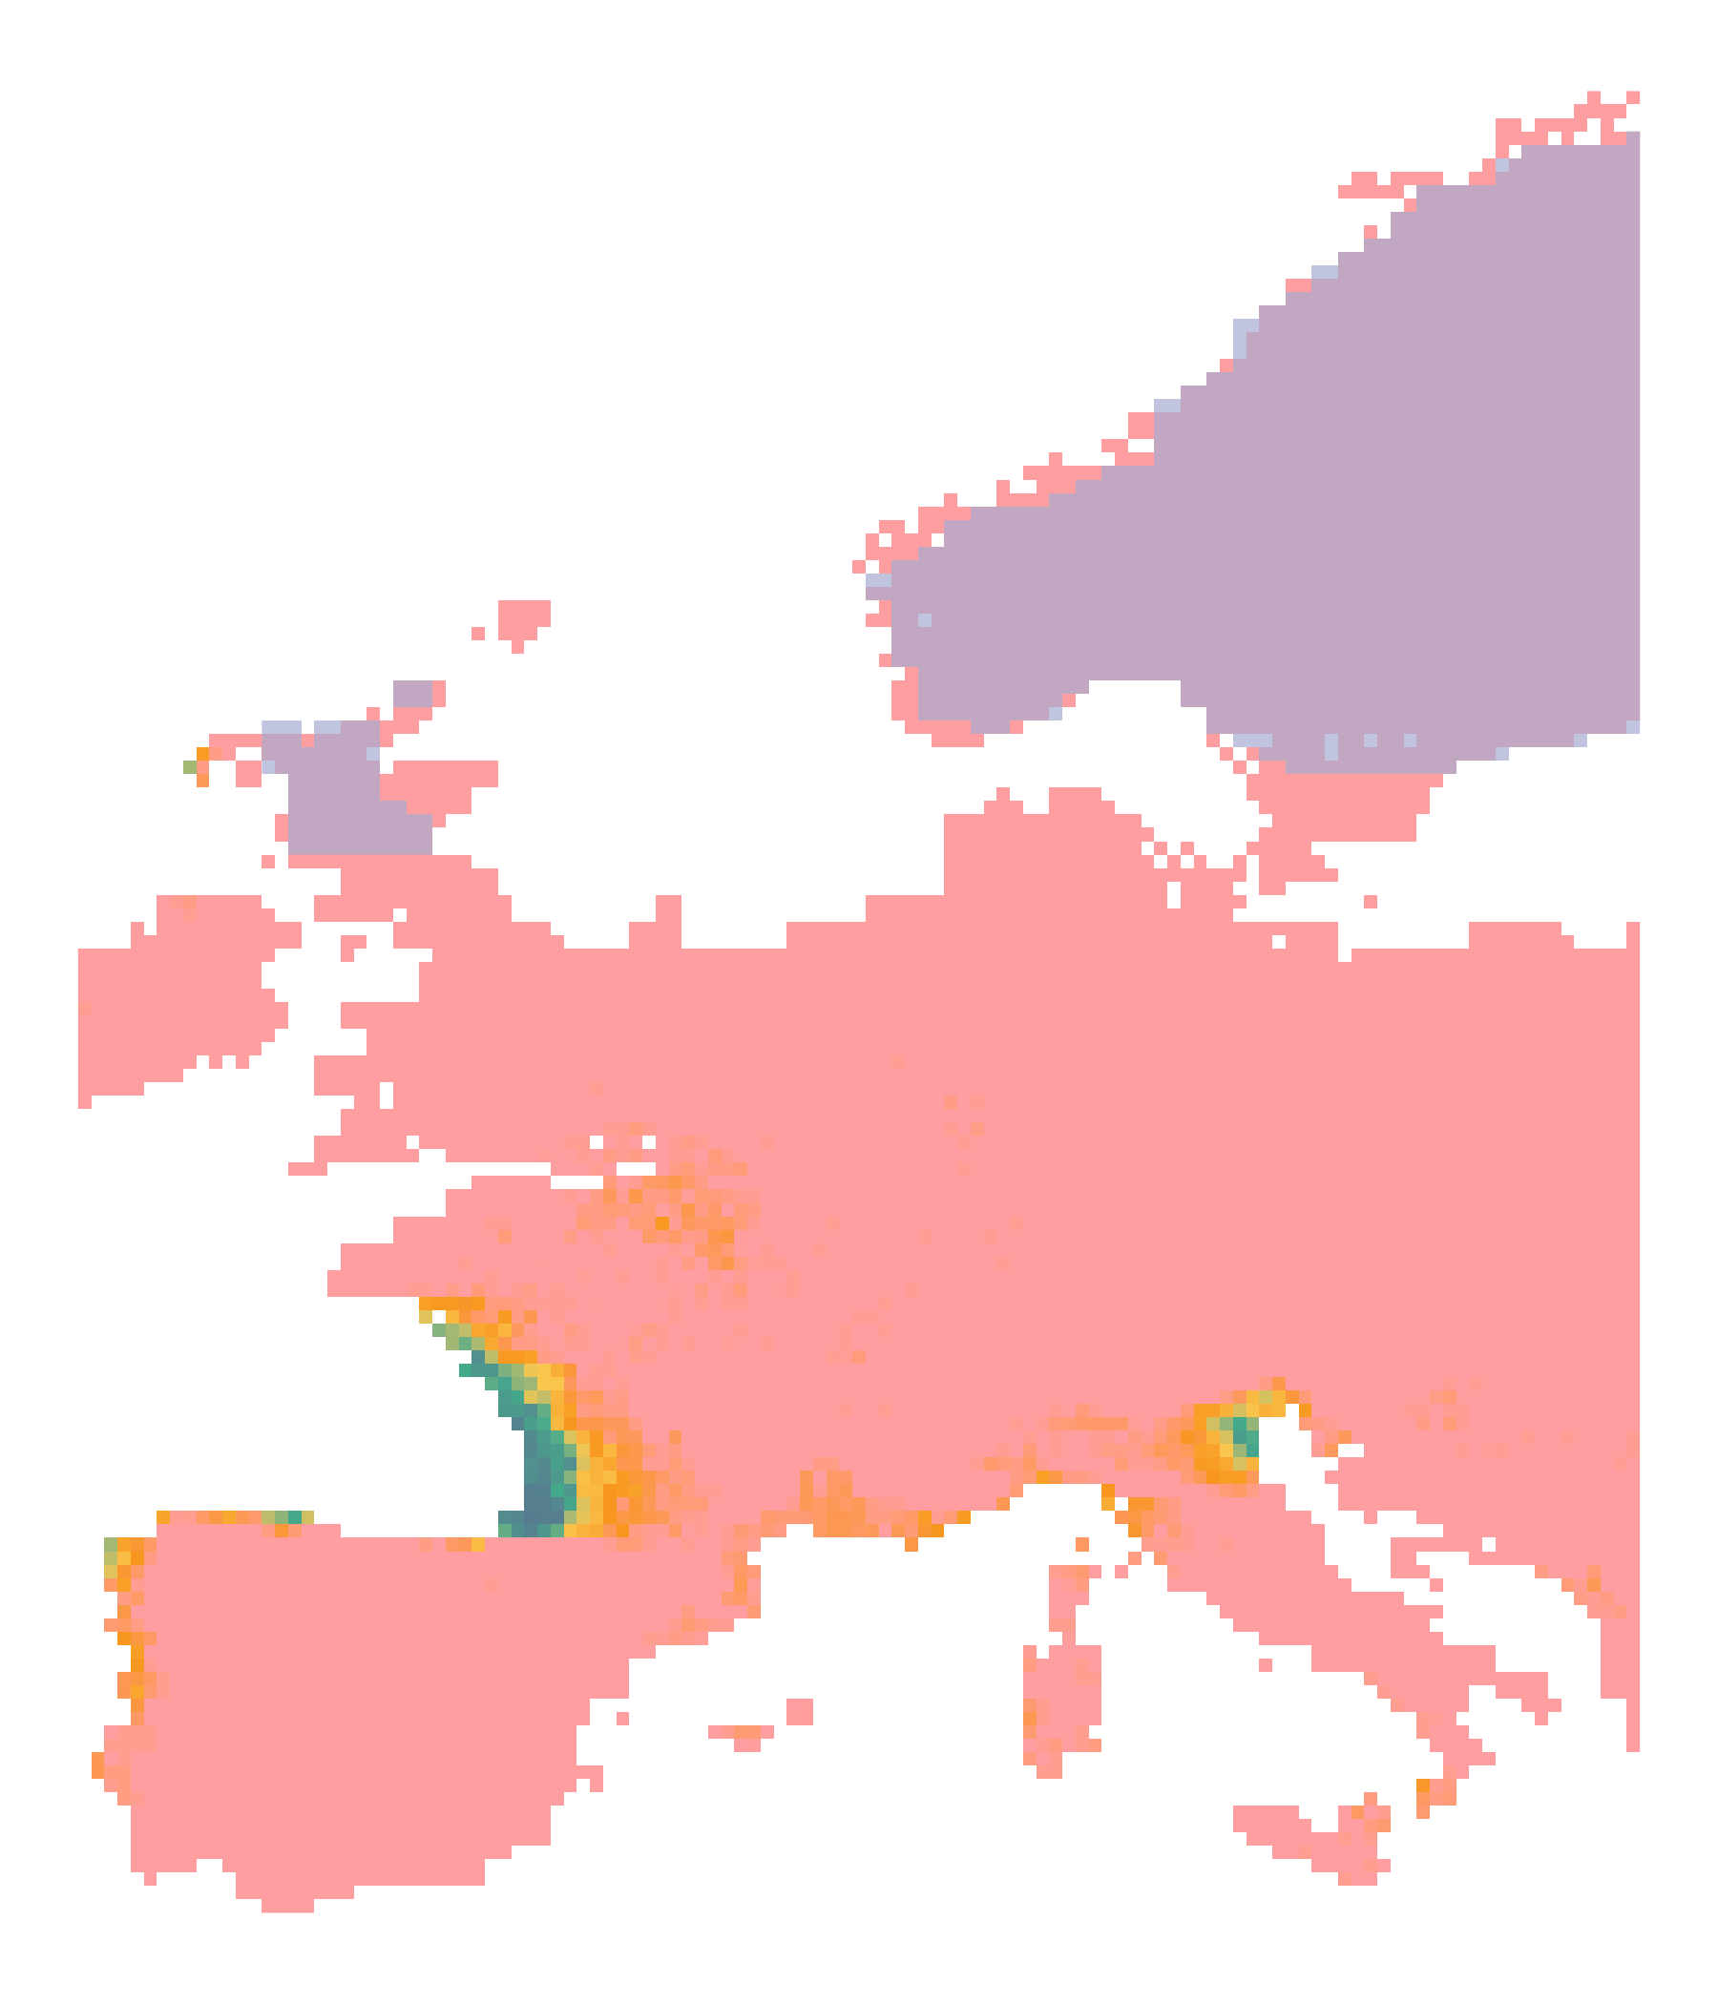
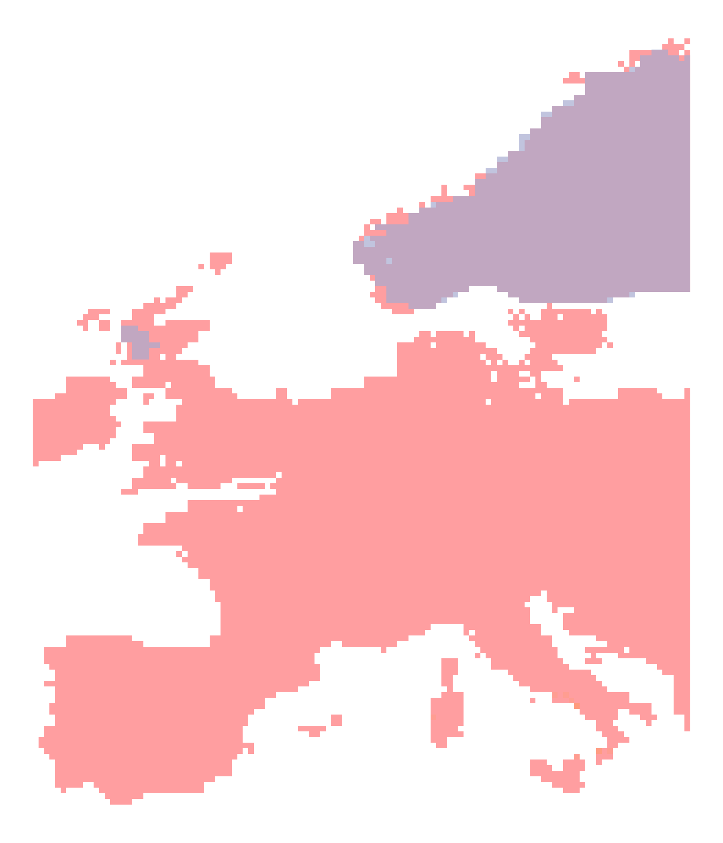
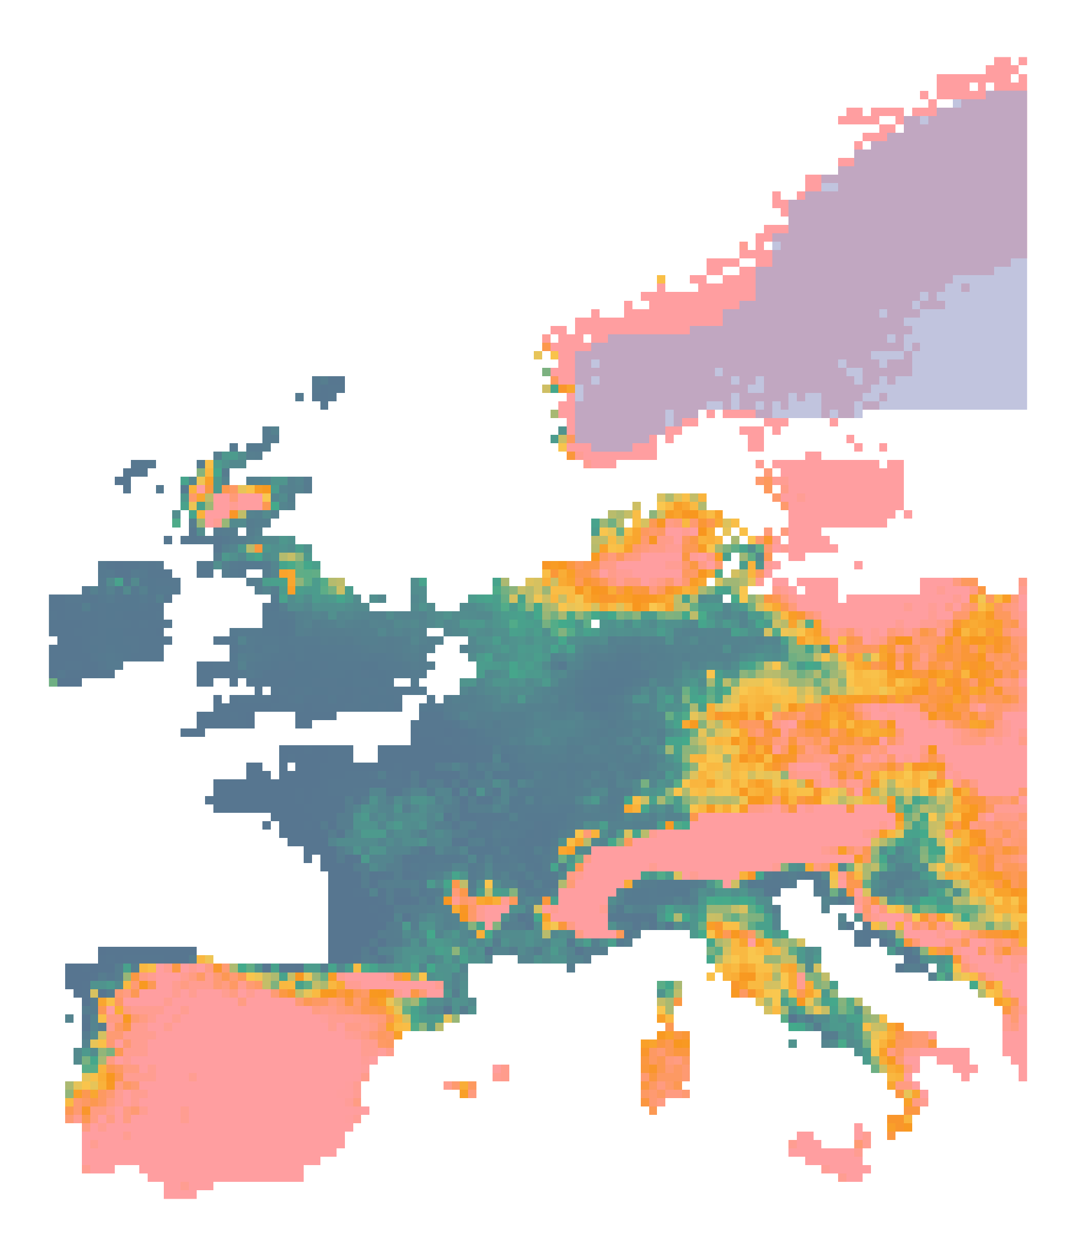
First paleosimulations
PHENOFIT

Slide 41
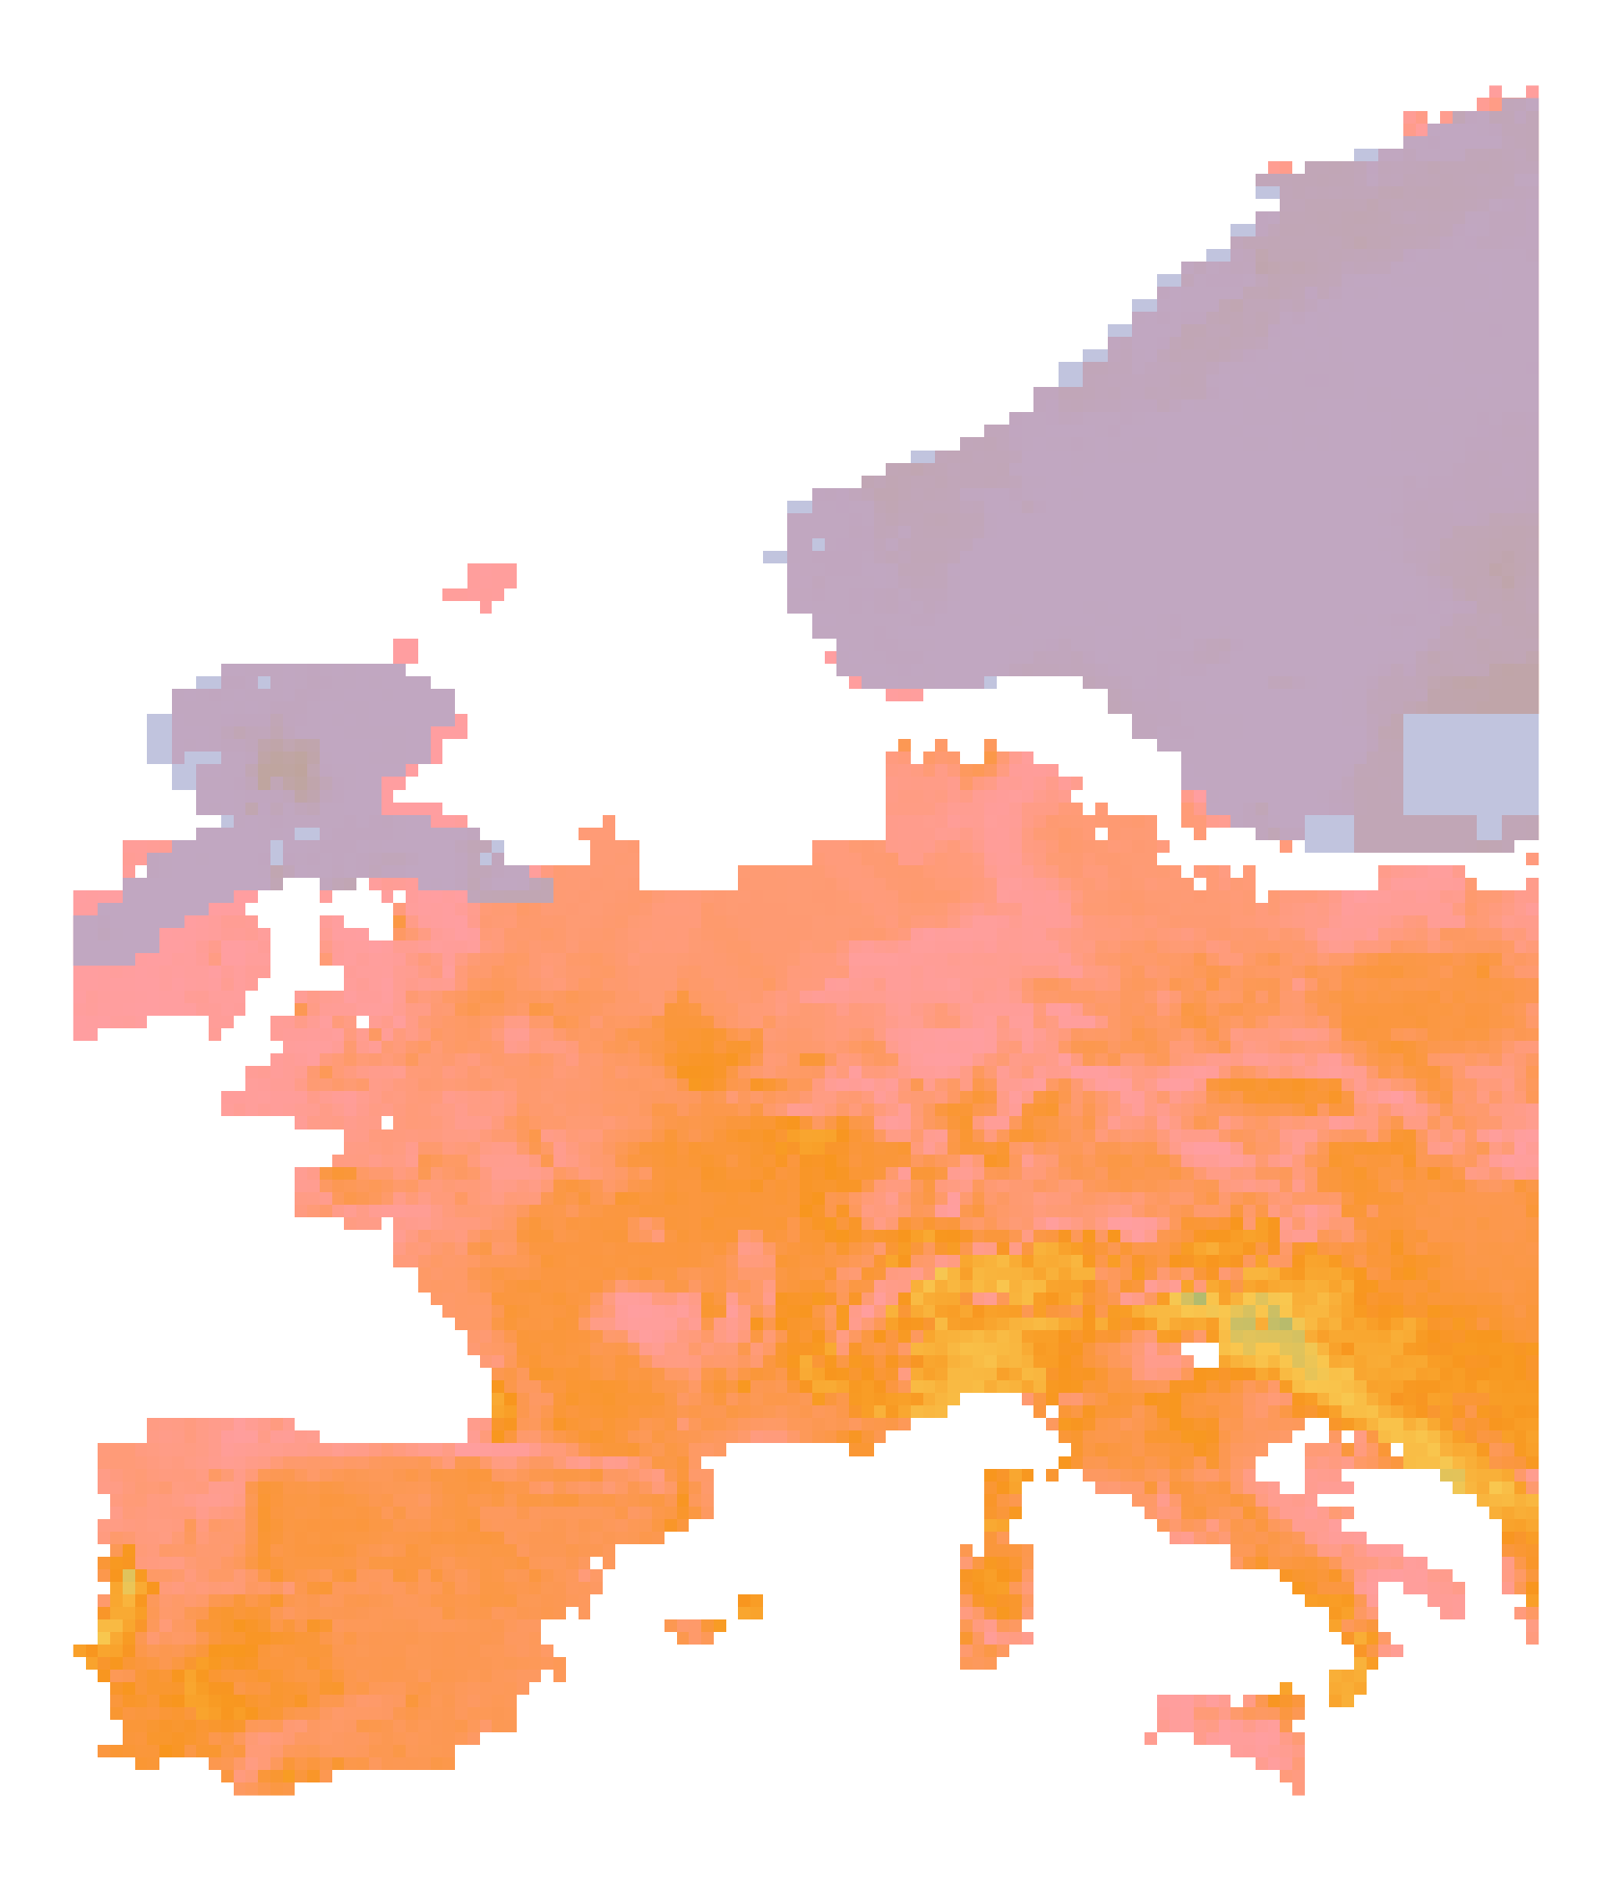
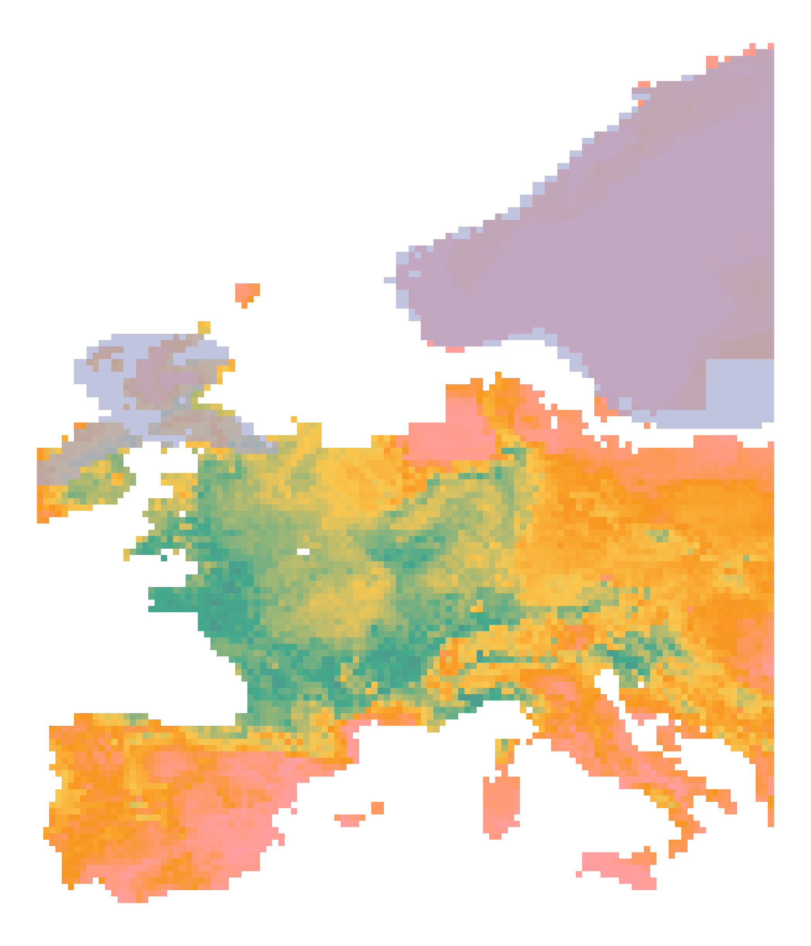
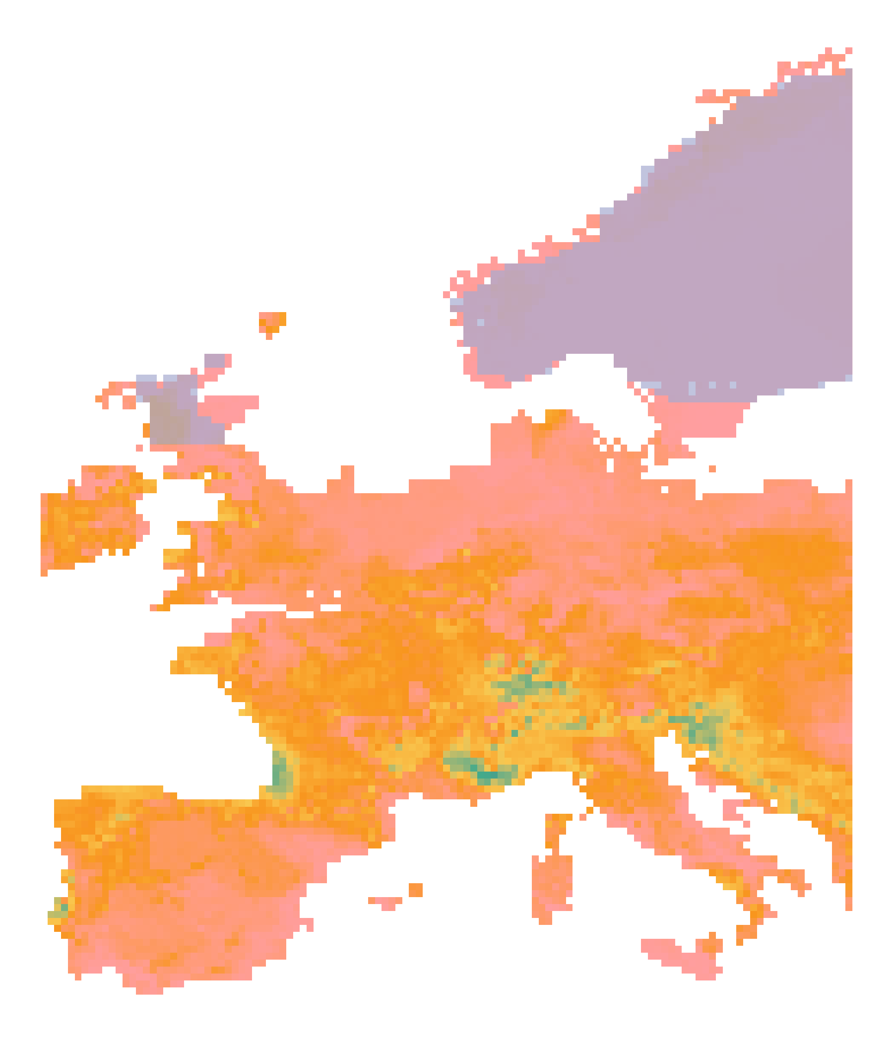
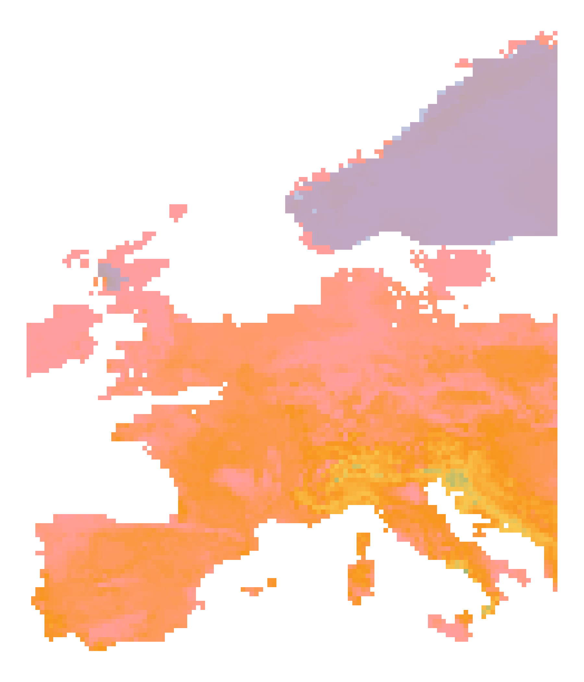
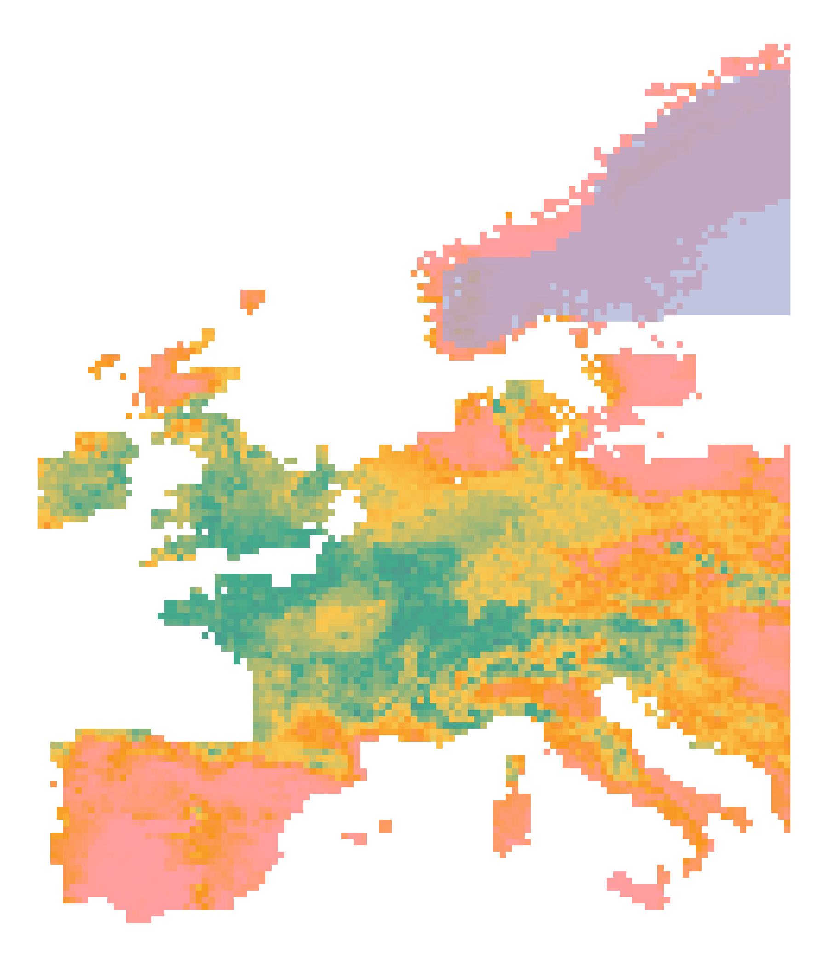
First paleosimulations
Random Forest

Slide 42
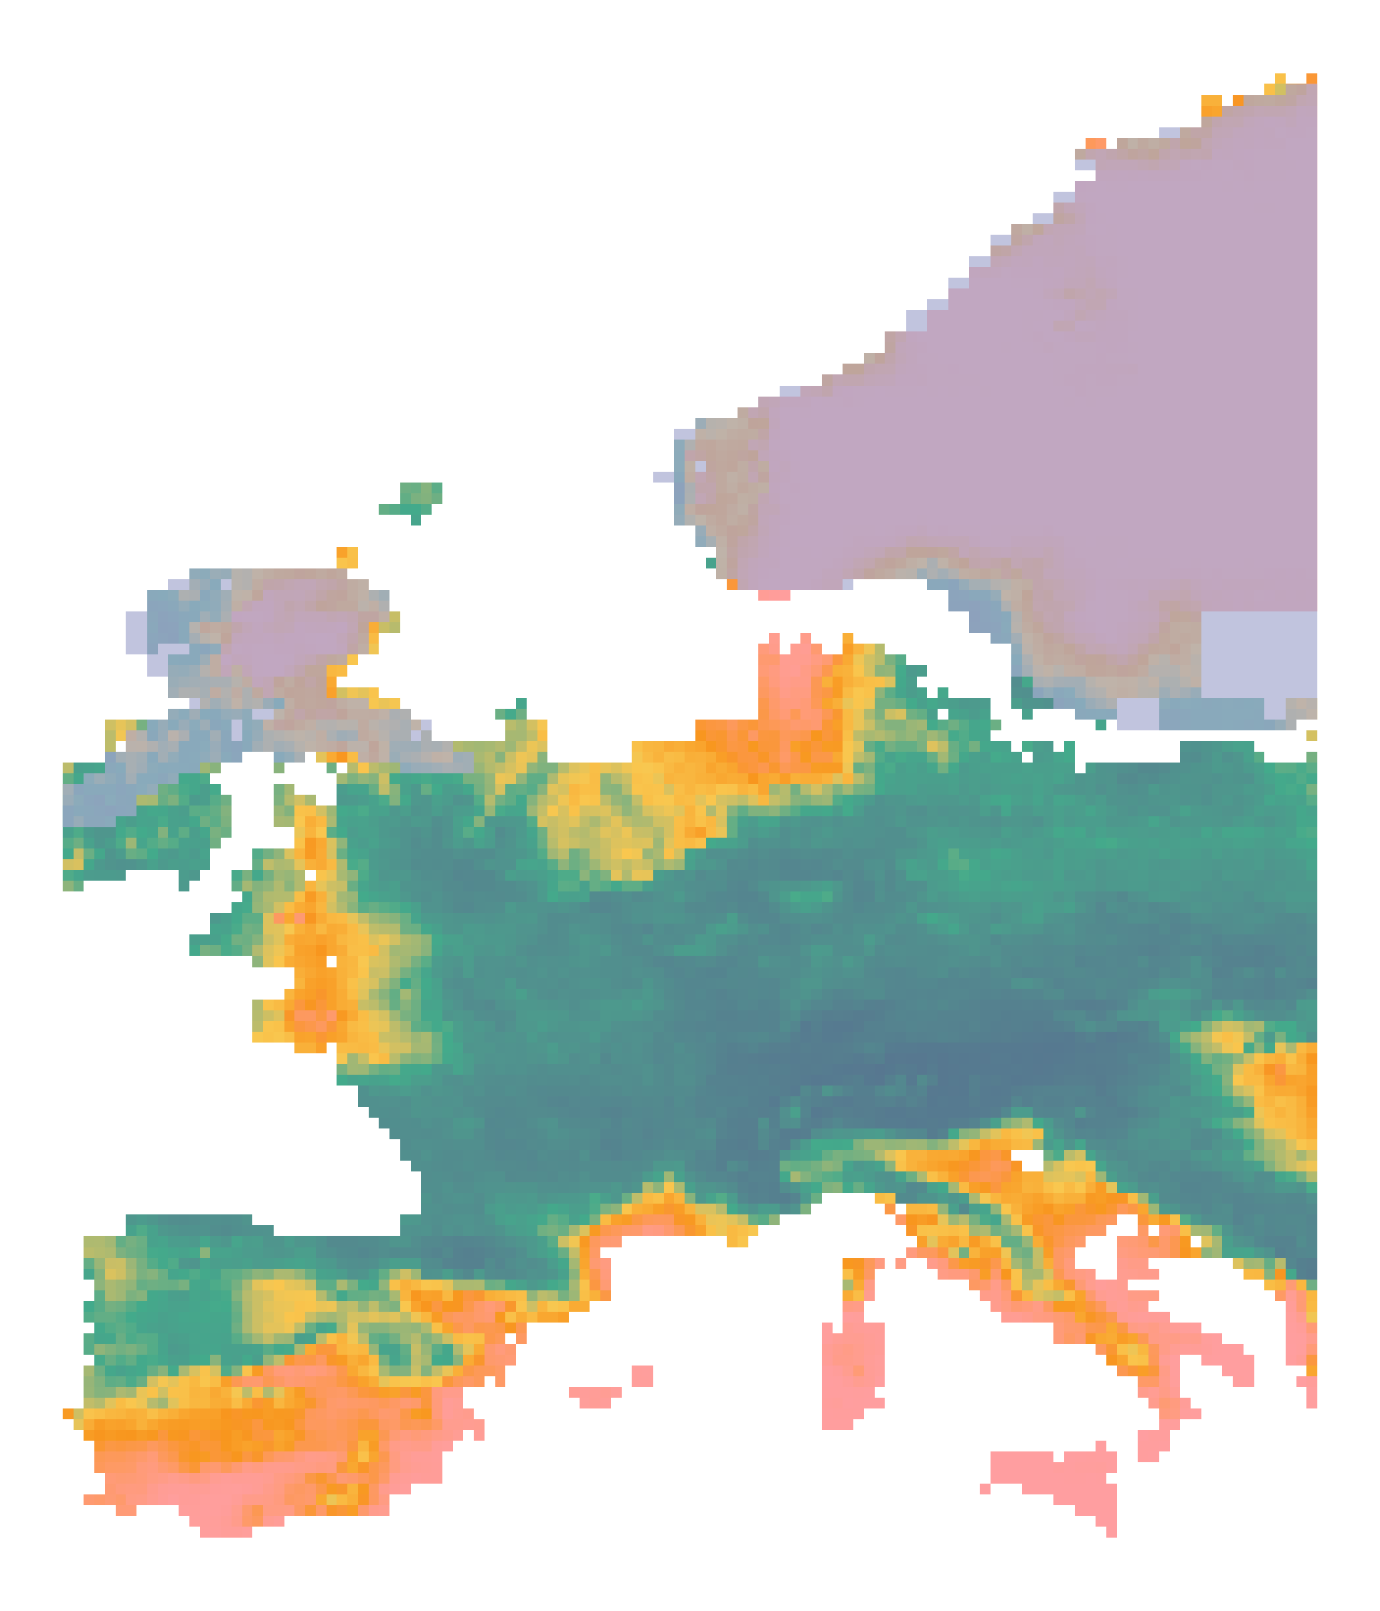
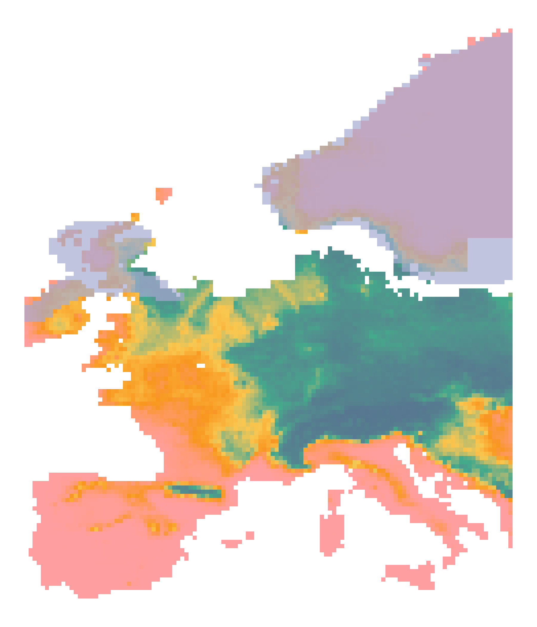
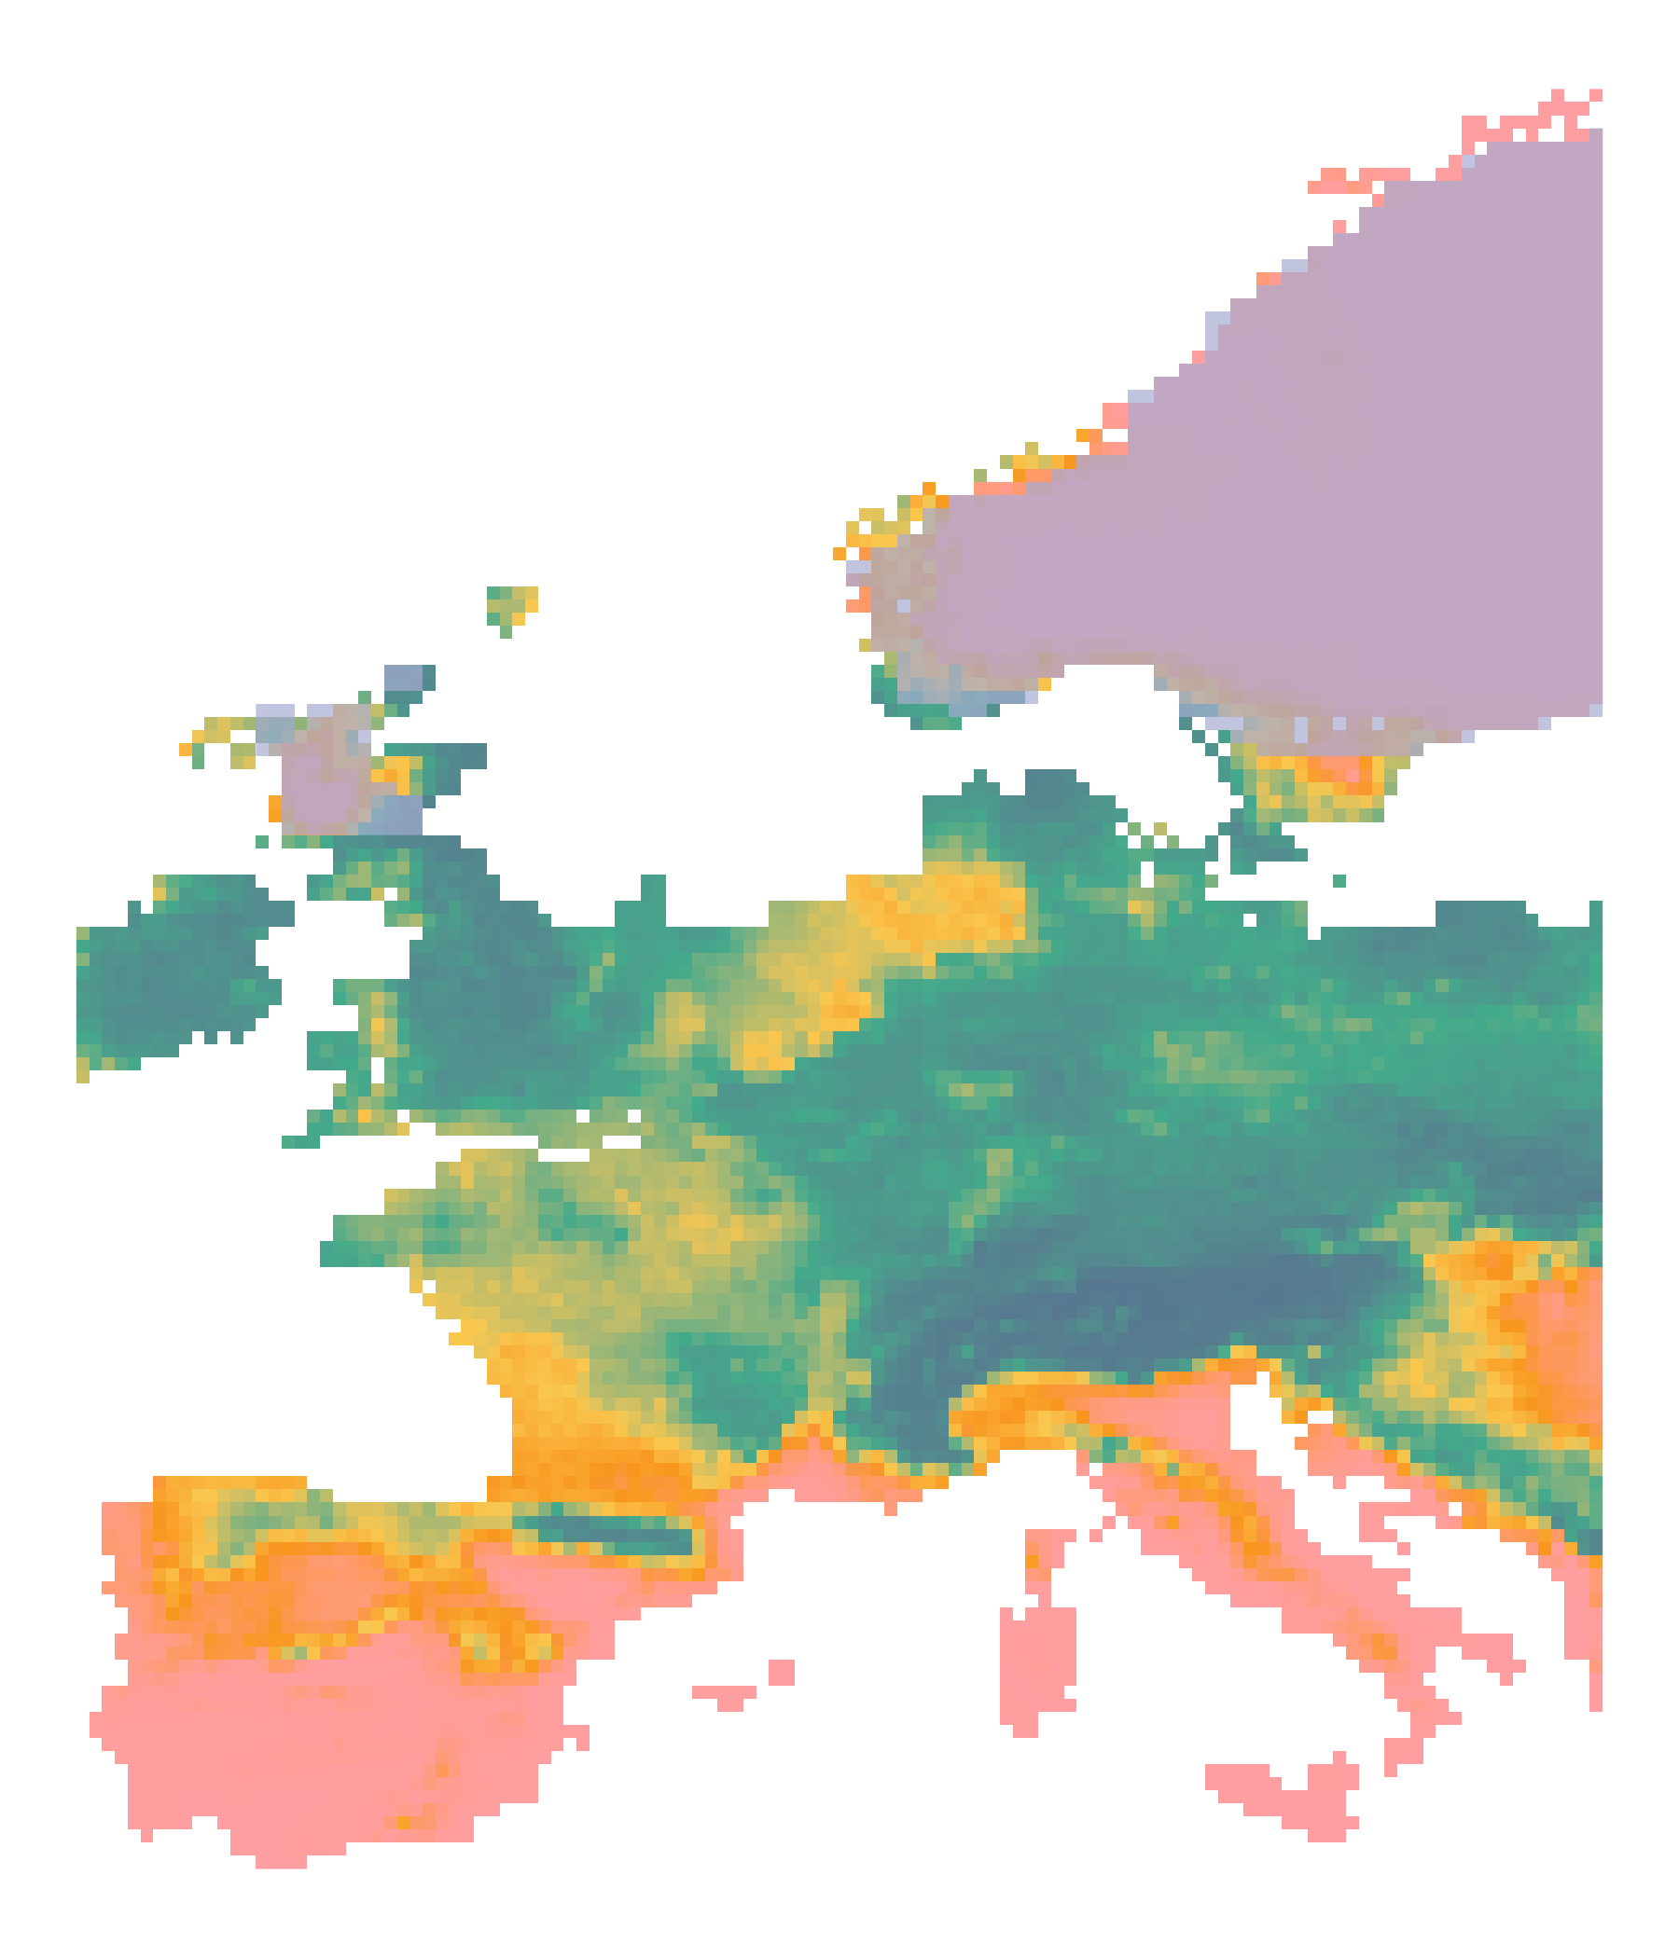
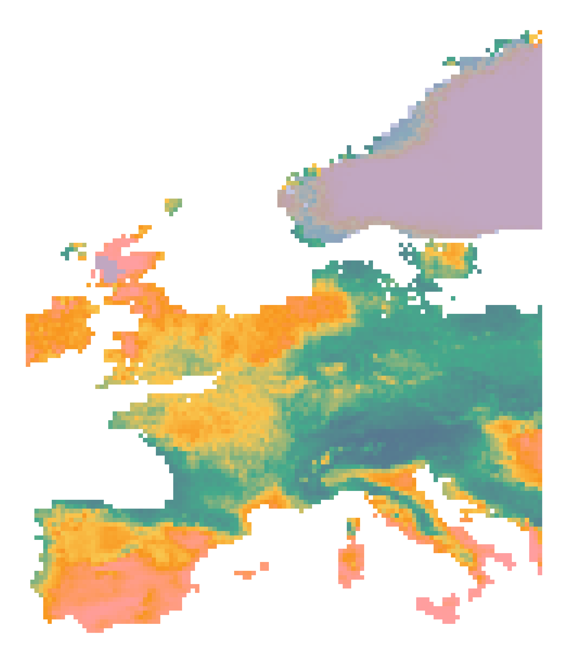
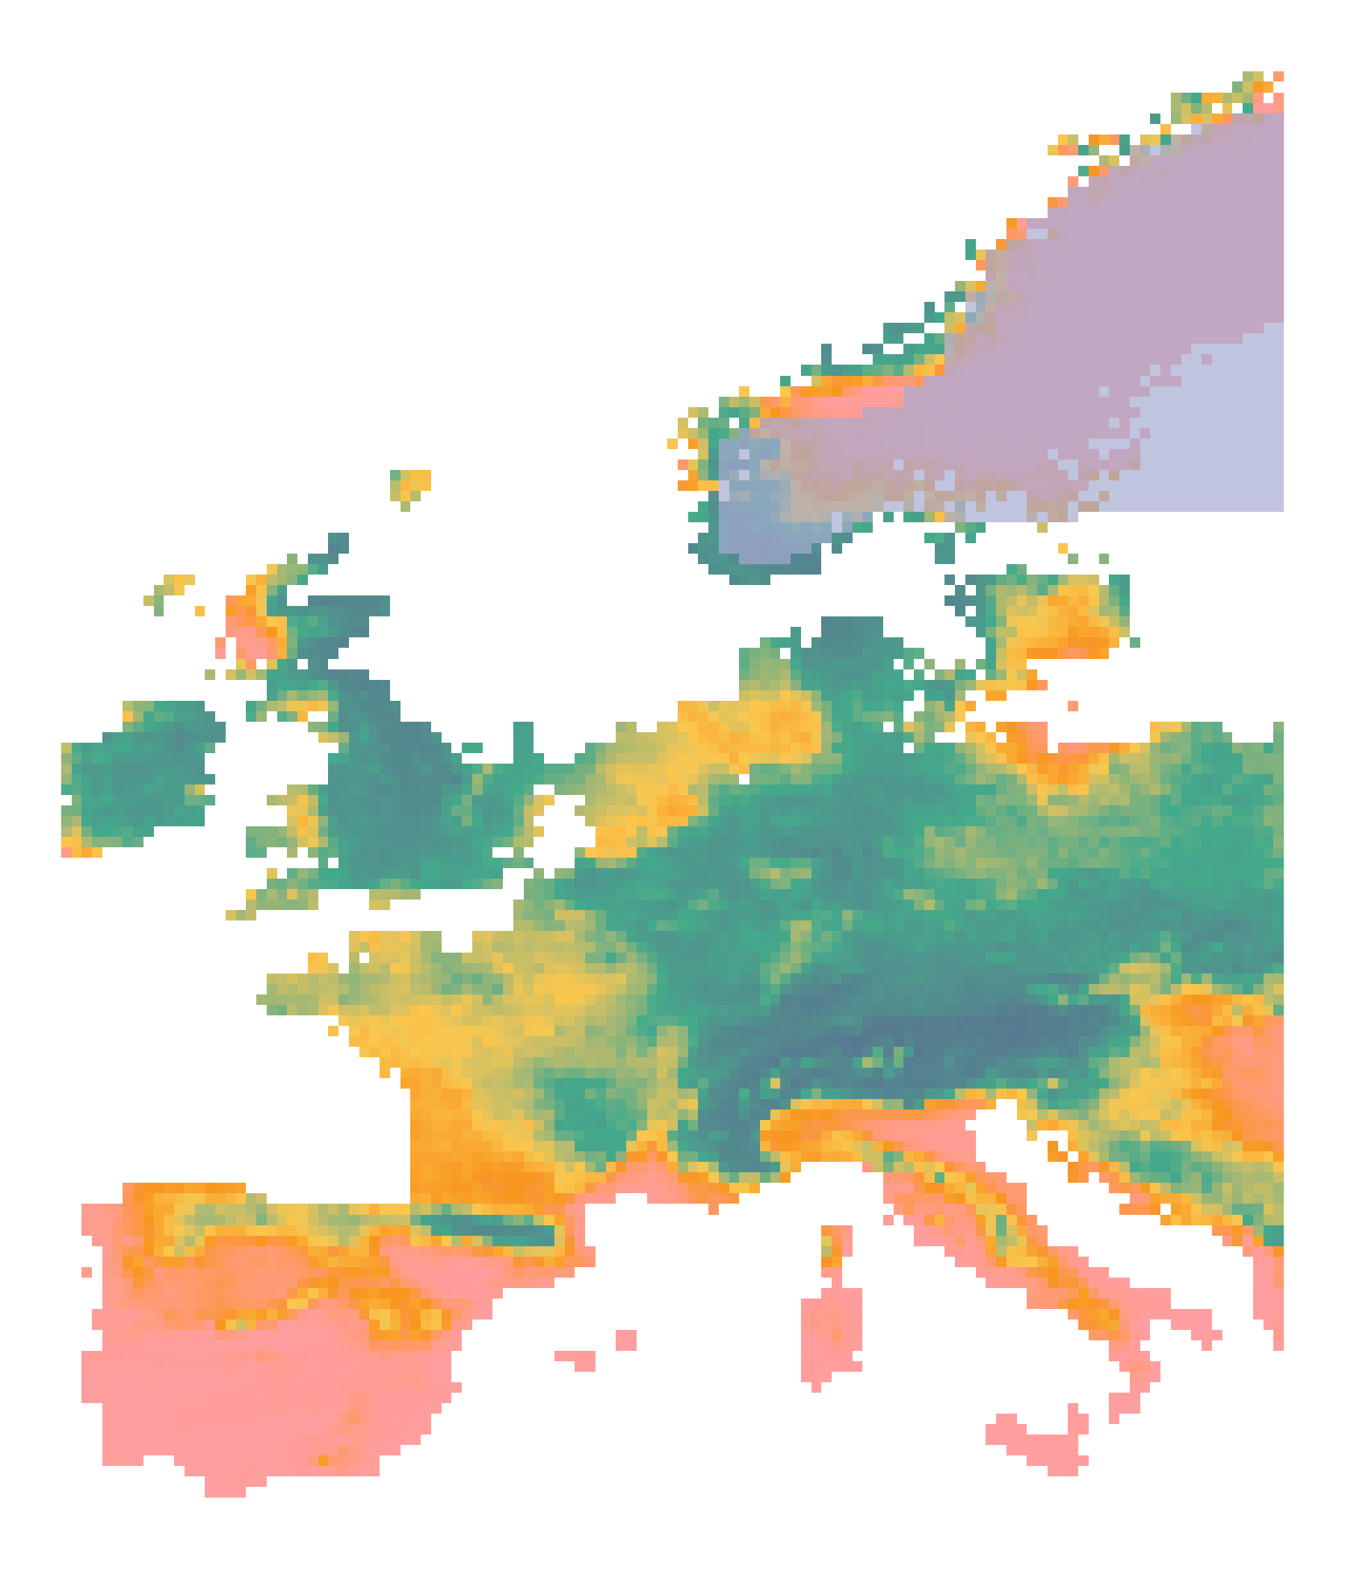
First paleosimulations
Lasso GLM

Slide 43
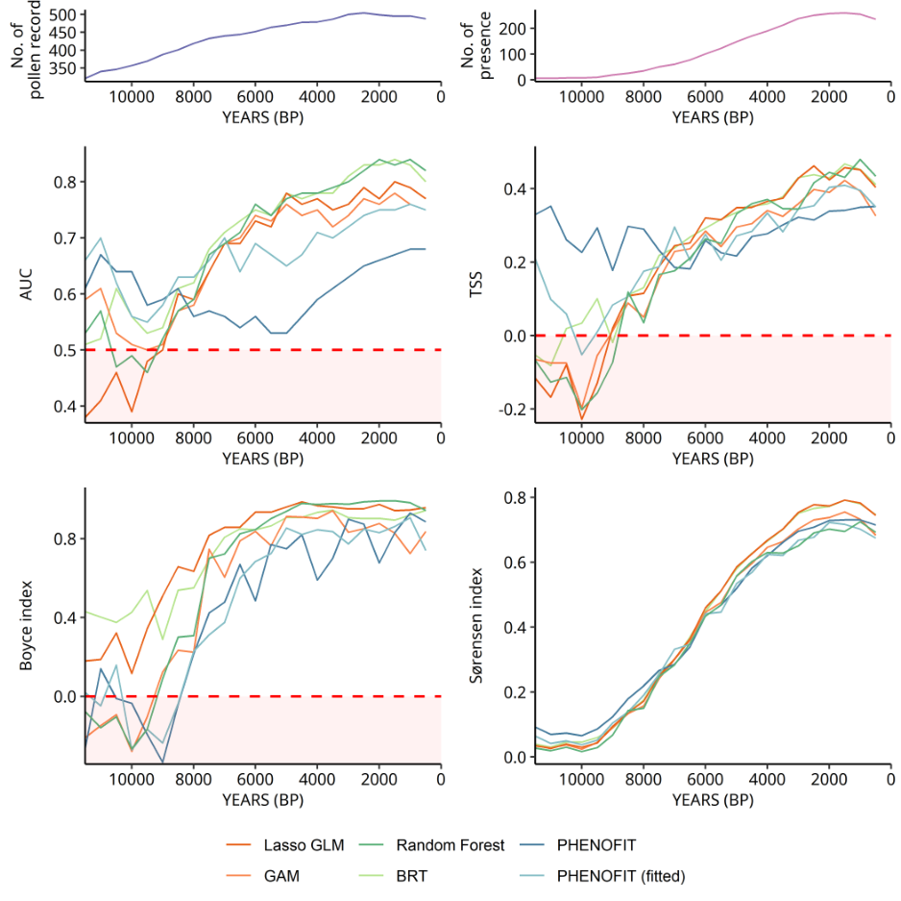
First paleosimulations

Slide 44
Novelty metrics: climatic distance
PAST CLIMATE
e.g. 9000 years BP
BASELINE CLIMATE
1970 - 2000
N predictors
N predictors

Slide 45
Novelty metrics: climatic distance
PAST CLIMATE
e.g. 9000 years BP
BASELINE CLIMATE
1970 - 2000
From each cell:
{ ; ; … }

Slide 46
Novelty metrics: climatic distance
PAST CLIMATE
e.g. 9000 years BP
BASELINE CLIMATE
1970 - 2000
Minimum
Euclidean distance
(N-dimensional)
From each cell:
{ ; ; … }
To the set of all cells
in the calibration period

Slide 47
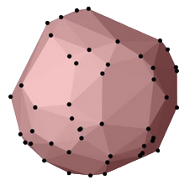
Novelty metrics: hypervolume similarity
PAST CLIMATE
e.g. 9000 years BP
N-dimensional hypervolume

Slide 48
Novelty metrics: hypervolume similarity
PAST CLIMATE
e.g. 9000 years BP
BASELINE CLIMATE
1970 - 2000
N-dimensional hypervolume
N-dimensional hypervolume

Slide 49
Novelty metrics: hypervolume similarity
PAST CLIMATE
e.g. 9000 years BP
BASELINE CLIMATE
1970 - 2000

Slide 50
Novelty metrics: hypervolume similarity
PAST CLIMATE
e.g. 9000 years BP
BASELINE CLIMATE
1970 - 2000
Hypervolume overlap
(Sørensen similarity)

Slide 51
Novelty metrics: average distance to niche centroid
BASELINE CLIMATE
1970 - 2000
Observed niche
Calibration domain
N-dimensional hypervolume

Slide 52
Novelty metrics: average distance to niche centroid
BASELINE CLIMATE
1970 - 2000
+
+
+
N-dimensional hypervolume

Slide 53
Novelty metrics: average distance to niche centroid
BASELINE CLIMATE
1970 - 2000
+
Average distance between pollen records and niche centroid
+
+
N-dimensional hypervolume

Slide 54
Novelty metrics: average distance to niche centroid
BASELINE CLIMATE
1970 - 2000
+
Average distance between pollen records and niche centroid
+
+
+
Outlier ?
N-dimensional hypervolume

Slide 55
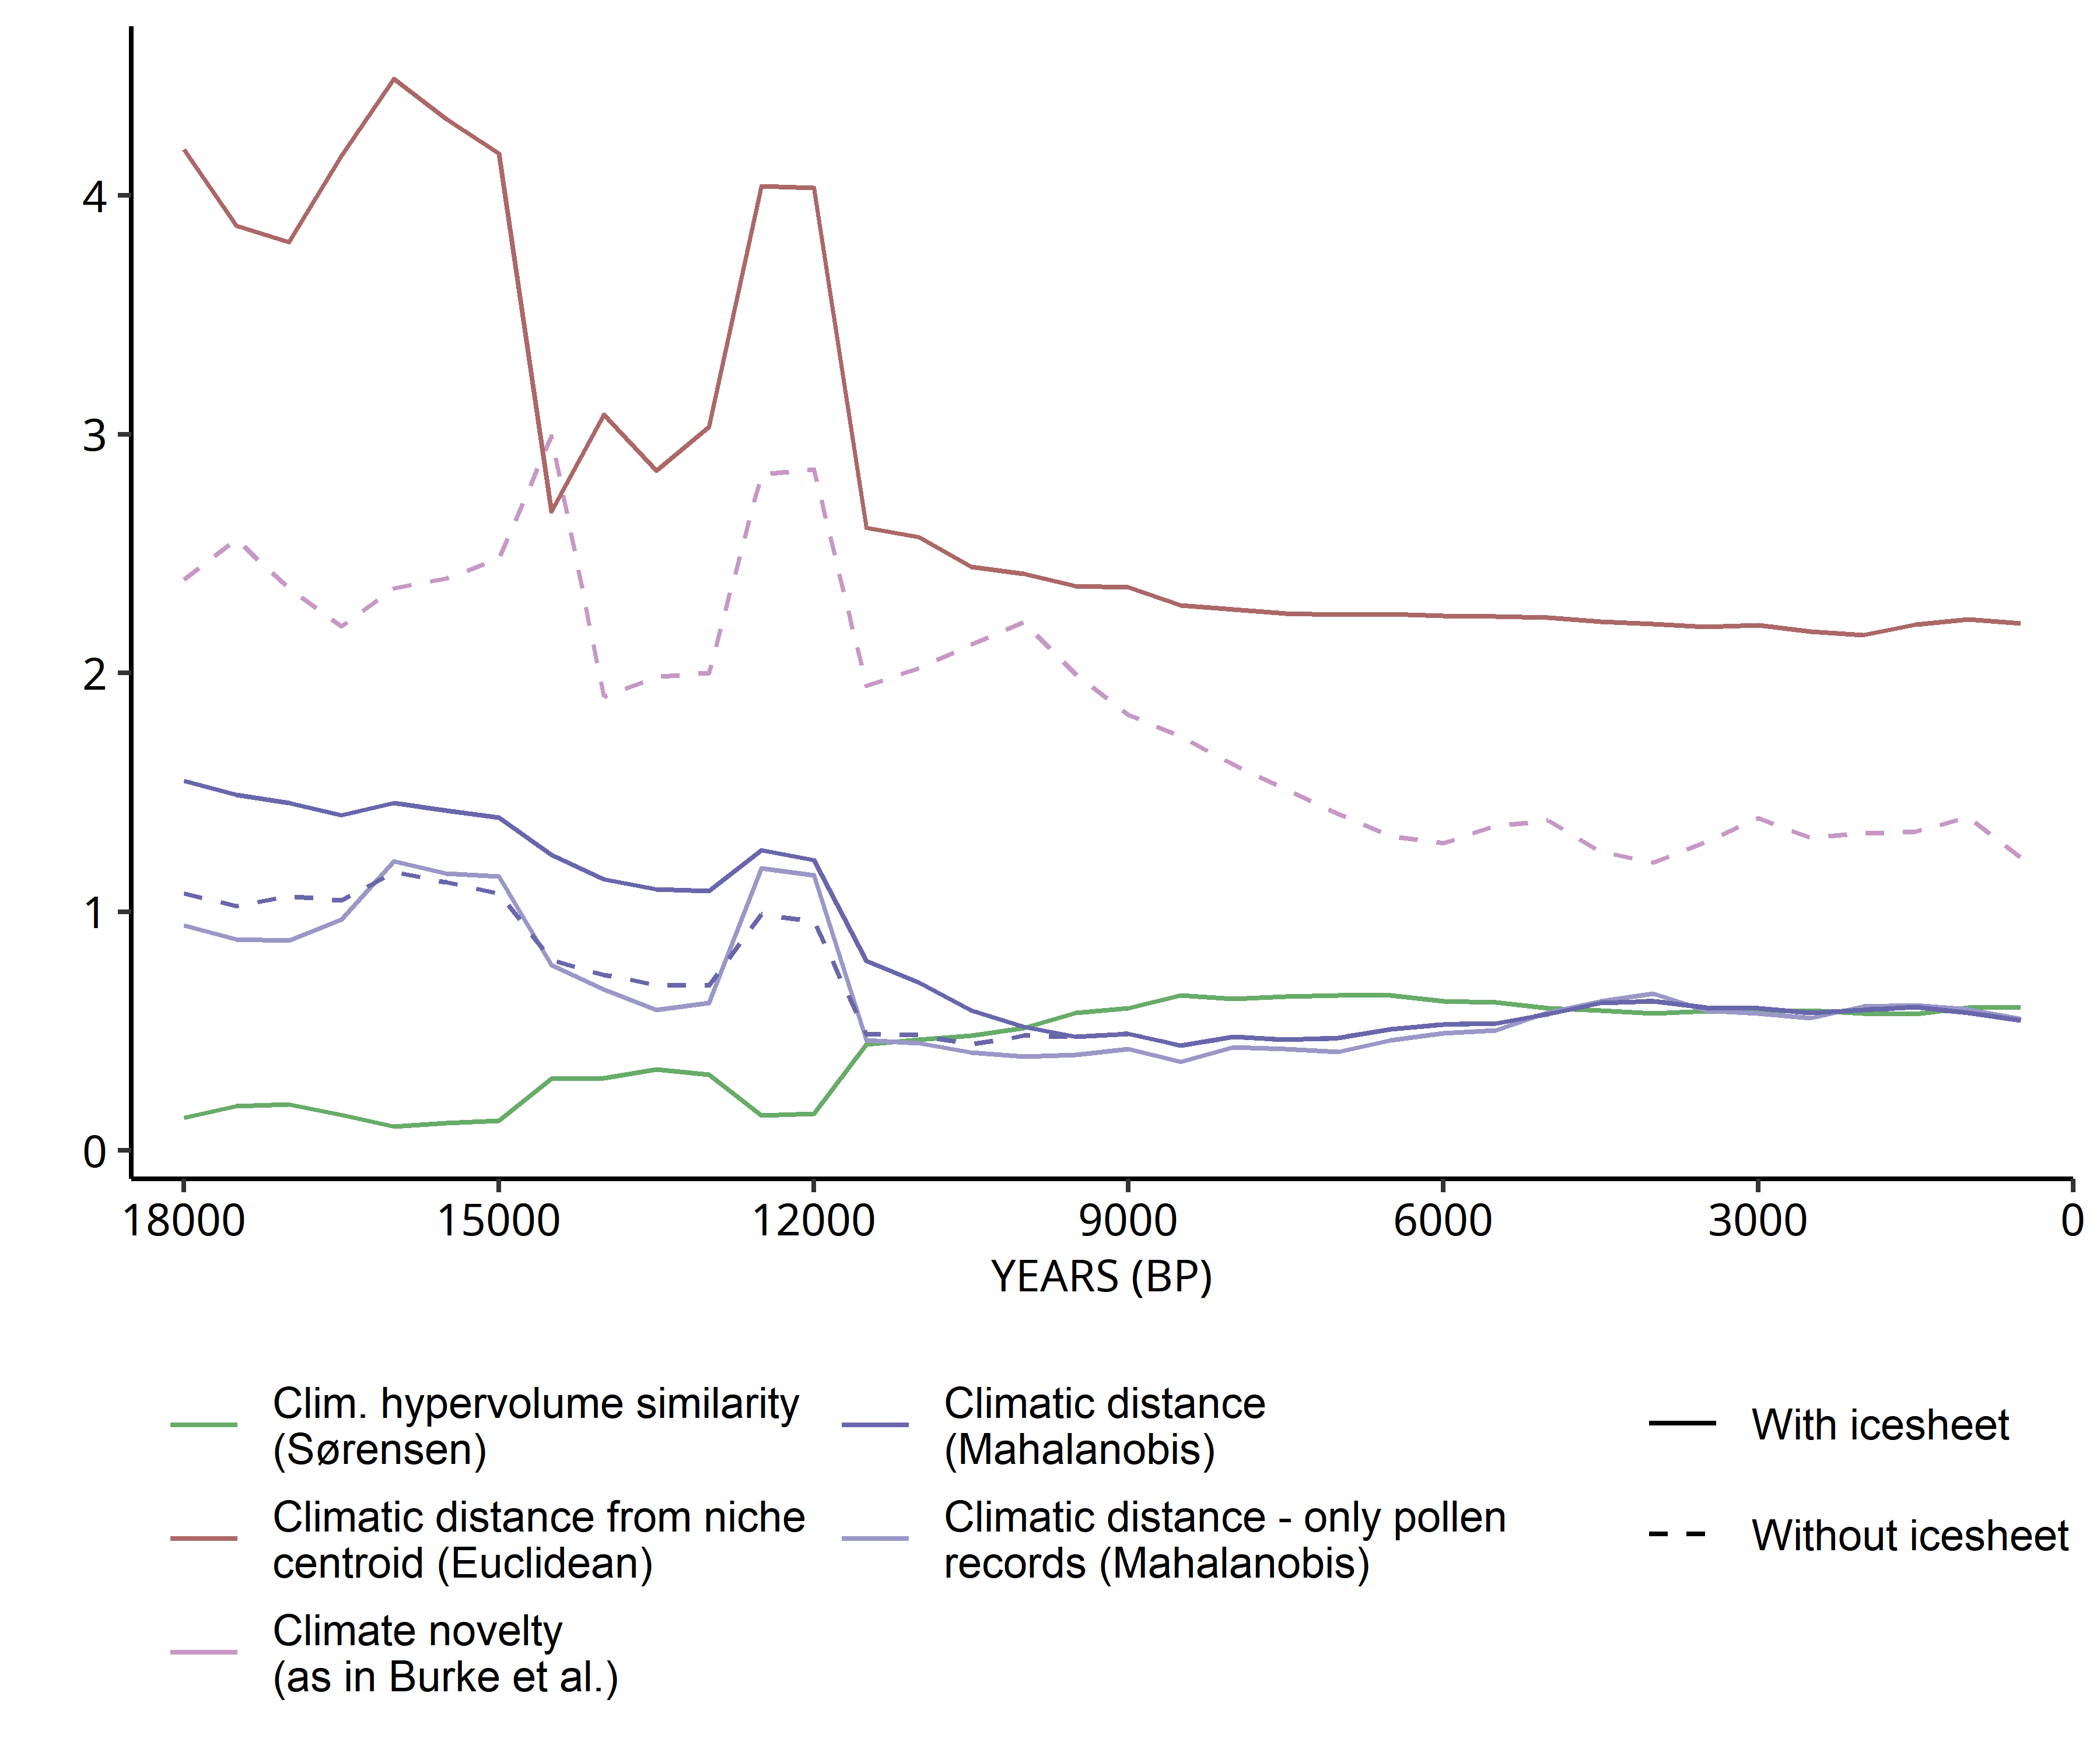
Novelty metrics

Slide 56
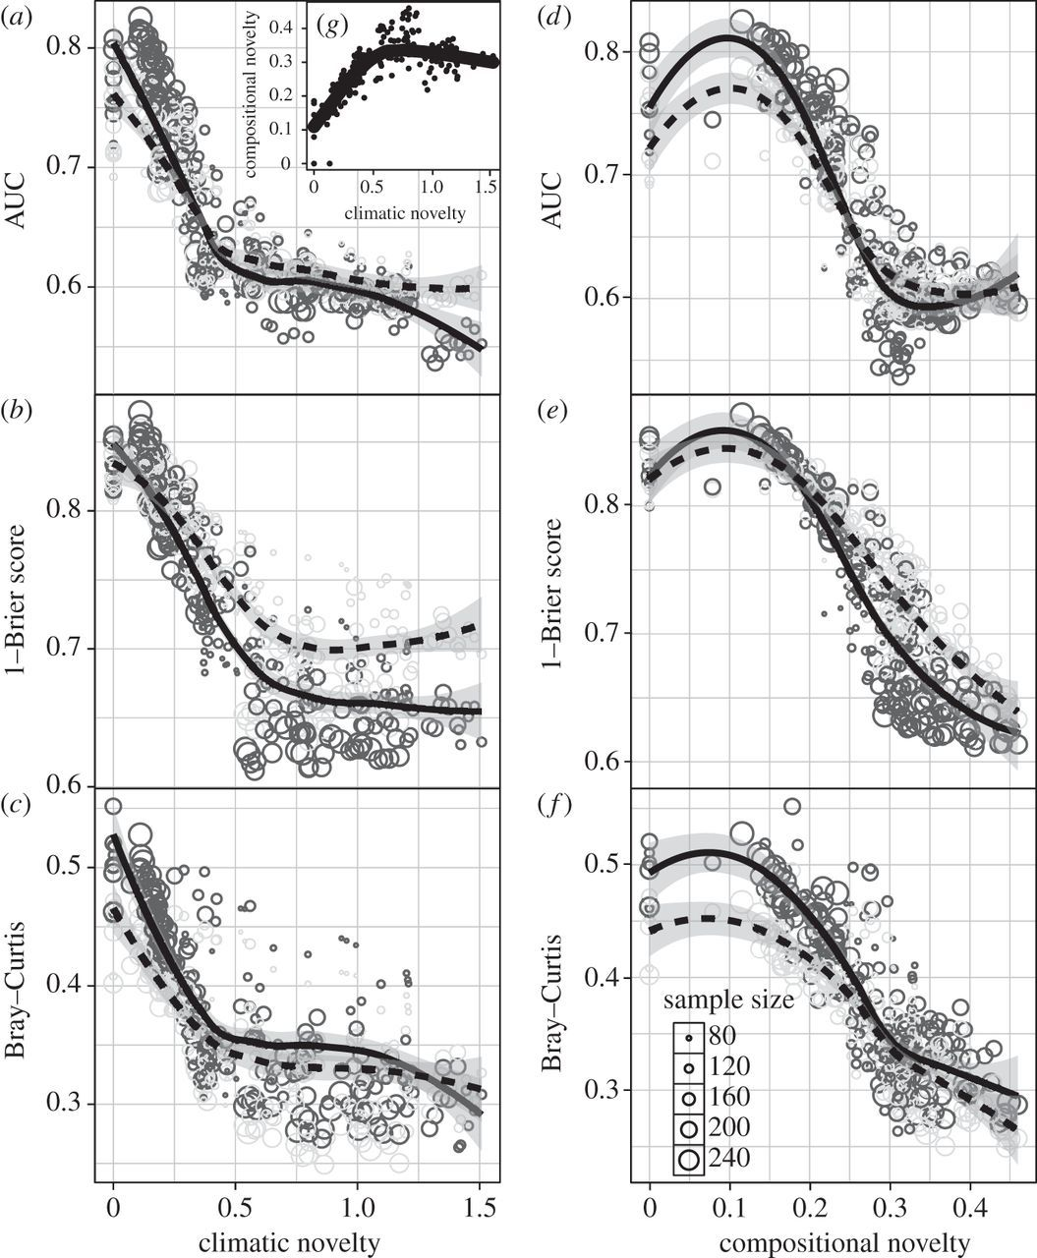
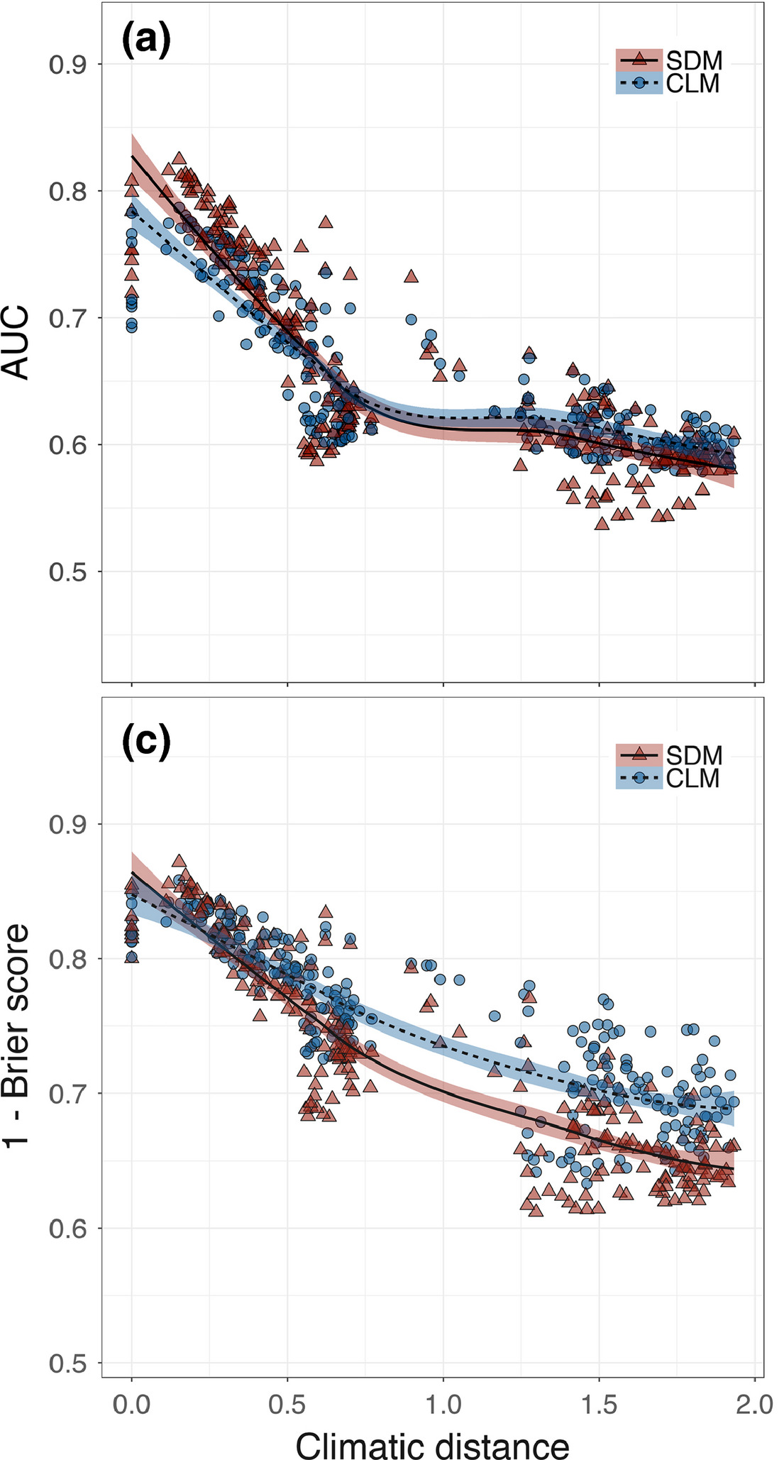
Model performance against novelty: previous studies
Maguire et al. (2016)
Fitzpatrick et al. (2018)

Slide 57
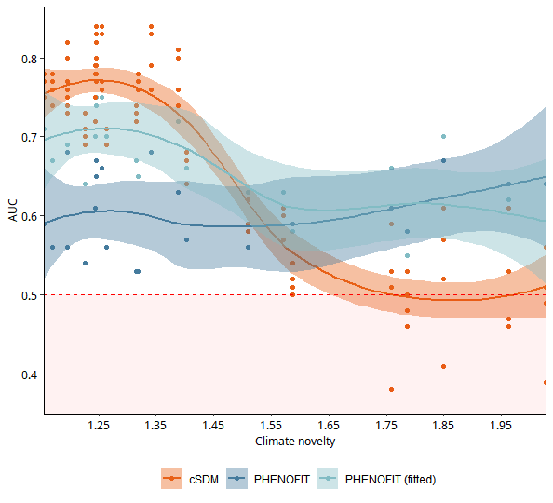
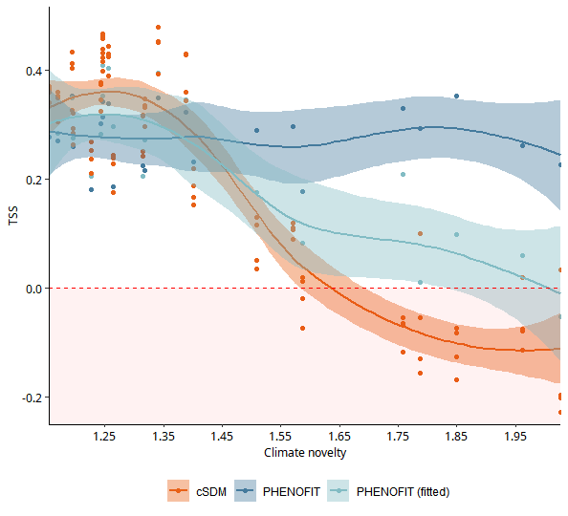
Model performance against novelty: preliminary results
Fagus sylvatica

Slide 58
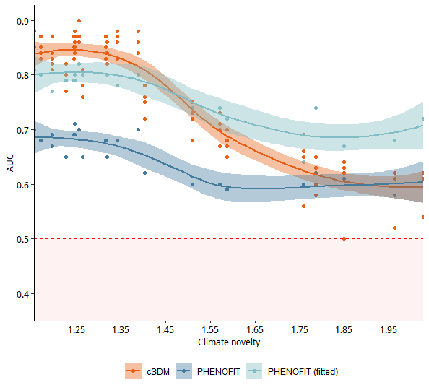
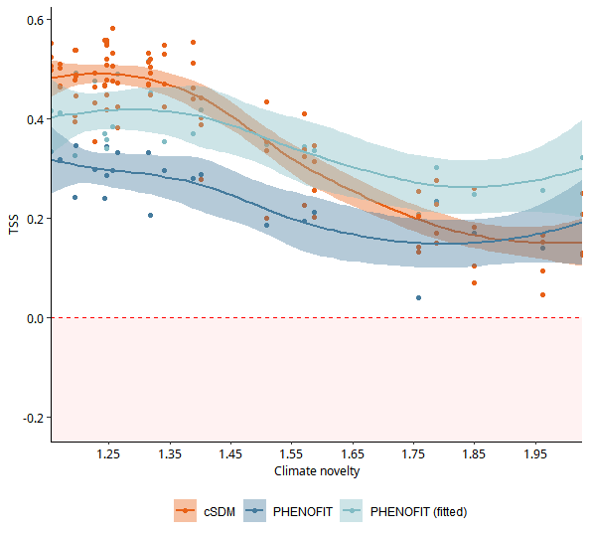
Model performance against novelty: preliminary results
Abies alba

Slide 59
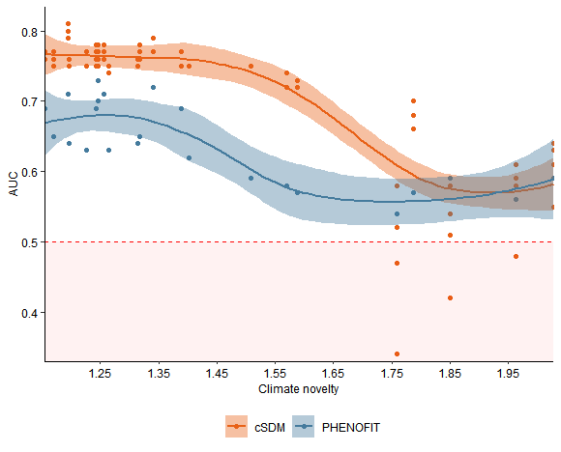
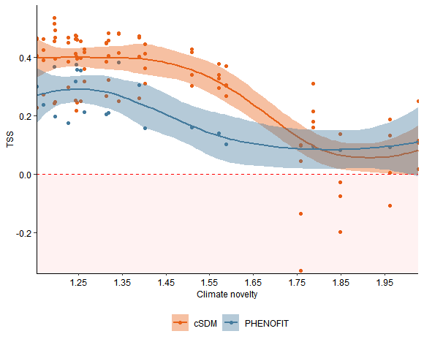
Model performance against novelty: preliminary results
Quercus (deciduous)

Slide 60
Response curves in different conditions
BASELINE CLIMATE
1970 - 2000
Calibration domain
N-dimensional hypervolume
Qiao et al. (2019)

Slide 61
Response curves in different conditions
BASELINE CLIMATE
1970 - 2000
Calibration range
N-dimensional hypervolume
Qiao et al. (2019)

Slide 62
Response curves in different conditions
BASELINE CLIMATE
1970 - 2000
Full extrapolation
N-dimensional hypervolume
Qiao et al. (2019)

Slide 63
Response curves in different conditions
BASELINE CLIMATE
1970 - 2000
+
+
+
+
+
+
+
+
+
+
+
+
N-dimensional hypervolume
Qiao et al. (2019)

Slide 64
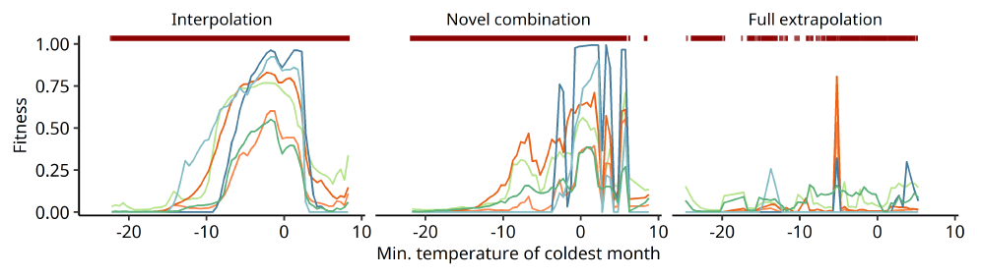
Response curves in different conditions

