Slide 1
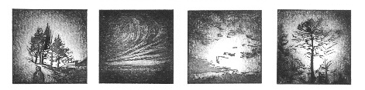
Comité de suivi individuel – 2ème année
Reliability of species distribution model projections
V. Van der Meersch, sous la direction de I. Chuine
Linogravures par C. Rescan

Slide 2
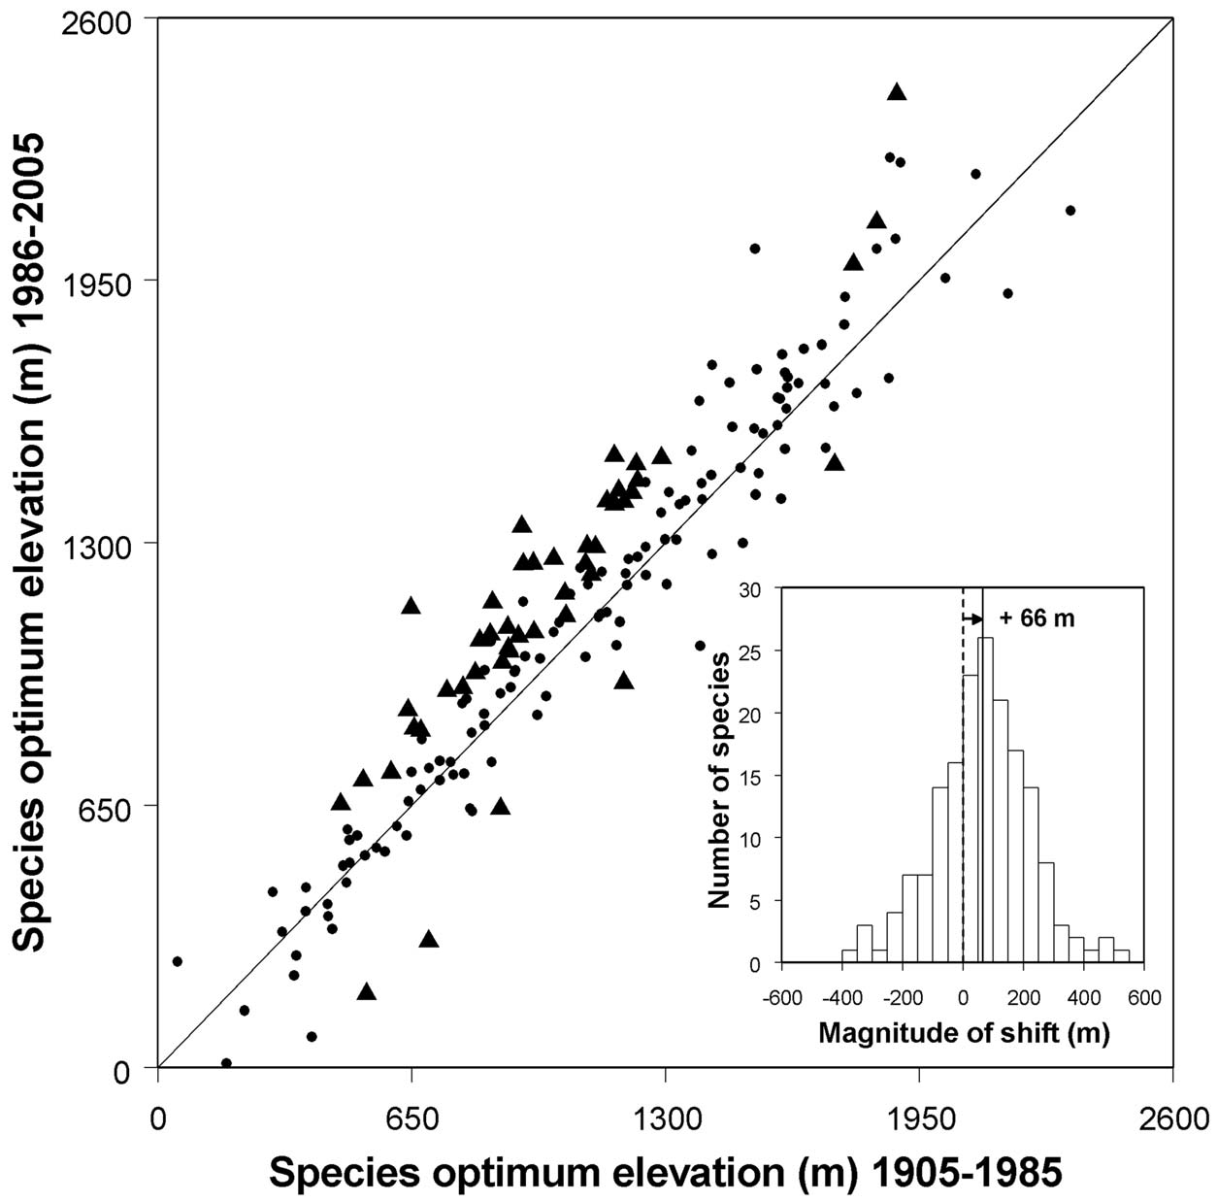
WHAT WE OBSERVE: SPECIES RANGE SHIFTS
Forest plant species
+66m
Lenoir et al. (2008)

Slide 3

HOW WE COULD PREDICT THE FUTURE: POPULAR STATISTICAL APPROACHES
Correlative niche models
Bioclimatic predictors
Current distribution

Slide 4
HOW WE COULD PREDICT THE FUTURE: POPULAR STATISTICAL APPROACHES
Correlative niche models
Fit a statistical
relationship
Bioclimatic predictors
Current distribution

Slide 5

HOW WE COULD PREDICT THE FUTURE: POPULAR STATISTICAL APPROACHES
Correlative niche models
Fit a statistical
relationship
Bioclimatic predictors
Current distribution
FIND PATTERNS

Slide 6
HOW WE COULD PREDICT THE FUTURE: POPULAR STATISTICAL APPROACHES
Correlative niche models
Make predictions
Future distribution
Future predictors

Slide 7

HOW WE COULD PREDICT THE FUTURE: POPULAR STATISTICAL APPROACHES
Correlative niche models
Make predictions
Future distribution
Future predictors
MAIN HYPOTHESIS: CORRELATIONS HOLD TRUE

Slide 8

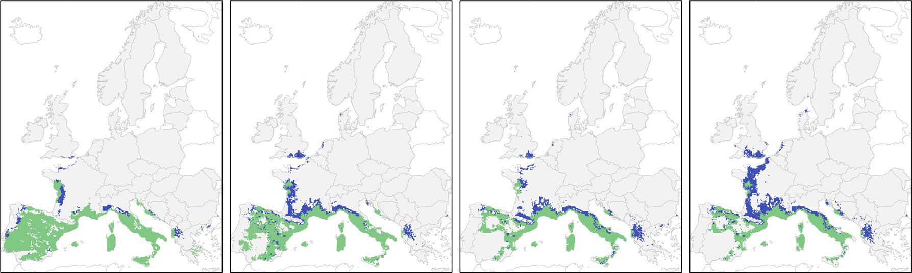
HOW WE COULD PREDICT THE FUTURE: POPULAR STATISTICAL APPROACHES
Example: Quercus ilex projected range shift
Present
Suitable
CURRENT
2095
Mauri et al. (2022)

Slide 9
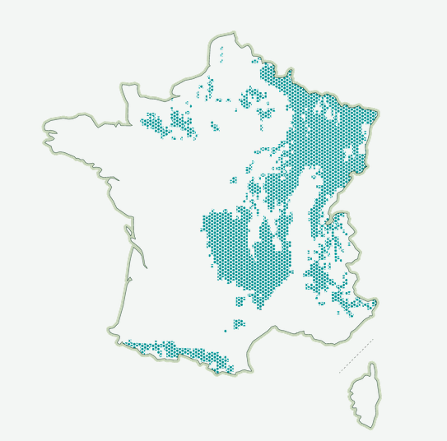


HOW WE COULD PREDICT THE FUTURE: POPULAR STATISTICAL APPROACHES
Example: F. sylvatica future distribution and mainstream media
“Le hêtre, victime parfaite du réchauffement climatique”
Sources: Mauri et al. (2022)

Slide 10


HOW WE COULD PREDICT THE FUTURE: POPULAR STATISTICAL APPROACHES
Key advantages
▶ easy handling of the models
▶ calibration can be envisaged for many species
▶ standard methods, reproducibility

Slide 11
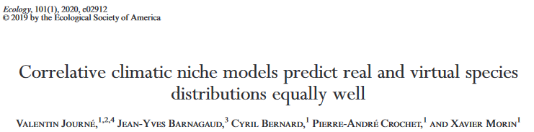
HOW WE COULD PREDICT THE FUTURE: POPULAR STATISTICAL APPROACHES
Approach criticized: lack of biological realism?
“high predictive power […] not necessarily reflect causal relationships between climate and species distributions”

Slide 12
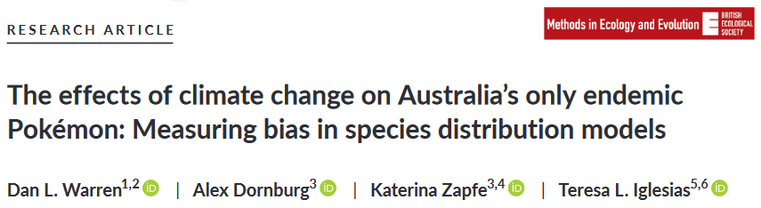
HOW WE COULD PREDICT THE FUTURE: POPULAR STATISTICAL APPROACHES
Approach criticized: lack of biological realism?
Consistent predictions from meaningless data

Slide 13
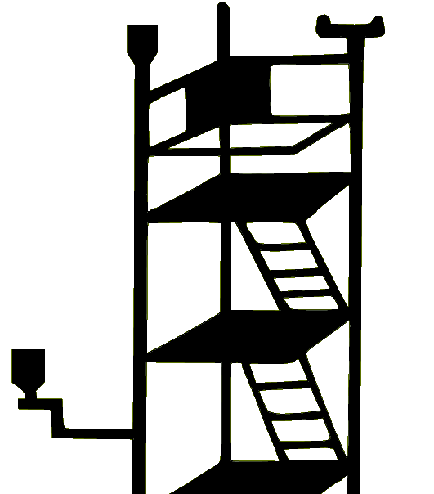


HOW WE COULD PREDICT THE FUTURE: PROCESS-BASED APPROACHES
Process-based models, in a nutshell
Experimentations
A priori knowledge
Observations

Slide 14
HOW WE COULD PREDICT THE FUTURE: PROCESS-BASED APPROACHES
Process-based models, in a nutshell
Experimentations
A priori knowledge
Observations
Processes

Slide 15


HOW WE COULD PREDICT THE FUTURE: PROCESS-BASED APPROACHES
Bioclimatic inputs
Process-based models, in a nutshell
Translate in mathematical
equations
Experimentations
A priori knowledge
Observations
Processes

Slide 16
HOW WE COULD PREDICT THE FUTURE: PROCESS-BASED APPROACHES
Bioclimatic inputs
Process-based models, in a nutshell
Translate in mathematical
equations
Experimentations
A priori knowledge
Observations
Processes

Slide 17
HOW WE COULD PREDICT THE FUTURE: PROCESS-BASED APPROACHES
Bioclimatic inputs
Process-based models, in a nutshell
Translate in mathematical
equations
Experimentations
A priori knowledge
Observations
Processes
DESCRIBE PROCESSES

Slide 18
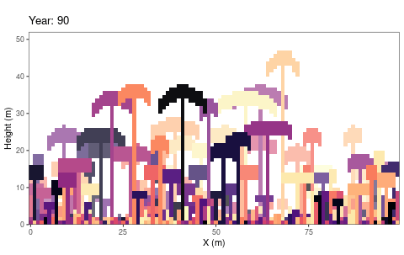
HOW WE COULD PREDICT THE FUTURE: PROCESS-BASED APPROACHES
e.g. individual-based models
TROLL model (Maréchaux & Chave, 2017),
ForCEEPS model (Morin et al., 2021)...
Schmitt et al. (2023)

Slide 19




HOW WE COULD PREDICT THE FUTURE: PROCESS-BASED APPROACHES
e.g. “average tree” models
CASTANEA model (Dufrêne et al., 2005),
PHENOFIT model (Chuine & Beaubien, 2001)...

Slide 20






HOW WE COULD PREDICT THE FUTURE: PROCESS-BASED APPROACHES
PHENOFIT: focus on phenology
FITNESS
Reproductive success
Survival
Frost resistance
Thermal energy
Frost and drought
Leaf unfolding
Flowering
Fruit maturation
Leaf senescence

Slide 21
HOW WE COULD PREDICT THE FUTURE: PROCESS-BASED APPROACHES
Key advantages: greater comprehension of the complexity of ecosystems?
▶ mathematical formalisation of current knowledge, with a direct biological interpretation
▶ further validation of our understanding of processes against observations
▶ testing new hypotheses

Slide 22
HOW WE COULD PREDICT THE FUTURE: PROCESS-BASED APPROACHES
Main drawbacks: finding the appropriate amount of complexity?
▶ take more time to develop, more challenging to use
▶ data available to calibrate them only for a few species
▶ important role of modeller subjectivity
▶ lack of transparency

Slide 23

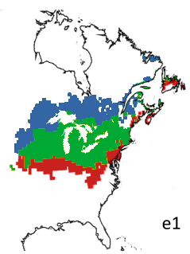

HOW WE COULD PREDICT THE FUTURE: DIVERGENCE BETWEEN APPROACHES
Different predictions, e.g. Quercus bicolor in 2100
PHENOFIT
BIOMOD
Extinct
Present
Suitable
Correlative models more pessimistic?
Adapted from Morrin & Thuiller (2009)

Slide 24
HOW WE COULD PREDICT THE FUTURE: CONTINUITY AMONG MODELS
Correlative models
Process-based models
PATTERNS
PROCESSES
Adapted from Dormann et al. (2012)

Slide 25
HOW WE COULD PREDICT THE FUTURE: CONTINUITY AMONG MODELS
Correlative models
Process-based models
PATTERNS
PROCESSES
▶ implicit representation of processes
▶ explicit representation of processes
Adapted from Dormann et al. (2012)

Slide 26
HOW WE COULD PREDICT THE FUTURE: CONTINUITY AMONG MODELS
Correlative models
Process-based models
PATTERNS
PROCESSES
▶ implicit representation of processes
▶ calibrated with current distribution data
▶ explicit representation of processes
▶ calibrated with process-related data
Adapted from Dormann et al. (2012)

Slide 27
HOW WE COULD PREDICT THE FUTURE: CONTINUITY AMONG MODELS
COMMON ASSUMPTION: PROCESS-BASED MODELS might provide more robust projections in novel conditions
e.g. Evans (2012), Singer et al. (2016), Urban et al. (2016), Zurell et al. (2016)

Slide 28
HOW WE COULD PREDICT THE FUTURE: CONTINUITY AMONG MODELS
COMMON ASSUMPTION: PROCESS-BASED MODELS might provide more robust projections in novel conditions
YET TO BE VERIFIED
e.g. Evans (2012), Singer et al. (2016), Urban et al. (2016), Zurell et al. (2016)

Slide 29




THESIS FRAMEWORK
RECENT past
FUTURE
Late Pleistocene - Holocene
1970 - 2000
20th century
21St century
DISTANT PAST
PREsent

Slide 30
THESIS FRAMEWORK
Model calibrationS
- Inverse calibration of process-based models
- Statistical fit of niche models
RECENT past
FUTURE
Late Pleistocene - Holocene
1970 - 2000
20th century
21St century
DISTANT PAST
PREsent

Slide 31
INVERSE CALIBRATION OF PROCESS-BASED MODELS
Correlative models
Process-based models
PATTERNS
PROCESSES
Adapted from Dormann et al. (2012)

Slide 32
INVERSE CALIBRATION OF PROCESS-BASED MODELS
Correlative models
Process-based models
PATTERNS
PROCESSES
Fitted process-based models
Adapted from Dormann et al. (2012)

Slide 33
INVERSE CALIBRATION OF PROCESS-BASED MODELS
Correlative models
Process-based models
PATTERNS
PROCESSES
Fitted process-based models
▶ calibrated with current distribution data
▶ explicit representation of processes
Adapted from Dormann et al. (2012)

Slide 34
INVERSE CALIBRATION OF PROCESS-BASED MODELS
Correlative models
Process-based models
PATTERNS
PROCESSES
Fitted process-based models
▶ calibrated with current distribution data
▶ explicit representation of processes
Combine both approaches
Adapted from Dormann et al. (2012)

Slide 35
REMINDER : OPTIMISATION ALGORITHM
CMA-ES: covariance matrix adaptation – evolution strategy
▶ based on the principle of evolutionary biology, via recombination, mutation and selection of the most fit candidate solutions
▶ widely accepted as a robust optimization algorithm for nonlinear and nonseparated optimization problems in continuous domain

Slide 36
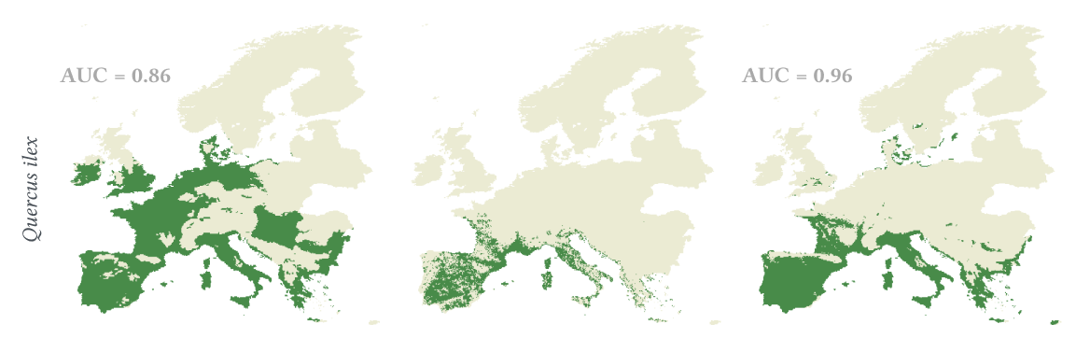
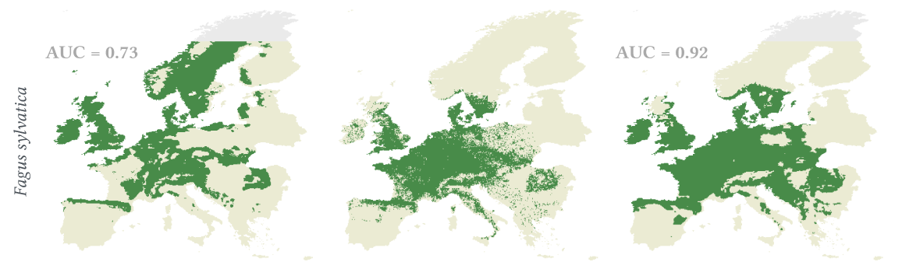
RESULTS OF CALIBRATION
Classical calibration
Observed distribution
Inverse calibration
PHENOFIT
CASTANEA
Van der Meersch & Chuine (2023)

Slide 37

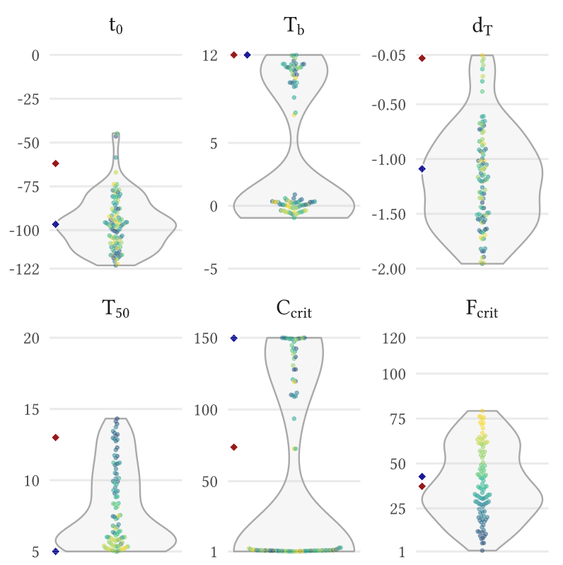
RESULTS OF CALIBRATION
Expected issue: non-identifiability of parameter values
Effects of stochasticity of CMA-ES calibration on PHENOFIT leaf unfolding model parameters
Van der Meersch & Chuine (2023)

Slide 38
RESULTS OF CALIBRATION
Expected issue: non-identifiability of parameter values
Effects of stochasticity of CMA-ES calibration on PHENOFIT leaf unfolding model parameters
multiple parameter sets produce equally good fits to the observed data
Van der Meersch & Chuine (2023)

Slide 39
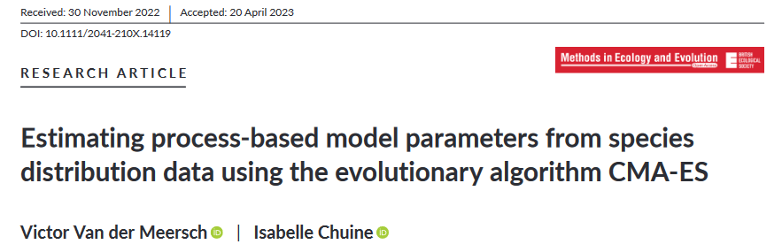
FIRST PUBLICATION
poster presentation during the SFE2/GFO conference in Metz (Nov. 2022)
Van der Meersch & Chuine (2023)

Slide 40
THESIS FRAMEWORK
Model calibrationS
- Inverse calibration of process-based models
- Statistical fit of niche models
RECENT past
FUTURE
Late Pleistocene - Holocene
1970 - 2000
20th century
21St century
DISTANT PAST
PREsent

Slide 41
CALIBRATION OF CORRELATIVE MODELS
▶ presence-only approach, with these models (Valavi et al. 2022):
GLM with lasso regularization BRT
GAM Random Forest down-sampled
(background points sampled irrespective of the location of species records)

Slide 42
CALIBRATION OF CORRELATIVE MODELS
▶ presence-only approach, with these models (Valavi et al. 2022):
GLM with lasso regularization BRT
GAM Random Forest down-sampled
(background points sampled irrespective of the location of species records)
▶ predictors:
minimum temperature of the coldest month (frost tolerance)
GDD >5°C April-September (growth)
total precipitation (accumulated water)
water balance June-July (summer drought)
+ pH, water holding capacity

Slide 43
CALIBRATION OF CORRELATIVE MODELS
▶ 5-fold environmental block cross-validation to estimate errors

Slide 44
CALIBRATION OF CORRELATIVE MODELS
▶ 5-fold environmental block cross-validation to estimate errors
training set
testing set

Slide 45
CALIBRATION OF CORRELATIVE MODELS
▶ 5-fold environmental block cross-validation to estimate errors
Combine predictions
training set
testing set
Error estimation (AUC, ...)

Slide 46
CALIBRATION OF CORRELATIVE MODELS
▶ 5-fold environmental block cross-validation to estimate errors
Combine predictions
training set
testing set
Error estimation (AUC, ...)
▶ final model: all the available data used to fit the model
“favours final prediction quality over perfect accuracy of error estimates”

Slide 47
THESIS FRAMEWORK
Model calibrationS
- Inverse calibration of process-based models
- Statistical fit of niche models
RECENT past
FUTURE
Late Pleistocene - Holocene
1970 - 2000
20th century
21St century
DISTANT PAST
PREsent

Slide 48
THESIS FRAMEWORK
Lessons from the past
- Comparison of models’ predictions to pollen records
- Identify the strengths and weaknesses of each model
Model calibrationS
- Inverse calibration of process-based models
- Statistical fit of niche models
RECENT past
FUTURE
Late Pleistocene - Holocene
1970 - 2000
20th century
21St century
DISTANT PAST
PREsent

Slide 49
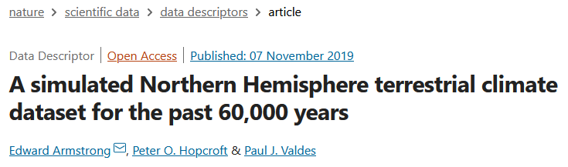
INSIGHTS FROM THE PAST: PROCESSING PALEOCLIMATE SIMULATION
▶ monthly data from HadCM3B general circulation model simulations
▶ 0.5° spatial resolution, bias corrected
▶ collaboration with E. Armstrong, who generated specific variables for
this project

Slide 50
INSIGHTS FROM THE PAST: PROCESSING PALEOCLIMATE SIMULATION
HadCM3B – 0.5°
(Armstrong et al. 2019)

Slide 51
INSIGHTS FROM THE PAST: PROCESSING PALEOCLIMATE SIMULATION
HadCM3B – 0.5°
(Armstrong et al. 2019)
ICE-6G-C altitude
(Peltier et al. 2015)
Downscaled HadCM3B
Monthly - 0.25°
Temperatures
Precipitation
Wind
Cloudiness
No. of wet days

Slide 52
INSIGHTS FROM THE PAST: PROCESSING PALEOCLIMATE SIMULATION
HadCM3B – 0.5°
(Armstrong et al. 2019)
ICE-6G-C altitude
(Peltier et al. 2015)
Downscaled HadCM3B
Monthly - 0.25°
Generated daily values
Temperatures
Precipitation
Wind
Cloudiness
No. of wet days
Temperatures
Precipitation
Wind
Cloudiness
GWGEN
(Sommer & Kaplan 20197)

Slide 53
INSIGHTS FROM THE PAST: PROCESSING PALEOCLIMATE SIMULATION
HadCM3B – 0.5°
(Armstrong et al. 2019)
Orbital parameters
Radiation processing
(Kaplan et al. 2016)
ICE-6G-C altitude
(Peltier et al. 2015)
Downscaled HadCM3B
Monthly - 0.25°
Generated daily values
Temperatures
Precipitation
Wind
Cloudiness
No. of wet days
Temperatures
Precipitation
Wind
Cloudiness
GWGEN
(Sommer & Kaplan 20197)

Slide 54
INSIGHTS FROM THE PAST: PROCESSING PALEOCLIMATE SIMULATION
HadCM3B – 0.5°
(Armstrong et al. 2019)
Orbital parameters
Computed daily values
Radiation processing
(Kaplan et al. 2016)
ICE-6G-C altitude
(Peltier et al. 2015)
Global radiation
Downscaled HadCM3B
Monthly - 0.25°
Generated daily values
Temperatures
Precipitation
Wind
Cloudiness
No. of wet days
Temperatures
Precipitation
Wind
Cloudiness
GWGEN
(Sommer & Kaplan 20197)

Slide 55
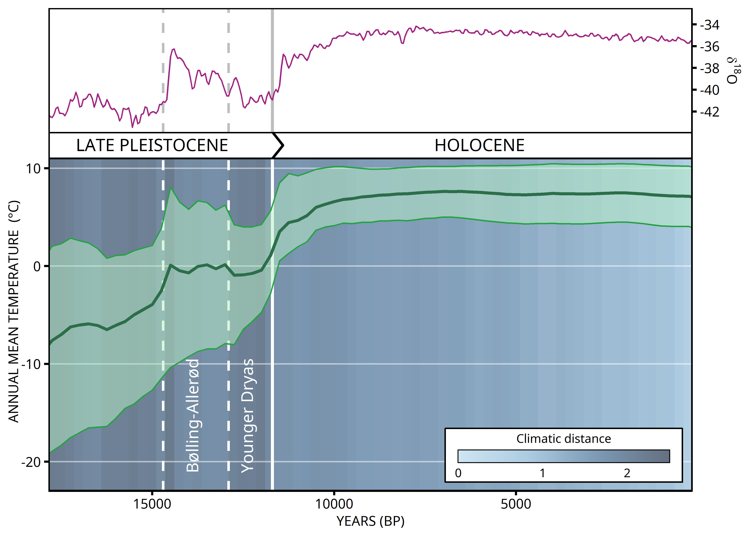
INSIGHTS FROM THE PAST: PROCESSING PALEOCLIMATE SIMULATION

Slide 56
INSIGHTS FROM THE PAST: PROCESSING POLLEN FOSSIL RECORDS
▶ global databases: EPD, Neotoma
▶ LegacyPollen: records from Neotoma, standardized chronologies with age uncertainties (and taxonomically harmonized)
▶ three genera: Fagus, Abies, Quercus
▶ 500-year windows
Q. robur, Q. petraea, Q. ilex

Slide 57
INSIGHTS FROM THE PAST: PROCESSING POLLEN FOSSIL RECORDS
e.g. 3kyr BP
Multiple samples within the same site

Slide 58
INSIGHTS FROM THE PAST: PROCESSING POLLEN FOSSIL RECORDS
e.g. 3kyr BP
X
Keep only samples with uncertainty <= 500 years

Slide 59
INSIGHTS FROM THE PAST: PROCESSING POLLEN FOSSIL RECORDS
e.g. 3kyr BP
X
X
Keep only samples with at least 200 pollen grains

Slide 60
INSIGHTS FROM THE PAST: PROCESSING POLLEN FOSSIL RECORDS
500-year time slice
e.g. 3kyr BP

Slide 61
INSIGHTS FROM THE PAST: PROCESSING POLLEN FOSSIL RECORDS
500-year time slice
e.g. 3kyr BP
Weighted mean of pollen counts, taking into account both uncertainty and time distance

Slide 62
INSIGHTS FROM THE PAST: PROCESSING POLLEN FOSSIL RECORDS
500-year time slice
e.g. 3kyr BP
Weighted mean of pollen counts, taking into account both uncertainty and time distance

Slide 63
INSIGHTS FROM THE PAST: PROCESSING POLLEN FOSSIL RECORDS
0.25°
Species pollen relative abundance

Slide 64
INSIGHTS FROM THE PAST: PROCESSING POLLEN FOSSIL RECORDS
0.25°
▶ specific threshold:
1% for Fagus, Abies
2.5% for Quercus
Presence threshold

Slide 65
INSIGHTS FROM THE PAST: PROCESSING POLLEN FOSSIL RECORDS
0.25°
“One is enough”
Presence threshold

Slide 66
INSIGHTS FROM THE PAST: MIGRATION SIMULATIONS
▶ simple cellular automaton (MigClim – modified to incorporate both short-distance and long-distance dispersal kernels)
▶ dispersal kernels from Zani et al. (2022), for each species
▶ 500m resolution, yearly step (habitat suitability updated each 250 years)

Slide 67
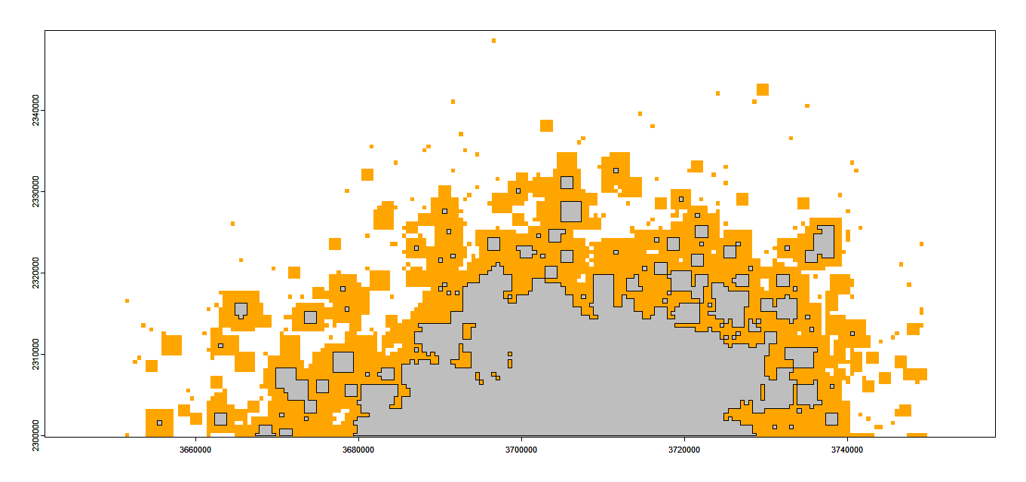
INSIGHTS FROM THE PAST: MIGRATION SIMULATIONS
“Fine scale” migration
e.g. zoom on Fagus migration during one century

Slide 68
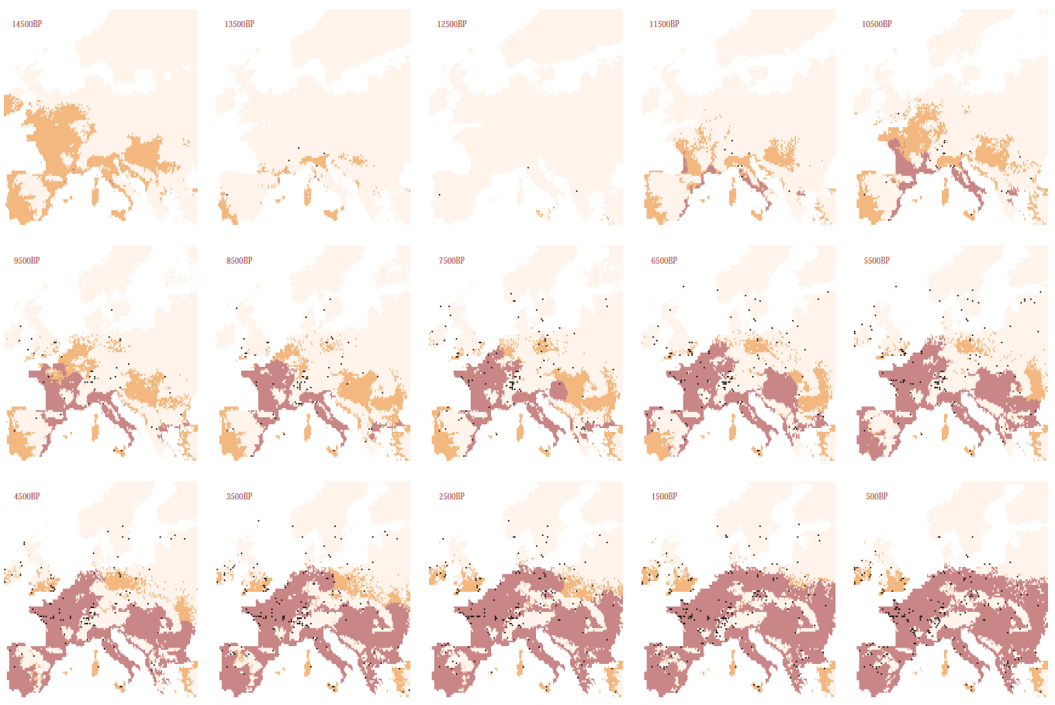
INSIGHTS FROM THE PAST: MIGRATION SIMULATIONS
e.g. Quercus simulations with PHENOFIT

Slide 69
INSIGHTS FROM THE PAST: MODEL ROBUSTNESS AGAINST CLIMATE NOVELTY
HOW TO ASSESS THE TRANSFERABILITY OF OUR MODELS
in (PAST) novel conditions
WE NEED BOTH:
- a novelty metric
- a measure of model performance

Slide 70
INSIGHTS FROM THE PAST: MODEL ROBUSTNESS AGAINST CLIMATE NOVELTY
PAST CLIMATE
e.g. 9000 years BP
BASELINE CLIMATE
Calibration conditions
N predictors
N predictors

Slide 71
INSIGHTS FROM THE PAST: MODEL ROBUSTNESS AGAINST CLIMATE NOVELTY
PAST CLIMATE
e.g. 9000 years BP
BASELINE CLIMATE
Calibration conditions
From each cell:
{ ; ; … }

Slide 72
INSIGHTS FROM THE PAST: MODEL ROBUSTNESS AGAINST CLIMATE NOVELTY
PAST CLIMATE
e.g. 9000 years BP
BASELINE CLIMATE
Calibration conditions
Minimum
distance
(N-dimensional)
From each cell:
{ ; ; … }
To the set of all cells
in the calibration period

Slide 73
INSIGHTS FROM THE PAST: MODEL ROBUSTNESS AGAINST CLIMATE NOVELTY

Slide 74
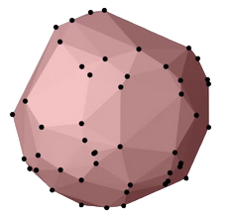
INSIGHTS FROM THE PAST: MODEL ROBUSTNESS AGAINST CLIMATE NOVELTY
PAST CLIMATE
e.g. 9000 years BP
N-dimensional hypervolume

Slide 75
INSIGHTS FROM THE PAST: MODEL ROBUSTNESS AGAINST CLIMATE NOVELTY
PAST CLIMATE
e.g. 9000 years BP
BASELINE CLIMATE
Calibration conditions
N-dimensional hypervolume
N-dimensional hypervolume

Slide 76
INSIGHTS FROM THE PAST: MODEL ROBUSTNESS AGAINST CLIMATE NOVELTY
PAST CLIMATE
e.g. 9000 years BP
BASELINE CLIMATE
Calibration conditions

Slide 77
INSIGHTS FROM THE PAST: MODEL ROBUSTNESS AGAINST CLIMATE NOVELTY
PAST CLIMATE
e.g. 9000 years BP
BASELINE CLIMATE
Calibration conditions
Hypervolume overlap
(Sørensen similarity)

Slide 78
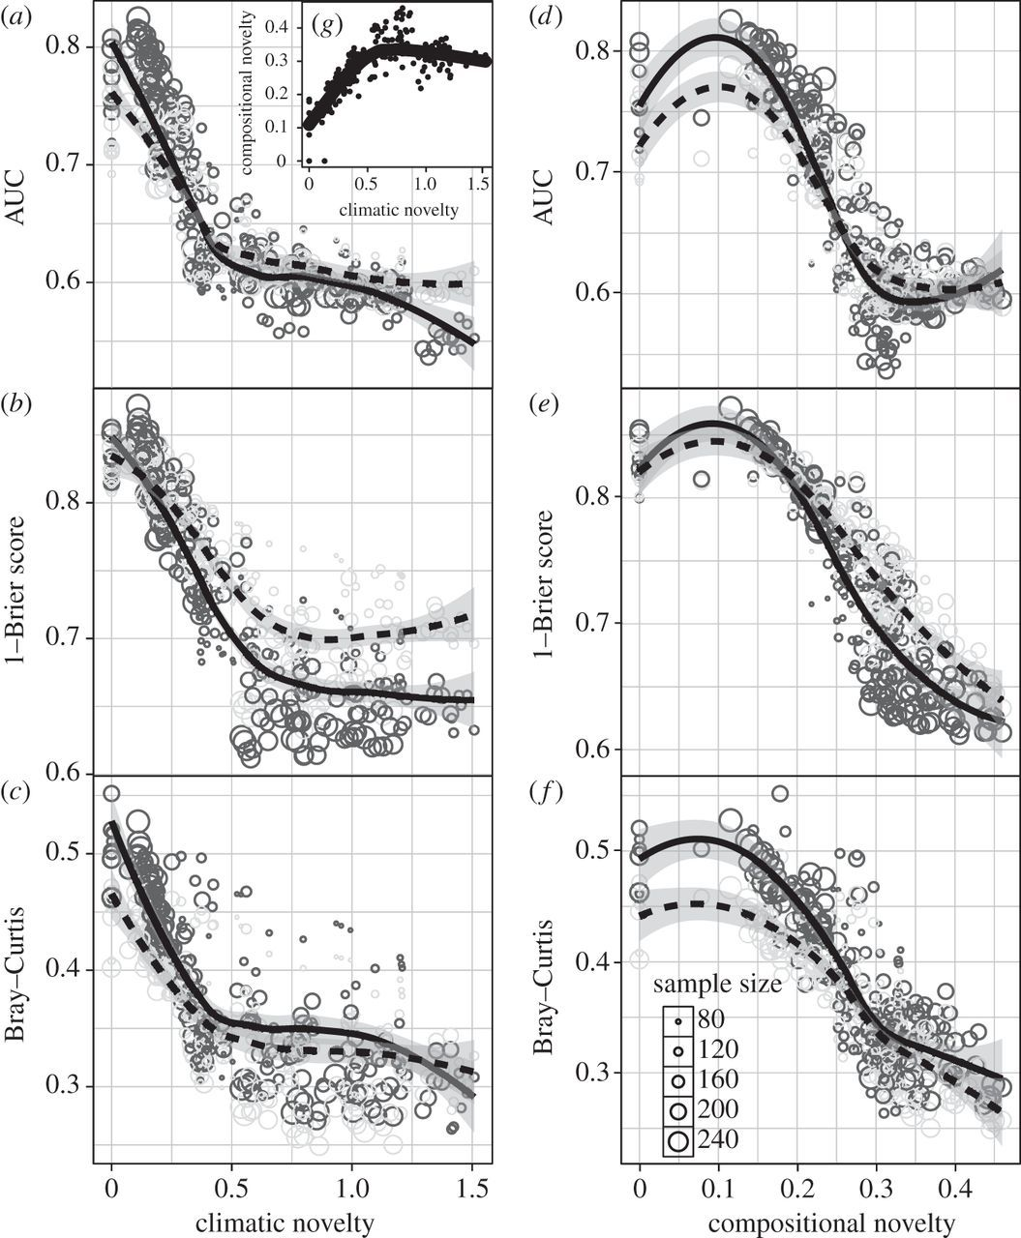
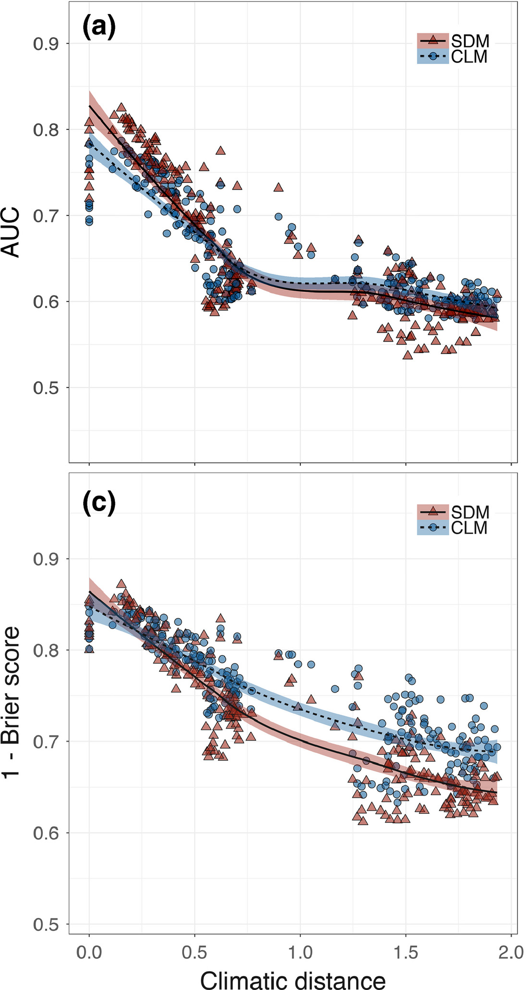
INSIGHTS FROM THE PAST: MODEL ROBUSTNESS AGAINST CLIMATE NOVELTY
Maguire et al. (2016)
Fitzpatrick et al. (2018)

Slide 79
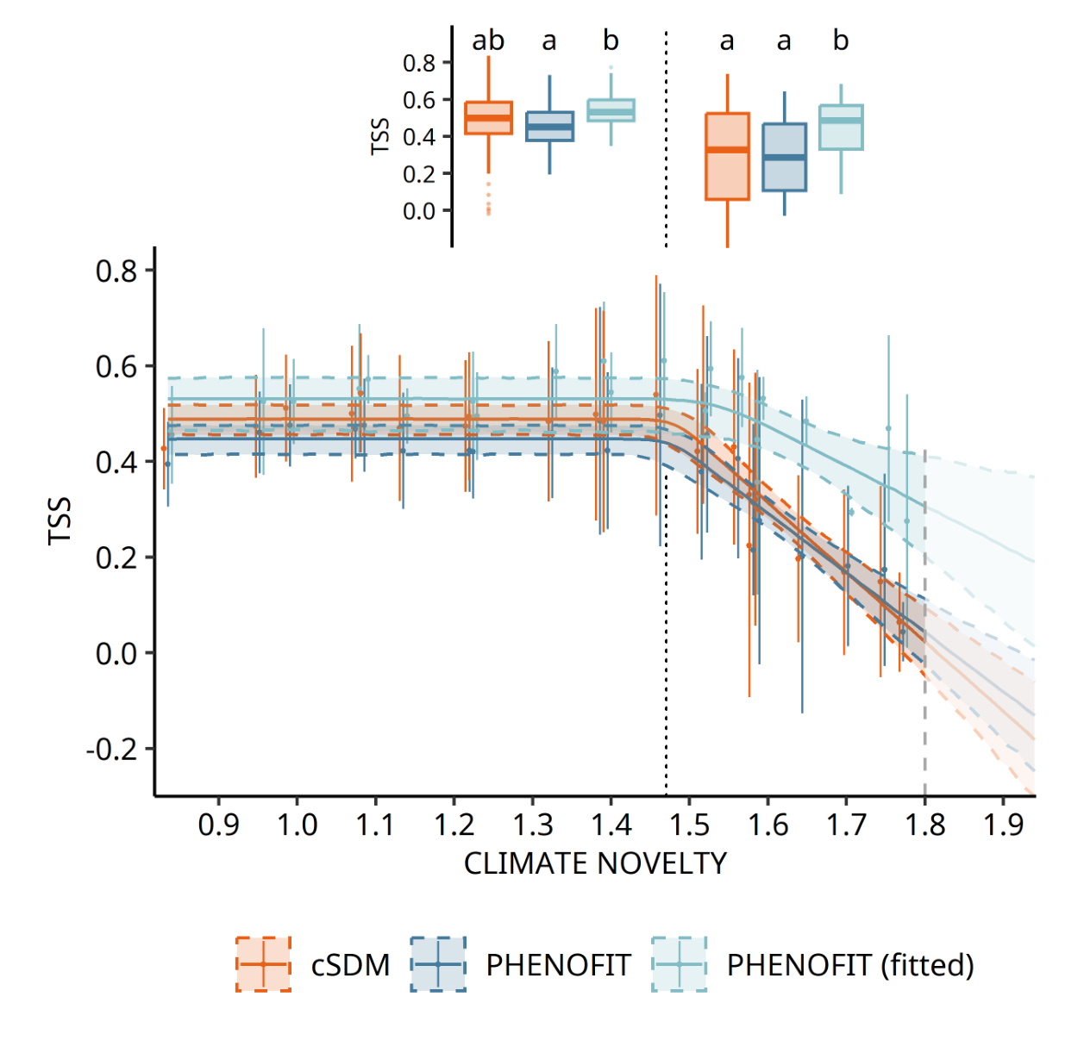
INSIGHTS FROM THE PAST: MODEL ROBUSTNESS AGAINST CLIMATE NOVELTY

Slide 80
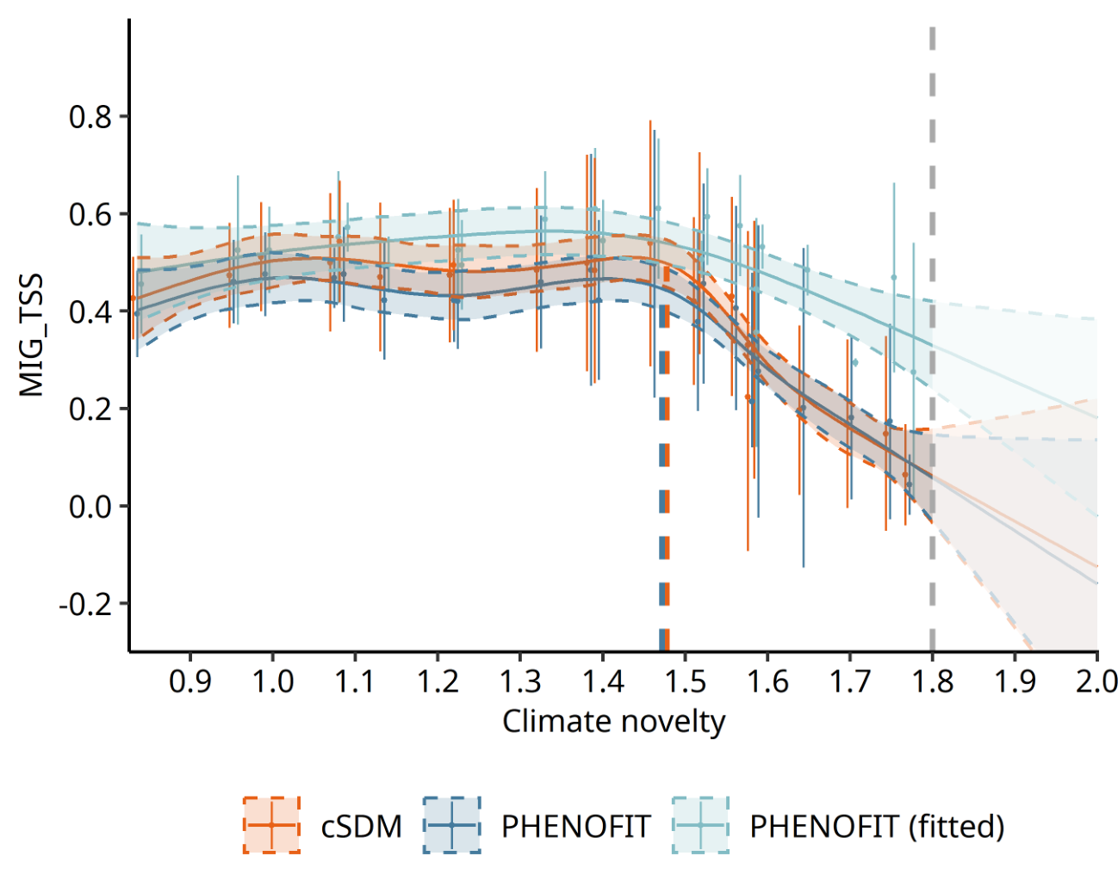
INSIGHTS FROM THE PAST: MODEL ROBUSTNESS AGAINST CLIMATE NOVELTY
▶ same patterns with a GAM

Slide 81
THESIS FRAMEWORK
Lessons from the past
- Comparison of models’ predictions to pollen records
- Identify the strengths and weaknesses of each model
Model calibrationS
- Inverse calibration of process-based models
- Statistical fit of niche models
RECENT past
FUTURE
Late Pleistocene - Holocene
1970 - 2000
20th century
21St century
DISTANT PAST
PREsent

Slide 82
THESIS FRAMEWORK
Lessons from the past
- Comparison of models’ predictions to pollen records
- Identify the strengths and weaknesses of each model
Model calibrationS
- Inverse calibration of process-based models
- Statistical fit of niche models
RECENT past
FUTURE
Late Pleistocene - Holocene
1970 - 2000
20th century
21St century
Fine-Scale comparisonS
Assessing the importance of climate variability at the leading and trailing edge of tree species ranges
DISTANT PAST
PREsent

Slide 83
RECENT PAST: FINE-SCALE COMPARISON IN SWITZERLAND
▶ take advantage of the richness and precision of Swizz NFI data
▶ compare the models in the recent past (1980-2020) at a high spatiotemporal resolution
▶ identify regions of greatest discrepancy and the causes of these discrepancies
Collaboration with D. Scherrer and G. Stadelmann (WSL, Suisse)
(+ provide process-based future projections of Swiss forest species distribution)

Slide 84
THESIS FRAMEWORK
Lessons from the past
- Comparison of models’ predictions to pollen records
- Identify the strengths and weaknesses of each model
Model calibrationS
- Inverse calibration of process-based models
- Statistical fit of niche models
RECENT past
FUTURE
Late Pleistocene - Holocene
1970 - 2000
20th century
21St century
Fine-Scale comparisonS
Assessing the importance of climate variability at the leading and trailing edge of tree species ranges
DISTANT PAST
PREsent

Slide 85
THESIS FRAMEWORK
Lessons from the past
- Comparison of models’ predictions to pollen records
- Identify the strengths and weaknesses of each model
Model calibrationS
- Inverse calibration of process-based models
- Statistical fit of niche models
RECENT past
FUTURE
Late Pleistocene - Holocene
1970 - 2000
20th century
21St century
Fine-Scale comparisonS
Assessing the importance of climate variability at the leading and trailing edge of tree species ranges
Future projections
Elaboration of consensual maps of species projected occurrences and
associated uncertainty
DISTANT PAST
PREsent

Slide 86
FUTURE PREDICTIONS AND UNCERTAINTIES
How to quantify model uncertainties under future climate scenarios ?
compute the same climatic distance
▶ CMIP6 future simulations downscaled on Europe (IPSL, Noel et al. 2022)

Slide 87
FUTURE PREDICTIONS AND UNCERTAINTIES
How to quantify model uncertainties under future climate scenarios ?
1921 1950
11500BP
11250BP
11000BP
250BP
HadCM3B paleosimulations
...

Slide 88
FUTURE PREDICTIONS AND UNCERTAINTIES
How to quantify model uncertainties under future climate scenarios ?
1921 1950
11500BP
11250BP
11000BP
250BP
HadCM3B paleosimulations
...
CMIP6 future projections
...
1951 1980

Slide 89
FUTURE PREDICTIONS AND UNCERTAINTIES
How to quantify model uncertainties under future climate scenarios ?
1921 1950
11500BP
11250BP
11000BP
250BP
HadCM3B paleosimulations
...
CRU dataset
CMIP6 future projections
...
1951 1980

Slide 90
FUTURE PREDICTIONS AND UNCERTAINTIES
How to quantify model uncertainties under future climate scenarios ?
1921 1950
11500BP
11250BP
11000BP
250BP
HadCM3B paleosimulations
...
Bias correction
CRU dataset
Bias correction
CMIP6 future projections
...
1951 1980

Slide 91
FUTURE PREDICTIONS AND UNCERTAINTIES
How to quantify model uncertainties under future climate scenarios ?
After bias correction:
climate_novelty(HadCM3B 1920-1951) = climate_novelty(CMIP6 1951-1980) = 0

Slide 92
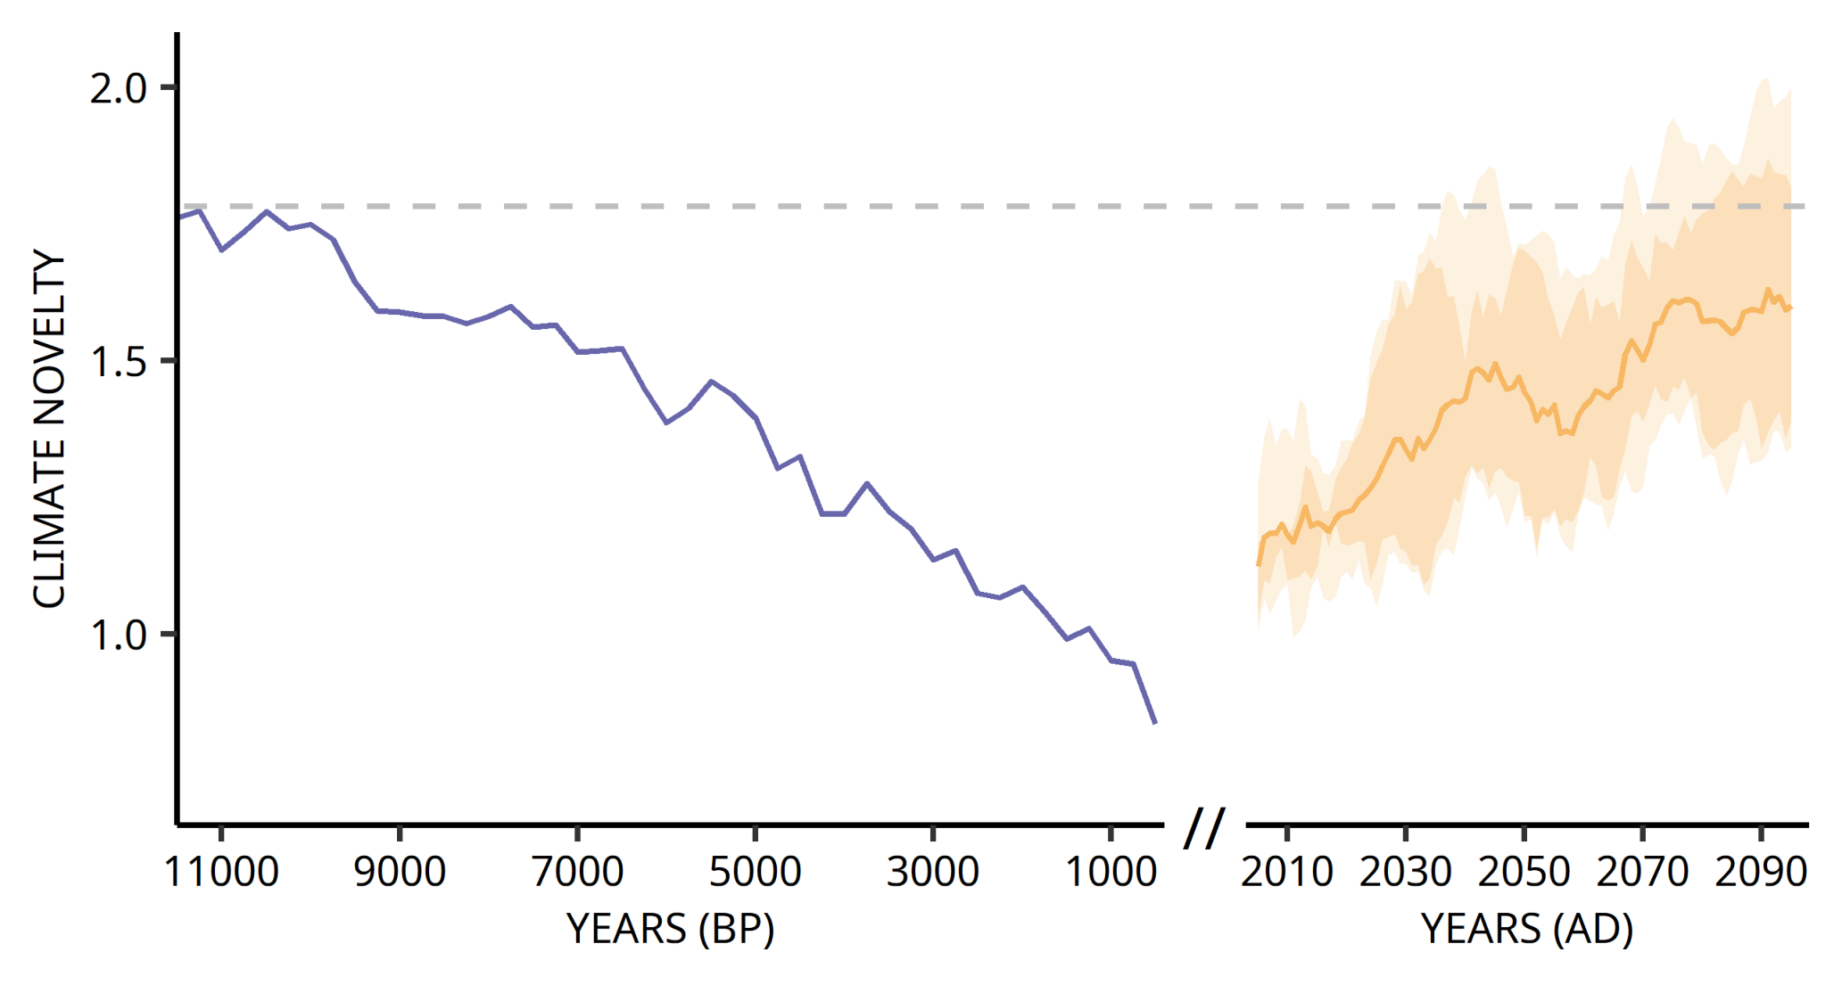
FUTURE PREDICTIONS AND UNCERTAINTIES
Strong uncertainties by the end of the 21th century

Slide 93
FUTURE PREDICTIONS AND UNCERTAINTIES
▶ distant past simulations allow models to be evaluated in conditions that are significantly different from present
▶ but past conditions are not analogous to these expect over the
21st century

Slide 94
FUTURE PREDICTIONS AND UNCERTAINTIES
▶ distant past simulations allow models to be evaluated in conditions that are significantly different from present
▶ but past conditions are not analogous to these expect over the
21st century
but still increase our confidence that models represent
the essential processes, implicitly or explicitly
(same problem with GCMs ?)

Slide 95
INSIGHTS FROM THE PAST: MODEL ROBUSTNESS AGAINST CLIMATE NOVELTY
Pre
Distance from past and future conditions to reference
Reference
Temp

Slide 96
INSIGHTS FROM THE PAST: MODEL ROBUSTNESS AGAINST CLIMATE NOVELTY
Pre
Distance from past and future conditions to reference
Temp
Which “analogue” point is the closest ?

Slide 97
FUTURE PREDICTIONS AND UNCERTAINTIES
What does the accuracy of a model simulation of past distribution
really say about the accuracy of its projections in future climate ?

Slide 98
FUTURE PREDICTIONS AND UNCERTAINTIES
What does the accuracy of a model simulation of past distribution
really say about the accuracy of its projections in future climate ?
forecast proficiency

Slide 99
FUTURE PREDICTIONS AND UNCERTAINTIES
Better communication on model uncertainties is crucial
▶ a more comprehensive understanding of the potential errors by
decision-makers
▶ prevents the misinterpretation of model outputs as deterministic representations of the reality
▶ directly linked to risk assessment

Slide 100
NEXT POINTS
▶ last paleosimulations (CASTANEA),
analysis and redaction
▶ fine-scale simulations in Switzerland (recent past)
▶ future simulations
how to link the likelihood of projections to the past transferability?
▶ further analyse the inverse calibration outcomes
what can we learn ? deficiencies in model parametrization/structure?

Slide 101
ADDITIONAL POINTS
▶ collaboration with Elizabeth Wolkovich (UBC, Canada)
(visiting period at CEFE in 2023)

Slide 102
ADDITIONAL POINTS
▶ collaboration with Elizabeth Wolkovich (UBC, Canada)
(visiting period at CEFE in 2023)
conceptual paper: trade-off between growing season length (future warming) versus risk (climate variability)
Case study with PHENOFIT: does means vs variability shifts lead to increases of decreases in fitness?

Slide 103
ADDITIONAL POINTS
▶ internship project (if corresponding funding is obtained) as part of the CEMEB “Equipe de recherche junior”: analyse discrepancies between different modelling approaches (hybrid statistical model, PHENOFIT fitted and PHENOFIT), focus on frost vulnerability (present and future conditions)
Integrative Models for Forests: Understand and Simulate the
Impacts Of Novel climates (IMFUSION)
Collaboration with Anne Baranger (PhD student at LESSEM, Grenoble)

Slide 104
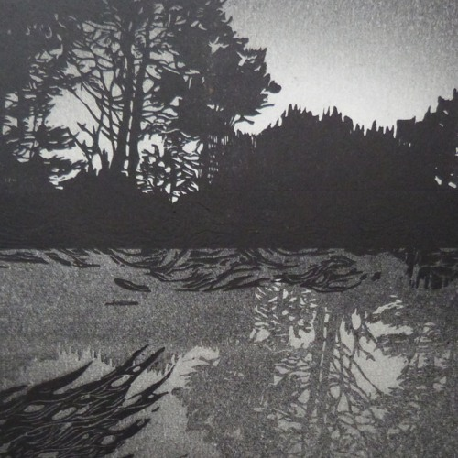
THANK YOU !
Linocut print by C. Rescan

Slide 105
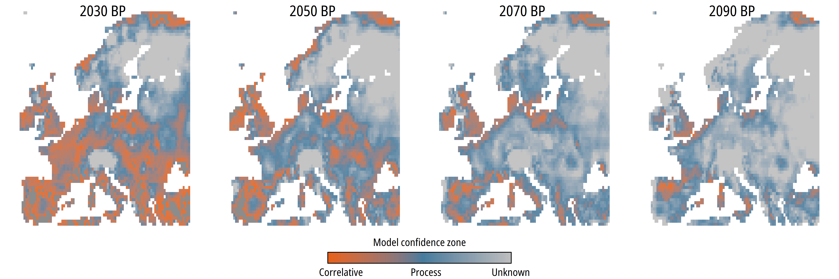
IMPLICATIONS FOR FUTURE CONFIDENCE IN MODEL PROJECTIONS
Strong uncertainties by the end of the 21th century
Correlative
Process-based
Fitted process-based

Slide 106
INSIGHTS FROM THE PAST: COMPARE MODEL PROJECTIONS
Predicted niche model A
Predicted niche model B
N-dimensional hypervolume
N-dimensional hypervolume

Slide 107
INSIGHTS FROM THE PAST: COMPARE MODEL PROJECTIONS

Slide 108
INSIGHTS FROM THE PAST: COMPARE MODEL PROJECTIONS
Hypervolume overlap
2 |A ∩ B |
Sørensen similarity =
|A | + | B |

Slide 109
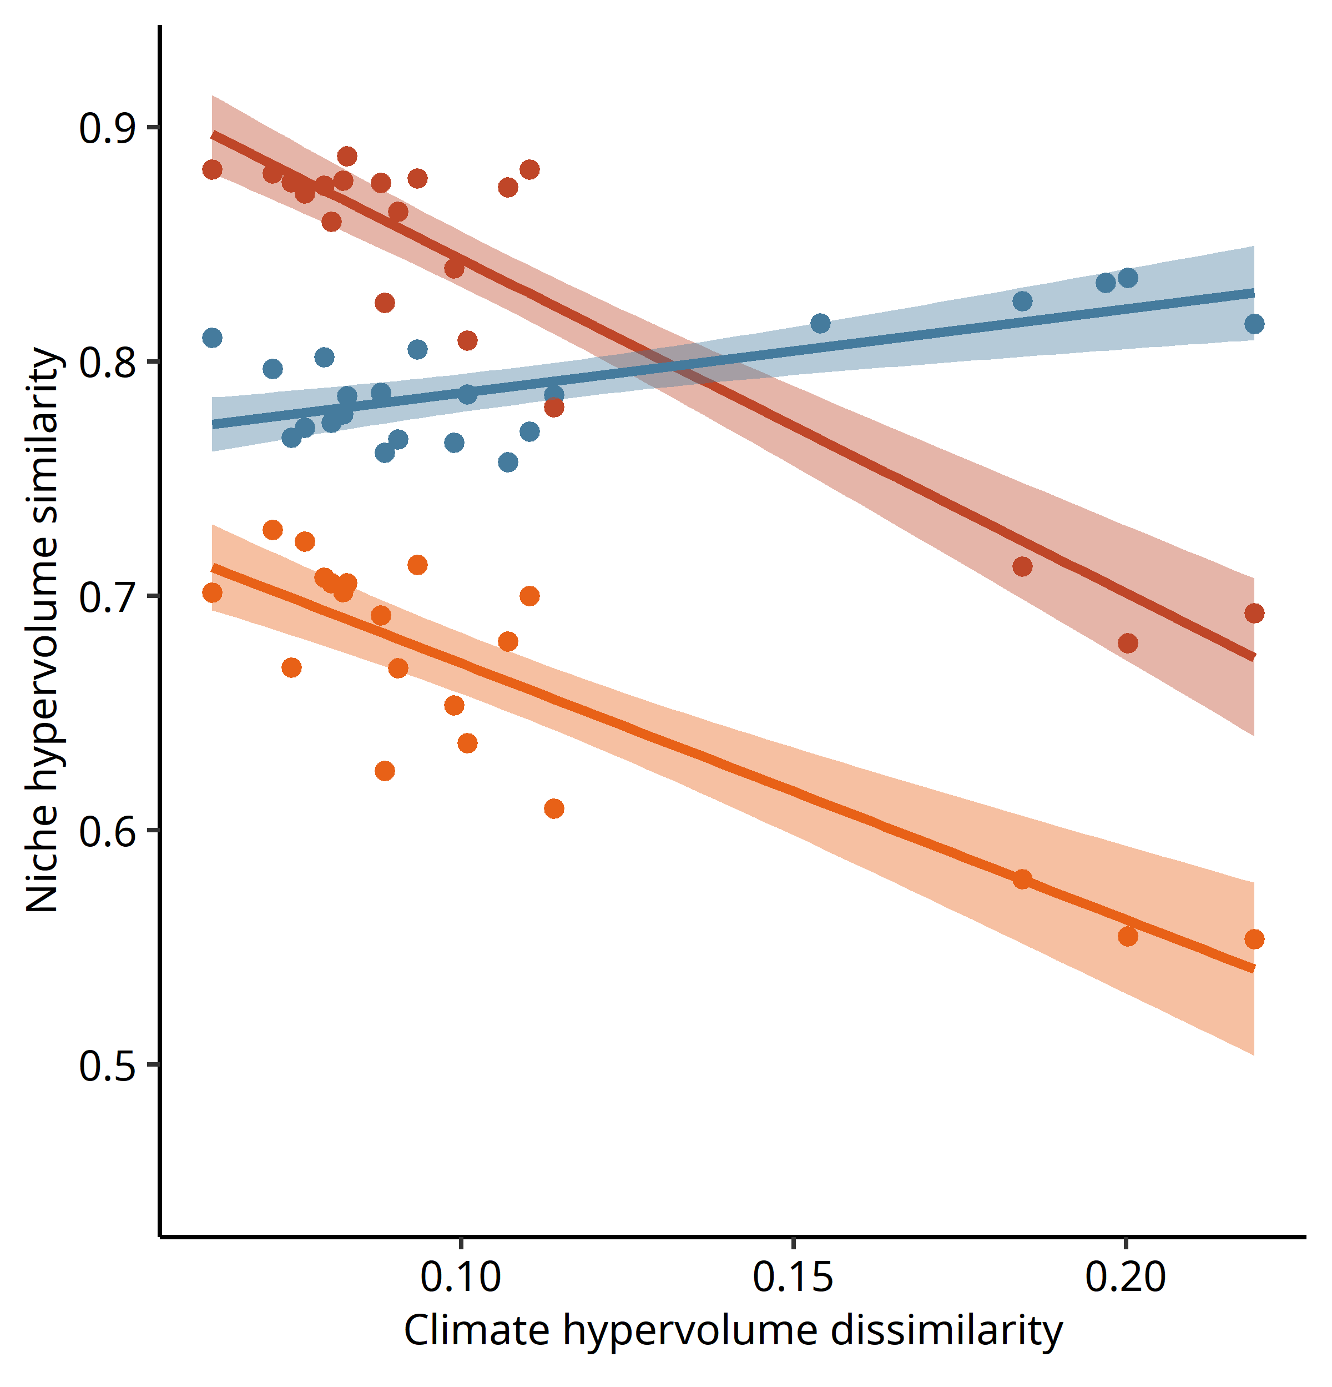
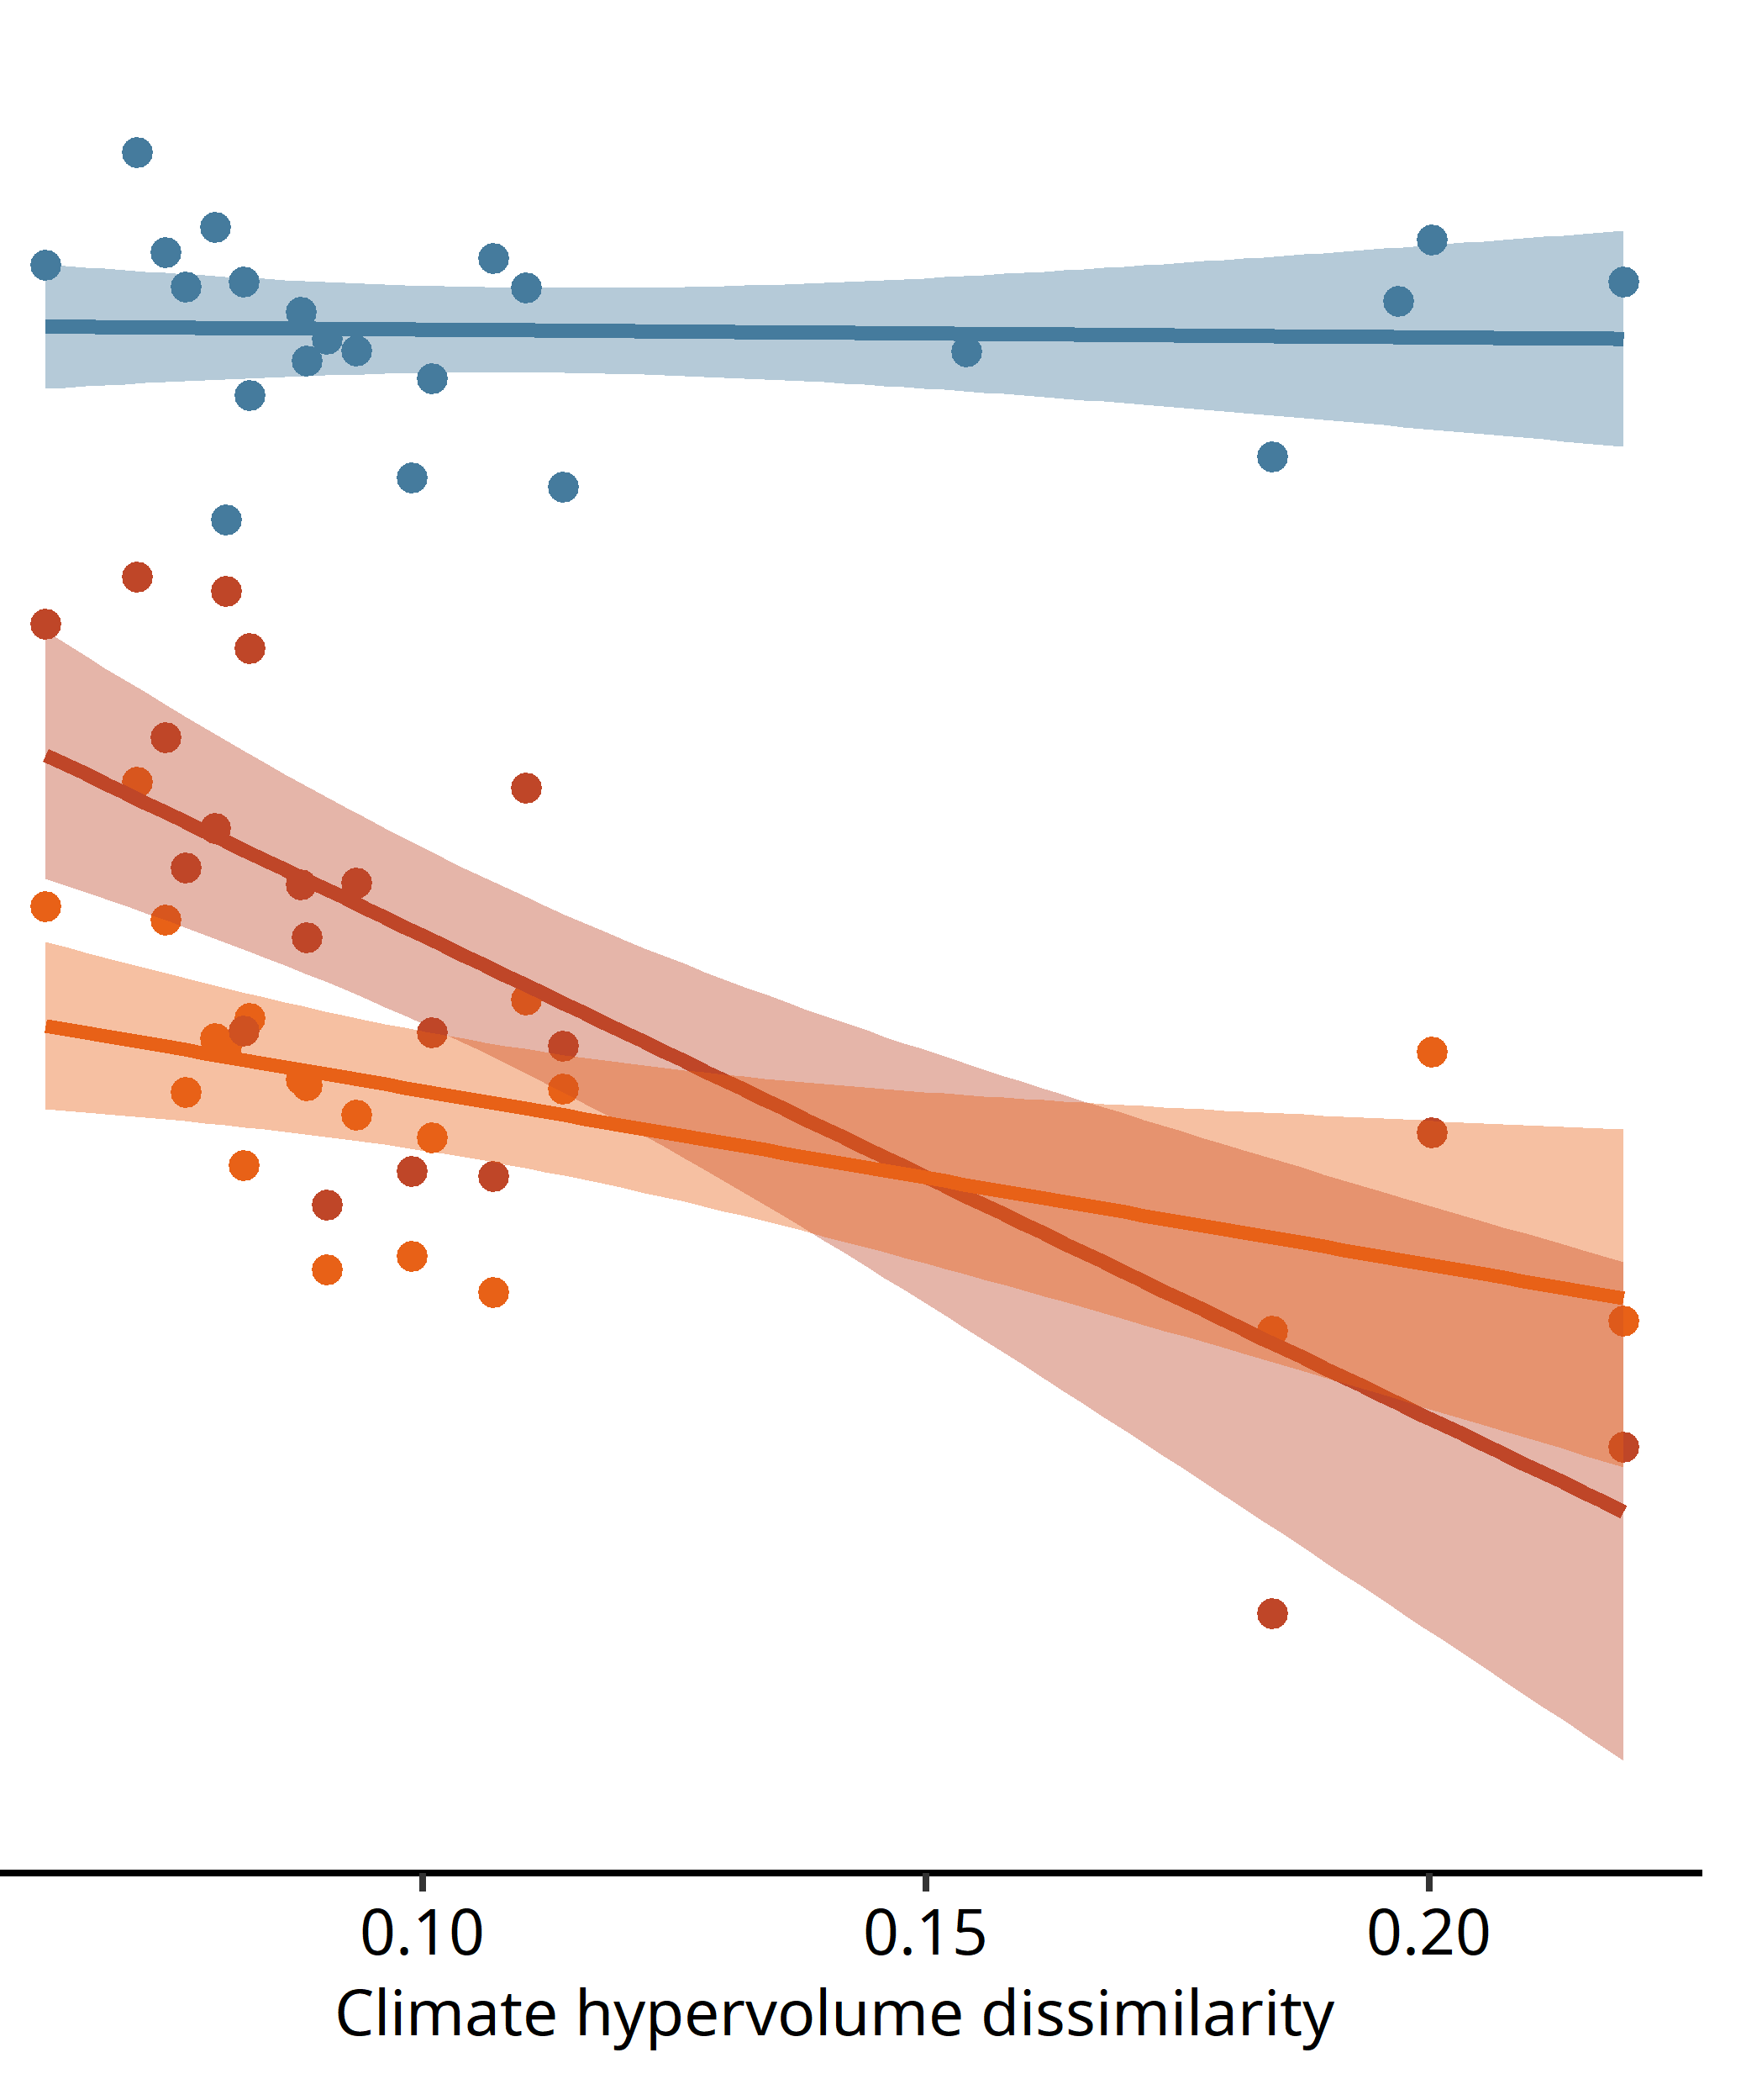
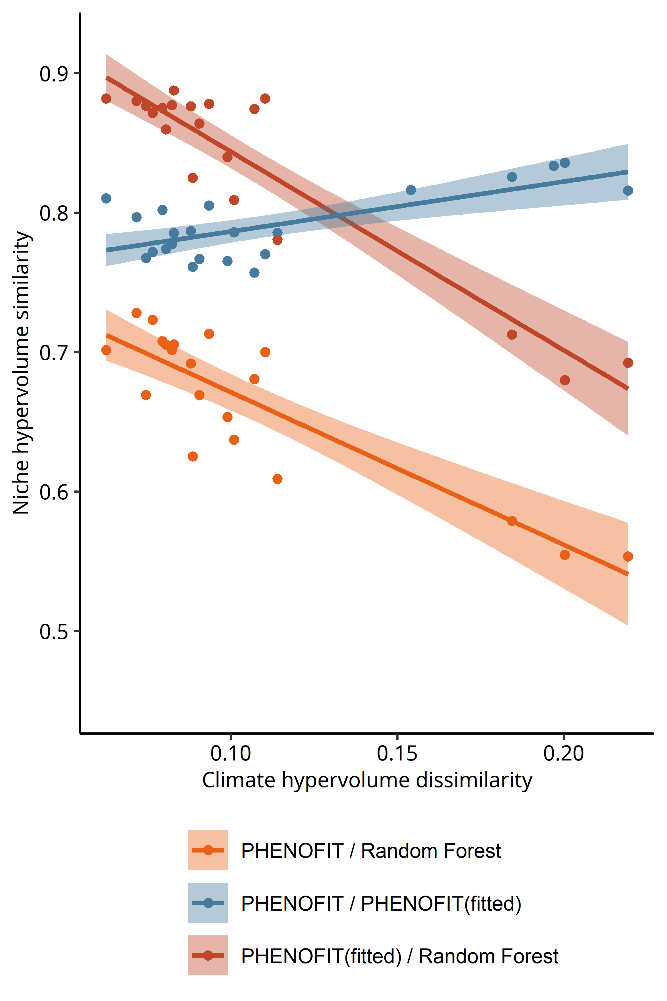
INSIGHTS FROM THE PAST: COMPARE MODEL PROJECTIONS
Fagus sylvatica
Abies alba

Slide 110

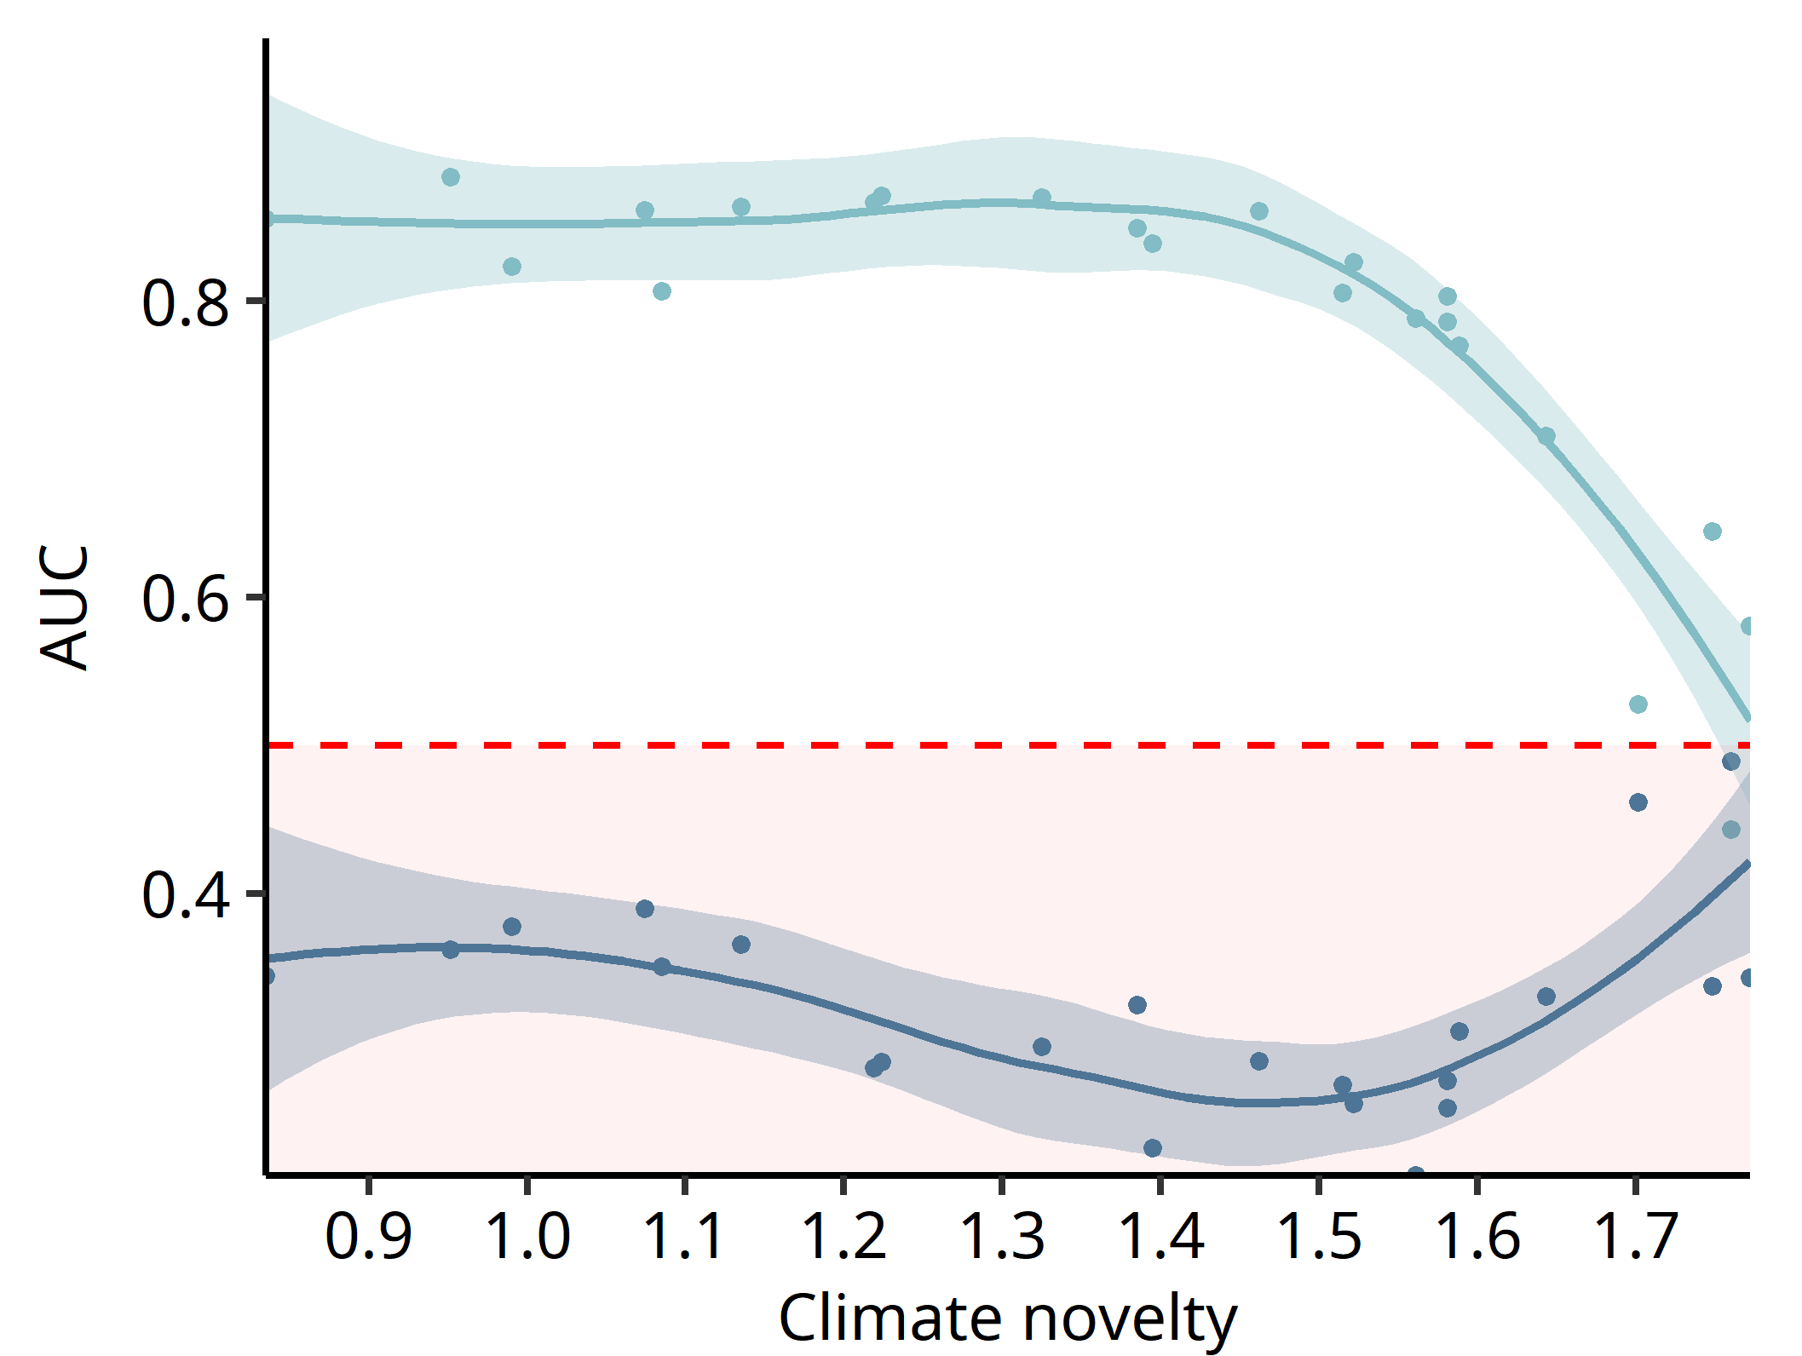
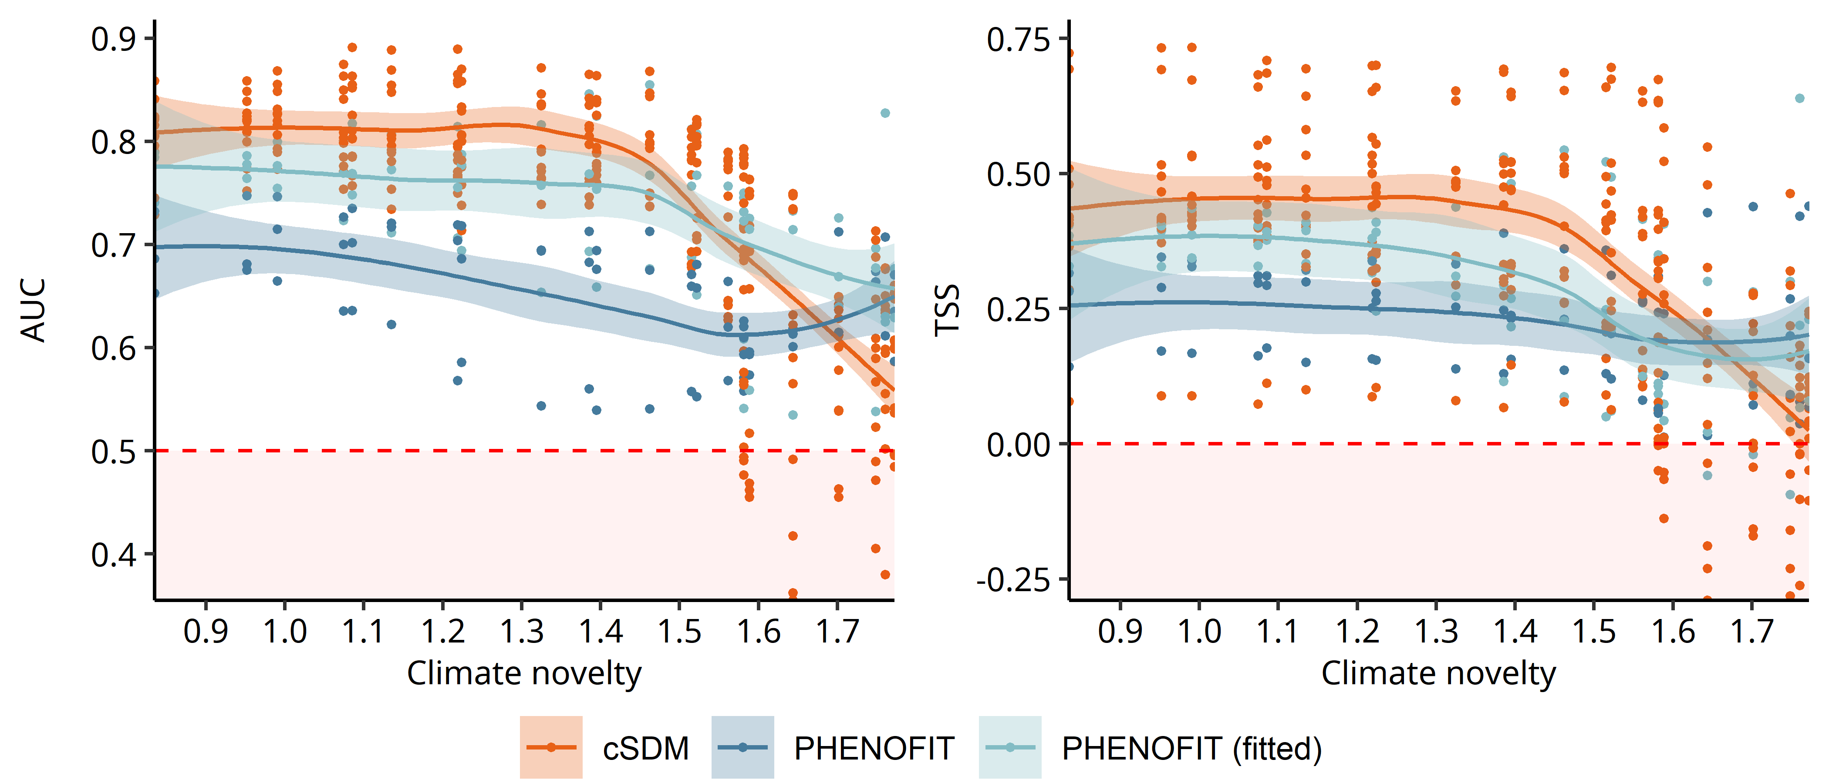
CHALLENGES TO PROCESS-BASED APPROACHES
Palaeoecology: a tool for model diagnostics?
Larix

Slide 111
CHALLENGES TO PROCESS-BASED APPROACHES
Palaeoecology: a tool for model diagnostics?
Worst than
random model
Larix

Slide 112
CHALLENGES TO PROCESS-BASED APPROACHES
Palaeoecology: a tool for model diagnostics?
Worst than
random model
Bad calibration due to scarce data rather than a model misspecification?
Larix

