Slide 1
CLIMATE APPROACH: Climatic distance
PAST CLIMATE
e.g. 9000 years BP
BASELINE CLIMATE
1970 - 2000
N predictors
N predictors

Slide 2
CLIMATE APPROACH: Climatic distance
PAST CLIMATE
e.g. 9000 years BP
BASELINE CLIMATE
1970 - 2000
From each cell:
{ ; ; … }

Slide 3
CLIMATE APPROACH: Climatic distance
PAST CLIMATE
e.g. 9000 years BP
BASELINE CLIMATE
1970 - 2000
Minimum
Euclidean distance
(N-dimensional)
From each cell:
{ ; ; … }
To the set of all cells
in the calibration period

Slide 4
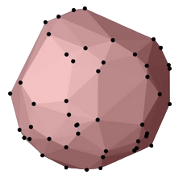
CLIMATE APPROACH: Hypervolume similarity
PAST CLIMATE
e.g. 9000 years BP
N-dimensional hypervolume

Slide 5
CLIMATE APPROACH: Hypervolume similarity
PAST CLIMATE
e.g. 9000 years BP
BASELINE CLIMATE
1970 - 2000
N-dimensional hypervolume
N-dimensional hypervolume

Slide 6
CLIMATE APPROACH: Hypervolume similarity
PAST CLIMATE
e.g. 9000 years BP
BASELINE CLIMATE
1970 - 2000

Slide 7
CLIMATE APPROACH: Hypervolume similarity
PAST CLIMATE
e.g. 9000 years BP
BASELINE CLIMATE
1970 - 2000
Hypervolume overlap
(Sørensen similarity)

Slide 8
CLIMATE APPROACH: Categorical differenciation
BASELINE CLIMATE
1970 - 2000
Calibration domain
N-dimensional hypervolume

Slide 9
CLIMATE APPROACH: Categorical differenciation
BASELINE CLIMATE
1970 - 2000
Calibration range
N-dimensional hypervolume

Slide 10
CLIMATE APPROACH: Categorical differenciation
BASELINE CLIMATE
1970 - 2000
Full extrapolation
N-dimensional hypervolume

Slide 11
CLIMATE APPROACH: Categorical differenciation
BASELINE CLIMATE
1970 - 2000
+
+
+
+
+
+
+
+
+
+
+
+
N-dimensional hypervolume

Slide 12
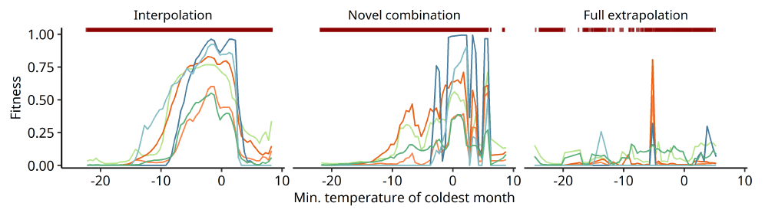
CLIMATE APPROACH: Categorical differenciation and model response

Slide 13
NICHE APPROACH: average distance to centroid
BASELINE CLIMATE
1970 - 2000
Observed niche
Calibration domain
N-dimensional hypervolume

Slide 14
NICHE APPROACH: average distance to centroid
BASELINE CLIMATE
1970 - 2000
+
+
+
N-dimensional hypervolume

Slide 15
NICHE APPROACH: average distance to centroid
BASELINE CLIMATE
1970 - 2000
+
+
+
N-dimensional hypervolume

Slide 16
NICHE APPROACH: average distance to centroid
BASELINE CLIMATE
1970 - 2000
+
+
+
+
Outlier ?
N-dimensional hypervolume

Slide 17
NICHE APPROACH: average distance to centroid
BASELINE CLIMATE
1970 - 2000
+
Average distance between pollen records and centroid
+
+
N-dimensional hypervolume

