Slide 1
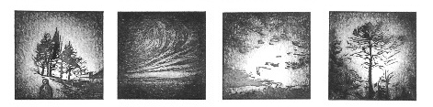
Reliability of species distribution model projections
Drawing insights from palaeoecological data
V. Van der Meersch, supervised by I. Chuine
Linocut print by C. Rescan

Slide 2
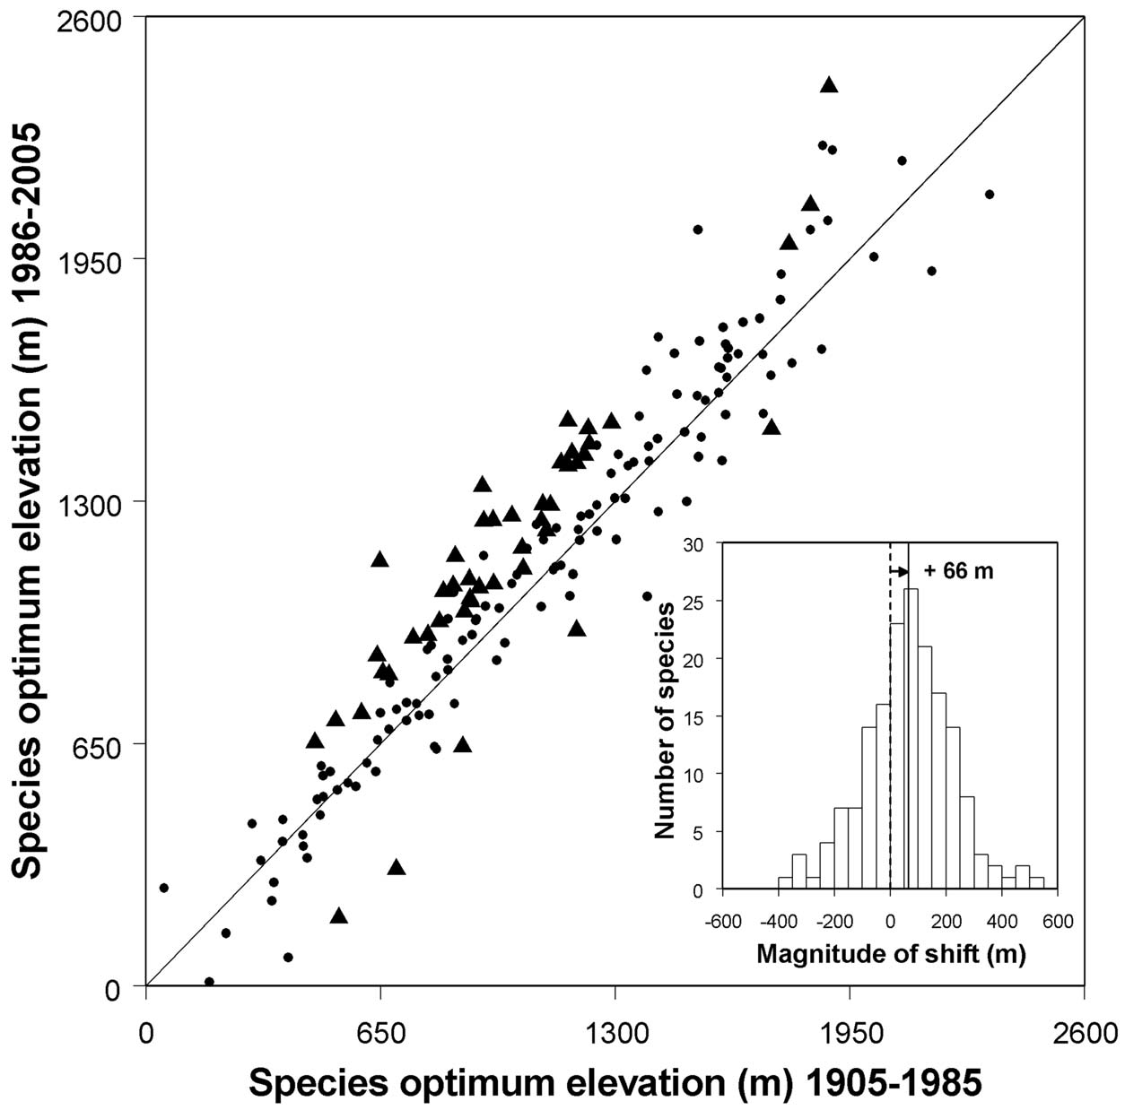
WHAT WE OBSERVE: SPECIES RANGE SHIFTS
Forest plant species
+66m
Lenoir et al. (2008)

Slide 3

HOW WE COULD PREDICT THE FUTURE: POPULAR STATISTICAL APPROACHES
Correlative niche models
Bioclimatic predictors
Current distribution

Slide 4
HOW WE COULD PREDICT THE FUTURE: POPULAR STATISTICAL APPROACHES
Correlative niche models
Fit a statistical
relationship
Bioclimatic predictors
Current distribution

Slide 5

HOW WE COULD PREDICT THE FUTURE: POPULAR STATISTICAL APPROACHES
Correlative niche models
Fit a statistical
relationship
Bioclimatic predictors
Current distribution
FIND PATTERNS

Slide 6
HOW WE COULD PREDICT THE FUTURE: POPULAR STATISTICAL APPROACHES
Correlative niche models
Make predictions
Future distribution
Future predictors

Slide 7

HOW WE COULD PREDICT THE FUTURE: POPULAR STATISTICAL APPROACHES
Correlative niche models
Make predictions
Future distribution
Future predictors
MAIN HYPOTHESIS: CORRELATIONS HOLD TRUE

Slide 8

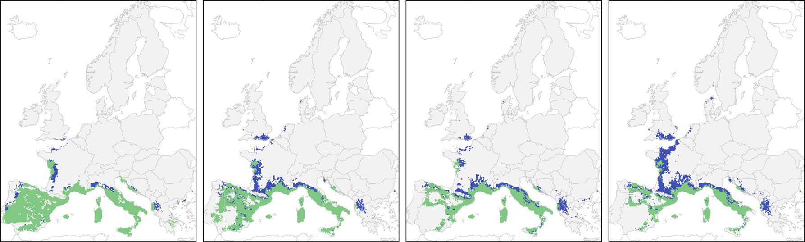
HOW WE COULD PREDICT THE FUTURE: POPULAR STATISTICAL APPROACHES
Example: Quercus ilex projected range shift
Present
Suitable
CURRENT
2095
Mauri et al. (2022)

Slide 9


HOW WE COULD PREDICT THE FUTURE: POPULAR STATISTICAL APPROACHES
Key advantages
▶ easy handling of the models
▶ calibration can be envisaged for many species
▶ standard methods, reproducibility

Slide 10
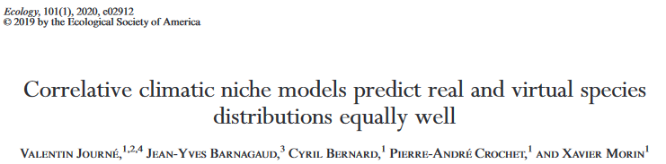
HOW WE COULD PREDICT THE FUTURE: POPULAR STATISTICAL APPROACHES
Approach criticized: lack of biological realism?
“high predictive power […] not necessarily reflect causal relationships between climate and species distributions”

Slide 11
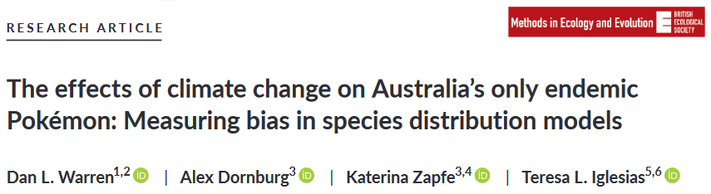
HOW WE COULD PREDICT THE FUTURE: POPULAR STATISTICAL APPROACHES
Approach criticized: lack of biological realism?
Consistent predictions from meaningless data

Slide 12
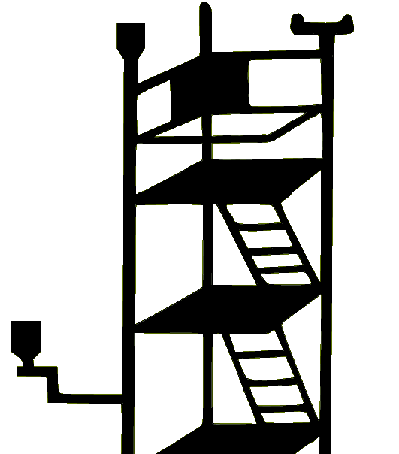


HOW WE COULD PREDICT THE FUTURE: PROCESS-BASED APPROACHES
Process-based models, in a nutshell
Experimentations
A priori knowledge
Observations

Slide 13
HOW WE COULD PREDICT THE FUTURE: PROCESS-BASED APPROACHES
Process-based models, in a nutshell
Experimentations
A priori knowledge
Observations
Processes

Slide 14

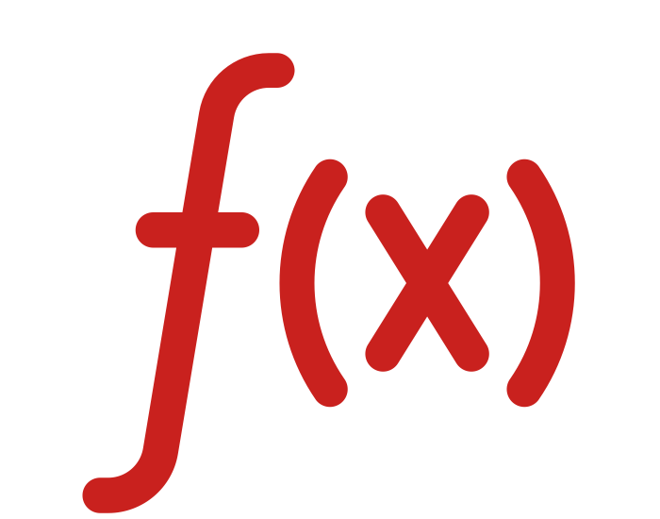
HOW WE COULD PREDICT THE FUTURE: PROCESS-BASED APPROACHES
Bioclimatic inputs
Process-based models, in a nutshell
Translate in mathematical
equations
Experimentations
A priori knowledge
Observations
Processes

Slide 15
HOW WE COULD PREDICT THE FUTURE: PROCESS-BASED APPROACHES
Bioclimatic inputs
Process-based models, in a nutshell
Translate in mathematical
equations
Experimentations
A priori knowledge
Observations
Processes

Slide 16
HOW WE COULD PREDICT THE FUTURE: PROCESS-BASED APPROACHES
Bioclimatic inputs
Process-based models, in a nutshell
Translate in mathematical
equations
Experimentations
A priori knowledge
Observations
Processes
DESCRIBE PROCESSES

Slide 17
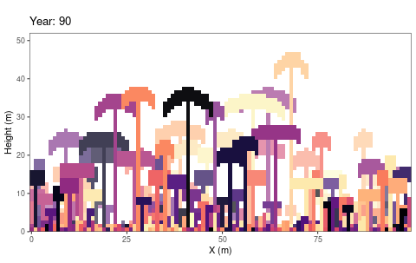
HOW WE COULD PREDICT THE FUTURE: PROCESS-BASED APPROACHES
e.g. individual-based models
TROLL model (Maréchaux & Chave, 2017),
ForCEEPS model (Morin et al., 2021)...
Schmitt et al. (2023)

Slide 18



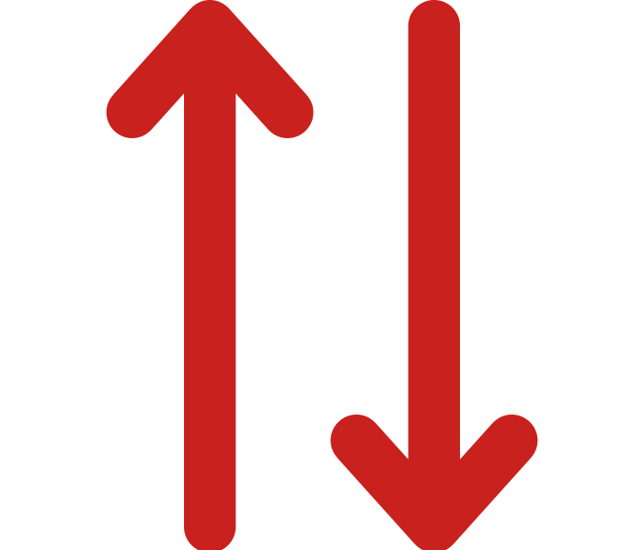
HOW WE COULD PREDICT THE FUTURE: PROCESS-BASED APPROACHES
e.g. “average tree” models
CASTANEA model (Dufrêne et al., 2005),
PHENOFIT model (Chuine & Beaubien, 2001)...

Slide 19




HOW WE COULD PREDICT THE FUTURE: PROCESS-BASED APPROACHES
PHENOFIT: focus on phenology
Frost resistance
Thermal energy
Frost and drought
Leaf unfolding
Flowering
Fruit maturation
Leaf senescence

Slide 20


HOW WE COULD PREDICT THE FUTURE: PROCESS-BASED APPROACHES
PHENOFIT: focus on phenology
FITNESS
Reproductive success
Survival
Frost resistance
Thermal energy
Frost and drought
Leaf unfolding
Flowering
Fruit maturation
Leaf senescence

Slide 21
HOW WE COULD PREDICT THE FUTURE: PROCESS-BASED APPROACHES
Key advantages: greater comprehension of the complexity of ecosystems?
▶ mathematical formalisation of current knowledge, with a direct biological interpretation
▶ further validation of our understanding of processes against observations
▶ testing new hypotheses

Slide 22
HOW WE COULD PREDICT THE FUTURE: PROCESS-BASED APPROACHES
Main drawbacks: finding the appropriate amount of complexity?
▶ take more time to develop, more challenging to use
▶ data available to calibrate them only for a few species
▶ important role of modeller subjectivity
▶ lack of transparency

Slide 23

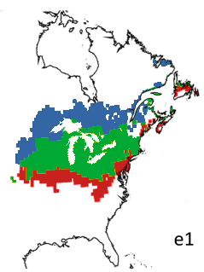

HOW WE COULD PREDICT THE FUTURE: DIVERGENCE BETWEEN APPROACHES
Different predictions, e.g. Quercus bicolor in 2100
PHENOFIT
BIOMOD
Extinct
Present
Suitable
Correlative models more pessimistic?
Adapted from Morrin & Thuiller (2009)

Slide 24
HOW WE COULD PREDICT THE FUTURE: CONTINUITY AMONG MODELS
Correlative models
Process-based models
PATTERNS
PROCESSES
Adapted from Dormann et al. (2012)

Slide 25
HOW WE COULD PREDICT THE FUTURE: CONTINUITY AMONG MODELS
Correlative models
Process-based models
PATTERNS
PROCESSES
▶ implicit representation of processes
▶ explicit representation of processes
Adapted from Dormann et al. (2012)

Slide 26
HOW WE COULD PREDICT THE FUTURE: CONTINUITY AMONG MODELS
Correlative models
Process-based models
PATTERNS
PROCESSES
▶ implicit representation of processes
▶ calibrated with current distribution data
▶ explicit representation of processes
▶ calibrated with process-related data
Adapted from Dormann et al. (2012)

Slide 27
HOW WE COULD PREDICT THE FUTURE: CONTINUITY AMONG MODELS
COMMON ASSUMPTION: PROCESS-BASED MODELS might provide more robust projections in novel conditions
e.g. Evans (2012), Singer et al. (2016), Urban et al. (2016), Zurell et al. (2016)

Slide 28
HOW WE COULD PREDICT THE FUTURE: CONTINUITY AMONG MODELS
COMMON ASSUMPTION: PROCESS-BASED MODELS might provide more robust projections in novel conditions
YET TO BE VERIFIED
e.g. Evans (2012), Singer et al. (2016), Urban et al. (2016), Zurell et al. (2016)

Slide 29




THESIS FRAMEWORK
RECENT past
FUTURE
Late Pleistocene - Holocene
1970 - 2000
20th century
21St century
DISTANT PAST
PREsent

Slide 30
THESIS FRAMEWORK
Model calibrationS
- Inverse calibration of process-based models
- Statistical fit of niche models
RECENT past
FUTURE
Late Pleistocene - Holocene
1970 - 2000
20th century
21St century
DISTANT PAST
PREsent

Slide 31
INVERSE CALIBRATION OF PROCESS-BASED MODELS
Correlative models
Process-based models
PATTERNS
PROCESSES
Adapted from Dormann et al. (2012)

Slide 32
INVERSE CALIBRATION OF PROCESS-BASED MODELS
Correlative models
Process-based models
PATTERNS
PROCESSES
Fitted process-based models
Adapted from Dormann et al. (2012)

Slide 33
INVERSE CALIBRATION OF PROCESS-BASED MODELS
Correlative models
Process-based models
PATTERNS
PROCESSES
Fitted process-based models
▶ calibrated with current distribution data
▶ explicit representation of processes
Adapted from Dormann et al. (2012)

Slide 34
INVERSE CALIBRATION OF PROCESS-BASED MODELS
Correlative models
Process-based models
PATTERNS
PROCESSES
Fitted process-based models
▶ calibrated with current distribution data
▶ explicit representation of processes
Combine both approaches
Adapted from Dormann et al. (2012)

Slide 35
INVERSE CALIBRATION OF PROCESS-BASED MODELS
Optimisation algorithm: covariance matrix adaptation – evolution strategy
Bioclimatic inputs
Current distribution
Processes
Van der Meersch & Chuine (2023)

Slide 36
INVERSE CALIBRATION OF PROCESS-BASED MODELS
Optimisation algorithm: covariance matrix adaptation – evolution strategy
Bioclimatic inputs
Find best
parameter set
with CMA-ES
Current distribution
Processes
Van der Meersch & Chuine (2023)

Slide 37
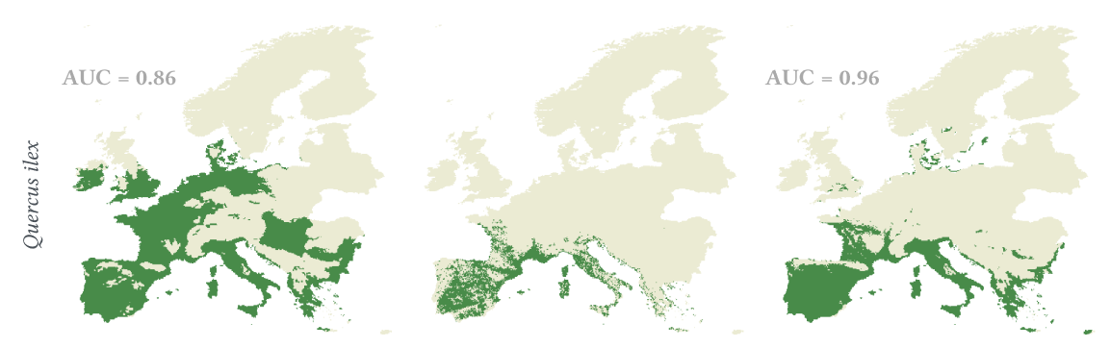
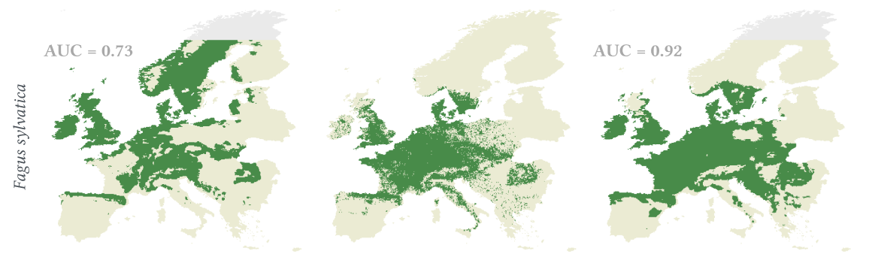
INVERSE CALIBRATION OF PROCESS-BASED MODELS: RESULTS
Classical calibration
Observed distribution
Inverse calibration
PHENOFIT
CASTANEA
Van der Meersch & Chuine (2023)

Slide 38

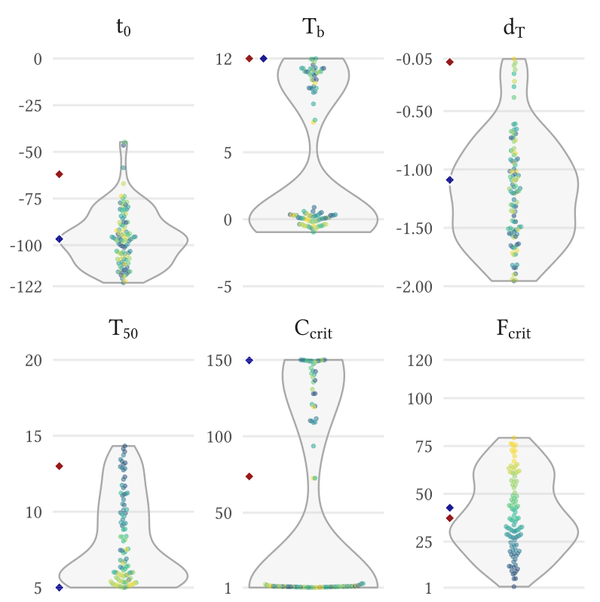
INVERSE CALIBRATION OF PROCESS-BASED MODELS: RESULTS
Expected issue: non-identifiability of parameter values
Effects of stochasticity of CMA-ES calibration on PHENOFIT leaf unfolding model parameters
Van der Meersch & Chuine (2023)

Slide 39
INVERSE CALIBRATION OF PROCESS-BASED MODELS: RESULTS
Expected issue: non-identifiability of parameter values
Effects of stochasticity of CMA-ES calibration on PHENOFIT leaf unfolding model parameters
multiple parameter sets produce equally good fits to the observed data
Van der Meersch & Chuine (2023)

Slide 40
THESIS FRAMEWORK
Model calibrationS
- Inverse calibration of process-based models
- Statistical fit of niche models
RECENT past
FUTURE
Late Pleistocene - Holocene
1970 - 2000
20th century
21St century
DISTANT PAST
PREsent

Slide 41
THESIS FRAMEWORK
Lessons from the past
- Comparison of models’ predictions to pollen records
- Identify the strengths and weaknesses of each model
Model calibrationS
- Inverse calibration of process-based models
- Statistical fit of niche models
RECENT past
FUTURE
Late Pleistocene - Holocene
1970 - 2000
20th century
21St century
DISTANT PAST
PREsent

Slide 42
INSIGHTS FROM THE PAST: PROCESSING PALEOCLIMATE SIMULATION
HadCM3B – 0.5°
(Armstrong et al. 2019)

Slide 43
INSIGHTS FROM THE PAST: PROCESSING PALEOCLIMATE SIMULATION
HadCM3B – 0.5°
(Armstrong et al. 2019)
ICE-6G-C altitude
(Peltier et al. 2015)
Downscaled HadCM3B
Monthly - 0.25°
Temperatures
Precipitation
Wind
Cloudiness
No. of wet days

Slide 44
INSIGHTS FROM THE PAST: PROCESSING PALEOCLIMATE SIMULATION
HadCM3B – 0.5°
(Armstrong et al. 2019)
ICE-6G-C altitude
(Peltier et al. 2015)
Downscaled HadCM3B
Monthly - 0.25°
Generated daily values
Temperatures
Precipitation
Wind
Cloudiness
No. of wet days
Temperatures
Precipitation
Wind
Cloudiness
GWGEN
(Sommer & Kaplan 20197)

Slide 45
INSIGHTS FROM THE PAST: PROCESSING PALEOCLIMATE SIMULATION
HadCM3B – 0.5°
(Armstrong et al. 2019)
Orbital parameters
Radiation processing
(Kaplan et al. 2016)
ICE-6G-C altitude
(Peltier et al. 2015)
Downscaled HadCM3B
Monthly - 0.25°
Generated daily values
Temperatures
Precipitation
Wind
Cloudiness
No. of wet days
Temperatures
Precipitation
Wind
Cloudiness
GWGEN
(Sommer & Kaplan 20197)

Slide 46
INSIGHTS FROM THE PAST: PROCESSING PALEOCLIMATE SIMULATION
HadCM3B – 0.5°
(Armstrong et al. 2019)
Orbital parameters
Computed daily values
Radiation processing
(Kaplan et al. 2016)
ICE-6G-C altitude
(Peltier et al. 2015)
Global radiation
Downscaled HadCM3B
Monthly - 0.25°
Generated daily values
Temperatures
Precipitation
Wind
Cloudiness
No. of wet days
Temperatures
Precipitation
Wind
Cloudiness
GWGEN
(Sommer & Kaplan 20197)

Slide 47
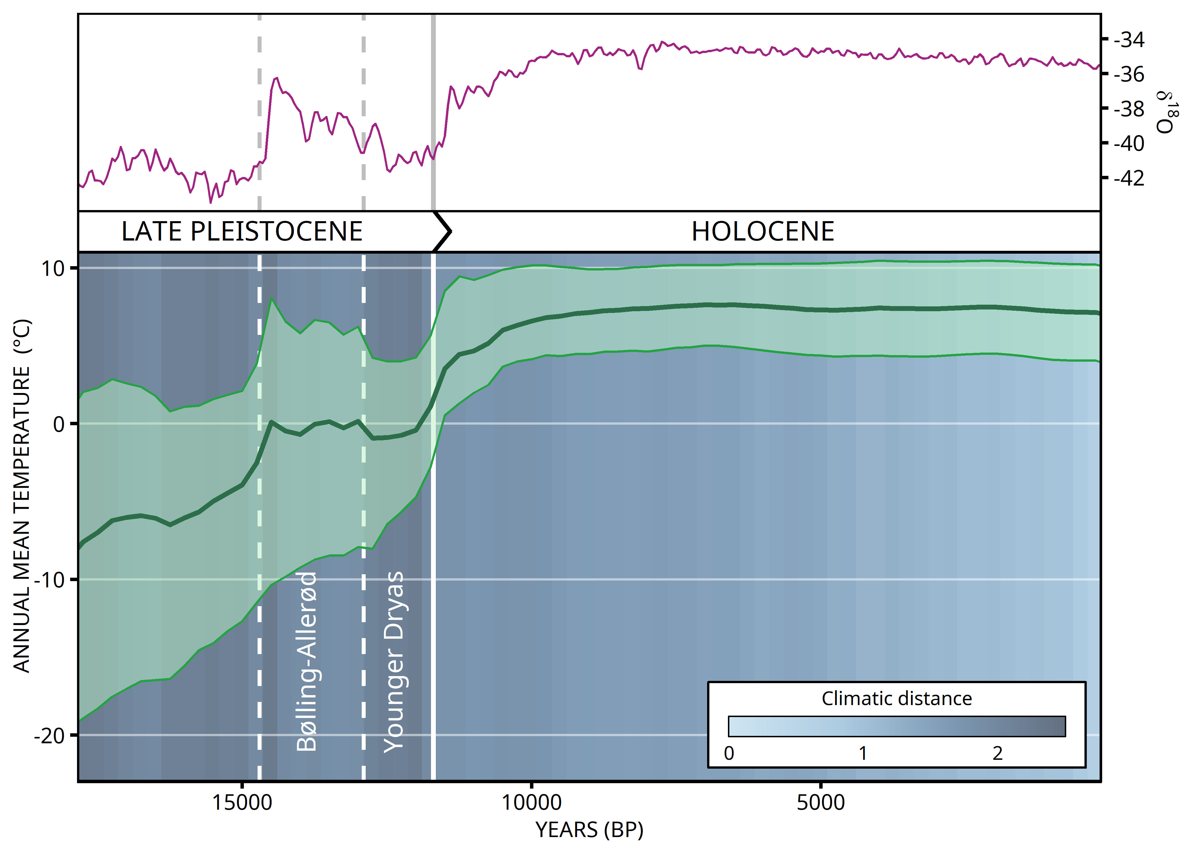
INSIGHTS FROM THE PAST: PROCESSING PALEOCLIMATE SIMULATION

Slide 48
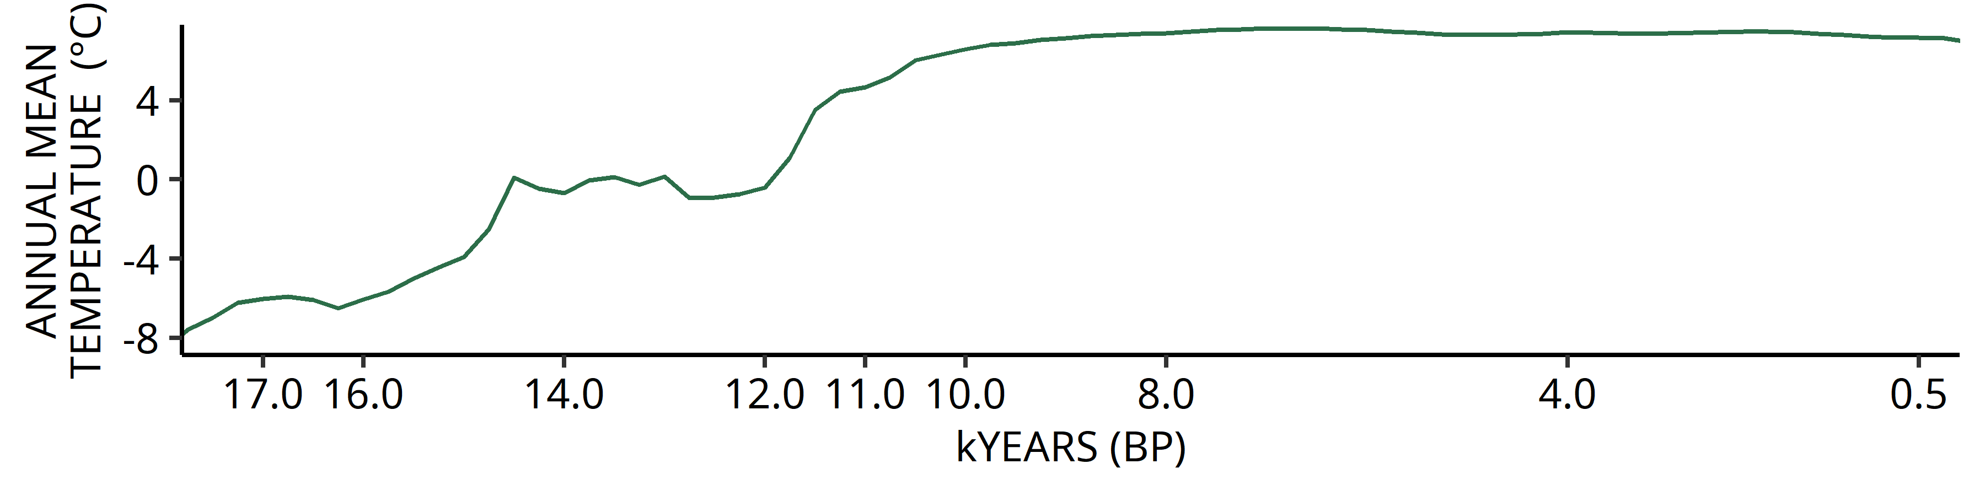
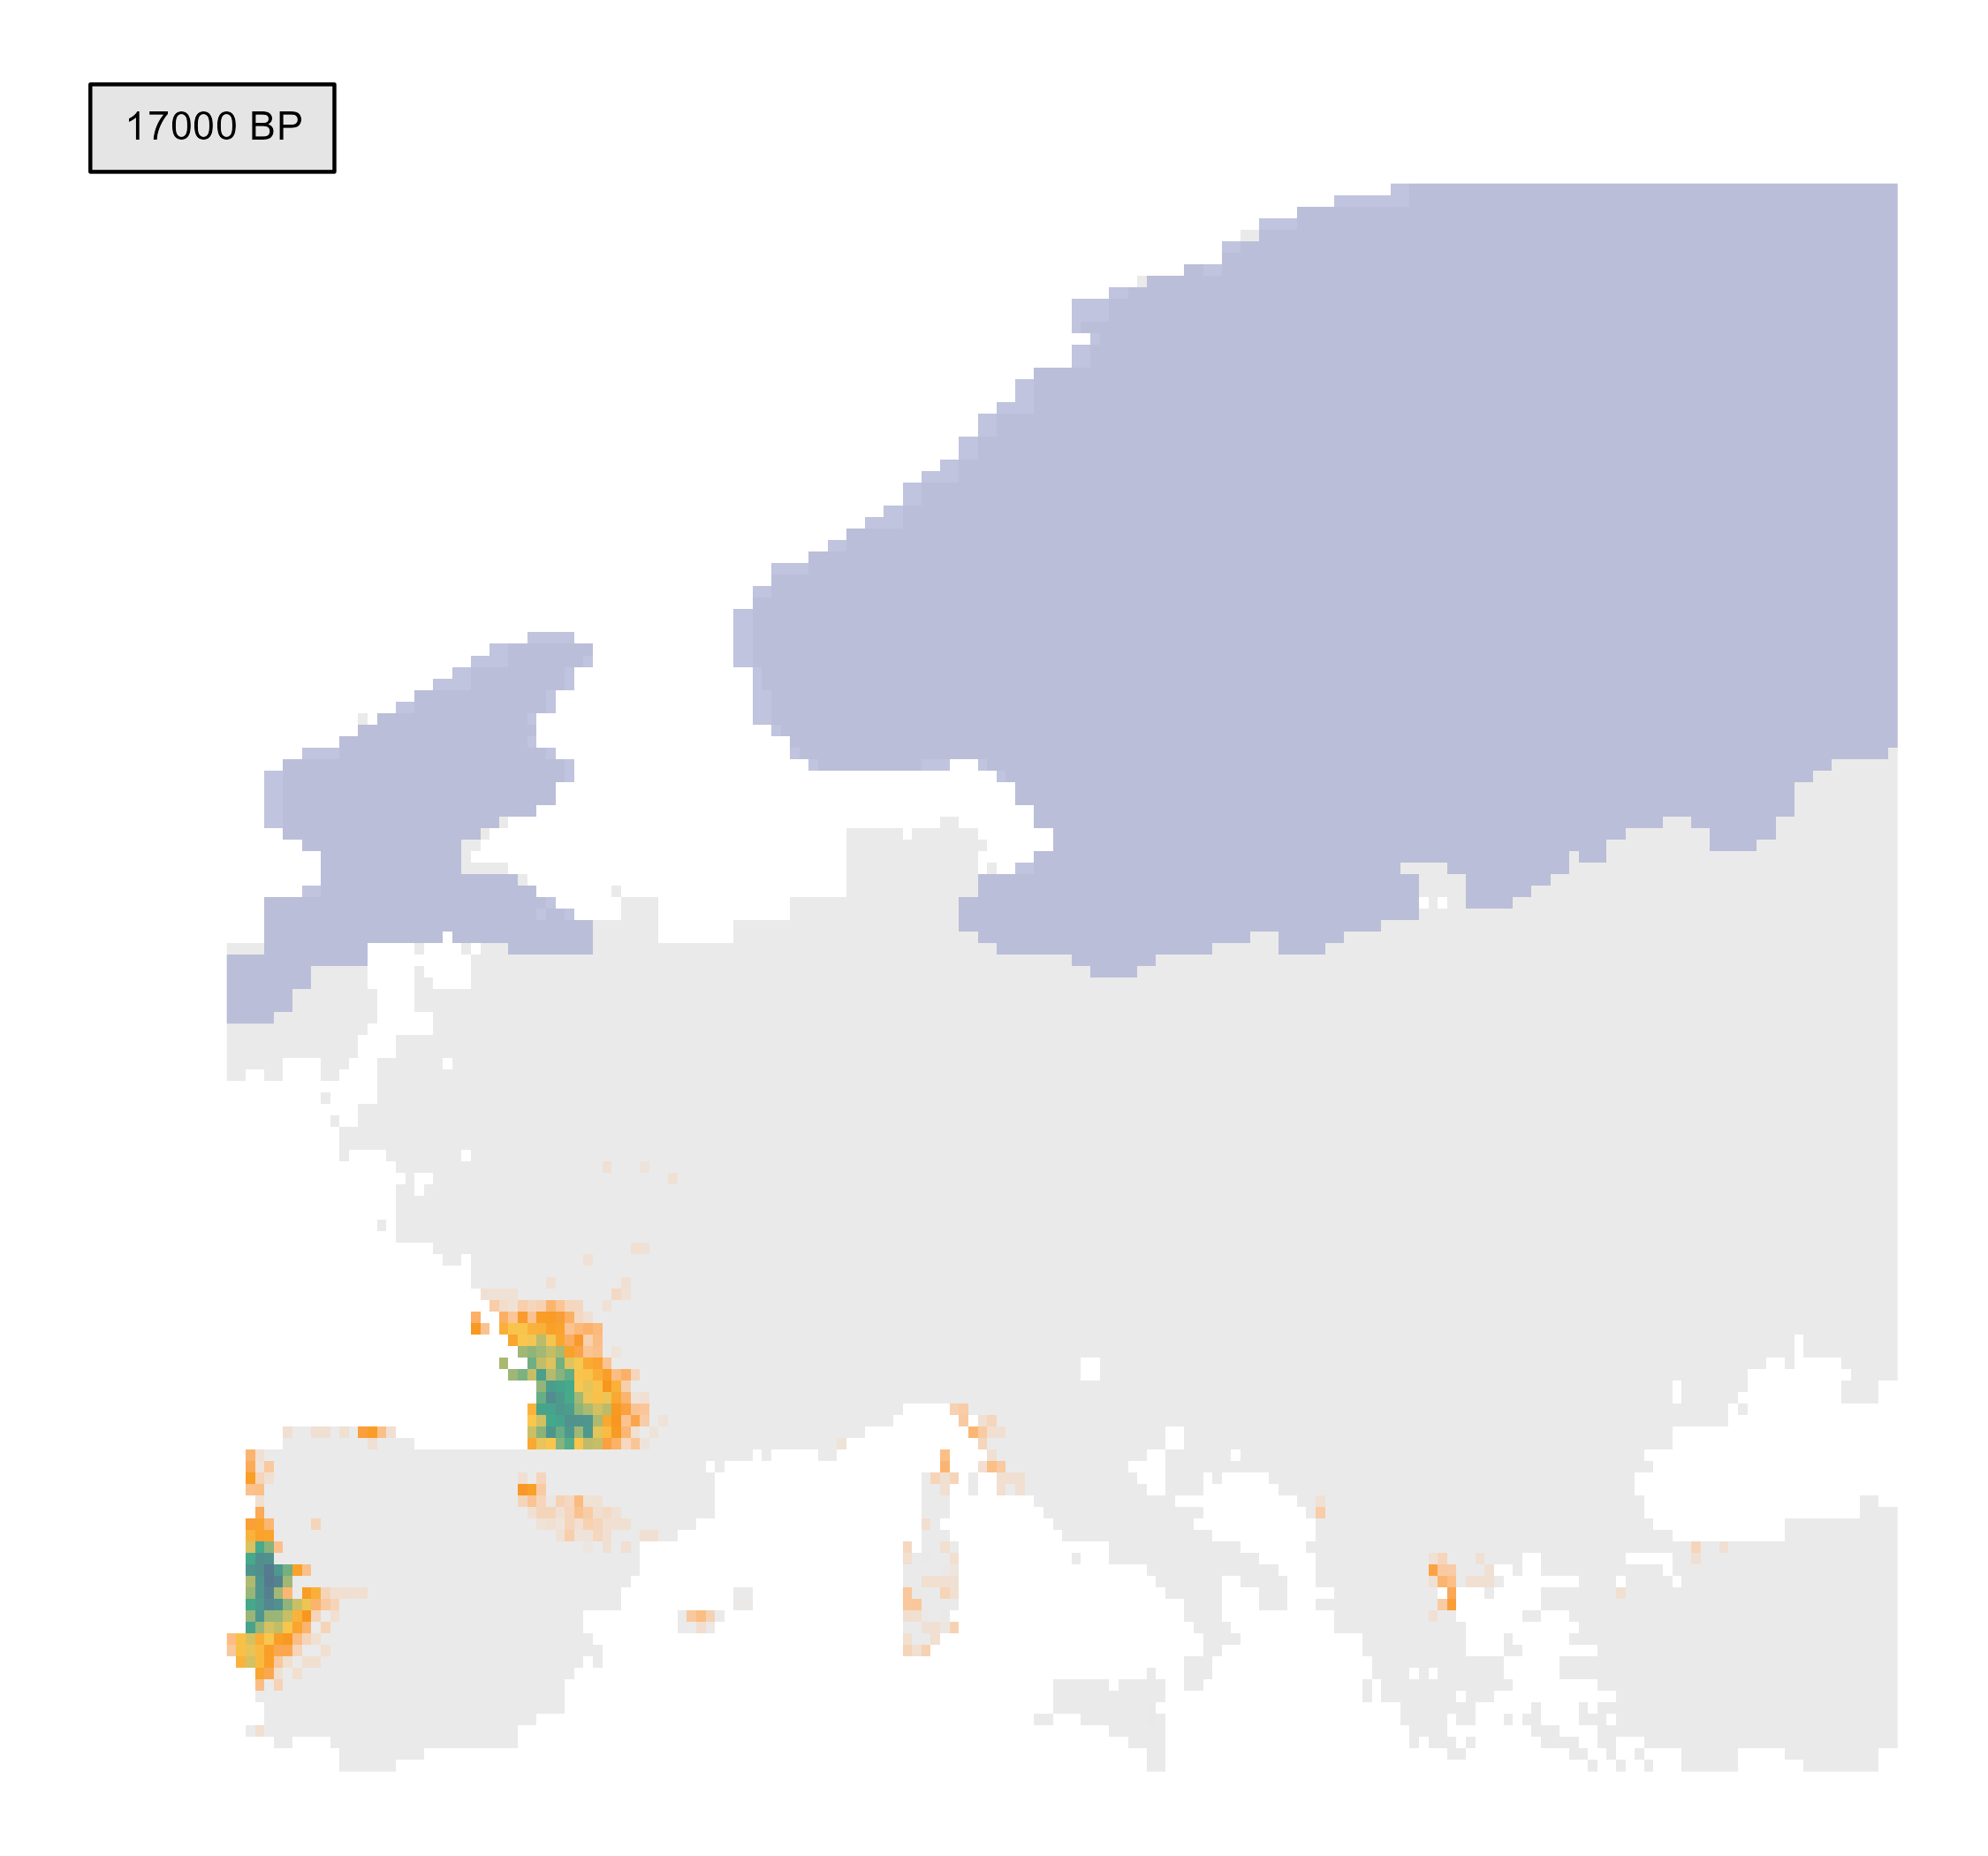
INSIGHTS FROM THE PAST: PHENOFIT PROJECTIONS
e.g. Fagus sylvatica

Slide 49
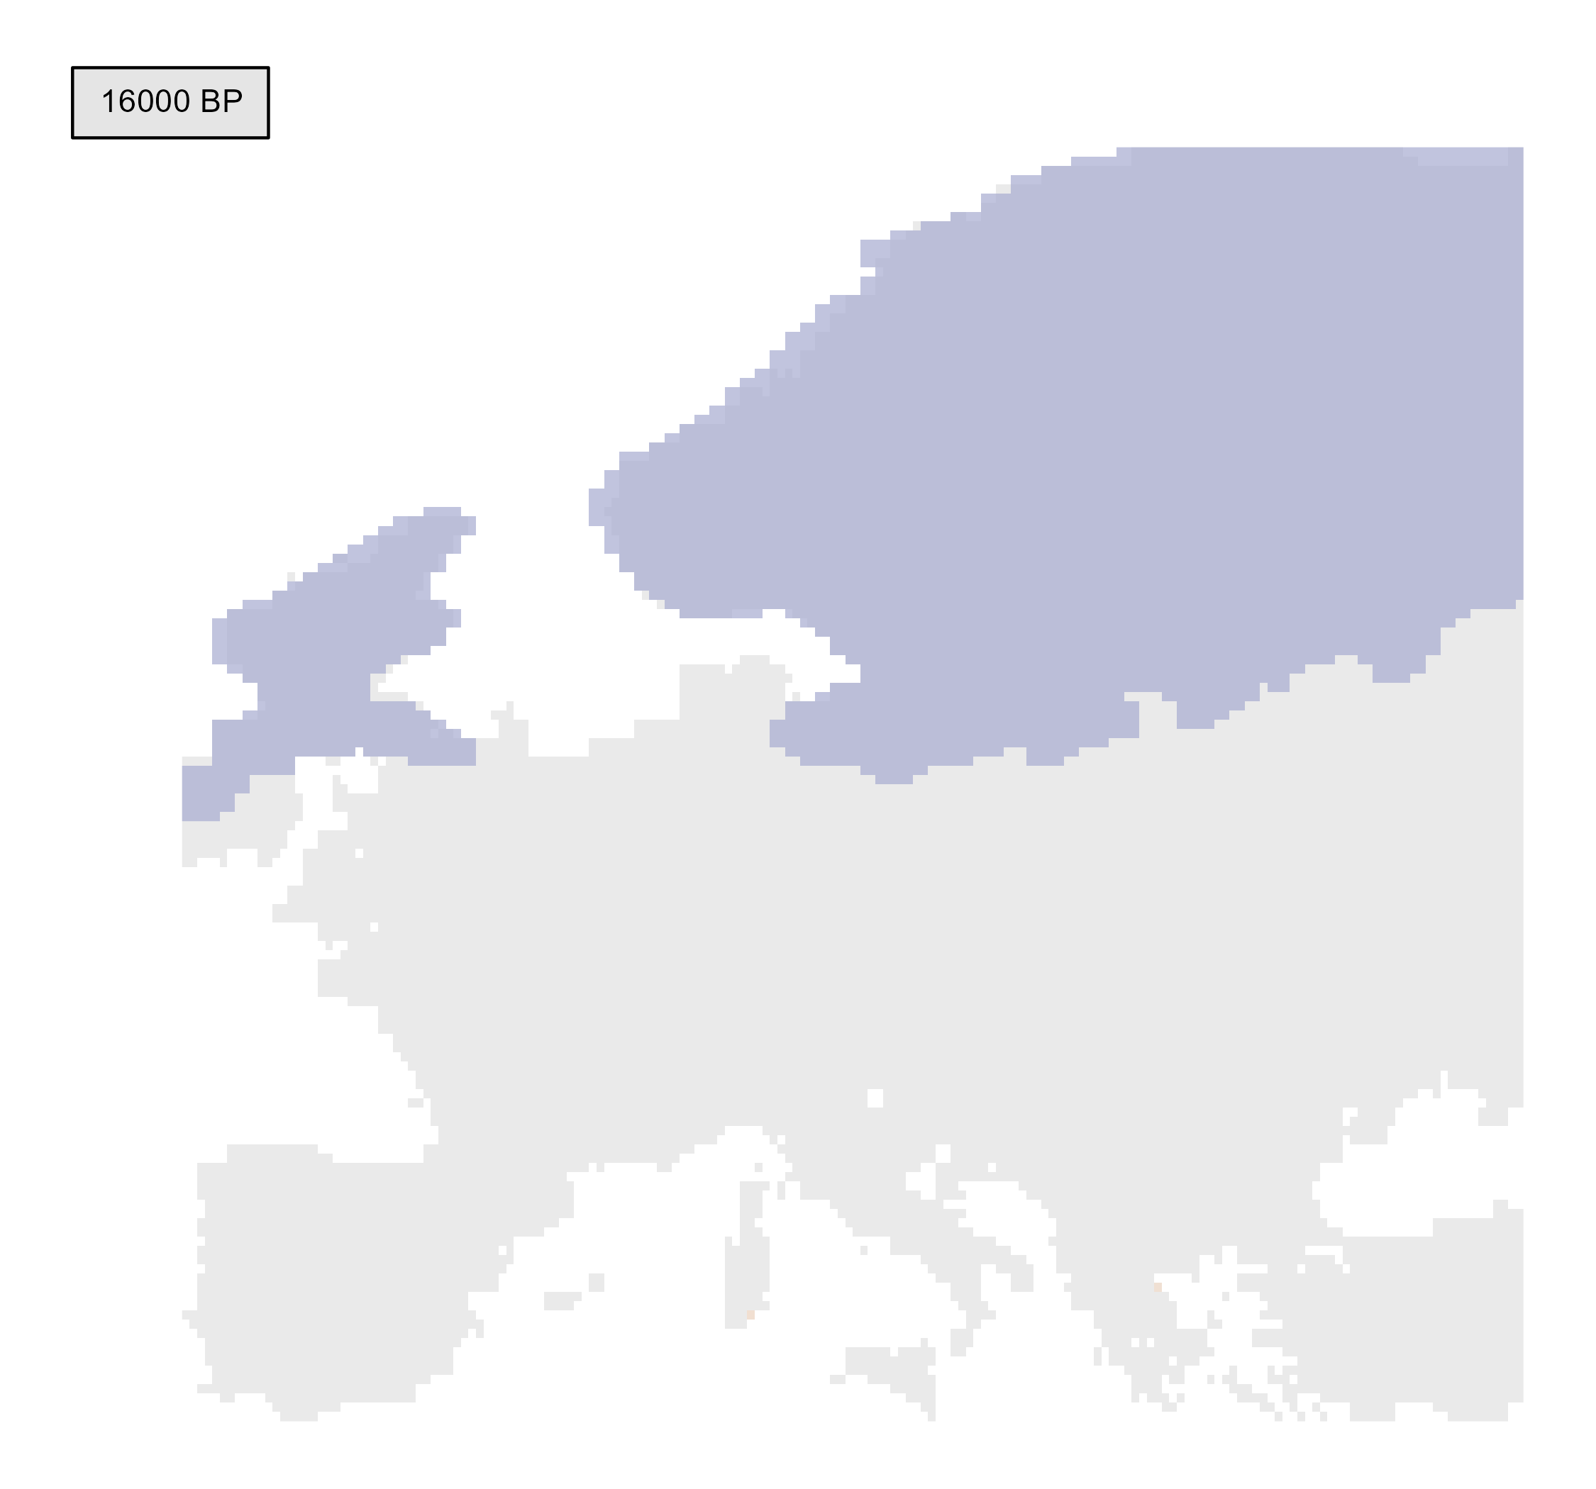
INSIGHTS FROM THE PAST: PHENOFIT PROJECTIONS
e.g. Fagus sylvatica

Slide 50
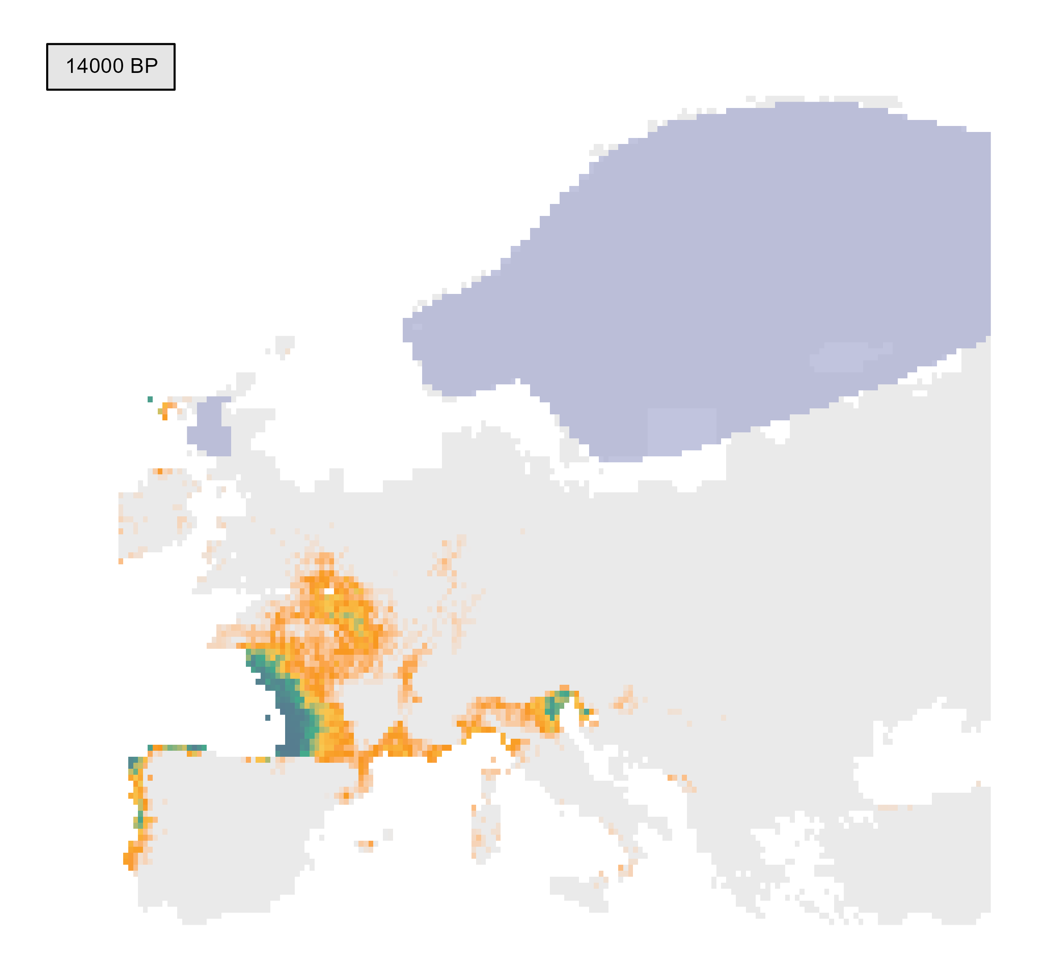
INSIGHTS FROM THE PAST: PHENOFIT PROJECTIONS
Bølling-Allerød oscillation
temperate climate
e.g. Fagus sylvatica

Slide 51
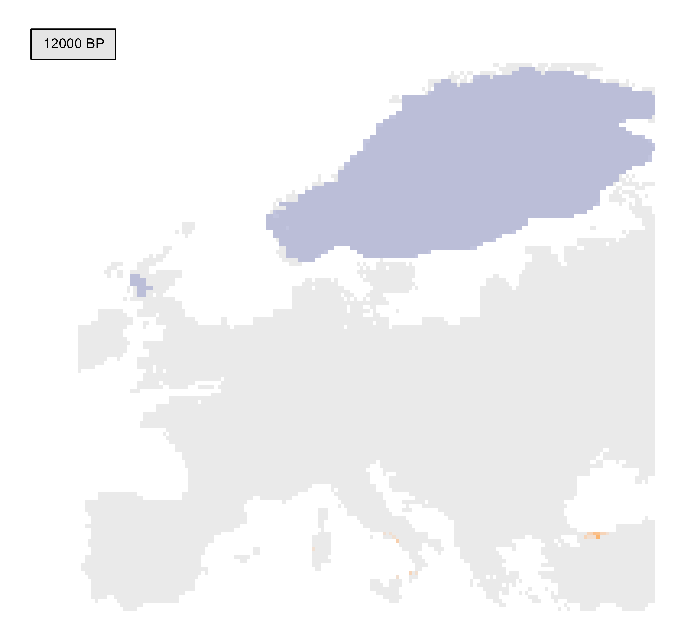
INSIGHTS FROM THE PAST: PHENOFIT PROJECTIONS
Younger Dryas
glacial conditions
e.g. Fagus sylvatica

Slide 52
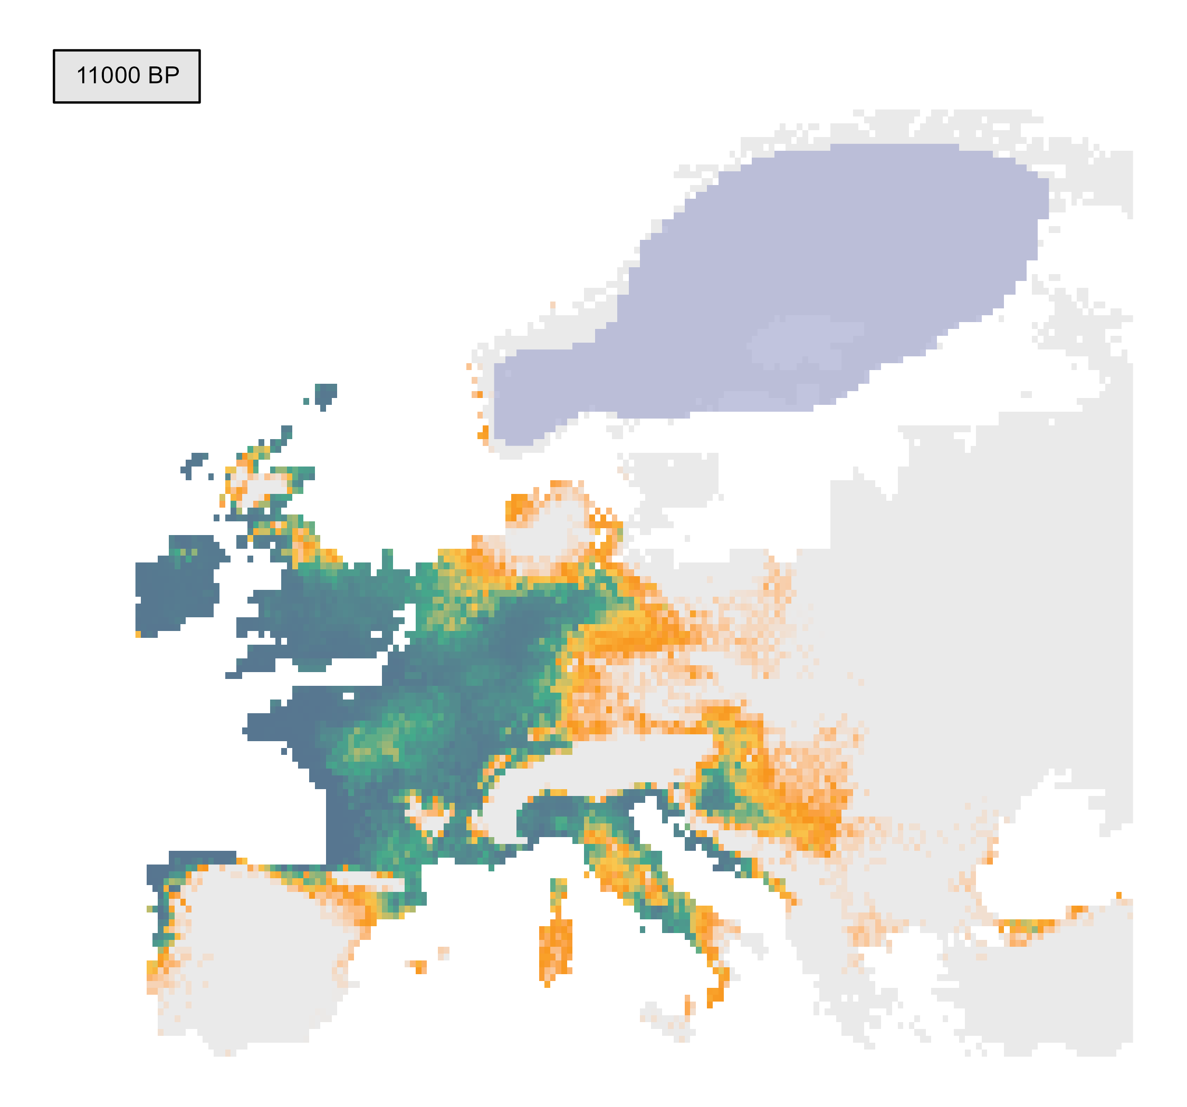
INSIGHTS FROM THE PAST: PHENOFIT PROJECTIONS
Beginning of the Holocene
e.g. Fagus sylvatica

Slide 53
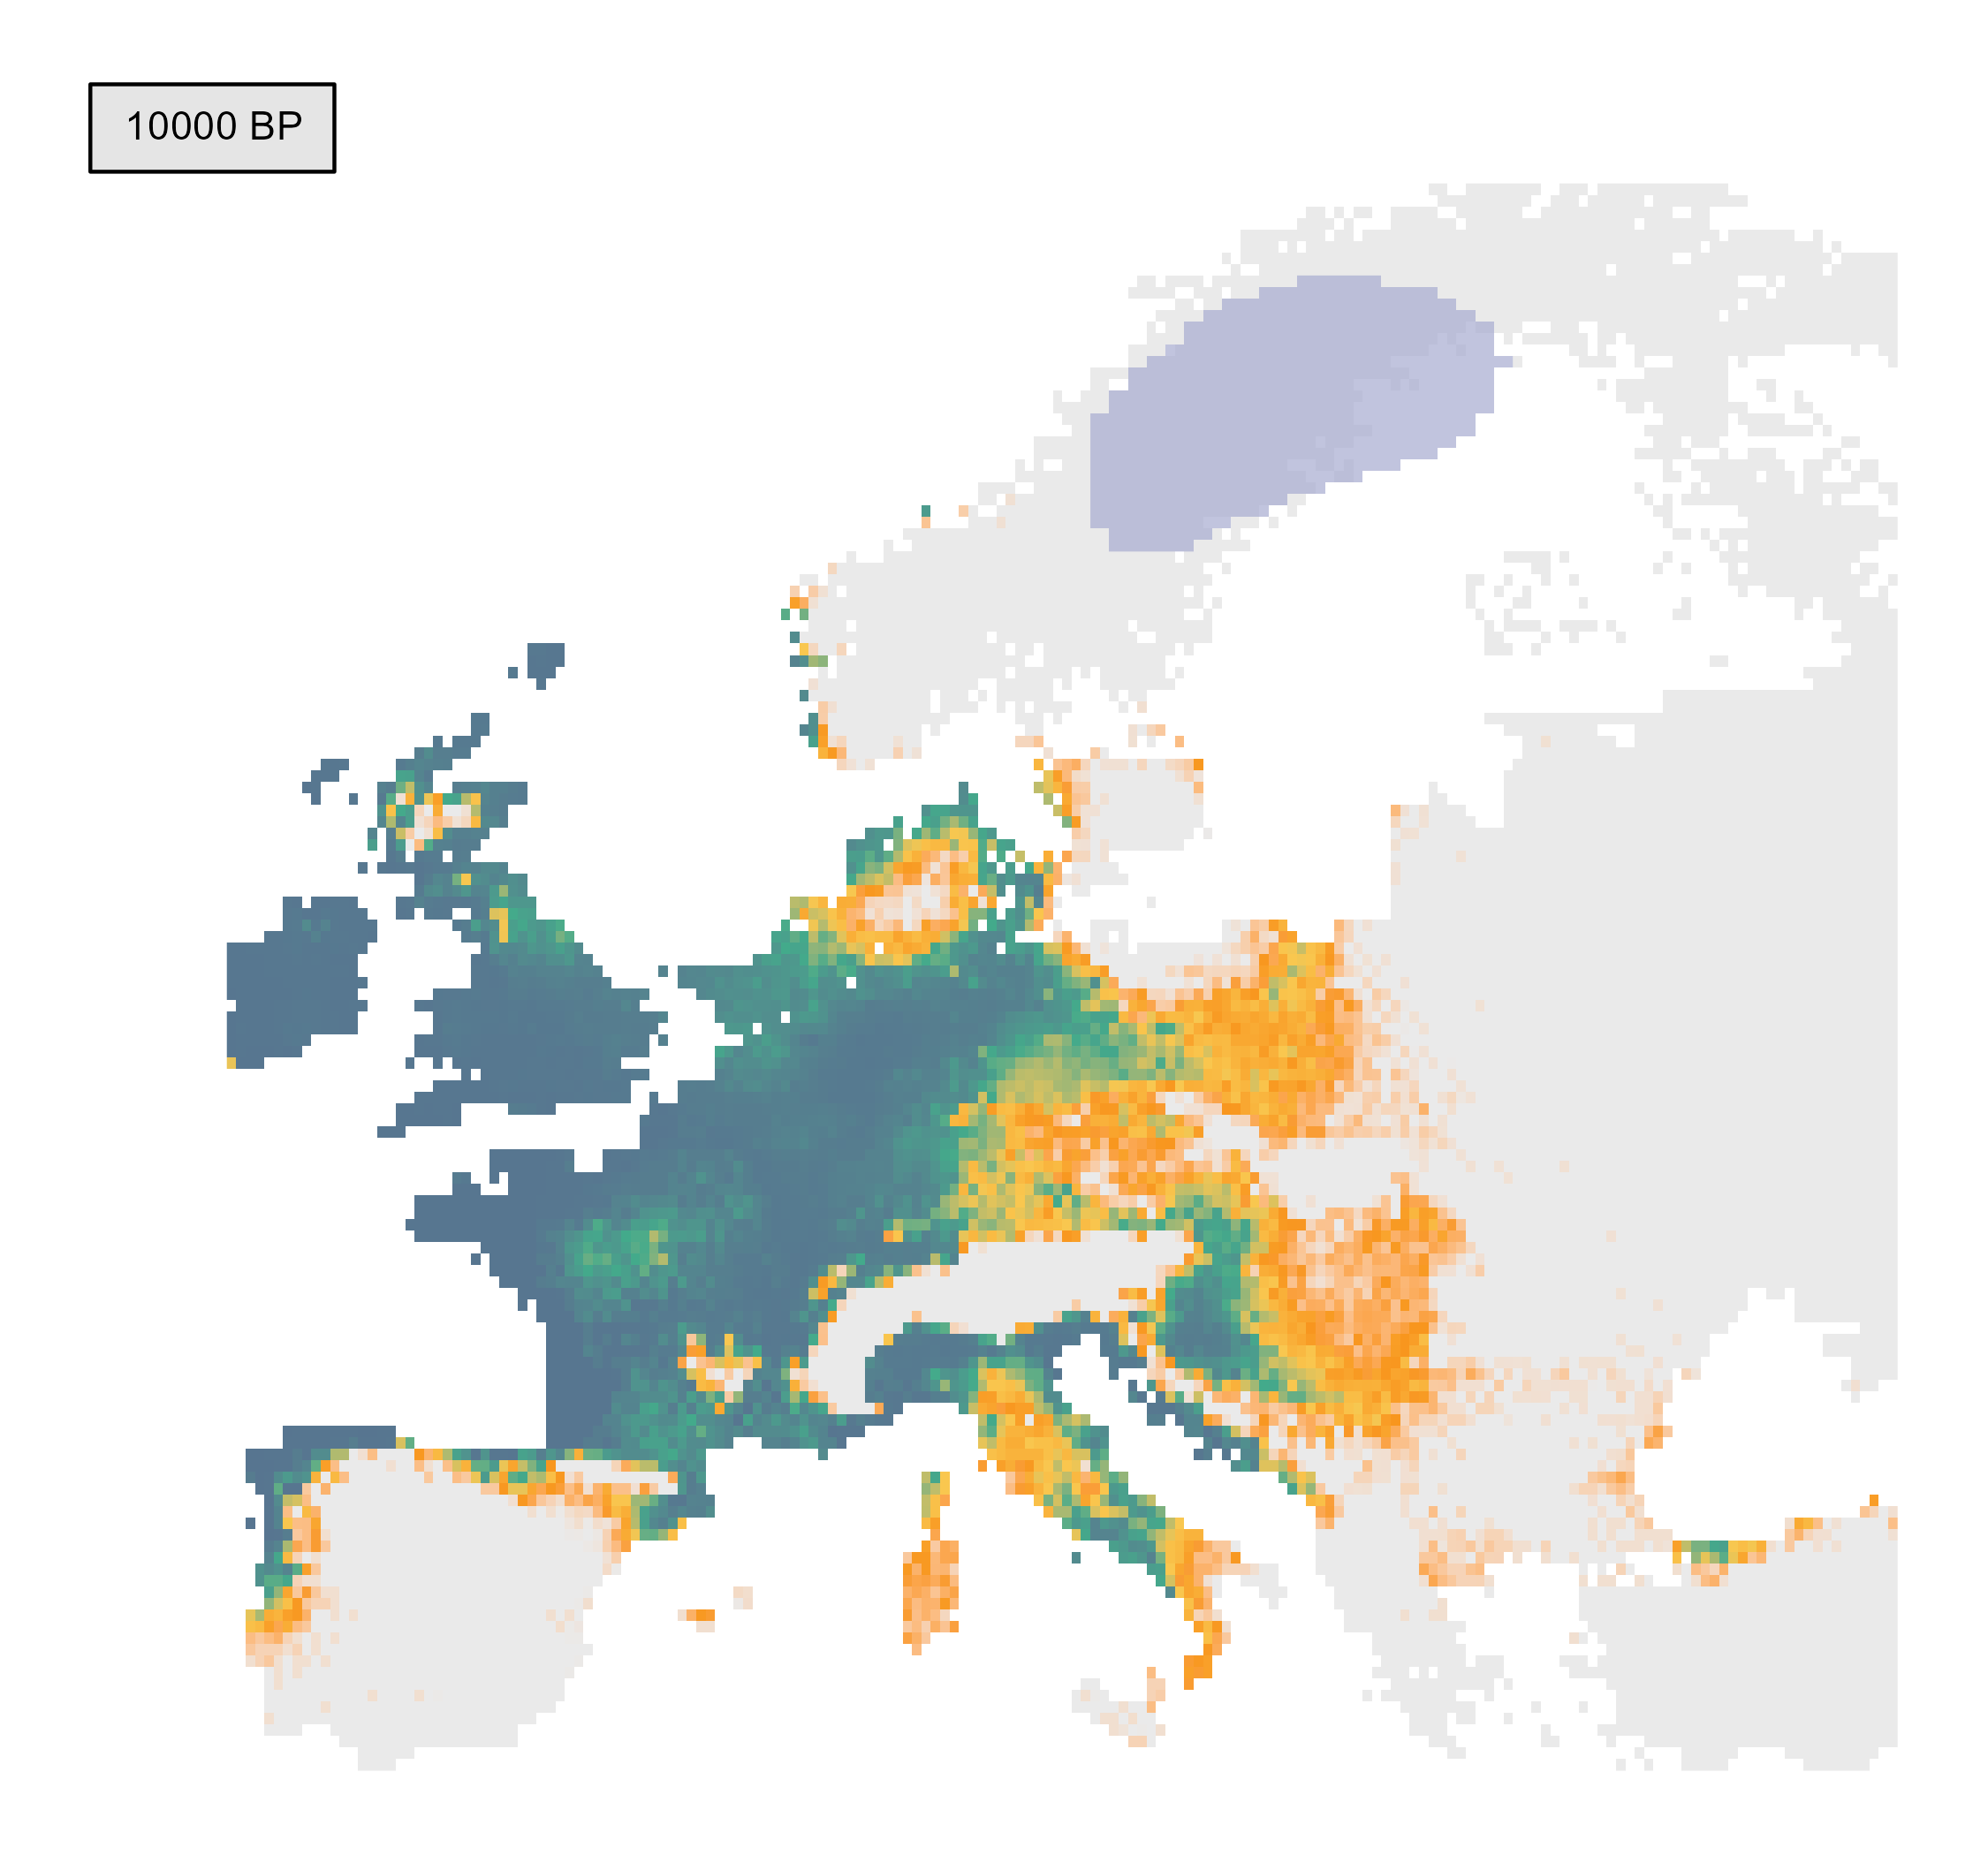
INSIGHTS FROM THE PAST: PHENOFIT PROJECTIONS
Glacial retreat
e.g. Fagus sylvatica

Slide 54
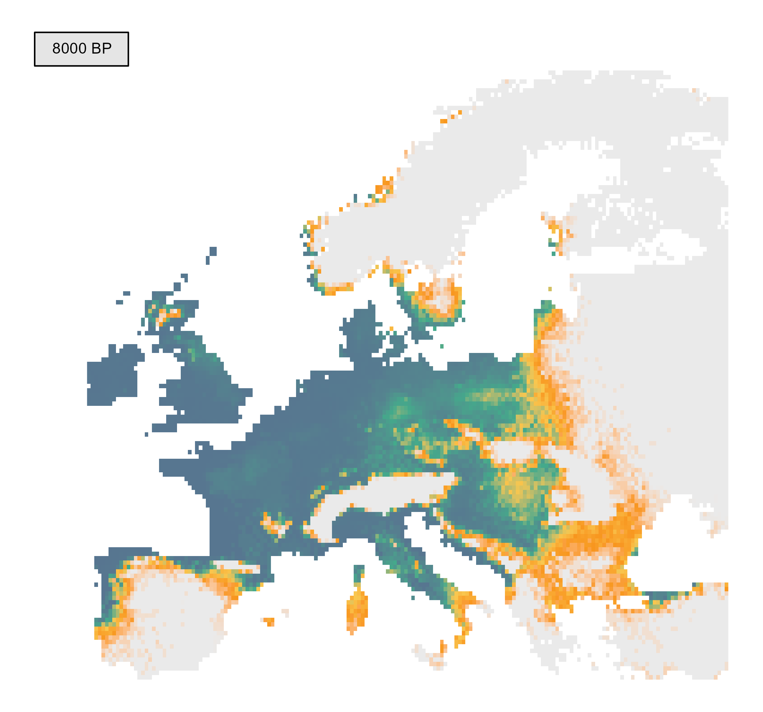
INSIGHTS FROM THE PAST: PHENOFIT PROJECTIONS
Relatively stable climate
e.g. Fagus sylvatica

Slide 55
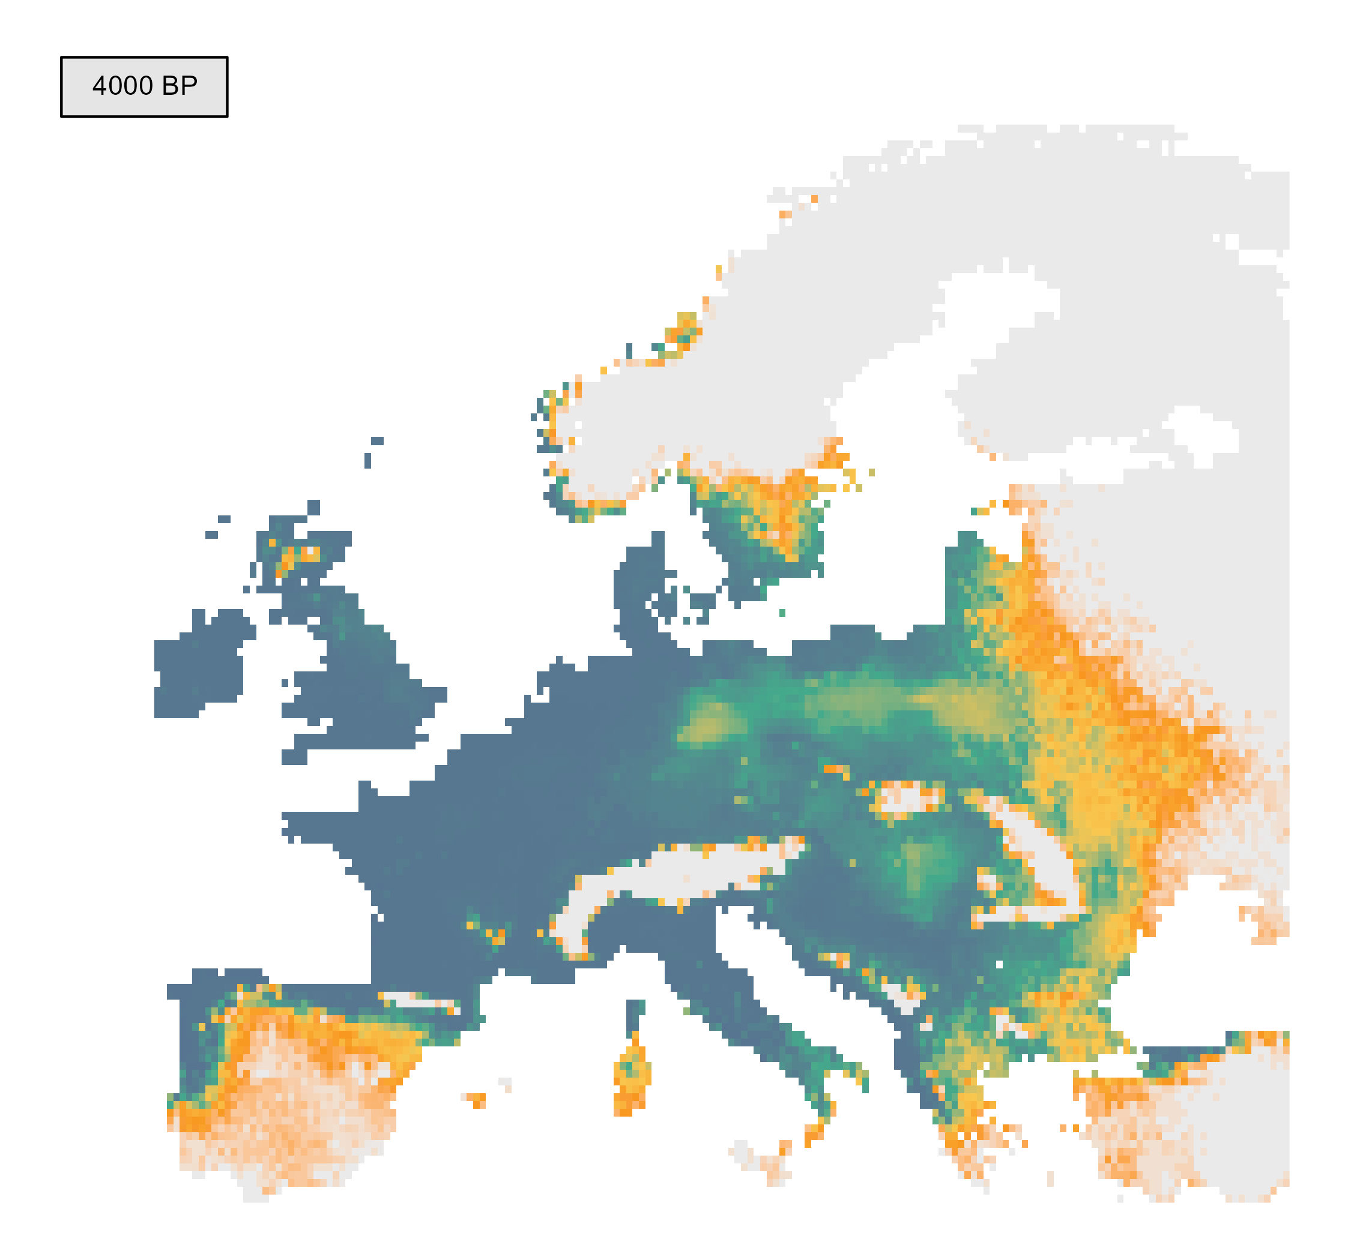
INSIGHTS FROM THE PAST: PHENOFIT PROJECTIONS
Relatively stable climate
e.g. Fagus sylvatica

Slide 56
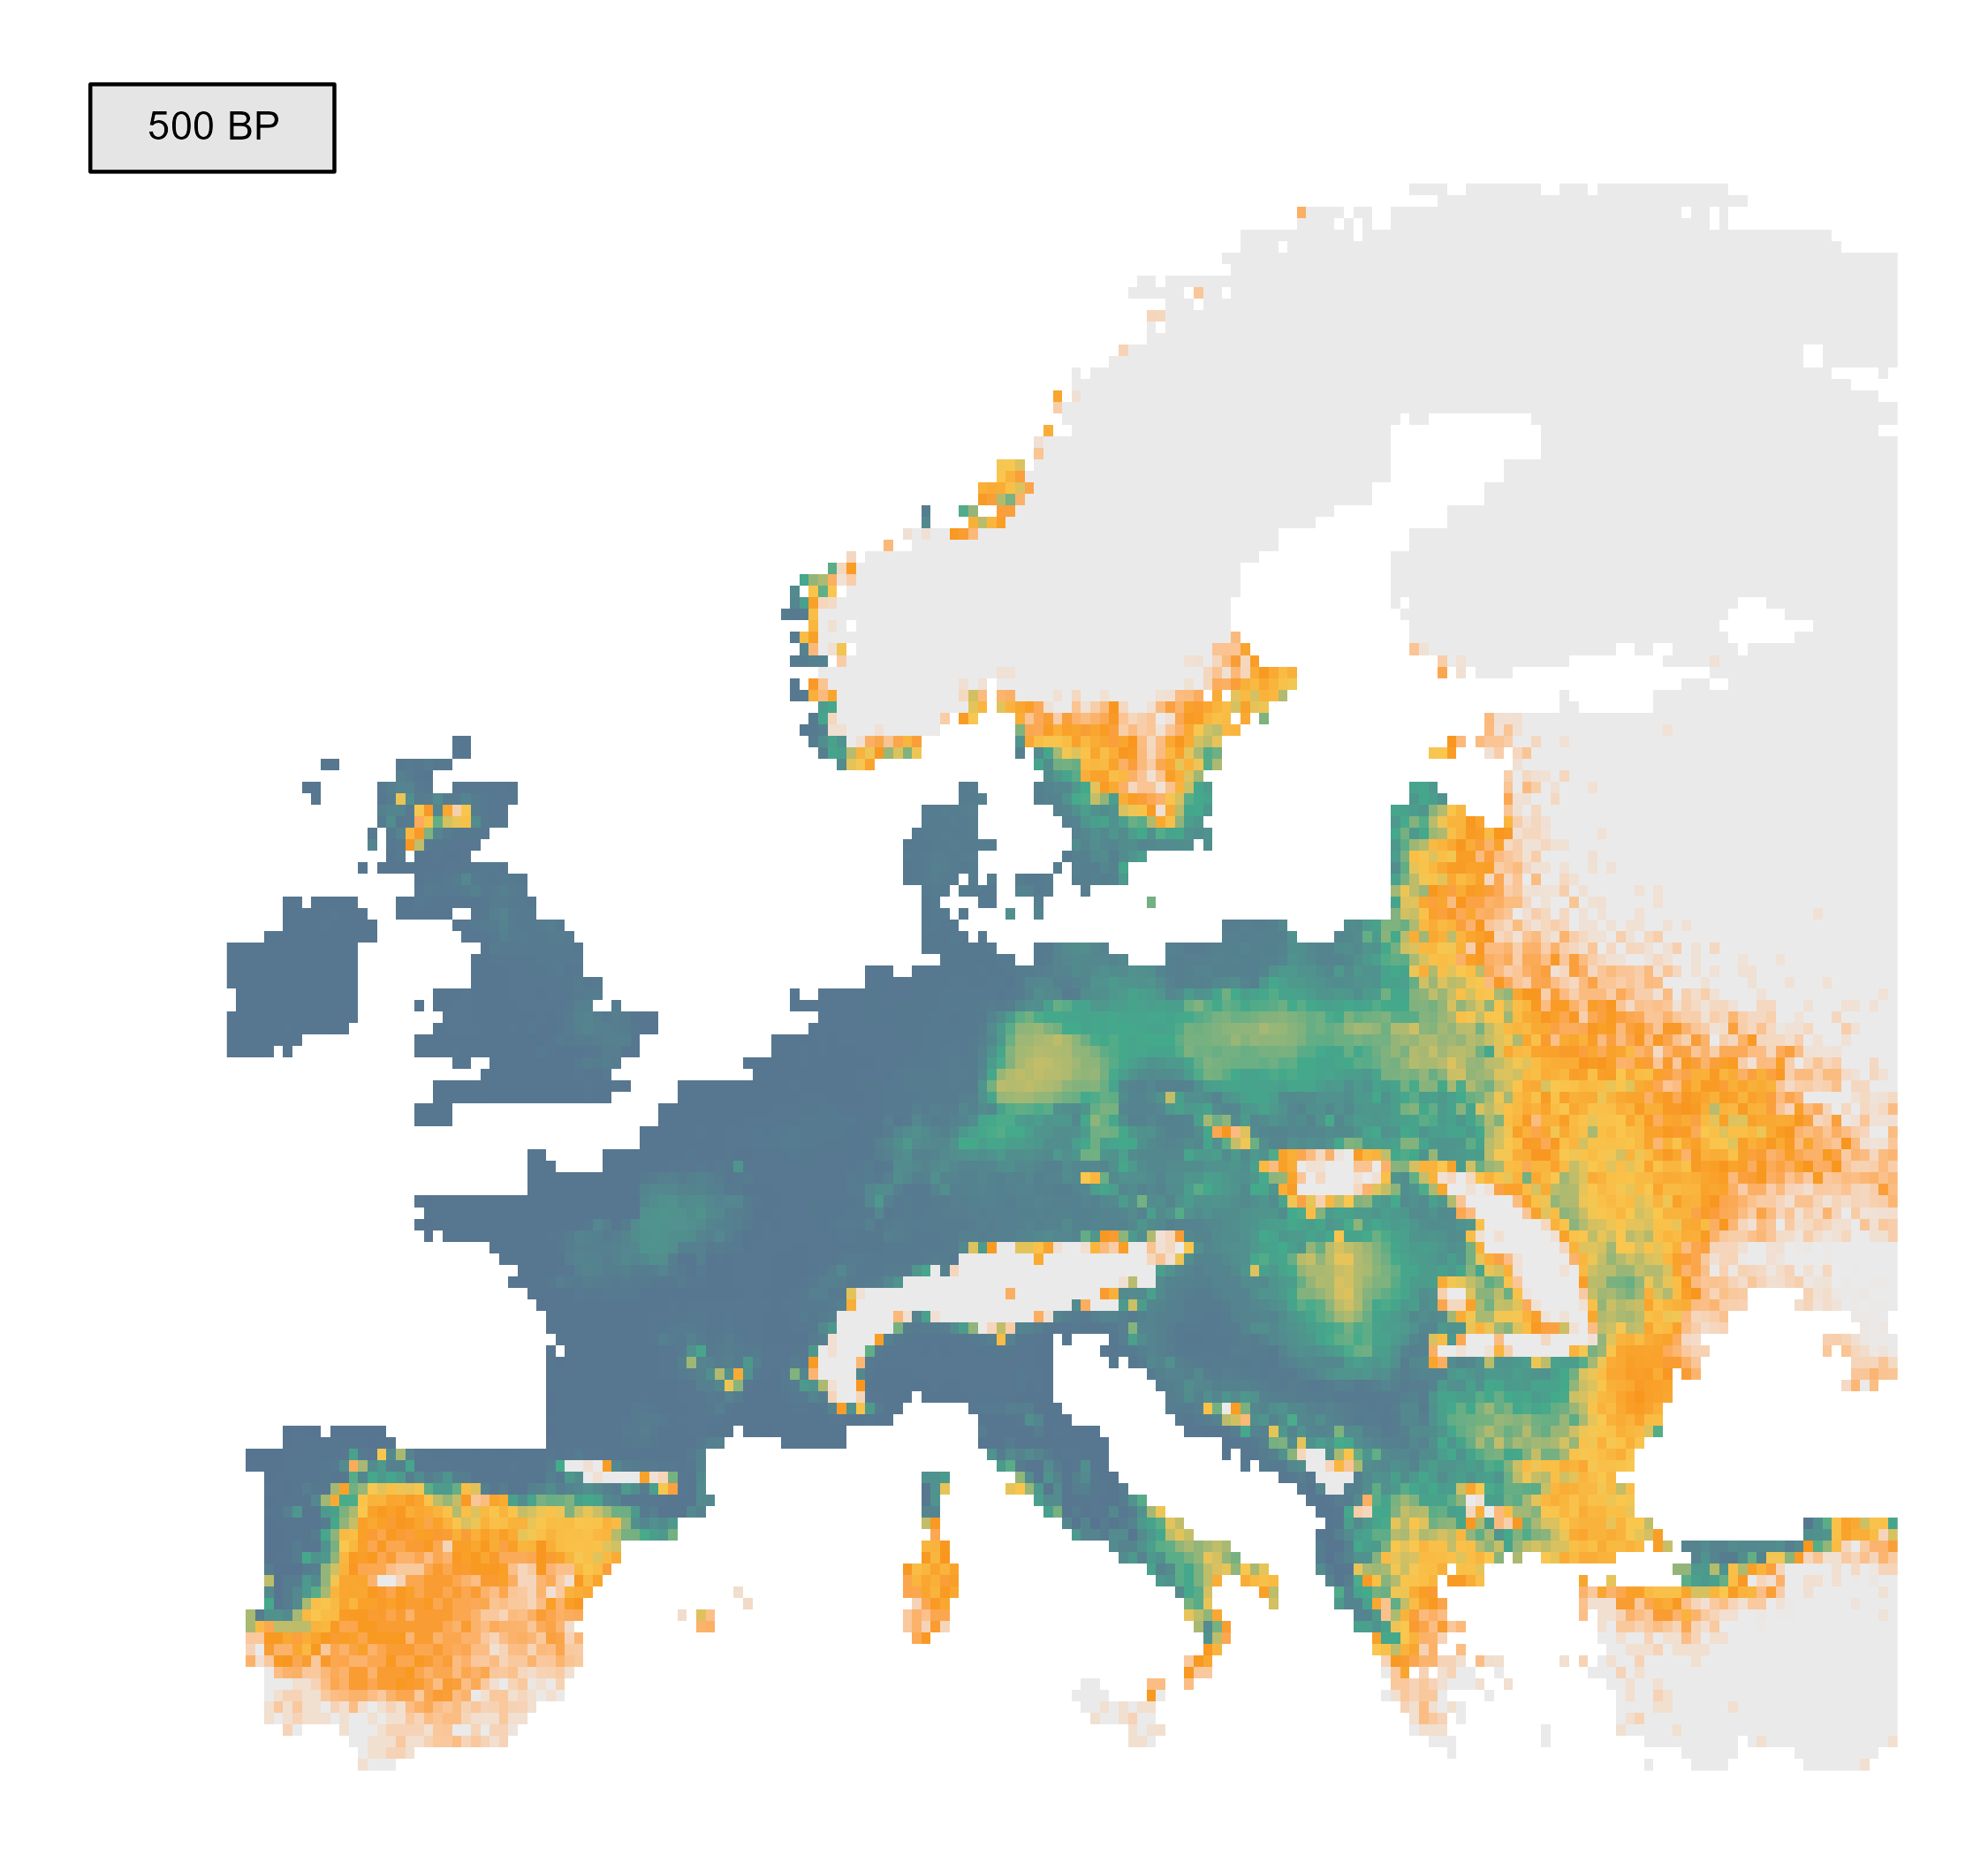
INSIGHTS FROM THE PAST: PHENOFIT PROJECTIONS
Relatively stable climate
e.g. Fagus sylvatica

Slide 57
INSIGHTS FROM THE PAST: COMPARE MODEL PROJECTIONS
Predicted niche model A
Predicted niche model B
N-dimensional hypervolume
N-dimensional hypervolume

Slide 58
INSIGHTS FROM THE PAST: COMPARE MODEL PROJECTIONS

Slide 59
INSIGHTS FROM THE PAST: COMPARE MODEL PROJECTIONS
Hypervolume overlap
2 |A ∩ B |
Sørensen similarity =
|A | + | B |

Slide 60
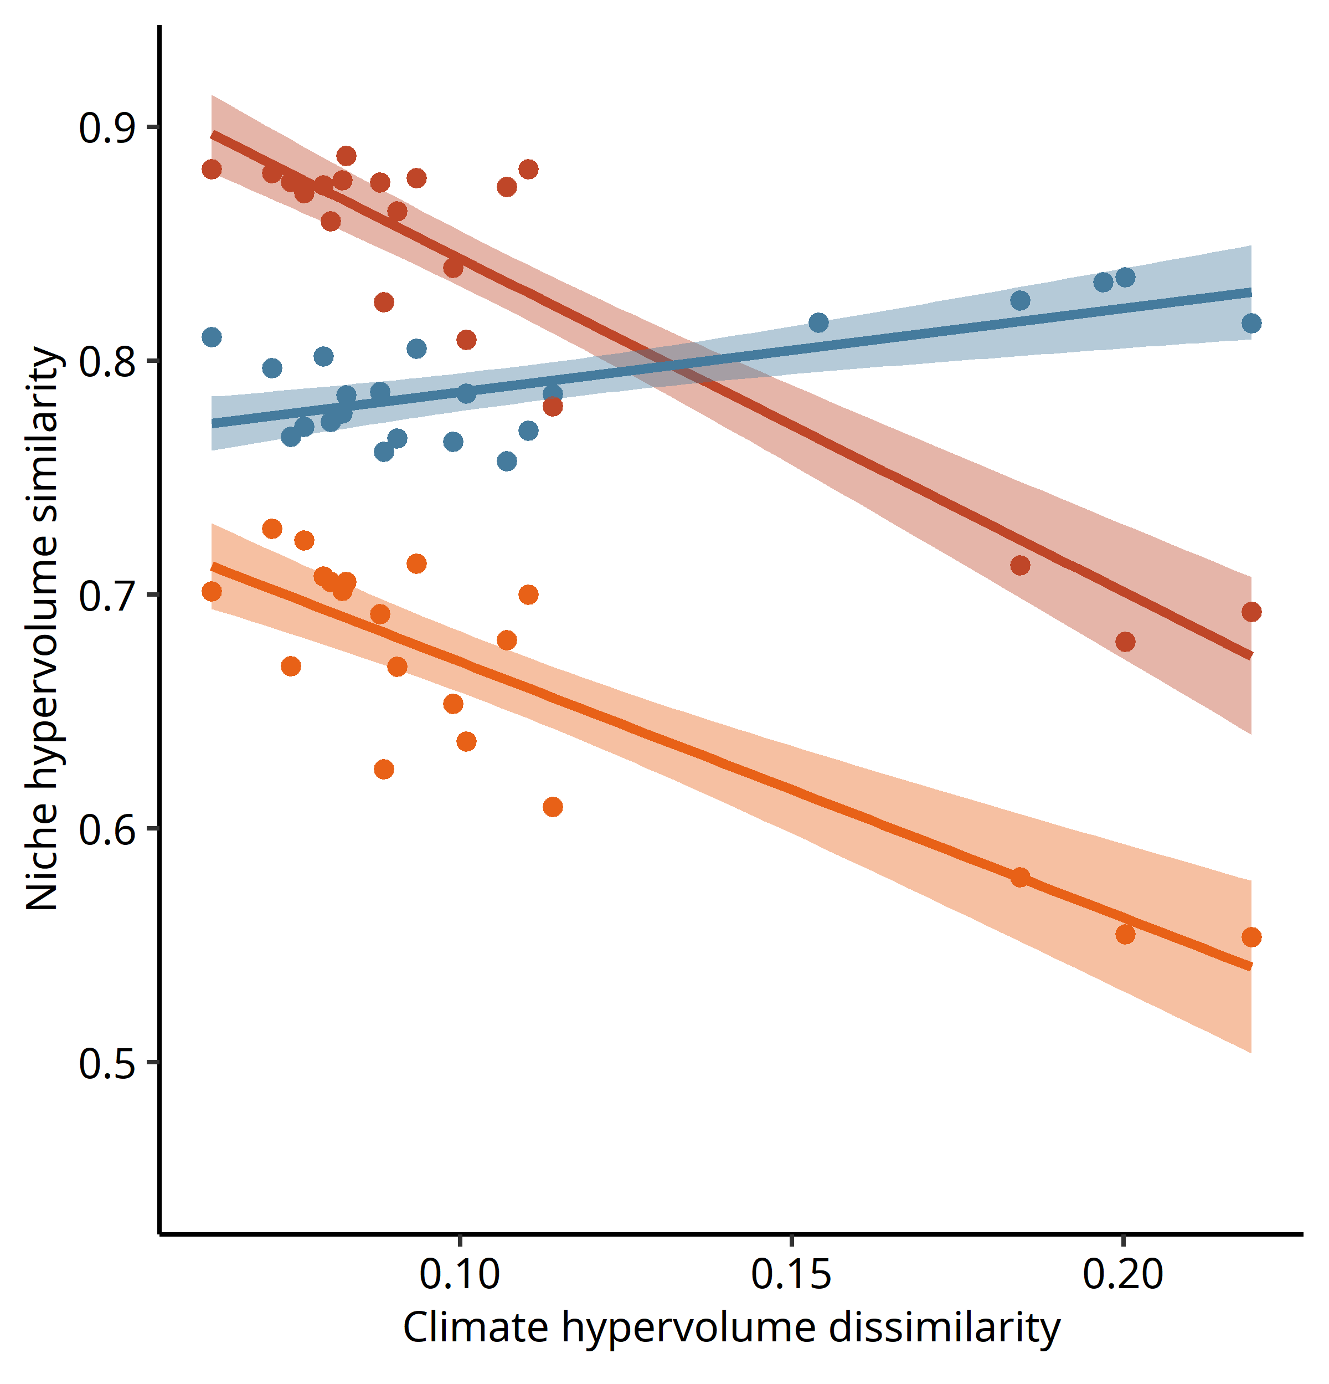
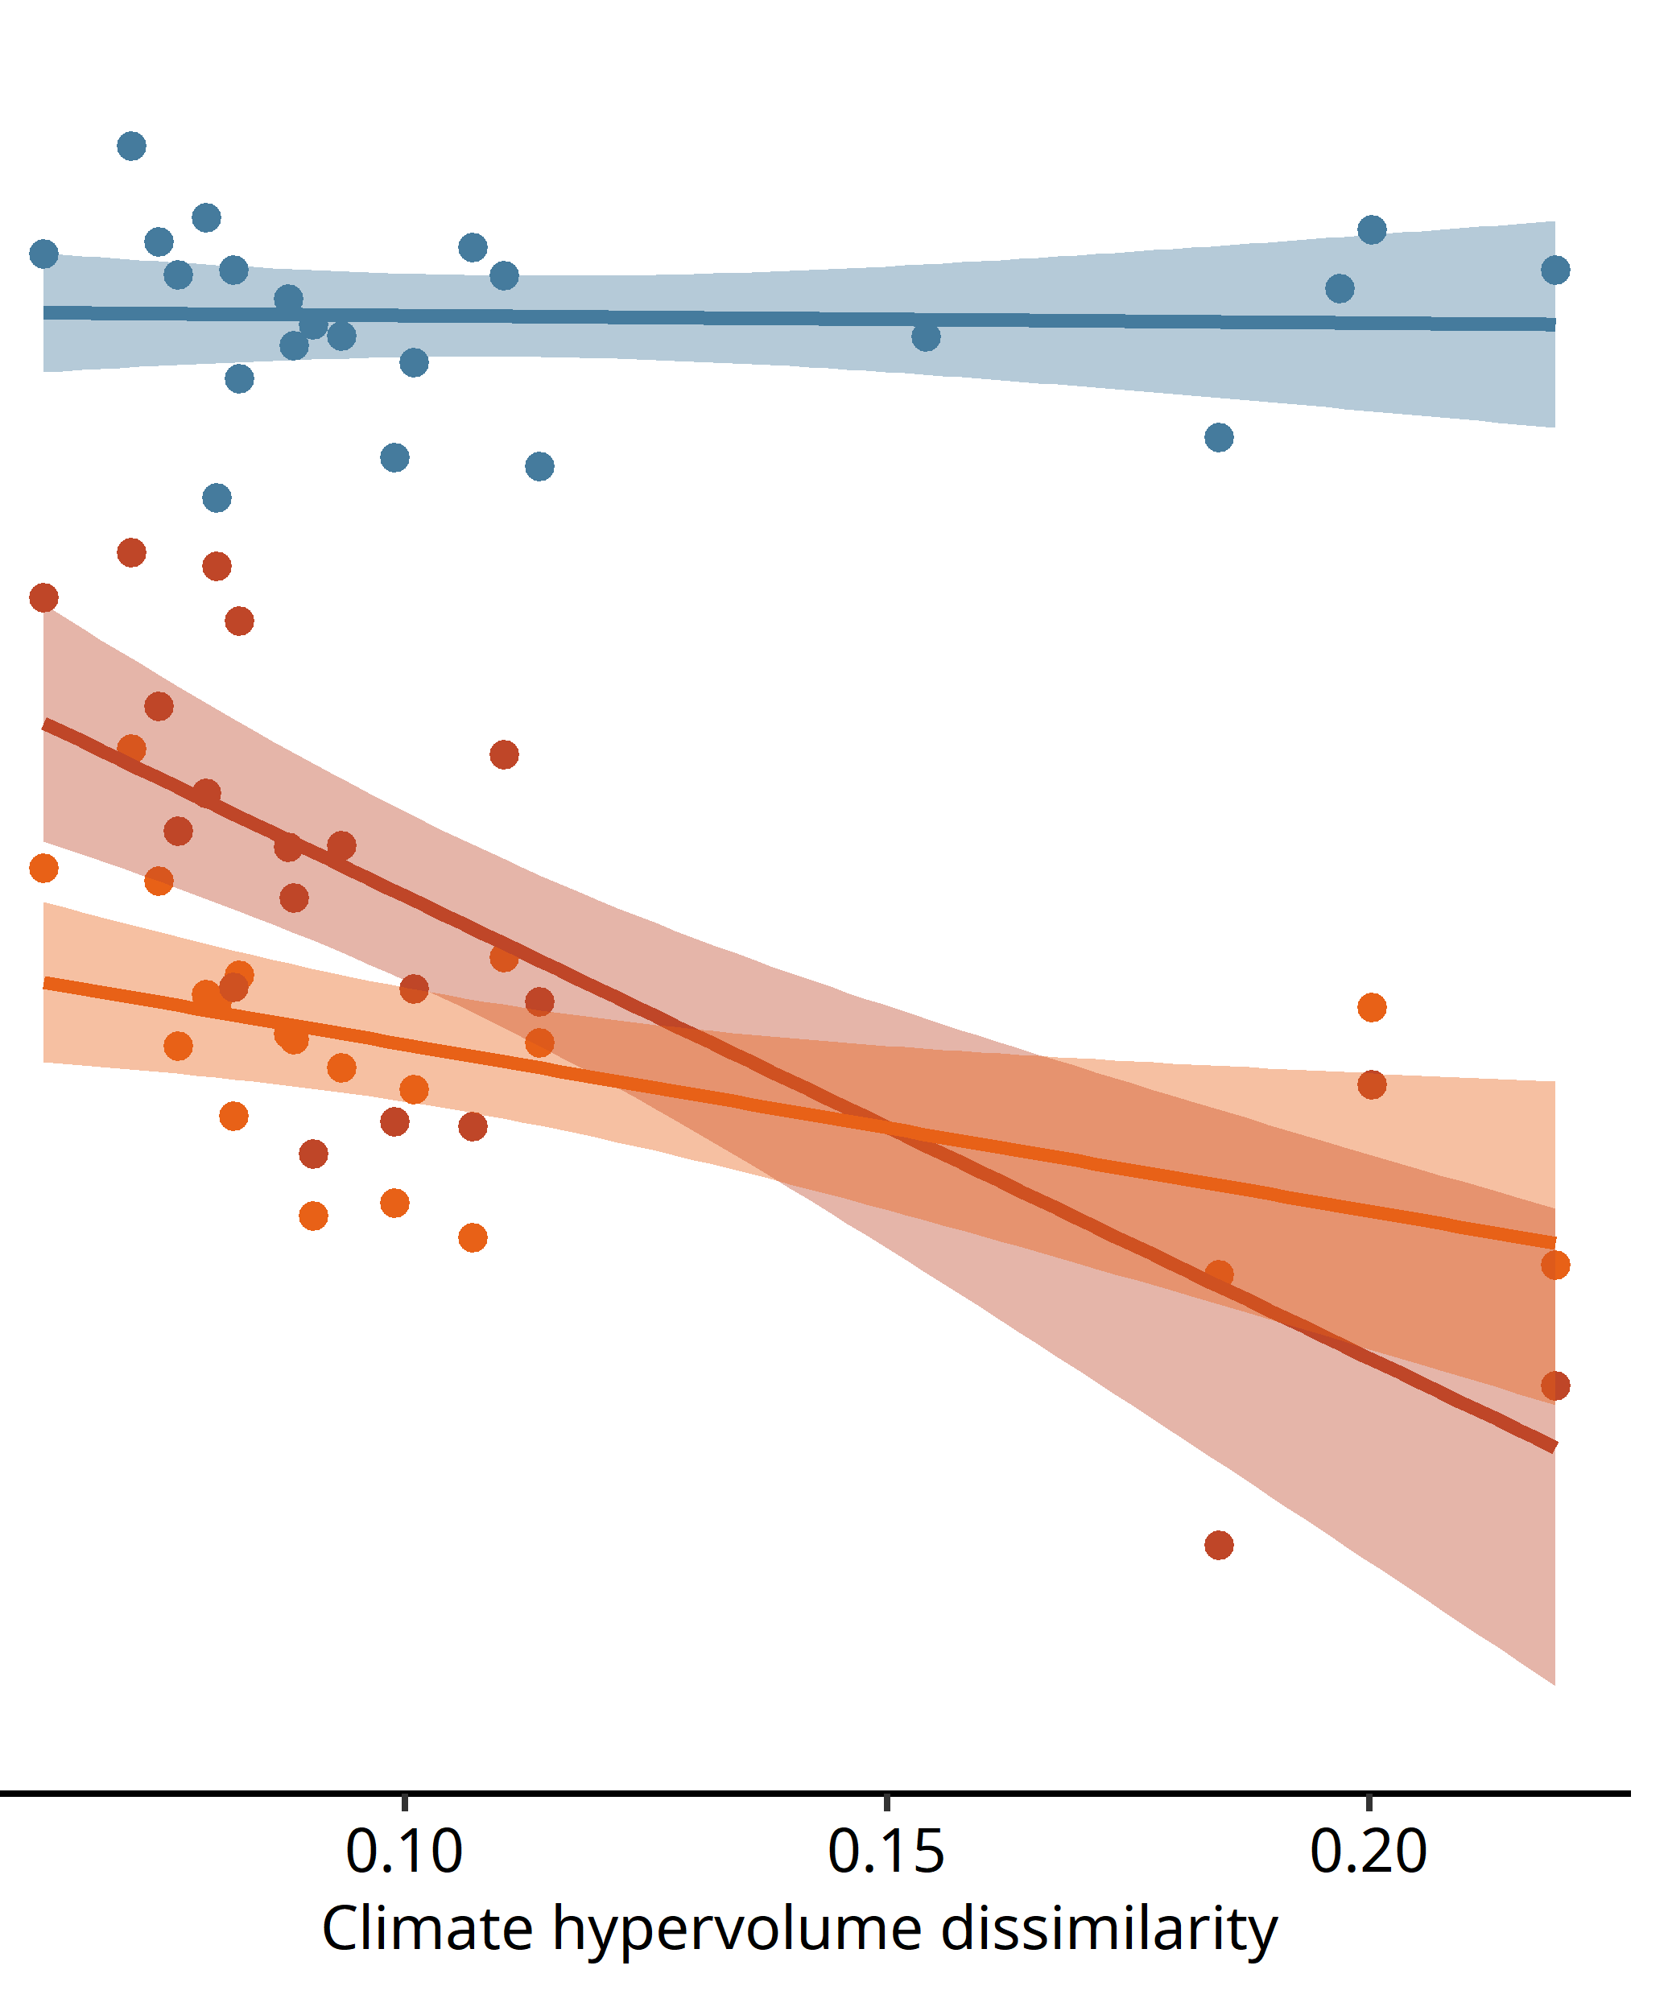
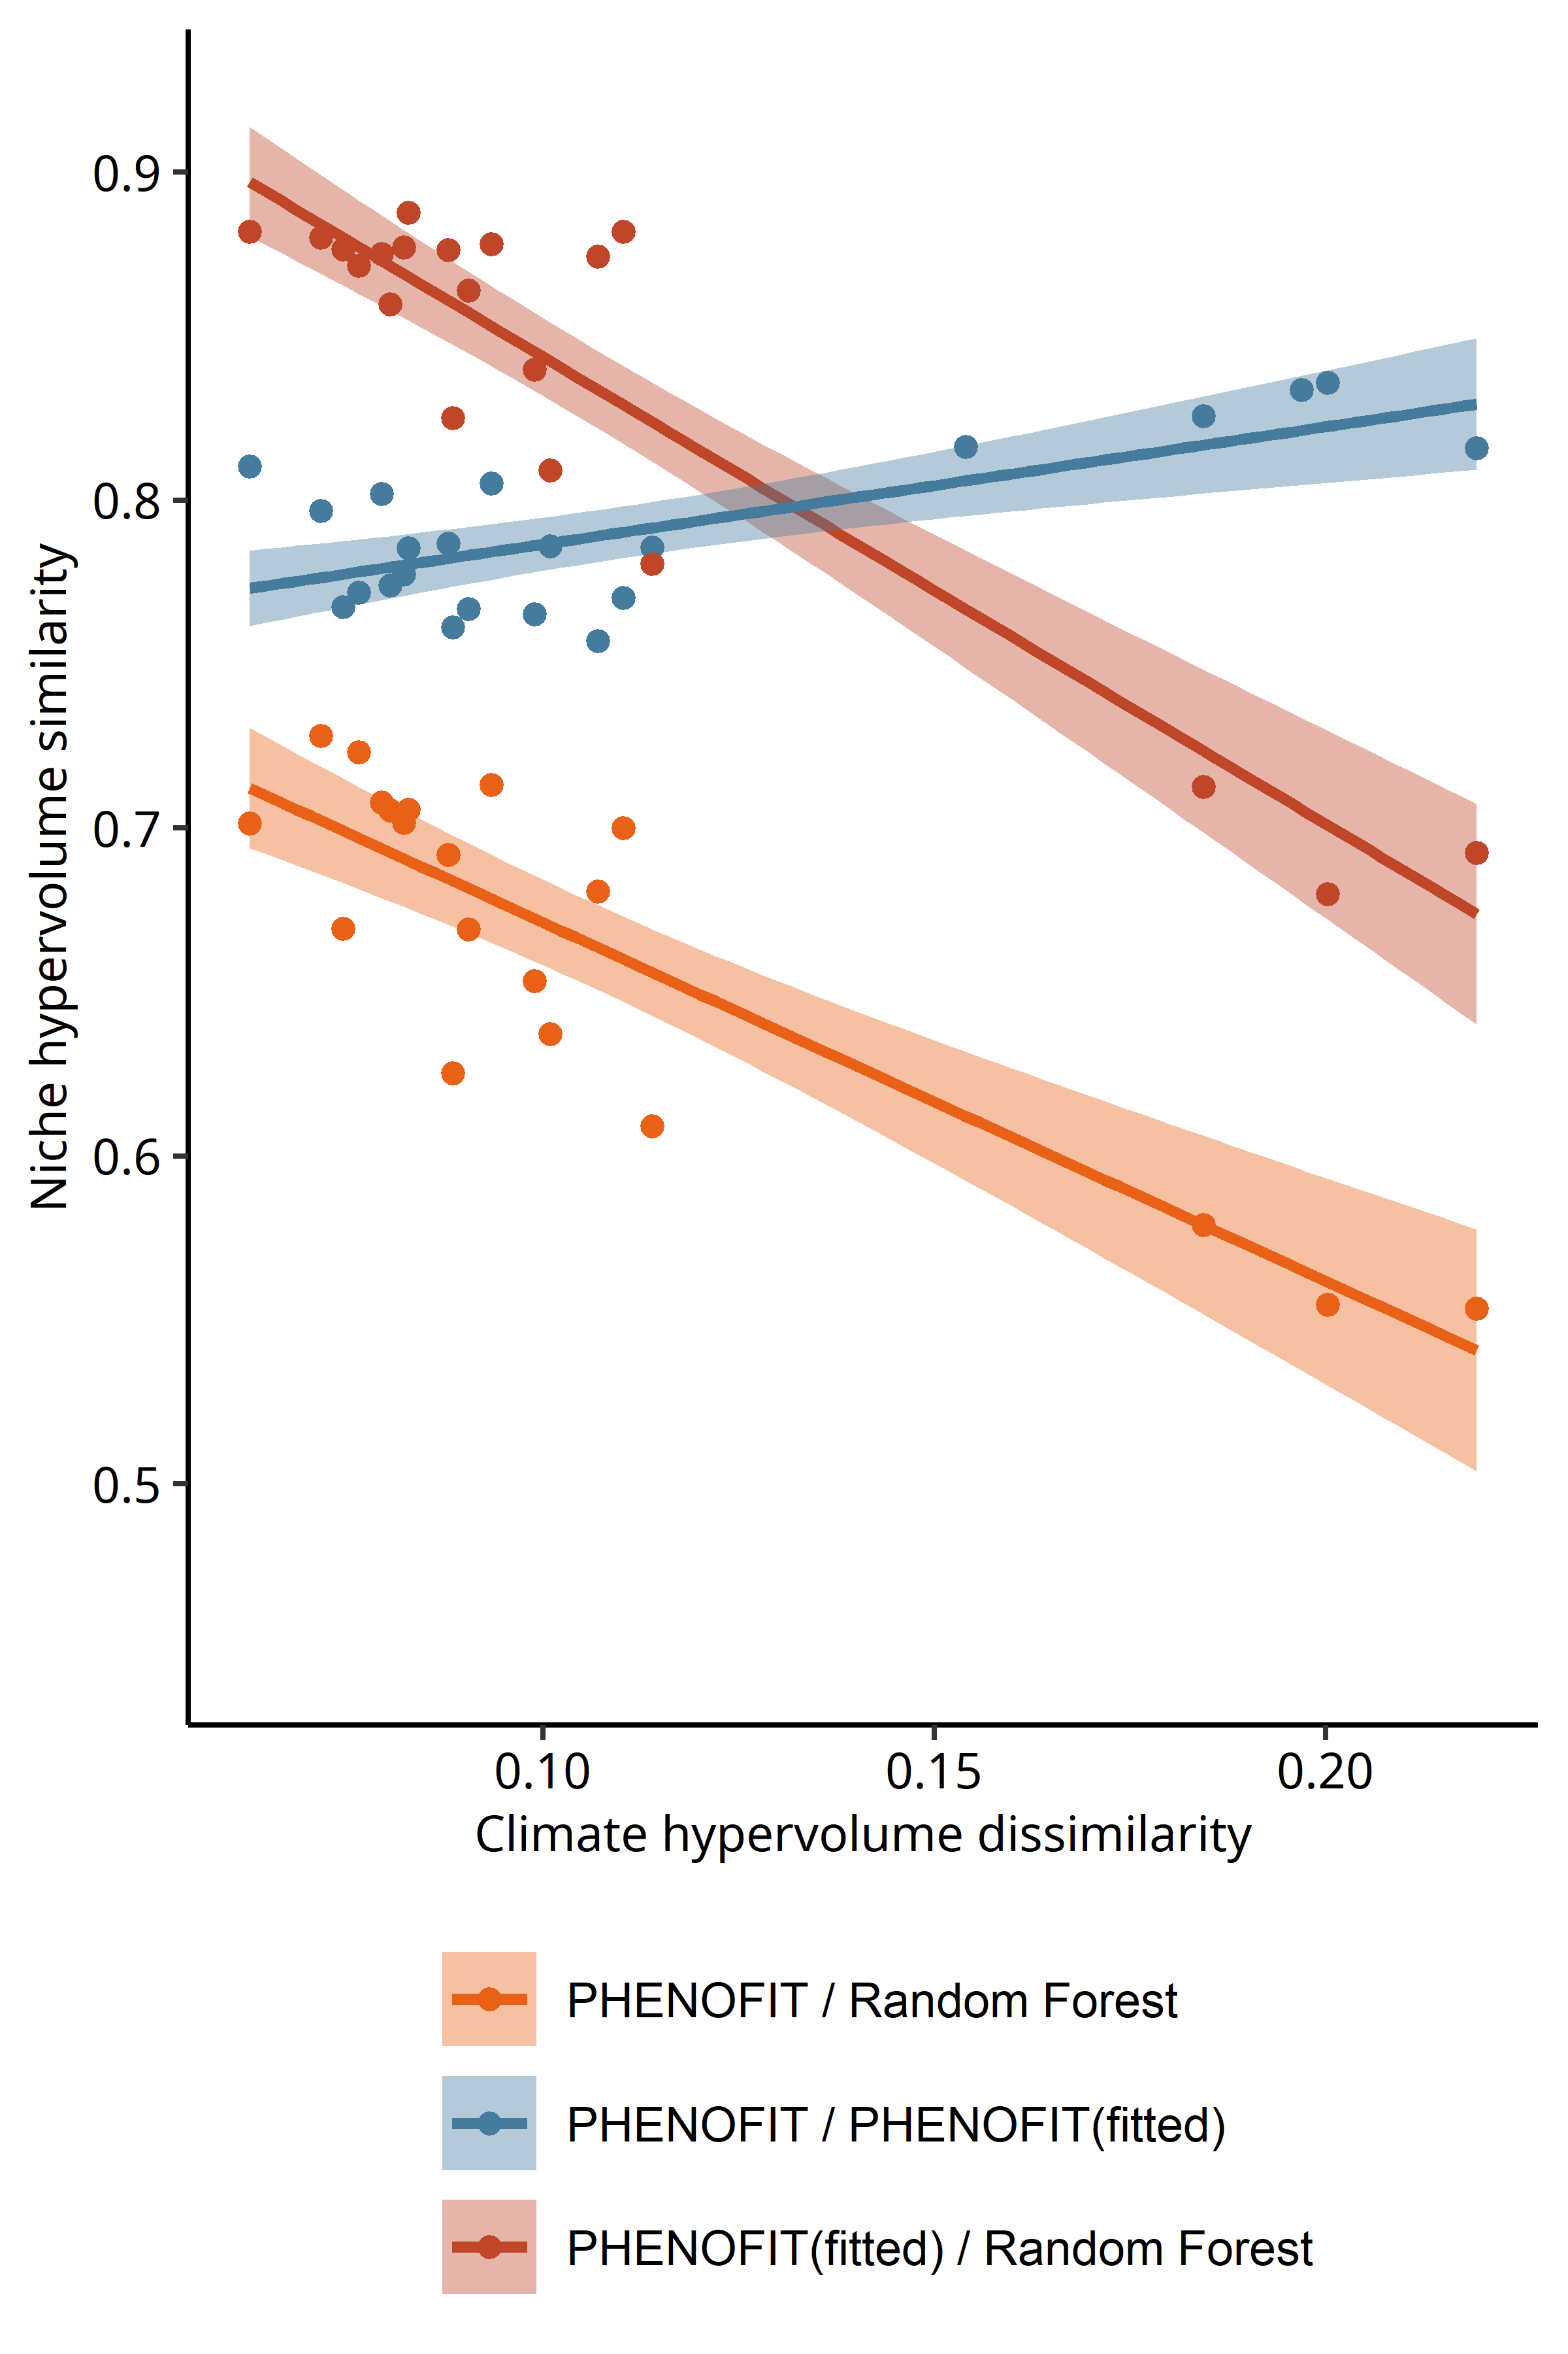
INSIGHTS FROM THE PAST: COMPARE MODEL PROJECTIONS
Fagus sylvatica
Abies alba

Slide 61
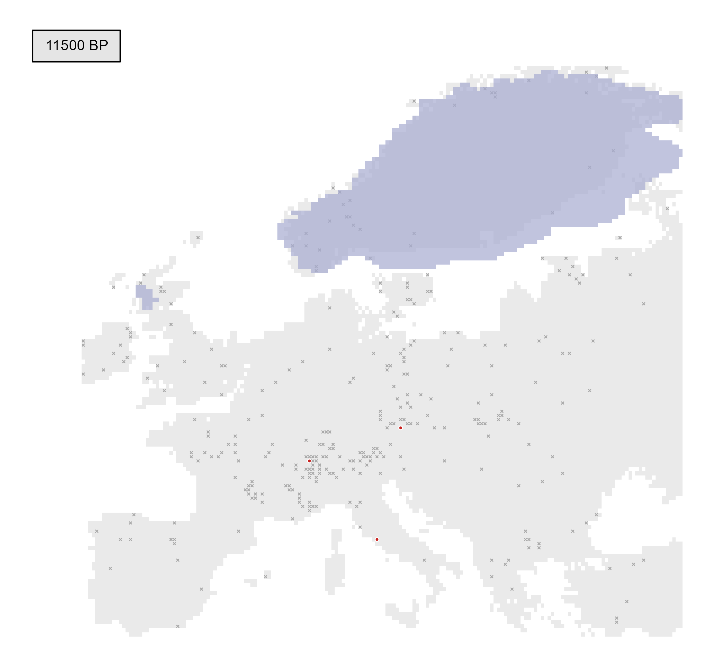
INSIGHTS FROM THE PAST: POLLEN RECORDS
Present
Absent
e.g. Fagus pollen records

Slide 62
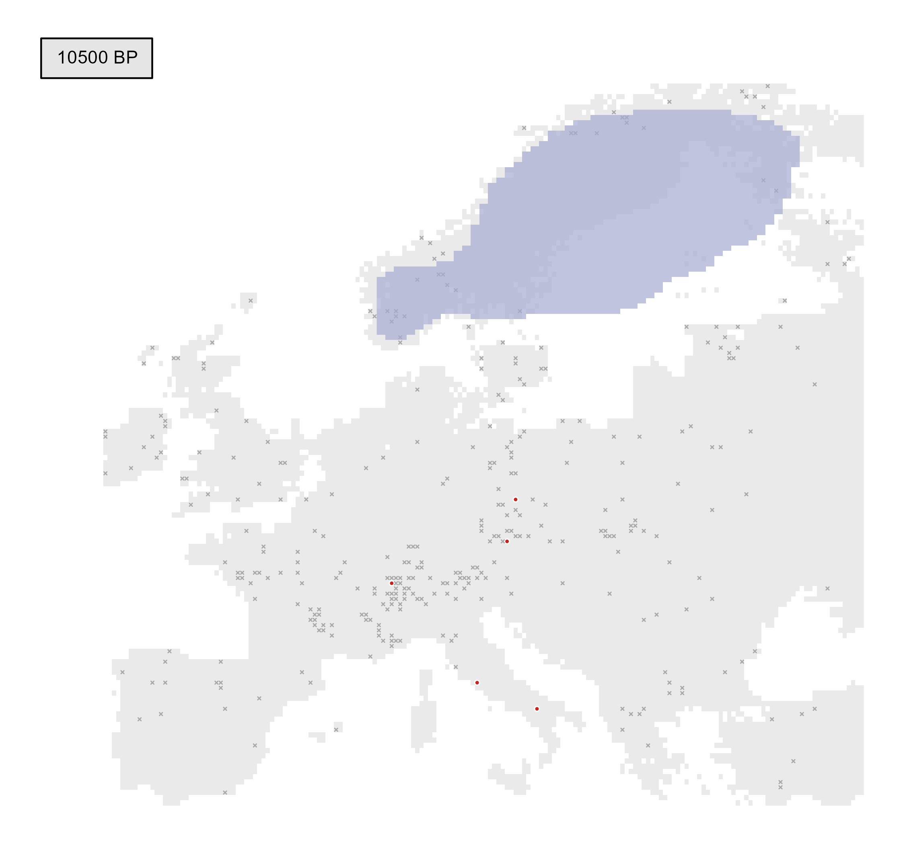
INSIGHTS FROM THE PAST: POLLEN RECORDS
Present
Absent
e.g. Fagus pollen records

Slide 63
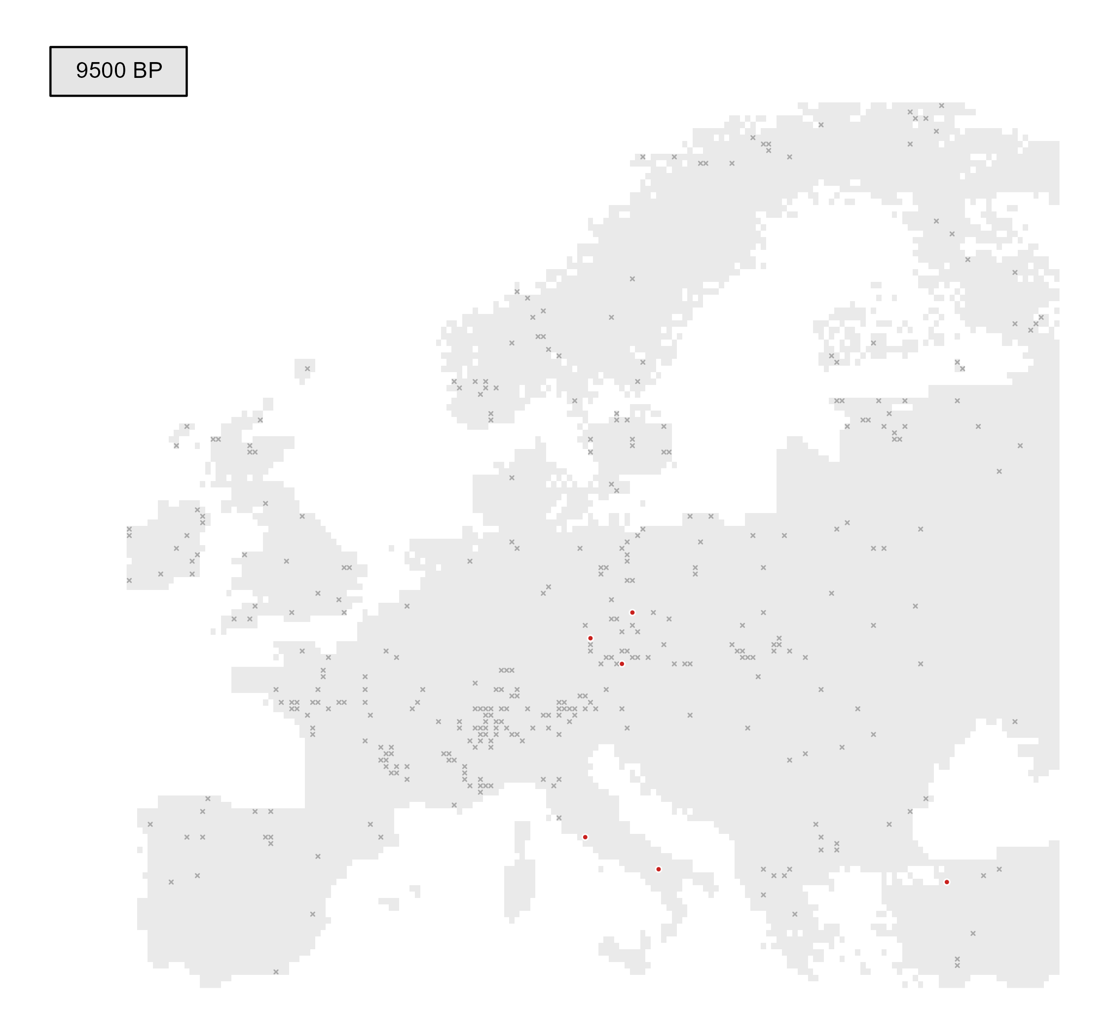
INSIGHTS FROM THE PAST: POLLEN RECORDS
Present
Absent
e.g. Fagus pollen records

Slide 64
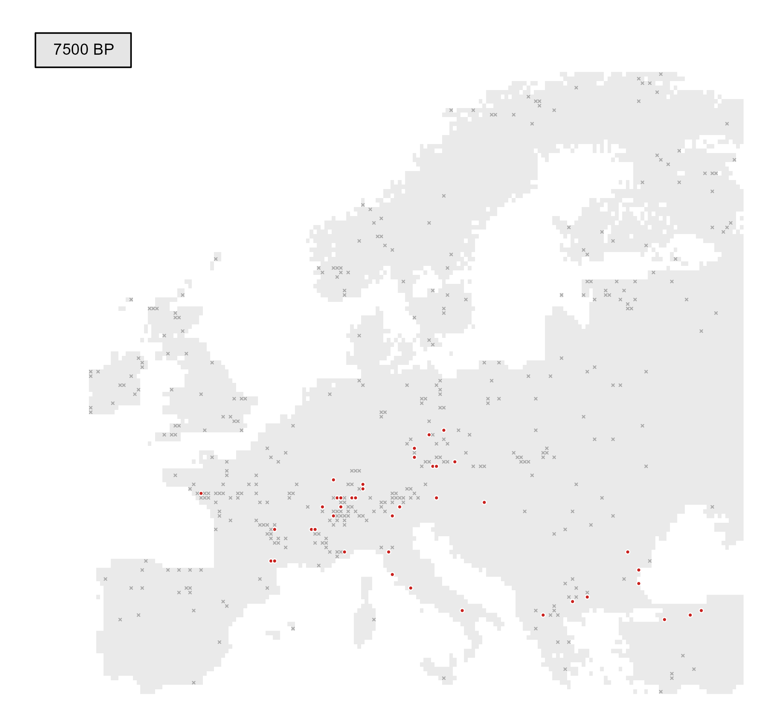
INSIGHTS FROM THE PAST: POLLEN RECORDS
Present
Absent
e.g. Fagus pollen records

Slide 65
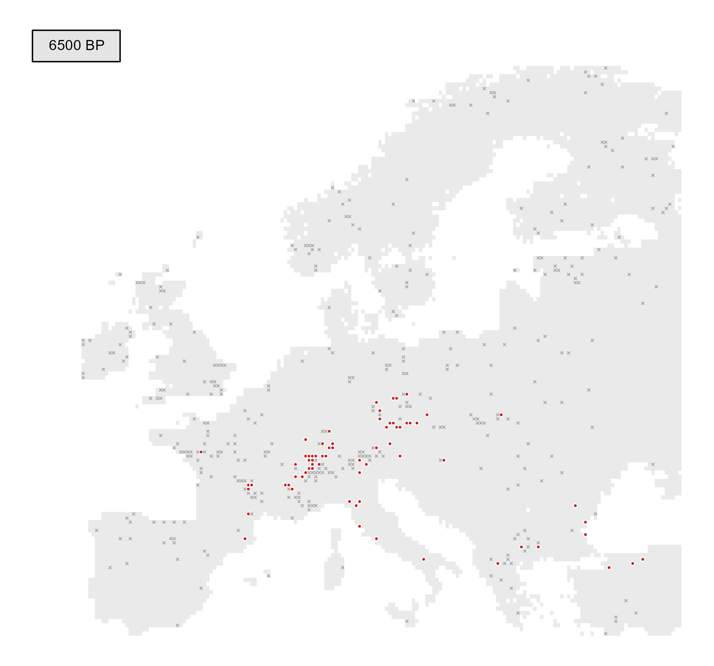
INSIGHTS FROM THE PAST: POLLEN RECORDS
Present
Absent
e.g. Fagus pollen records

Slide 66
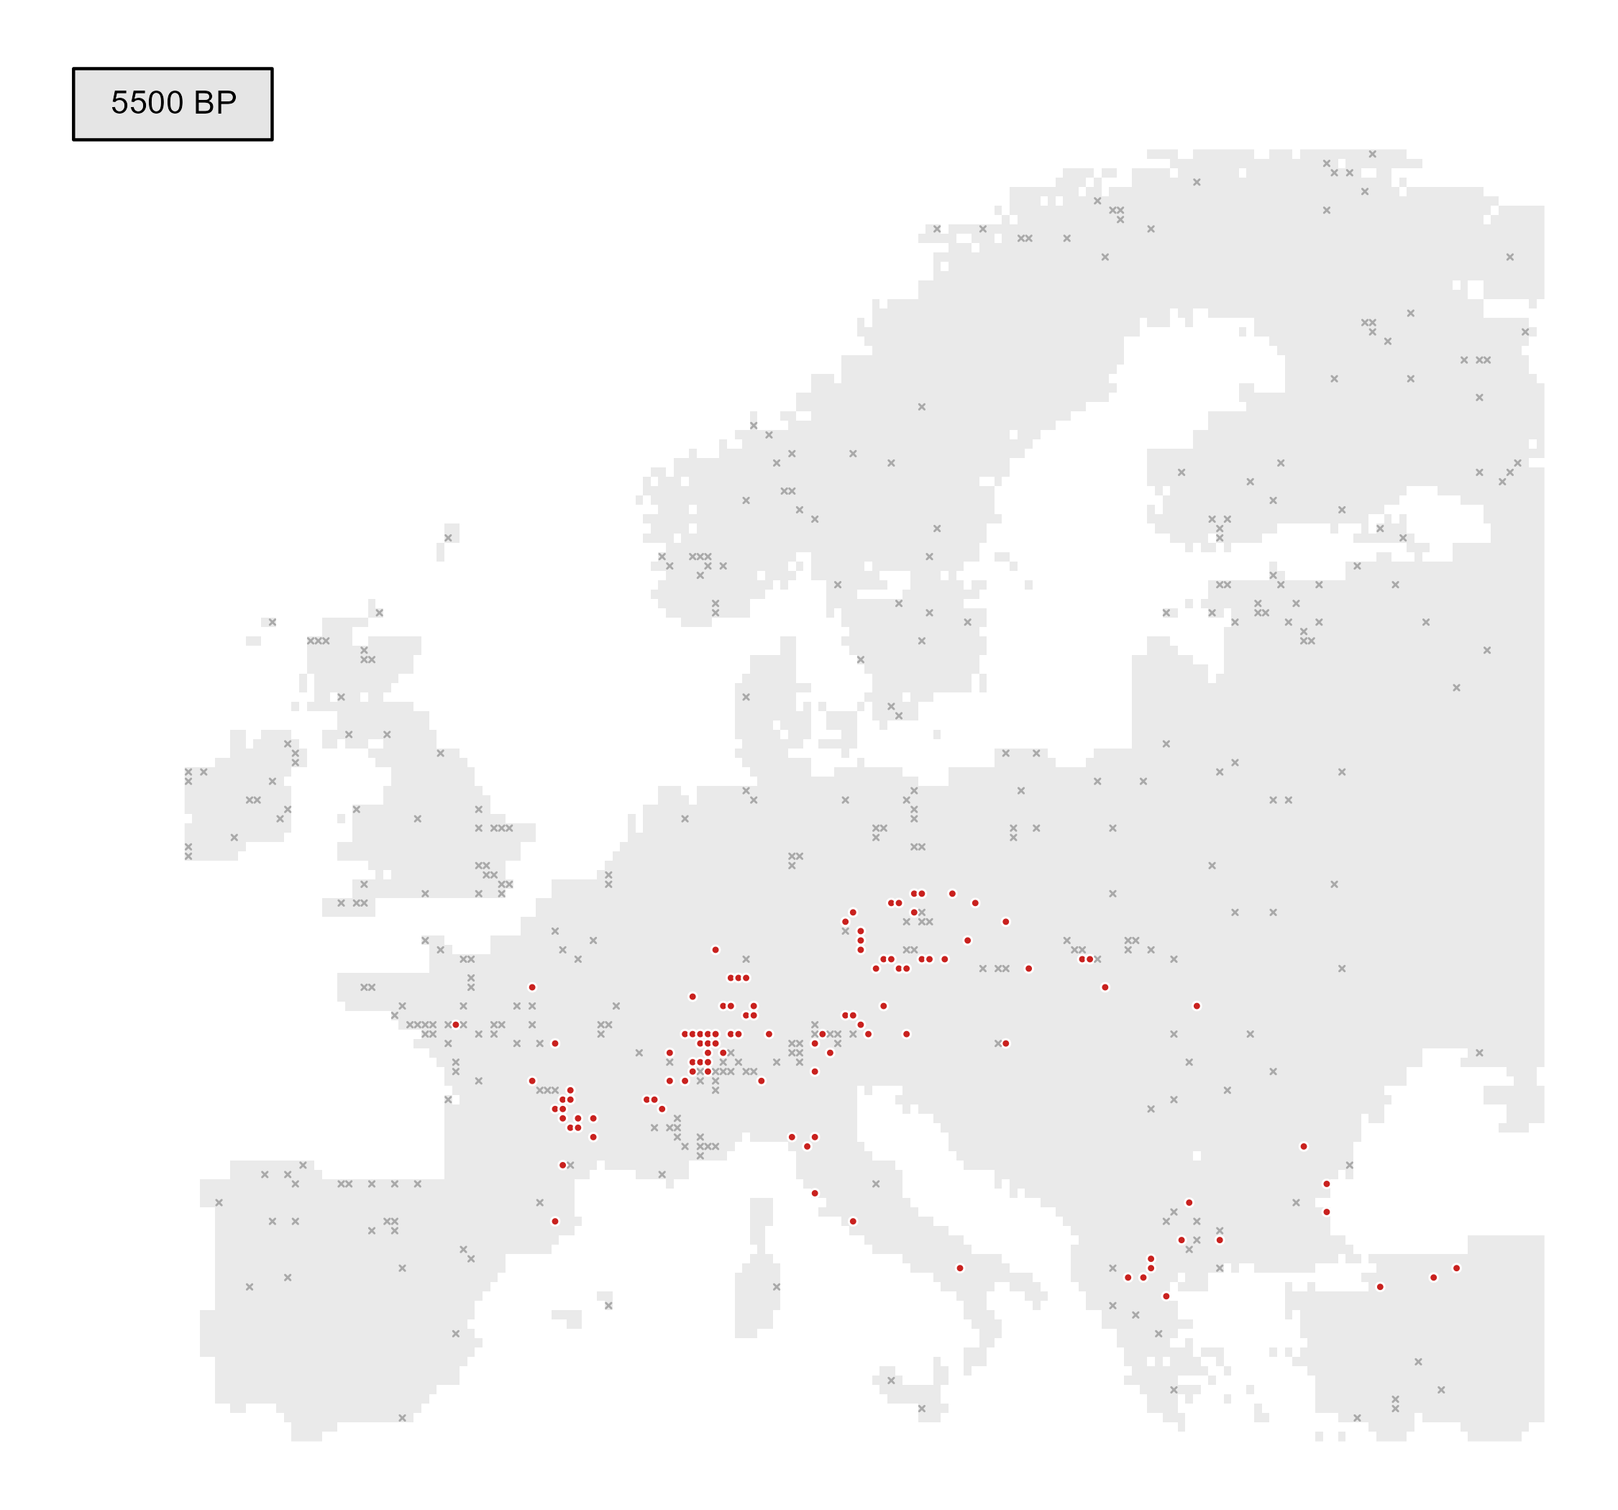
INSIGHTS FROM THE PAST: POLLEN RECORDS
Present
Absent
e.g. Fagus pollen records

Slide 67
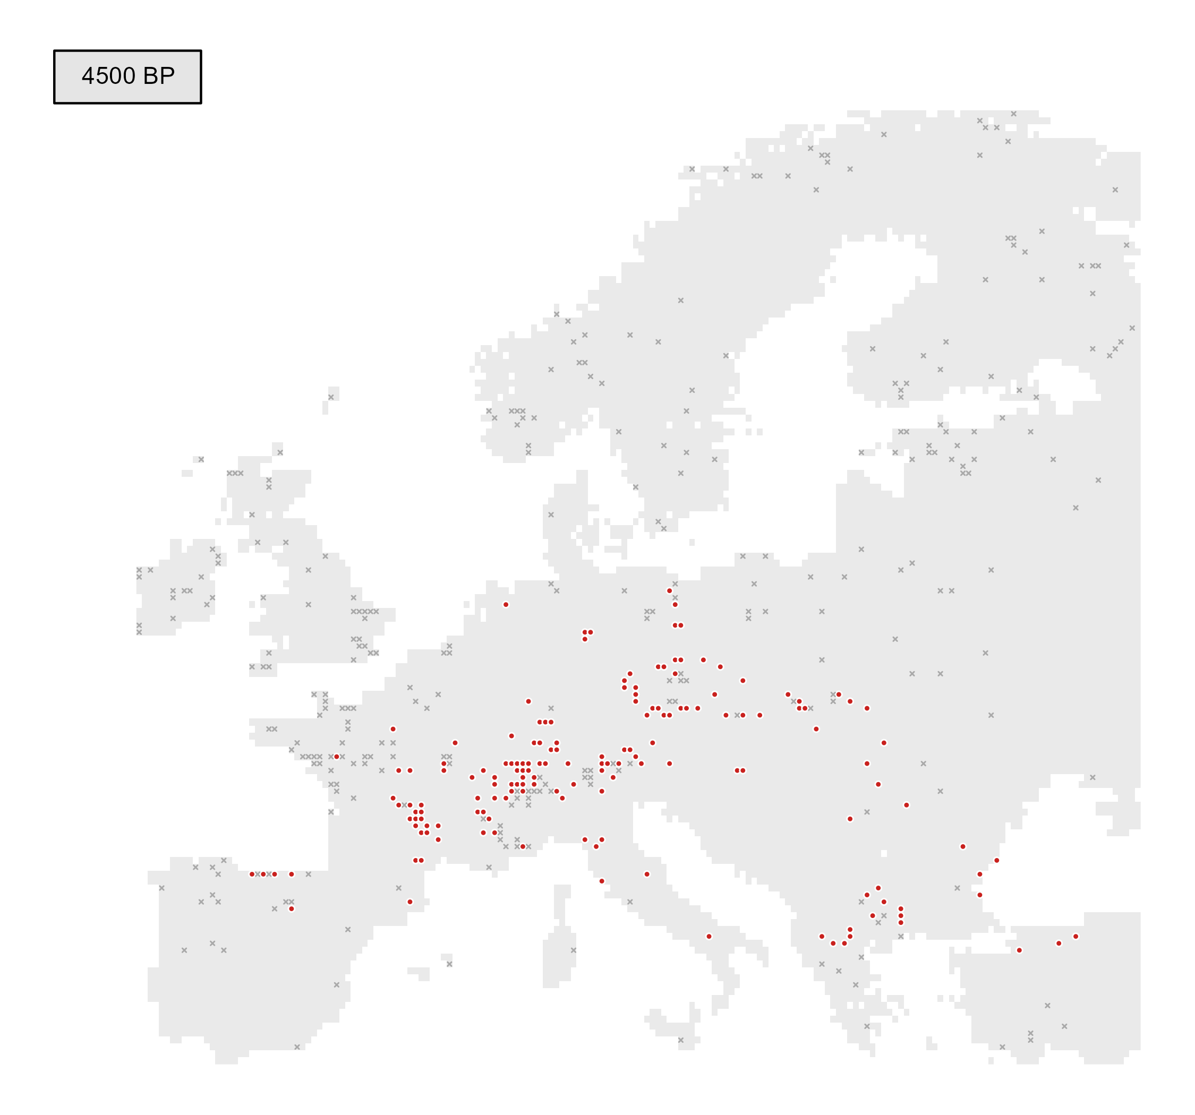
INSIGHTS FROM THE PAST: POLLEN RECORDS
Present
Absent
e.g. Fagus pollen records

Slide 68
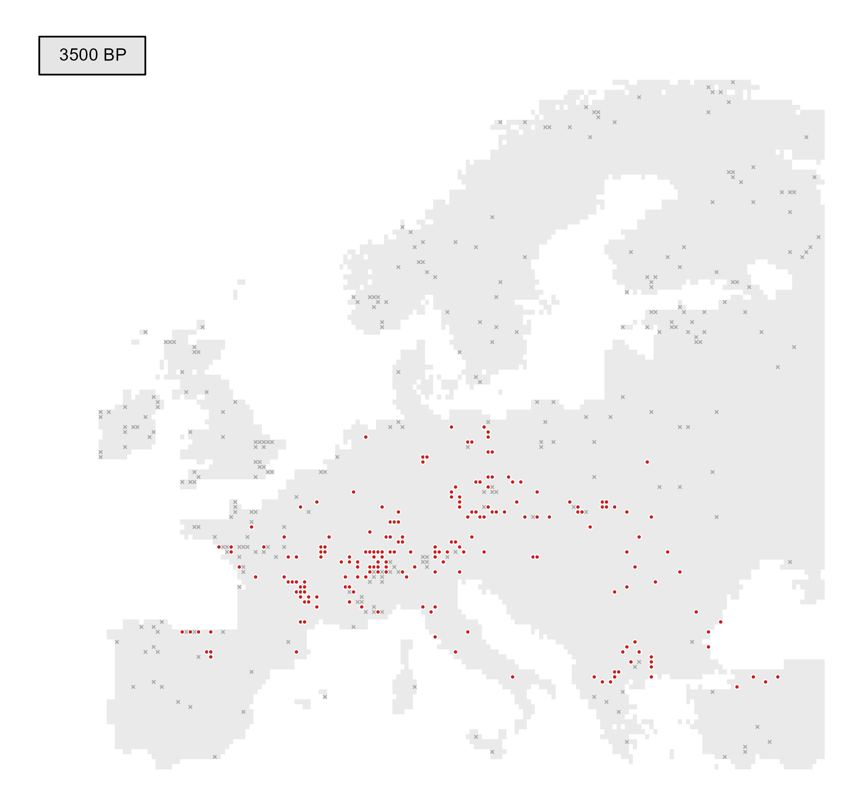
INSIGHTS FROM THE PAST: POLLEN RECORDS
Present
Absent
e.g. Fagus pollen records

Slide 69

INSIGHTS FROM THE PAST: POLLEN RECORDS
Present
Absent
e.g. Fagus pollen records

Slide 70
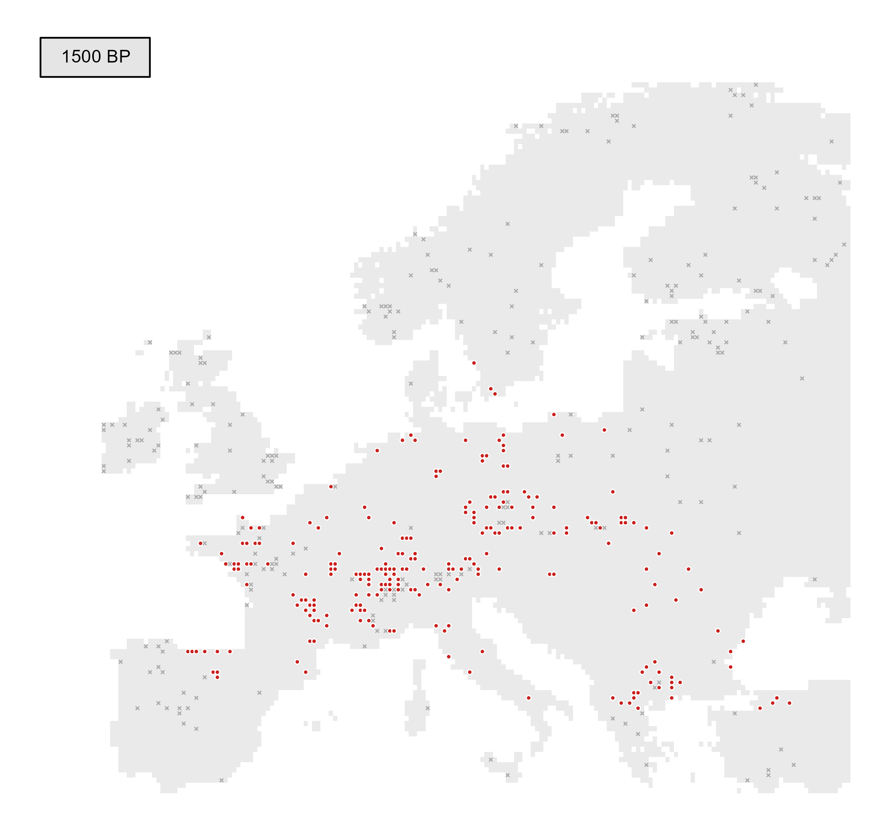
INSIGHTS FROM THE PAST: POLLEN RECORDS
Present
Absent
e.g. Fagus pollen records

Slide 71
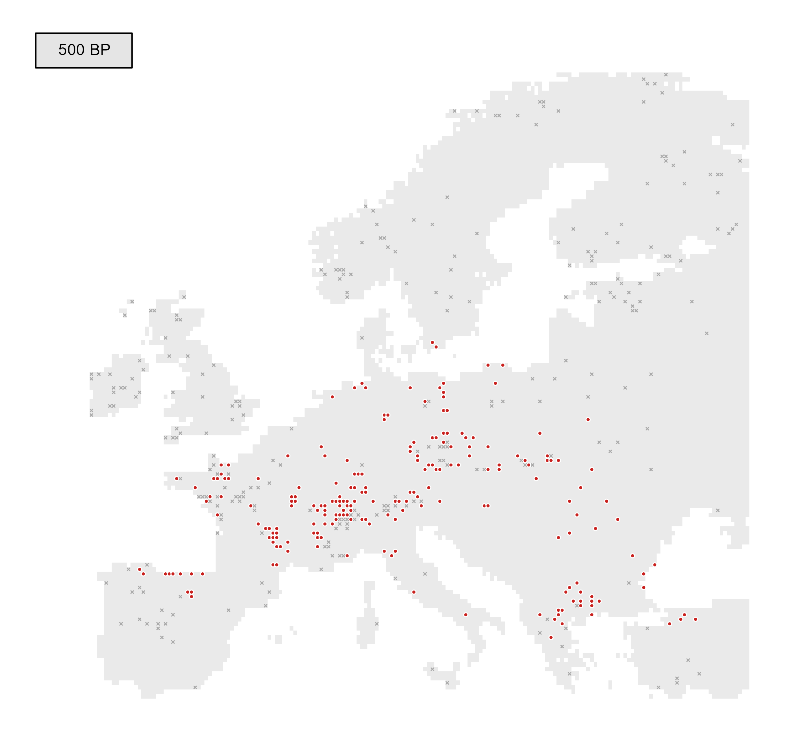
INSIGHTS FROM THE PAST: POLLEN RECORDS
Present
Absent
e.g. Fagus pollen records

Slide 72

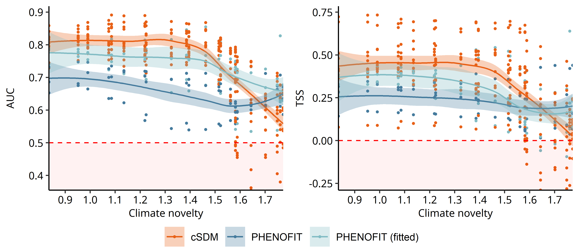
INSIGHTS FROM THE PAST: MODEL PROJECTIONS V.S. POLLEN RECORDS
Comparison with three genus-level records
Fagus, Quercus and Abies (Holocene only)

Slide 73
INSIGHTS FROM THE PAST: MODEL PROJECTIONS V.S. POLLEN RECORDS
Comparison with three genus-level records
Fagus, Quercus and Abies (Holocene only)

Slide 74
INSIGHTS FROM THE PAST: MODEL PROJECTIONS V.S. POLLEN RECORDS
Comparison with three genus-level records
Better performance
of cSDM
Fagus, Quercus and Abies (Holocene only)

Slide 75
INSIGHTS FROM THE PAST: MODEL PROJECTIONS V.S. POLLEN RECORDS
Comparison with three genus-level records
Intermediate performance of
fitted process-based
models
Fagus, Quercus and Abies (Holocene only)

Slide 76
INSIGHTS FROM THE PAST: MODEL PROJECTIONS V.S. POLLEN RECORDS
Comparison with three genus-level records
Fagus, Quercus and Abies (Holocene only)

Slide 77
INSIGHTS FROM THE PAST: MODEL PROJECTIONS V.S. POLLEN RECORDS
Comparison with three genus-level records
Substantial
decrease of cSDM
performance
Fagus, Quercus and Abies (Holocene only)

Slide 78
INSIGHTS FROM THE PAST: MODEL PROJECTIONS V.S. POLLEN RECORDS
Comparison with three genus-level records
Better
performance ?
Fagus, Quercus and Abies (Holocene only)

Slide 79
INSIGHTS FROM THE PAST: MODEL PROJECTIONS V.S. POLLEN RECORDS
Comparison with three genus-level records
Fagus, Quercus and Abies (Holocene only)

Slide 80
INSIGHTS FROM THE PAST: MODEL PROJECTIONS V.S. POLLEN RECORDS
Comparison with three genus-level records
Fagus, Quercus and Abies (Holocene only)

Slide 81
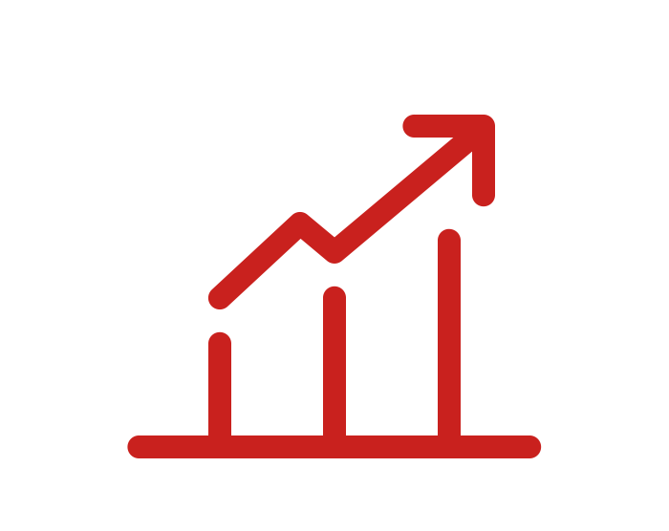
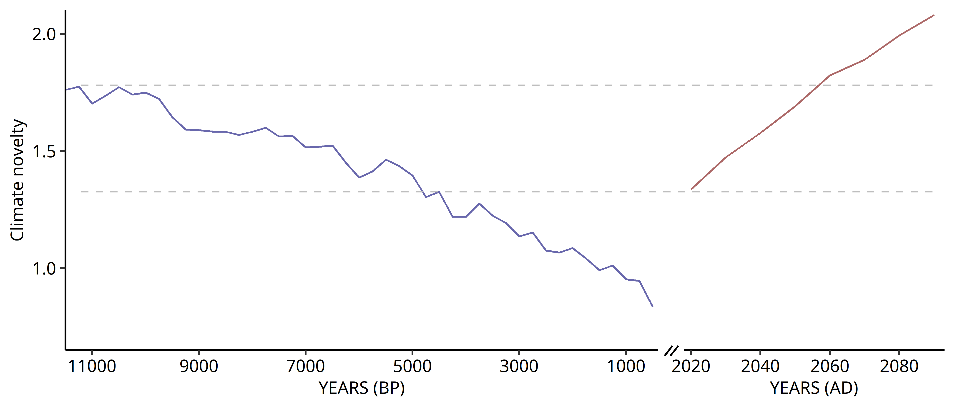
IMPLICATIONS FOR FUTURE CONFIDENCE IN MODEL PROJECTIONS
Future climate states with no analog

Slide 82
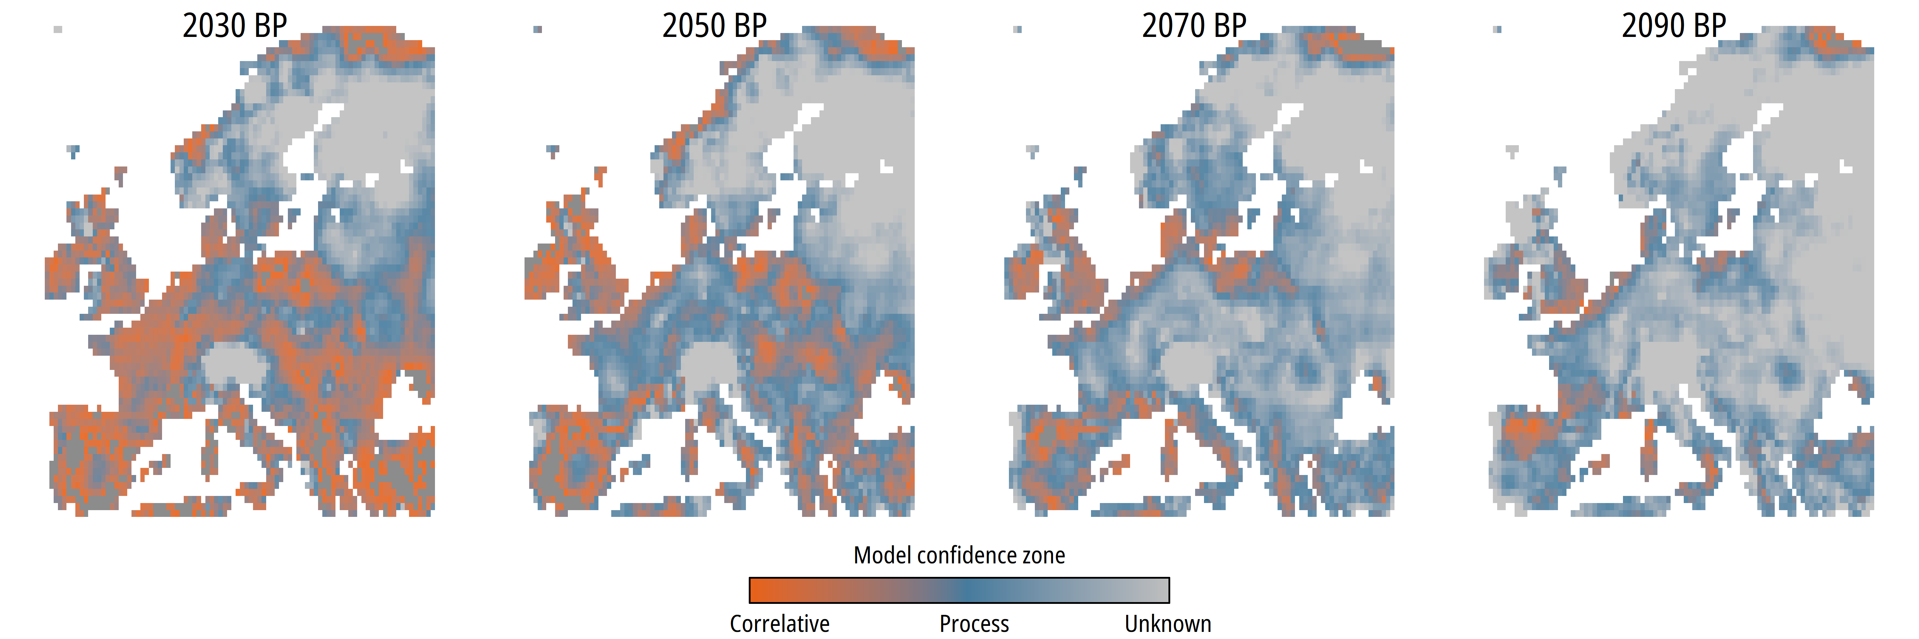
IMPLICATIONS FOR FUTURE CONFIDENCE IN MODEL PROJECTIONS
Strong uncertainties by the end of the 21th century

Slide 83

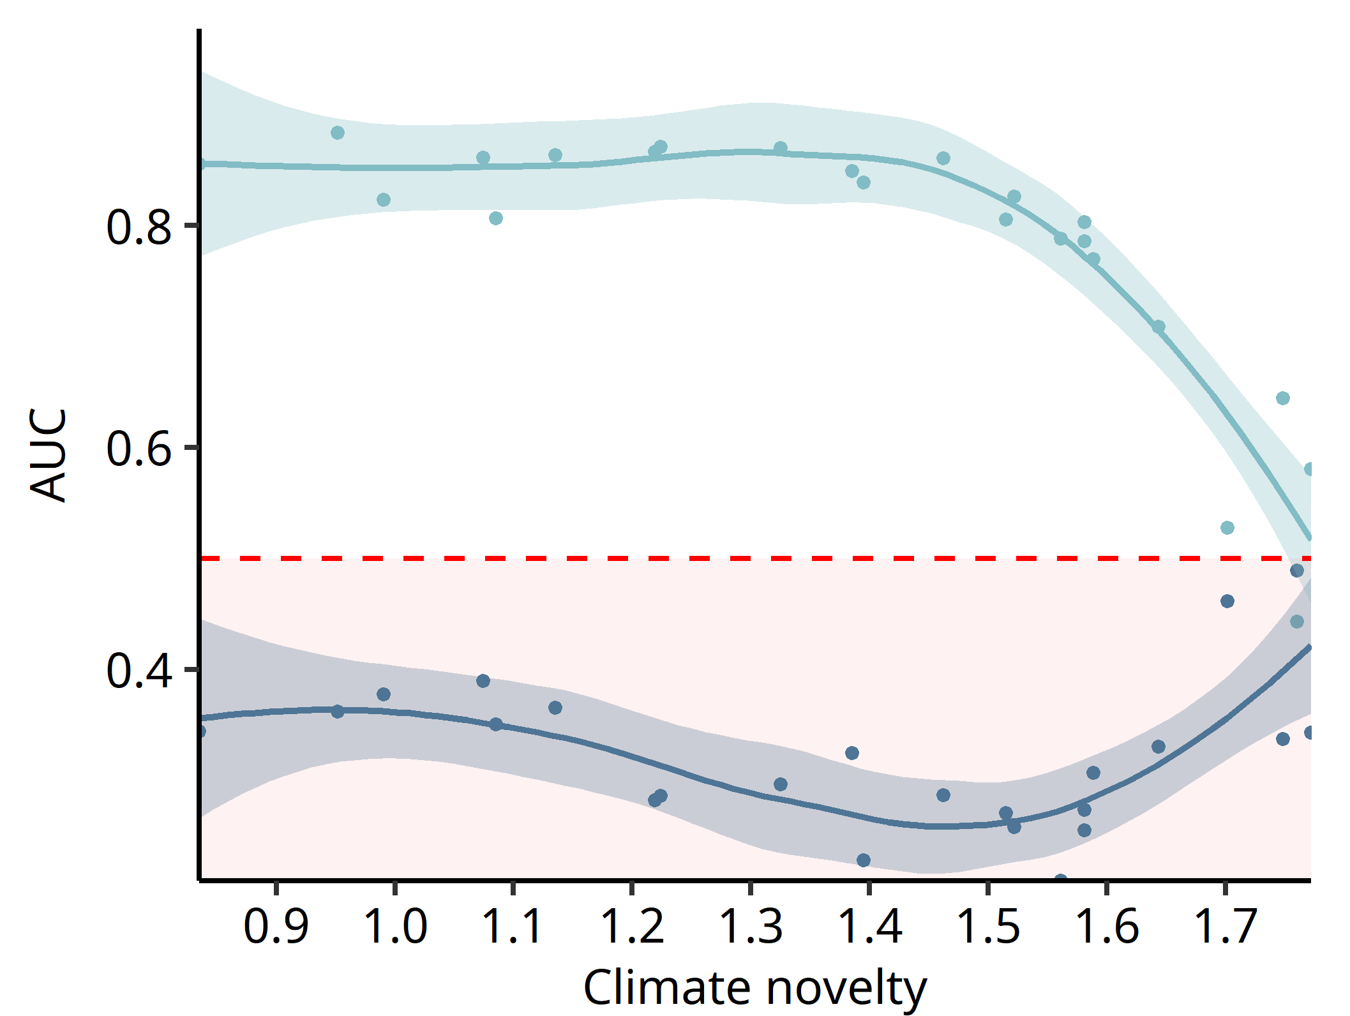
CHALLENGES TO PROCESS-BASED APPROACHES
Palaeoecology: a tool for model diagnostics?
Larix

Slide 84
CHALLENGES TO PROCESS-BASED APPROACHES
Palaeoecology: a tool for model diagnostics?
Worst than
random model
Larix

Slide 85
CHALLENGES TO PROCESS-BASED APPROACHES
Palaeoecology: a tool for model diagnostics?
Worst than
random model
Bad calibration due to scarce data rather than a model misspecification?
Larix

Slide 86
LIMITATIONS AND PERSPECTIVES
▶ strong limitations of pollen data
▶ biotic interactions and land-use changes are not taken into account
▶ for the moment, we do not model migration processes

Slide 87
FINAL THOUGHTS
Better communication on model uncertainties is crucial

Slide 88
FINAL THOUGHTS
Better communication on model uncertainties is crucial
▶ a more comprehensive understanding of the potential errors by
decision-makers

Slide 89
FINAL THOUGHTS
Better communication on model uncertainties is crucial
▶ a more comprehensive understanding of the potential errors by
decision-makers
▶ prevents the misinterpretation of model outputs as deterministic representations of the reality

Slide 90
FINAL THOUGHTS
Better communication on model uncertainties is crucial
▶ a more comprehensive understanding of the potential errors by
decision-makers
▶ prevents the misinterpretation of model outputs as deterministic representations of the reality
▶ directly linked to risk assessment

Slide 91
FINAL THOUGHTS
Better communication on model uncertainties is crucial
▶ a more comprehensive understanding of the potential errors by
decision-makers
▶ prevents the misinterpretation of model outputs as deterministic representations of the reality
▶ directly linked to risk assessment
LET’S PROVE OUR MODELS ARE WRONG!

Slide 92
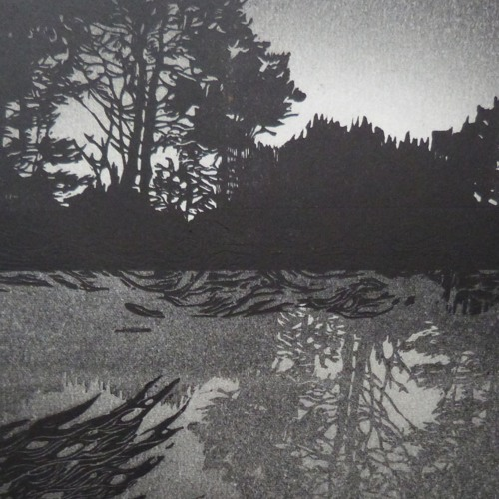
THANK YOU !
Linocut print by C. Rescan

