Slide 1
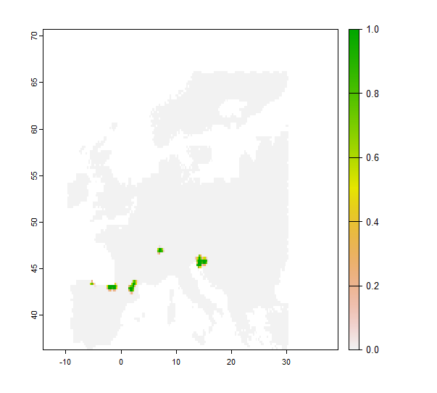
PHENOFIT fitted
11000 BP

Slide 2
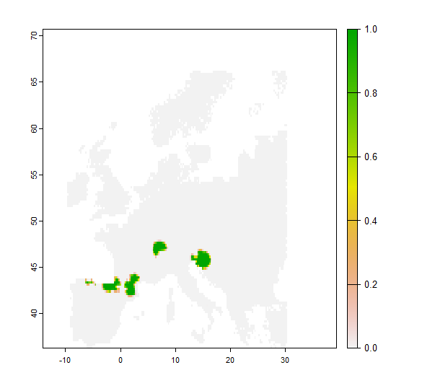
PHENOFIT fitted
10000 BP

Slide 3
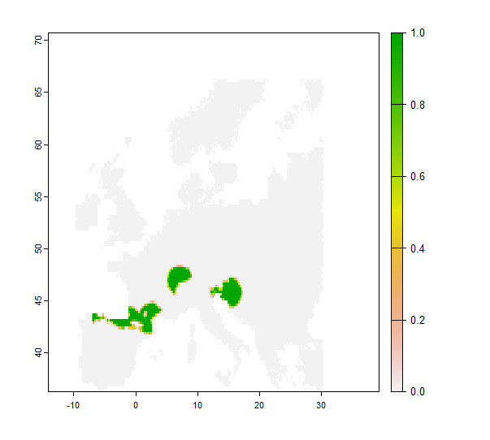
PHENOFIT fitted
9000 BP

Slide 4
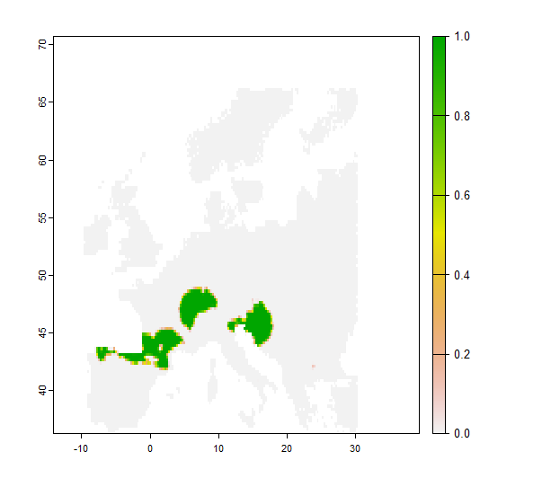
PHENOFIT fitted
8000 BP

Slide 5
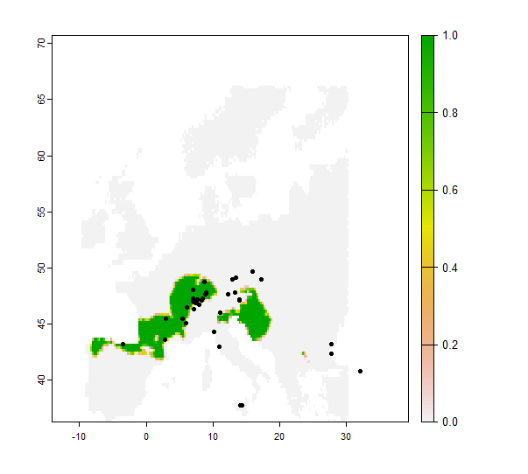
PHENOFIT fitted
7000 BP

Slide 6
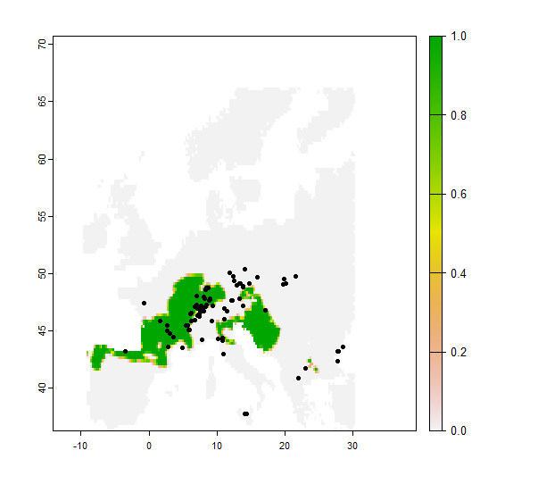
PHENOFIT fitted
6000 BP

Slide 7
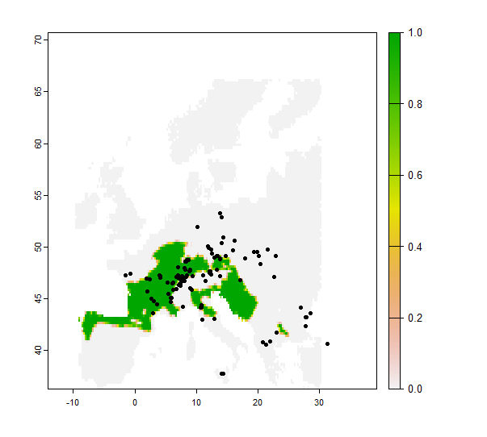
PHENOFIT fitted
5000 BP

Slide 8
PHENOFIT fitted
5000 BP
Already a strong lag

Slide 9
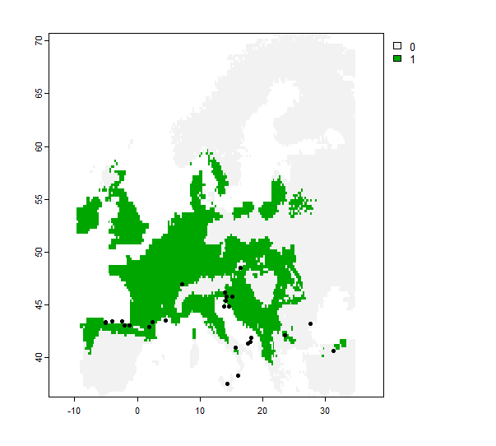
PHENOFIT fitted
5000 BP
Habitat suitability + refugia
Carpathian and
Black Sea refugia still
in an unsuitable area

Slide 10
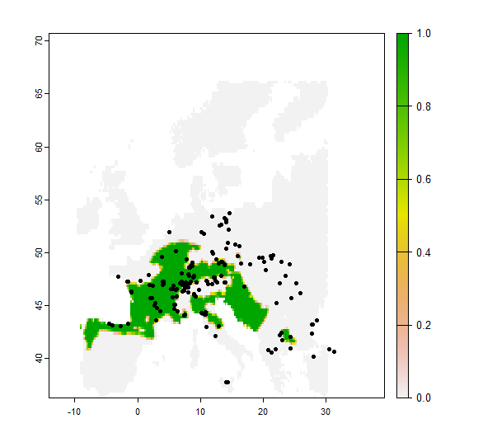
PHENOFIT fitted
4000 BP

Slide 11
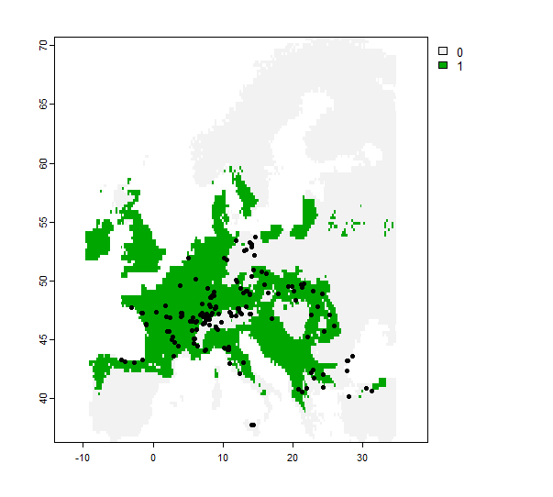
PHENOFIT fitted
4000 BP
Habitat suitability

Slide 12
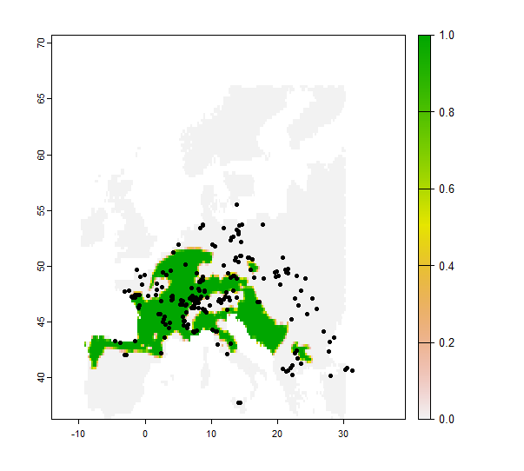
PHENOFIT fitted
3000 BP

Slide 13
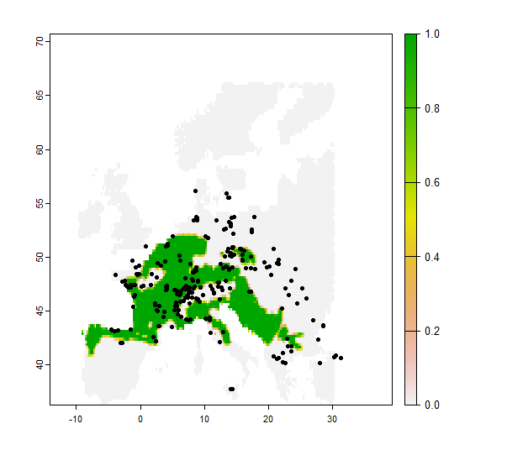
PHENOFIT fitted
2000 BP

Slide 14
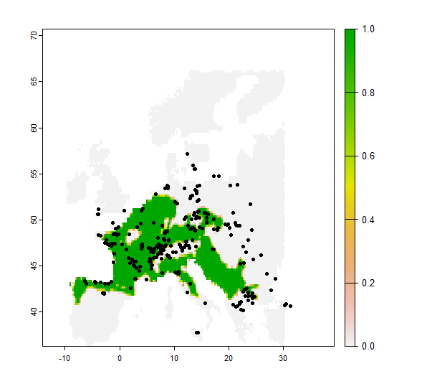
PHENOFIT fitted
1000 BP

Slide 15
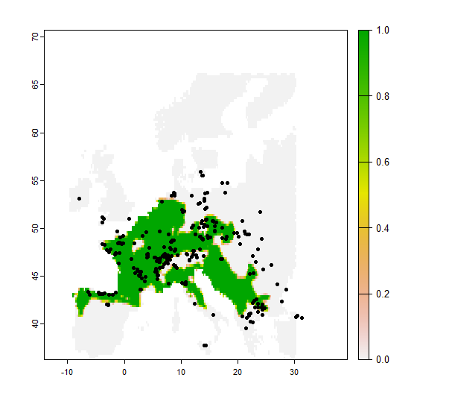
PHENOFIT fitted
250 BP

Slide 16
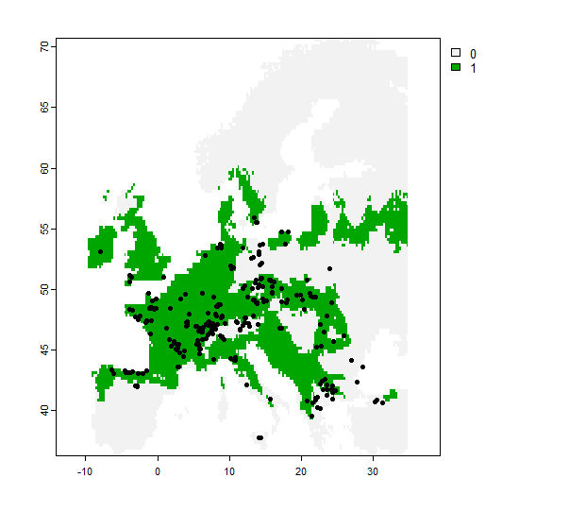
PHENOFIT fitted
250 BP
Habitat suitability

Slide 17
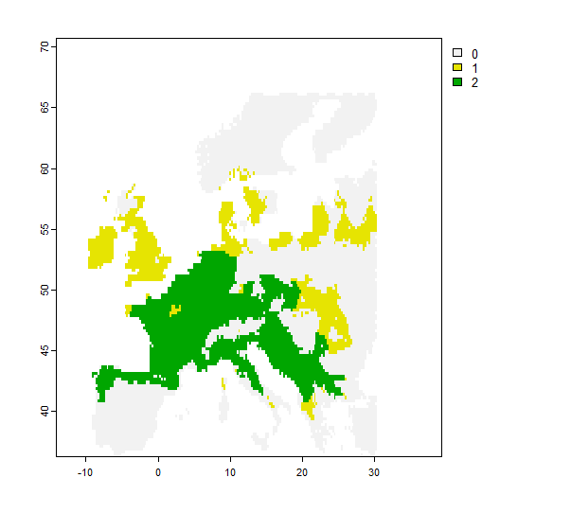
PHENOFIT fitted
250 BP

Slide 18
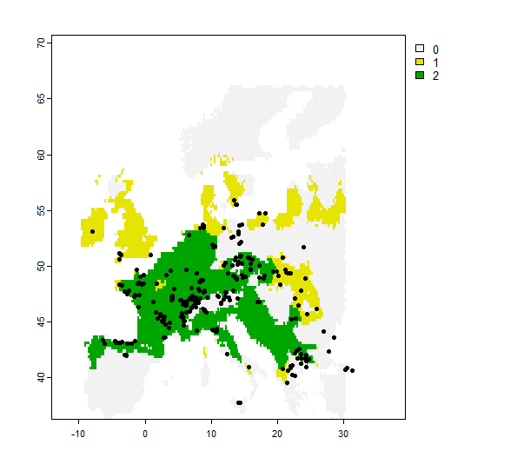
PHENOFIT fitted
250 BP

Slide 19
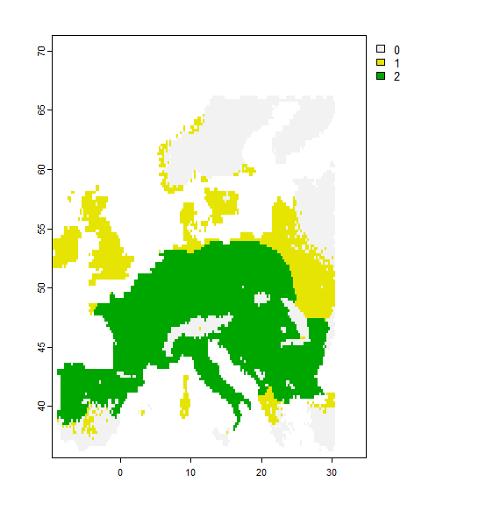
250 BP
PHENOFIT fitted
PHENOFIT

