Slide 1
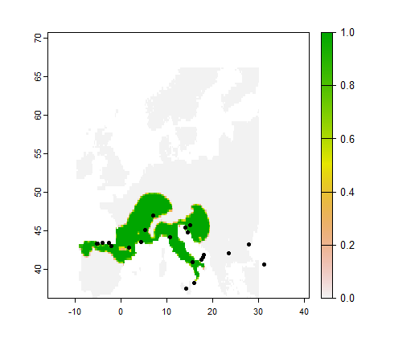
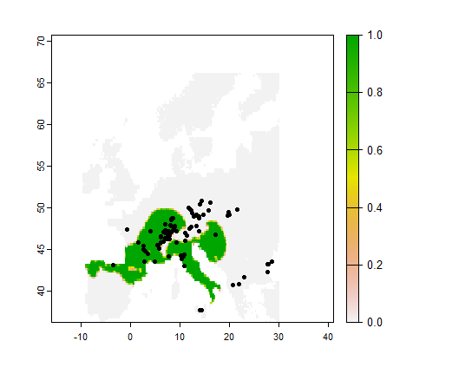
6k BP + refugia
6k BP + pollen

Slide 2
6k BP + refugia
6k BP + pollen
Missing a refugia?

Slide 3
6k BP + refugia
6k BP + pollen
Threshold approach too exclusive ?

Slide 4
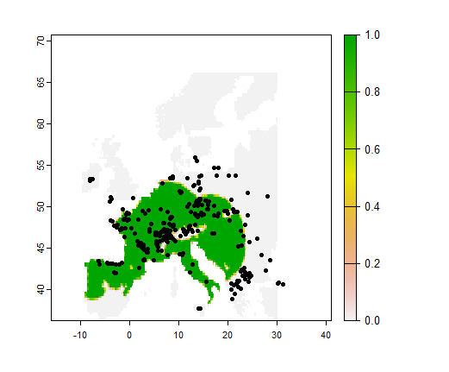
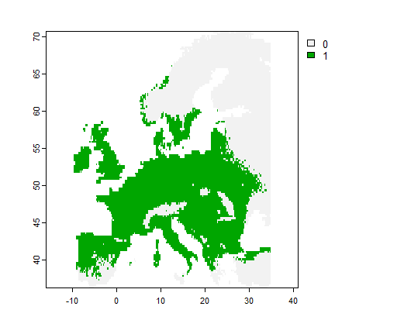
Predicted range + migration
Predicted range

Slide 5
Predicted range + migration
Predicted range
English Lowlands beech forests : introduced ?

Slide 6
Predicted range + migration
Predicted range
Missing Balkan beech forests : threshold too exclusive ?

Slide 7
Predicted range + migration
Predicted range
Lag too important : missing refugia + threshold too exclusive ?

Slide 8
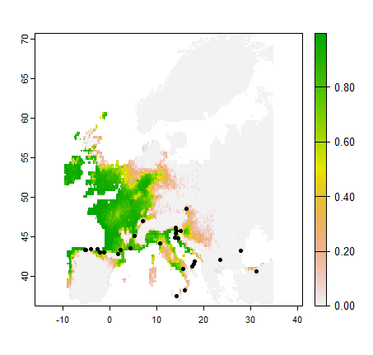
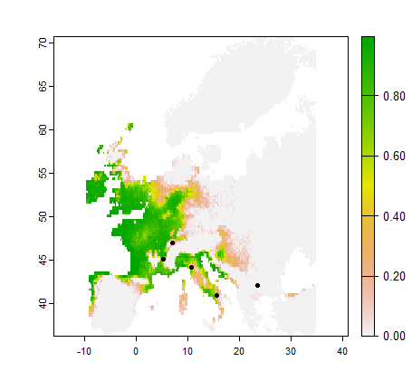

Pollen + Magri data (10k and +)
Pollen + Magri data
(10k-13k)
Pollen
Central Europe refugia!

Slide 9
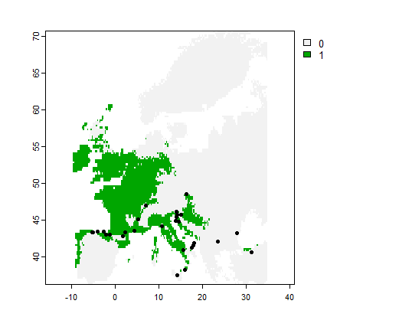
Threshold 0.162

Slide 10
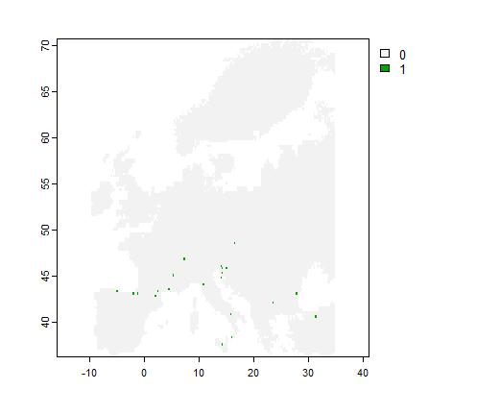
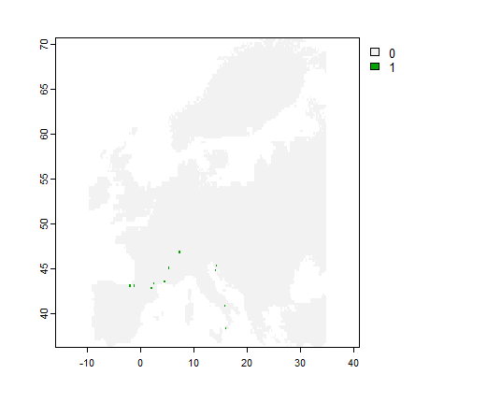
Starting points
Threshold 0.162
Threshold exclude this refugia
Zero fitness exclude this one

Slide 11
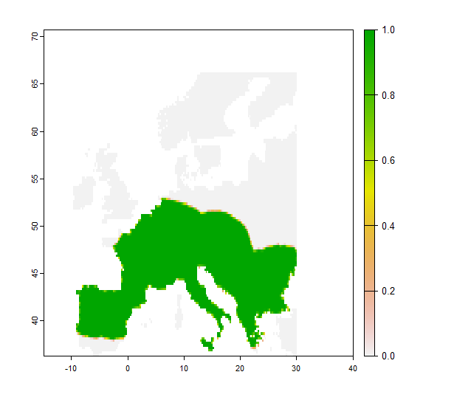
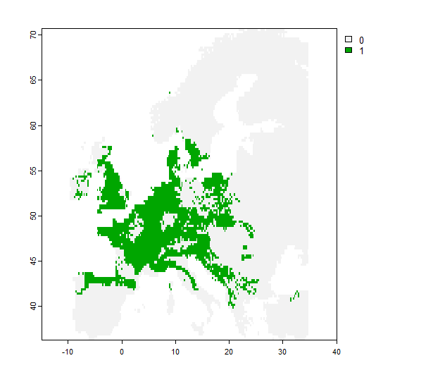
Example no-threshold policy with RandomForest
Predicted range + migration
Predicted range

Slide 12
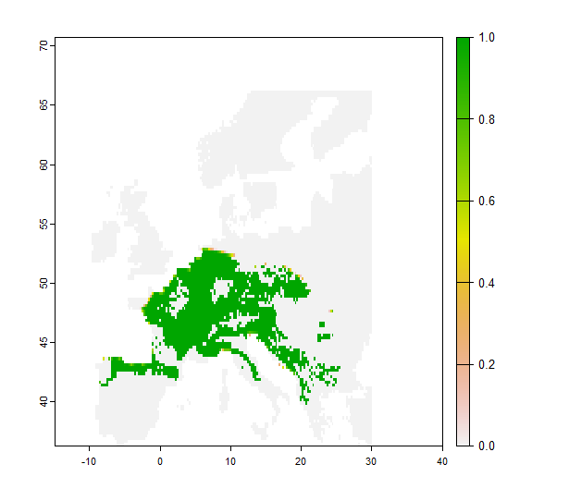
Example no-threshold policy with RandomForest
Predicted range + migration
Predicted range
A posterio theshold ?

Slide 13
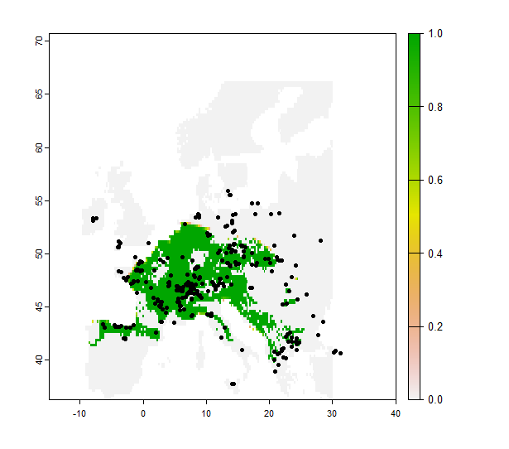
Example no-threshold policy with RandomForest
Predicted range + migration
Predicted range

Slide 14
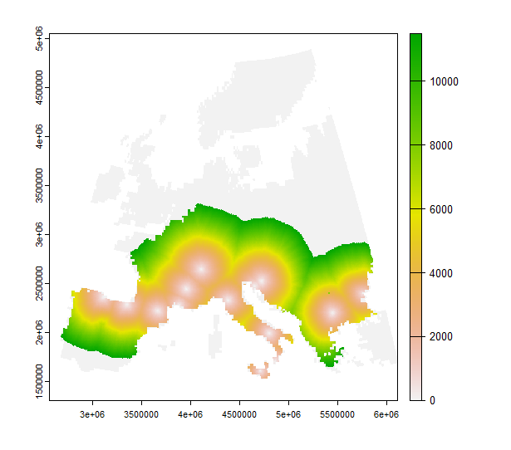

Slide 15
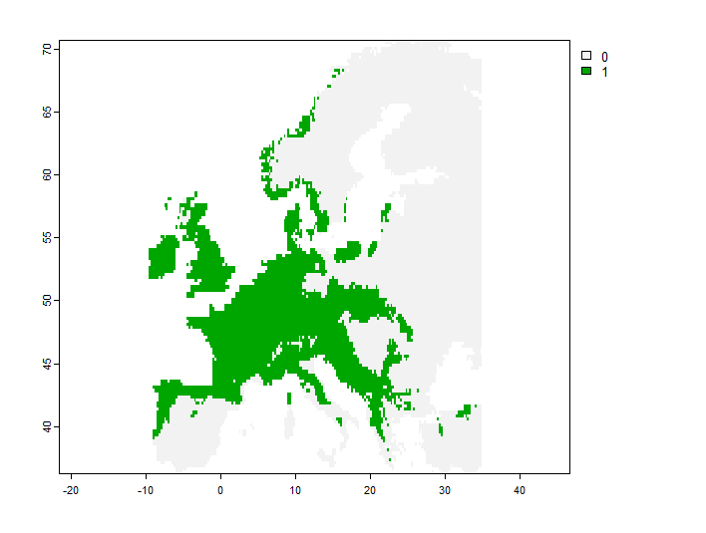
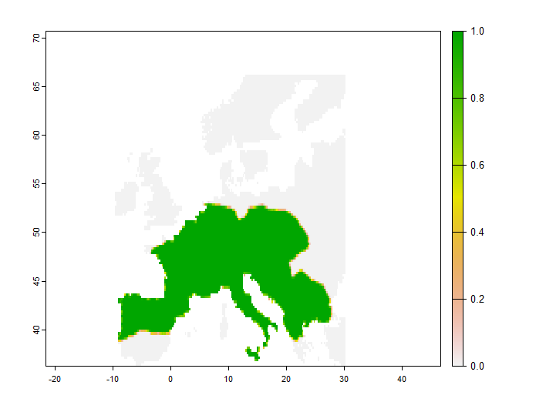
Example no-zero policy (<threshold => 0.001) - GAM

Slide 16
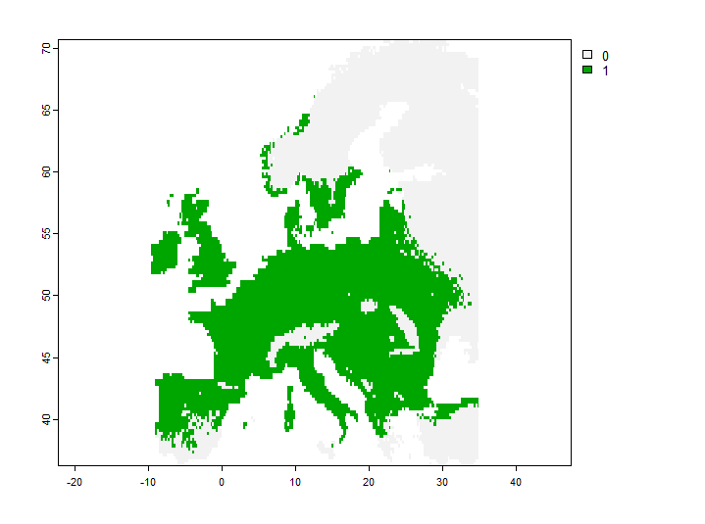
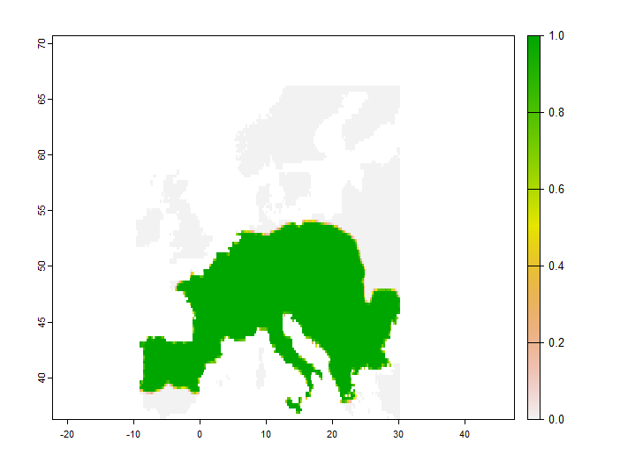
Example no-zero policy (<threshold => 0.001) - PHENOFIT

Slide 17
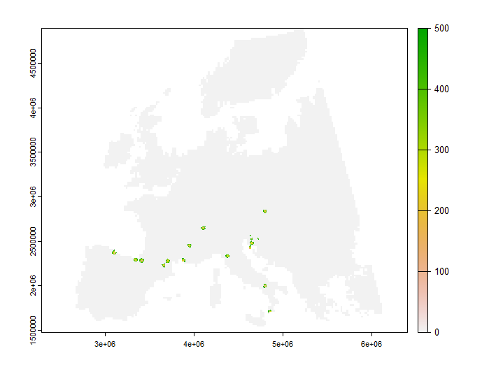
Example no-zero policy on refugia - PHENOFIT

