Slide 1
Fiabilité des projections des modèles
d’aire de répartition des arbres forestiers d’Europe
2021-2024

Slide 2
Objectif : comparer les capacités des modèles corrélatifs et des modèles basés sur les processus à prédire les répartitions passée et future d’espèces d’arbres

Slide 3
Objectif : comparer les capacités des modèles corrélatifs et des modèles basés sur les processus à prédire les répartitions passée et future d’espèces d’arbres
Quelle est l’origine de leur robustesse ?
► les hypothèses du modèle (relations mécanistes vs. statistiques) ?
► la façon dont les paramètres sont estimés ?

Slide 4
Objectif : comparer les capacités des modèles corrélatifs et des modèles basés sur les processus à prédire les répartitions passée et future d’espèces d’arbres
Quelle est l’origine de leur robustesse ?
► les hypothèses du modèle (relations mécanistes vs. statistiques) ?
► la façon dont les paramètres sont estimés ?
Modèles : PHENOFIT, CASTANEA, FORCEPS ? + plusieurs modèles corrélatifs
Versions plus ou moins complètes, et paramétrées différemment

Slide 5
Objectif : comparer les capacités des modèles corrélatifs et des modèles basés sur les processus à prédire les répartitions passée et future d’espèces d’arbres
Quelle est l’origine de leur robustesse ?
► les hypothèses du modèle (relations mécanistes vs. statistiques) ?
► la façon dont les paramètres sont estimés ?
Modèles : PHENOFIT, CASTANEA, FORCEPS ? + plusieurs modèles corrélatifs
Versions plus ou moins complètes, et paramétrées différemment
Périodes : - passé lointain (Holocène)
- passé proche (1850-2015)
- présent (calibration)
- futur proche (2025-2100)

Slide 6
Efficiency/accuracy: ability of the model to provide accurate predictions in conditions that have been used to calibrate the model
Robustness: ability of the model to provide accurate projections in external conditions, i.e. other conditions than those used to calibrate the model
⇒ determines its transferability in time and space
(Janssen and Heuberger, 1995 ; Asse et al., 2020)

Slide 7
Correlative vs process-based : non-exhaustive state of the art
► Présent
Shabani et al. (2016) :
Climex vs. 5 CSDMs (calibration : outside Australia, evaluation : Australia)
Higgins et al. (2020) :
TTR-SDM vs. Maxent (calibration : Australia, evaluation : outside Australia)
Gritti et al. (2013) :
STASH, LPJ, et PHENOFIT
Magarey et al. (2018) :
TTR-SDM vs. Maxent (calibration : outside US, evaluation : US)
► Futur
Cheaib et al. (2012) :
PHENOFIT, CASTANEA et 2 CSDMs...
Morin and Thuiller (2009) :
PHENOFIT vs. Biomod
Kearney et al. (2010) :
NicheMapper vs. Maxent
Keenan et al. (2011) :
GOTILWA+ vs. Biomod
Schneiderman et al. (2015) :
LINKAGES 2.2 vs. TreeAtlas model
Kramer et al. (2010) :
LPJ-GUESS vs. Biomod
And so on...

Slide 8
Asse et al. (2020). Process-based models outcompete correlative models in projecting spring phenology of trees in a future warmer climate. Agricultural and Forest Meteorology

Slide 9
Asse et al. (2020). Process-based models outcompete correlative models in projecting spring phenology of trees in a future warmer climate. Agricultural and Forest Meteorology
Modèle phénologique corrélatif vs. modèles basés sur les processus paramétrisés différemment:
► entièrement à partir des données (backward)
► en fixant certains paramètres grâce à des données expérimentales (partly forward)

Slide 10
Asse et al. (2020). Process-based models outcompete correlative models in projecting spring phenology of trees in a future warmer climate. Agricultural and Forest Meteorology
Modèle phénologique corrélatif vs. modèles basés sur les processus paramétrisés différemment:
► entièrement à partir des données (backward)
► en fixant certains paramètres grâce à des données expérimentales (partly forward)
« Our results show that robustness of process-based models can come additionally from forward parameter estimation, but also that forward parameter estimation is not necessarily the Holy Grail that we should seek. »

Slide 11
Asse et al. (2020). Process-based models outcompete correlative models in projecting spring phenology of trees in a future warmer climate. Agricultural and Forest Meteorology
Modèle phénologique corrélatif vs. modèles basés sur les processus paramétrisés différemment:
► entièrement à partir des données (backward)
► en fixant certains paramètres grâce à des données expérimentales (partly forward)
« Our results show that robustness of process-based models can come additionally from forward parameter estimation, but also that forward parameter estimation is not necessarily the Holy Grail that we should seek. »
⇒ Et pour les modèles d’aire de répartition ?

Slide 12
Data

Slide 13
Data
Recent past - Present
Occurence data
Environmental data
Pure forest stands with tree positions

Slide 14
Data
Paleo
Recent past - Present
Occurence data
Occurence data
Reconstructed environmental data
Environmental data
Refugia
Pure forest stands with tree positions

Slide 15
Data
Paleo
Recent past - Present
Future
Occurence data
Occurence data
Projected
environmental data
Reconstructed environmental data
Environmental data
Refugia
Pure forest stands with tree positions

Slide 16
Data
Paleo
Recent past - Present
Future
Occurence data
Occurence data
Projected
environmental data
Reconstructed environmental data
Environmental data
Refugia
Pure forest stands with tree positions
Which resolution ? Which extent ?

Slide 17
Data
Paleo
Recent past - Present
Future
Occurence data
European Pollen Database
(see Giesecke et al. 2017)
Occurence data
ICP Forest
National forest inventories
Refugia
Pure forest stands with tree positions
Reconstructed environmental data:
- climatic
TraCE-21ka
(Paleoview + BioSIM)
- edaphic
EU-SoilHydroGrids
- land use
HYDE 3.1
Environmental data:
- climatic
SAFRAN (France)
CRU, ATEAM
- edaphic
EU-SoilHydroGrids
- land use
HYDE 3.1, CLC
Projected
environmental data:
- climatic
EURO-CORDEX
- edaphic
EU-SoilHydroGrids
- land use
GRAS

Slide 18
Models

Slide 19
Models
Correlative
Common framework
Point-process model
Maxent
GAM
GLM
Random forest
Boosted regression tree
etc.
Ensemble model

Slide 20
Models
Correlative
Common framework
Point-process model
Maxent
GAM
GLM
Random forest
Boosted regression tree
etc.
Ensemble model
Calibration
Which predictors ?
Which model validation technique?

Slide 21
Models
Correlative
Process-based
Common framework
Versions of varying complexity
Point-process model
Maxent
PHENOFIT 4
CASTANEA
GAM
GLM
Random forest
PHENOFIT 5 ?
FORCEEPS ?
Boosted regression tree
etc.
Ensemble model
Calibration
Which predictors ?
Which model validation technique?

Slide 22
Models
Correlative
Process-based
Common framework
Versions of varying complexity
Point-process model
Maxent
PHENOFIT 4
CASTANEA
GAM
GLM
Random forest
PHENOFIT 5 ?
FORCEEPS ?
Boosted regression tree
etc.
Calibration
Ensemble model
Forward
Current settings ?
New parameterisation ?
Backward
Which optimisation method ?
Calibration
Which predictors ?
Which model validation technique?

Slide 23
Challenges
Non-identifiability
Estimation of parameter uncertainties
Computational cost

Slide 24
Challenges
Non-identifiability
Estimation of parameter uncertainties
Computational cost
Framework
Programming language
JAVA
Executing Java code ?
etc.
R
J4R
rJAVA

Slide 25
Challenges
Non-identifiability
Estimation of parameter uncertainties
Computational cost
Framework
Programming language
Strategy
JAVA
Executing Java code ?
etc.
Free data-driven
Prior knowledge
R
J4R
rJAVA

Slide 26
Challenges
Non-identifiability
Estimation of parameter uncertainties
Computational cost
Framework
Programming language
Strategy
JAVA
Executing Java code ?
etc.
Free data-driven
Prior knowledge
R
J4R
rJAVA
Parallel implementation
Objective(s) function(s)
Algorithm

Slide 27


Challenges
Non-identifiability
Estimation of parameter uncertainties
Computational cost
Framework
Programming language
Strategy
JAVA
Executing Java code ?
etc.
Free data-driven
Prior knowledge
R
J4R
rJAVA
Parallel implementation
Objective(s) function(s)
Algorithm
Diverse
Bayesian
Evolutionnary
Approximate bayesian computation
Nlopt library
ECJ system
FME package
EvA2
Adaptative MCMC
Multi-objective
Kernel approximations
see F. Bach work
Multistart global optim.
Parallelized NISE
GLOBAL algorithm

Slide 28
+
Migration models
Gibbs-based migration model
Alternative model ?
Which coupling/link strategy ?

Slide 29
Comparison of predictions

Slide 30
Comparison of predictions
Metrics
AUC-ROC
AUC-POC
Point-bisserial cor.
Remaining deviance
RMSE
1-Brier score
Sensitivity
Specificity
Prevalence
F-measures
Coefficient of residual mass
AUC-PR
MAE
Boyce ind.
TSS
etc.

Slide 31
Comparison of predictions
Metrics
Approaches
AUC-ROC
AUC-POC
Point-bisserial cor.
Absolute differences
Remaining deviance
RMSE
1-Brier score
Sensitivity
Specificity
Prevalence
F-measures
Coefficient of residual mass
AUC-PR
MAE
Boyce ind.
TSS
etc.

Slide 32
Comparison of predictions
Metrics
Approaches
AUC-ROC
AUC-POC
Point-bisserial cor.
Absolute differences
Remaining deviance
RMSE
1-Brier score
Explicit comparisons
Sensitivity
Specificity
Prevalence
Spatially: map comparisons, positions of range front/centre/rear edge, etc.
F-measures
Coefficient of residual mass
AUC-PR
Boyce ind.
TSS
etc.
Ecologically: % newly suitable cells, used habitat calibration plots, shapes of response curves, etc.
MAE
Climatically: performance under novelty

Slide 33
Comparison of predictions
Metrics
Approaches
AUC-ROC
AUC-POC
Point-bisserial cor.
Absolute differences
Remaining deviance
RMSE
1-Brier score
Explicit comparisons
Sensitivity
Specificity
Prevalence
Spatially: map comparisons, positions of range front/centre/rear edge, etc.
F-measures
Coefficient of residual mass
AUC-PR
Boyce ind.
TSS
etc.
Ecologically: % newly suitable cells, used habitat calibration plots, shapes of response curves, etc.
MAE
Quantify similiraties between the reference and projection domains: define a forecast horizon ?
Climatically: performance under novelty

Slide 34
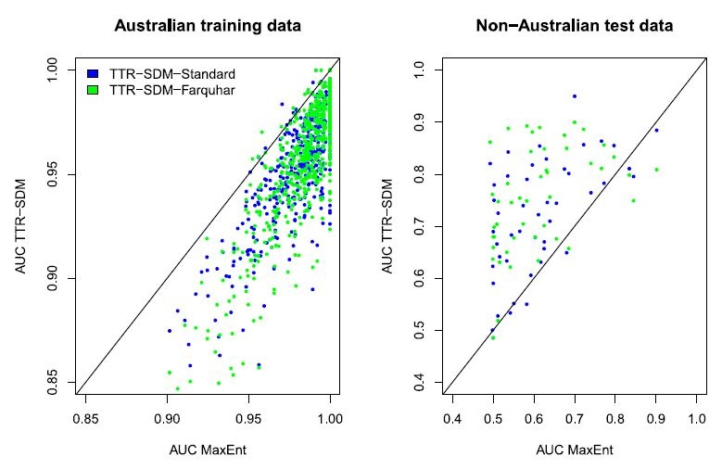
Absolute differences
Higgins et al. (2020)
interpolation
extrapolation

Slide 35
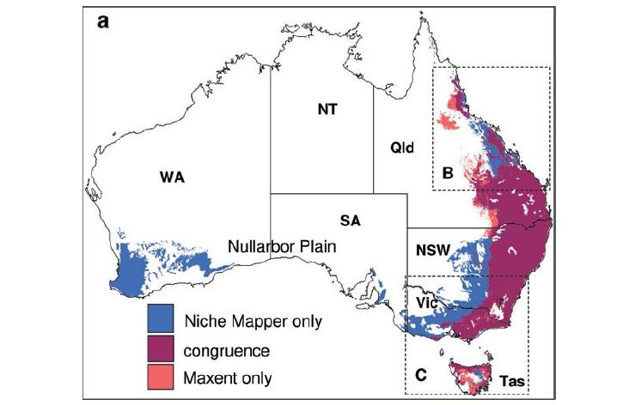
Spatially explicit comparisons
Kearney et al. (2010)
Congruence between model predictions

Slide 36
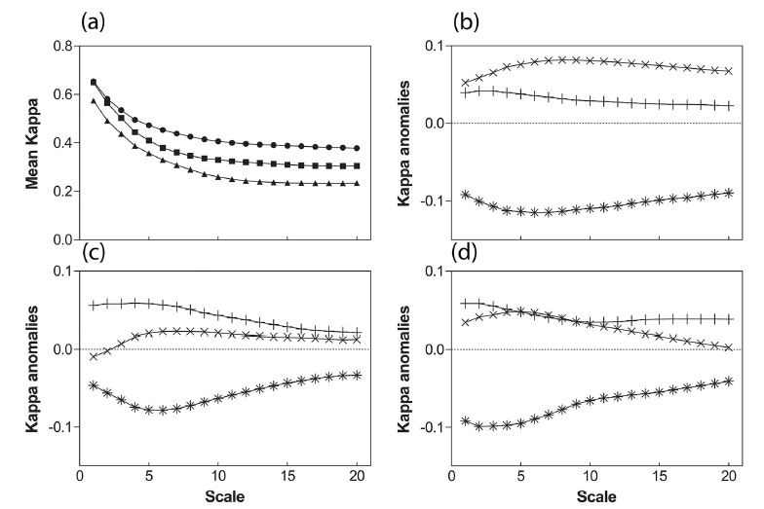
Spatially explicit comparisons
Gritti et al. (2013a)
Scale-dependent comparisons (CMP method)

Slide 37
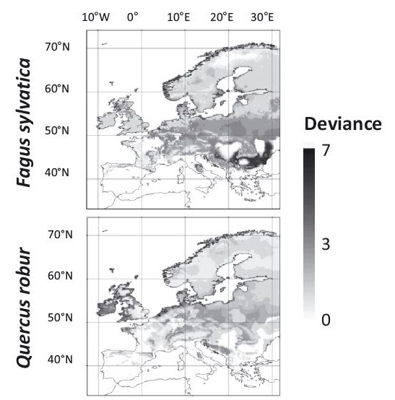
Spatially explicit comparisons
Gritti et al. (2013b)
Deviance between models

Slide 38
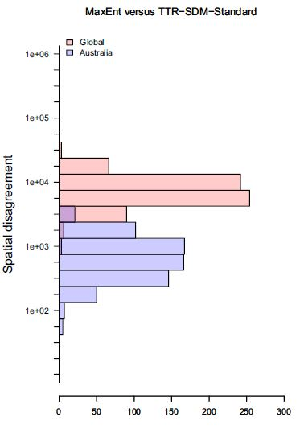
Spatially explicit comparisons
Higgins et al. (2020)
Spatial disagreement

Slide 39
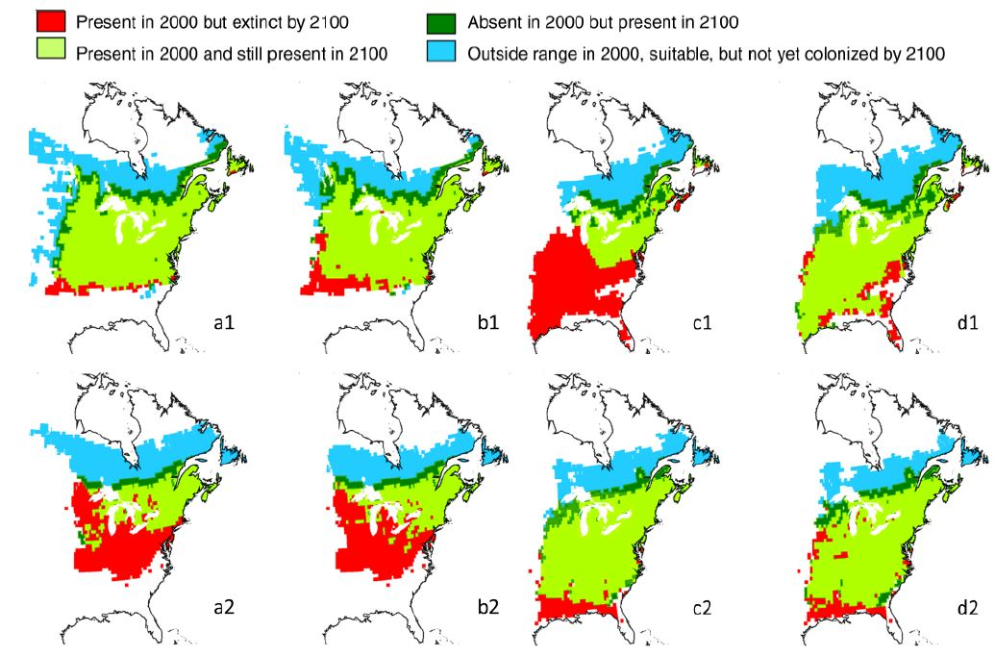
Ecologically explicit comparisons
Morrin et Thuiller (2009)
Extinction, colonization

Slide 40
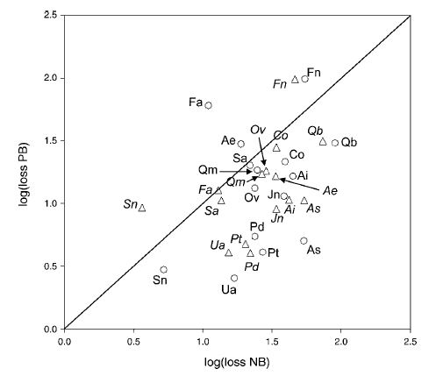
Ecologically explicit comparisons
Morrin et Thuiller (2009)
Percentage of extinction

Slide 41
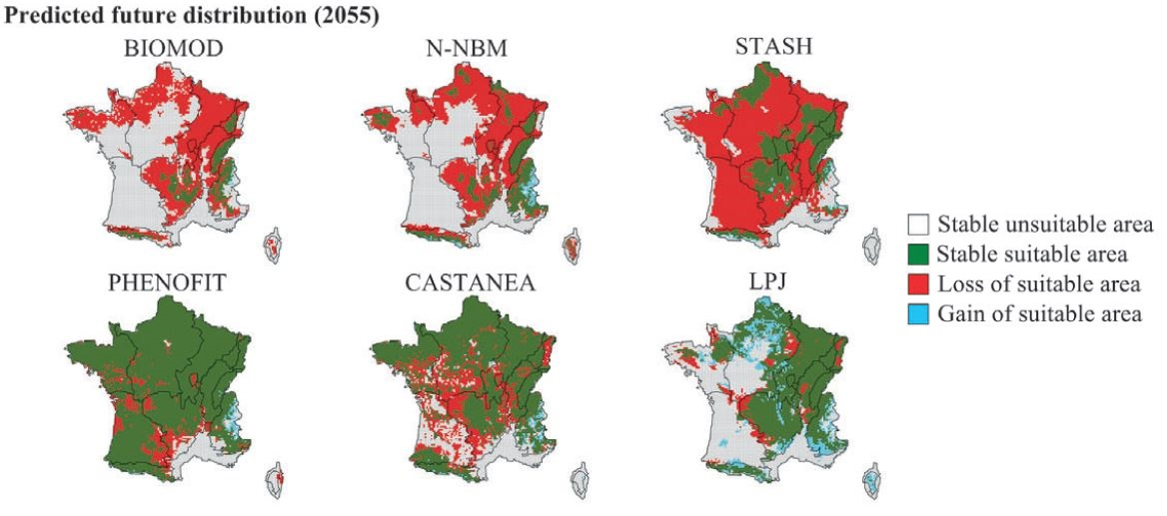
Ecologically explicit comparisons
Cheaib et al. (2012)
Suitable, unsuitable

Slide 42
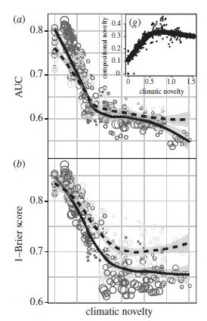
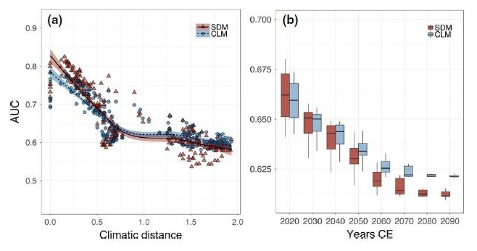
Climatically explicit comparisons
Maguire et al. (2016)
Fitzpatrick et al. (2018)
Performance under climatic novelty

Slide 43
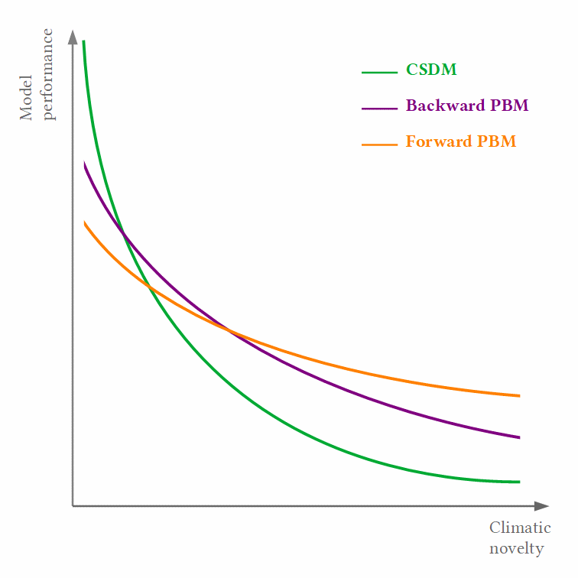
A possible hypothesis ?

Slide 44
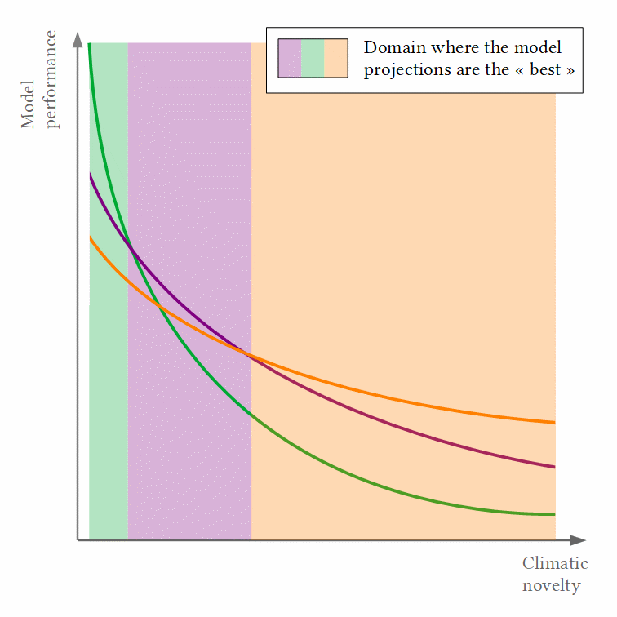
A possible hypothesis ?

Slide 45
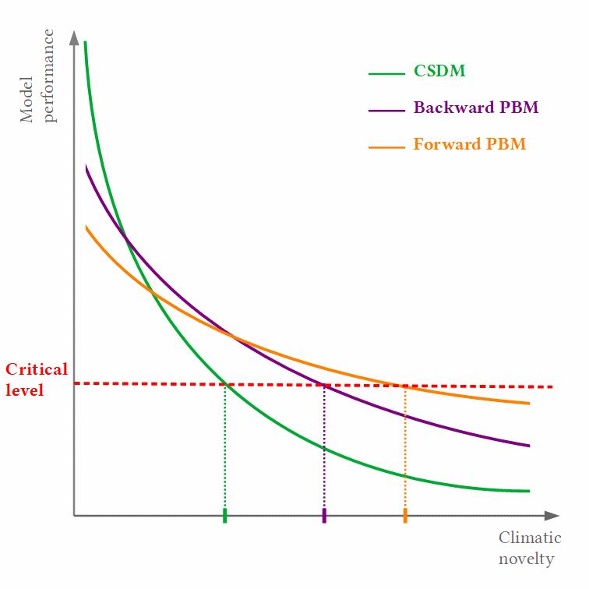
A possible hypothesis ?

Slide 46
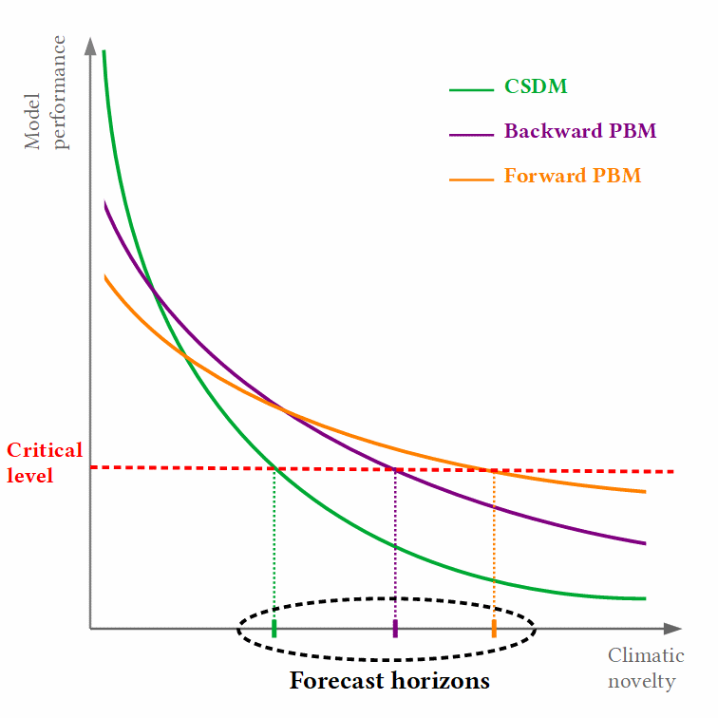
A possible hypothesis ?
Define a "forecast horizon", beyond which sufficiently useful predictions can no longer be made (Petchey et al, 2015)

Slide 47
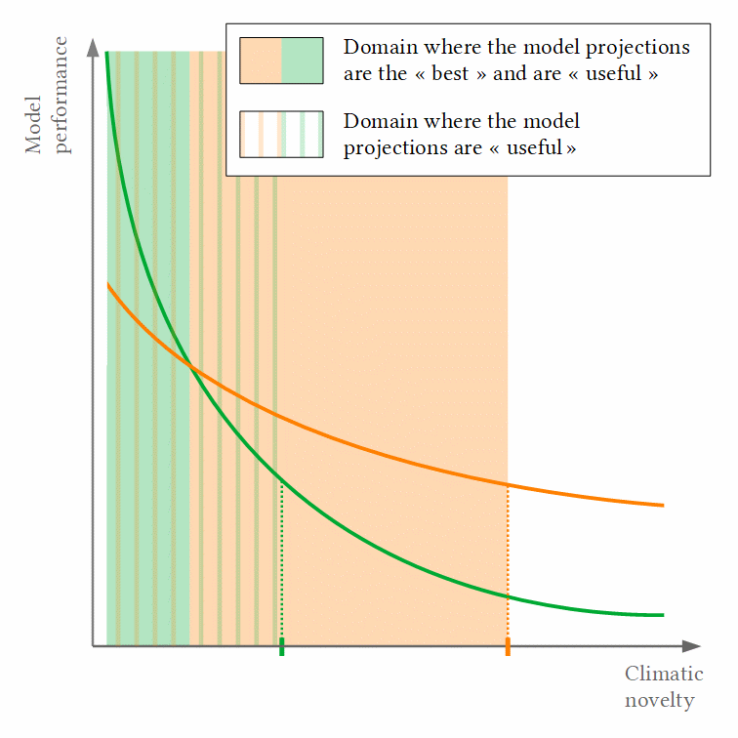
A possible hypothesis ?

Slide 48
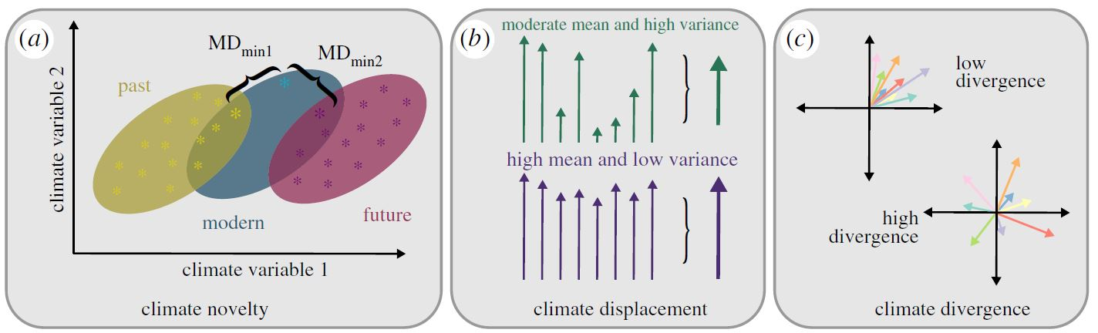
Others climatic mechanisms ?
Climate novelty...
Burke et al. (2019), adapted from Ordonnez et al. (2016)

Slide 49
Others climatic mechanisms ?
Climate displacement Climate divergence
Burke et al. (2019), adapted from Ordonnez et al. (2016)

Slide 50
Points à aborder
► Données
► Période de terrain
► Stratégie pour l’inverse modelling
► Interactions avec l’équipe en fonction du calendrier
(fréquence, déplacements, outils de travail)
► Publications

Slide 51
Data
Paleo
Recent past - Present
Future
Occurence data
European Pollen Database
(see Giesecke et al. 2017)
Occurence data
ICP Forest
National forest inventories
Refugia
Pure forest stands with tree positions
Reconstructed environmental data:
- climatic
TraCE-21ka
(Paleoview + BioSIM)
- edaphic
EU-SoilHydroGrids
- land use
HYDE 3.1
Environmental data:
- climatic
SAFRAN (France)
CRU, ATEAM
- edaphic
EU-SoilHydroGrids
- land use
HYDE 3.1, CLC
Projected
environmental data:
- climatic
EURO-CORDEX
- edaphic
EU-SoilHydroGrids
- land use
GRAS

Slide 52
Challenges
Non-identifiability
Estimation of parameter uncertainties
Computational cost
Framework
Programming language
Strategy
JAVA
Executing Java code ?
etc.
Free data-driven
Prior knowledge
R
J4R
rJAVA
Parallel implementation
Objective(s) function(s)
Algorithm
Diverse
Bayesian
Evolutionnary
Approximate bayesian computation
Nlopt library
ECJ system
FME package
EvA2
Adaptative MCMC
Multi-objective
Kernel approximations
see F. Bach work
Multistart global optim.
Parallelized NISE
GLOBAL algorithm

Slide 53
Publications potentielles
► (Article 1 : méthode pour la calibration backward)
► Article 2 : Paléo, passé lointain
► Article 3 : Passé récent
► Article 4 : Futur
► (Article 5 : incertitudes des modèles, ensemble des périodes)

