Slide 1
<Recog – Optical Character Recognition>
CS 293 Final Project Demo
24th November
Anirudh V, 110050055
Vinod Reddy K, 110050060

Slide 2
Outline <for a total of 30 mins>
Aim of project (1 mins)
Demo (5 mins)
Teamwork Details (0.5 min)
Design Details –Algorithm (5 mins)
Design Details – Implementation (8 mins)
Viva (9 mins)
Transition time to next team (2 mins)

Slide 3
Aim of the project
An application that takes an image containing characters and recognizes the characters present in them and outputs them into the terminal.

Slide 4
Demo
Now explain the program further while doing the demo
  Tip: one member can explain, one member can do demo

Slide 5
Teamwork Details
Work Division:
  Vinod Reddy K: Image Manipulation, basic OpenCV functions regarding image processing, linking the training and recognizing parts of the program, overall class and code structure, Coding the whole Image processing part.
  Anirudh V: OpenCV data structures, Basic OpenCV functions regarding Machine Learning, classifiers, Coding the whole training part, Database development, Designing the Box class for perfect ordering,
Overall Contribution by Vinod Reddy K | Overall Contribution by Anirudh V
50% | 50%

Slide 6
Design Details
Algorithm
  Detecting Characters: In the first stage, we have to detect the characters in the image given and mark them.
  Training Characters: After detecting the characters and marking them, we have to train the program to recognize these characters.
  Recognizing Characters: After training, the user provides the test image whose characters are detected and recognized.

Slide 7
Design Details
Algorithm
  Ordering of Characters: When we detect the contours we have used an algorithm which detects from top to bottom. When it encounters a black pixel, it creates a ‘blob’ and joins all the adjoining black pixels to the ‘blob’ and detects a contour. Due to this, we detect the tallest character in the line first and then the shorter ones. Thus, we had to prevent this and detect the characters in the order that they were present in.

Slide 8
Design Details
Implementation
  We have used OpenCV (Open Computer Vision library) for the detection and training part. We have used Machine Learning (K-Nearest Classifier) for training the characters. More on K-Nearest Classifier in following slides.
  We have used data structures such as vector, CvMat(matrix data structure in OpenCV), CvSeq and many others for data storage and manipulation. We have used priority queue for a very important operation which will be described in the following slides.

Slide 9
Algorithm Design
Detection of Characters: We have to detect the characters present in the image and mark them for future operations.
We threshold the image to turn it into a Binary Image so that we don’t have to deal with any blurredness/noise. Then we find contours present in the image and draw bounding rectangles around them. These contours represent the boundaries of the characters.

Slide 10
Algorithm Design
Detection of Characters: We have to detect the characters present in the image and mark them for future operations.
Whenever we find a contour, we identify both the inner and outer boundary as contours. But we need only the outer contour, so we disregard the inner contours by a predicate defined in OpenCV (CV_IS_SEQ_HOLE(contour))

Slide 11
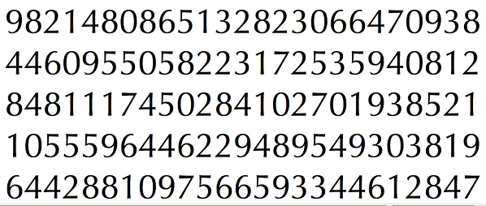
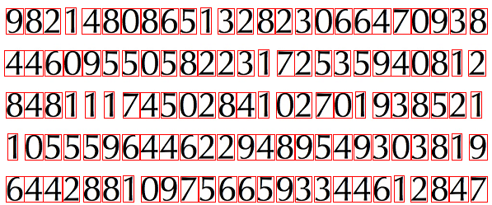
Algorithm Design
Detection of Characters: We have to detect the characters present in the image and mark them for future operations.
Image Source: StackOverFlow.com

Slide 12
Algorithm Design
Ordering of Characters: We have to detect the characters present in the image in the order that they are present.
We defined a priority queue and defined a different class for the bounding rectangle of character with the operator< overloaded so that when we push the object into the priority queue they get ordered according to the position of the rectangle in the image thus resulting in getting an ordered set of characters.

Slide 13
Algorithm Design
Training of Characters: After detecting and marking the characters of the training image, we train the program to recognize these characters
We isolate the characters in the training image and resize each of them into a 20x20 image. We store the 400 pixels of this character image in a vector. We read the corresponding label for this character from a file and write the vector and label into separate files for future use.

Slide 14
Algorithm Design
Training of Characters: After detecting and marking the characters of the training image, we train the program to recognize these characters
We read vectors and labels from the files and store them in matrices(CvMat) and load them into a K-Nearest Classifier object. This object will act as a classifier from now on.

Slide 15

Algorithm Design
Training of Characters: After detecting and marking the characters of the training image, we train the program to recognize these characters

Slide 16
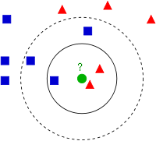
Algorithm Design
K-Nearest Neighbor Algorithm: We classify based on closest training examples in the feature space. For a specific value of K, we observe the K nearest neighbors in the feature space and output the label which is present in majority among the neighbors.
Source: Wikipedia

Slide 17
Algorithm Design
Recognizing Characters: When the user presents the test image, our program detects and recognizes the characters in the image.
After, detecting the characters in the test image and marking them, we pass the 400 element feature vector of each 20x20 character image to the K-Nearest Classifier which outputs the label of the character according to the K-Nearest Neighbor algorithm described in the previous slide.

Slide 18
Algorithm Design
Recognizing Characters: When the user presents the test image, our program detects and recognizes the characters in the image.
400
Number of training images
Number of training images
K-Nearest Classifier
Samples matrix
Labels matrix

Slide 19
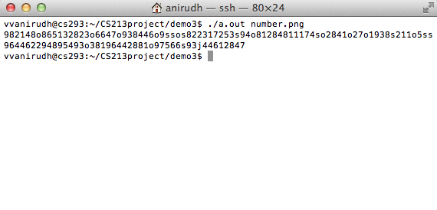
Algorithm Design
Recognizing Characters: When the user presents the test image, our program detects and recognizes the characters in the image.

Slide 20
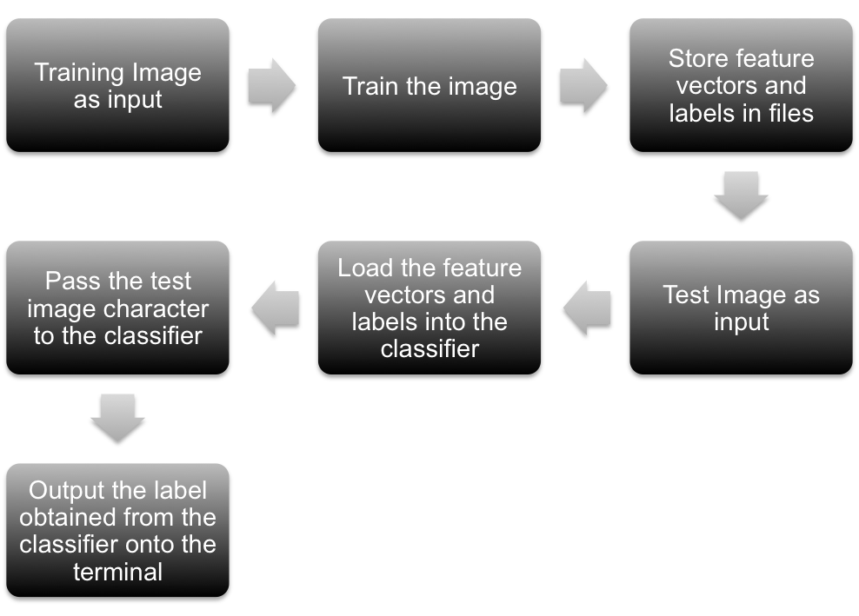
Project Workflow

Slide 21
Class Design – High level
For simplicity in understanding and ease of collaborating, we have divided the whole project into two parts: Image Processing, Machine Learning.
The class “Image” deals with all the image processing functions used. Any manipulation done in the image is done within the Image class.
The class “TrainedData” deals with all the training and recognizing part of the project. Any function regarding classifiers, data storage and training is done within the TrainedData class.
As you can observe, we have divided the work between us in the same way making our collaboration simpler.

Slide 22
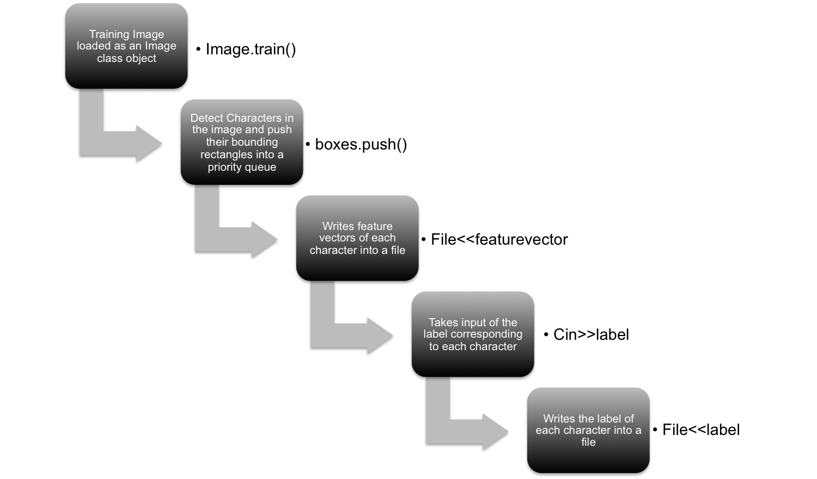
Class Design – High level
TRAINING

Slide 23
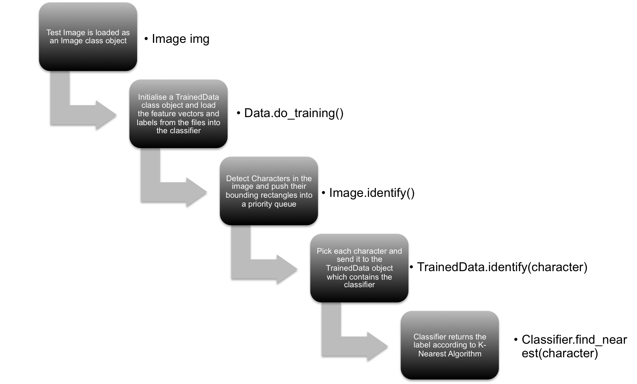
Class Design – High level
RECOGNIZING

Slide 24
Class Design - Details
Image:
  Description: Contains the information and attributes of an image that is loaded into the program. This class has all the methods that we use to detect, recognize and train images. This is the class in which the image processing and manipulation part is done.
  Data Members:
    IplImage : The OpenCV image data structure. This is the data member in which the image is stored.
    Priority Queue: The priority queue that stores the bounding rectangles of the contours.

Slide 25
Class Design - Details
    CvSeq* : The sequence of contours present in the image.
    uchar* : The data structure in which the data regarding the image is present(i.e. the pixel values)
  Methods:
    box() : Draws the bounding rectangles on the contours found in the image.
    display() : displays the image in a separate window.
    train() : Trains the image.
    identify(TrainedData& data) : identifies the characters in the image using ‘data’.

Slide 26
Class Design - Details
TrainedData:
  Description: Contains the information about the trained data. This class is the place where all the characters that have been trained upon are stored in their feature vector form.
  Data Members:
    CvMat* samples : The OpenCV matrix data structure. This is the data member in which all the trained images feature vectors are stored.
    CvMat* labels: The OpenCV matrix data structure in which all the corresponding labels of the trained images are stored in.

Slide 27
Class Design - Details
    CvKNearest : The K-Nearest classifier in which the data is loaded.
    CvMat* identifysample: The data structure in which the feature vector of the test image is present(i.e. the pixel values)
    CvMat* identifylabel: The data structure in which we obtain the label of the test image.
  Methods:
    identify(vector<int> sample) : This method identifies the given feature vector and returns the corresponding label.
    do_training() : This method does the training on the data present in samples and labels.

Slide 28
Class Design - Details
Box:
  Description: The class containing the bounding rectangle of a character. This class is defined to ensure ordering of characters.
  Data Members:
    CvRect : OpenCV data structure to store a rectangle. This stores the bounding rectangle of a character.
  Methods:
    setRect(CvRect) : sets the rectangle to the given rectangle.
    getRect(): returns the rectangle present in the class.

Slide 29
Class Design - Details
    operator< : Overloads the < operator to ensure that when these ‘boxes’ are pushed into a priority queue, they get ordered according to their position in the original image.

Slide 30
Data Structures Used
Purpose for which data structure is used | Data Structure Used | Whether Own Implementation or STL
Perfect ordering of contours | Priority queue | STL
Storing of feature vector and labels | CvMat | OpenCV
Storing of contours | CvSeq | OpenCV
Storing of feature vector of a single image | vector | STL
Storing bounding rectangle | Box | Own

Slide 31
Source Code Information
File Name | Brief Description | Author (Team Member)
Image.h | Declares Image class and methods | Vinod Reddy K
Image.cpp | Implements Image class methods | Vinod Reddy K
TrainedData.h | Declares TrainedData class and its methods | Anirudh V
TrainedData.cpp | Implements TrainedData class methods | Anirudh V
Box.h | Declares Box class and its methods | Anirudh V

Slide 32
Source Code Information
File Name | Brief Description | Author (Team Member)
Box.cpp | Implements Box class methods | Anirudh V
train.cpp | Main function which trains on a set of images | Anirudh V
recog.cpp | Main function which recognizes the character in a test image | Vinod Reddy K

Slide 33
Brief Conclusion
Although this OCR performs well on good quality images, it fails on noisy images where two/more characters may be combined. Thus we have demonstrated the project only on good quality images.

Slide 34
Thank You – Questions?
< time for me to do viva>

