Slide 1
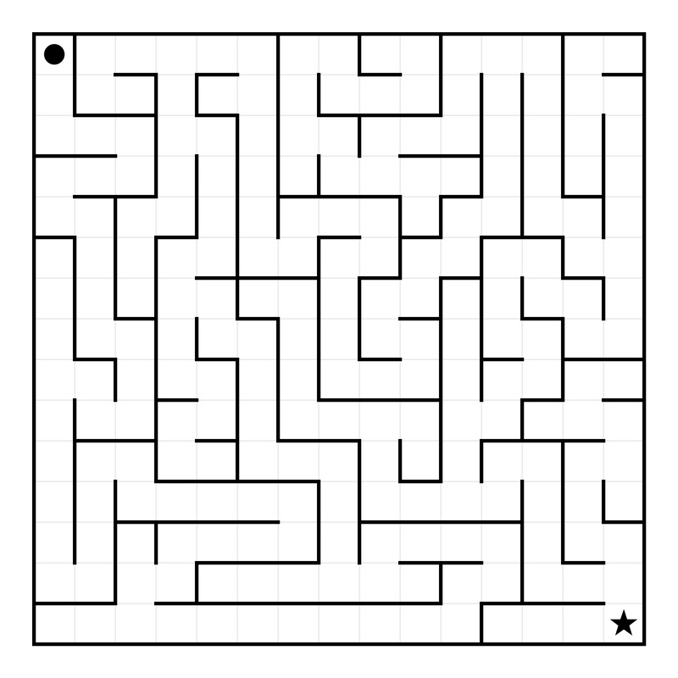
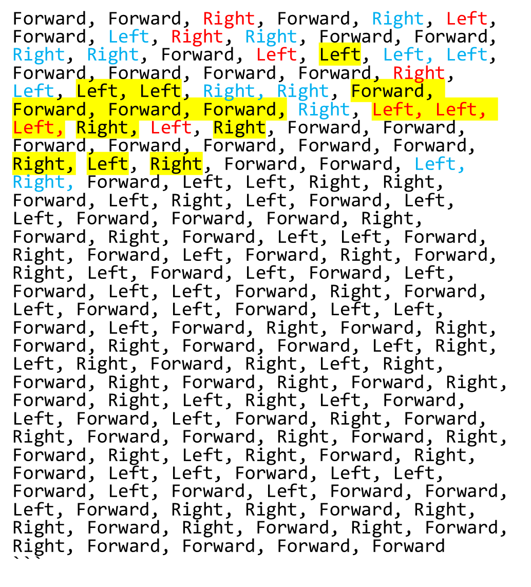
… repetition
Line Adj Json
NR allo
R coords, R allo
NR coords
NR ego
… repetition
R ego: blauw is goed, rood is gewisseld op lateral vlak

Slide 3
Line Adj Txt
NR allo
R coords
NR coords
NR ego
13,12),(12,12),(11,12),(10,12),(10,13),(10,14),(9,14),(9,13),(9,12),(9,11),(10,11),(11,11),(11,10),(12,10),(12,9),(12,8),(13,8),(13,7),(13,6),(13,5),(14,5),(14,6),(14,7),(14,8),(14,9),(13,9),(13,8),(13,7),(12,7),(11,7),(10,7),(10,6),(9,6),(8,6),(7,6),(6,6),(6,5),(7,5),(8,5),(9,5),(10,5),(10,4),(10,3),(9,3),(9,4),(8,4),(8,3),(7,3),(6,3),(5,3),(5,4),(4,4),(3,4),(2,4),(1,4),(1,5),(0,5),(0,6),(0,7),(1,7),(1,6),(2,6),(3,6),(3,7),(2,7),(1,7),(1,8),(1,9),(0,9),(0,8),(0,9),(1,9),(2,9),(2,8),(3,8),(3,7),(4,7),(4,6),(5,6),(5,5),(4,5),(3,5),(2,5),(1,5),(1,4),(2,4),(3,4),(4,4),(4,3),(3,3),(2,3),(2,4),(3,4),(4,4),(5,4),(6,4),(7,4),(7,3),(8,3),(9,3),(10,3),(10,2),(10,1),(11,1),(12,1),(13,1),(13,0),(14,0),(14,1),(13,1),(13,2),(14,2),(14,3),(13,3),(12,3),(12,4),(12,5),(11,5),(11,4),(11,3),(11,2),(10,2),(11,2),(12,2),(13,2),(13,3),(12,3),(12,4),(11,4),(10,4),(10,5),(9,5),(8,5),(7,5),(6,5),(6,6),(7,6),(8,6),(9,6),(10,6),(11,6),(12,6),(12,5),(13,5),(13,4),(14,4),(14,5),(14,6),(13,6),(12,6),(11,6),(10,6),(10,7),(9,7),(8,7),(8,6),(9,6),(9,7),(9,8),(8,8),(8,7),(7,7),(6,7),(5,7),(5,8),(4,8),(4,9),(3,9),(3,10),(2,10),(2,9),(1,9),(0,9),(0,10),(0,11),(1,11),(2,11),(3,11),(4,11),(4,10),(5,10),(5,9),(6,9),(7,9),(8,9),(9,9),(10,9),(10,8),(11,8),(11,7),(12,7),(13,7),(13,8),(13,9),(14,9),(14,10),(13,10),(12,10),(11,10),(10,10),(9,10),(8,10),(9,10),(10,10),(11,10),(12,10),(13,10),(14,10),(14,11),(13,11),(12,11),(11,11),(10,11),(9,11),(9,10),(10,10),(10,11),(11,11),(12,11),(13,11),(14,11),(14,12),(13,12),(12,12),(11,12),(10,12),(10,13),(11,13),(12,13),(9,13),(9,14),(10,14),(11,14),(12,14),(13,14),(14,14)

Slide 4

0
1
2
3
4
5
6
7
8
9
10
11
12
13
14
NR coords JSON
(0, 0), (1, 0), (2, 0), (2, 1), (3, 1), (3, 2), (4, 2), (5, 2), (5, 3), (5, 4), (6, 4), (7, 4), (7, 5), (8, 5), (9, 5), (9, 6), (10, 6), (11, 6), (11, 7), (11, 8), (12, 8), (13, 8), (13, 9), (13, 10), (13, 11), (12, 11), (11, 11), (10, 11), (9, 11), (8, 11), (7, 11), (6, 11), (5, 11), (4, 11), (3, 11), (2, 11), (1, 11), (1, 12), (1, 13), (1, 14), (2, 14), (3, 14), (4, 14), (5, 14), (6, 14), (7, 14), (8, 14), (9, 14), (10, 14), (11, 14), (12, 14), (13, 14), (14, 14)
0
1
2
3
4
5
6
7
8
9
10
11
12
13
14

Slide 5
0
1
2
3
4
5
6
7
8
9
10
11
12
13
14
NR coords JPG
`(0, 0), (1, 0), (2, 0), (2, 1), (2, 2), (3, 2), (4, 2), (4, 1), (4, 0), (5, 0), (6, 0), (7, 0), (7, 1), (7, 2), (8, 2), (8, 3), (8, 4), (9, 4), (10, 4), (11, 4), (11, 3), (11, 2), (12, 2), (13, 2), (14, 2), (14, 3), (14, 4), (14, 5), (14, 6), (14, 7), (14, 8), (14, 9), (14, 10), (14, 11), (14, 12), (14, 13), (14, 14)`
0
1
2
3
4
5
6
7
8
9
10
11
12
13
14

Slide 6
0
1
2
3
4
5
6
7
8
9
10
11
12
13
14
NR coords JPG
`(0, 0), (1, 0), (2, 0), (2, 1), (2, 2), (3, 2), (4, 2), (4, 1), (4, 0), (5, 0), (6, 0), (7, 0), (7, 1), (7, 2), (8, 2), (8, 3), (8, 4), (9, 4), (10, 4), (11, 4), (11, 3), (11, 2), (12, 2), (13, 2), (14, 2), (14, 3), (14, 4), (14, 5), (14, 6), (14, 7), (14, 8), (14, 9), (14, 10), (14, 11), (14, 12), (14, 13), (14, 14)`
0
1
2
3
4
5
6
7
8
9
10
11
12
13
14

Slide 7
0
1
2
3
4
5
6
7
8
9
10
11
12
13
14
NR coords JPG
`(0, 0), (1, 0), (2, 0), (2, 1), (2, 2), (3, 2), (4, 2), (4, 1), (4, 0), (5, 0), (6, 0), (7, 0), (7, 1), (7, 2), (8, 2), (8, 3), (8, 4), (9, 4), (10, 4), (11, 4), (11, 3), (11, 2), (12, 2), (13, 2), (14, 2), (14, 3), (14, 4), (14, 5), (14, 6), (14, 7), (14, 8), (14, 9), (14, 10), (14, 11), (14, 12), (14, 13), (14, 14)`
0
1
2
3
4
5
6
7
8
9
10
11
12
13
14

Slide 8
0
1
2
3
4
5
6
7
8
9
10
11
12
13
14
NR coords JPG
`(0, 0), (1, 0), (2, 0), (2, 1), (2, 2), (3, 2), (4, 2), (4, 1), (4, 0), (5, 0), (6, 0), (7, 0), (7, 1), (7, 2), (8, 2), (8, 3), (8, 4), (9, 4), (10, 4), (11, 4), (11, 3), (11, 2), (12, 2), (13, 2), (14, 2), (14, 3), (14, 4), (14, 5), (14, 6), (14, 7), (14, 8), (14, 9), (14, 10), (14, 11), (14, 12), (14, 13), (14, 14)`
0
1
2
3
4
5
6
7
8
9
10
11
12
13
14

Slide 11
