Slide 1

Building, Deploying and Operating Containerized Application in AWS
Submitted By:
Darshil Shah
Mahima Shastri
Vanshita Verma

Slide 2

Goals and Objectives
GOALS
The primary goal is to create a containerized Django application on AWS.
OBJECTIVES
Containerization of the Application:
Utilize containerization tools like Docker to package our Django application along with its dependencies, ensuring consistency across different environments.
AWS Infrastructure Setup:
Set up necessary AWS resources, such as EC2 instances, and any other required services.

Slide 3
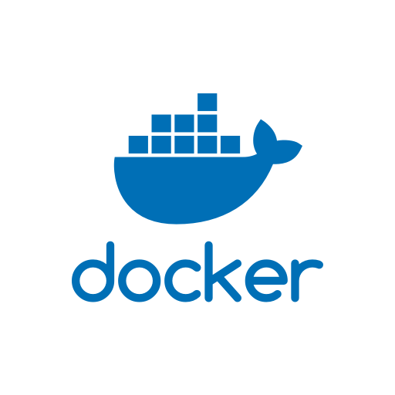


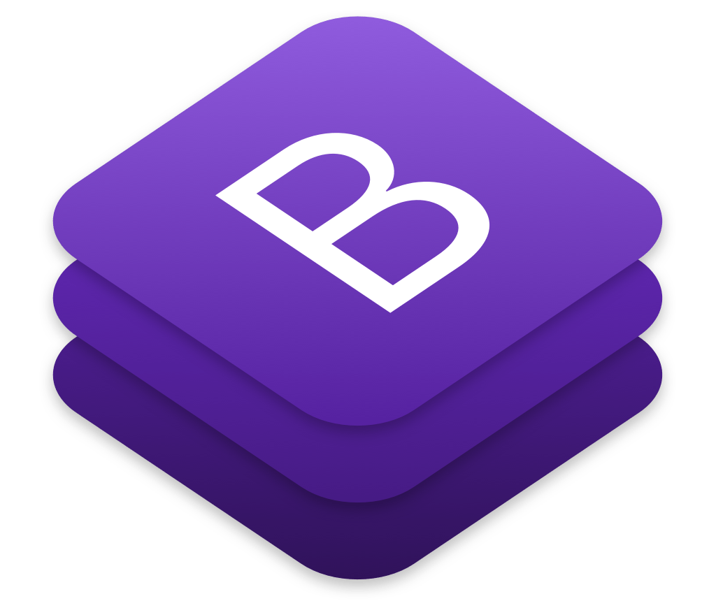
Introduction
Tech Stack:
Django for the backend
MySql for the backend database
HTML, Bootstrap, CSS, and JavaScript for the frontend
Docker for containerization
AWS EC2 as host machine
GitHub for version control
Key Features:
Book cataloging with detailed information
Responsive design for cross-device accessibility achieved via Bootstrap.
Data persistency is implemented via using volumes for the containers.
Deployment:
Docker for containerized deployment
Hosted on AWS EC2 instance
Version Control:
GitHub repository for versioned code

Slide 4
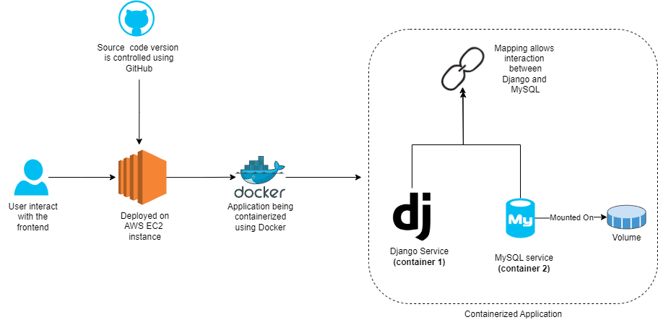
Workflow

Slide 5
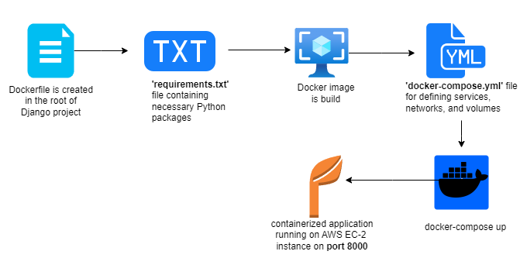
How is the application containerized?

Slide 6
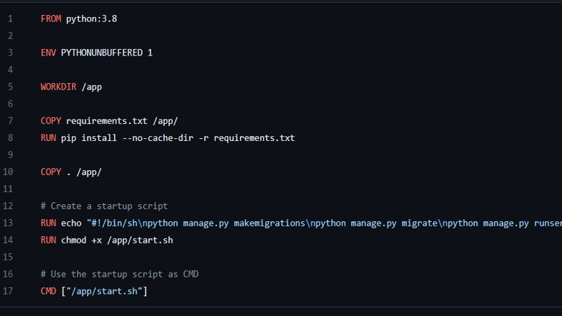
Docker file

Slide 7
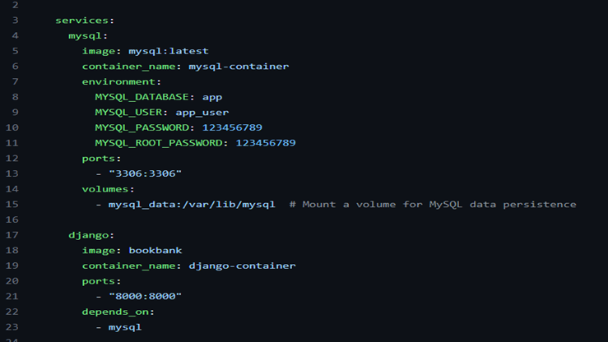
Docker-compose.yml

Slide 8

Limitations and Future Scope
LIMITATIONS
No CI/CD Pipeline
No Kubernetes Orchestration
Single Point of Failure
Scalability Challenges
FUTURE SCOPE
Implement CI/CD
Container Orchestration
High Availability Architecture
Scalability Strategies
Monitoring and Logging
Security Enhancements
Cloud Migration

Slide 9
Conclusion
Outcomes
Django Development Success
Efficient Collaboration via GitHub
Docker for Consistent Containerization
Enhanced Functionality through Integration
CI/CD Pipeline Need Identified
Kubernetes Consideration for Scalability
Scalability Strategies Acknowledged
Learnings
High Availability Awareness
Django Development Proficiency
Containerization Insights with Docker
Technology Integration Expertise
Importance of CI/CD Pipelines
Considerations for Orchestration
High Availability Design Awareness
Scalability Strategies Exploration
Continuous Improvement Mindset
Effective Use of GitHub

