Slide 1
Severstal Steel Defect Detection
Workflow and thought process
V. Bauman
December 2021 – January 2022

Slide 2
Transfer learning methodology (Dec 1 - 7)
INITIAL IDEA
Adopted from Wang 2021 paper, also recommended by Kaggle competition winners:
Using a binary classifier, classify images as either having a defect or not having a defect
For those images classified as having a defect, get the defect class and location/bounding box
Caveat: use 1 image from each class to make training set
(for steel dataset, there are 5 classes total: 1 non-defect, 4 defect. Exclude examples with >1 defect)
BINARY CLASSIFICATION MODEL & CREATING TRAINING SET
Binary classifier is ResNet50 with transfer learning: all layers except for the final dense/classification layer is trained using ImageNet dataset, final layer is trained using our data (4098 parameters to learn).
Training set created by first creating some duplicates of available images then using the images in Keras ImageDataGenerator (augments images on-the-fly as the model is being trained, doesn’t keep the original images so duplicates in training set might be OK?)
RESULTS
Training set made using ImageDataGenerator alone is too small to learn the 4098 parameters
High variability within classes in the steel dataset. Idea: be selective in choosing images to use in training set, might be worthwhile to get similarity between train and test images when making predictions, to understand and contextualize test set accuracy
NEXT STEPS
Try offline image augmentation to generate more images – recommended to improve data diversity and improve model robustness (see link to blog at bottom of slide). Also good because you can see the augmented images and know what transformations were applied
A 2-layer CNN could be sufficient for defect classification. Trying this as an alternative methodology
Link to blog on image augmentation: https://www.analyticsvidhya.com/blog/2021/06/offline-data-augmentation-for-multiple-images/

Slide 3
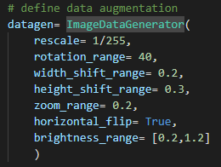
Transfer learning con't (Dec 9 – Dec 16)
OFFLINE IMAGE AUGMENTATION
Generated 7010 images from 5 original images (1 from each defect class) using Keras ImageDataGenerator.
Using 90/10 split for training with transfer learning
TRANSFER LEARNING MODEL
In general, there are two approaches to transfer learning. Approach tried here:
1. Load pre-trained ResNet50 model 2. Run dataset through ResNet50 once (not training. Instead, it's predicting) and record the output at the last layer. This output represents the features extracted by ResNet50 3. Use this output as the starting point for training a fully connected model that predicts defect class
"bottleneck features" method
RESULTS
Fully connected model architecture: 128-unit with relu activation, 5-unit with softmax activation. Adam optimizer (0.001 learning rate). 30 epochs, 64 batch size for training and validation
Training acc= 91.1% Validation acc= 97.4%
Test set mean recall= 29.8% class 0 = 47.2% class 1 = 2.0% class 2 = 9.7% class 3 = 16.1% class 4 = 4.3%
Note: test set was all the images in the Kaggle dataset where there was 1 defect
Fully connected model architecture: 256-unit with relu activation, 5-unit with softmax activation. Adam optimizer (0.001). 30 epochs, 64 batch size for training and validation
Training acc= 97.0% Validation acc= 97.4%
Test set mean recall= 31.1% class 0 = 54.1% class 1 = 0.4% class 2 = 5.6% class 3 = 11.1% class 4 = 5.0%
NEXT STEPS
Recall is very low. To improve recall, re-do image augmentation and model training with more images.

Slide 4
Transfer learning con't (Dec 9 – Dec 16)
OFFLINE IMAGE AUGMENTATION
Generated 12,354 images from 5 original images using Keras ImageDataGenerator.
Using 90/10 split for training with transfer learning
TRANSFER LEARNING MODEL
Use the same "bottleneck features" method previously described, with the same fully connected model architecture:
Fully connected model architecture: 128-unit with relu activation, 5-unit with softmax activation. Adam optimizer (0.001 learning rate). Trained for 30 epochs, 64 batch size for training and validation
RESULTS
Training acc= 91.8% Validation acc= 97.1%
Test set mean recall= 29.1% class 0 = 43.6% class 1 = 2.6% class 2 = 2.6% class 3 = 18.8% class 4 = 5.8%
Note: test set was all the images in the Kaggle dataset where there was 1 defect (same as before, when a smaller training set was used)
Adding more training images made no difference on test set performance
NEXT STEPS
Kaggle community observed high variability among images in class 0 (non-defect class). Quantify similarity between class 0 images in the test set and the class 0 image in the training set. Remove dis-similiar class 0 images from the test set

Slide 5
Transfer learning con't (Dec 16 – Dec 23)
REMOVE DISSIMILAR IMAGES FROM TEST SET
Using the full Kaggle dataset as the test set might be causing pessimistic results, since there is high variability and many one-off images for the class 0 images. Training set it based on 1 image from each class, so can't expect model to perform well if there is high variability within the classes
For the test set, keep class 0 images that have a Euclidean distance less than 100 from the class 0 image used to make the training set (number of class 0 images in the test set is reduced from 5967 to 941)
TRANSFER LEARNING MODEL
Use the same "bottleneck features" method previously described, with the same fully connected model architecture:
Fully connected model architecture: 128-unit with relu activation, 5-unit with softmax activation. Adam optimizer (0.001 learning rate). Trained for 30 epochs, 64 batch size for training and validation
RESULTS
Training acc= 96.3% Validation acc= 98.0%
Test set mean recall= 20.4% class 0 = 81.6% class 1 = 1.3% class 2 = 9.7% class 3 = 13.2% class 4 = 7.8%
NEXT STEPS
Having high variability among the class 0 images in the test set makes no difference on test set performance.
Change back to binary classification (defect/no defect)

Slide 6
Transfer learning con't (Dec 23 – Jan 4)
TRANSFER LEARNING MODEL
Binary classification model using the "bottleneck features" method with a 90/10 train/validation split (7010 images total)
HYPERPARAMETERS TESTED & RESULTS
All models used the Adam optimizer (learning rate = 0.001) and 1 as the test set batch size Class 0 is the non-defect class, class 1 is the defect class
Fully connected model | Epochs | Train/Validation batch size | Training acc | Validation acc | Test set mean recall | Class recall
128 units w/relu, 2 units w/softmax | 40 | 64 | 97.3 | 97.1 | 66.3 | Class 0 = 78.5 Class 1 = 64.5
128 units w/relu, 2 units w/softmax | 40 | 128 | 97.7 | 96.1 | 68.1 | Class 0 = 75.9 Class 1 = 66.9
128 units w/relu, 2 units w/softmax | 40 | 32 | 96.2 | 83.9 | 82.6 | Class 0 = 33.4 Class 1 = 90.0
256 units w/relu, 128 units w/relu, 2 units w/softmax | 40 | 32 | 97.2 | 98.0 | 62.7 | Class 0 = 85.0 Class 1 = 59.4
What is challenging about this binary classification task? Is it due to too large of a difference between training and test sets (due to only 1 image from each defect class used to create the training set)?

Slide 7
Methodology 2 (Not completed)
INITIAL IDEA
Develop a few-layer (i.e. 2-layer) CNN as a multi-class classifier for defect detection
Caveat: use 1 image from each class to make training set
MULTI-CLASS CLASSIFICATION MODEL & CREATING TRAINING SET
Creating dataset in progress...
RESULTS
In progress…
NEXT STEPS
In progress…

Slide 8
Appendix – quantifying image similarity
High variability among images in the same class in the test set could be why recall is so low in the transfer learning approach
For class 0 in particular (I.e. non-defect class), want images in the test set to be somewhat similar to those in the training set
Quantify similarity: get the Euclidean distance between class 0 images in the test set and the class 0 image used to make the training set
Discard class 0 images in the test set that have a Euclidean distance greater than some threshold
This is a crude approach, might be better to get distance between image feature maps (i.e. output after convolutional layers)

Slide 9
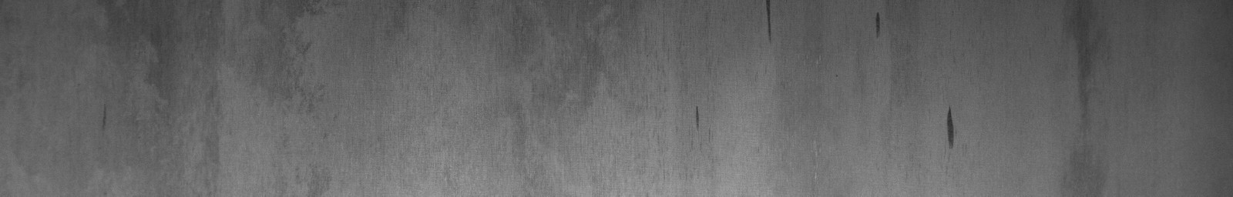

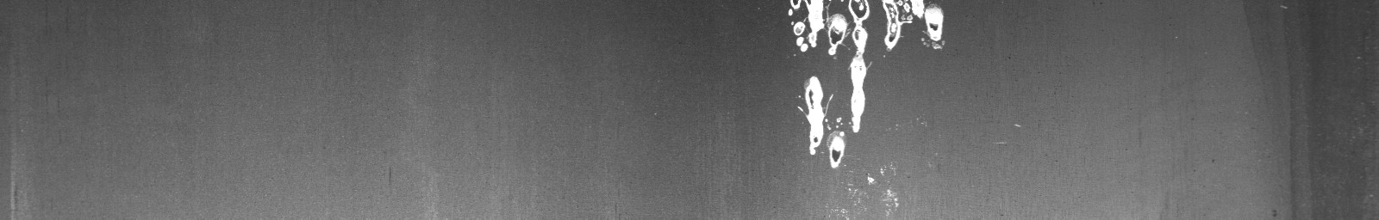
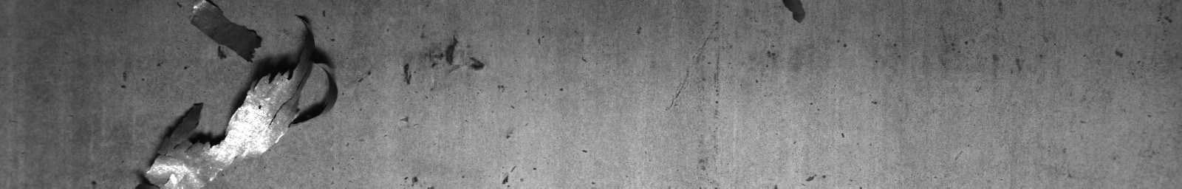
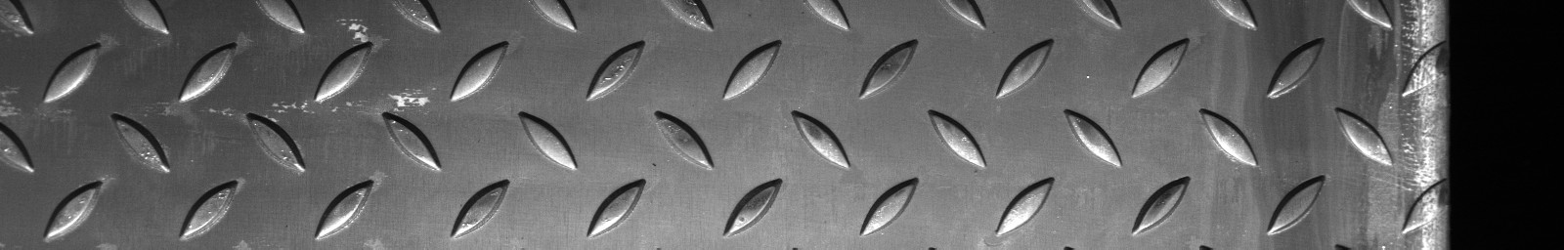
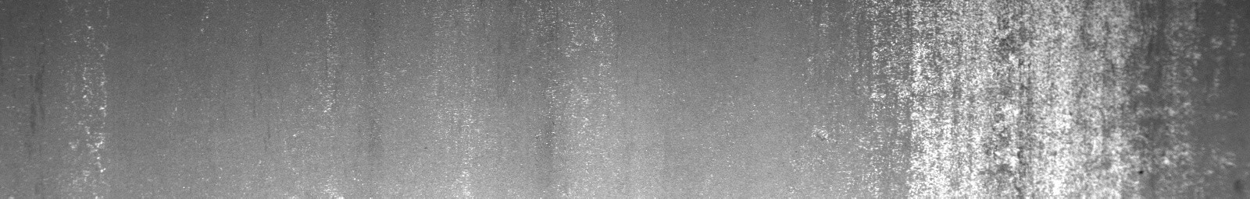
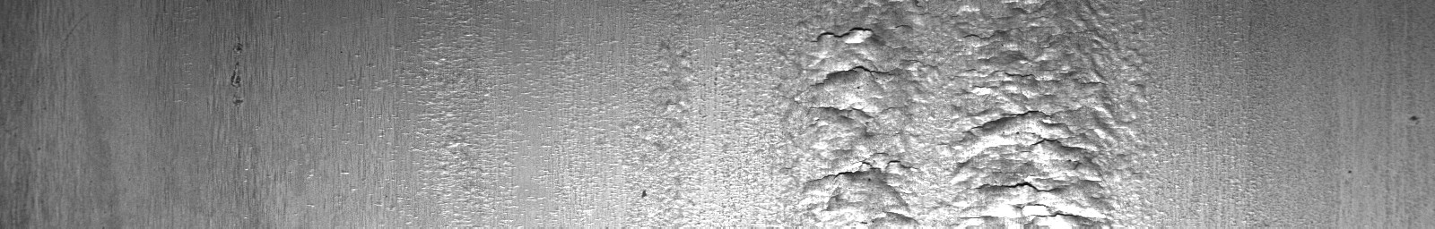
Visualizing similar class 0 images
Class 0 image used to generate training set
69e5aff01.jpg - Euclidean distance = 36.7
e1b97f71c.jpg - Euclidean distance = 100.1
ab93fca16.jpg - Euclidean distance = 130.0
5ba431673.jpg - Euclidean distance = 160.2
12baa6dc4.jpg - Euclidean distance = 190.0
5ed3c7563.jpg - Euclidean distance = 230.2

Slide 10
Appendix – alternative transfer learning method
OFFLINE IMAGE AUGMENTATION
Same a bottleneck features model: Generated 7010 images from 5 original images (1 from each defect class) using Keras ImageDataGenerator.
Using 90/10 split for training with transfer learning
TRANSFER LEARNING
Approach tested:
1. Load pre-trained ResNet50 model 2. Run dataset through the pre-trained ResNet50 with fully connected layer at end of ResNet50 (training set runs through ResNet50 each epoch. ResNet50 pre-trained weights are frozen so they don't change with each epoch. Weights in fully connected network train/update with each epoch)
Fully connected layer: 5-unit with softmax activation
("freeze model" method)
RESULTS
Fully connected model architecture: pooling layer, 5-unit with softmax activation. Adam optimizer (0.001 learning rate). 30 epochs, 64 batch size for training and validation
Training acc= 66.6% Validation acc= 74.0%
Test set mean recall= 19.9% class 0 = 31.9% class 1 = 2.7% class 2 = 23.6% class 3 = 8.6% class 4 = 8.5%
Note: test set was all the images in the Kaggle dataset where there was 1 defect
Fully connected model architecture: pooling layer, 128-unit with relu activation, 5-unit with softmax activation. Adam optimizer (0.001 learning rate). 50 epochs, 64 batch size for training and validation
Training acc = 89.5%
Validation acc = 89.7%
Test set mean recall = 20.2%
Class 0 = 80.4%
Class 1 = 12.6%
Class 2 = 2.6%
Class 3 = 12.0%
Class 4 = 3.7%
Test set was all images in the Kaggle dataset, with the dissimilar class 0 images removed

