Slide 1
Current State Analysis
1.1.1 Fabric and Azure AI Analysis
Current user mapping, pain points, and platform-specific opportunities across Fabric-native capabilities, Purview governance, and Azure AI services.
1.1.2 Technology Stack Evaluation
Assessment of 25+ platforms including Salesforce, Genesys, Fabric, and MuleSoft. Identified unused AI licenses, platform duplication issues, and strategic cost drivers.
1.1.3 Platform Access Gap Analysis
Prioritized AI capabilities by ROI: underutilized licenses, high-value opportunities, and implementation opportunities for 2026-2027.

Slide 2
Current State Analysis
1.1.1 Fabric and Azure AI Analysis
Current user mapping, pain points, and platform-specific opportunities across Fabric-native capabilities, Purview governance, and Azure AI services.
1.1.2 Technology Stack Evaluation
Assessment of 25+ platforms including Salesforce, Genesys, Fabric, and MuleSoft. Identified unused AI licenses, platform duplication issues, and strategic cost drivers.
1.1.3 Platform Access Gap Analysis
Prioritized AI capabilities by ROI: underutilized licenses, high-value opportunities, and implementation opportunities for 2026-2027.

Slide 3
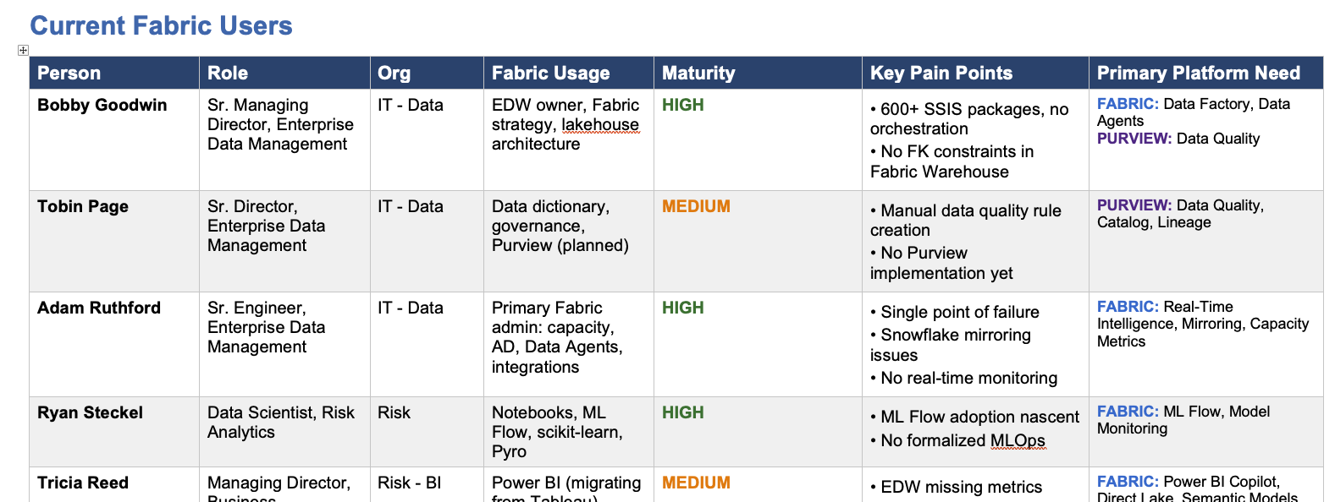
1.1.1 Fabric & Azure AI Analysis
Document Scope
Maps current Fabric users and identifies opportunities across three platform categories—each with distinct licensing, skillsets, and implementation approaches.
Deliverable Contents
Platform Taxonomy (Fabric vs. Purview vs. Azure AI)
Current Fabric Users (10 stakeholders mapped)
Fabric-Native Opportunities (8)
Purview Governance Opportunities (4)
Azure AI Opportunities (5)
Prioritized Recommendations (8)
Platform Delineation / Licensing
Microsoft Fabric: Subscription-based, already licensed. Copilot features included. Most opportunities here are 'activation' not procurement.
Microsoft Purview: Separate licensing from Fabric. Critical for banking compliance. Data Quality GA Sept 2025.
Azure AI Services: Pay-per-use. Different skillset (developers vs. analysts). Subject to AI Governance Policy.
Appendix
Purview Implementation Approach (3-phase plan with detailed guidance)

Slide 4
Opportunities by Platform
Current Fabric Usage
10 stakeholders mapped across IT-Data, Risk, BI, and Operations. Maturity ranges from LOW to HIGH. Key pain points: 600+ SSIS packages, manual data quality rules, shadow AI usage, 30-40 min query times.
Purview Governance (4 opportunities)
AI-Generated Data Quality Rules, Data Classification/PII Tagging, Data Lineage Visualization, Data Catalog/Discovery. Separate licensing, critical for banking compliance.
→ See Appendix: Purview Implementation Approach
Fabric-Native (8 opportunities)
NLP Query Interface, SQL/Code Generation, Real-Time Intelligence, MLOps Formalization, BI Migration Support, Capacity Observability, Platform Integration, ETL Modernization. Already licensed—activation not procurement.
Azure AI (5 opportunities)
Sanctioned LLM Access (URGENT), Document Intelligence (MEDIUM), Research Automation (MEDIUM), Knowledge RAG (ASSESS), Telematics Processing (FUTURE). Net-new capabilities requiring separate licensing and governance.

Slide 5
Prioritized Recommendations
Immediate (Fabric Activation)
Expand Code Assistance Tools—address 30-40 min queries blocking IT
Expand Data Agents / NLP Query—democratize data access
Near-Term (Purview)
Accelerate Purview Deployment—95% of data untagged for AI use
Activate Real-Time Intelligence—fraud detection, payment patterns
Urgent (Azure AI - Governance)
Provide Sanctioned LLM Access—replace shadow ChatGPT usage
Medium-Term (Azure AI - Additive)
Pilot Research Automation for Economics team
Assess Document Intelligence when DMS matures

