Slide 1

February 13, 2026
STELLANTIS Financial Services US
Solutions Testing Team AI Optimization Assessment
Prepared
exclusively for:

Slide 2

▶
Agenda
Time | Topic | Presenter
1:00 | 1.0 Executive Summary | Dominique
2:00 | 1.1 Current State Analysis | Dominique
3:00 | 1.2 Critical Pain Points | Dominique
4:00 | 1.3 AI Usage Assessment | Dominique
5:00 | 1.4 Prompt Analysis & Improvements | Dominique
6:00 | 1.5 AI Opportunities Roadmap | Dominique
7:00 | 1.6 Recommendations & Next Steps | Dominique
8:00 | Q&A | Dominique
2
© 2026 Earley Information Science, Inc. All rights reserved.
CONFIDENTIAL www.earley.com

Slide 3
▶
Executive Summary
Team Structure
Current AI Usage
40 manual testers + 9 automation engineers
75% contractors, 25% FTEs
Automation team grew from 3 to 9 in past year
Team proactively adopted Microsoft Copilot
for Gherkin test case generation with
custom prompt template
Key Challenge
Top Opportunity
Two-week sprint cycles with immediate
production deployment create severe
pressure on testing capacity
AI-driven test impact analysis to enable
risk-based regression testing and reduce
5-day regression window
3
© 2026 Earley Information Science, Inc. All rights reserved.
CONFIDENTIAL www.earley.com

Slide 4
▶
Current State Analysis
Organizational Structure
Tools & Technology Stack
Team | Size | Leadership
Manual Testing | 40 | Corinne Anderson
Automation | 9 | Stephen Kinnison
Total | 49 | Swarupa Kota (Dir.)
Category | Tools
UI Automation | Behave, Playwright
API Testing | Pytest, Requests
CI/CD | Jenkins
Test Management | Spira Test
Version Control | Azure DevOps, Git
AI Tools | Microsoft Copilot
Coverage Metrics
Application | Coverage
MySFS | 41%
Overall average | 25-30%
Testing focus | 80-85% UI
4
EARLEY
© 2026 Earley Information Science, Inc. All rights reserved.
CONFIDENTIAL www.earley.com

Slide 5
▶
Critical Pain Points Identified
Locator Management
Compressed Timeline
"Automation engineers spend considerable
daily effort identifying failed tests, finding
new working locators for changed elements."
"The team must 'pray' that bug fixes don't
introduce new issues, as there's no time
for additional regression cycles."
~50% of automation time spent on maintenance
No comprehensive regression in QA environment
Vague User Stories
No Impact Analysis
"They're not as defined as we need them to
be... we have to dig a lot deeper and ask
a ton of questions."
"The team lacks systematic impact analysis
tools to identify which test cases should
execute based on code changes."
Quality in = Quality out for AI generation
Manual coordination doesn't scale
5
EARLEY
© 2026 Earley Information Science, Inc. All rights reserved.
CONFIDENTIAL www.earley.com

Slide 6
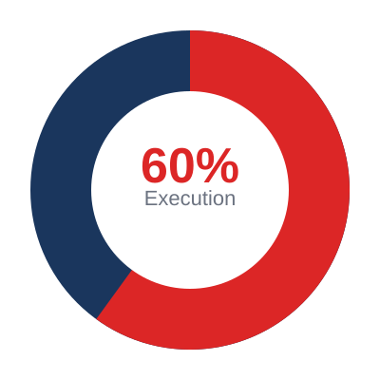
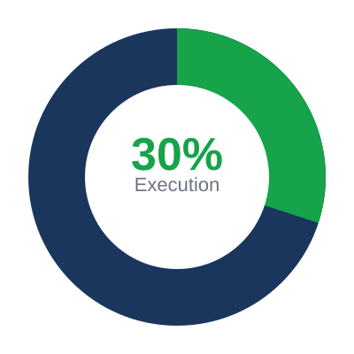
▶
Testing Effort Imbalance
Current State
Target State
Execution 60%
Planning 40%
Execution 30%
Planning 70%
Root cause: Extensive bug retesting cycles and insufficient automation coverage drive execution-heavy imbalance.
6
EARLEY
© 2026 Earley Information Science, Inc. All rights reserved.
CONFIDENTIAL www.earley.com

Slide 7




▶
Testing Effort Imbalance
Why Is Execution So High? Four Compounding Drivers
Repeated Bug Retesting Cycles
No Risk-Based Regression
Bug fixes within a sprint must be re-verified, often multiple times, consuming execution hours that crowd out planning and design.
Without impact analysis, the team runs broad regression passes rather than targeted suites — 5 full days of execution per release.
Low Automation Coverage (25-30%)
Staging as Second Test Pass
Most regression is still executed manually. The 9-person automation team spends ~50% of their time on locator maintenance, not new coverage.
Bandwidth constraints prevent a full second pass in QA, so staging becomes de facto retesting — adding another execution cycle.
Where do these numbers come from? The 60/40 split was reported by the manual testing team during the Dec 18 optimization session. Industry benchmark for mature testing orgs targets a 30/70 execution-to-planning ratio (ISTQB, Capgemini World Quality Report). Closing the gap requires reducing manual re-execution through automation, smarter regression selection, and fewer retesting loops.
7
© 2026 Earley Information Science, Inc. All rights reserved.
CONFIDENTIAL www.earley.com

Slide 8
▶
Current AI Workflow: Copilot for Test Generation
1
→
2
→
3
→
4
→
5
→
6
1
2
3
4
5
6
Jira User
Story
Copy to
Copilot
Run
Prompt
Excel
Output
Manual
Cleanup
Import to
Spira
What's Working
Limitations
Standardized Gherkin format output
Excel export matches ~80% of Spira template
Covers positive, negative, alternate scenarios
Team-wide adoption across manual testers
No integration with Jira or Spira
Cannot access test data or account numbers
Manual copy/paste workflow required
Output quality depends on user story quality
8
EARLEY
© 2026 Earley Information Science, Inc. All rights reserved.
CONFIDENTIAL www.earley.com

Slide 9
▶
Copilot Prompt Analysis
Strengths Identified
Issues Identified
Persona specification ("I" persona)
Prompt overload - too many instructions
Explicit column ordering for Spira
Missing application/domain context
Priority definitions with clear criteria
No examples provided (few-shot gap)
Testing type categorization
Ambiguous expected results rule
Step 0 pattern for metadata
Trailing question weakens output
"Validate" prefix standardization
No acceptance criteria extraction step
9
EARLEY
© 2026 Earley Information Science, Inc. All rights reserved.
CONFIDENTIAL www.earley.com

Slide 10
▶
Recommended Prompt Improvements
1. Add Structure
2. Add Context Block
3. Add Examples
Replace wall of text with categorized lists grouped by priority
Include application name, domain, platform, user types
Include 1-2 complete scenarios matching Spira format
4. Multi-Step Process
5. Data Placeholders
6. Completion Criteria
Extract AC → Map to test types → Generate scenarios
Define: [ACCOUNT_NUMBER], [VIN], [CUSTOMER_NAME]
Remove question, set minimum scenarios, output only
Expected Impact
30-50%
20-40%
25%
50%
Better output consistency
Less manual cleanup
Better test coverage
Less rework needed
10
EARLEY
© 2026 Earley Information Science, Inc. All rights reserved.
CONFIDENTIAL www.earley.com

Slide 11
▶
AI Opportunities Roadmap
Immediate (2-3 Months)
Quick Wins
Enhanced Copilot prompt with examples | AI-driven test impact analysis pilot
User story quality validation | Bug pattern analysis for high-risk areas
Medium-Term (3-6 Months)
Integration
Jira → AI → Spira pipeline | Pre-deployment merge validation
AI-enhanced test case review | Automated test data generation
Strategic (6-12 Months)
Transformation
Self-healing locator framework | Predictive defect analysis
Autonomous regression selection | AI-powered root cause analysis
11
EARLEY
© 2026 Earley Information Science, Inc. All rights reserved.
CONFIDENTIAL www.earley.com

Slide 12
▶
Key Recommendations
1
Mandate data-test-id Attributes
4
Shift Automation Left
Require developers to implement stable element identifiers to reduce 50% maintenance overhead
Move from Staging to QA environment to catch issues earlier in cycle
2
Implement Test Impact Analysis
5
AI-Assisted Story Validation
Highest-ROI opportunity to enable risk-based regression and reduce 5-day testing window
Upstream quality improvement to ensure complete requirements before testing
3
Enhance Copilot Prompt
6
Establish Test Data Management
Add examples, structure, and context to improve output consistency by 30-50%
Prevent conflicts across testing activities with dedicated data management
12
EARLEY
© 2026 Earley Information Science, Inc. All rights reserved.
CONFIDENTIAL www.earley.com

Slide 13
▶
Proposed Next Steps
Week 1-2
Week 3-4
Week 5-8
Deploy enhanced Copilot prompt
Gather 20 sample user stories
Document current process
Identify pilot application
Test impact analysis POC design
Measure prompt improvements
Dev alignment on data-test-id
Define success metrics
Execute impact analysis pilot
Build Jira → Spira prototype
Measure time & quality impact
Present findings & scale plan
Success Metrics
50%
30%
40%
25%
Less locator maintenance
Faster test generation
Smaller regression scope
Fewer production defects
13
EARLEY
© 2026 Earley Information Science, Inc. All rights reserved.
CONFIDENTIAL www.earley.com

Slide 14



Questions & Discussion
"The five-day regression testing window represents the highest
opportunity for improvement through AI-driven automation."
— Deepak Khemchandani, EPMO Lead
Dominique Legault
Earley Information Science

