Slide 1





STELLANTIS Financial Services
AI Maturity, Themes & Findings
Prepared
exclusively for:
1

Slide 2

AI Readiness
51% Overall Readiness | 66% Governance (Strength) | 43% Knowledge Readiness | 43% Operational Readiness
Domain | Score | Max | Percentage | Status
Knowledge Readiness | 39 | 90 | 43% | Early Stage
Operational Readiness | 43 | 100 | 43% | Early Stage
Technical Readiness | 42 | 85 | 49% | Gap
Governance Readiness | 63 | 95 | 66% | Strength
Overall | 187 | 370 | 51% | Early Stage
© 2026 Earley Information Science, Inc.

Slide 3
Six Themes
Theme 1: Knowledge Architecture Foundation
Theme 2: Operational AI Enablement
Theme 3: Customer Experience Intelligence
Theme 4: Developer & Analyst Productivity
Theme 5: Data Platform Modernization
Theme 6: AI Governance Operationalization
Themes = Strategic grouping of capabilities (ways to think about problem clusters)

Slide 4
Fifteen Findings
Enterprise Data Foundation Incomplete
AI Governance Gap / Shadow IT
Customer Service Highest ROI Opportunity
Testing Bottleneck
BI Productivity Constrained
Remarketing Lacks Intelligence
Conversational AI Lacks Rigor
Cross-System Integration Barriers
Document Intelligence Untapped
Portfolio Growth Needs Predictive Analytics
Knowledge Management Inadequate
Website/Digital Underperforms
Resource Allocation Lacks Prioritization
Process Maturity Gap
Competitive Positioning Needs Strategy
Findings = Atomic pain points (the problems/symptoms we heard)

Slide 5
Sixteen Initiatives
1.1 Genesis AI Activation
1.2 AI Governance Operationalization
1.3 Unified Metadata Schema Design
1.4 BI Code Generation Pilot
2.1 Payment Automation Deployment
2.2 Test Automation Enhancement
2.3 Content Inventory & Tagging
2.4 AI Center of Excellence Launch
3.1 AI Monitoring Dashboard
3.2 End-of-Lease AI Preparation
3.3 GitHub Copilot Deployment
3.4 Natural Language Query Expansion
4.1 Collections AI Augmentation
4.2 Einstein Activation
4.3 Knowledge Graph Implementation
4.4 ROI Validation & 2027 Planning
Initiatives = Projects/actions to solve problems

Slide 6
AI Readiness
Maturity Baseline to inform program activities

Slide 7
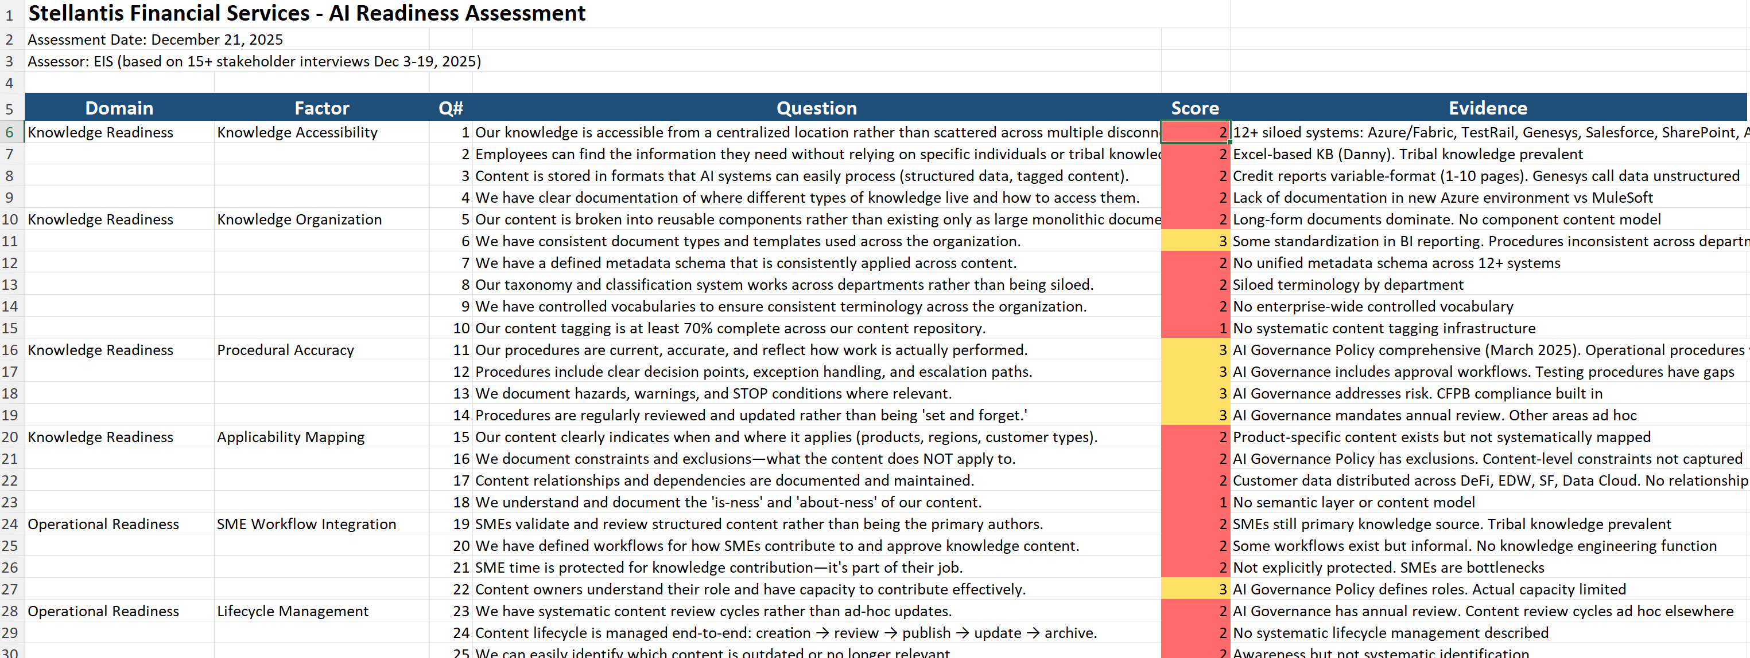
74 Question EIS AI Readiness Maturity Framework
4 Domains:
Knowledge Readiness
Operational Readiness
Technical Readiness
Governance Readiness
17 Factors:
Knowledge Accessibility
Knowledge Organization
Procedural Accuracy
Applicability Mapping
SME Workflow Integration
Lifecycle Management
Drift Monitoring
Retrieval Performance
Operational Maturity
Technical Foundation
Integration & Orchestration
Monitoring & Telemetry
Security & Compliance
Governance Structure
Cross-Functional Alignment
Culture & Adoption
Strategy & Investment
Responses are contextualized based on Financial Services Industry Benchmarks

Slide 8
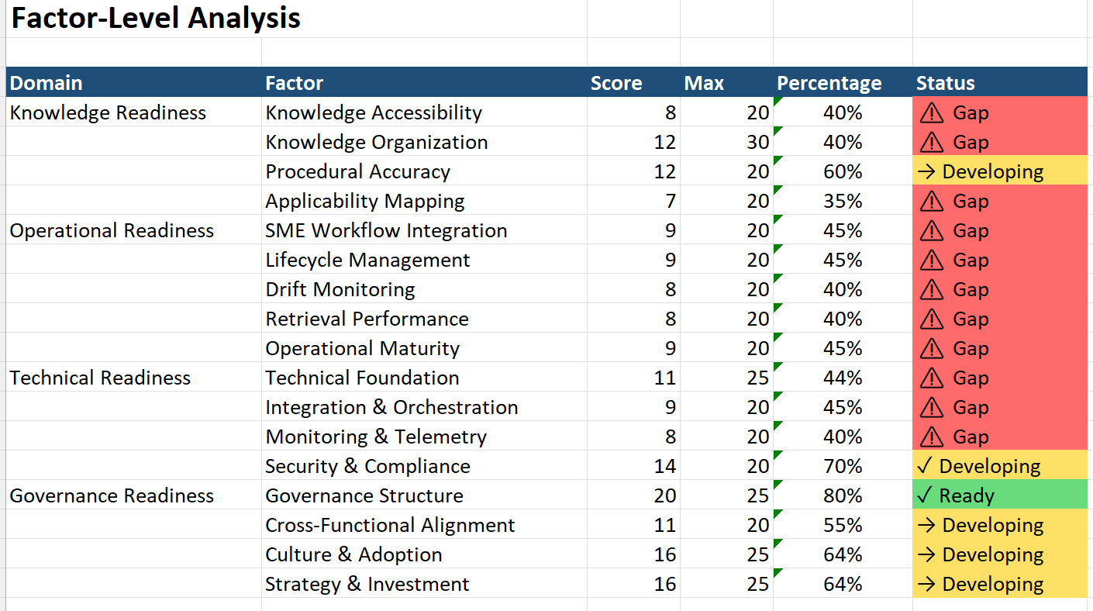
Aggregate scoring across 17 Factors reveals areas of strength, developing capabilities and critical gaps

Slide 9
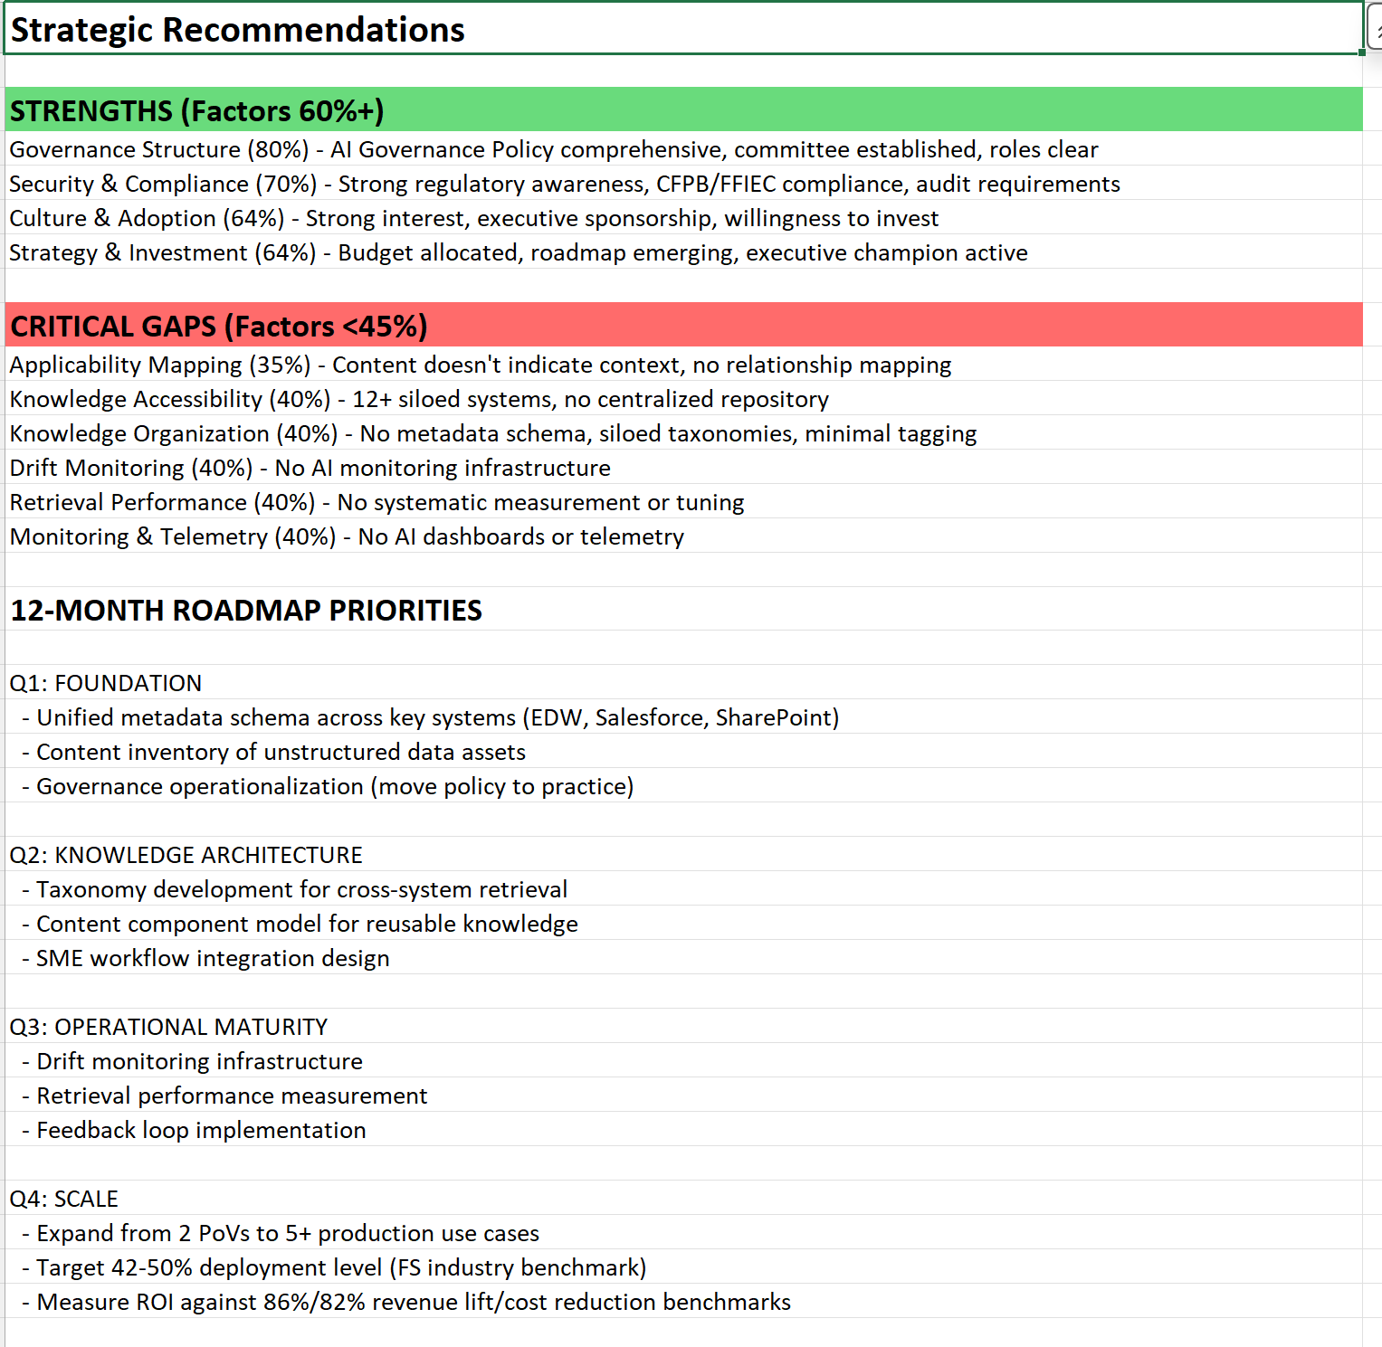
Strategic recommendations are contextualized based on Financial Services Industry Benchmarks
The EIS AI Maturity Readiness Assessment includes both objective and subjective factors
The baseline score is a snapshot in time and can be updated on a regular basis to monitor progress
Integration with enterprise data sources also forms the foundation for automated monitoring of semantics which are critical to AI success

