Slide 1

January 2026
STELLANTIS Financial Services US
KM Framework
Overview
Prepared
exclusively for:

Slide 2

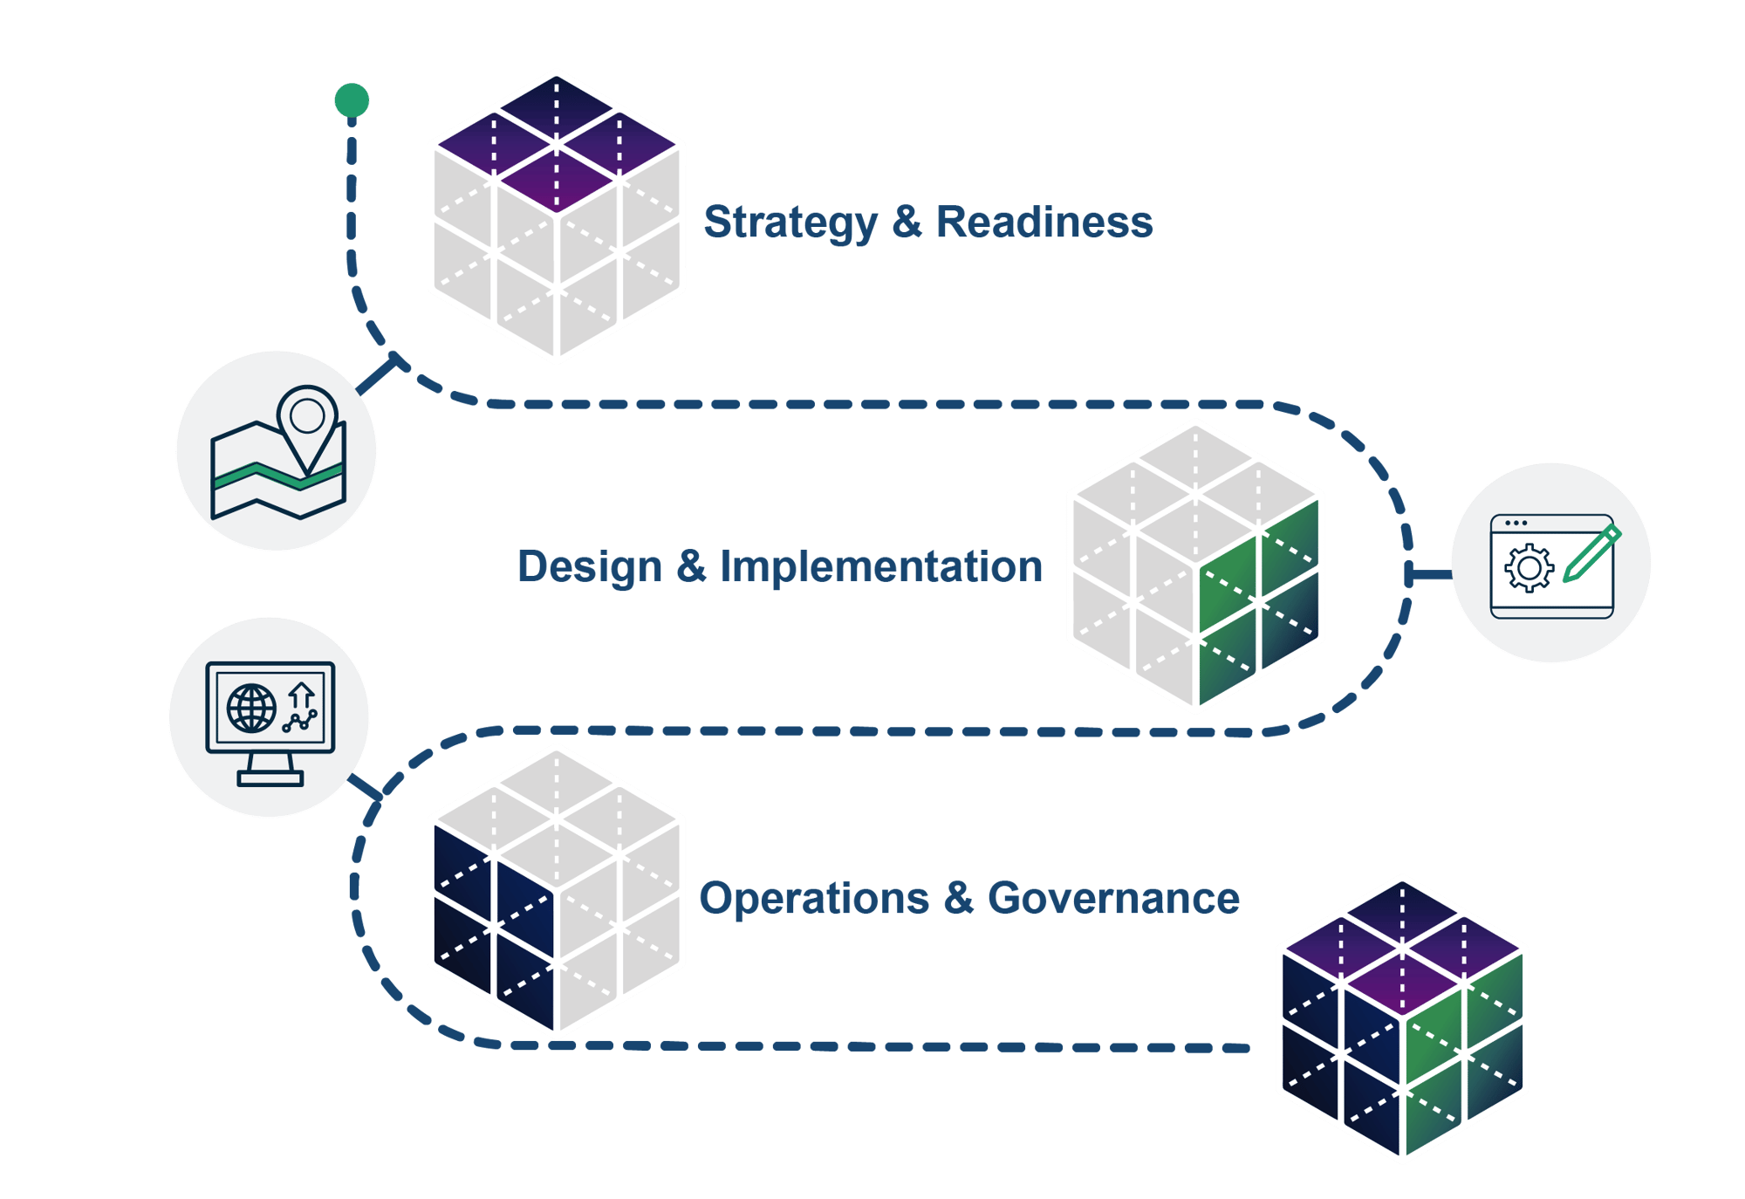
1.5 KM Framework Navigation
1.5.1 Executive Summary
1.5.2 KM Maturity Model
1.5.3 Gap Analysis
1.5.4 KM Capabilities
1.5.5 KM Principles & Standards
1.5.6 Roles & Responsibilities
1.5.7 Success Metrics
1.5.8 Conclusions & Path Forward

Slide 3
1.5.1 Executive Summary
Section Summary
This section provides a high-level overview of the knowledge management initiative, identifying core organizational challenges in knowledge capture and sharing, and outlining strategic opportunities to transform knowledge into a competitive advantage through systematic capture, organization, and AI-enabled access.
Key Topics
Overview
Core Challenges
Strategic Opportunities

Slide 4
1.5.1.1 Executive Summary – Current State
Stellantis Financial Services operates at Knowledge Management Maturity Level 2 (Aware):
Critical tribal knowledge concentrated in individuals.
Only 30-40% of enterprise integrations are documented.
Data classification stands at 70% versus 99% regulatory target.
Organization lacks enterprise search capabilities.
Resulting in:
Forcing 10-day BI turnaround times.
Consuming 50% of testing capacity on maintenance.

Slide 5
1.5.1.2 Executive Summary – Core Challenges
Critical expertise bottlenecks are creating single points of failure.
Undocumented integration landscape across a complex technology ecosystem.
No enterprise search; employees rely on email and personal networks.
Multiple concurrent technology migrations without a unified KM strategy.
Governance and data quality gaps are preventing AI adoption and regulatory compliance.
Collections scaling to 200+ agents constrained by knowledge management limitations.

Slide 6
1.5.1.3 Executive Summary – Strategic Opportunities
SFS's modern Azure/Fabric infrastructure enables rapid transformation.
Quick wins include:
Genesys Cloud AI for customer calls.
AI-powered SQL generation to reduce BI turnaround.
Self-healing test automation.
Advanced capabilities:
Federated search.
Knowledge graphs.
Chatbots targeting call deflection.
Natural language EDW queries.
Position SFS for competitive differentiation while achieving 99% data classification compliance and eliminating operational risk.

Slide 7
1.5.2 KM Maturity Assessment
Section Summary
A comprehensive evaluation of current knowledge management capabilities across six critical dimensions, establishing baseline maturity levels and identifying strengths and weaknesses in collaboration tools, expertise location, content management, information architecture, search functionality, and governance processes.
Key Topics
Assessment Findings Overview
Core Collaboration
Expertise Location
Content Curation
Information Architecture
Search Integration
Governance

Slide 8
1.5.2 KM Maturity Assessment
Current State
Target State
 | 1 Unpredictable | 2 Aware | 3 Competent | 4 Synchronized | 5 Choreographed
Core Collaboration | Rudimentary, random, haphazard | Intentional, ineffective knowledge capture and codification | Practices identified, formal harvesting and promotion of output | Integrated into processes with creation, access, and reuse mapped | Seamless and habitual with collaboration processes integrated with business needs and downstream uses
Expertise Location | Who you know | Word of mouth | Key skills identified and captured | Formal expertise directories leveraged | Expertise derivation through text analytics, community participation, and group interactions
Content Curation | Haphazard and application-limited | Pockets of curated content, sub-optimized across processes | Content aligned with platform and process, governance-driven information concierge | Workflow-driven integration with hybrid tagging and entity extraction processes | Value added at each touch point, core metadata flows with content, lifecycles managed, retention enforced
Information Architecture | IA is Navigation, inconsistent metadata, few standards, and poor usability | Application and department localized taxonomies | Classification structures applied to support dynamic knowledge | Multi-channel, device and format-independent cross-application architecture | Upstream supply chain and downstream syndication w/ partner & customer processes
Infrastructure | Foundational, little to no collaborative tools, CM is rudimentary | Foundational tools in place, but without out-of-the-box deployment | Knowledge harvesting integrated with collaboration and reuse | Expertise in location, community management, and intentional knowledge optimization | Multiple tools mapped to detailed requirements and use cases with ongoing tuning and enhancement
Search Integration | Search as “Random Document Generator “ | Some tuning of the search ranking algorithm with content tagging | Integration across structured and unstructured systems for content in context | Expertise mapped to search domains and terms, reduced e-discovery risk | Search-driven integration across platforms, knowledge in the task and process context
Governance | Nonexistent | Initial attempts led to fiefdoms | Repeatable, defined KM governance | Integrated, cross-functional managed processes | Business value-driven, enterprise-wide deployment
Maturity
Capability

Slide 9
1.5.3 Gap Analysis
Section Summary
Detailed analysis of critical gaps between current state and desired future state, organized by business impact priority. Identifies risks in tribal knowledge retention, integration documentation, search capabilities, departmental silos, governance scalability, technology migration coordination, AI readiness, data quality, and customer self-service.
Key Topics
Priority 1: Critical Business Risk
Priority 2: High Operational Impact
Priority 3: Medium Strategic Impact

Slide 10
1.5.3.1.1 Gap Analysis – Priority 1
Gap 1: Enterprise Integration Documentation Void
Only 30-40% of enterprise integrations are documented.
70% data classification vs. 99% regulatory target.
Enterprise Document Management System still "in development."
Business Impact:
30-40% documentation gap creates regulatory exposure (FTC, GLBA, FDIC, PCI DSS).
Unknown dependencies increase system failure risk during changes.
Audit preparation requires excessive manual reconstruction.
New team members cannot independently understand the architecture.
Comprehensive impact analysis is impossible.

Slide 11
1.5.3.2.1 Gap Analysis – Priority 2
Gap 2: Absent Enterprise Search & Discovery
No centralized intranet search beyond SharePoint native capabilities.
BI team has "no systematic way to discover similar existing reports or reuse query logic.
" Customer Service SharePoint "wasn't very searchable" and lacked version control.
Collections uses Excel-based knowledge tool requiring agents to "go outside of the system."
200+ legacy data sources with undiscovered documentation.
Business Impact:
10-day average BI report turnaround, mostly spent on data discovery.
Duplicated reports and queries waste resources.
1.2-2 calls per customer issue due to knowledge access limits.
50,000+ monthly calls could be deflected with better self-service.

Slide 12
1.5.3.2.2 Gap Analysis – Priority 2
Gap 3: Fragmented Departmental Knowledge Silos
"Information is not in the same location across departments" with varying procedure versions.
Each department maintains independent SharePoint sections with no cross-functional visibility.
Collections, Customer Service, BI, and UX teams operate separate systems. "Salesforce data not yet ported out into a usable format without manual export."
Business Impact:
Inconsistent customer experience from procedural variations.
Duplicated maintenance effort across departments.
Cross-functional collaboration hindered.
Complex onboarding across disconnected systems.
Strategic initiatives delayed by inability to aggregate insights.

Slide 13
1.5.3.2.3 Gap Analysis – Priority 2
Gap 4: Manual Governance Bottlenecks Preventing Scale
Single OpEx specialist manages knowledge base for 400-500 Customer Service employees.
"Manual tracking and updating creates maintenance bottlenecks." Salesforce KM "not a full standalone product" requiring workarounds. No Knowledge-Centered Service (KCS) methodology. Model cannot scale to support 200+ Collections agents (2026 target).
Business Impact:
Content updates delayed by single-person bottleneck.
OpEx specialist is single point of failure for all CS knowledge.
Cannot scale knowledge management with bottlenecks.
Quality inconsistency across domains.
Collections expansion blocked by governance capacity.

Slide 14
1.5.3.3.1 Gap Analysis – Priority 3
Gap 5: Concurrent Technology Migrations Without Integration Strategy
Multiple major migrations are proceeding simultaneously without a unified approach:
(1) SharePoint to Salesforce KM (launched Dec 13, 2025).
(2) MuleSoft to Azure API Management (only 6 APIs migrated).
(3) Legacy to Microsoft Fabric EDW.
(4) Enterprise Document Management "in development."
"Salesforce data not yet ported out into a usable format without manual export."
The testing teams spends 50% of their time on maintenance rather than new development.
Business Impact:
Integration gaps create manual workarounds between systems.
Testing burden increases exponentially per platform.
Data accessibility issues from unsynchronized migration schedules.
Technical debt as interim solutions become permanent.
Team capacity stretched across too many initiatives.

Slide 15
1.5.3.3.2 Gap Analysis – Priority 3
Gap 6: Insufficient AI Readiness & Tooling Access
Azure AI Foundry "access restricted to Mike and two others."
The BI team has "no access to GitHub Copilot" and "wasn't aware" of M365 Copilot capabilities.
Microsoft Copilot restricted to public/internal data only; confidential/restricted data prohibited.
PWC vendors "use Enterprise ChatGPT" while SFS lacks similar tools.
Heavy workload "prevents exploration of new tools." AI Governance Policy exists but tooling rollout lags.
Business Impact:
Competitive disadvantage vs. AI-enabled organizations.
BI 10-day turnaround is reducible with AI-assisted SQL.
Testing 50% maintenance burden addressable with AI self-healing.
Developer productivity 20-30% below industry benchmarks.
Strategic AI initiatives delayed by tooling gaps.

Slide 16
1.5.3.3.3 Gap Analysis – Priority 3
Gap 7: Inadequate Data Quality & Metadata Management
Data classification at 70% vs. 99% regulatory target → 29% compliance gap.
Vendor data dictionaries are "incomplete, requiring tribal knowledge consultation."
Detailed lineage documents are not published.
BI must manually trace Tableau report lineage during migration.
50-100 third-party data sources with inconsistent metadata management.
Business Impact:
Regulatory exposure (FTC, GLBA, FDIC, PCI DSS) from 29% classification gap.
Report accuracy concerns from unknown lineage.
New analyst productivity severely hampered.
Cannot perform a comprehensive impact analysis.
AI/ML model reliability compromised by poor data quality.

Slide 17
1.5.3.3.4 Gap Analysis – Priority 3
Gap 8: Limited Customer Self-Service Knowledge
Website Learning Center has "not a ton of content."
50,000+ monthly calls, 60-65% payment-related, many deflectable.
The FAQ page is "more developed" but lacks integration across touchpoints.
Secured messaging/chat "built but not released" pending knowledge base foundation.
No chatbot despite being "on the roadmap." "Traditionally requires a consolidated knowledge base, but AI/LLMs enable more sophisticated approaches."
Business Impact:
50,000+ monthly calls with 20-30% deflection opportunity.
Customer frustration with the inability to self-serve.
Agent capacity consumed by repetitive, preventable questions.
Collections scaling to 200+ agents requires proportional knowledge investment.
Competitive disadvantage vs. AI-powered financial services firms.

Slide 18
1.5.3.3.5 Gap Analysis – Priority 3
Gap 9: Tribal Knowledge Concentration & Succession Risk
BI teams rely on "person-to-person consultation" due to incomplete vendor data dictionaries.
Organization culture reflects "small, acquired company scaling rapidly" where teams "don't know what they don't know."
Business Impact:
- New analysts require months to reach productivity.
- Scaling to 200+ Collections agents (2026 target) is impossible without knowledge transfer.
- No documented succession plans threaten operational continuity.

Slide 19
1.5.4 KM Capability Definitions
Section Summary
Defines the core capabilities required for a mature knowledge management program, establishing the functional building blocks across knowledge capture, content organization, expertise location, search and discovery, content lifecycle management, and governance to create a comprehensive and sustainable knowledge ecosystem.
Key Topics
Knowledge Capture & Creation
Content Organization & Structure
Expertise Location & Access
Search & Discovery
Content Lifecycle Management
Governance & Quality

Slide 20
1.5.4.1 KM Capability Definitions
Knowledge Capture & Creation
Context: Critical knowledge concentrated in key SMEs (esp. data/systems); only 30-40% integrations documented; Collections scaling 400→600 FTE by EOY 2026.
SME Knowledge Extraction: Structured interviews, video/audio transcription, vendor workshops, exit protocols, peer transfer documentation.
Call/Meeting Insights: Observe AI (Collections: 5-6yr data), Genesys Cloud (Customer Service: 46-50K monthly calls), nightly MFT to Observe AI, Snowflake/Fabric analytics integration.
Workflow Documentation: Agent shadowing, screen recording (Genesys/DeFy/Salesforce/NSF), decision rationale capture, workaround procedures, RPA failure analysis.
Tribal Knowledge Conversion: Priority: undocumented legacy data marts, data lineage, 20+ year database knowledge, Risk SQL business rules, case type "fuzzy logic."
AI Feedback Learning: Copilot FAQ analysis, Observe AI override tracking, Genesys AI query gaps, successful resolution formalization, AI summary knowledge base integration.

Slide 21
1.5.4.2 KM Capability Definitions
Content Organization & Structure
Context: Inconsistent SharePoint sites; Customer Service migrating to Salesforce Knowledge (Dec 13, 2025); no enterprise taxonomy; departmental silos.
Enterprise Taxonomy: Business-friendly EDW naming; Product (Retail/Lease/Insurance/Floor Plan); Systems (Genesys/Salesforce/DeFy/RePay/NSF); Process (Collections/Customer Service/Testing/Risk); Data classification (Public→Highly Restricted); Regulatory tags (FTC/GLBA/FDIC/PCI/SOC 2).
Metadata Schema: System applicability (Genesys vs. Salesforce); Product (Retail vs. Lease); Role (agent/back-office/analytical); Lifecycle stage; EDW migration waves; Version specificity.
Content Reusability: Modular components (procedures/policies/decision trees); Single-source authoring across channels; Template library; Consistent formatting per platform.
Cross-System Alignment: SharePoint→Salesforce mapping; Testing docs to enterprise taxonomy; BI metadata to business domains; EDW to operational processes; Observe AI to knowledge articles.
Version Control: Salesforce Knowledge versioning; Git/GitHub for technical docs; Change notifications; Audit archive; Stale content tracking.

Slide 22
1.5.4.3 KM Capability Definitions
Expertise Location & Access
Context: Knowledge concentrated in key individuals; no skills directory; growth demands succession planning.
Skills Directory: Technical/System/Domain expertise mapped; Specialists identified (MuleSoft/Fabric/SOC 2/PCI DSS); Contact routing (MOD support/escalation/after-hours).
SME Routing: Contact embedding in articles; Salesforce auto-routing; MOD real-time chat; Testing structure documented; Enterprise Architecture contacts.
Knowledge Graph: Map dependencies; Collaboration patterns; Bottleneck identification; Mentor relationships; Knowledge flows.
Succession Planning: Priority 1: Integration/data lineage (30-40%→80%+); Priority 2: Collections scaling (200 FTE); Priority 3: Legacy BI migration; "Bus factor" risks; Cross-training.
Contribution Recognition: Track authorship/maintenance; Salesforce gamification; Performance criteria; Incentivize tribal knowledge conversion.

Slide 23
1.5.4.4 KM Capability Definitions
Search & Discovery
Context: No unified enterprise search; SharePoint limited to individual sites; separate team repositories; Customer Service moving to Salesforce Knowledge search; 70%→99% unstructured data tagging target.
Unified Enterprise Search: Single interface across all repositories (SharePoint/Salesforce/Spira/BI/EDW/email); Role-based access; M365 Copilot for Public/Internal tiers; Ranked by recency/role/patterns/quality; Federated search respecting data classification.
Natural Language Queries: Map questions to procedures ("wrongful repo prevention"→Collections docs); Surface troubleshooting ("DeFy error codes"); Retrieve analytics ("residual value calculation"); Conversational AI over Fabric (Adam Ruthford Treasury pilot); Natural language test queries.
Similar Content Discovery: BI report similarity to prevent duplicates; "Others found helpful" recommendations; Related articles via semantic similarity; Find existing SQL queries; Discover reusable test cases.
Contextual In-App Search: Salesforce Knowledge within agent console; Genesys AI Knowledge ChatGPT-like interface; IDE-integrated for automation engineers; Power BI within Fabric; Context-aware prioritization.
AI-Powered Semantic Retrieval: Intent beyond keywords (charge-off/120-day delinquency); RAG architectures for LLM access; Semantic search over transcripts; Vector embeddings for technical docs; Multi-modal search (text/diagrams/screenshots/video).

Slide 24
1.5.4.5 KM Capability Definitions
Content Lifecycle Management
Context: Salesforce Knowledge implementing approval workflows Dec 13; SharePoint lacks governance; Customer Service OpEx specialist manually maintains knowledge; Testing docs inconsistently updated; no enterprise lifecycle management.
Content Creation and Approval Workflows: Salesforce native workflows (draft→SME review→approval→publication); Multi-tier for regulatory content (SME→Compliance→Legal); Emergency expedited approvals; Collaborative authoring; Template enforcement.
Scheduled Review and Refresh Cycles: Tier 0 systems (Genesys/Salesforce/DeFy): Quarterly; Compliance/regulatory: Semi-annual or trigger-based; General operations: Annual; Legacy systems: During migration; Automated 30-day reminders; Manager escalation for missed deadlines.
Archival and Retention Policies: 7-year retention for compliance docs; Archive decommissioned systems (MuleSoft→Azure Integration Hub); Version history for audits; Sunset obsolete content; Maintain legacy docs during transitions.
Quality Validation and Compliance Checks: Peer review for technical accuracy; Compliance review (FTC/GLBA/FDIC/PCI/SOC 2); Readability scoring; Automated link validation; Screenshot currency flagging; Consistency checks across related articles.
Usage Analytics for Content Optimization: Track search queries; Monitor helpful/not helpful ratings; Analyze time spent; Identify zero-hit searches; Case creation patterns vs. existing articles; A/B testing formats/structures.

Slide 25
1.5.4.6 KM Capability Definitions
Governance & Quality
Context: AI Governance Committee (CDO-led, A1 maturity, 3-month policies); no enterprise KM governance; department-specific approaches.
Content Ownership: Named individual owners (not teams); Backup owners; Escalation paths (owner→lead→sponsor).
Quality Standards: Accuracy (SME verified, tested); Completeness (prerequisites, procedures, outcomes, troubleshooting); Clarity (audience-appropriate, enterprise vocabulary); Currency (cycle reviewed); Regulatory alignment (FTC/GLBA/FDIC/PCI/SOC 2); Cross-reference integrity.
Audit Trails: Complete change history; Historical documentation access; SOC 2/PCI DSS/FDIC evidence; User access logs for Restricted content.
Performance Metrics:
Knowledge Health: Coverage (30-40%→80%+); Currency (95%+); Quality (4.0+/5.0); Tribal knowledge conversion.
Usage/Impact: Search success (70%+); Self-service resolution (20% reduction from 46-50K calls); Time to competency; First call resolution (1.2-2→1.1); Zero-hit searches declining.
Operational: Contribution rate; SME time allocation; Testing question reduction; BI duplicate prevention; EDW lineage %.
AI Enhancement: Resolution rate; Recommendation acceptance; Copilot adoption; Content quality ratings.

Slide 26
1.5.5 Principles and Standards
Section Summary
Establishes foundational principles and technical standards that govern knowledge management operations, including strategic guiding principles, content quality requirements, metadata frameworks, data classification standards with AI access controls, and enforcement mechanisms to ensure consistency and compliance.
Key Topics
Guiding Principles
Content Quality Standards
Metadata Requirements
Data Classification Standards & AI Access Controls
Classification Enforcement

Slide 27
1.5.5.1 Principles and Standards
5.1 Guiding Principles
Context: Framework transforms fragmented knowledge into strategic advantage while maintaining compliance. Leverages five-tier classification; integrates with security infrastructure (Purview/Zscaler/CrowdStrike/Defender); addresses tribal knowledge risks.
Knowledge as Strategic Asset: Organizational asset requiring investment and attrition protection; Systematically mitigate single points of failure (integrations, data lineage, business rules).
Point-of-Creation Capture: Capture within operational workflows (not post-hoc); Issue resolution/system changes trigger documentation before completion; Vendor implementations include knowledge transfer deliverables.
Regulatory-Aligned Access Control: Five-tier classification (Public/Internal/Confidential/Restricted/Highly Restricted) aligned with regulations (FTC/GLBA/FDIC/PCI DSS/SOC 2); Audit trails for access tracking.
AI as Knowledge Amplifier: AI enhances but doesn't replace human expertise; Limited to Public/Internal until governance validated; Human oversight mandatory before publication/business use.
Data-Driven Continuous Improvement: Measure via usage analytics, search success, time-to-resolution, feedback; Regular review cycles; Sunset outdated content.
Tribal Knowledge Systematization: Extract and formalize expertise from key individuals; SME documentation as core responsibility; Validated transfer before personnel transitions.

Slide 28
1.5.5.2 Principles and Standards
5.2 Content Quality Standards
Context: Standards ensure knowledge accuracy, completeness, and usability across SFS repositories; aligned with enterprise vocabulary and compliance requirements.
Accuracy: SME/owner verified; Technical content tested; Regulatory/compliance approved by Compliance/Legal; Sources attributed; Current within review cycle (quarterly Tier 0, semi-annual critical, annual general); Conflicting sources reconciled.
Completeness: Full scope (prerequisites, procedures, outcomes, troubleshooting); System integrations include data flows, dependencies, failure modes, rollback, escalation; Related content linked; Applicability specified (products/processes/roles/scenarios); Limitations and edge cases documented.
Clarity & Usability: Written for target audience proficiency; Terminology aligned with EDW data dictionary; Structured per approved templates; Visual aids supplement text; Procedures testable and reproducible.
Versioning & Change History: Major revisions versioned with change documentation; Previous versions retained per retention policy; System docs indicate applicable software/platform version.

Slide 29
1.5.5.3 Principles and Standards
5.3 Metadata Requirements
Context: All knowledge assets require metadata for discovery, governance, and lifecycle management; enables search, compliance tracking, and content optimization.
Core Identification: Title (descriptive, business terminology); Content Type (procedure/reference/troubleshooting/architecture/decision support/FAQ); Owner (named individual, not role/department); Backup Owner; Created/Modified Dates (automated).
Classification & Security: Data Classification (Public/Internal/Confidential/Restricted/Highly Restricted); Regulatory Tags (FTC/GLBA/FDIC/PCI DSS/SOC 2); Access Restrictions (role-based).
Contextual Metadata: Applicability (products/processes/roles/departments/systems); Business Domain (Risk/Collections/Customer Service/Data Management/Testing); System Dependencies (Genesys/Salesforce/DeFy/Fabric); Version/Release (if version-specific).
Lifecycle Management: Review Frequency (quarterly/semi-annual/annual by criticality); Next Review Date; Retirement Date (for time-limited content).
Source & Relationships: Source (SME interview/vendor docs/internal analysis/regulatory guidance); Related Content (associated materials/prerequisites/dependencies); Supersedes (prior versions/deprecated content).
Usage & Feedback: View Count (prioritize updates, identify valuable content); User Ratings (quality feedback); Last Accessed (staleness indicator).

Slide 30
1.5.5.4 Principles and Standards
5.4 Data Classification Standards & AI Access Controls
Context: Five-tier classification aligned with regulatory obligations; AI access restricted by classification level and governance maturity.
Classification Tiers & AI Access:
Public: Externally shareable | AI: Full Copilot | Regulatory: None
Internal: General internal use | AI: Full Copilot | Regulatory: SSO, basic controls
Confidential: Business-sensitive (strategies, financial analysis, contracts, architecture) | AI: Case-by-case approval | Regulatory: Enhanced logging, NDAs
Restricted: Regulated data (credit bureau 1,700+ attributes, dealer/OEM proprietary, risk models) | AI: Prohibited without Committee approval | Regulatory: FTC/GLBA/SOC 2, DLP
Highly Restricted: PII/financial/payment/legal (SSN, accounts, PCI card data, legal matters) | AI: Prohibited | Regulatory: GLBA/FDIC/PCI DSS, encryption, audit trails
Pseudo-Classifications: Financial (budget, P&L, pricing); IT Secrets (credentials, API keys); PII/NPI; Legal (attorney-client, litigation); Regulatory (examiner review).
Special Handling: Legacy Data (undocumented databases, tribal knowledge tagged for priority documentation); Vendor-Specific (source attribution); VIN Numbers (Internal per Stellantis); Compliance Documentation (retention tagged).
AI Expansion Roadmap: Current: Public/Internal only | Future requires: Proven governance/monitoring, Committee approval, Compliance/Legal validation, enhanced audit/DLP, value justification with risk mitigation.

Slide 31
1.5.5.5 Principles and Standards
5.5 Classification Enforcement
Microsoft Purview provides automated classification and DLP monitoring.
Approximately 70% of unstructured data is currently tagged; target: 99% identification.
Zscaler and SSL decryption monitor data uploads to unauthorized AI services.
CrowdStrike endpoint protection detects anomalous AI tool usage patterns.

Slide 32
1.5.6 Roles & Responsibilities
Section Summary
Defines the organizational structure and accountability framework for knowledge management, establishing clear roles from executive sponsorship through operational leadership, domain stewardship, and practitioner responsibilities, ensuring that knowledge management is embedded across all levels of the organization with defined success metrics.
Key Topics
Knowledge Management Governance Committee
Executive Sponsorship & Strategic Direction
Operational Leadership
Domain Knowledge Stewards
Knowledge Practitioners
All Employees
Success Metrics & Accountability

Slide 33
1.5.6 Roles & Responsibilities
Context: Clear ownership and accountability framework; augment existing roles with KM responsibilities rather than creating parallel structures.
Knowledge Management Governance Committee: Chuck Berend (Risk-data quality/compliance), Mike Calaway (Security-access control), Tony Grogan (IT Governance-technology standards), Bobby Goodwin (Data-EDM), Business unit representatives (rotating) | Responsibilities: Approve KM policies/standards, resolve cross-functional governance issues, review quarterly metrics, allocate resources.
Executive Sponsorship:
CIO (Phil Maternowski): Executive sponsorship, resource/budget allocation, culture champion, quarterly performance review, major technology investment approval.
CRO (Chuck Berend): Regulatory compliance/risk management alignment, Risk/BI/Analytics knowledge capture sponsorship, risk model/pricing algorithm documentation validation, risk-sensitive information governance approval.
AI Governance Committee (CDO-led): AI-enhanced KM policies/standards, AI/ML initiative review/approval, responsible AI knowledge asset support, data governance compliance monitoring.
Enterprise Architecture (Larry Burgess/Tony Grogan/Vik Chopra): Technical architecture standards, enterprise system integration, reference architectures for capture/storage/retrieval, technology selection review/approval, infrastructure governance oversight.

Slide 34
1.5.6 Roles & Responsibilities
Operational Leadership: Owns domain-specific knowledge management within their respective areas, ensuring documentation standards, knowledge transfer, and continuity during organizational scaling and technology transitions.
Domain Knowledge Stewards (by functional area): Identify critical knowledge assets, validate accuracy/relevance, participate in capture sessions/reviews, flag knowledge gaps, facilitate transfer/mentoring.
Knowledge Practitioners:
Technical Writers (to be established): Create/maintain formal documentation, convert tribal knowledge to structured assets, ensure quality/consistency/governance, maintain version control.
System Administrators (IT Operations): Platform administration, security/permissions/access configuration, performance/adoption monitoring, technical support, backup/availability.
Content Curators (departmental): Quarterly accuracy/relevance reviews, archive/sunset outdated content, identify gaps from tickets/incidents/FAQs, tag/categorize content, promote valuable assets.
All Employees:
Contributors: Document solutions, share lessons learned, contribute to repositories, tag tribal knowledge holders, and flag inaccurate content.
Consumers: Search before escalating, provide feedback, suggest improvements, report gaps/broken links.

Slide 35
1.5.7 Success Metrics
Section Summary
Comprehensive measurement framework establishing quantifiable metrics to track program effectiveness across multiple phases and priorities. Includes executive dashboards for overall program health, priority-specific metrics for foundation stabilization and enterprise integration, and reporting cadence to ensure continuous visibility into knowledge management performance and ROI.
Key Topics
Executive Dashboard: Overall Program Health
Priority 1 Metrics: Foundation Stabilization
Priority 2 Metrics: Enterprise Integration
Phase 3 Metrics: Enhanced Operations
Other Metrics
Executive Reporting Cadence

Slide 36
1.5.7 Success Metrices
Success metrics align with assessment factors, industry benchmarks, and business outcomes. Regular measurement enables course correction and demonstrates value to stakeholders.
Continuous Improvement Processes.
Quarterly KM metrics review with executive sponsors.
Monthly content quality audits sampling knowledge base randomly.
User feedback loops: systematic follow-up on "not helpful" ratings.
A/B testing for content structure and formatting.
Regular review of zero-hit searches to identify content gaps.
Benchmarking against industry best practices for financial services knowledge management.
Post-implementation reviews: lessons learned from major knowledge initiatives (e.g., Salesforce Knowledge deployment).

Slide 37
1.5.7 Success Metrices
Executive Dashboard: Overall Program Health: Tracks high-level KM maturity progression, integration documentation coverage, and data classification compliance over 18 months from baseline to target state.
Tribal Knowledge Capture: Knowledge Transfer Completeness: Measures the systematic capture of critical knowledge through documentation sessions, system coverage, backup personnel certification, and exception scenario documentation.
Integration Documentation Coverage & Quality: Tracks the improvement of integration documentation from 30-40% baseline to 90%+ coverage with quality scores and reduced time-to-find metrics.
Enterprise Search Deployment: Effectiveness & Adoption: Monitors search system performance, user adoption, findability scores, and reduction in email-based information requests across 200+ data sources.
Data Classification Progress: Compliance Readiness: Measures progress in data classification coverage from 70% to 99%, PII/financial data tagging accuracy, and regulatory audit readiness improvement.
Governance Model Transformation/Scalability: Tracks the transition from single-person (OpEx specialist) to distributed governance model with 50+ content owners and improved update cycle times.
Advanced Search & Discovery Effectiveness: Measures semantic search accuracy, natural language query success, knowledge graph usage, and reduction in report discovery time and duplicate report creation.

Slide 38
1.5.7 Success Metrices
Cross Departmental Integration: Knowledge Sharing & Collaboration: Tracks unified platform adoption across all departments, cross-functional knowledge reuse, active Communities of Practice, and employee contribution rates.
Data Quality & Lineage: Data Trust & Traceability: Monitors data lineage coverage for 100% of EDW pipelines, data quality scores, metadata completeness, and reduction in data-related incidents.
Customer Self-Service: Call Deflection & Customer Satisfaction: Measures the effectiveness of self-service capabilities in deflecting 20-30% of 50K monthly calls while maintaining high customer satisfaction and first contact resolution rates.
Regulatory Compliance Achievement: Readiness & Audit Performance: Tracks achievement of 99%+ data classification compliance, 95%+ integration documentation, and improvement in regulatory audit readiness from 2.0 to 4.5 out of 5.0.
Collections Scaling Support/Success: Measures KM effectiveness in supporting Collections growth to 200+ agents with reduced ramp-up time from 6-9 months to under 12 weeks.
Employee Experience & Adoption: Tracks overall employee satisfaction, daily active users, time saved, AI tool adoption, training completion, and change resistance across the organization.

Slide 39
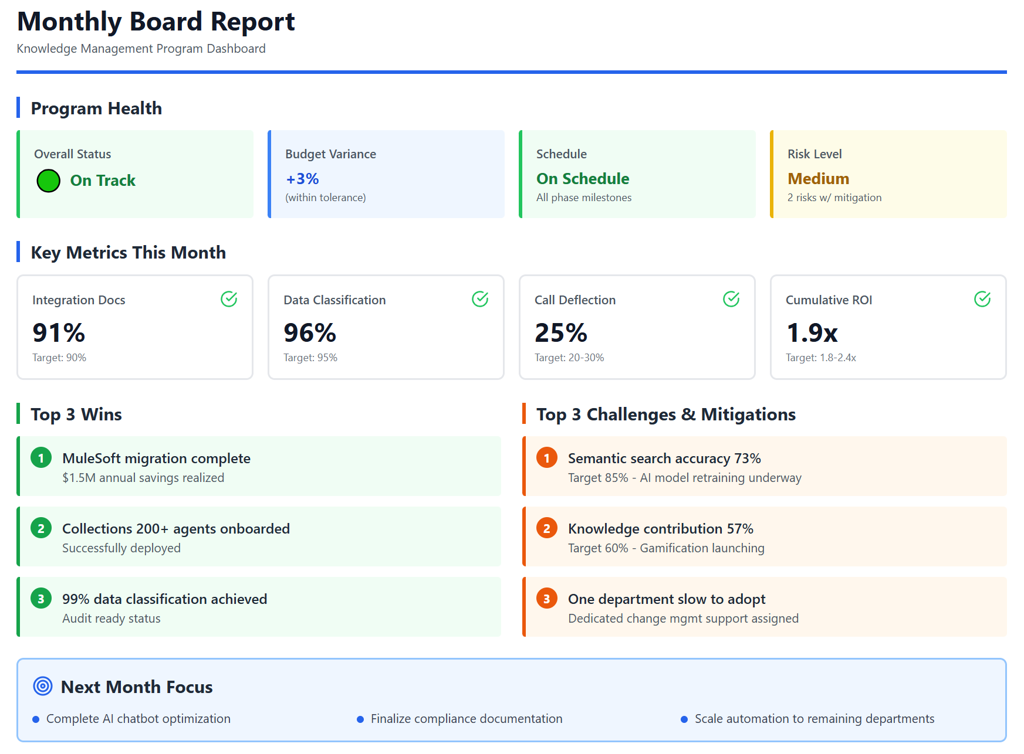
1.5.7 Success Metrices

Slide 40
1.5.8 Conclusion: The Path Forward
Synthesizes the strategic framework into actionable next steps, outlining the implementation roadmap and reinforcing the business case for knowledge management as a critical enabler of organizational effectiveness, operational efficiency, risk mitigation, and competitive advantage in an increasingly complex business environment.
The time to act is now. With a Q1 2026 program kickoff, SFS will achieve operational resilience, regulatory compliance, Collections scaling capability, competitive parity, and enterprise AI readiness by Q2 2027, positioning the organization for sustainable success in an increasingly competitive and AI-driven financial services landscape.

