Slide 1
Chapter 1
Introduction

Slide 2
CONTENTS
A BRIEF HISTORY
PROTOCOLS AND STANDARDS
STANDARDS ORGANIZATIONS
INTERNET STANDARDS
INTERNET ADMINISTRATION

Slide 3
1.1
A
BRIEF
HISTORY

Slide 4
Time Line
The following is a list of important Internet events in chronological order:
1969. Four-node ARPANET established.
1970. ARPA hosts implement NCP.
1973. Development of TCP/IP suite begins.
1977. An internet tested using TCP/IP.
1978. UNIX distributed to academic sites.

Slide 5
1981. CSNET established.
1983. TCP/IP becomes the official protocol
1983. MILNET was born.
1986. NSFNET established.
1990. ARPANET replaced by NSFNET.
1995. NSFNET became a research network.
1995. ISPs started.

Slide 6
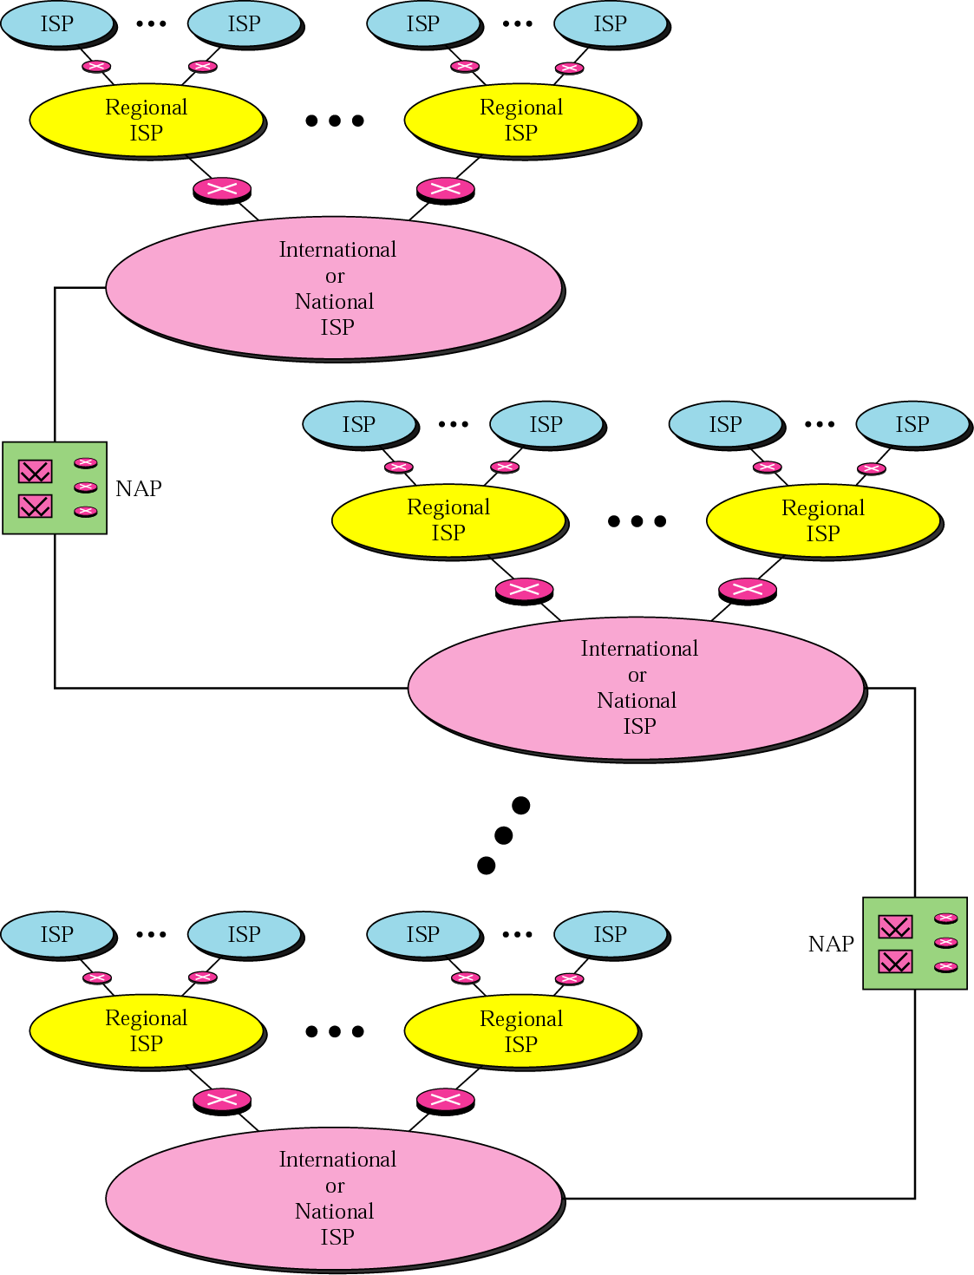
Figure 1-1
Internet today

Slide 7
1.2
PROTOCOLS
AND
STANDARDS

Slide 8
1.3
STANDARDS
ORGANIZATIONS

Slide 9
Standards Creation Committees
International Standards Organization (ISO)
International Telecommunications Union–
Telecommunication Standards Sector (ITU-T)
American National Standards Institute (ANSI)
Institute of Electrical and Electronics Engineers (IEEE)
Electronic Industries Association (EIA)

Slide 10
Forums
Frame Relay Forum
ATM Forum
Regulatory Agencies
Federal Communications Commission (FCC)

Slide 11

The websites for the
above organizations
are given in Appendix G.

Slide 12
1.4
INTERNET
STANDARDS

Slide 13
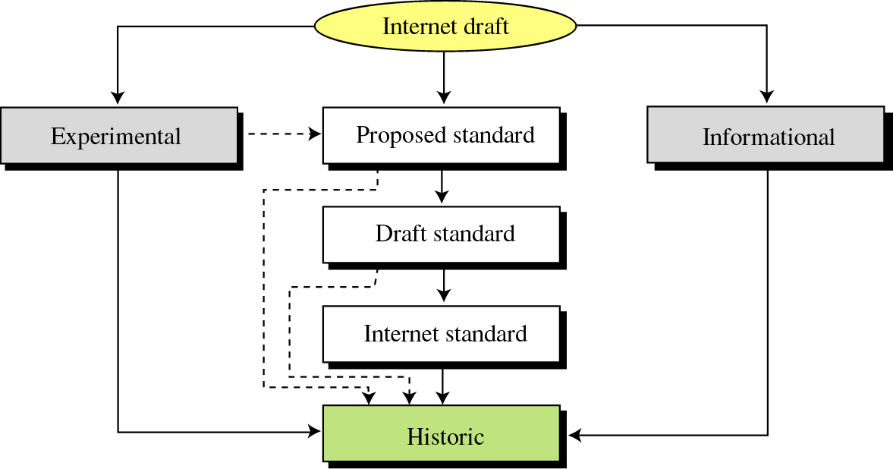
Figure 1-2
Maturity levels of an RFC

Slide 14
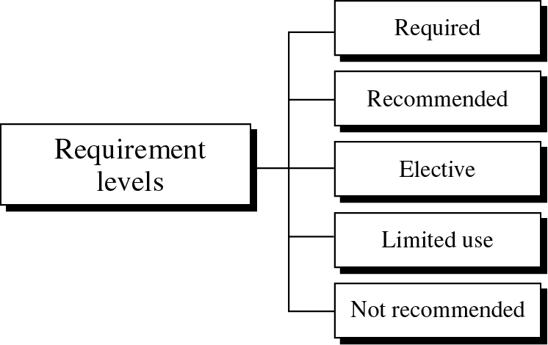
Figure 1-3
Requirement levels of an RFC

Slide 15
1.5
INTERNET
ADMINISTRATION

Slide 16
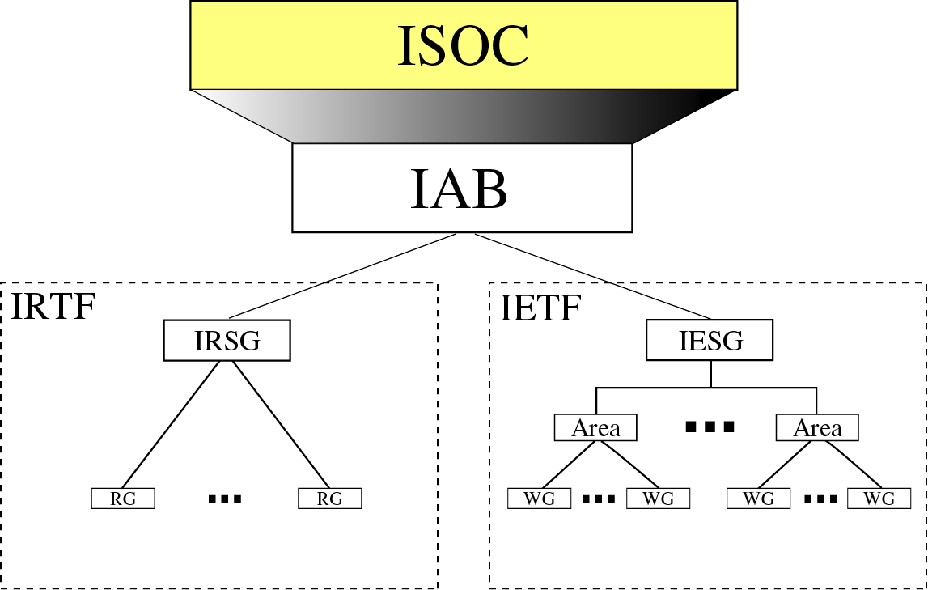
Figure 1-4
Internet Administration

