Slide 1
Chapter 2
The OSI Model
and
TCP/IP
Protocol Suite

Slide 2
CONTENTS
THE OSI MODEL
LAYERS IN THE OSI MODEL
TCP/IP PROTOCOL SUITE
ADDRESSING
TCP/IP VERSIONS

Slide 3
2.1
THE
OSI
MODEL

Slide 4

ISO is the organization.
OSI is the model.

Slide 5
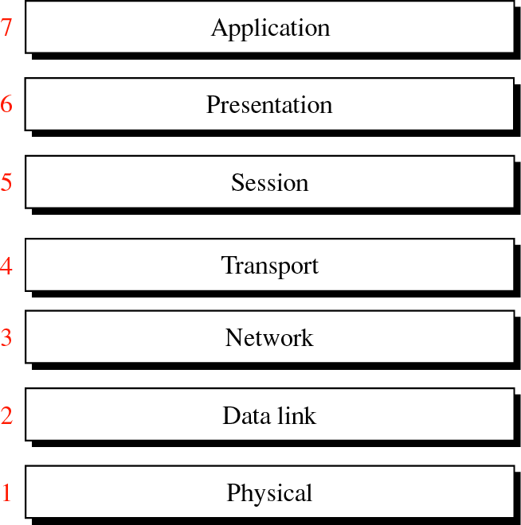
Figure 2-1
OSI
Model

Slide 6
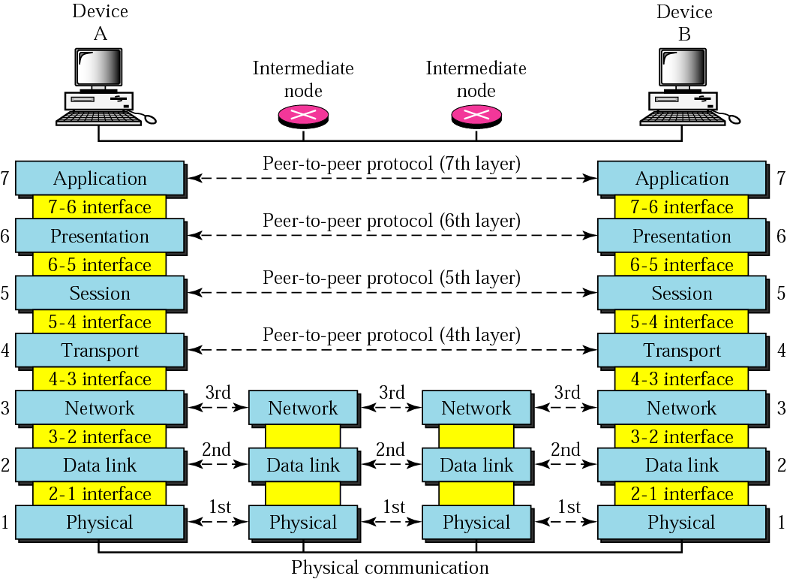
Figure 2-2
OSI layers

Slide 7
Headers are added
to the data at layers
6, 5, 4, 3, and 2.
Trailers are usually
added only at layer 2.

Slide 8
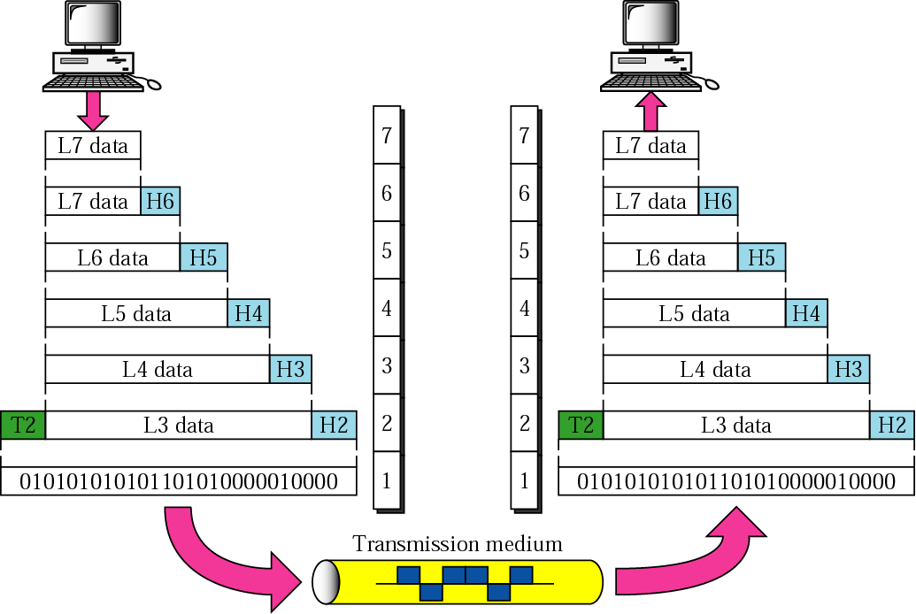
Figure 2-3
An exchange using the OSI model

Slide 9
2.2
LAYERS
IN
THE
OSI
MODEL

Slide 10
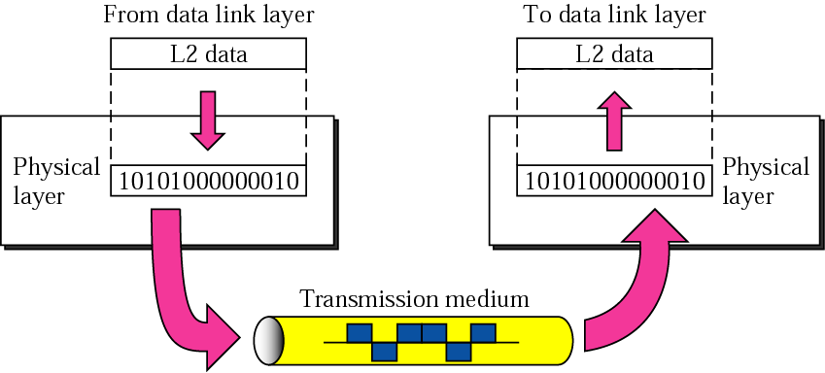
Figure 2-4
Physical Layer

Slide 11
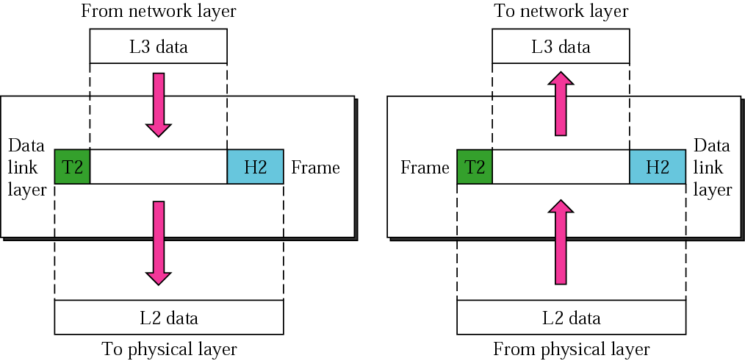
Figure 2-5
Data Link Layer

Slide 12
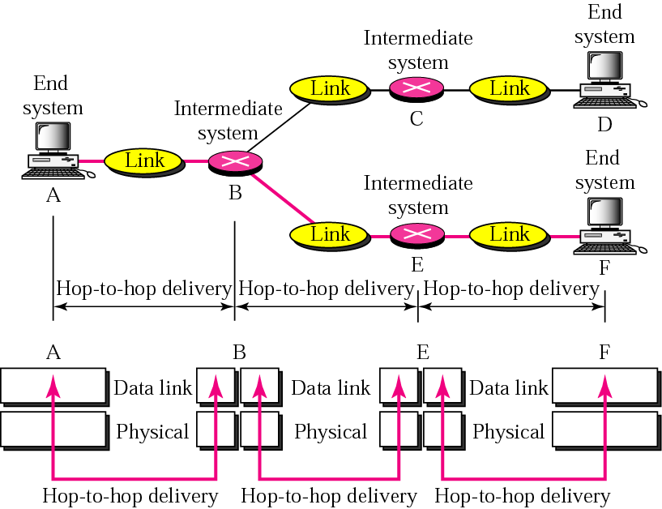
Figure 2-6
Node-to-node delivery

Slide 13
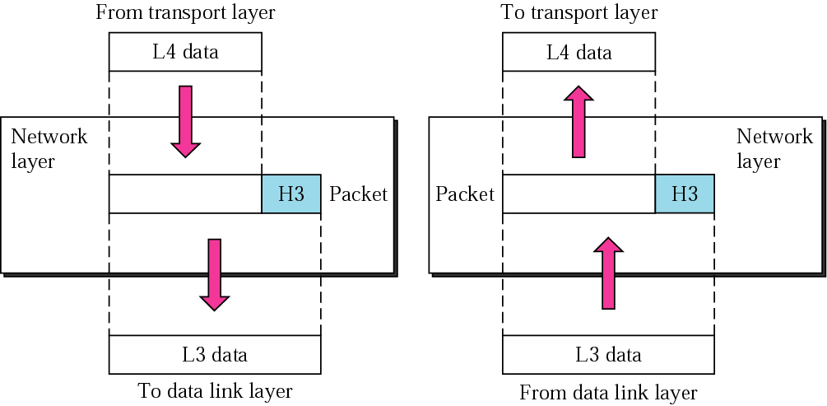
Figure 2-7
Network Layer

Slide 14
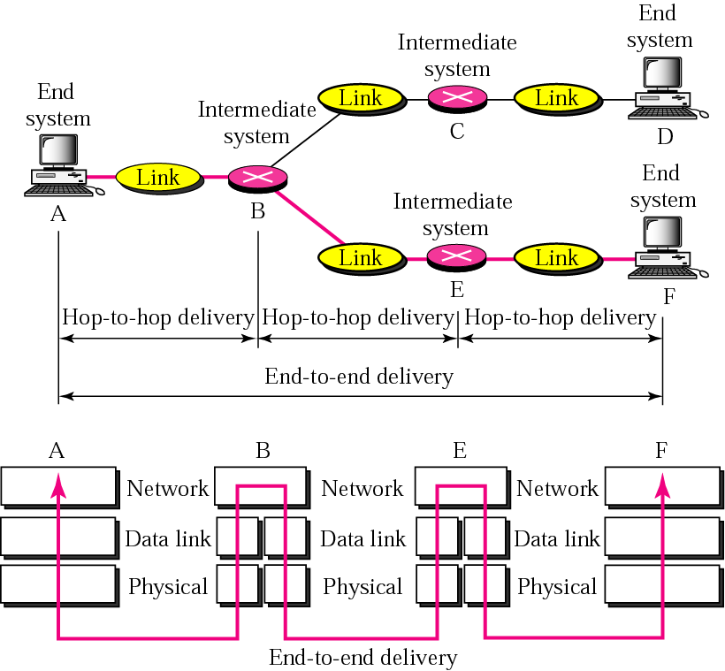
Figure 2-8
End-to-end delivery

Slide 15
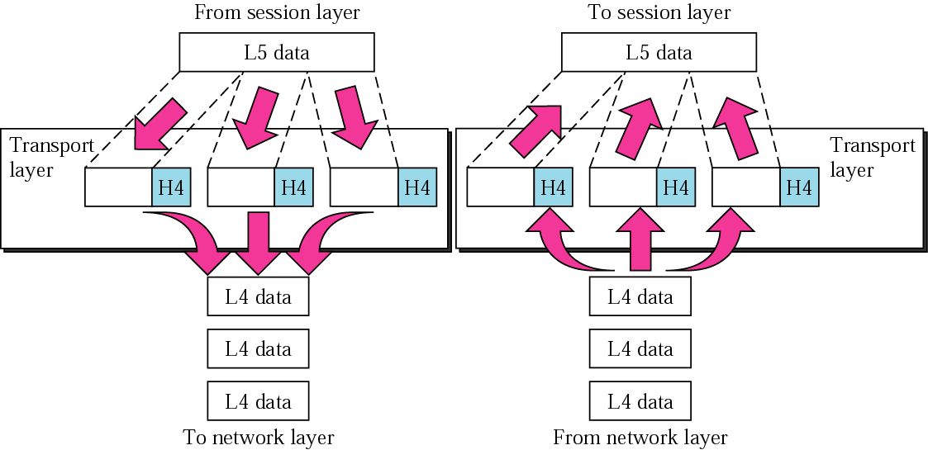
Figure 2-9
Transport Layer

Slide 16
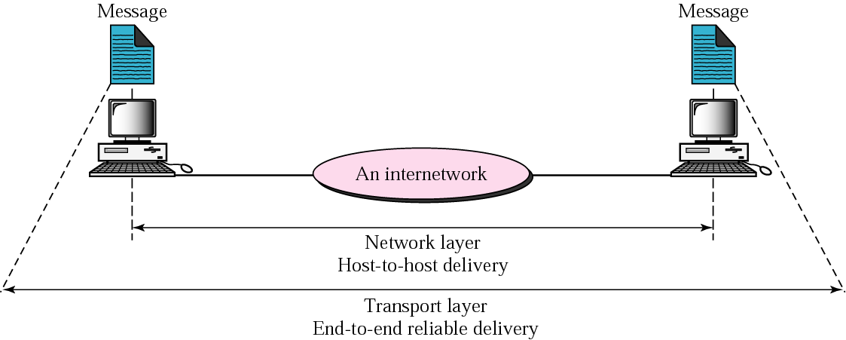
Figure 2-10
Reliable end-to-end delivery of a message

Slide 17
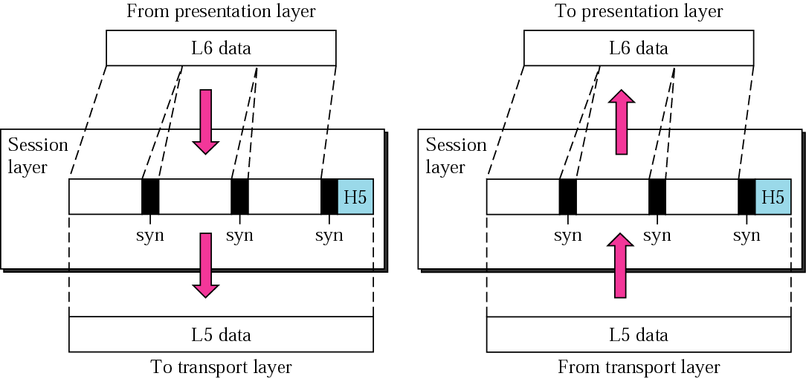
Figure 2-11
Session Layer

Slide 18
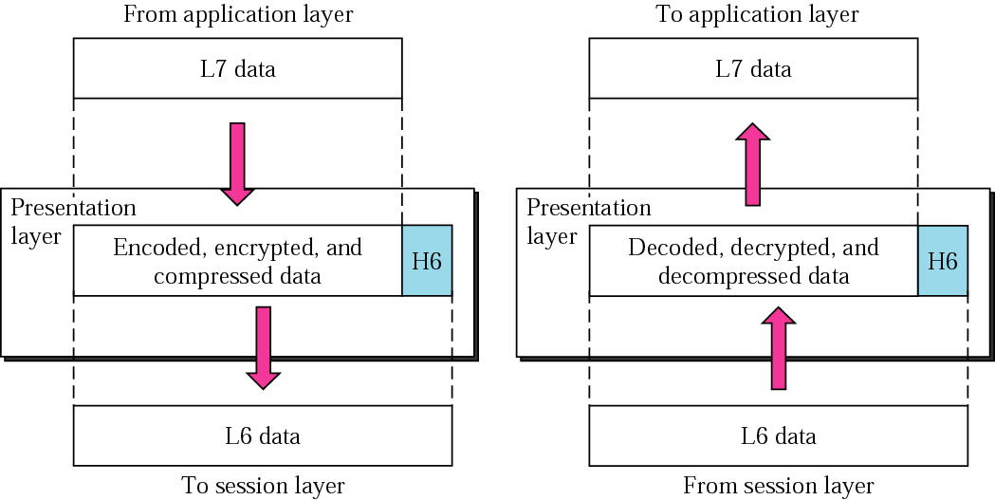
Figure 2-12
Presentation Layer

Slide 19
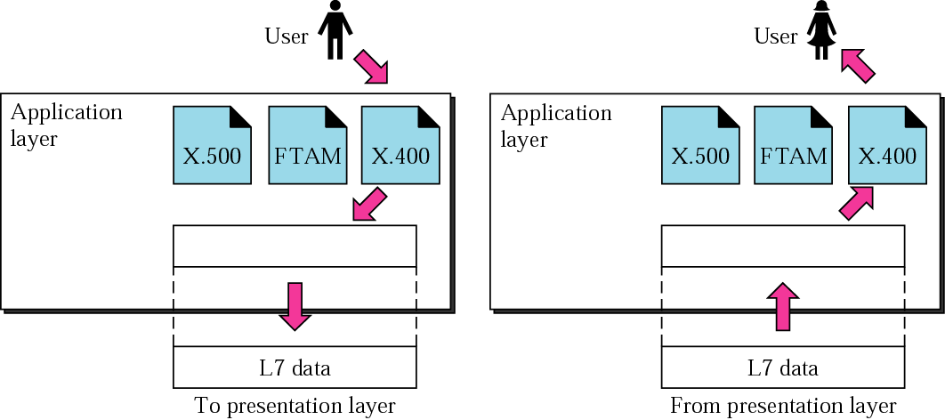
Figure 2-13
Application Layer

Slide 20
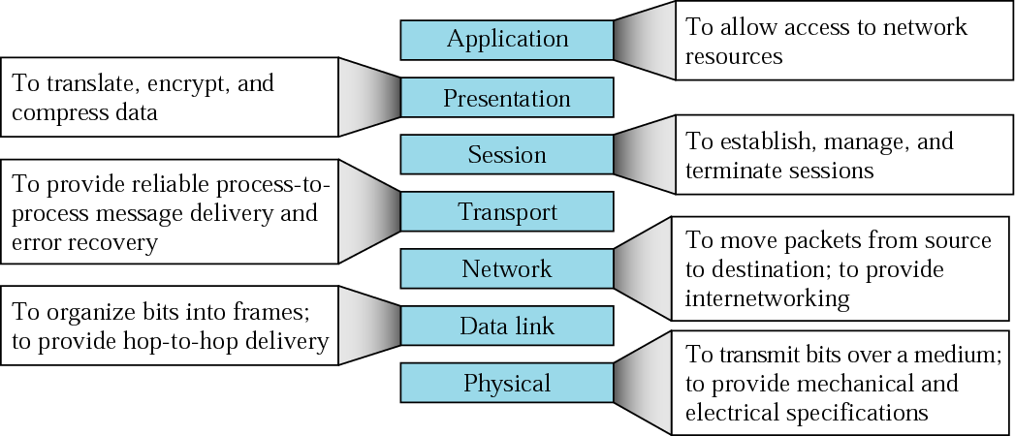
Figure 2-14
Summary of layers

Slide 21
2.3
TCP/IP
PROTOCOL
SUITE

Slide 22
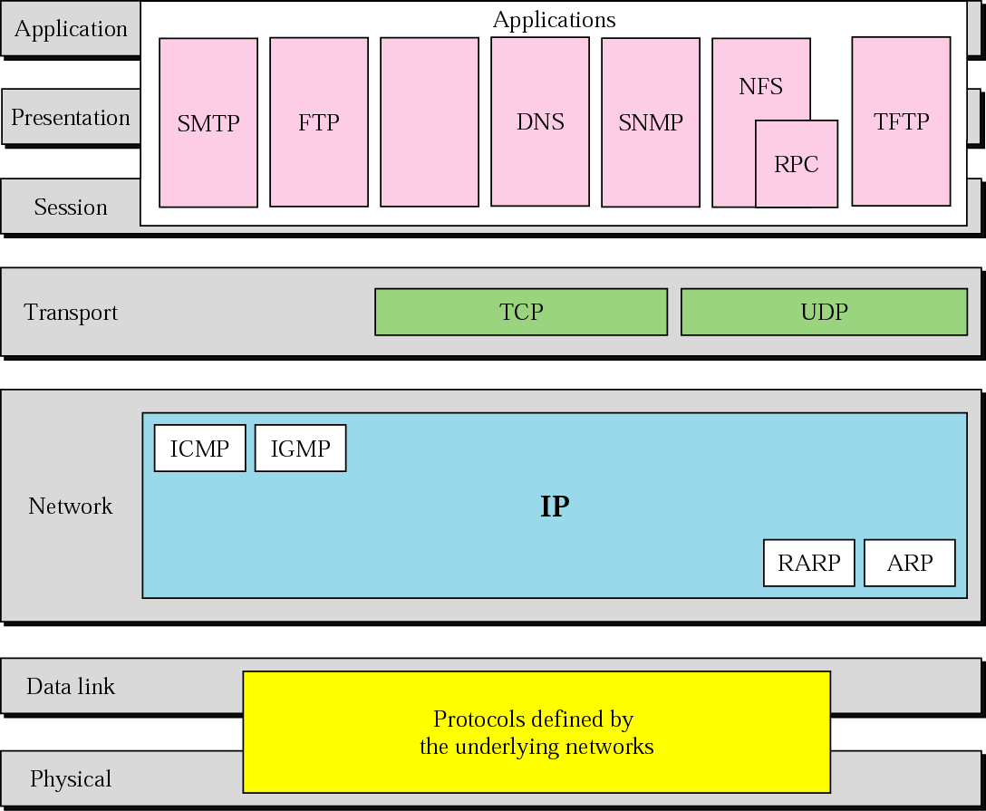
Figure 2-15
TCP/IP and OSI model

Slide 23
2.4
ADDRESSING

Slide 24
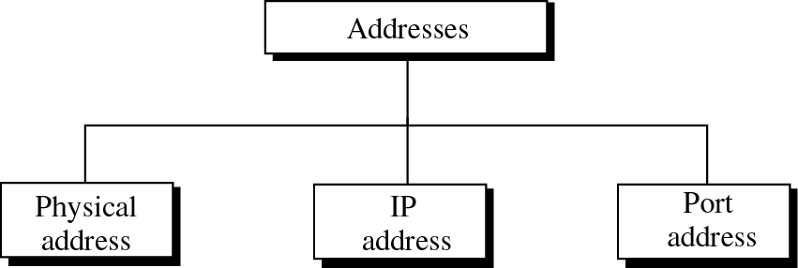
Figure 2-16
Addresses in TCP/IP

Slide 25
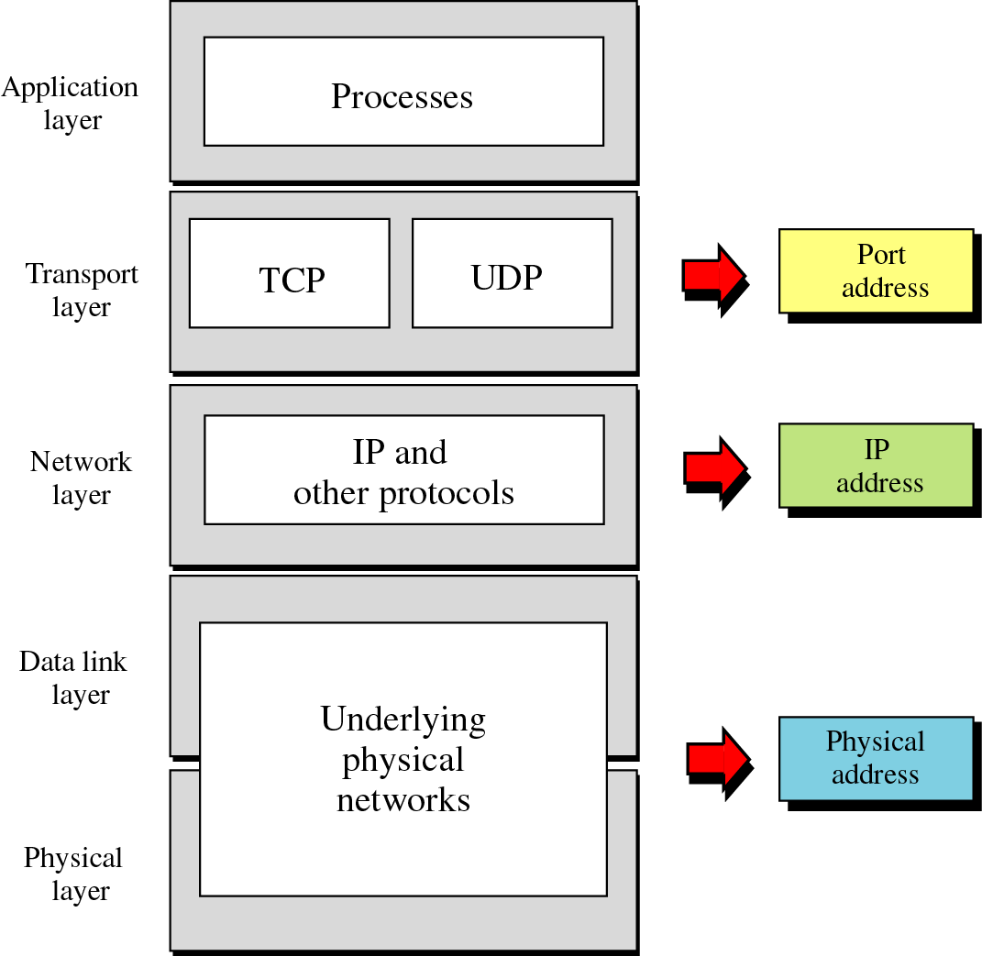
Figure 2-17
Relation-
ship
of
layers
and
addresses
in TCP/IP

Slide 26
Example 1
Figure 2.18 shows an example of physical addresses.

Slide 27
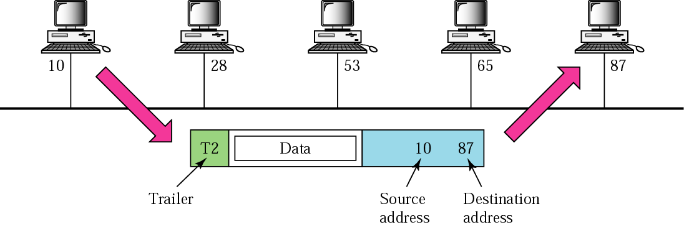
Figure 2-18
Physical addresses

Slide 28
Example 2
Most local area networks use a 48-bit (6 bytes) physical address written as 12 hexadecimal digits, with every 2 bytes separated by a hyphen as shown below:
07-01-02-01-2C-4B
A 6-byte (12 hexadecimal digits) physical address

Slide 29
Example 3
Figure 2.19 shows an example of Internet addresses.

Slide 30
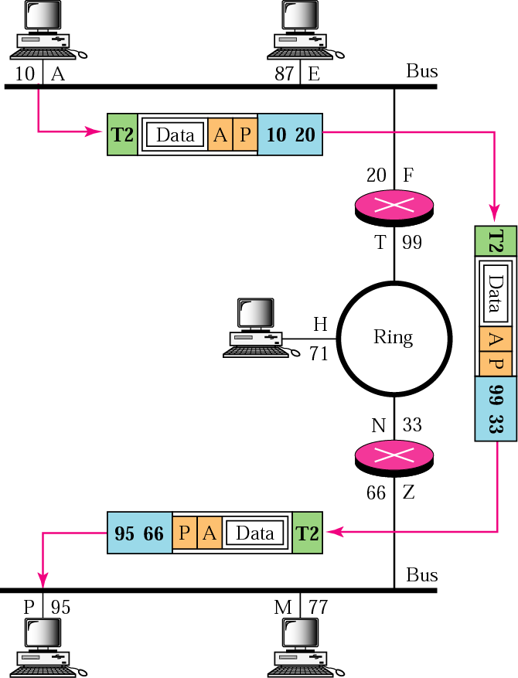
Figure 2-19
IP addresses

Slide 31
Example 4
As we will see in Chapter 4, an Internet address (in IPv4) is 32 bits in length, normally written as four decimal numbers, with each number representing 1 byte. The numbers are separated by a dot. Below is an example of such an address.
132.24.75.9

Slide 32
Example 5
Figure 2.20 shows an example of transport layer communication.

Slide 33
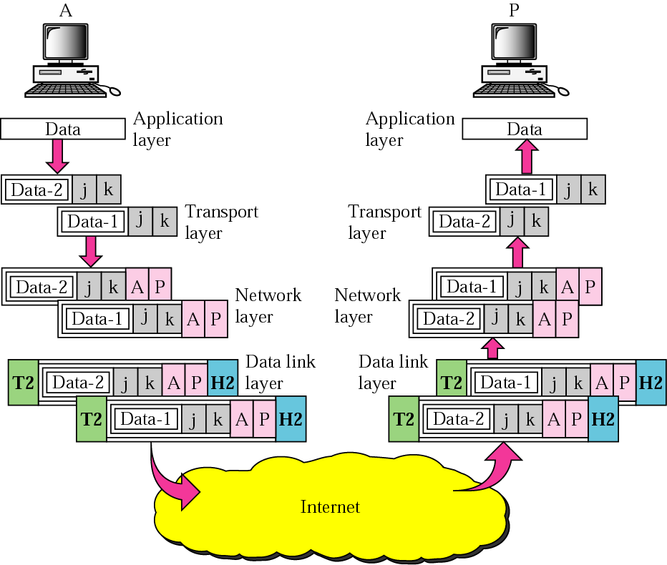
Figure 2-20
Port addresses

Slide 34
Example 6
As we will see in Chapters 11 and 12, a port address is a 16-bit address represented by one decimal number as shown below.
753 A 16-bit port address

Slide 35
2.5
TCP/IP
VERSIONS

Slide 36
Versions:
Version 4 (current)
Version 5
Version 6 (future)

