Slide 1
Chapter 3
Underlying
Technologies

Slide 2
CONTENTS
LANS
POINT-TO-POINT WANS
SWITCHED WANS
CONNECTING DEVICES

Slide 3
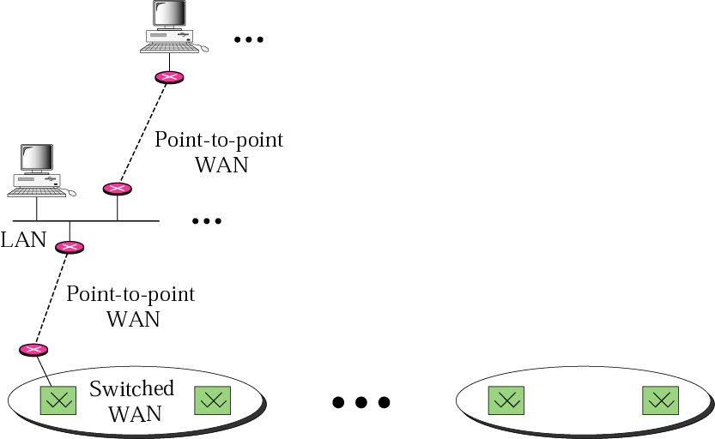
Figure 3-1
Internet model

Slide 4
3.1
LOCAL AREA
NETWORKS
(LANS)

Slide 5
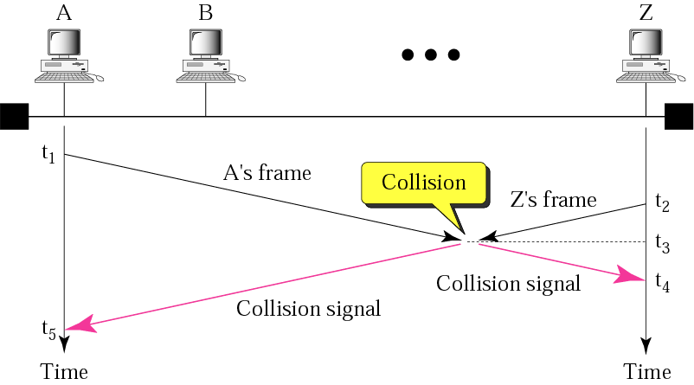
Figure 3-2
CSMA/CD

Slide 6

Minimum frame length/Transmission rate is proportional to Collision domain / Propagation speed

Slide 7
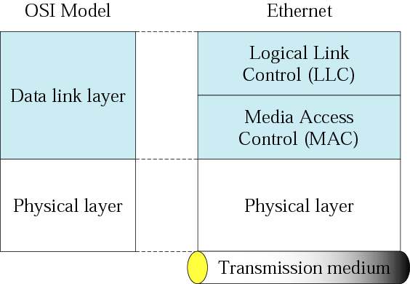
Figure 3-3
Ethernet layers

Slide 8
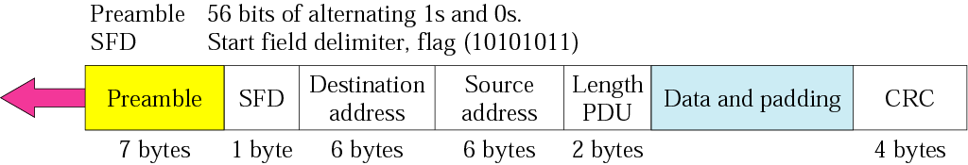
Figure 3-4
Ethernet frame

Slide 9
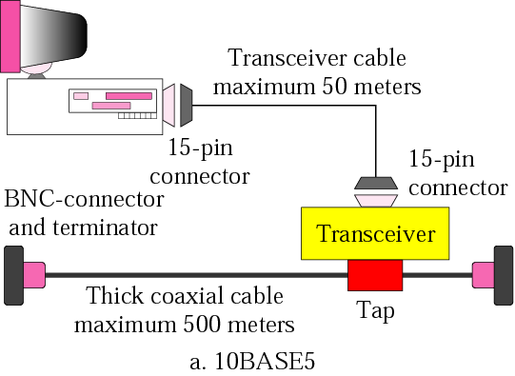
Figure 3-5:a
Ethernet implementation

Slide 10
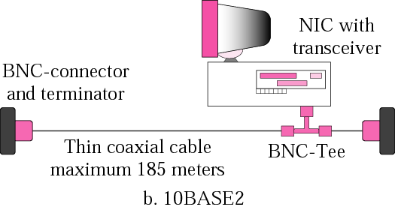
Figure 3-5:b
Ethernet implementation

Slide 11
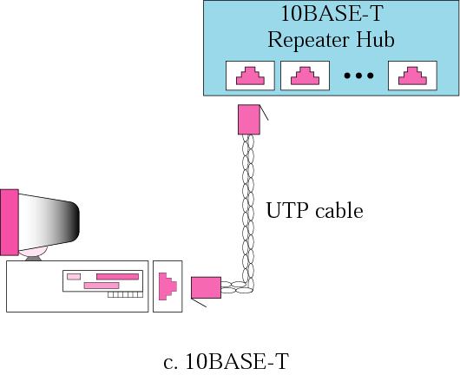
Figure 3-5:c
Ethernet implementation

Slide 12
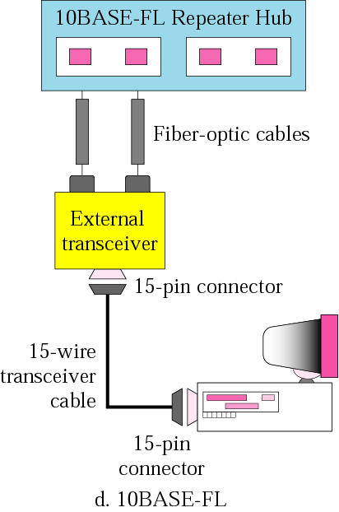
Figure 3-5:d
Ethernet implementation

Slide 13
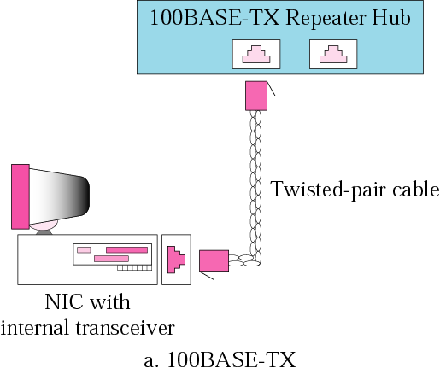
Figure 3-6:a
Fast Ethernet implementation

Slide 14
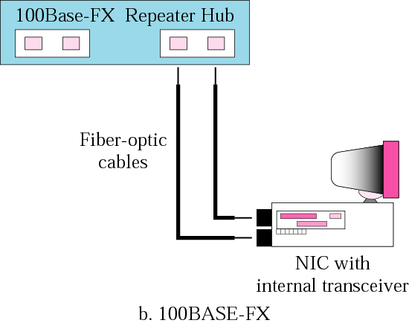
Figure 3-6:b
Fast Ethernet implementation

Slide 15
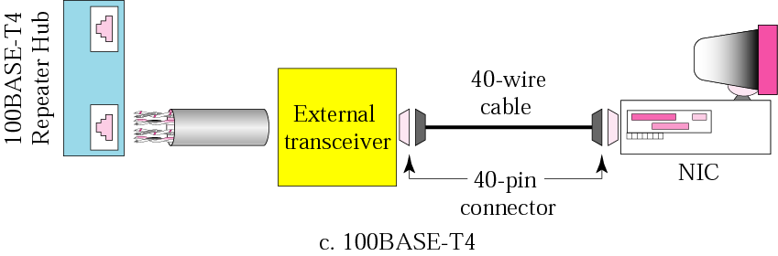
Figure 3-6:c
Fast Ethernet implementation

Slide 16
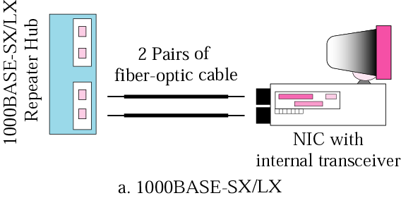
Figure 3-7:a
Gigabit Ethernet implementation

Slide 17
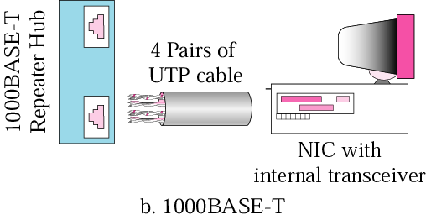
Figure 3-7:b
Gigabit Ethernet implementation

Slide 18
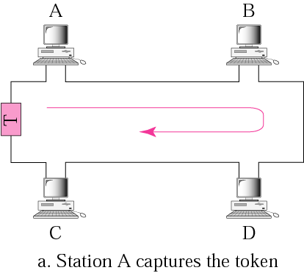
Figure 3-8:a
Token passing

Slide 19
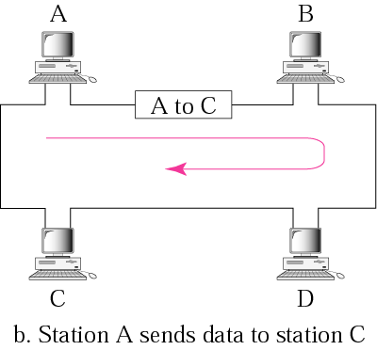
Figure 3-8:b
Token passing

Slide 20
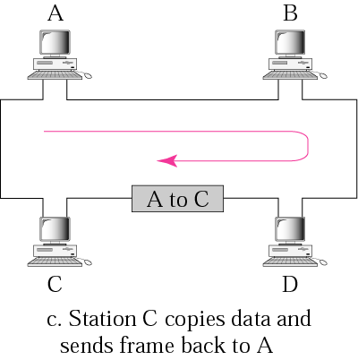
Figure 3-8:c
Token passing

Slide 21
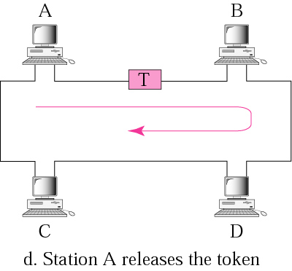
Figure 3-8:d
Token passing

Slide 22
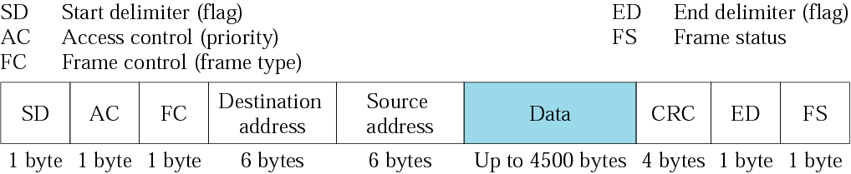
Figure 3-9
Data frame

Slide 23
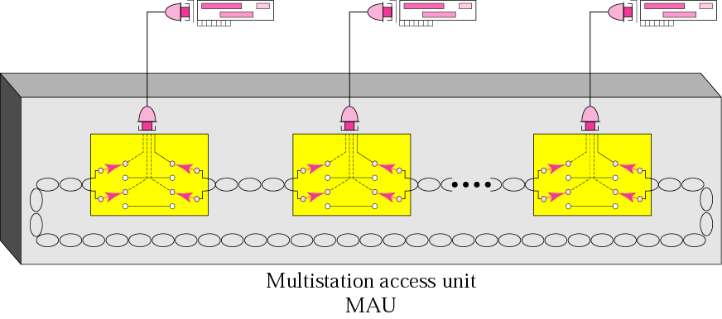
Figure 3-10
MAU

Slide 24
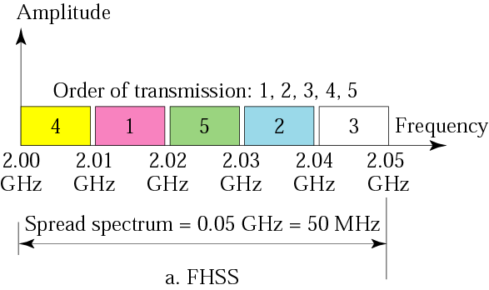
Figure 3-11:a
Spread spectrum techniques

Slide 25
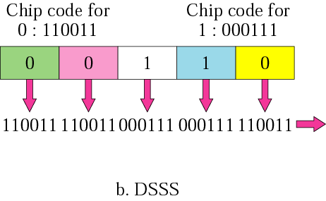
Figure 3-11:b
Spread spectrum techniques

Slide 26
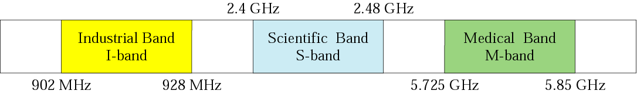
Figure 3-12
ISM bands

Slide 27
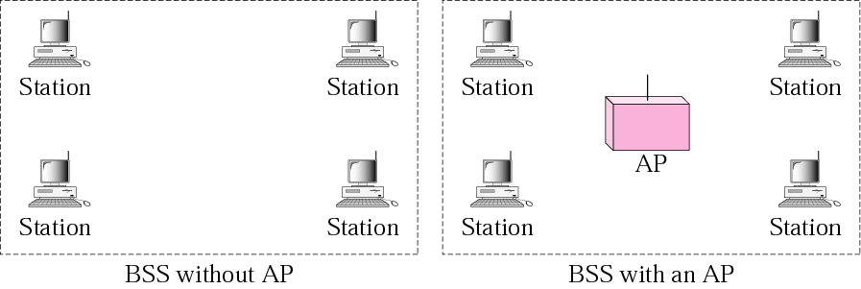
Figure 3-13
BSSs

Slide 28
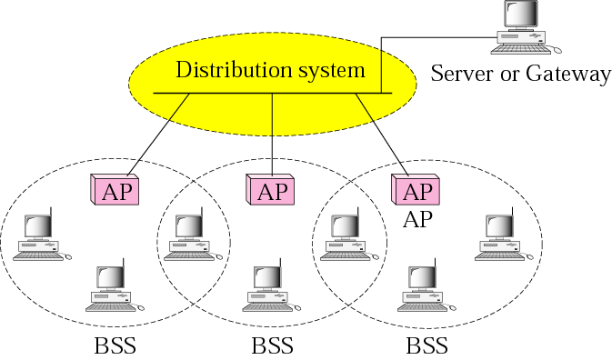
Figure 3-14
ESS

Slide 29
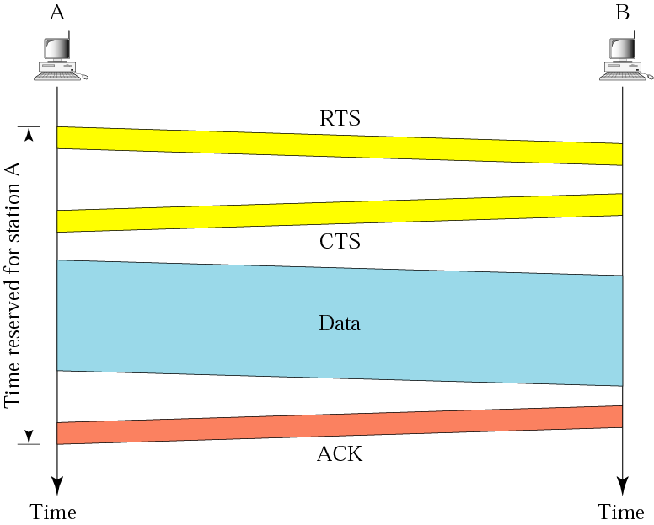
Figure 3-15
CSMA/CA

Slide 30
3.2
POINT-TO-POINT
WANS

Slide 31
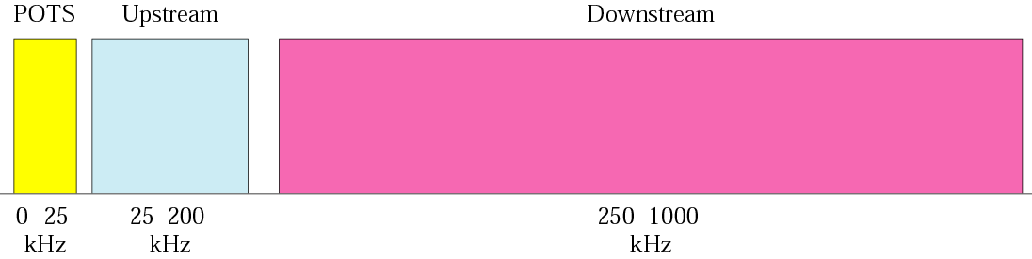
Figure 3-16
Band for ADSL

Slide 32
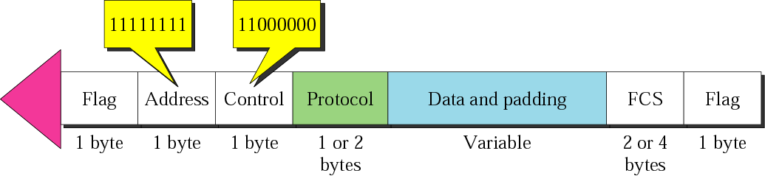
Figure 3-17
PPP frame

Slide 33
3.3
SWITCHED
WANS

Slide 34
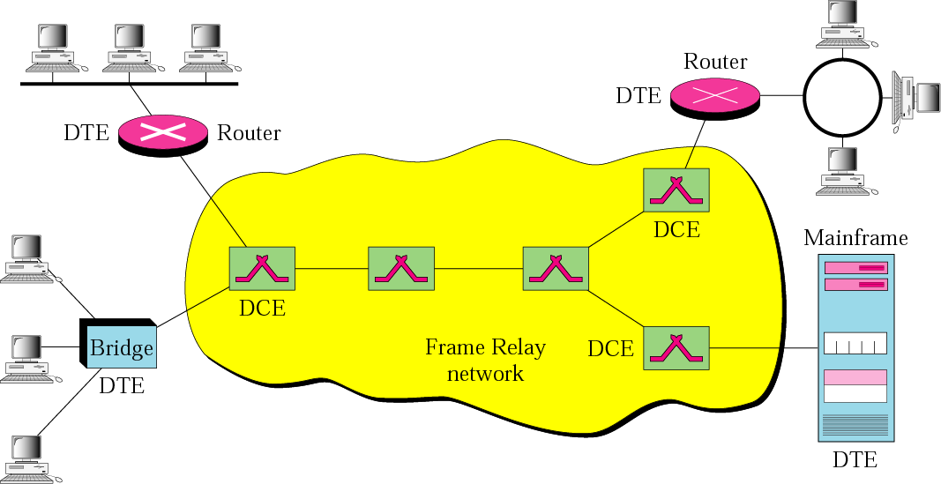
Figure 3-18
Frame Relay network

Slide 35
A cell network uses the cell as the basic unit of data exchange. A cell is defined as a small, fixed-sized block of information.

Slide 36
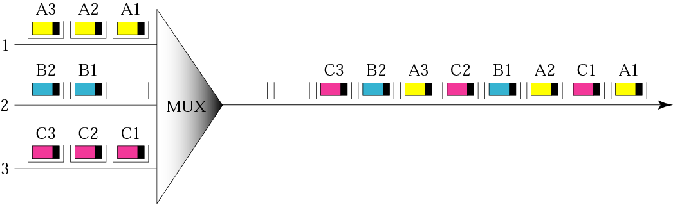
Figure 3-19
ATM multiplexing

Slide 37
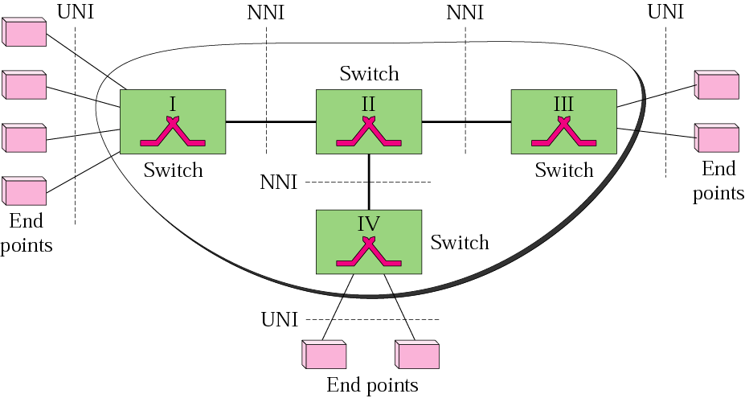
Figure 3-20
Architecture of an ATM network

Slide 38
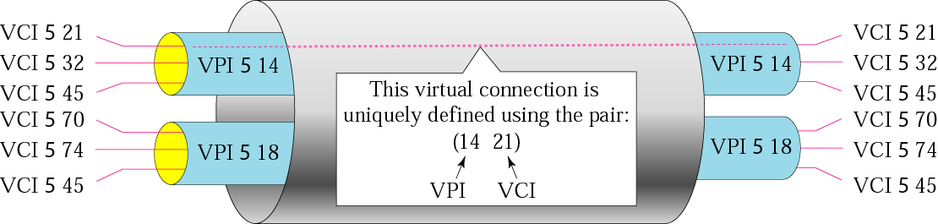
Figure 3-21
Virtual circuits

Slide 39
Note that a virtual connection is defined by a pair of numbers: the VPI and the VCI.

Slide 40
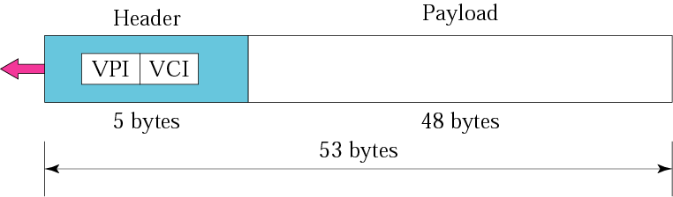
Figure 3-22
An ATM cell

Slide 41
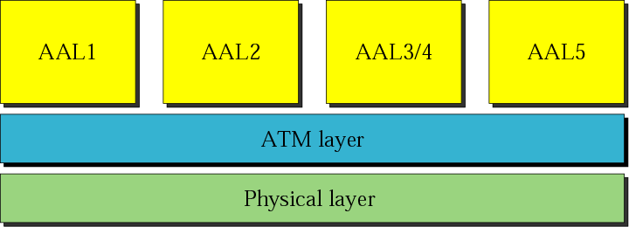
Figure 3-23
ATM layers

Slide 42
The IP protocol uses the AAL5 sublayer.

Slide 43
We will discuss IP over ATM in
Chapter 26.

Slide 44
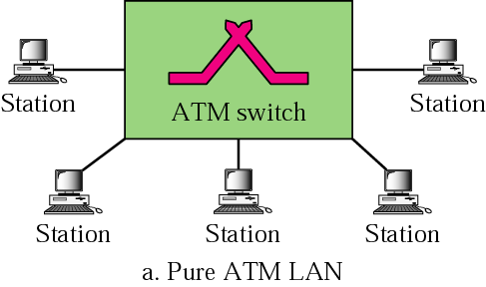
Figure 3-24:a
ATM LAN architecture

Slide 45
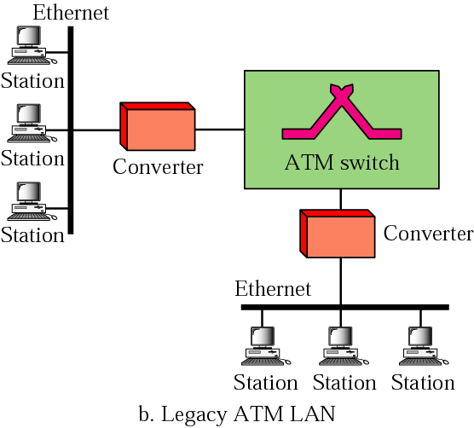
Figure 3-24:b
ATM LAN architecture

Slide 46
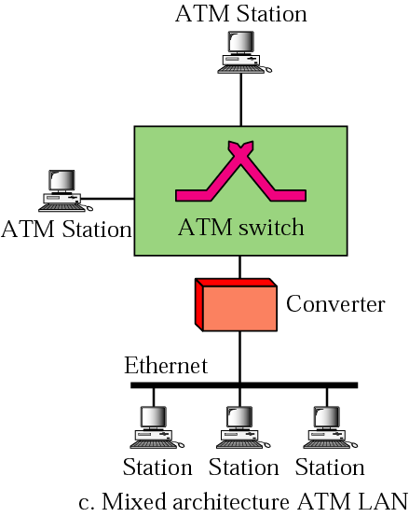
Figure 3-24:c
ATM LAN architecture

Slide 47
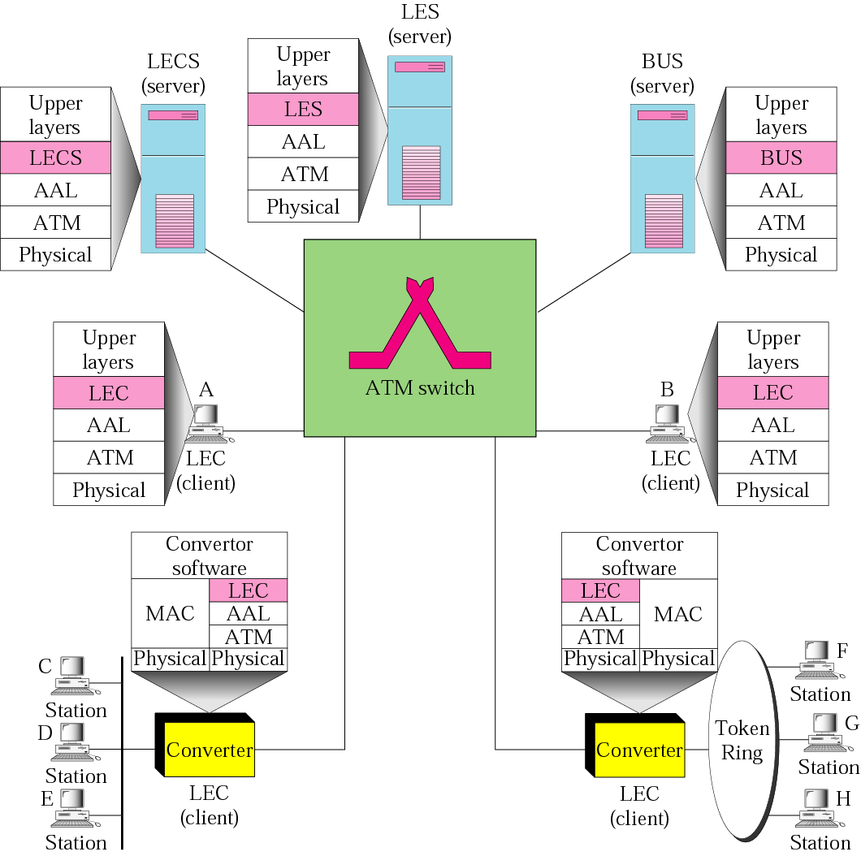
Figure 3-25
A mixed architecture ATM LAN
using LANE

Slide 48
3.4
CONNECTING
DEVICES

Slide 49
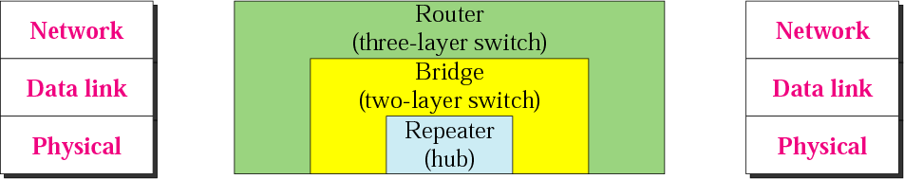
Figure 3-26
Connecting devices

Slide 50
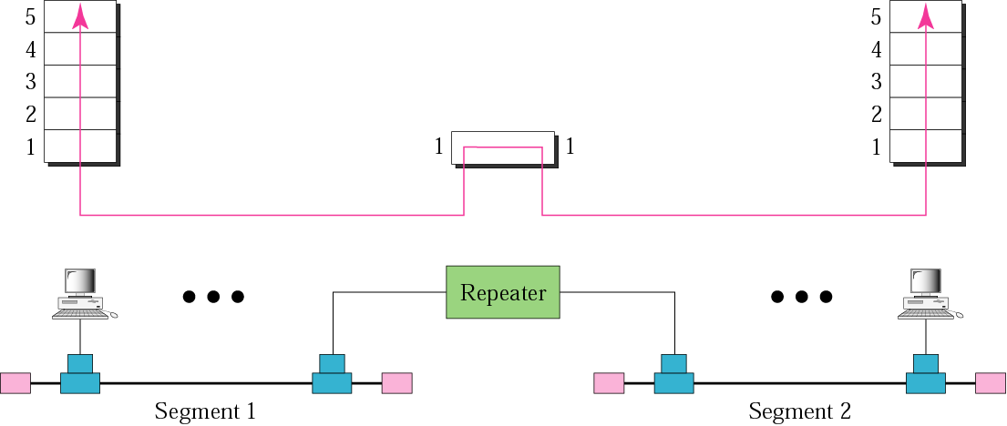
Figure 3-27
Repeater

Slide 51
A repeater connects segments of a
LAN together.

Slide 52
A repeater forwards every packet; it has no filtering capability.

Slide 53
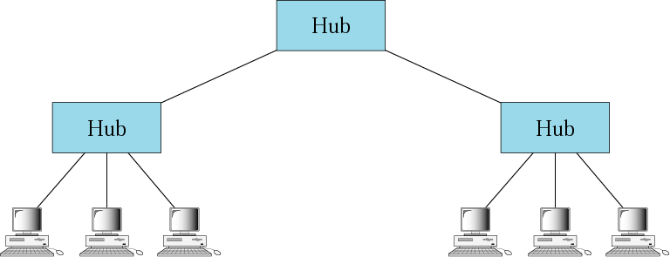
Figure 3-28
Hubs

Slide 54
A bridge has a table used in filtering decisions.

Slide 55
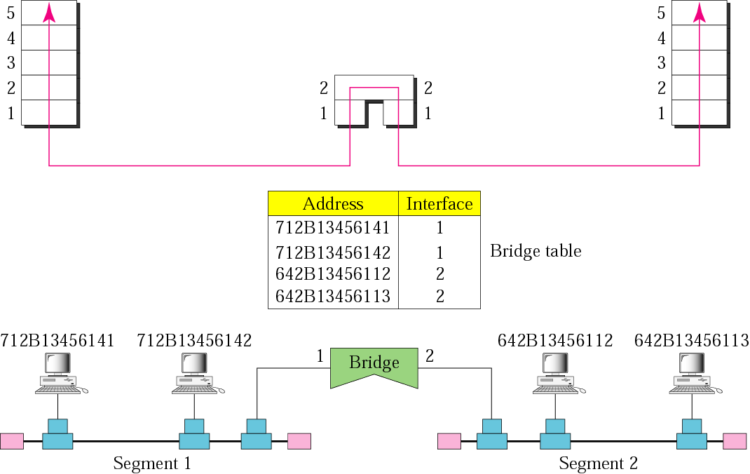
Figure 3-29
Bridge

Slide 56
A bridge connects segments of a LAN together.

Slide 57
A router is a three-layer (physical, data link, and network) device.

Slide 58
A repeater or a bridge connects segments
of a LAN.
A router connects independent LANs or WANs to create an internetwork (internet).

Slide 59
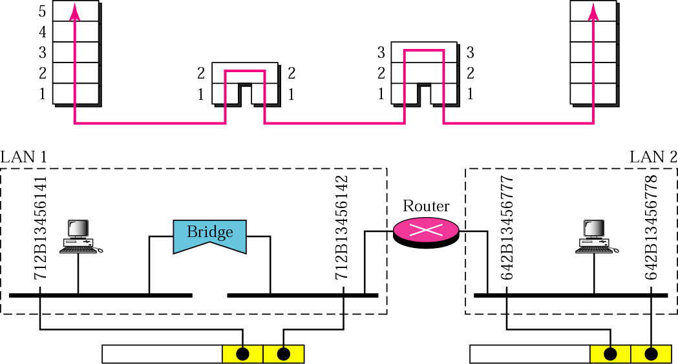
Figure 3-30
Routing example

Slide 60
A router changes the physical addresses in a packet.

